Slide 1


Learning outcomes in
South African schools.
Nic Spaull
Research on Socioeconomic Policy (RESEP)
Stellenbosch University
31 July 2018
|
Department of Economics
•
Faculty of Economic and Management Sciences

Slide 2
Introduction – today’s lecture
Learning outcomes
in SA schools
  The good ☺
  The bad 😐
  The ugly ☹
What is to be done?

Slide 3
The Good
☺

Slide 4
Getting the facts straight…
South Africa's education system is worse today than the "gutter education" the country had under the apartheid government, says academic and struggle heroine Mamphela Ramphele.” Maths literacy... what is that? It's worse than the arithmetic I did under Bantu education.”
Dr Mamphele Ramphele
“We can now state without fear of contradiction that this government's track record on education has been an unmitigated failure.”
– Prof Jonathan Jansen (2017)
Is this true?

Slide 5



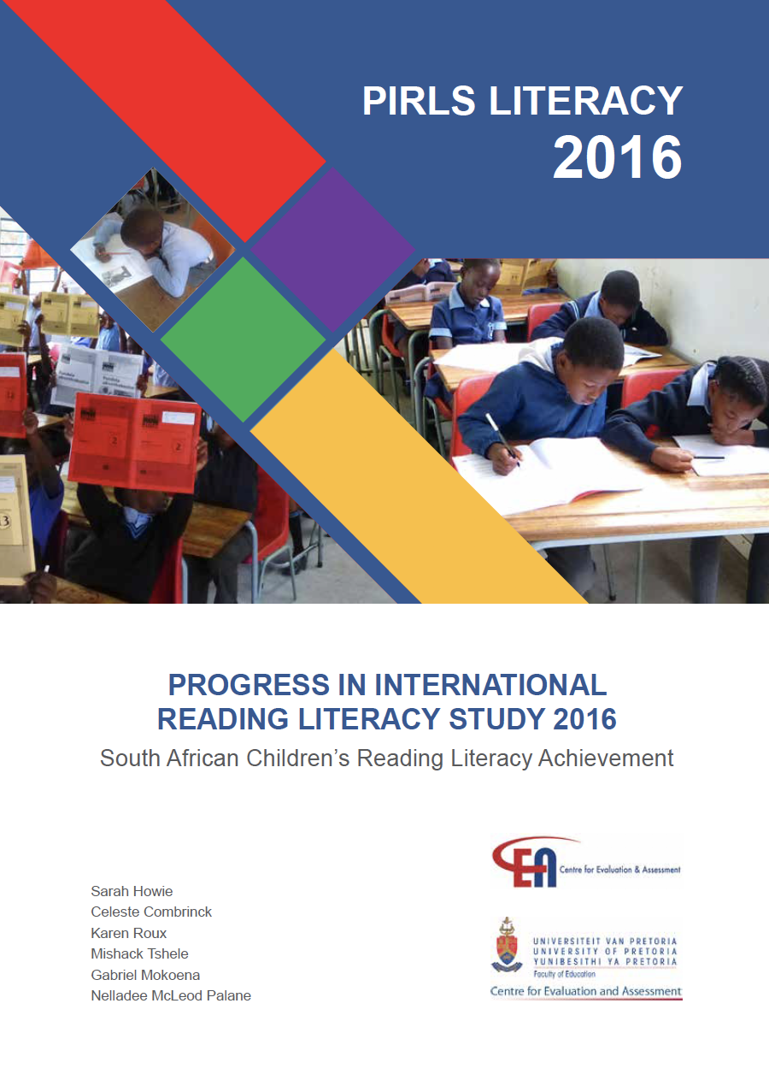



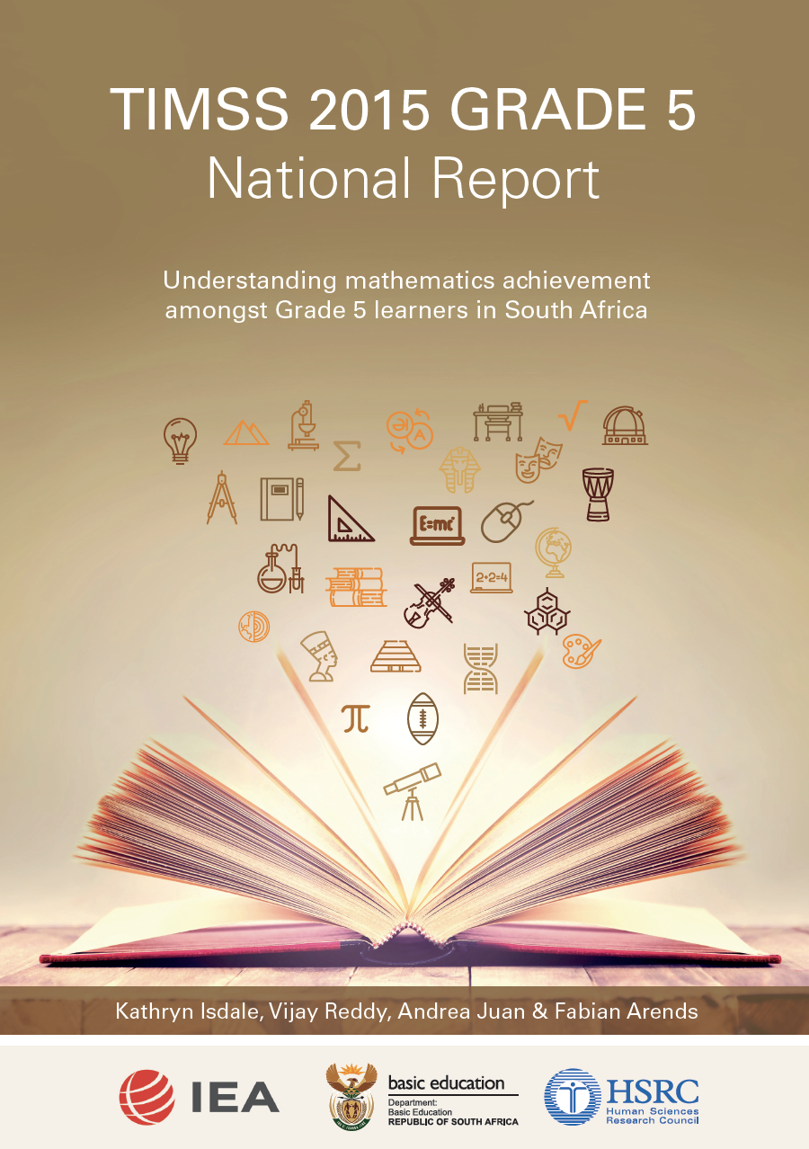

Slide 6
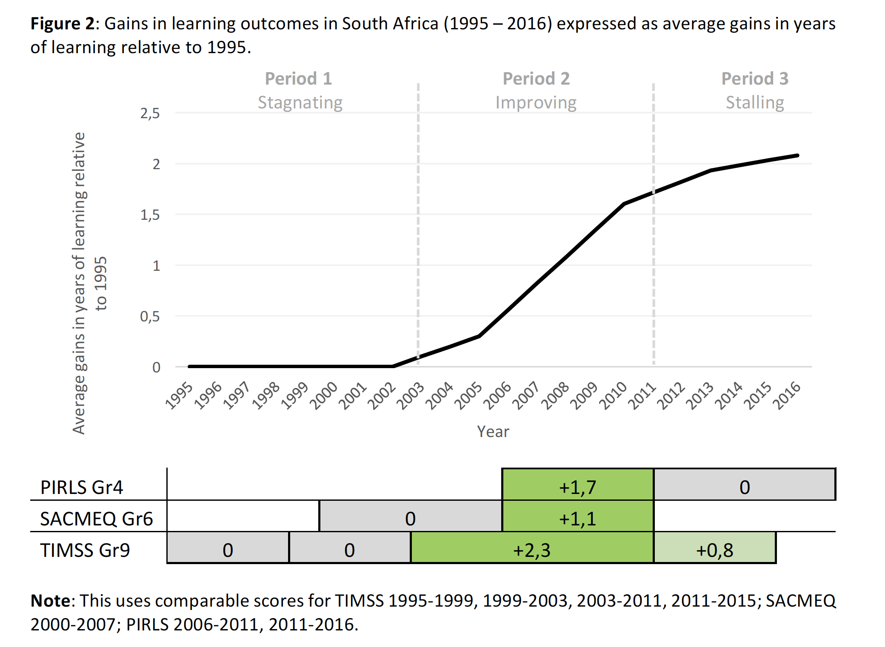
Learning outcomes
(Spaull, 2018, forthcoming)

Slide 7
Learning outcomes
And what about traditional measures of SA school system performance like…
  The # of students getting matric?
  The # of students getting bachelor passes?
  The # of students getting degrees?

Slide 8
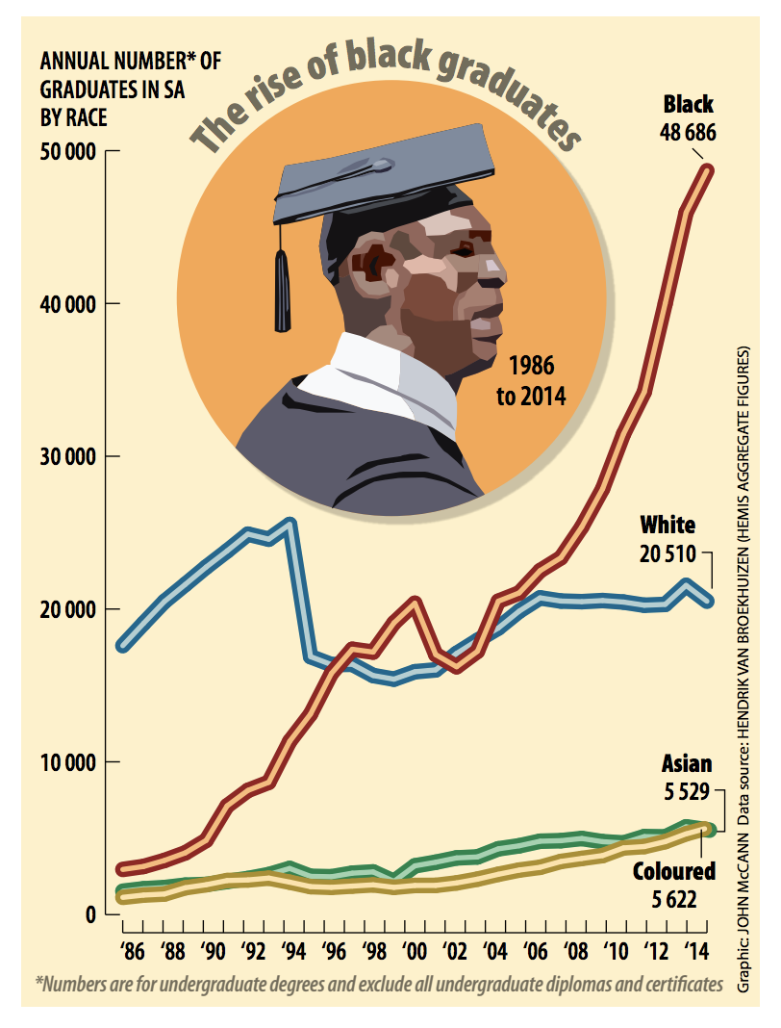
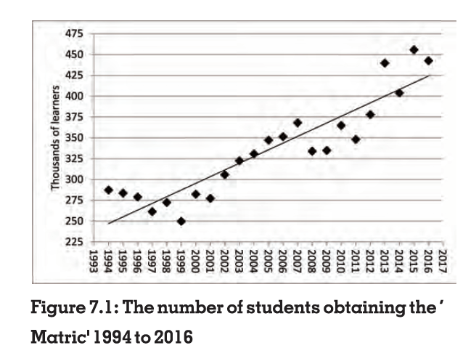
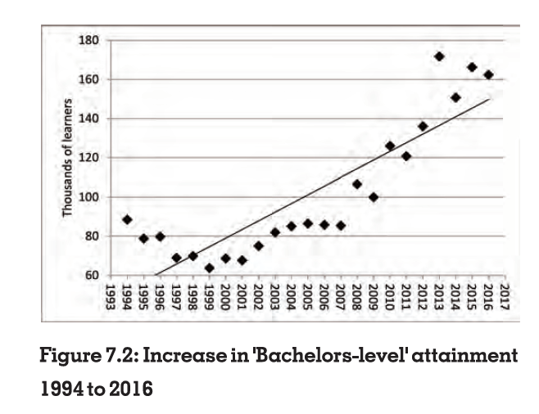
The good…☺

Slide 9

This matters a lot…
(Own calculations using Census 2011 data)

Slide 10
The good
Curriculum: Stuck with a solid curriculum (CAPS)
Workbooks: Roll out of government (DBE) workbooks to all (95%+) Grades 1-9
Nutrition: Successful school nutrition programme (NSNP) feeding 70% of publicly-funded learners in the country
Grade R: More than 95% of learners complete Grade R
Bursary funding: Funza Lushaka system to fund teachers

Slide 11
The Bad
😐

Slide 12
The Bad…
Why?
Increase in births by 13% from 2005
Above-inflation wage increases for teachers
See “Throwing basic education under the bus” Business Day 16/4/2018)
R17,800/learner
-10%
R16,000/learner

Slide 13
Learning outcomes
Between 2011 and 2015 food poverty (R14/day)
⬆ from 21% to 25% (StatsSA)
% sometimes experiencing hunger according to GHS went from 29% (2002) → 13% (2011) → 13% (2016)
Between 2009 and 2017 the unemployment rate ⬆ from 25% to 28%.
# of educators working in public schools ⬇ by 3% between 2013 and 2016
(Mweli, 2018: p78-79)
Between 2011 and 2016 # learners/class in PIRLS Gr4 classes ⬆ from 40 to 45 (Howie et al., 2018: 13, 127)
  Poorest 60%: 41-->48
  Richest 10%: 33-->35
(Spaull, 2018)
Spaull, 2018 – Springer Book

Slide 14
True… but how many students actually make it to university?
(2)

Slide 15

How many students actually make it to university?
How many of those who start school reach matric? Graduate with matric? Graduate with a degree?
New (2016) study followed the entire matric cohort of 2008 into university and tracked them 2009-2014
(Van Broekhuizen & Van der Berg, 2016)

Slide 16

How many students actually make it to university?

Slide 17

How many students actually make it to university?

Slide 18

How many students actually make it to university?

Slide 19

How many students actually make it to university?
Source: Van Broekhuizen & Van der Berg, 2016 (Higher Education Access and Outcomes for the 2008 National Matric Cohort)

Slide 20
How many students actually make it to university?
}
?
Source: Van Broekhuizen & Van der Berg, 2016 (Higher Education Access and Outcomes for the 2008 National Matric Cohort)

Slide 21
What does low quality schooling actually look like?

Slide 22
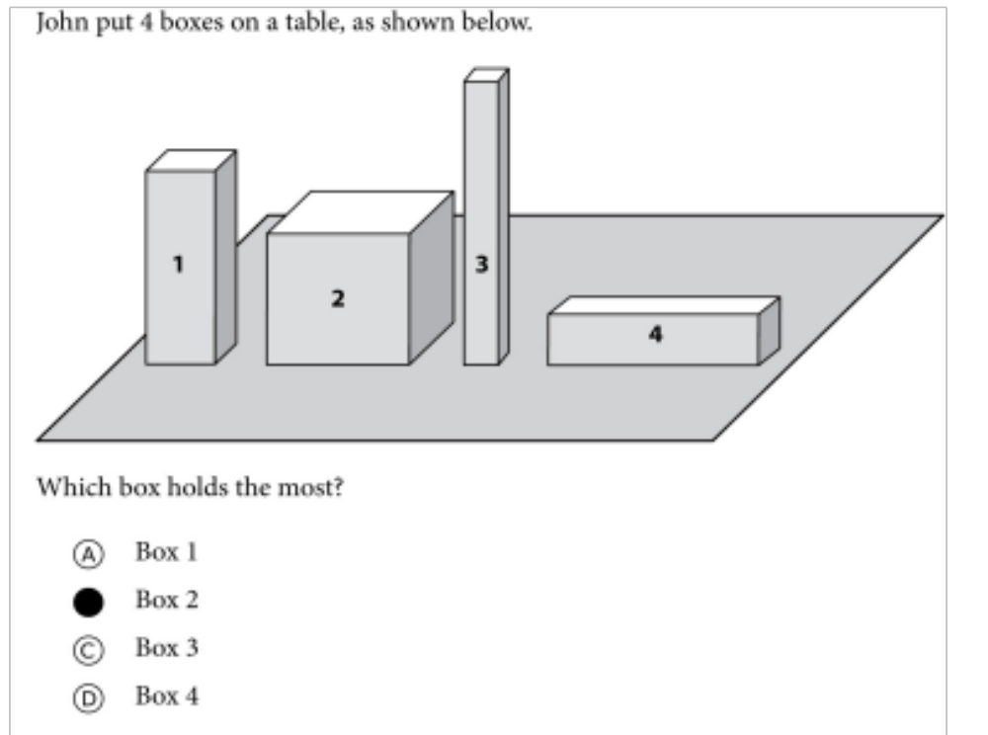

Mathematics
For this question:
Richest 10% SA schools = 94%
Poorest 10% SA schools = 34%
New Solutions for a New Future
TIMSS Gr5: Example questions from the test
2015 was the first time that SA participated in TIMSS Numeracy (Gr5)

Slide 23
What about reading?

Slide 24


78%
22% can read for meaning
of Grade 4 children in South Africa can not read for meaning in any language.
PIRLS Literacy 2016 (Howie et al., 2017)

Slide 25
SA PIRLS 2016 results in context
Mullis et al. 2017

Slide 26

40 WCPM
Note: Gr5 NEEDU (2013) rural-only, not PIRLS

Slide 27
What does this look like in reality?
Many
years
ago
Leopard
was
a
creature
with
no
spots.
Recommended rate at Gr5
One
day,
he
was
relaxing
in
the
shade
of
a
thorn
tree
when
Zebra
walked
past.
Many
years
ago
Leopard
was
a
creature
with
no
spots.
40% of SA rural Gr5 learners (<40WCPM) WCPM
One
day,
he
was
relaxing
in
the
shade
of
a
thorn
tree
when
Zebra
walked
past.
Draper, K., and Spaull, S. (2015). Examining oral reading fluency among grade 5 rural English Second Language (ESL) learners in South Africa: Analysis of NEEDU 2013. South African Journal of Childhood Education 5(2) pp.44-77.
Notes:
40 words in 60s = 1,5s/word
130 words in 60s = 0,46s/word

Slide 28
How do fees fit into all of this?

Slide 29
78%
Reading: How does this differ by school wealth?
Spaull & Pretorius (2018) Falling at the first hurdle. Springer.

Slide 30
% Reaching the TIMSS Low International Benchmark in Maths (TIMSS-N 2015)

Slide 31
Wobbly snowman of fees
Elite fees
(R20,000+ p.a.)
High-fee
(R12,000+ p.a.)
(SR, 2016)
5%
Q5
1,8%
10% pay R5,000 + p.a.
Mid-fee
R2,000-R12,000
9%
Low-fee
(R0 – R2000)
20%
24% pay
R0→R5000 p.a.
Q4
Children paying
no fees
66%
Q1-3
DBE 2018 Report on GHS, page 33

Slide 32
The Ugly
☹

Slide 33
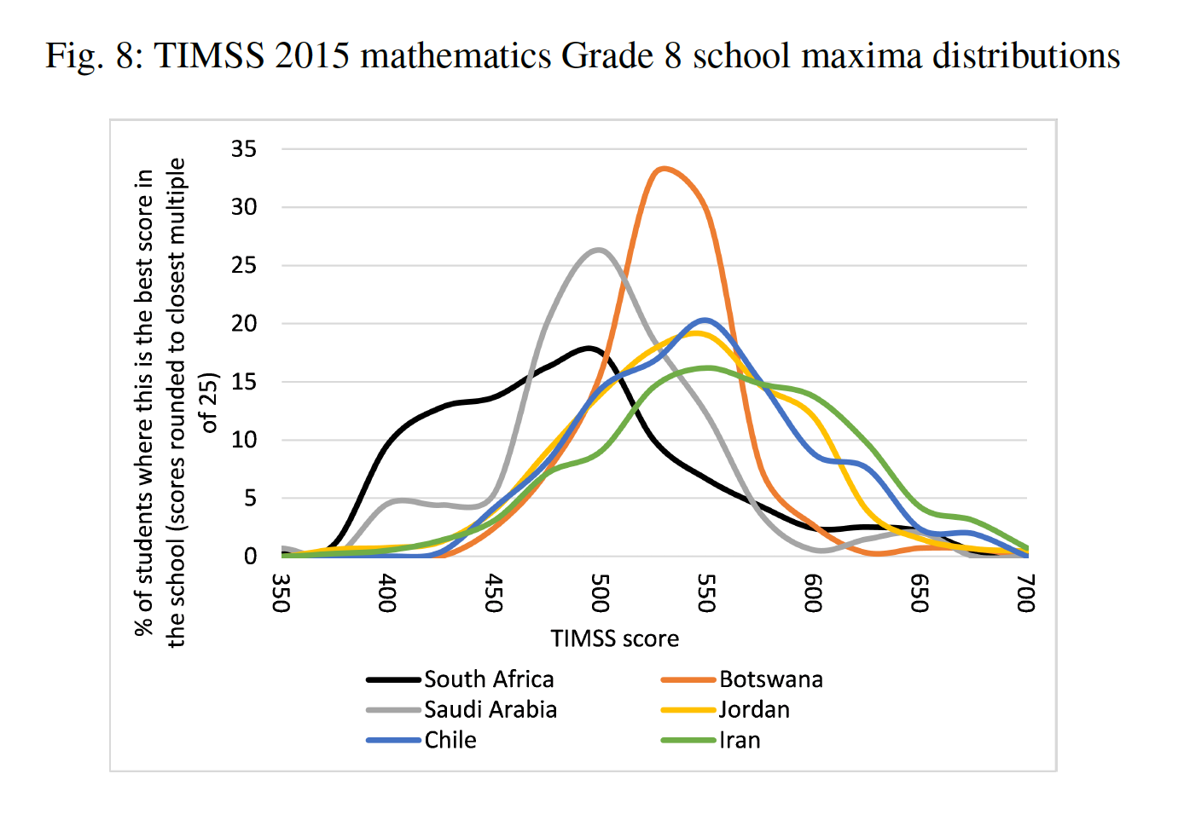
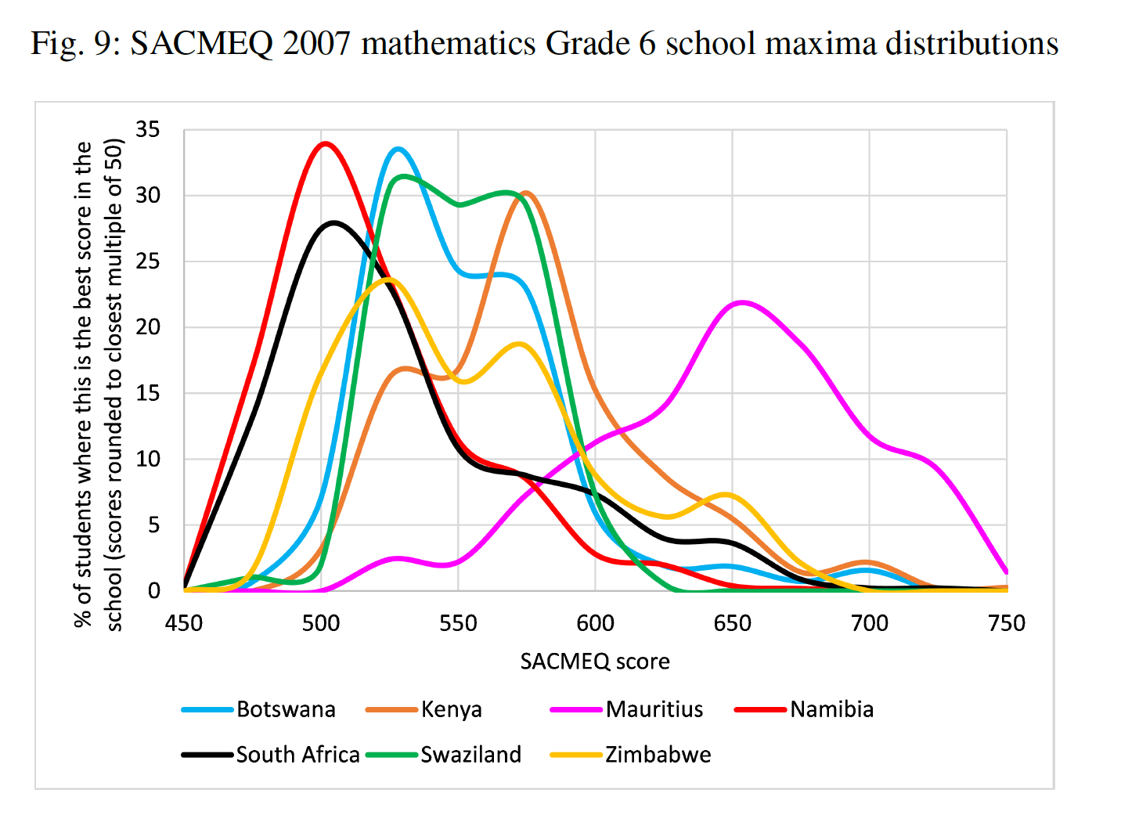
’Waste-zones’ of schooling
TIMSS 2015 Gr8/9:
“In SA, in 47% of schools there was not a single learner who reached 475 points (the TIMSS Intermediate International Benchmark). In this respect SA did much worse than any other country…In contrast, in Botswana only 2% of schools where unable to produce a single such learner).
(Van der Berg & Gustafsson, 2018: p16)

Slide 34
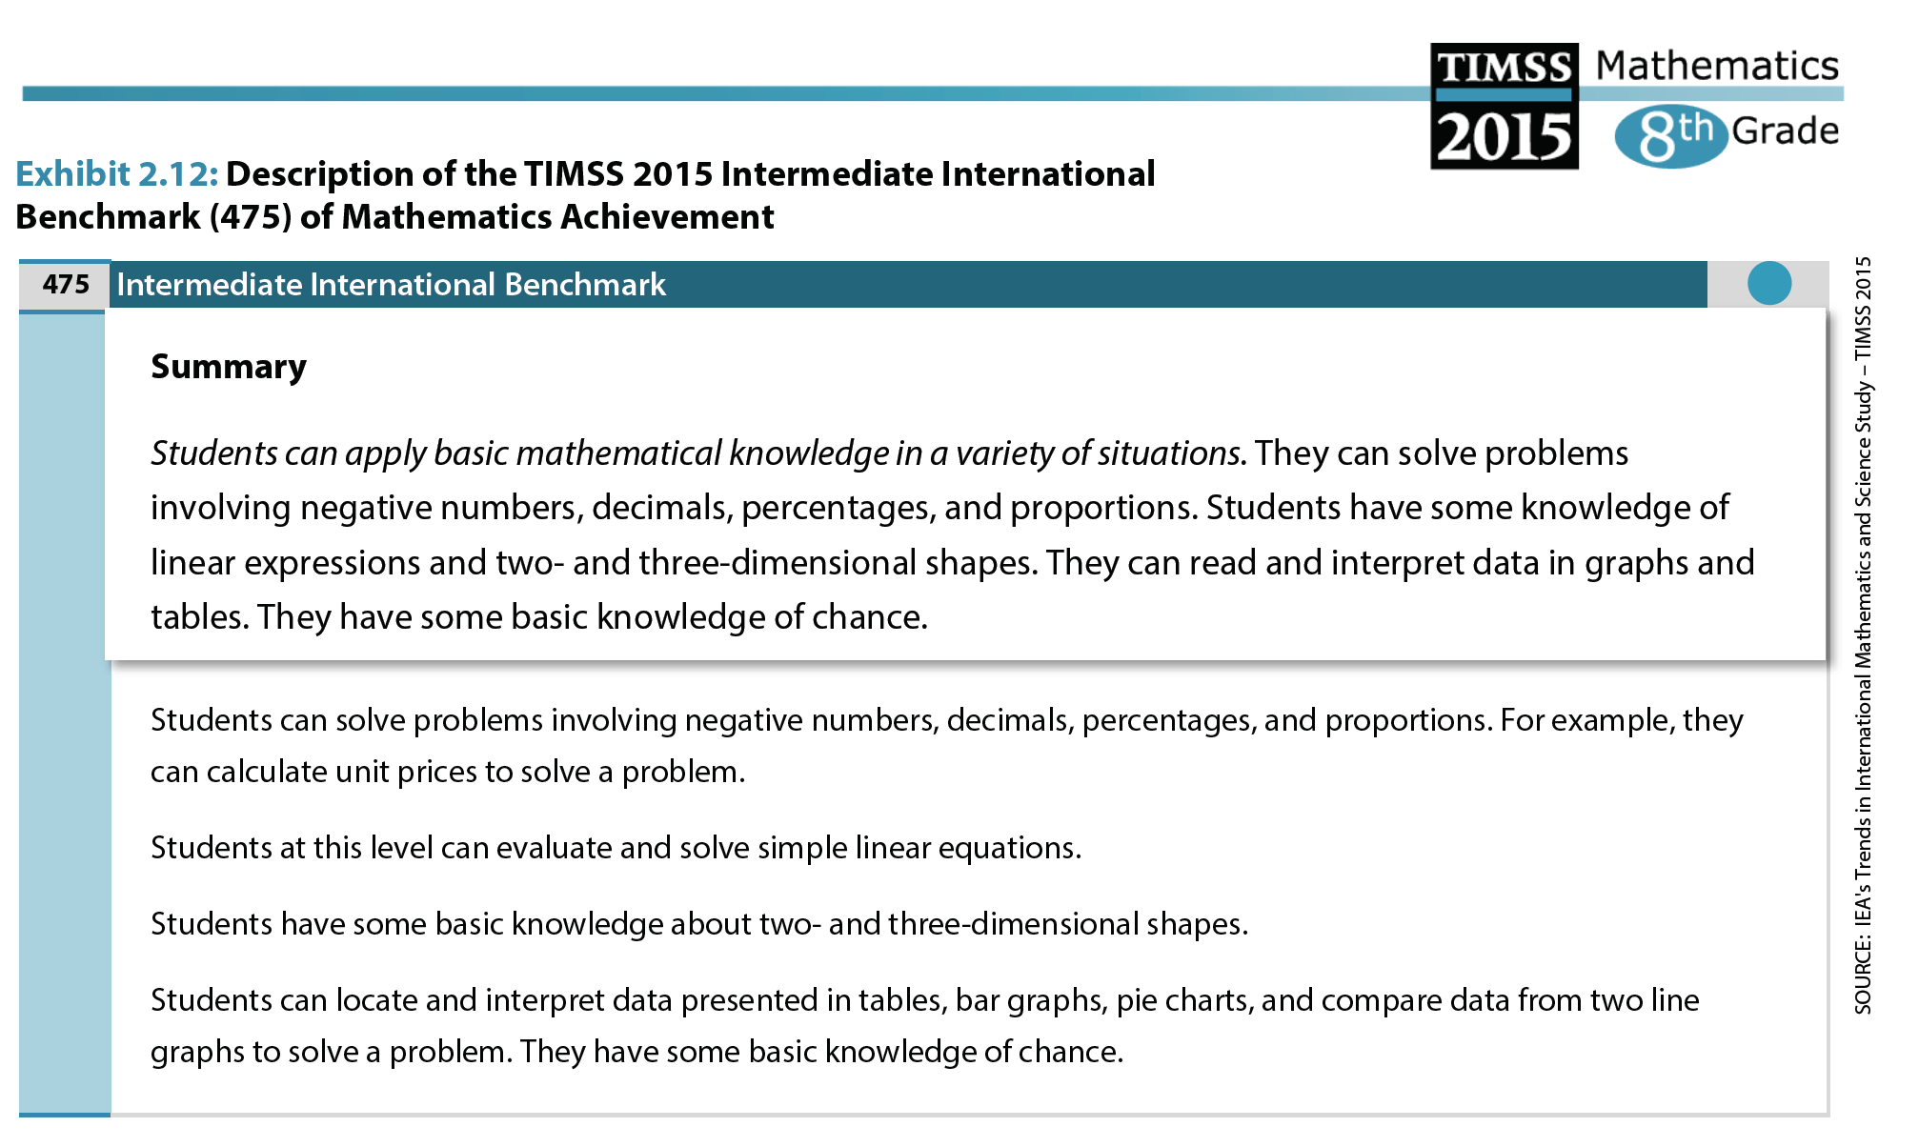
TIMSS 2015 Gr8 Intermediate International Benchmark
TIMSS 2015 Gr 8/9 International Report

Slide 35
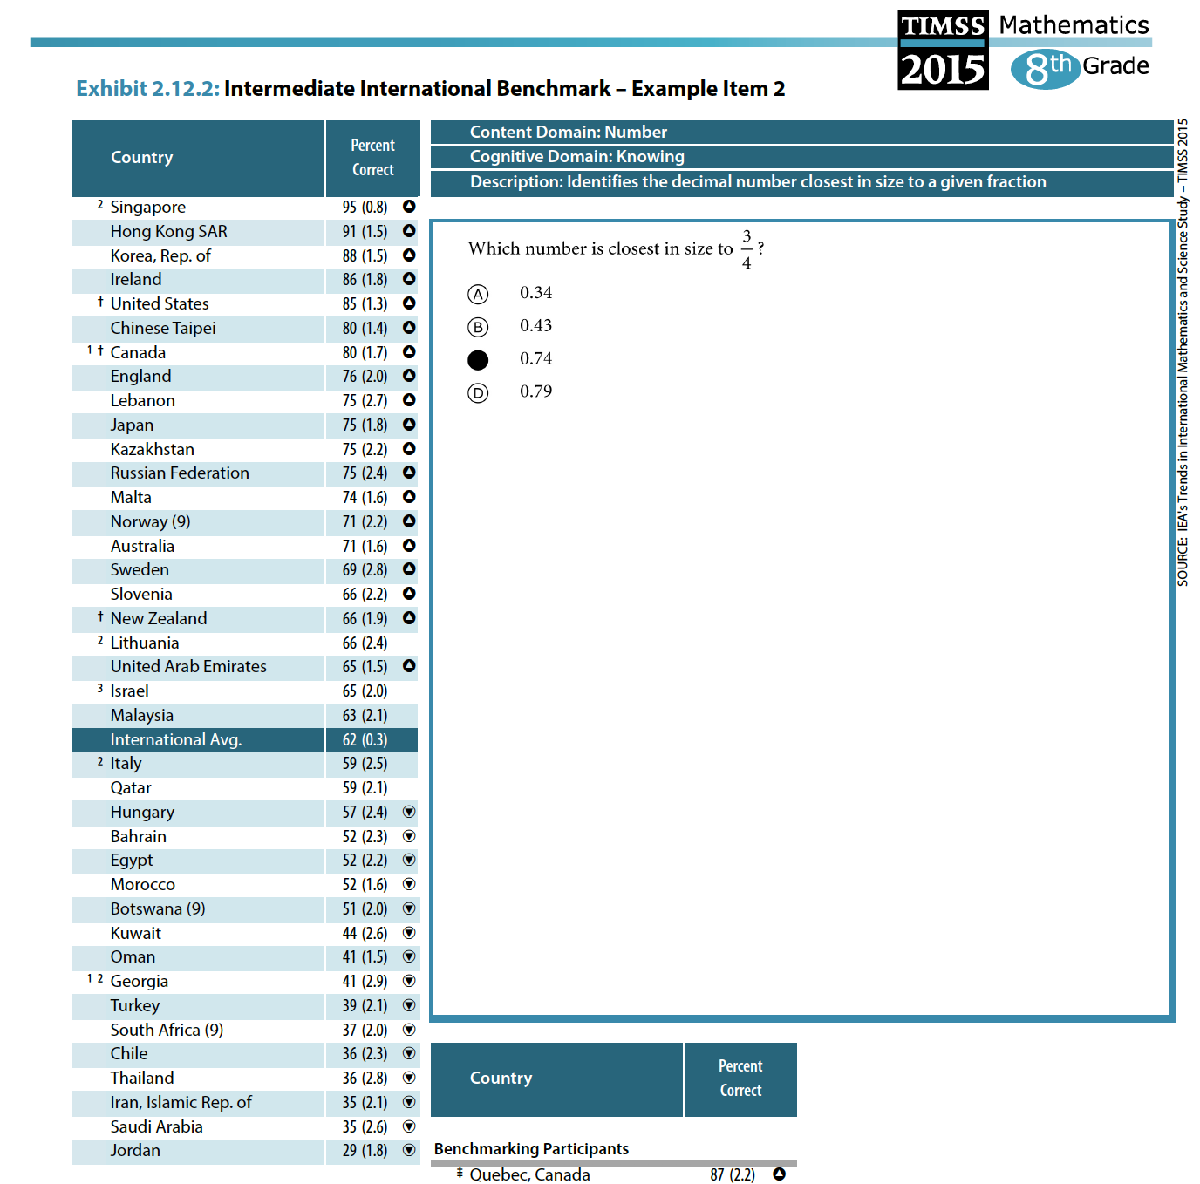
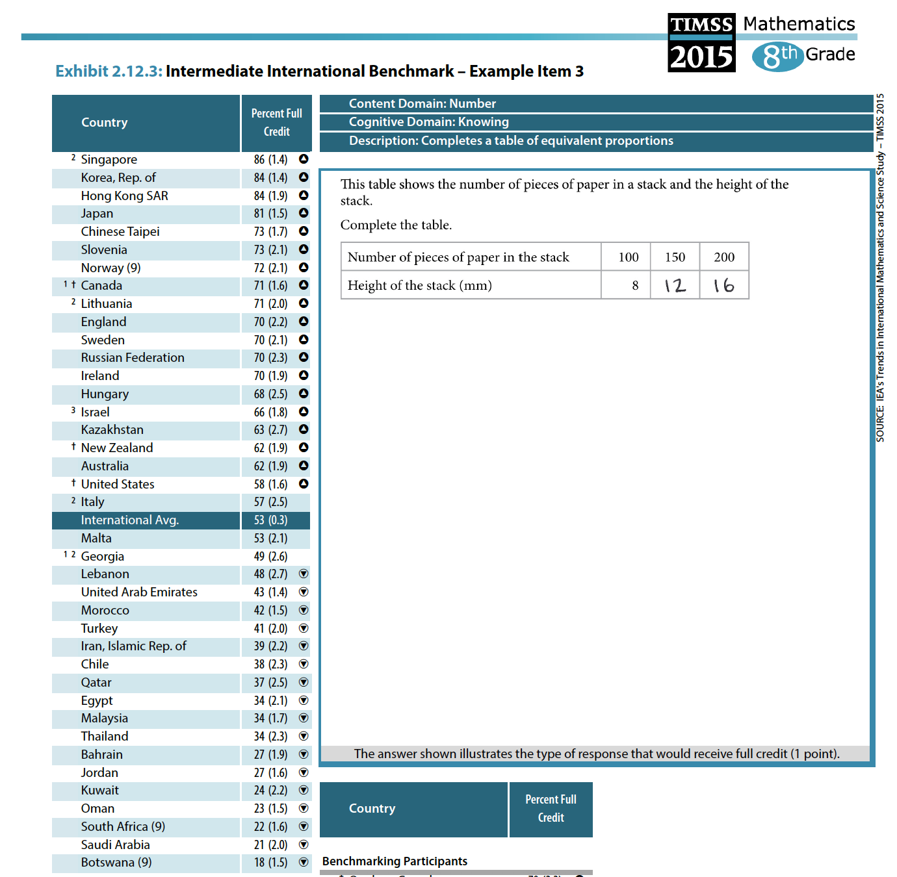
TIMSS 2015 Gr8
Intermediate International Benchmark
TIMSS 2015 Gr 8/9 International Report

Slide 36
What about primary schools and reading?

Slide 37
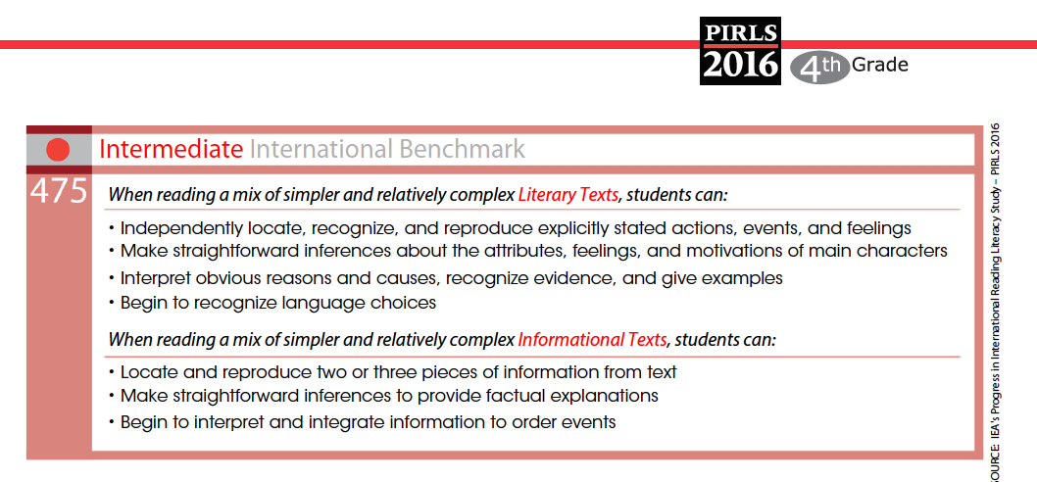
‘Waste-zones’ of schooling

Slide 38
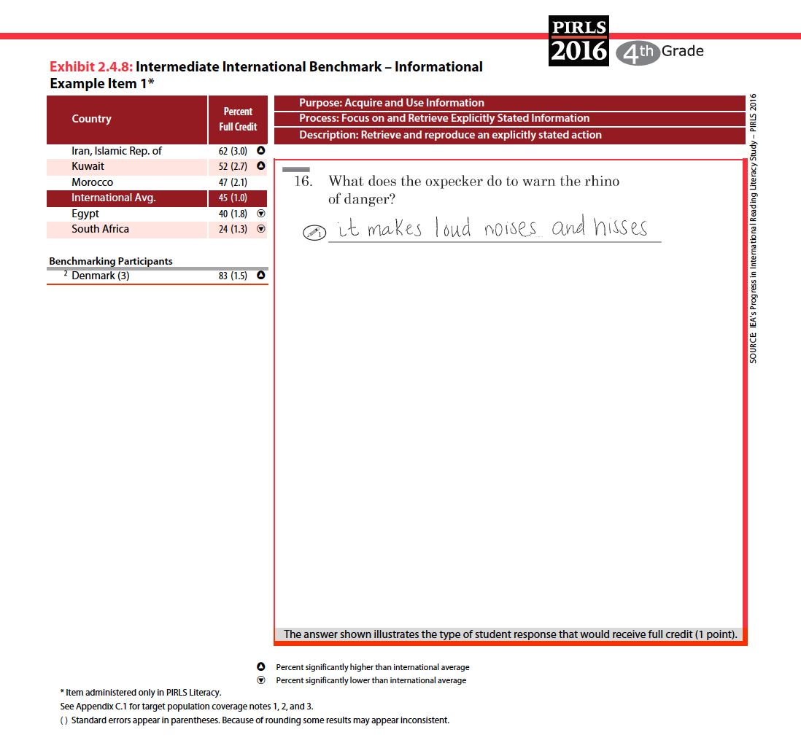
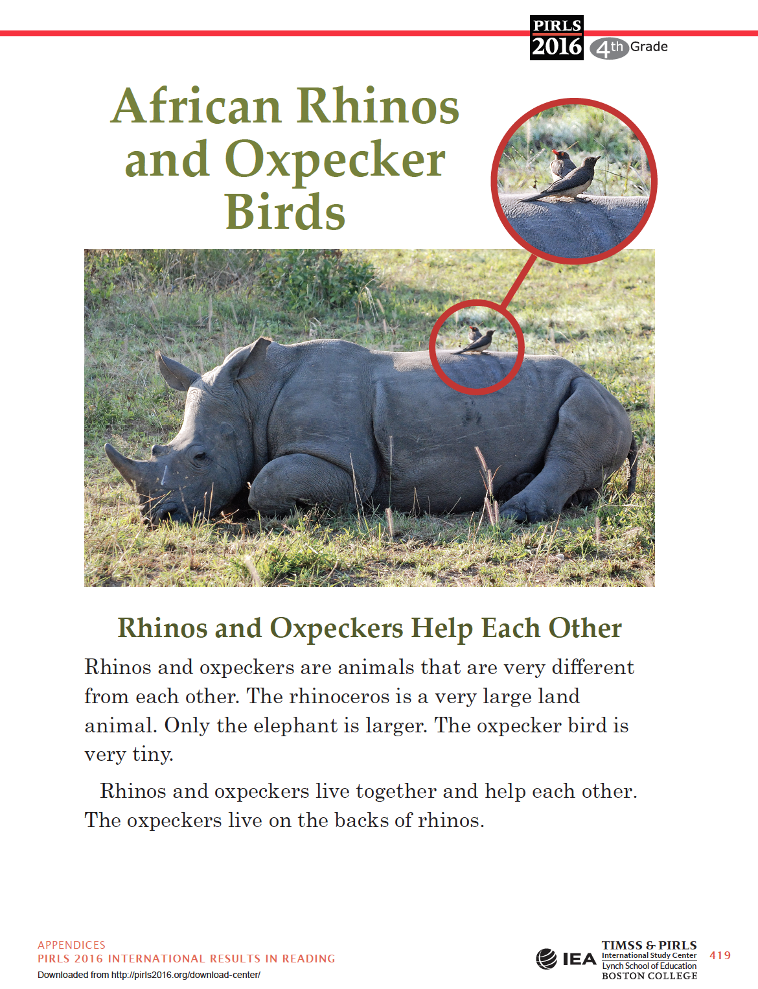
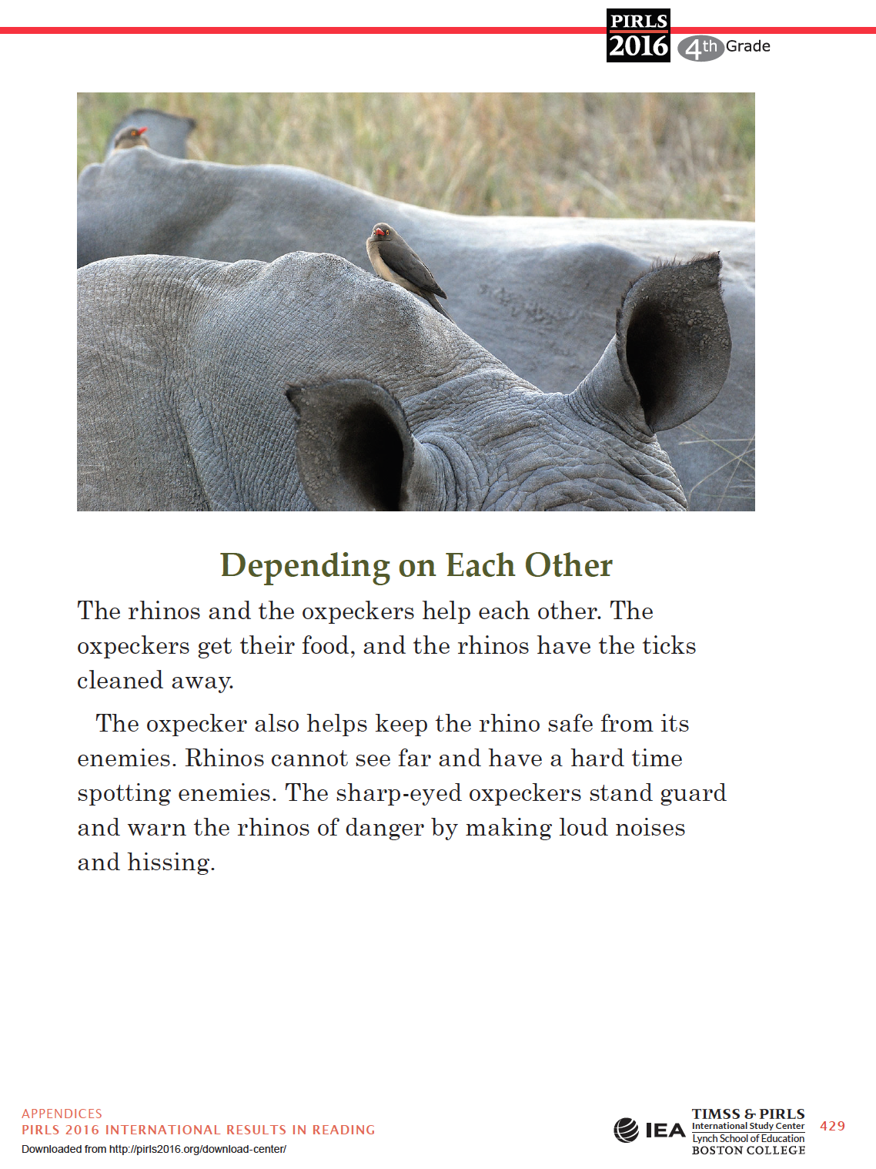
’Waste-zones’ of schooling

Slide 39
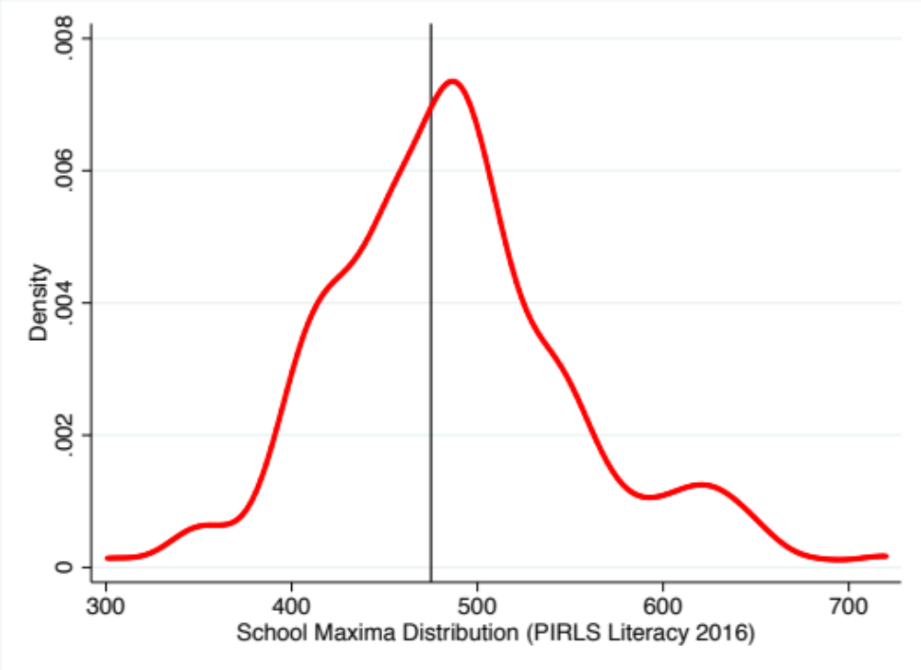
’Waste-zones’ of schooling
Figure: Maxima distribution PIRLS Literacy 2016
475 points
(PIRLS International Intermediate Benchmark)
In 45% of Gr4 classes in SA there is NOT A SINGLE STUDENT that can read & make inferences.
(PIRLS International Intermediate Benchmark)
(Maxima distribution is the distribution of the top student in each class)
45% of schools
PIRLS Literacy 2016 (own calculations)

Slide 40
’Waste-zones’ of schooling
47%
(TIMSS Gr9 2015)
45%
(PIRLS Literacy 2016)
In 47% of SA high schools the cognitive horizons of learners are so severely limited that NOT A SINGLE LEARNER in the class can “apply basic mathematical concepts in a variety of situations” after nine years of formal full-time schooling. In 45% of SA primary schools NOT A SINGLE LEARNER can read and make straight-forward inferences.
“Cognitive waste-zones”
Horrible term, but it’s difficult to think of adjectives that describe this situation that don’t sound like euphemisms or to which we are now immune (‘crisis’ ‘catastrophe’ ‘dire’).

Slide 42
What is to be done?
Declare early grade reading a national crisis and a national priority
  You cannot leap-frog literacy. 4th-Industrial Revolution & AI distracting us from ensuring basics in place.
  President Ramaphosa to declare a national goal:
  “Every child reading for meaning by age 10”
Back to basics
  Children are ”falling at the first hurdle”
  Ensure that all children learn to read for meaning and do basic mathematics before age 10.
    High quality teacher training.
    One workbook, One textbook, one story anthology.
Who has access to the fee-charging part of the system?
  Only 0,3% of learners receive a fee-exemption
  Proposal: Legislation requiring all fee-charging schools to admit at least 20% of learners that cannot pay fees.

Slide 43

www.NicSpaull.com/presentations
Thank you

Slide 44
Elite fees
(R20,000+ p.a.)
90% of fee-charging primary schools are Eng or Afrikaans LOLT
High-fee
(R12,000+ p.a.)
(SR, 2016)
5%
85% of white learners attend fee-charging schools
Q5
1,8%
Mid-fee
R2,000-R12,000
9%
Less than half of schools in WC & GP are no-fee
All independent schools charge fees
Low-fee
(R0 – R2000)
20%
Q4
Race
Province
Language
Children paying
no fees
66%
More than 90% of schools in LP, EC and NW are no-fee schools
Q1-3
98% of learners attending no-fee schools are Black or Coloured
78% of no-fee primary schools are African-language LOLT
DBE 2018 Report on GHS, page 33

Slide 45




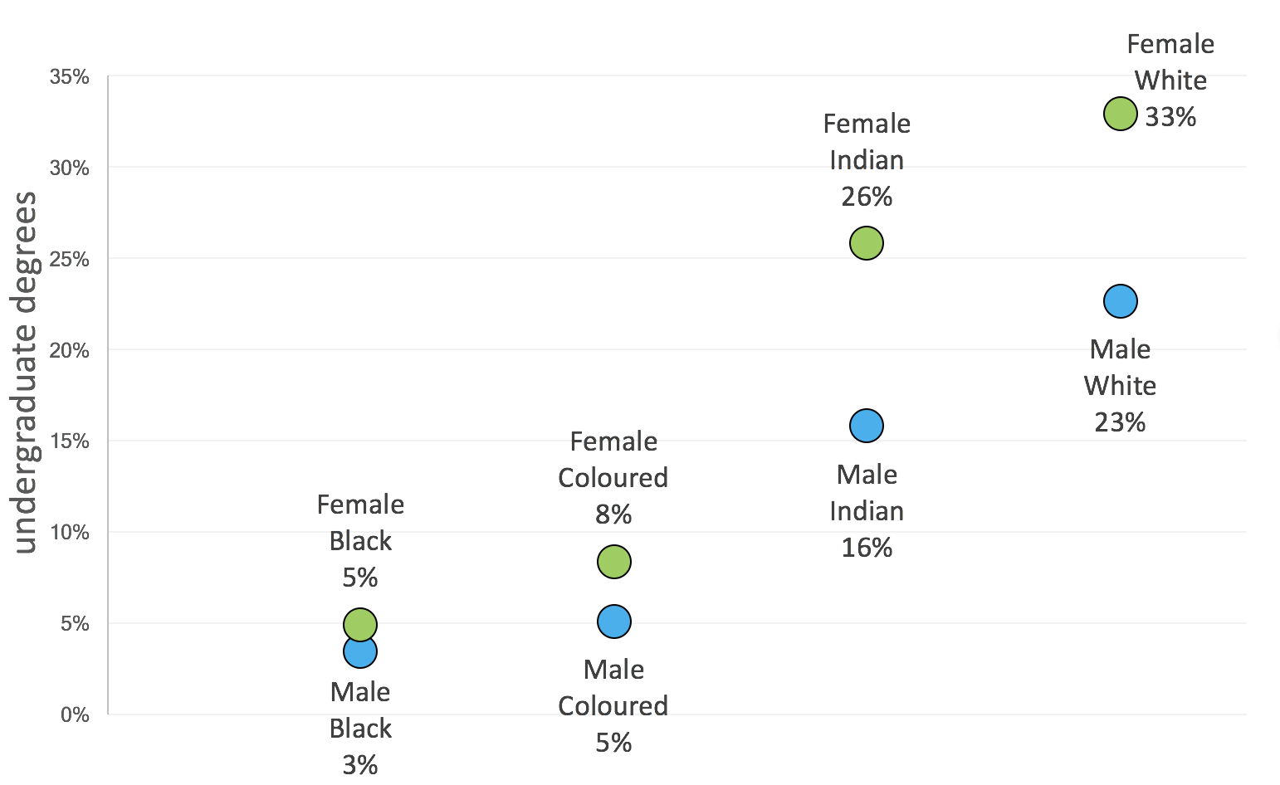
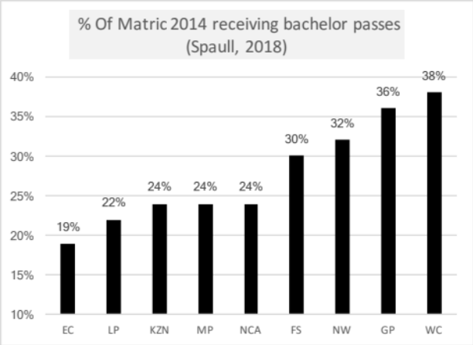

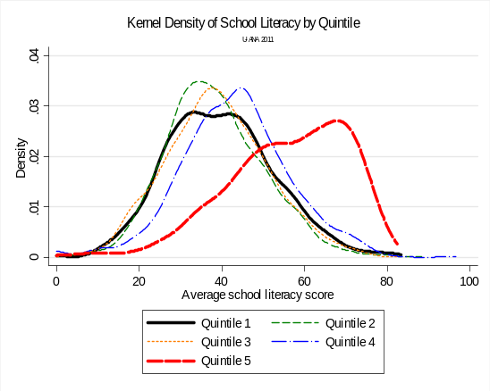
SA educ system
Language
Former department
Province
Quintile
SES
Race
Taylor, 2011

Slide 46
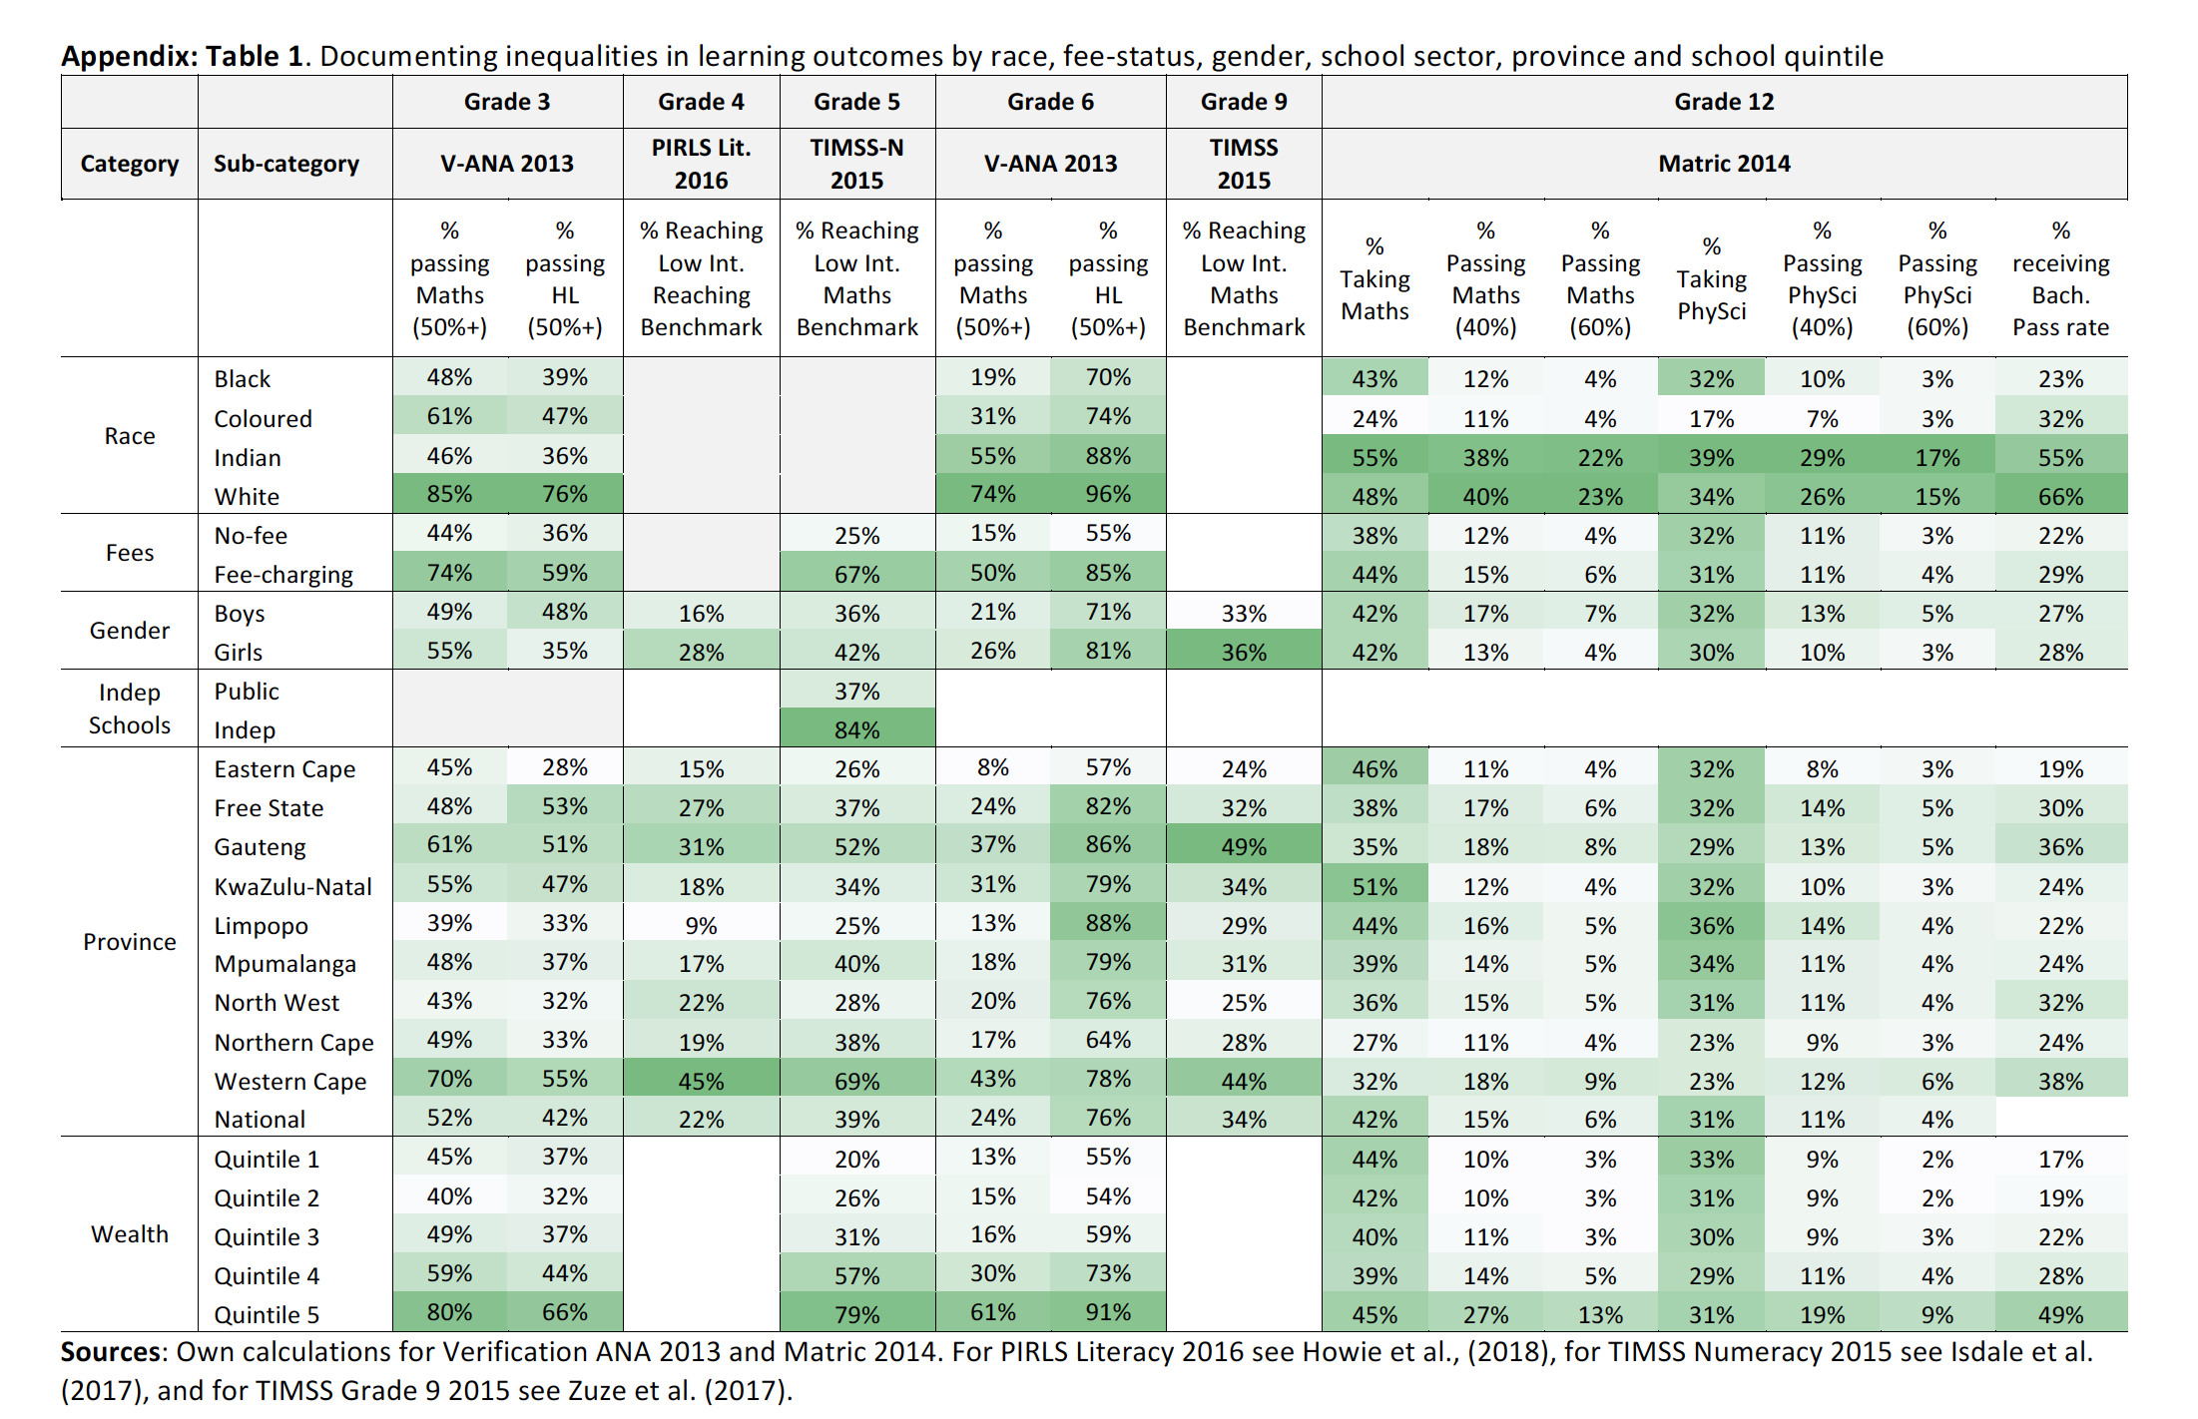
Learning outcomes
Spaull, 2018 – Springer Book

Slide 47
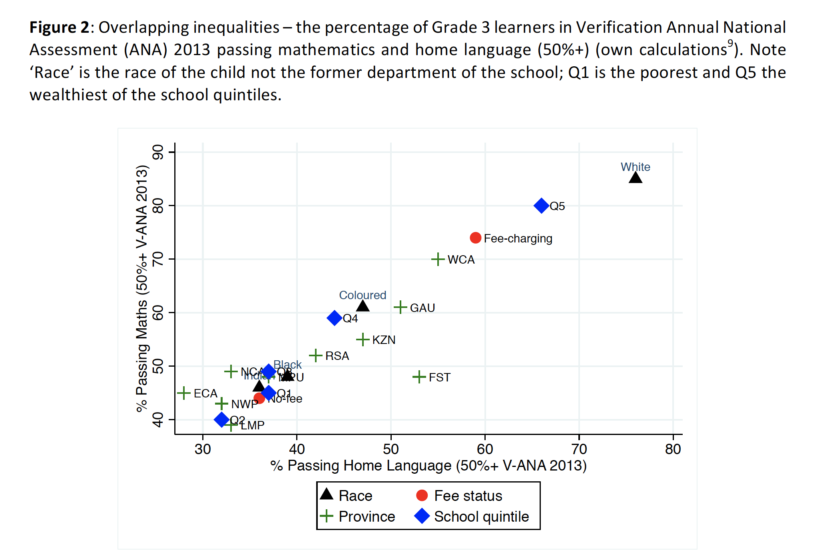
Overlapping inequalities
Spaull, 2018 – Springer Book

Slide 48
How many students actually make it to university?
Source: Van Broekhuizen & Van der Berg, 2016 (Higher Education Access and Outcomes for the 2008 National Matric Cohort)

Slide 49
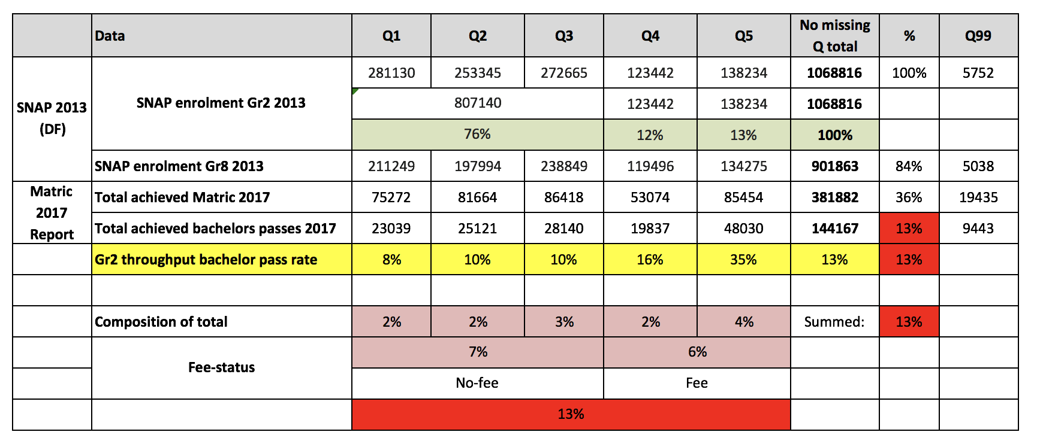
Nuance in the 2-school systems bimodal narrative:
About half (45%) of all high-level maths passes come from Q1-4 schools
66% of bachelor’s passes come from Q1-4 schools
All about PROBABILITIES!!
Source: Van Broekhuizen & Van der Berg, 2016 (Higher Education Access and Outcomes for the 2008 National Matric Cohort)

Slide 50

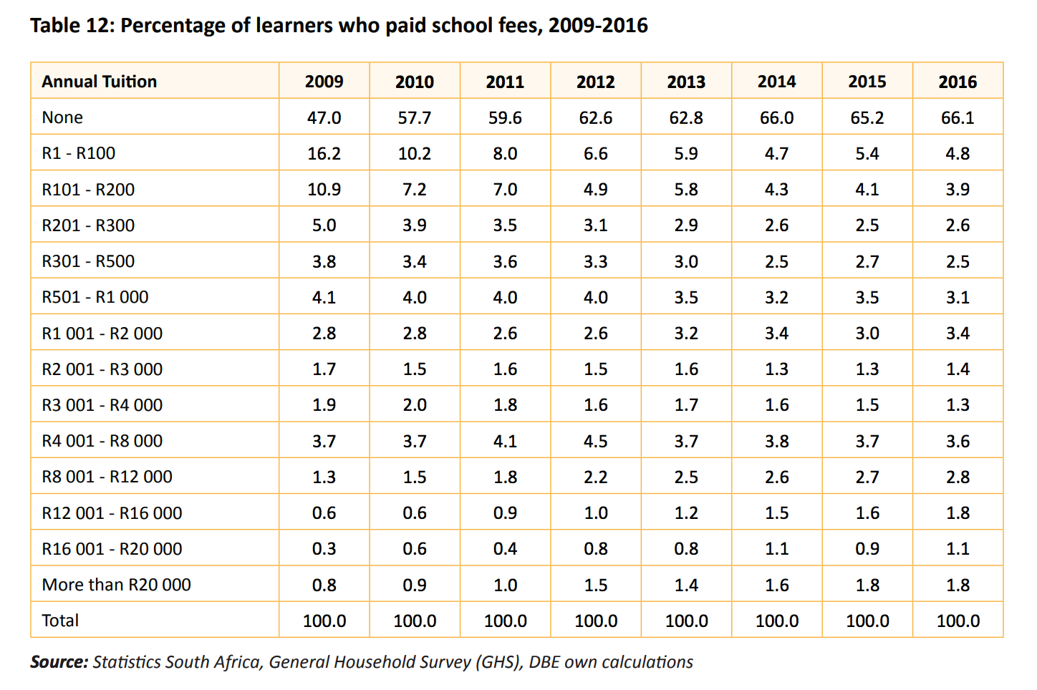



Fees
Sea Point High School
Sea Point High School
R14,400 p.a
De Kuilen High School
De Kuilen High School
R17,500 p.a
Brackenfell High School
Brackenfell High School
R20,100 p.a
Westerford High School
Westerford High School
R36,170 p.a
Only 5% of children in SA pay R12,000 p.a. or more in school fees
Rondebosch Boys High School
Rondebosch Boys High School
R49,000 p.a
DBE 2018 Report on GHS, page 33
Notes:
http://www.brakkies.co.za/wp-content/uploads/2017/03/Schoolfees-Circular-2018.pdf http://www.rondebosch.com/prep/admissions/fees.php http://www.dekuilen.com/files/dekuilen-schoolfees-letter.pdf

Slide 51
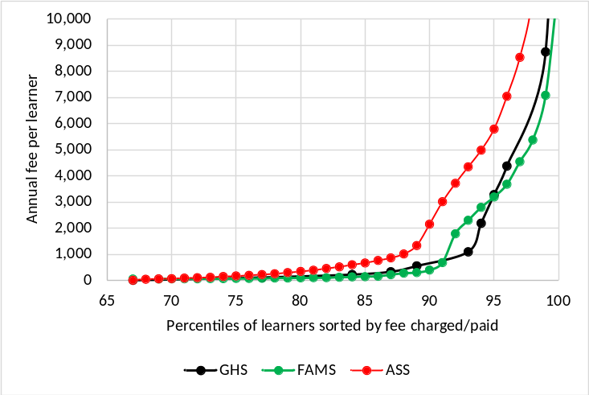
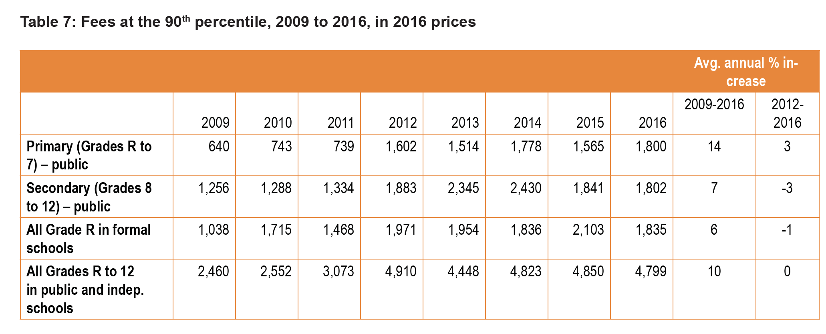
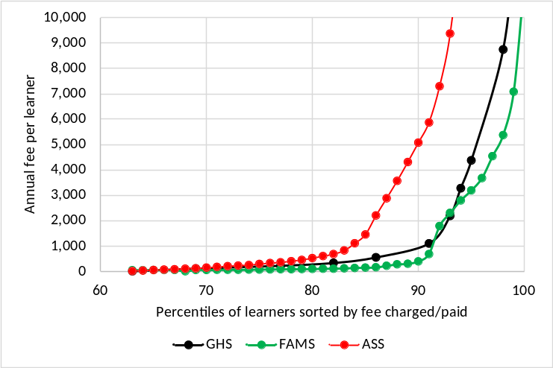
Fees
Figure 26: GHS versus other sources in public grades R to 7 (2011)
(Mweli, 2018: 89)
FAMS is the Funding and Management Survey which was a nationally representative sample of public schools conducted in 2009. It is not publicly available. To make it comparable to 2011 figures for GHS and ASS it has been inflated using CPI.
Figure 27: GHS versus other sources in public grades 8 to 12 (2011)
(Mweli, 2018: 87)
Notes:
Mweli, M. (2018). Basic Education’s Role in Tackling Poverty. Basic Education Matters (2018: 1). Journal of the Department of Basic Education.

Slide 52
Where should we be intervening?
New Solutions for a New Future
Insurmountable learning deficits
Figure 10b: South African mathematics learning trajectories by national socioeconomic quintiles using a variable standard deviation for a year of learning (0.28 in grade 3 to 0.2 in grade 8 with interpolated values for in-between grades (Based on NSES 2007/8/9 for grades 3/4/5, SACMEQ 2007 for grade 6 and TIMSS 2011 for grade 9, including 95% confidence interval
(Spaull & Kotze, 2015)

Slide 53
To wrap up…

Slide 54
Labour Market
Uni
&
FET
High productivity jobs and incomes (17%)
Mainly professional, managerial & skilled jobs
Requires graduates, good quality matric or good vocational skills
Historically mainly white
6%
15%
Legislators, managers, assoc professionals
Unemployed
(Broad - 35%)
Unskilled
(18%)
Elementary occupations & domestic workers
Semi-Skilled (32%)
Clerks, service workers, shop personnel, skilled agric/fishery workers, plant and machinery operators)
13%
High quality secondaryschool
High SES background
+ECD
High quality primary school
? %
?
Minority (25%)
Unequal society
7%
Big demand for good schools despite fees
Some scholarships/bursaries
Majority (75%)
Vocational training
Affirmative action
Attainment
Quality
Type
Low quality secondary
school
Low productivity jobs & incomes
Often manual or low skill jobs
Limited or low quality education
Minimum wage can exceed productivity
Low SES background
Low quality primary school
QLFS 2014
Notes:
The QLFS classifies professions as follows: Highly skilled (legislators, senior officials and managers, professionals, technicians and associate profesionals); Semi-skilled (Clerks, service workers and shop and market personnel, skilled agricultural and fishery workers, craft and related trade workers, plant and machinery operators and assembly), Unskilled (Elementary occupations, domestic workers).

Slide 55

NEEDU 2013: Can students read in English in Grade 5?
“We found that South African Grade 5 second language learners from rural areas in South Africa had essentially the same distribution as Grade 1 second language learners in Florida (U.S) They “cannot communicate meaning orally in English and demonstrate very little understanding in English”.
Draper & Spaull (2015)

Slide 56
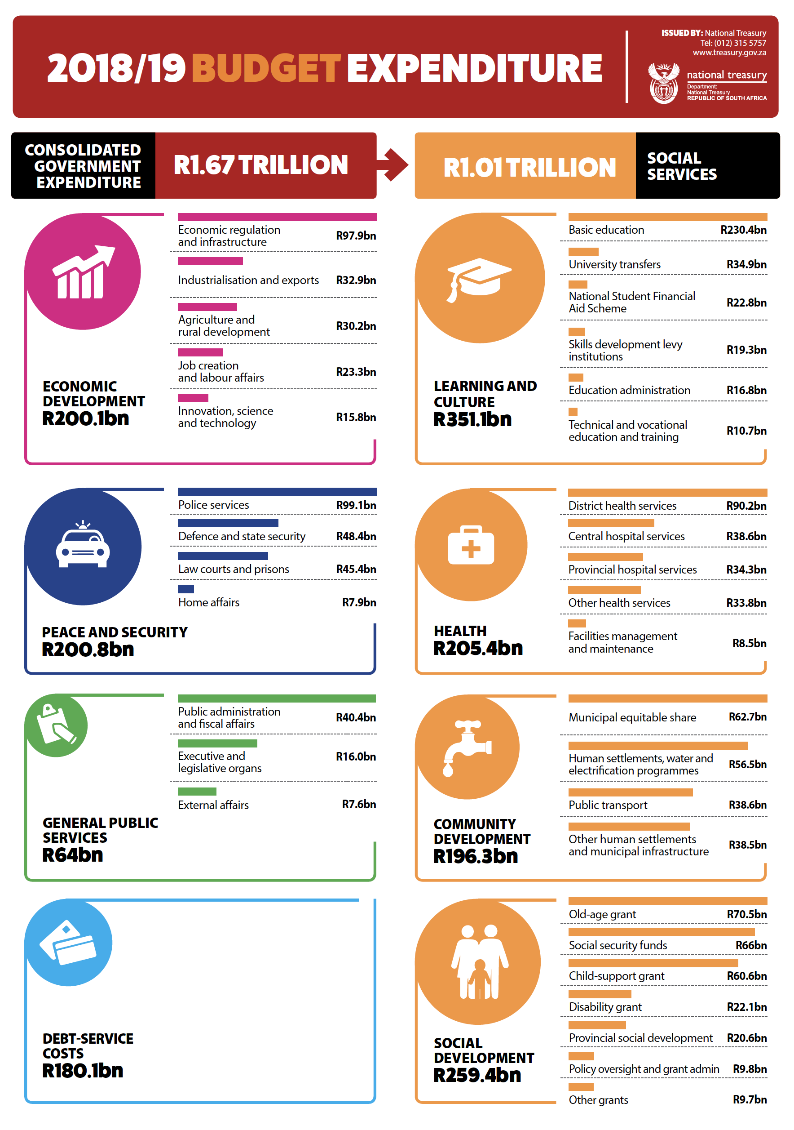
Funding
SA GDP = R3,16 trillion

Slide 57
Qualifications by age (birth cohort), 2011 (Van der Berg, 2013)

Slide 58

Higher education in perspective
When speaking about higher education it’s important to remember that this is only a very small proportion of the population
Source: DBE (2013) Internal Efficiency of the schooling System

Slide 59

Gustafsson, 2011 – When & how WP
“What do the magnitudes from Figure 4 mean in terms of the holding of qualifications? In particular, what widely recognised qualifications do the 60% of youths who do not obtain a Matric hold? …Only around 1% of youths hold no Matric but do hold some other non-school certificate or diploma issued by, for instance, an FET college”
(Gustafsson, 2011: p.11)
10%
Notes:
http://www.ekon.sun.ac.za/wpapers/2011/wp092011

Slide 60

How does SA fair internationally?
Gustafsson (2011) “The when and how of leaving school”
Notes:
http://www.ekon.sun.ac.za/wpapers/2011/wp092011

Slide 61
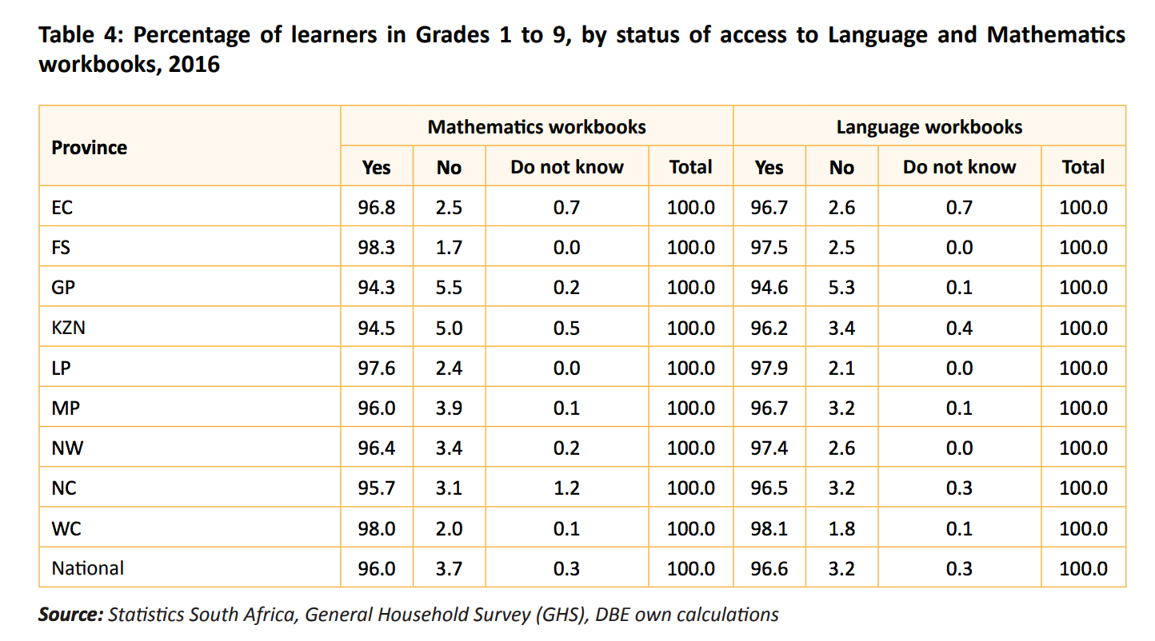
Resources
Access to language and mathematics workbooks (Grades 1-9) (GHS 2016)
DBE 2018 Report on GHS, page 24
Notes:
2018 DBE report on GHS - https://www.education.gov.za/LinkClick.aspx?fileticket=qt02-dal3BE%3D&tabid=92&portalid=0&mid=4362&forcedownload=true

Slide 62
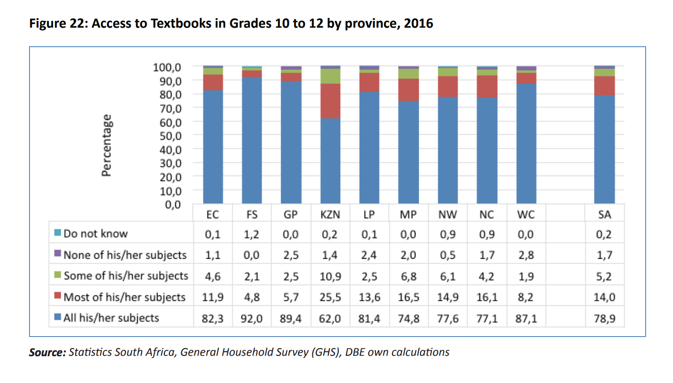
Resources
Access to textbooks in Grades 10-12 by province (GHS 2016)
DBE 2018 Report on GHS, page 25
Notes:
2018 DBE report on GHS - https://www.education.gov.za/LinkClick.aspx?fileticket=qt02-dal3BE%3D&tabid=92&portalid=0&mid=4362&forcedownload=true

Slide 63
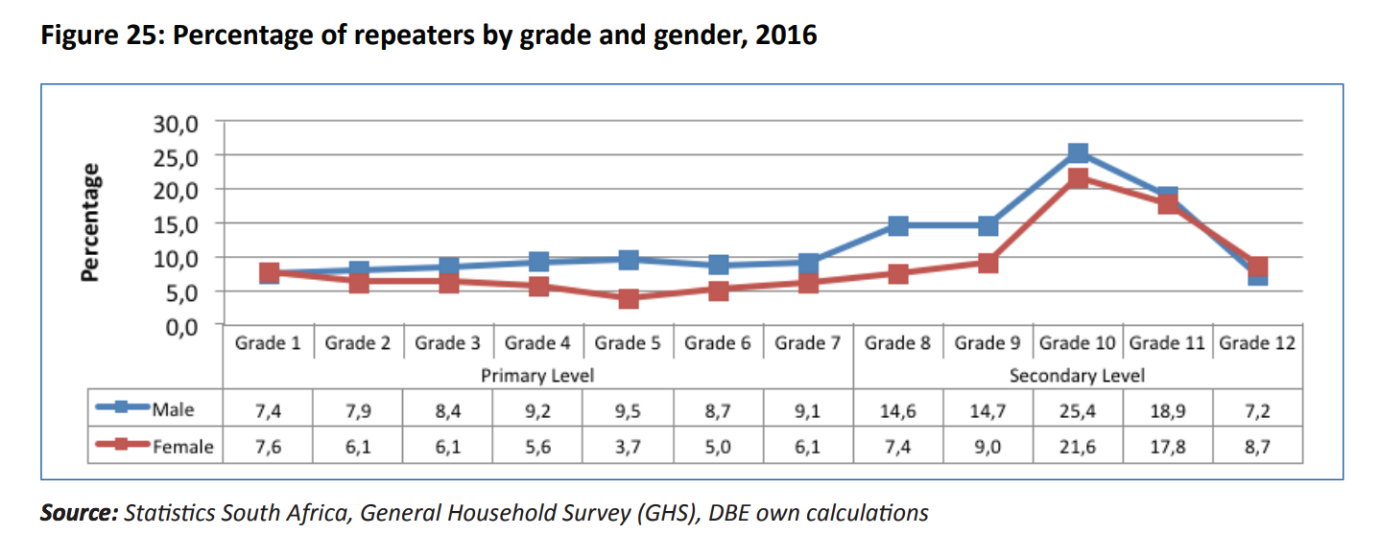
Grade repetition
DBE 2018 Report on GHS, page 28
Notes:
2018 DBE report on GHS - https://www.education.gov.za/LinkClick.aspx?fileticket=qt02-dal3BE%3D&tabid=92&portalid=0&mid=4362&forcedownload=true

Slide 64

NSES question 42
NSES followed about 15000 students (266 schools) and tested them in Grade 3 (2007), Grade 4 (2008) and Grade 5 (2009).
Foundational numeracy
Grade 3 maths curriculum: “Can perform calculations using appropriate symbols to solve problems involving: division of at least 2-digit by 1-digit numbers”
Even at the end of Grade 5 most (55%+) quintile 1-4 students cannot answer this simple Grade-3-level problem.
“The powerful notions of ratio, rate and proportion are built upon the simpler concepts of whole number, multiplication and division, fraction and rational number, and are themselves the precursors to the development of yet more complex concepts such as triangle similarity, trigonometry, gradient and calculus” (Taylor & Reddi, 2013: 194)
(Spaull & Kotze, 2015)
Notes:
Taylor, N., & Reddi, B. (2013). Writing and learning mathematics. In N. Taylor, S. Van der Berg, & T. Mabogoane, Creating Effective Schools. Cape Town: Pearson.

Slide 65
Teachers & unions
Breakdown as at 31 December 2012 (Audited stats for December 2013 will be availabkle mid-year)
These Stats include educators and a small numebr of support staff
Union | EC | GP | FS | KZN | LP | MP | NC | NW | WP | TOTAL
SADTU | 45968 | 29307 | 13853 | 57086 | 43706 | 25750 | 5826 | 18572 | 12944 | 253012
NAPTOSA | 12508 | 14805 | 4171 | 7346 | 687 | 2701 | 934 | 3335 | 9651 | 56138
SAOU | 2957 | 8090 | 4925 | 1244 | 1174 | 2452 | 1581 | 2242 | 4197 | 28862
PEU | 380 | 2807 | 71 | 193 | 7824 | 1728 | 128 | 1210 | 0 | 14341
NATU | 380 | 580 | 416 | 25424 | 55 | 1334 | 0 | 284 | 0 | 28473
TOTALS | 62193 | 55589 | 23436 | 91293 | 53446 | 33965 | 8469 | 25643 | 26792 | 380826
Thanks to Mike Myburgh (NAPTOSA) for supplying data
Notes:
There are two sources for the data: the main one is the PSCBC – Public Service Co-ordinating Bargaining Council (this is the forum where all of the public sector unions, including educator unions, bargain with the State on matters of mutual interest) And secondly the ELRC – Education Labour Relations Council (this is specifically for educator unions and the DBE to negotiate on matters not part of the PSCBC). Both conduct audits on an annual basis. These are not without errors! I tried to correct one or two of the significant figures and as indicated added in the Ind Sch and SGB members for NAPTOSA. SAOU may have about 2000 such members in addition to their State employed members (not certain of this though).

Slide 66
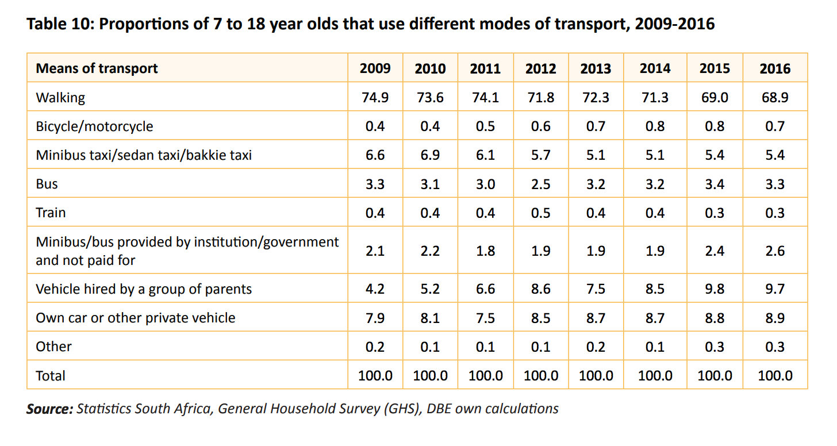
How do learners get to school in SA?

