Slide 1
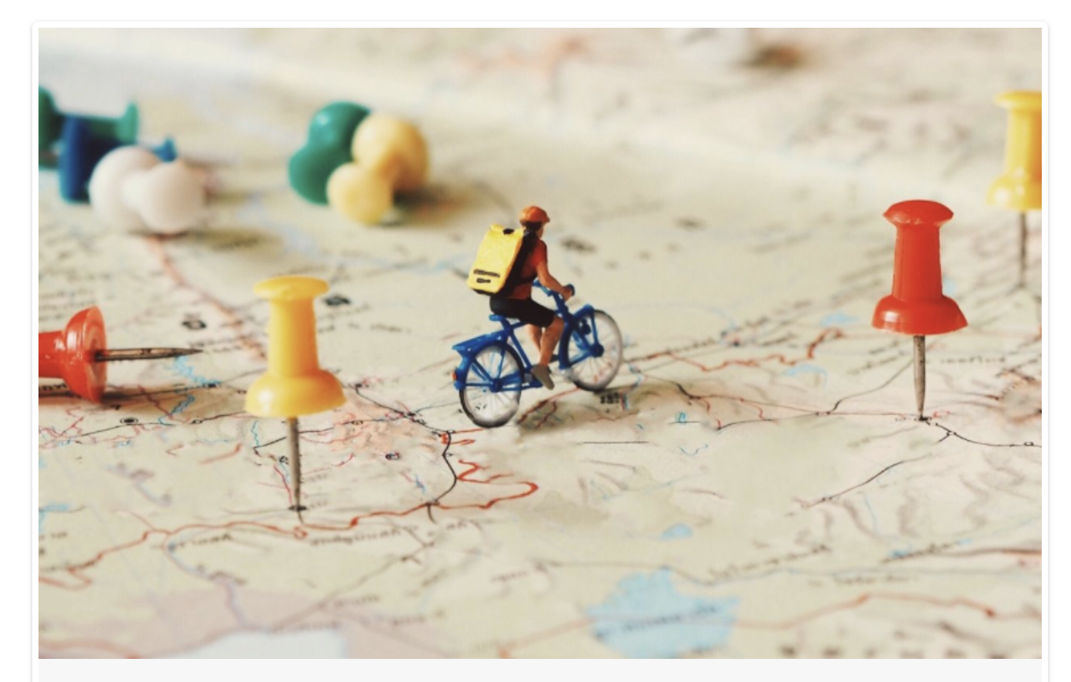
Education in South Africa
Wikimania Cape Town 2018
Dr Nic Spaull | www.NicSpaull.com | 18 July 2018
Logo – Design Thinking Australia . com

Slide 2
The South African context

Slide 3
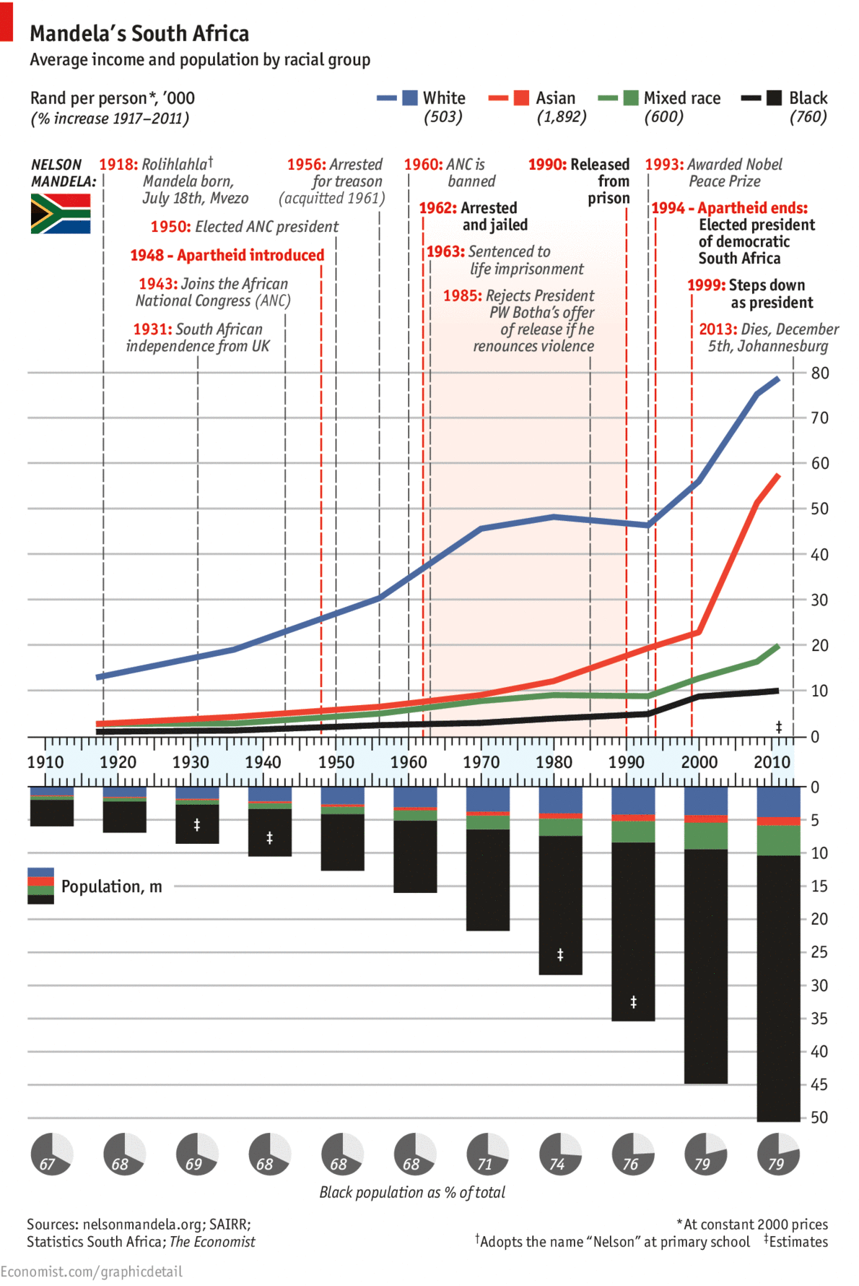

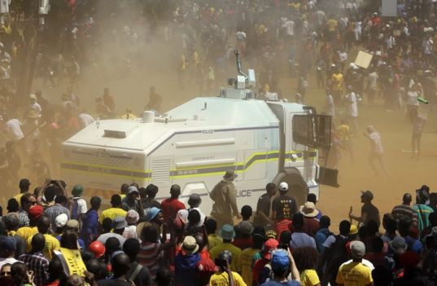
A trilemma of “rising unemployment, huge disparities in earnings and wealth; and an education system that perpetuates inequality”
Economic growth of 0,5%
Youth unemployment of 50%
Intergenerational inequality: If your parents are poor you the chances of your being poor are 90% (Finn et al, 2016)
Wealth inequality: 10% of the population own 95% of the wealth (Orthofer, 2016)
Successful system of social grants that sustain 17-million people and significantly reduce poverty (Woolard)
Small tax base: Only about 7-million South Africans (14%) pay income tax
New Solutions for a New Future
The South African context
Source: Leibbrandt & Green, 2017

Slide 4
South African Society
(NIDS 2009-2014/15) (values per person per month)
Schottee, Zizzamia & Leibbrandt (2017) Social Stratification, life chances and vulnerability to poverty in South Africa

Slide 5


#FeesMustFall

Slide 6

How many students actually make it to university?

Slide 7

How many students actually make it to university?

Slide 8

How many students actually make it to university?

Slide 9

How many students actually make it to university?

Slide 10

How many students actually make it to university?
Source: Van Broekhuizen & Van der Berg, 2016 (Higher Education Access and Outcomes for the 2008 National Matric Cohort)

Slide 11
How many students actually make it to university?
}
?
Source: Van Broekhuizen & Van der Berg, 2016 (Higher Education Access and Outcomes for the 2008 National Matric Cohort)

Slide 12


Who makes it to university?
Note: This is for a full cohort not just matrics
Poorest 10%
Richest 10%
Source: Van Broekhuizen & Van der Berg, 2016 (Higher Education Access and Outcomes for the 2008 National Matric Cohort)

Slide 13
Who makes it to university?
Low quality schooling
Note: This is for a full cohort not just matrics
Poorest 10%
Richest 10%
Source: Van Broekhuizen & Van der Berg, 2016 (Higher Education Access and Outcomes for the 2008 National Matric Cohort)

Slide 14
What does “low quality schooling” actually look like?

Slide 15
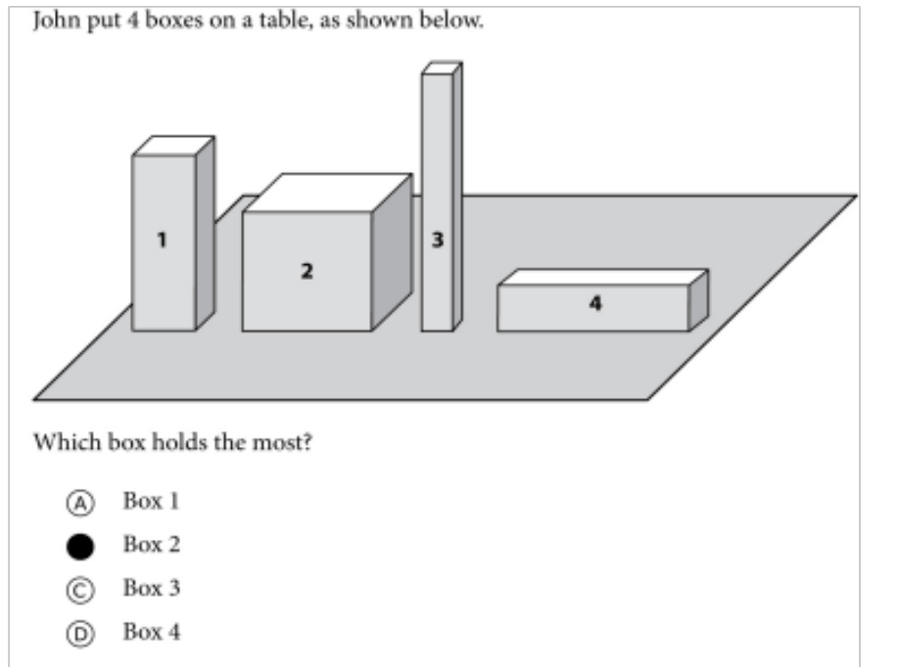

Mathematics
For this question:
Richest 10% SA schools = 94%
Poorest 10% SA schools = 34%
New Solutions for a New Future
TIMSS Gr5: Example questions from the test
2015 was the first time that SA participated in TIMSS Numeracy (Gr5)

Slide 16

NSES question 42
NSES followed about 15000 students (266 schools) and tested them in Grade 3 (2007), Grade 4 (2008) and Grade 5 (2009).
Foundational numeracy
Grade 3 maths curriculum: “Can perform calculations using appropriate symbols to solve problems involving: division of at least 2-digit by 1-digit numbers”
Even at the end of Grade 5 most (55%+) quintile 1-4 students cannot answer this simple Grade-3-level problem.
“The powerful notions of ratio, rate and proportion are built upon the simpler concepts of whole number, multiplication and division, fraction and rational number, and are themselves the precursors to the development of yet more complex concepts such as triangle similarity, trigonometry, gradient and calculus” (Taylor & Reddi, 2013: 194)
(Spaull & Kotze, 2015)
Notes:
Taylor, N., & Reddi, B. (2013). Writing and learning mathematics. In N. Taylor, S. Van der Berg, & T. Mabogoane, Creating Effective Schools. Cape Town: Pearson.

Slide 17
Where should we be intervening?
New Solutions for a New Future
Insurmountable learning deficits
Figure 10b: South African mathematics learning trajectories by national socioeconomic quintiles using a variable standard deviation for a year of learning (0.28 in grade 3 to 0.2 in grade 8 with interpolated values for in-between grades (Based on NSES 2007/8/9 for grades 3/4/5, SACMEQ 2007 for grade 6 and TIMSS 2011 for grade 9, including 95% confidence interval
(Spaull & Kotze, 2015)

Slide 18

“
“
Prevention is better than cure
FOUNDATIONS
“The later in life we attempt to repair early deficits, the costlier the remediation becomes’’
Nobel Laureate James Heckman (2000, p. 5).

Slide 19
What about reading?

Slide 20


78%
22% can read for meaning
of Grade 4 children in South Africa can not read for meaning in any language.
PIRLS Literacy 2016 (Howie et al., 2017)

Slide 21
SA PIRLS 2016 results in context
+
richest 10% of SA schools (71%)
Mullis et al. 2017

Slide 22
78%
How does this differ by school wealth?
Spaull & Pretorius (2018) Falling at the first hurdle. Springer.

Slide 23
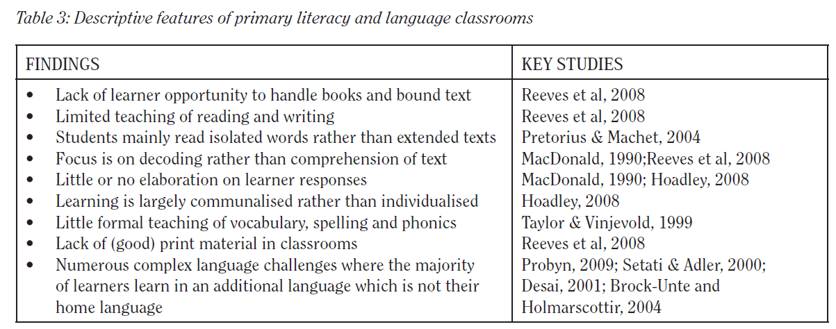
Do teachers know how to teach reading?
“South African learners’ performance in the PIRLS assessments accentuates the need for reading instruction practices aimed at addressing the difficulties South African learners encounter in both the Foundation Phase & Intermediate Phases … the qualifications that teachers do have, have not prepared them to teach reading literacy or … these teachers are not able to implement strategies they have gleaned from professional training.”
Prof Sarah Howie et al. (2008: 48)
Hoadley 2012 review of the literature

Slide 24
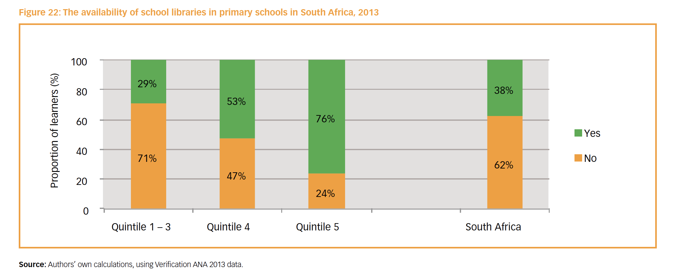
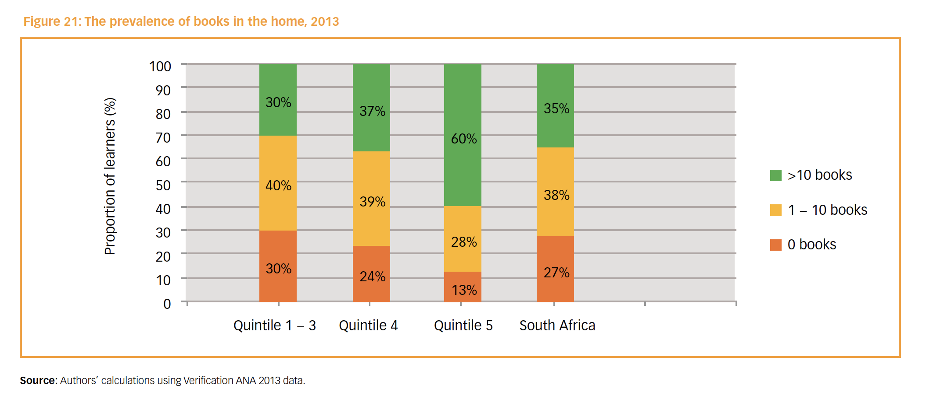

Slide 25
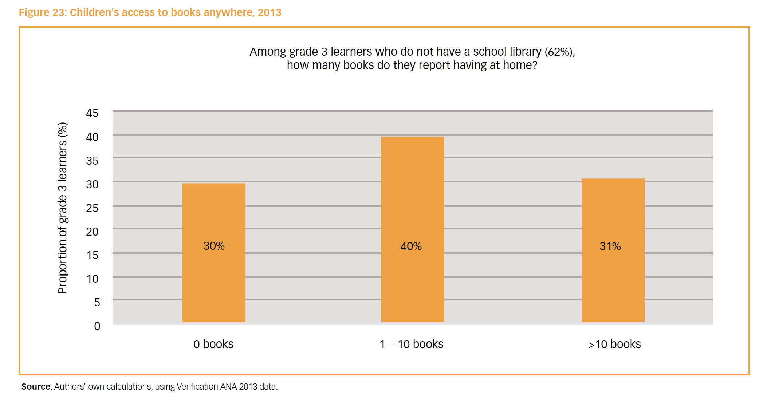

Slide 26
Labour Market
15%
Legislators, managers, assoc professionals
Unemployed
(Broad - 35%)
Unskilled
(18%)
Elementary occupations & domestic workers
Semi-Skilled (32%)
Clerks, service workers, shop personnel, skilled agric/fishery workers, plant and machinery operators)
University/FET
Type of institution (FET or University)
Quality of institution
Type of qualification (diploma, degree etc.)
Field of study (Engineering, Arts etc.)
High productivity jobs and incomes (17%)
Mainly professional, managerial & skilled jobs
Requires graduates, good quality matric or good vocational skills
Historically mainly white
High quality secondaryschool
High SES background
+ECD
High quality primary school
Minority (20%)
Some motivated, lucky or talented students make the transition
Unequal society
Big demand for good schools despite fees
Some scholarships/bursaries
Vocational training
Affirmative action
Majority (80%)
Quality
Low quality secondary
school
Attainment
Type
Low productivity jobs & incomes
Often manual or low skill jobs
Limited or low quality education
Minimum wage can exceed productivity
Low SES background
Low quality primary school
QLFS 2014
Notes:
The QLFS classifies professions as follows: Highly skilled (legislators, senior officials and managers, professionals, technicians and associate profesionals); Semi-skilled (Clerks, service workers and shop and market personnel, skilled agricultural and fishery workers, craft and related trade workers, plant and machinery operators and assembly), Unskilled (Elementary occupations, domestic workers).

Slide 27
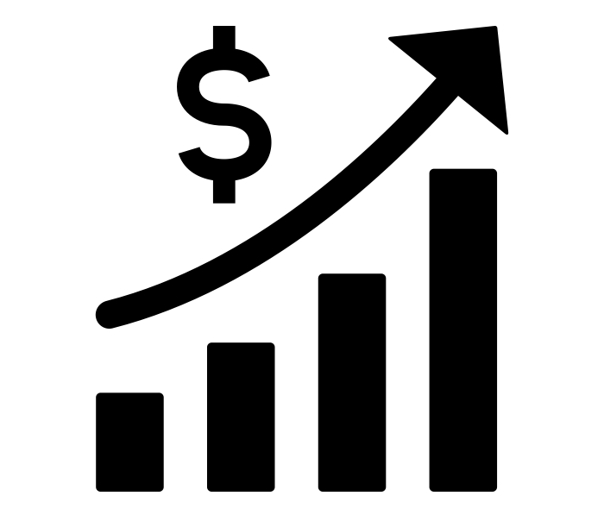
“
The best use of private money is influencing how public money is spent.
“
LEVERAGE
R351 Billion
R4,5 Billion
(1,2%)
2018 SA Government expenditure on education
Trialogue estimate of
all education CSI in SA

Slide 28
The SA education system
LEVERAGE
12 million learners
400,000 teachers
24,000 schools
  96% children are in public schools
  75%+ are in no-fee schools
How many children are we impacting with our investments?

Slide 29

“
What is the binding constraint to progress in this area?
“
PRIORITISE
“The binding constraints approach is based on the idea that not all constraints bind equally, and that a sensible and practical strategy consists of identifying the most serious constraints at work”
- Professor Dani Rodrik (2009: 6)

Slide 30

“The volume in the first barrel depends on the sum of the width of all slabs. Increasing the width of any slab will increase the volume of the barrel. So a strategy on improving anything you can, when you can, while you can, would be effective.”
(Hausmann, Klinger, & Wagner, 2008, p. 17).

Slide 31
“The volume in the second barrel is determined by the length of the shortest slab. Two implications of the second barrel are that the impact of a change in a slab on the volume of the barrel depends on whether it is the binding constraint or not. If not, the impact is zero”
(Hausmann, Klinger, & Wagner, 2008, p. 17).

Slide 33

“
What is the binding constraint to progress in this area?
“
PRIORITISE
Accountability
Capacity
The incentives to do what is in your job description.
The ability to do what is in your job description.
Improvement

Slide 34
So what is the BINDING CONSTRAINT
in the South African education system?

Slide 35
78%
of Grade 4 children in South Africa can not read for meaning in any language.
PIRLS Literacy 2016 (Howie et al., 2017)

Slide 36

What does this look like in reality?

Slide 37

FOUNDATIONS
Reading 40 Words Correct Per Minute
(starting point for reading comprehension in English)
NEEDU Grade 5 Rural SA

Slide 38
Reading speed…
Many
years
ago
Leopard
was
a
creature
with
no
spots.
Recommended rate at Gr5
One
day,
he
was
relaxing
in
the
shade
of
a
thorn
tree
when
Zebra
walked
past.
Many
years
ago
Leopard
was
a
creature
with
no
spots.
40% of SA rural Gr5 learners (<40WCPM) WCPM
One
day,
he
was
relaxing
in
the
shade
of
a
thorn
tree
when
Zebra
walked
past.
Draper, K., and Spaull, S. (2015). Examining oral reading fluency among grade 5 rural English Second Language (ESL) learners in South Africa: Analysis of NEEDU 2013. South African Journal of Childhood Education 5(2) pp.44-77.
Notes:
40 words in 60s = 1,5s/word
130 words in 60s = 0,46s/word

Slide 39

Falling at the first hurdle…
If children do not learn-to-read in Grades 1-3, they cannot read-to-learn in Grade 4 onwards
Spaull & Pretorius (2018) Falling at the first hurdle: Early grade reading in South Africa. Springer.

Slide 40




Funda Wande
A high-quality multimedia course to teach Foundation Phase teachers (Gr R-3) how to teach reading and maths.
2018-2023

Slide 41
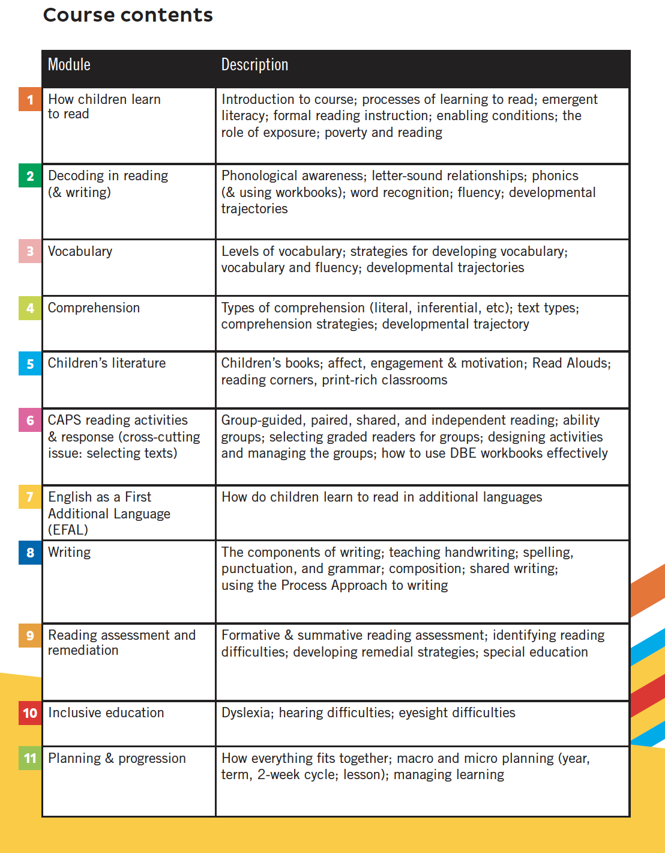


Slide 42
www.NicSpaull.com/presentations
Thank you
Other topics:
Co-funding
Assessment
Technology
Early Literacy

Slide 43
The Goldilocks Zone
A framework for thinking about evidence
Goldilocks zone for evidence
IDEAL
Goldilocks zone for policy
y
Measurement rigor
Consensus
Policy
Conclusive
5
Rigor of the Evidence
Causal
A
4
Small but rigorous
Confirming
3
Suggestive
☹
2
B
Large but weak evidence
Proof of concept
1
x
5
10
25
75
250
1500
5000+
Independence
Scale

Slide 44
Randomised Control Trial (RCT)

Slide 45

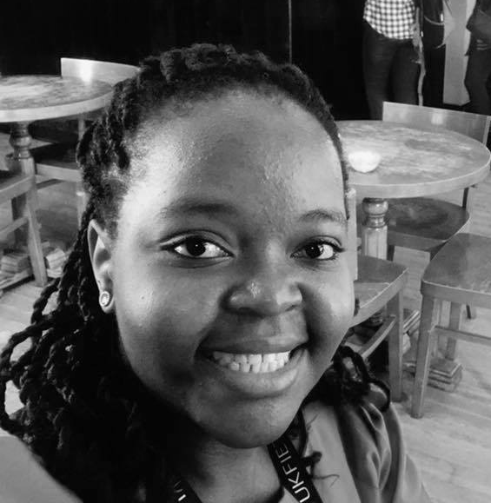

Slide 46
Sample: 230 schools in North West
Control group (80 schools) | “Training” Lesson plans, reading materials + central teacher training (50 schools) | “Coaching” Lesson plans, reading materials + on-site coaching (50 schools) | “Parent Involvement” (50 schools)
3 Interventions targeting HL literacy (Setswana)

Slide 47
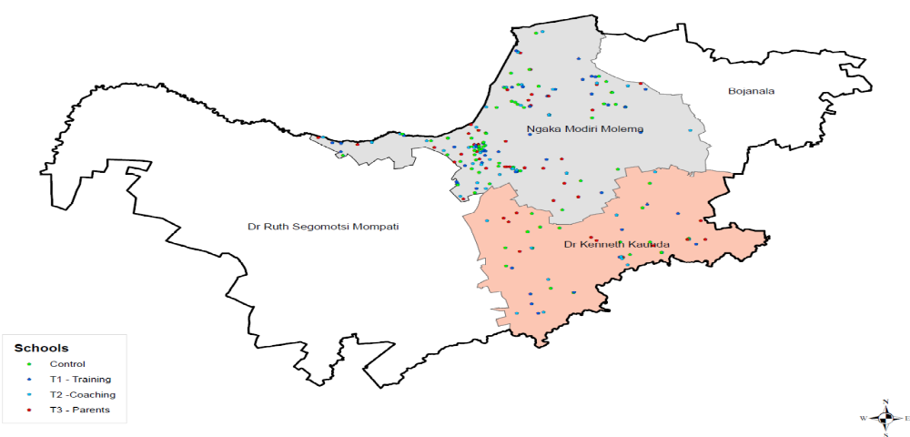
Sample: 230 schools in North West

Slide 48
How do things actually work?
Is evidence the binding constraint to improved policy on paper and improved implementation in practice?
  Probably not: “There is massive evidence that governments do not implement many many many projects/proposals/programs that are cost effective and do spend budget on items known to be not cost effective. The model of a benign social welfare planner hampered by lack of rigorous evidence on effectiveness whose behavior an RCT will change is complete wack nonsense. “ (Pritchett, 2018)
Primacy of politics
  Budget cycles → Feb/March splurge in SA
  Election cycles (new party/president/minister → new policy)
Role of culture, values and tradition
  The exact same evidence in US and Denmark will not have the same impact on policy (think about studies on (1) for-profit education, (2) competition/choice.)
Role of social networks
  Often policies are implemented or not implemented based on the Minister’s Whatsapp contacts or who’s in her calendar
Role of unpredictable factors
  Minister makes a trip overseas and loves the school(s) she sees. Changes policy.

