Slide 1
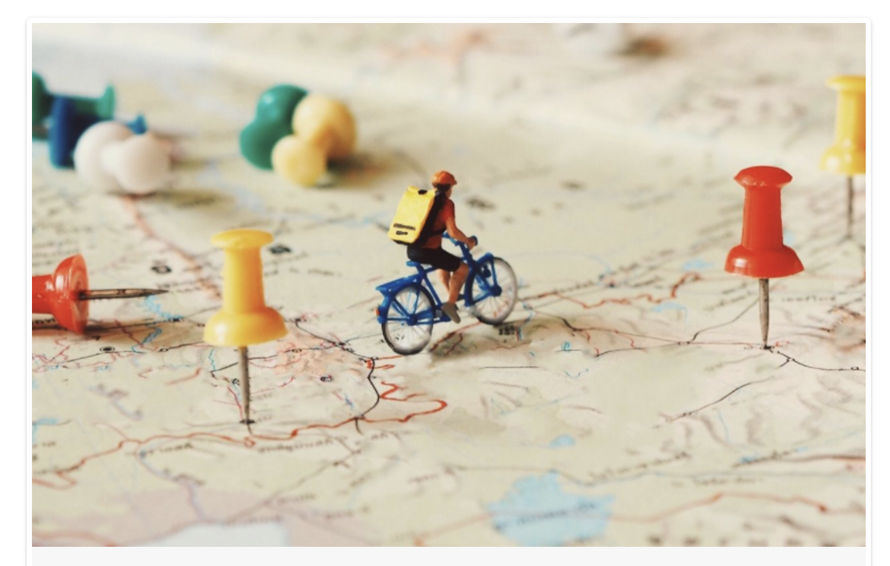
Reading for Meaning
Foundations for the Future
Dr Nic Spaull | www.NicSpaull.com | 13 July 2018
Logo – Design Thinking Australia . com

Slide 2


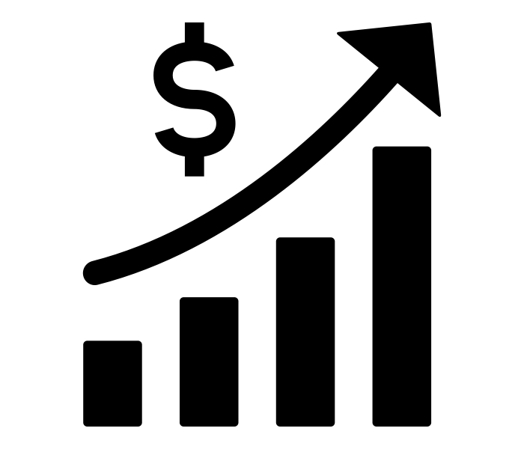


Getting reading right in South Africa
LEVERAGE
PRIORITISE
EVALUATE
FOUNDATIONS
1
2
3
4

Slide 3
The South African context

Slide 4
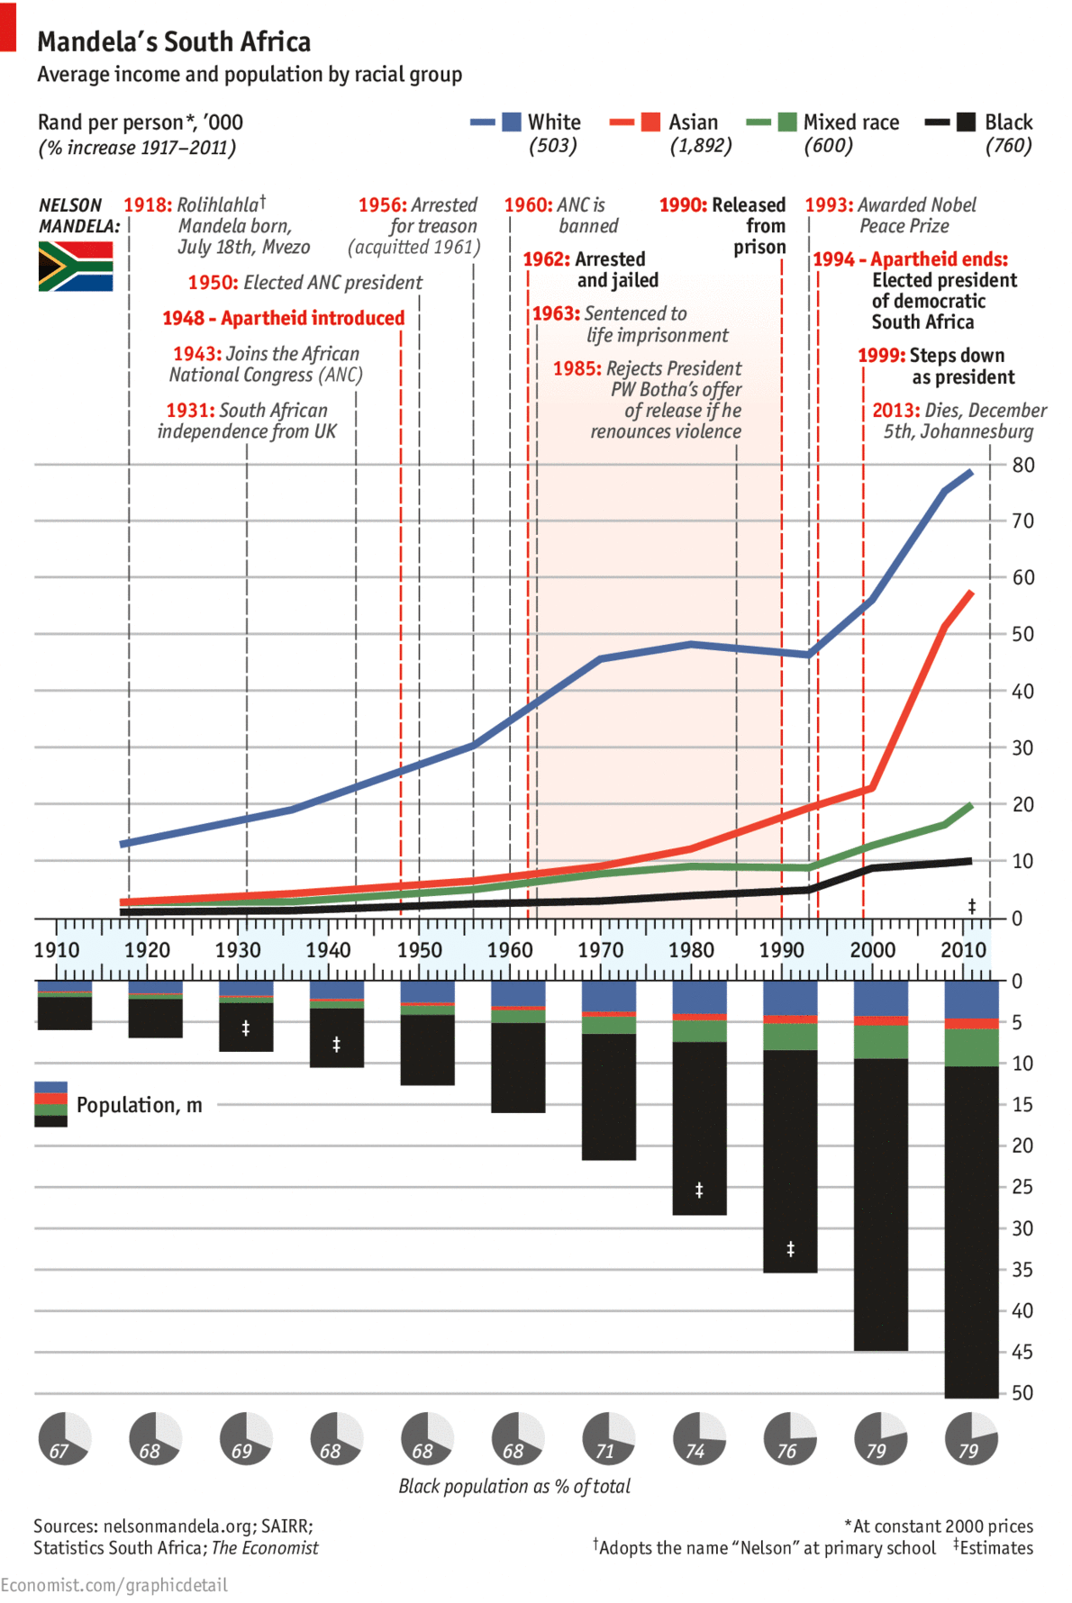

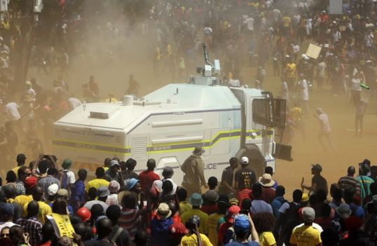
A trilemma of “rising unemployment, huge disparities in earnings and wealth; and an education system that perpetuates inequality”
Economic growth of 0,5%
Youth unemployment of 50%
Intergenerational inequality: If your parents are poor you the chances of your being poor are 90% (Finn et al, 2016)
Wealth inequality: 10% of the population own 95% of the wealth (Orthofer, 2016)
Successful system of social grants that sustain 17-million people and significantly reduce poverty (Woolard)
Small tax base: Only about 7-million South Africans (14%) pay income tax
New Solutions for a New Future
The South African context
Source: Leibbrandt & Green, 2017

Slide 5
South African Society
(NIDS 2009-2014/15) (values per person per month)
2/3rds of the elite are White
Schottee, Zizzamia & Leibbrandt (2017) Social Stratification, life chances and vulnerability to poverty in South Africa

Slide 6


#FeesMustFall

Slide 7

How many students actually make it to university?

Slide 8

How many students actually make it to university?

Slide 9

How many students actually make it to university?

Slide 10

How many students actually make it to university?

Slide 11

How many students actually make it to university?
Source: Van Broekhuizen & Van der Berg, 2016 (Higher Education Access and Outcomes for the 2008 National Matric Cohort)

Slide 12
How many students actually make it to university?
}
?
Source: Van Broekhuizen & Van der Berg, 2016 (Higher Education Access and Outcomes for the 2008 National Matric Cohort)

Slide 13


Who makes it to university?
Note: This is for a full cohort not just matrics
Poorest 10%
Richest 10%
Source: Van Broekhuizen & Van der Berg, 2016 (Higher Education Access and Outcomes for the 2008 National Matric Cohort)

Slide 14
Who makes it to university?
Low quality schooling
Note: This is for a full cohort not just matrics
Poorest 10%
Richest 10%
Source: Van Broekhuizen & Van der Berg, 2016 (Higher Education Access and Outcomes for the 2008 National Matric Cohort)

Slide 15
What does “low quality schooling” actually look like?

Slide 16
Language of instruction
More than 70% of SA children learn to read in an African language before switching to English in Grade 4
Fig. 1 Breakdown of the language of learning, teaching and assessment by grade—Annual National
Assessment (ANA) 2013 various grades (n = 7,630,240) (Pretorius & Spaull, 2016)
Pretorius & Spaull, 2016

Slide 17
NO
improvement
1,4 year improvement
Can be difficult to interpret what these scores mean
Mullis et al. 2017

Slide 18
NO
improvement
1,4 year improvement
% reaching the PIRLS Low International Benchmark
Mullis et al. 2017

Slide 19

Putting things in context…
PIRLS 2016 Low International Benchmark
If a learner can reach the PIRLS Low International Benchmark then they can
“locate and retrieve explicitly stated information, actions or ideas;
make straightforward inferences about events and reasons for actions; or
begin to interpret story events and central ideas” (Mullis et al, 2017; p.53).
  South Africa: 22%
Mullis et al. 2017, p.55

Slide 20
SA PIRLS 2016 results in context
Mullis et al. 2017

Slide 21


SA Gr4
Released passage from PIRLS Literacy 2016
40%
40%
32%
Mullis et al. 2017

Slide 22
SA Gr4
Released passage from PIRLS Literacy 2016
40%
Mullis et al. 2017

Slide 23
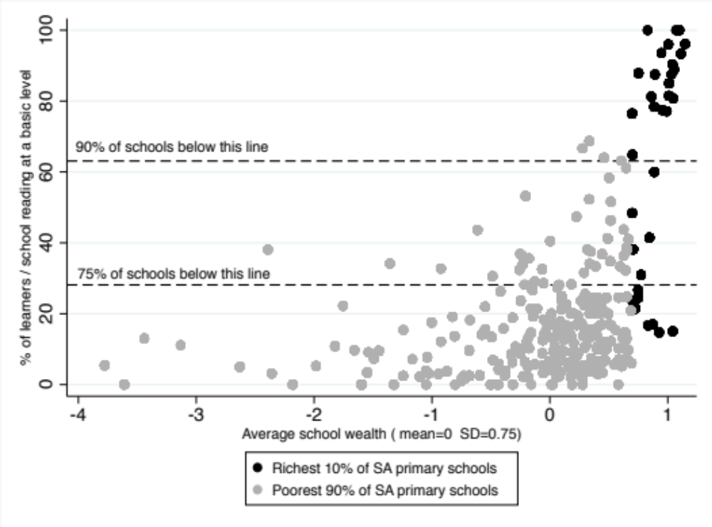
% of learners per school reading at a basic level in PIRLS 2016
By school socioeconomic status (avg student asset wealth)
Only 20 of 293 schools where 70%+ learners in the class learn to read at a basic level.
All are from the wealthiest decile. 14 of the 20 are from the wealthiest 3% of schools
Poorest
schools
Richest
schools
Spaull & Pretorius, 2018

Slide 24
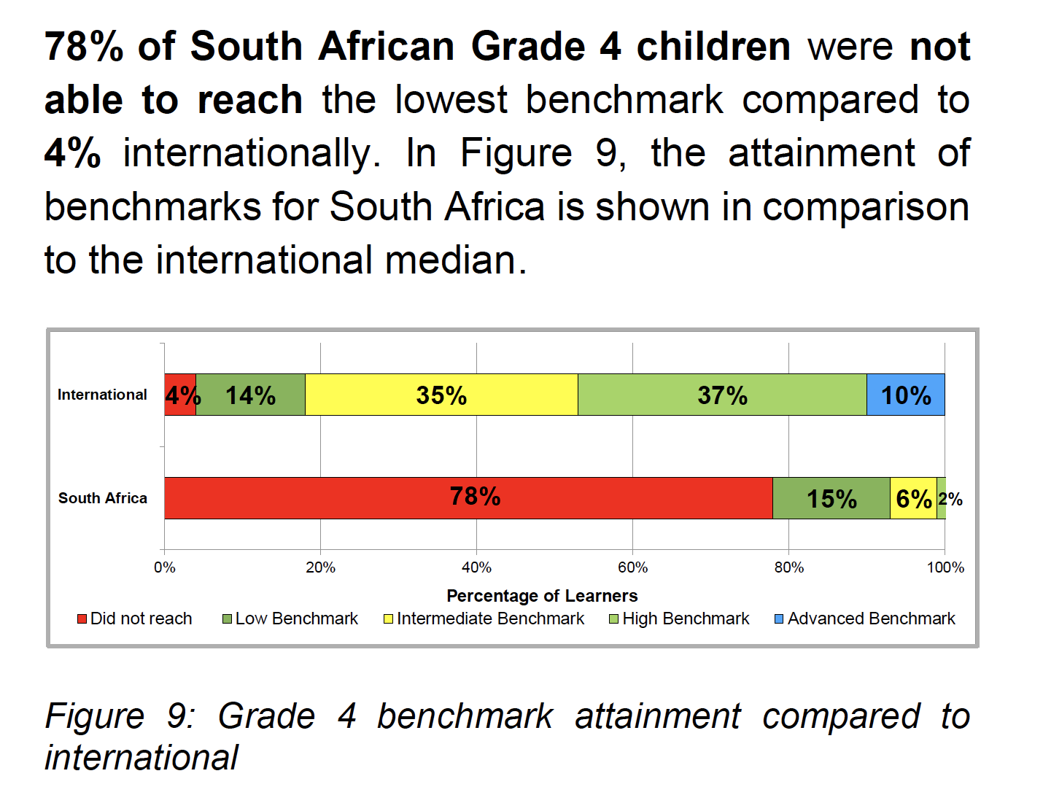
78%
of South African Gr4 learners cannot read for meaning in any language
Source: SA PIRLS Literacy 2016 report

Slide 25
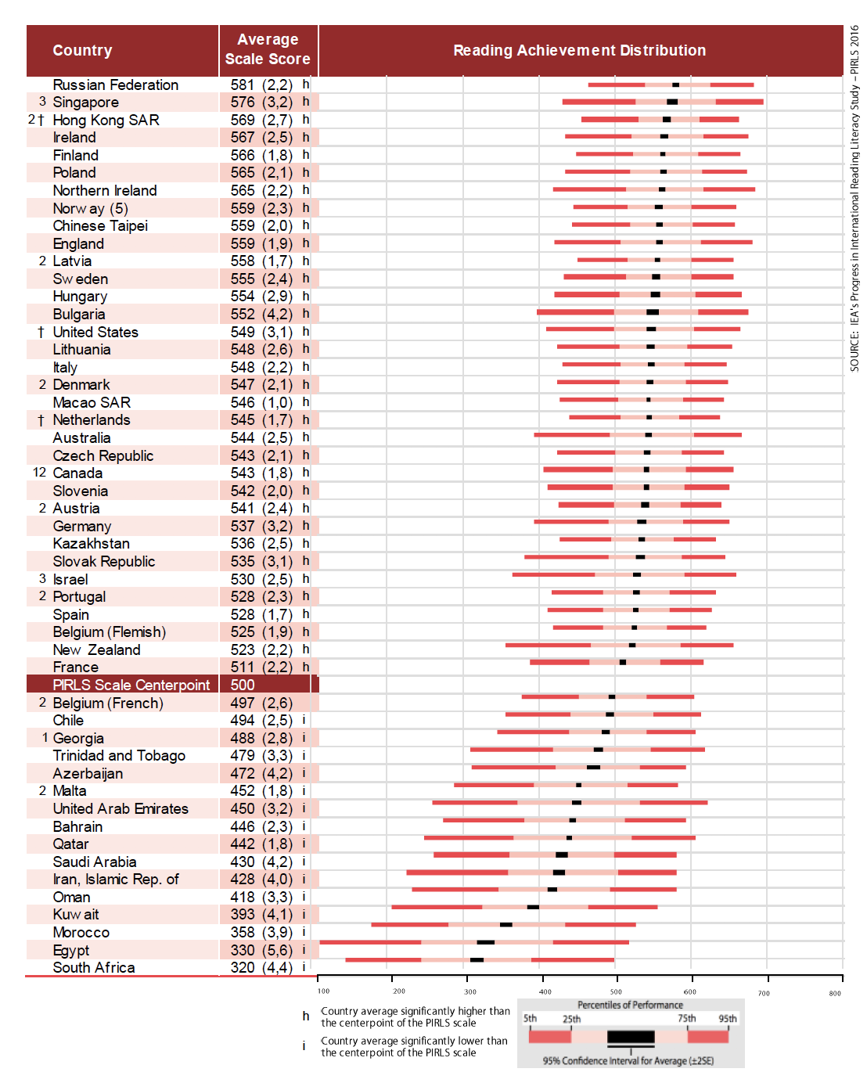
In 2016 SA came last of the 50 countries that participated.
No improvement in reading outcomes between 2011 and 2016
Source: PIRLS 2016 report

Slide 26
78%
How does this differ by school wealth?
Spaull & Pretorius (2018) Falling at the first hurdle. Springer.

Slide 27

NEEDU 2013: Can students read in English in Grade 5?
“We found that South African Grade 5 second language learners from rural areas in South Africa had essentially the same distribution as Grade 1 second language learners in Florida (U.S) They “cannot communicate meaning orally in English and demonstrate very little understanding in English”.
Draper & Spaull (2015)

Slide 28


Slide 29
What does this look like in reality?
Many
years
ago
Leopard
was
a
creature
with
no
spots.
Recommended rate at Gr5
One
day,
he
was
relaxing
in
the
shade
of
a
thorn
tree
when
Zebra
walked
past.
Many
years
ago
Leopard
was
a
creature
with
no
spots.
40% of SA rural Gr5 learners (<40WCPM) WCPM
One
day,
he
was
relaxing
in
the
shade
of
a
thorn
tree
when
Zebra
walked
past.
Draper, K., and Spaull, S. (2015). Examining oral reading fluency among grade 5 rural English Second Language (ESL) learners in South Africa: Analysis of NEEDU 2013. South African Journal of Childhood Education 5(2) pp.44-77.
Notes:
40 words in 60s = 1,5s/word
130 words in 60s = 0,46s/word

Slide 30
Labour Market
15%
Legislators, managers, assoc professionals
Unemployed
(Broad - 35%)
Unskilled
(18%)
Elementary occupations & domestic workers
Semi-Skilled (32%)
Clerks, service workers, shop personnel, skilled agric/fishery workers, plant and machinery operators)
University/FET
Type of institution (FET or University)
Quality of institution
Type of qualification (diploma, degree etc.)
Field of study (Engineering, Arts etc.)
High productivity jobs and incomes (17%)
Mainly professional, managerial & skilled jobs
Requires graduates, good quality matric or good vocational skills
Historically mainly white
High quality secondaryschool
High SES background
+ECD
High quality primary school
Minority (20%)
Some motivated, lucky or talented students make the transition
Unequal society
Big demand for good schools despite fees
Some scholarships/bursaries
Vocational training
Affirmative action
Majority (80%)
Quality
Low quality secondary
school
Attainment
Type
Low productivity jobs & incomes
Often manual or low skill jobs
Limited or low quality education
Minimum wage can exceed productivity
Low SES background
Low quality primary school
QLFS 2014
Notes:
The QLFS classifies professions as follows: Highly skilled (legislators, senior officials and managers, professionals, technicians and associate profesionals); Semi-skilled (Clerks, service workers and shop and market personnel, skilled agricultural and fishery workers, craft and related trade workers, plant and machinery operators and assembly), Unskilled (Elementary occupations, domestic workers).

Slide 31
Getting reading right
LEVERAGE
PRIORITISE
EVALUATE
FOUNDATIONS
1
2
3
4

Slide 32
“
The best use of private money is influencing how public money is spent.
“
LEVERAGE
R351 Billion
R4,5 Billion
(1,2%)
2018 SA Government expenditure on education
Trialogue estimate of
all education CSI in SA

Slide 33

“
What is the binding constraint to progress in this area?
“
PRIORITISE
Accountability
Capacity
The incentives to do what is in your job description.
The ability to do what is in your job description.
Improvement

Slide 34
“
If I had a week to chop down a tree I would spend 6 days sharpening the axe
“
EVALUATE
The imperative of independent evaluation
Evaluation: There is no guarantee that simply spending money on something will automatically lead to improvements
Independence: You cannot be both the player and the referee. The evaluator must be appointed by the funder (not the grantee)
5-10% on evaluation: Depending on the project one should allocate 5-10% of the overall budget on evaluation
Causal evaluations: Not all evaluations are created equal. Critical to do rigorous quantitative evaluations

Slide 35

Falling at the first hurdle…
If children do not learn-to-read in Grades 1-3, they cannot read-to-learn in Grade 4 onwards
Spaull & Pretorius (2018) Falling at the first hurdle: Early grade reading in South Africa. Springer.

Slide 36

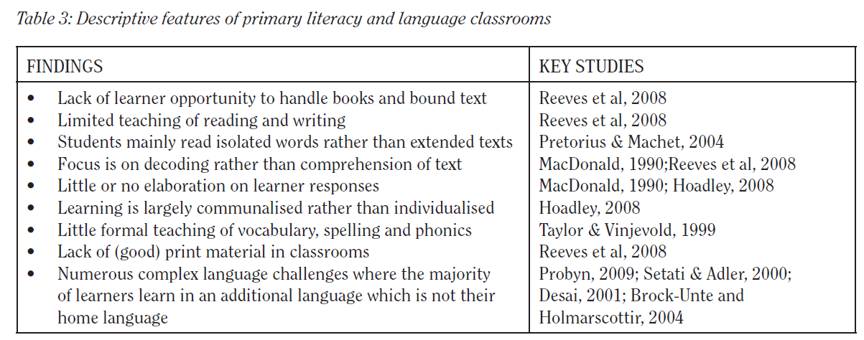
Do teachers know how to teach reading?
“South African learners’ performance in the PIRLS assessments accentuates the need for reading instruction practices aimed at addressing the difficulties South African learners encounter in both the Foundation Phase & Intermediate Phases … the qualifications that teachers do have, have not prepared them to teach reading literacy or … these teachers are not able to implement strategies they have gleaned from professional training.”
Prof Sarah Howie et al. (2008: 48)
Hoadley 2012 review of the literature

Slide 37




Funda Wande
A high-quality multimedia course to teach Foundation Phase teachers (Gr R-3) how to teach reading and maths.
2018-2023

Slide 38
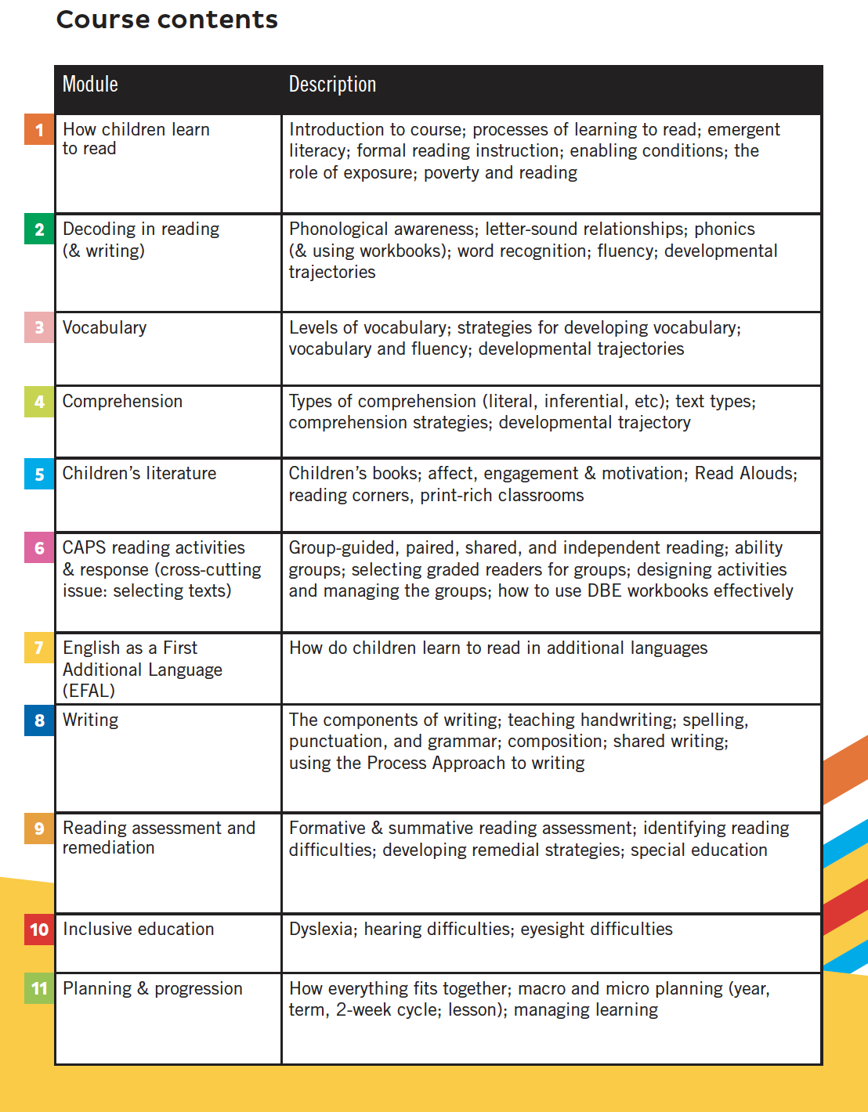


Slide 39
“
(1) The best use of private money is influencing how public money is spent.
“
LEVERAGE
“
(2) Avoid a ‘do everything’ strategy. Prioritize & identify the binding constraint. Address that.
“
PRIORITISE
“
(3) Focus on the foundations. ECD & early literacy are the foundations upon which all other learning depends.
FOUNDATIONS
“
“
(4) Independent evaluations of all projects. What impact are our grants having on how many people? Are we 100% sure?
“
EVALUATE

Slide 40
www.NicSpaull.com/presentations
Thank you
Other topics:
Inequality
Assessment
Technology
Evaluation

