Slide 1
Preparing for the 4th Industrial Revolution
Somerset House
Nic Spaull | www.NicSpaull.com | 22 Jan 2019

Slide 2
Key questions
The 4th Industrial Revolution
21st Century Skills and Socio-emotional skills
Racial integration & universities
Dispositions towards learning
South Africa’s education system

Slide 3

“Preparing students for jobs that don’t yet exist, using technologies that haven’t been invented yet, to solve problems that we don’t yet know are problems”
Notes:
Azadi Tower Iran

Slide 4





A Grade 3 child at Somerset House
1999
Grade 3 (9yo): 2019
Matric (18yo): 2028
Married (29yo): 2039
  (20 years from now?)
1999 = 20 years ago

Slide 6
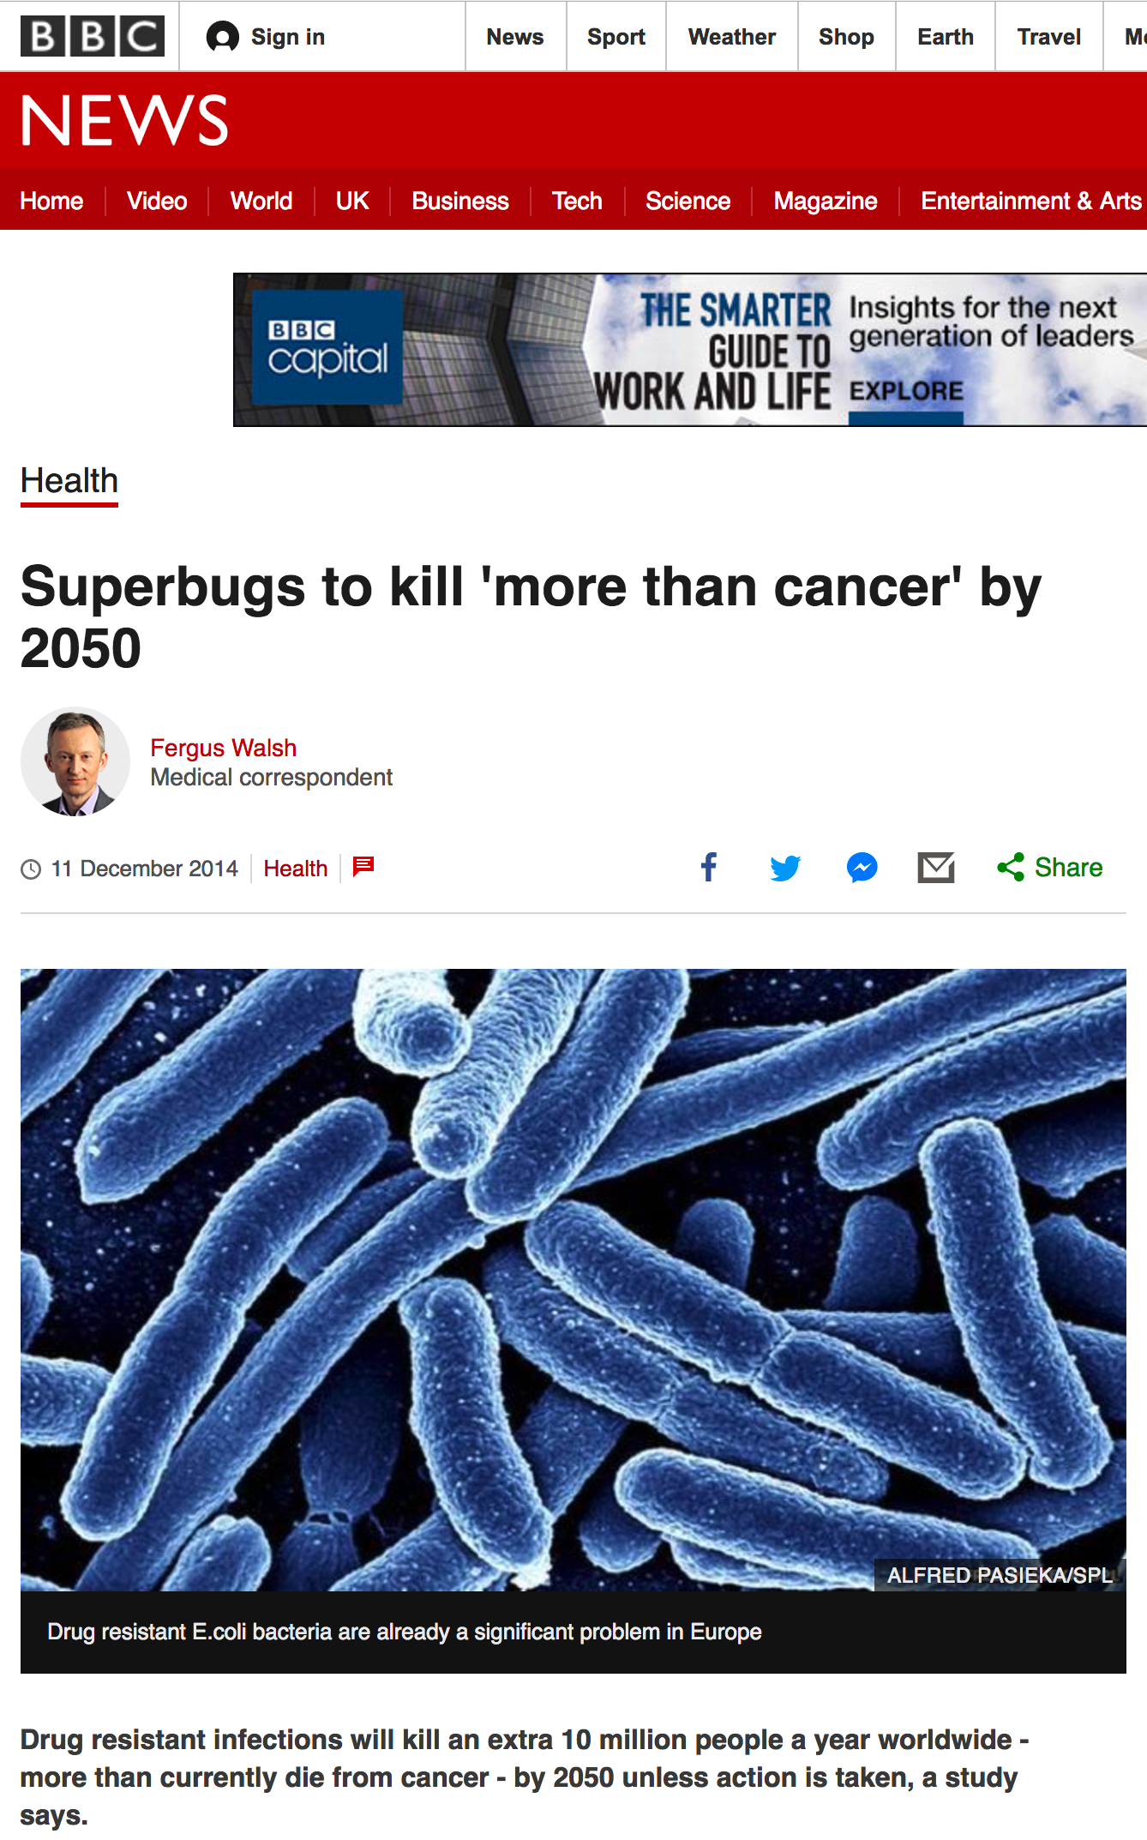
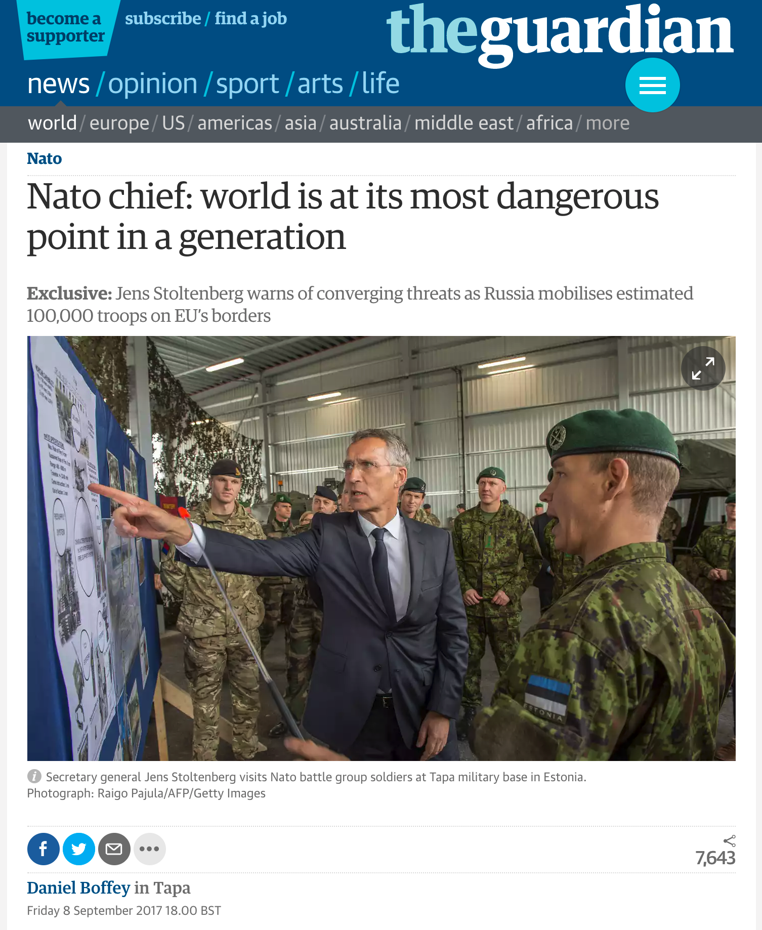
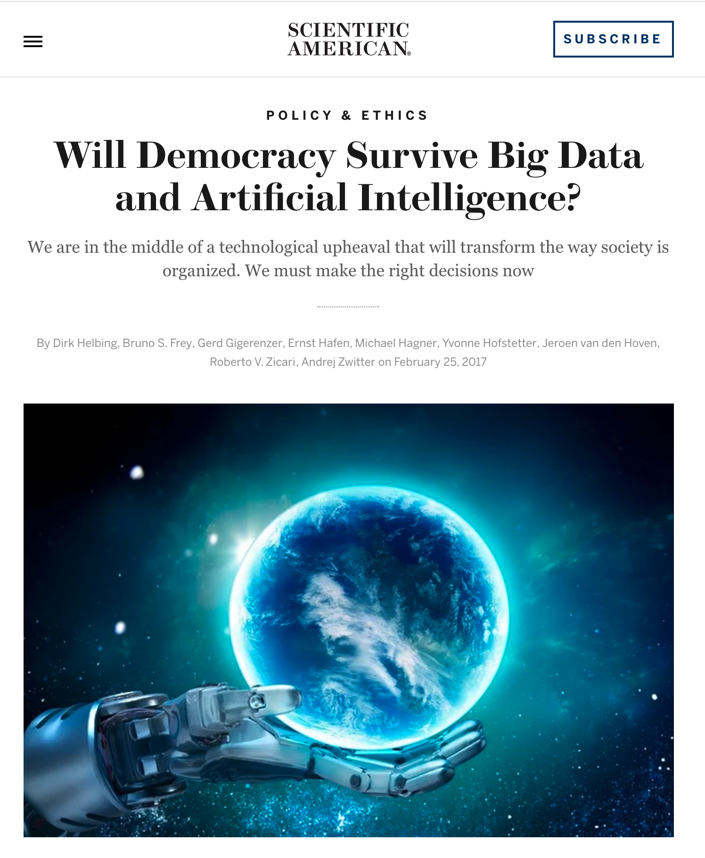
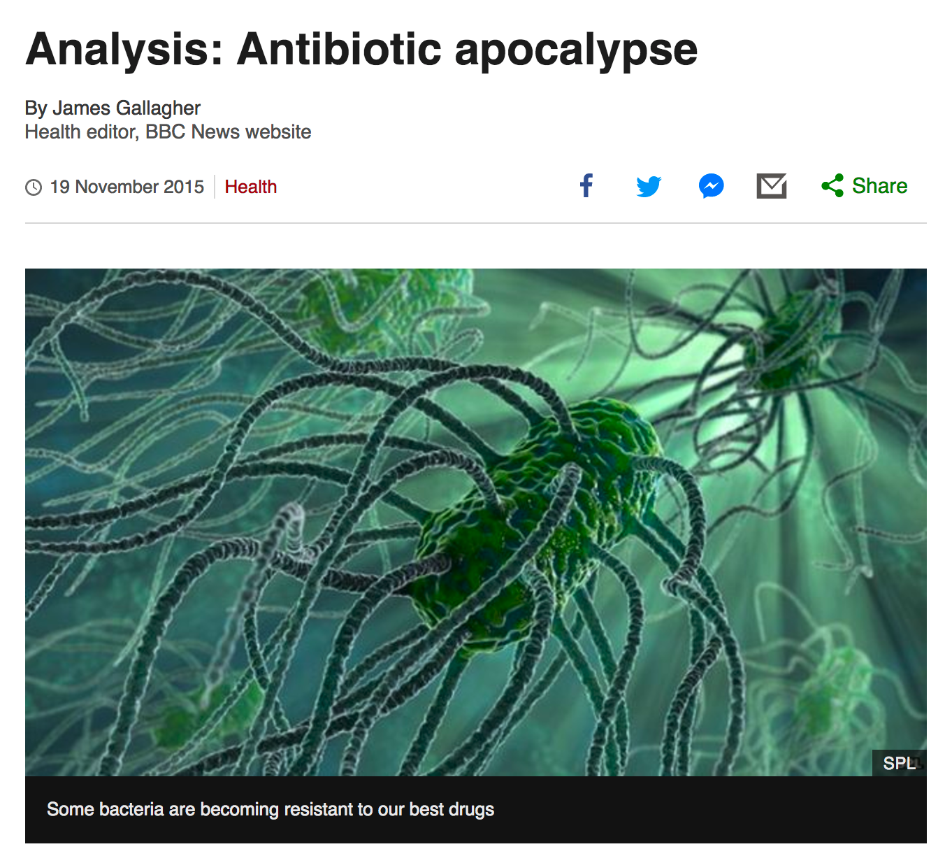
But…the 21st C will present many more challenges than just a different way of working. Hyper-connectivity, globalized citizens, acceleration brings fragility.

Slide 7



Slide 8


Slide 9
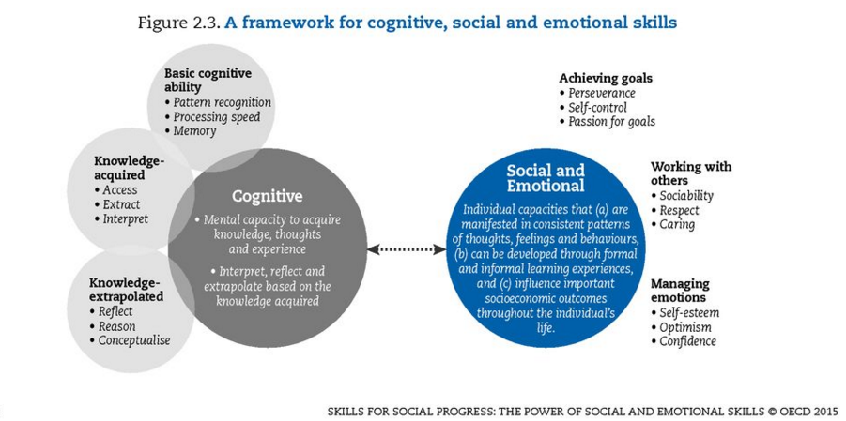

Slide 10
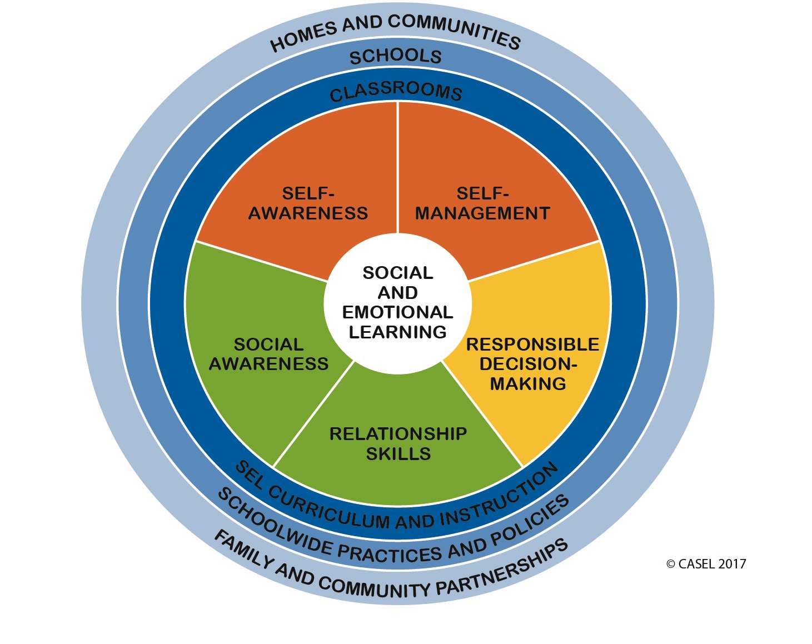

Slide 11
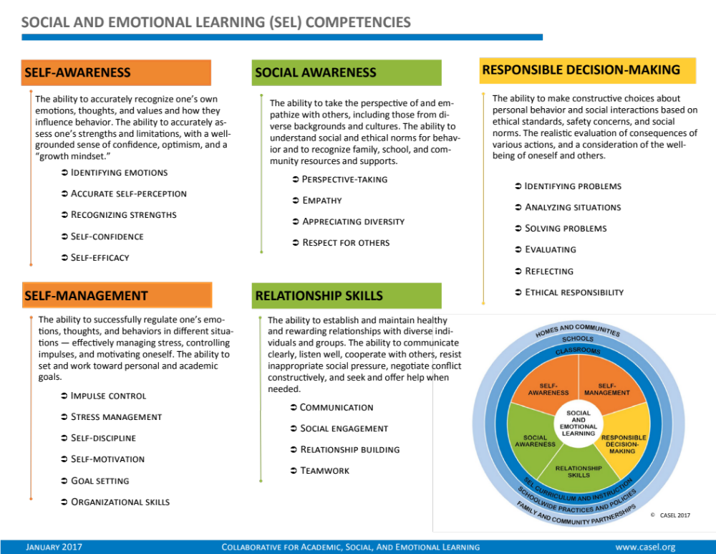

Slide 12
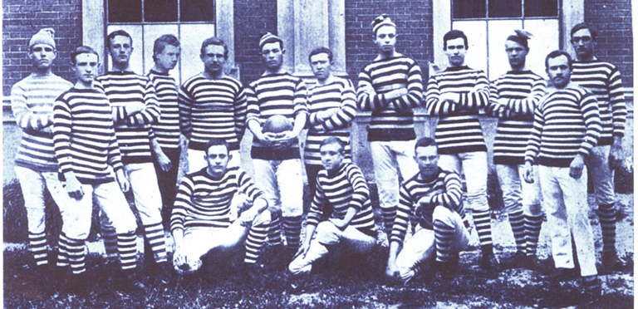
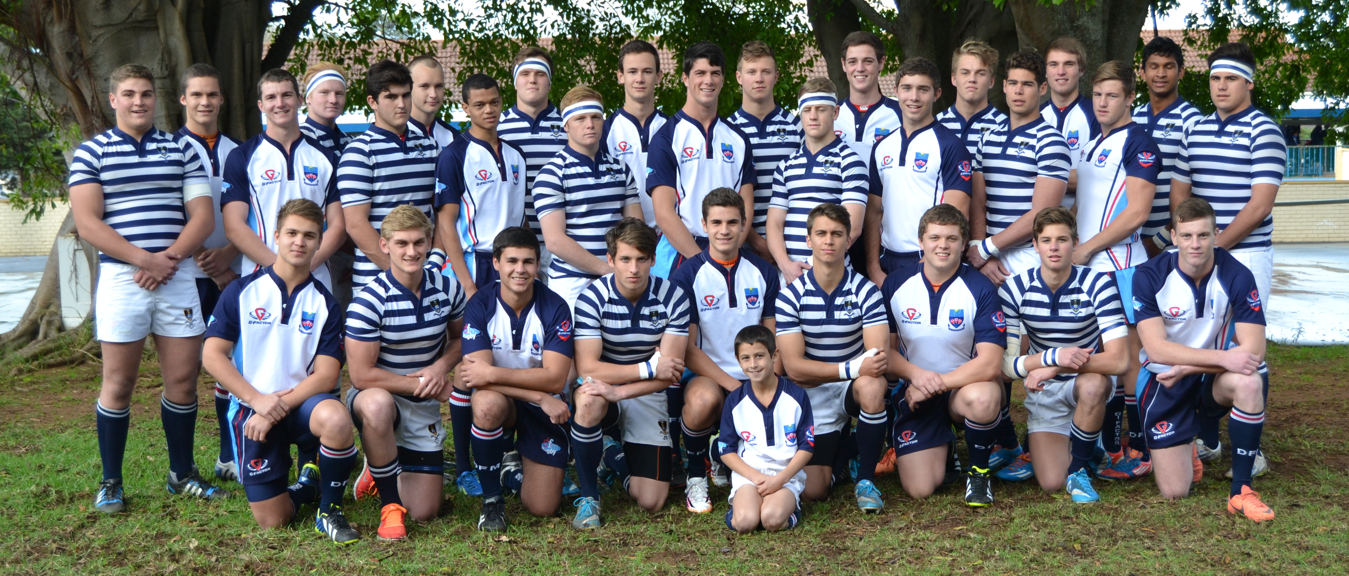
1882
2014

Slide 13
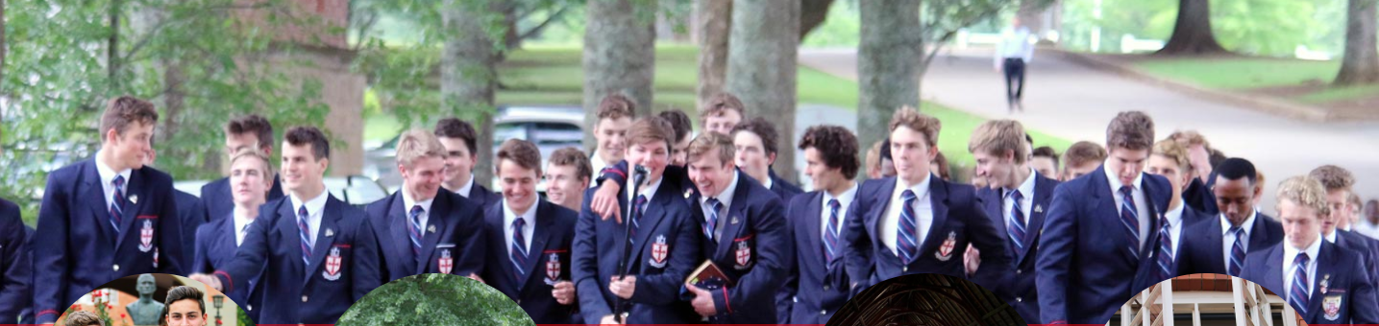
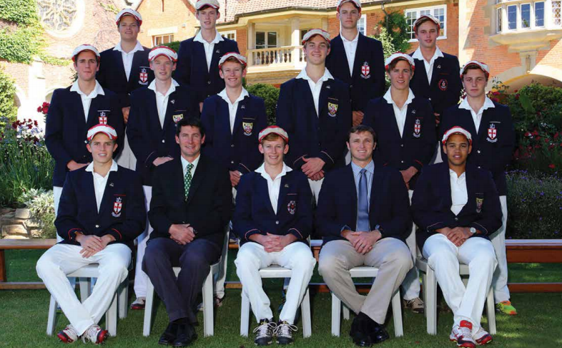
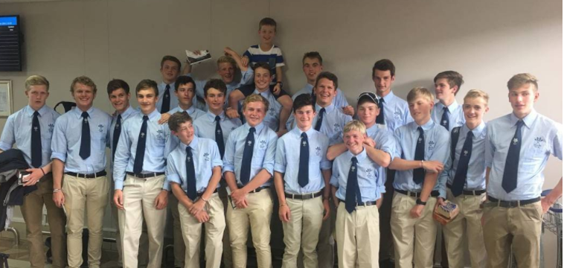


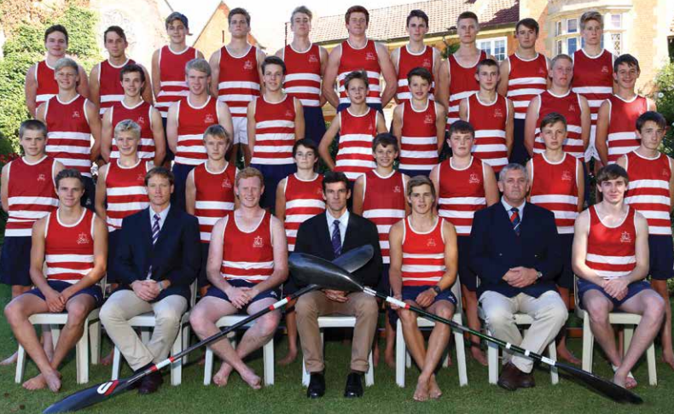

Slide 14
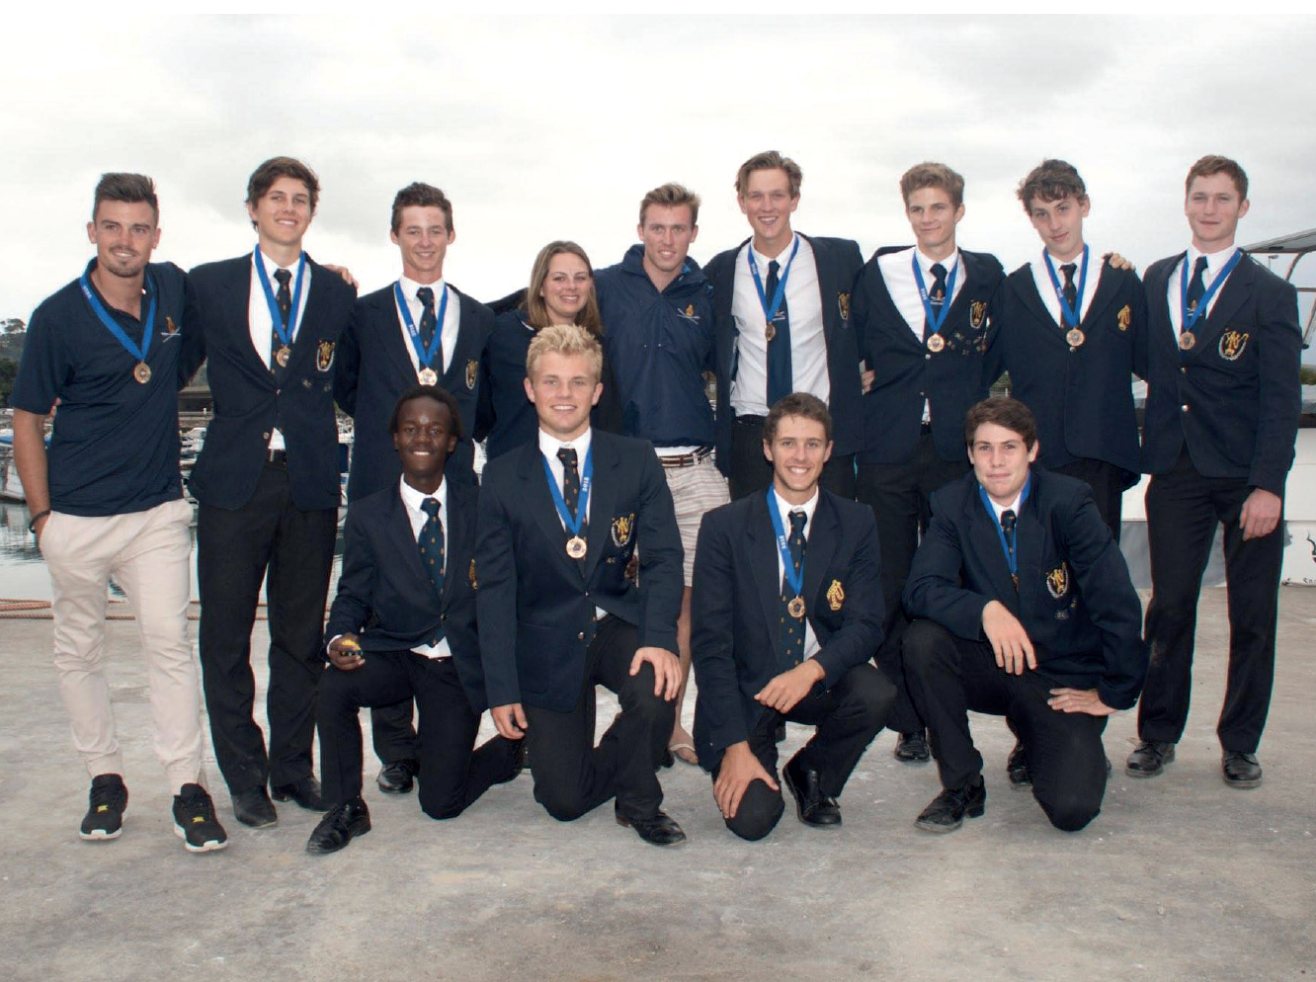
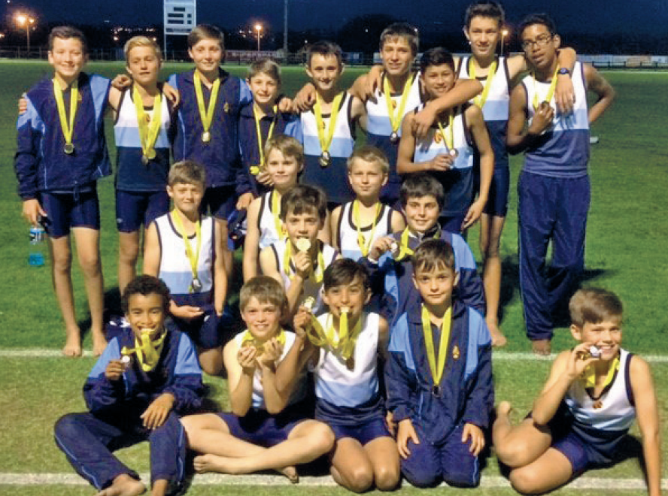
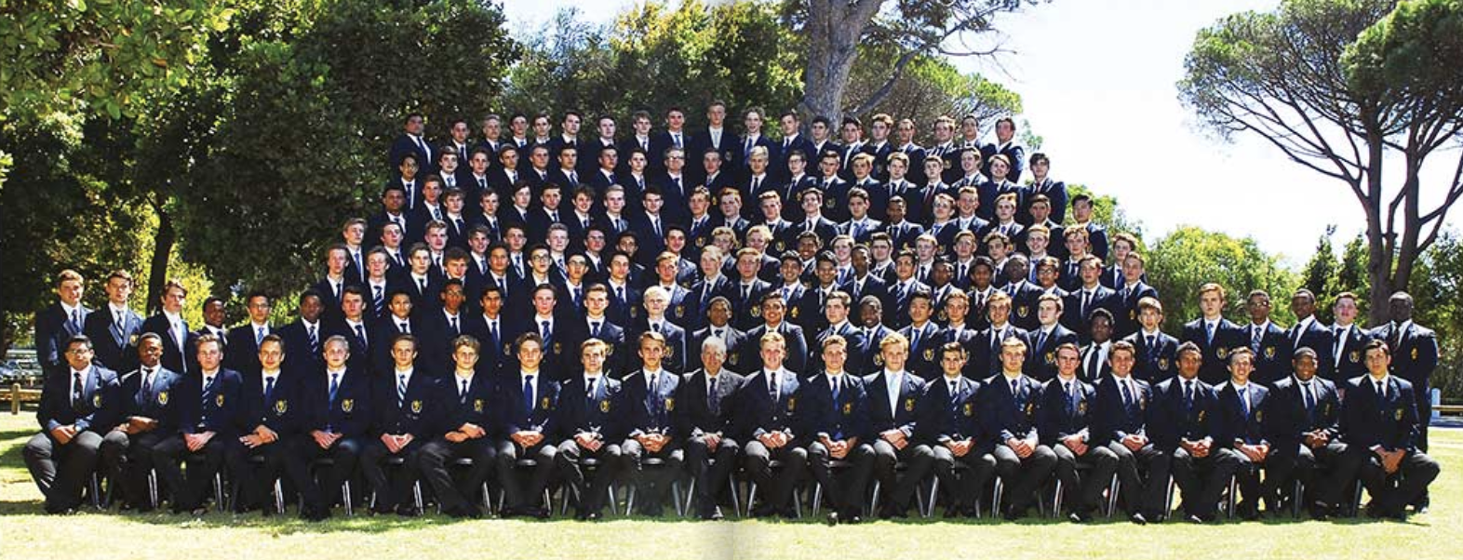
70 % White
75 % White

Slide 15
Case Study
From an elite SA Boys School to their ex-Head Boy:
“Did you feel that we prepared you for university?”

Slide 17
The
single biggest strategic threat to Somerset Houe is the lack of transformation of students and staff.
Way forward:
Be much more aggressive and set more ambitious non-negotiable targets.
Stop making excuses about why you can’t reach them.
Put your money where your mouth is.
You don’t need an atrium/indoor-swimming pool/new ICT lab. You need more black students.
Be pro-active and innovate.
Become the first elite school to become truly socioeconomically diverse.

Slide 18
Disposition towards learning…
We typically ask if kids are GOOD at something. “What did my child get in maths?” What are they struggling with? Much more important to understand their orientation/disposition towards it. Not so much their marks.
  Do you like maths?
  Do you find it interesting?
  Do you pursue it in your own time?
Emerging norm of ‘portfolio careers’…

Slide 19
Questions to ask ourselves:
Are we preparing our children for a world that will, in all likelihood, look radically different to what it does now?
Mastering content subjects is the new ‘floor’ – how pro-active are we being about this?
  It’s about a lot more than one-device-per-child.
Socio-emotional skills, dispositions, adaptability, flexibility, risk-tolerance, ability to re-skill.
  Are we teaching these explicitly?

Slide 20


Slide 21


READING
PIRLS 2016 – Grade 4
☹
60% wrong

Slide 22
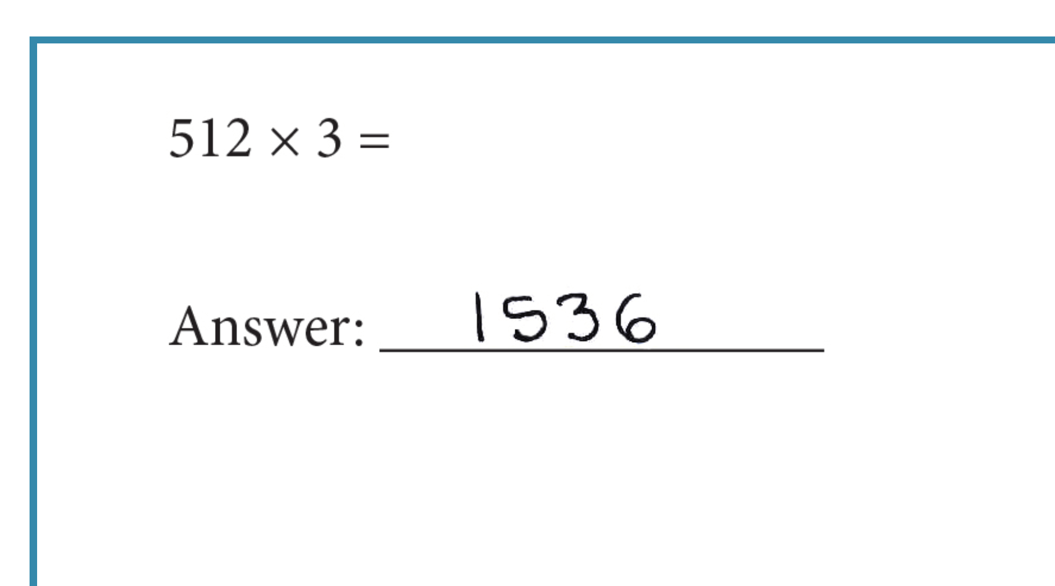
Maths
TIMSS 2015 – Grade 5
☹
59%
wrong

Slide 23
Nationally representative statistics
78% of Gr4 children cannot read for meaning (PIRLS 2016)
61% of Gr5 children cannot do basic maths (TIMSS-N 2015)
“The top 200 high schools in the country have more students achieving distinctions in Mathematics or Physical Science (80%+) than the remaining 6,476 high schools combined. Put differently, 3% of South African high schools create more Mathematics or Physical Science distinctions than the remaining 97% put together. Of those 200 schools, 185 are former White-only schools and all 185 charge significant fees.
Although they are now deracialized, 57% of the matrics in these top 200 schools were White. This is less surprising when one considers that in 2014/15, White South Africans still make up two-thirds of the ‘elite’ in South Africa (the wealthiest 4% of society) (Spaull, 2019)

Slide 24



Do we have a shared future?

Slide 25
#SchoolFeesMustFall ?
How sustainable are islands of excellence amid oceans of need?
Pro-active vs re-active responses
#FeesMustFall: Negotiating with a gun to your head.

Slide 27
Conclusions
Prioritizing dispositions towards learning and risk-taking rather than achievement.
Pro-active (front-foot) or re-active (back-foot) responses to the country you live in…
  A racially-integrated school isn’t a “nice-to-have”
  Preparation for the future
  Socioemotional skills

Slide 28
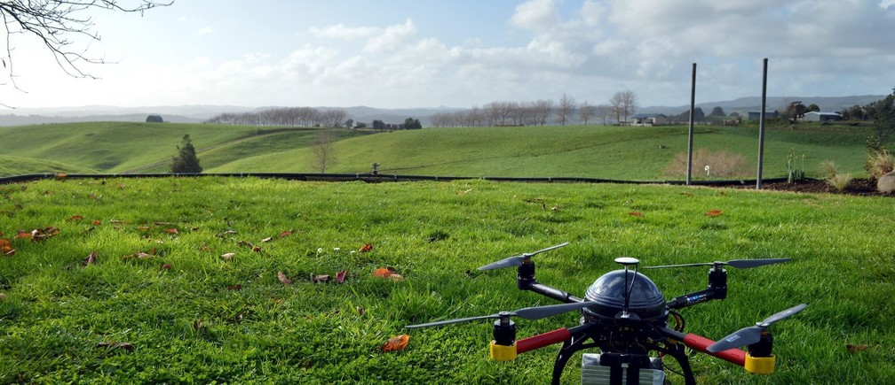
Questions & comments?
Presentation available at nicspaull.com

Slide 29
Radical prioritization of primary schools & Grades R-3
78% of Grade 4 learners cannot read for meaning in any language (PIRLS 2016)
61% of Grade 5 learners cannot do the most basic mathematics (TIMSS-N 2015)
Where should we be intervening?
New Solutions for a New Future
Insurmountable learning deficits
Figure 10b: South African mathematics learning trajectories by national socioeconomic quintiles using a variable standard deviation for a year of learning (0.28 in grade 3 to 0.2 in grade 8 with interpolated values for in-between grades (Based on NSES 2007/8/9 for grades 3/4/5, SACMEQ 2007 for grade 6 and TIMSS 2011 for grade 9, including 95% confidence interval
(Spaull & Kotze, 2015)

Slide 30
(2) Stop the decline in real per-learner expenditure in education
8% decline from 2010 to 2017 (R17,800 to R16,400)
Figure 2: Current provincial per learner expenditure on basic education 2010 to 2019 (Own calculations using real cost drivers and expressed in 2017 Rands, 2017-2019 projections based on MTEF)

Slide 31
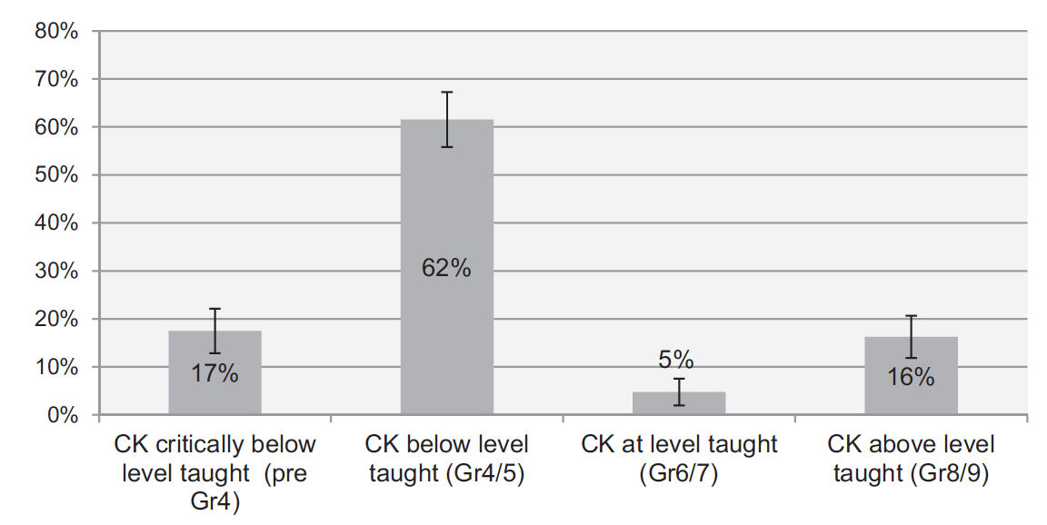
The need to radically improve teacher content knowledge and pedagogical skill
79% of Grade 6 maths teachers cannot get 60% on a Gr6 maths test
Figure 3: Proportion of South African grade 6 mathematics teachers by content knowledge (CK) group – SACMEQ 2007 (with 95% confidence interval) (Venkat & Spaull, 2015: p.127).

Slide 32
Integrity, Respect, Determination, Unselfish, Team Spirit
Honesty
Trust
Authenticity
Sportsmanship
Well-mannered
Tolerant
Considerate
Self-respect
Unselfish
Goal focused
Reliable
Disciplined
Tenacious
Hardworking
Diligent
Responsible
Informal relationships
Compassionate
Humble
Considerate
Kind
Self-controlled
Co-operate
Loyal
Energised
Inclusive
Fun
(Somerset House)

Slide 33
The world is changing
How many of these are bound up in a vision of a child from the 1900s?
What are the additional values that will be needed in the 21st C?

Slide 34
Integrity, Respect, Determination, Unselfish, Team Spirit
Honesty
Trust
Authenticity
Sportsmanship
Well-mannered
Tolerant
Considerate
Self-respect
Unselfish
Goal focused
Reliable
Disciplined
Tenacious
Hardworking
Diligent
Responsible
Informal relationships
Compassionate
Humble
Considerate
Kind
Self-controlled
Co-operative
Loyal
Energised
Inclusive
Fun
(Somerset House)

Slide 35
What about…
Unafraid to push the boundaries. (Critical thinking)
Pioneers? Explorers?
Challenges the status quo? (Confidence)
Unafraid to make mistakes?
Unafraid to be me? (individuality)

Slide 36
Questions for reflection…
Do we think the ‘best’ days of Bishops are ahead of us or behind us? 2022 Centenary
  What does a 21st Century Bishops boy look like?
  Often the descriptions you hear from SGBs and parents of elite/religious schools are better descriptors of 20th Century diplomats and Lords, than the movers and shakers of the 21st Century
Do we tolerate diversity or celebrate diversity?
  Policy on steroids but not on gay students/staff or diversity??
  Publicly-stated diversity goals. More difficult to not achive your goals when people are holding you accountable to them
Is Bishops a leader or a follower?
  Will Bishops be at the forefront of SA schooling in the next 10 years or always reacting/following?
  Where is SA at the moment (politically, economically, socially etc.)? Is Bishops attune to that?
  Reading the year book and website there is little indication Bishops is orientating itself to the future of this country. (c.f. see Hilton promo video)

Slide 37
Questions for reflection…
In what ways are we as a school deliberately teaching about broader issues in our society?
In what ways are we using our school’s privileged status to help other schools?
In what ways are we as a school providing spaces for students to talk about broader issues in our society? (#BlackLivesMatter, #FeesMustFall, White Privilege, refugees, global warming, terrorism etc.)
If you want to know if you are moving towards 21st-C teaching just ask yourself “How often am I out of my comfort zone while teaching?”
  Modeling a Growth Mindset
  Experimenting and failing are part of the process

Slide 38
Some empirical questions to ask about your school:
Of your previous 10 guest speakers how many of them were women? People of color? Gay?
What percentage of your staff are people of colour?
Of your total discretionary budget what percentage is spent on activities/events/awards on sports vs arts/culture?
Of the amounts spent on sport what percentage is spent on rugby and cricket vs other sports like soccer and basketball?
Does your school offer full colors/honors for all arts/cultural activities (dance, debating, theatre etc) if not why not?
Do you have a diversity policy? Is it on the website? Is it implemented?
What is your policy on gay students? Gay staff? Is it documented? Are you living in a don’t-ask-don’t-tell world or one that celebrates diversity?
What are the things that you and your staff “turn a blind eye” to? “They’re just being boys” = warning bell.
What do we currently do that may be offensive or exclusionary to some of our students?
What % of our prefects do not play in the first team for one of our sports?
As a school do we reward innovation / pushing the envelope / critical thinking?

Slide 39
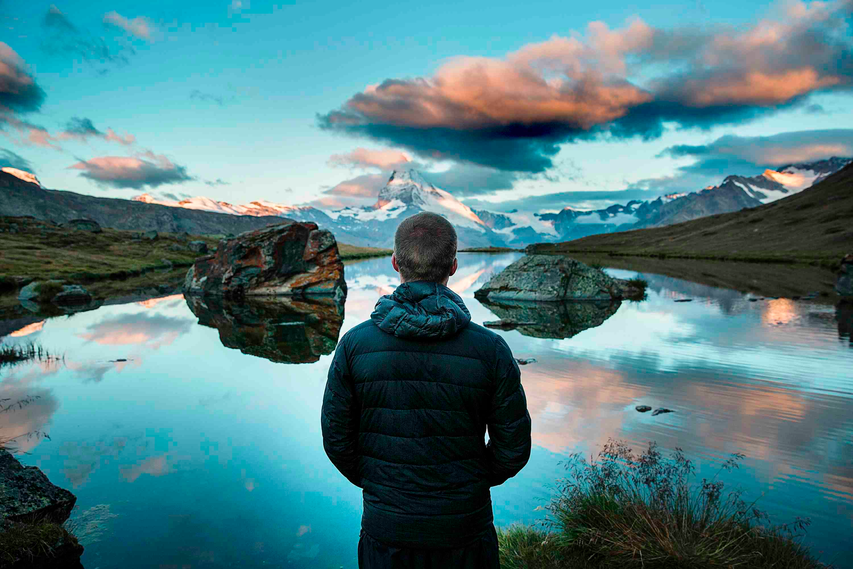
(1) How many of our students can authentically succeed against the vision of success our school casts?
(2) Can we recast our vision of success away from a narrow, exclusionary and performance-driven one and towards and more generous one that is collaborative and inclusive and that more people can attain?
(3) Isn’t our ultimate goal to ensure the full flourishing of all our boys, irrespective of the form of that flourishing?

Slide 40
Questions about me and my teaching
Last year I left my comfort zone while teaching…
    0 =“never” 10 =“every day”
Last year I left my comfort zone generally…
    0 “never” 10=“every day”
If I had to think back on 2017 and the time that I failed at something new I was trying out was…
    0=“I didn’t fail” 2=“Something small” 10=“Something BIG”
Am I a good model to my students of how to adapt to change? Growth mindset?
    0=“No!” 10=“DEFINITELY!”
If I have to think of my average lesson, what % of time is spent with me speaking/directing-the-lesson and what what % students speaking/directing-the-lesson?
    0% teacher=only students talking/directing 100% teacher = only teacher talking/directing

Slide 41
Masculinity
Success for Some | Success for Many
Only some can attain & perform the narrow criteria of masculinity: physically strong, sporty, well-liked, alpha-male + hierarchy. | Universally attainable values are emphasised (courage, empathy, integrity, leadership, hard-work etc.)
Do not be perceived as weak | Do not be perceived as inauthentic
External is emphasised - appearance | Internal is emphasised
Achievement in traditional sports emphasised: Rugby, cricket, water-polo (strong hierachy of 'acceptable' sports) | Achievement in all areas praised equally: drama, music, debating, hockey, art, dance etc.
School approval is conditional on achievement | School approval is conditional on growth, effort & values
Self-worth tied to performance and outcomes | Self-worth is innate
Shame: I am something wrong | Guilt: I did something wrong
Values emphasised: leadership, resilience, heroism, toughness, individuality | Values emphasised: empathy, compassion, vulnerability, courage

Slide 42
Success for Some | Success for Many
Scarce: Only some can attain the very limited criteria of success | Expansive: Many can attain some version of an expansive vision of success
Exclusive: Typically those with power/privilege benefit most | Inclusive: Many benefit, including those without power/privilege
Individual focus | Team focus
Primarily competitive - only some can win or attain the scarce resource/goal | Primarily collaborative - 'winning' isn't the aim.
Ego and fear are driving force | Interest, passion & goals are driving forces (flow)
Your success means my failure | Your success and my success are both attainable

Slide 43
Further links
Hilton Promo video - https://www.hiltoncollege.com/admissions/watch-our-video/

Slide 44
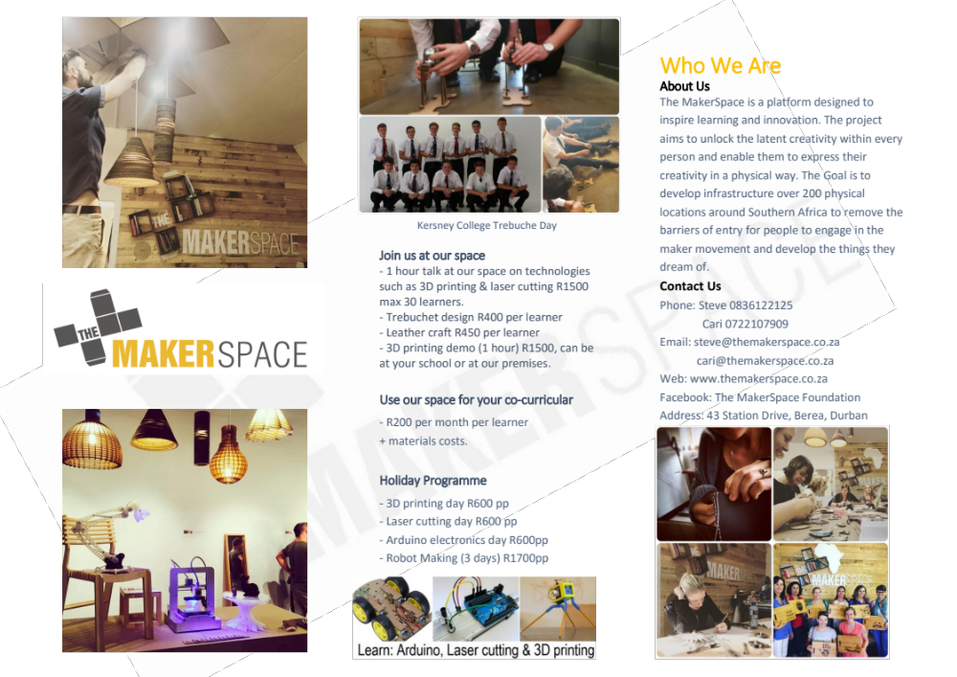

Slide 45
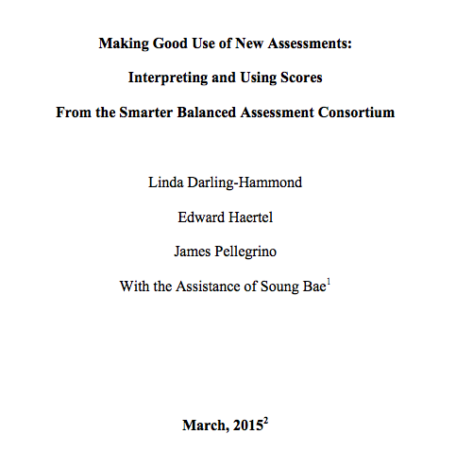
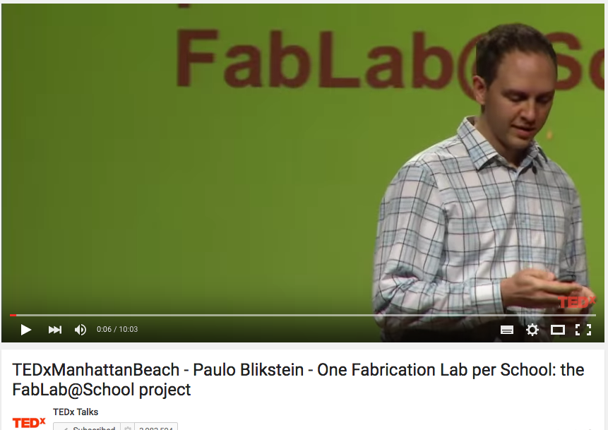
Resources
https://www.ideo.com/expertise/education/
https://vimeo.com/40895671
http://education.vermont.gov/documents/EDU-WhitePaper-Making_Good_Use-of_New_Assessments.pdf
Michael Fullan, Ken Robinson, Linda Darling-Hammond, Alaine De Botton, Carnegie Mellon University, d.school at Stanford
Released items - https://www.oecd.org/pisa/pisaproducts/PISA2015-Released-FT-Cognitive-Items.pdf

Slide 46
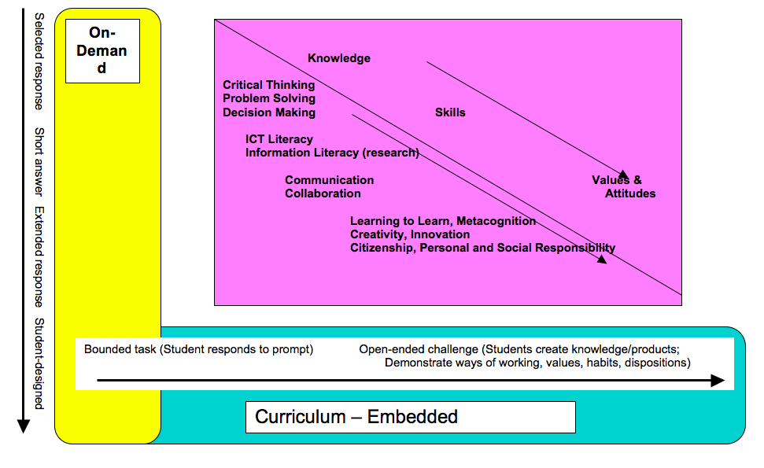
Draft White Paper 5 - Policy frameworks for new assessments
Linda Darling-Hammond 2015

Slide 47
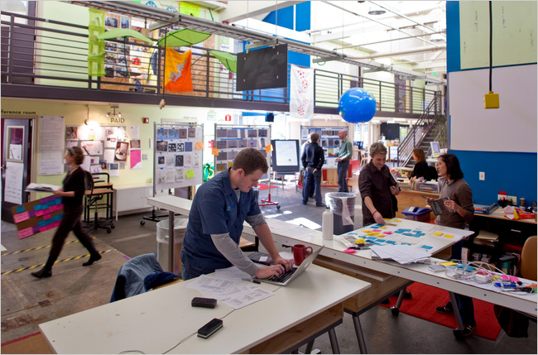
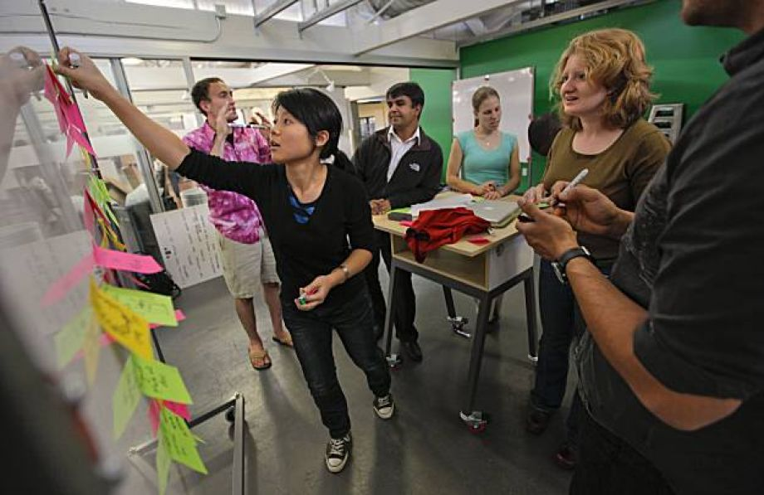
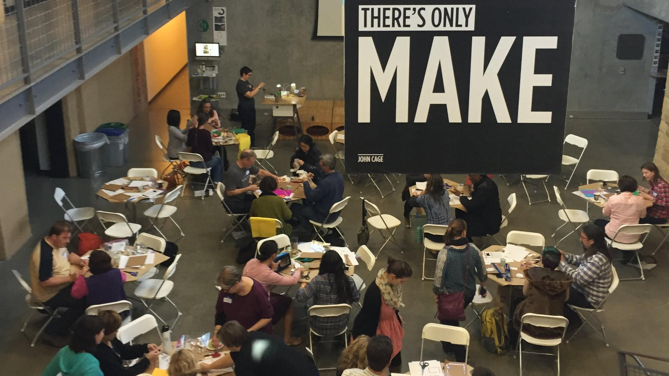
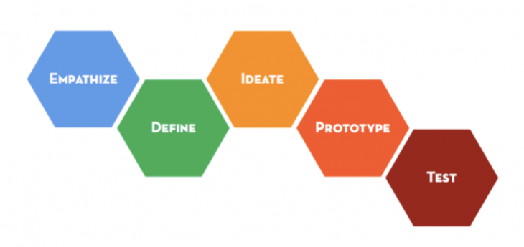
Design thinking…

Slide 48

Waking up with Mixed reality…

Slide 49
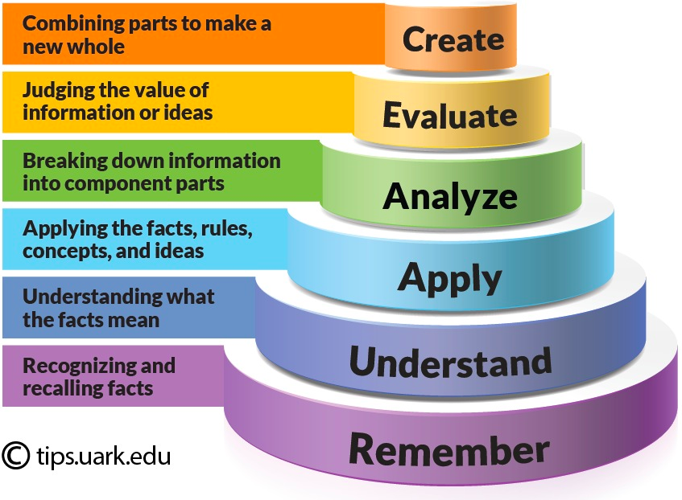
Bloom’s Taxonomy: Cognitive

Slide 50

Expectations for Learning are Changing
The new context means new expectations.
Ability to communicate
Adaptability to change
Ability to work in teams
Preparedness to solve problems
Ability to analyse and conceptualise
Ability to reflect on & improve performance
Ability to manage oneself
Ability to create, innovate and criticise
Ability to engage in learning new things at all times
Ability to cross specialist borders
Chris Wardlaw, "Mathematics in Hong Kong/China – Improving on Being First in PISA"

Slide 51
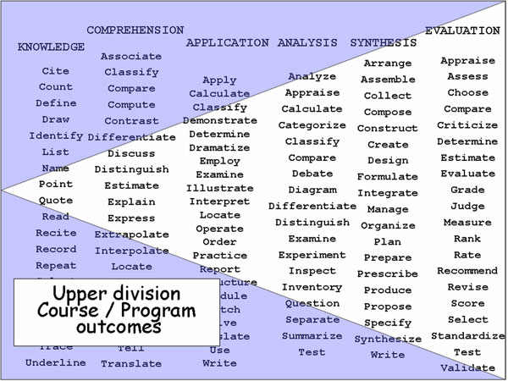

Slide 52
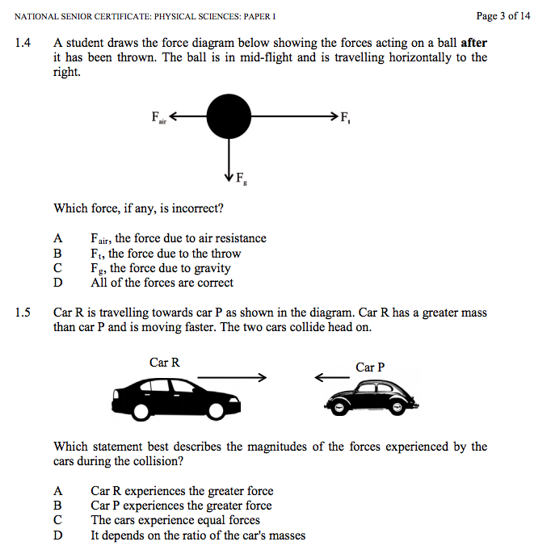
IEB NSC Physics P1 2015

Slide 53
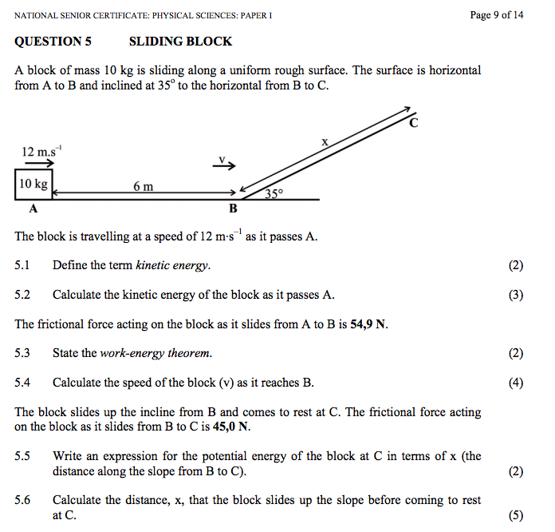

Slide 54
Expectations for Learning are Changing
The new context means new expectations. Most studies include:
Ability to communicate
Adaptability to change
Ability to work in teams
Preparedness to solve problems
Ability to analyse and conceptualise
Ability to reflect on and improve performance
Ability to manage oneself
Ability to create, innovate and criticise
Ability to engage in learning new things at all times
Ability to cross specialist borders
Chris Wardlaw, "Mathematics in Hong Kong/China – Improving on Being First in PISA"

Slide 55
Queensland Australia Gr9 Maths - Instruction to Students:
Your task is to design a space to store enough stackable chairs to seat all the staff and students in your school.
You will:
follow a series of steps to help you design a suitable space
use a research journal to record your ideas and rough working
write a report on the process and solutions.
Questions
1. Develop mathematical models for each dimension of a stack of chairs, where the number of chairs is unknown.
2. To help you think about the practicalities of storing chairs, use your mathematical models to find:
a. the greatest number of chairs in one stack that can fit into a storage area with a 4 m high ceiling
b. the number of stacks that fit across a 3.2 m wide area if there are 10 chairs in each stack
c. the height of a stack, if all the chairs for the school are put into one stack.
3. Use the understanding of the practicalities of storing chairs you developed in Question 2 to find a practical storage area for the chairs.
To answer these questions, work through the steps set out on the following pages. As you work, record everything you do in your research journal.
Using a research journal
A research journal is a record of what you and your group do. Your research journal should include:
what you and your group do in each class session, ideas, questions, plans, difficulties faced, how difficulties are managed, data collected, calculations, mathematical language, acknowledgment of any help you receive from friends, teachers or other people.
Your research journal should contain all the information you need to write your report. It will also help your teacher decide what you can do by yourself, and what you can do as part of a group.
Communicating your Findings
Write a report on your investigation. Your report should include:
(1) an introduction providing an overview of the scenario and the questions, (2) your solutions to the questions, (3) using mathematical language, data, calculations, diagrams, graphs and phrases or sentences that provide enough information for a person to know what you are calculating without having to read the questions, (4) a conclusion, summarising: your reflection on the practicalities of your solutions, any assumptions made or limitations to your answers, and suggestions for improving the investigation or strategies used.
Note: We are still testing the content and whether students have mastered the underlying skills

Slide 56
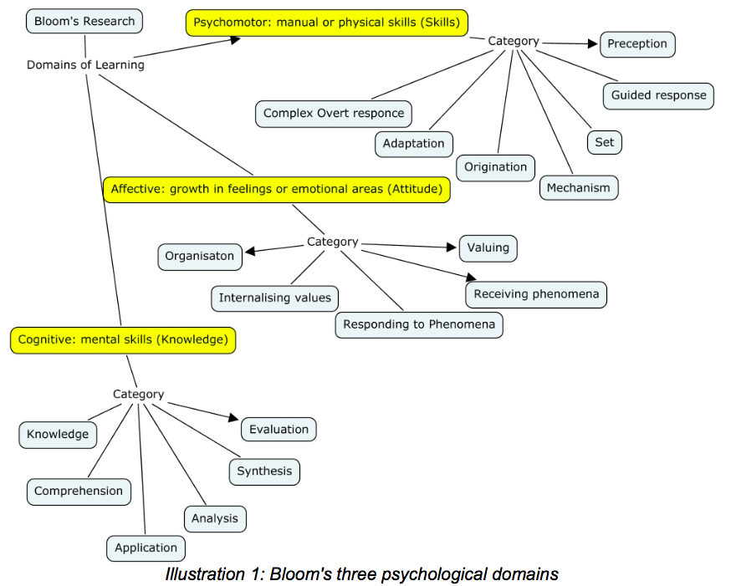
Bloom’s 3 psychological domains
Source: Andrew Churches – Bloom’s Digital Taxonomy
Notes:
Andrew Churches – Bloom’s Digital Taxonomy

Slide 57
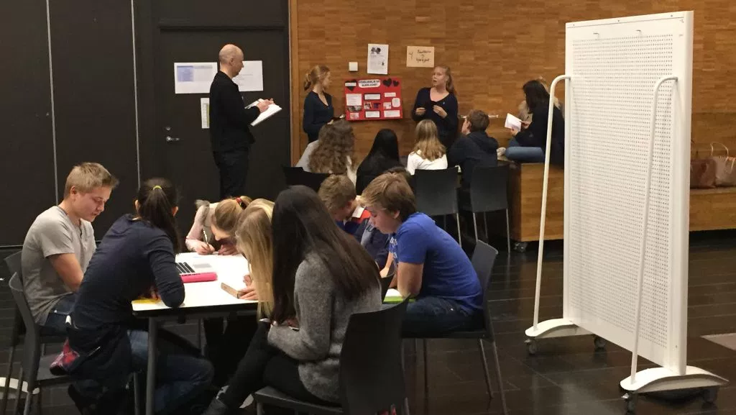
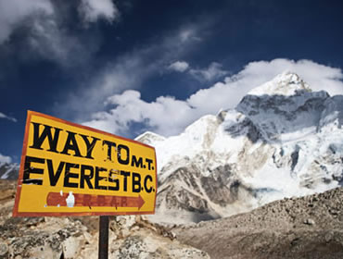
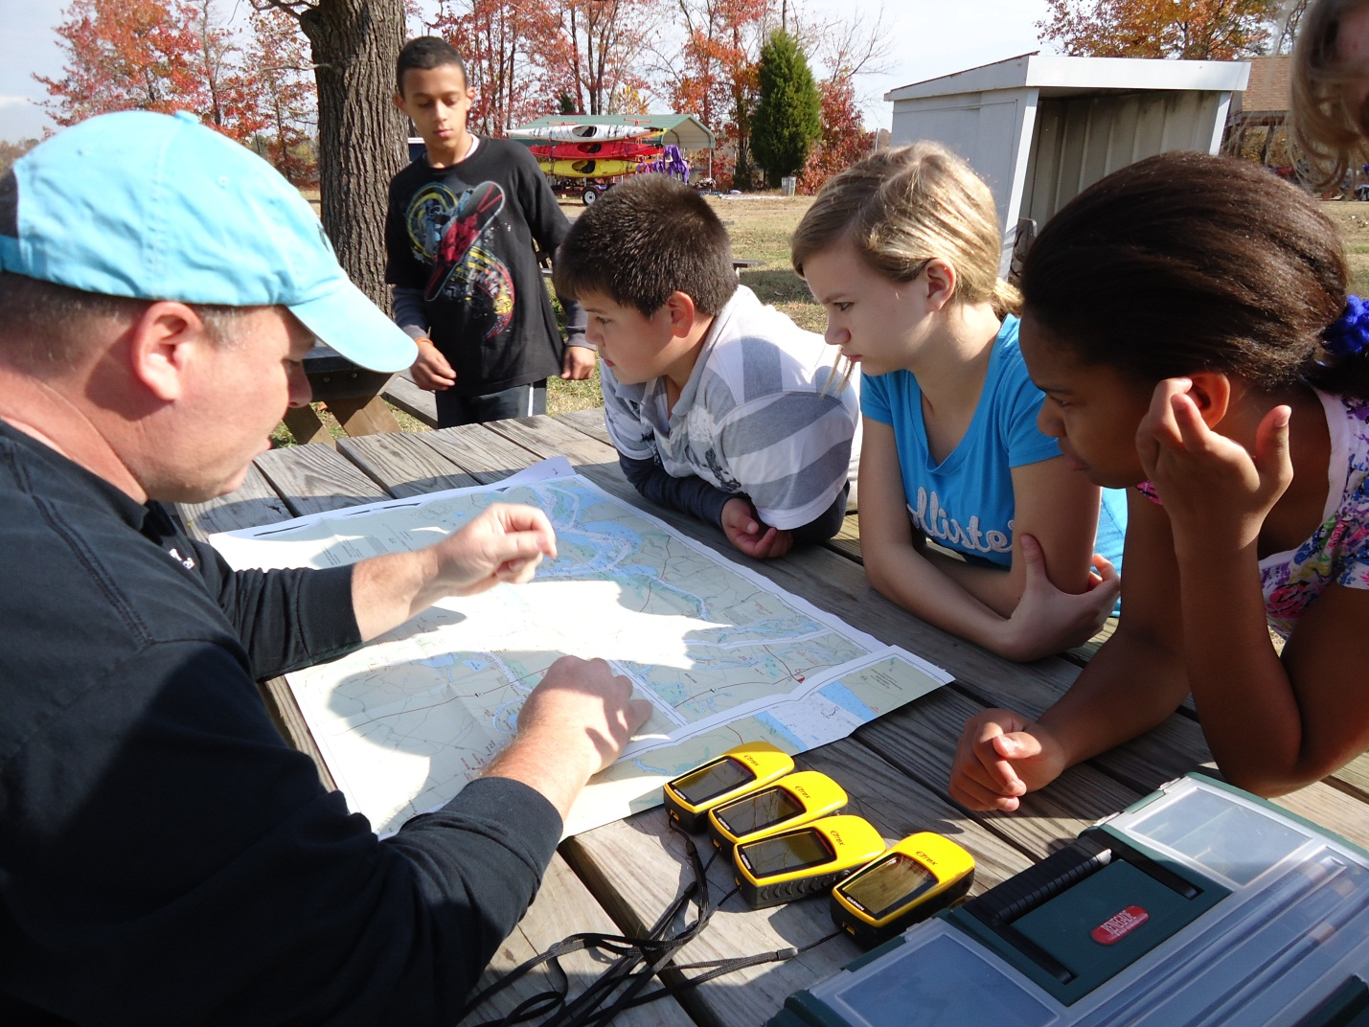
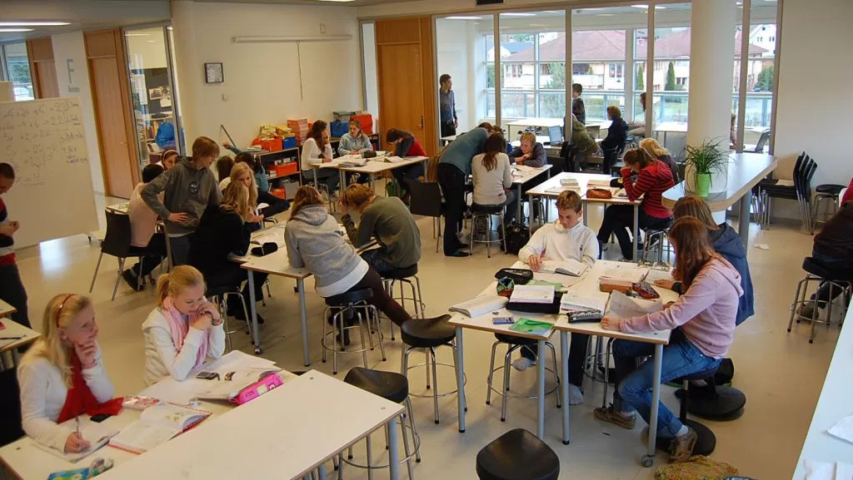
“Each team consists of four to six teachers and is responsible for 60 to 75 pupils. As an example of how they work, students in the eighth grade (13-year-olds) will often study earthquakes, volcanos and other earth forces - normally considered part of a geography or natural science lesson.
Now, however, teachers will come up with several different storylines for the lesson - encompassing other subjects In one, they pretend they have to climb Mount Everest.
It includes the study of maps, weather and climate, make a list of the equipment they need, calculate the time they will need, make a budget for the trip and apply for funding in English (a foreign language).”
Notes:
http://qz.com/377742/this-school-in-norway-abandoned-teaching-subjects-40-years-ago/

Slide 58
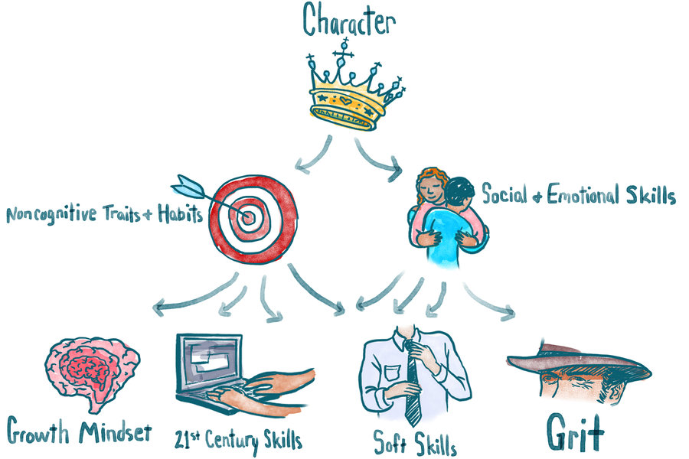
Notes:
http://www.npr.org/sections/ed/2015/05/28/404684712/non-academic-skills-are-key-to-success-but-what-should-we-call-them

Slide 59
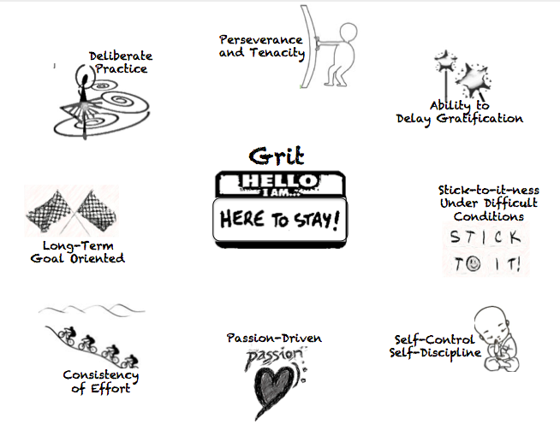
New research: Grit
Angela Duckworth – U Penn
Carol Dweck - Stanford

Slide 60
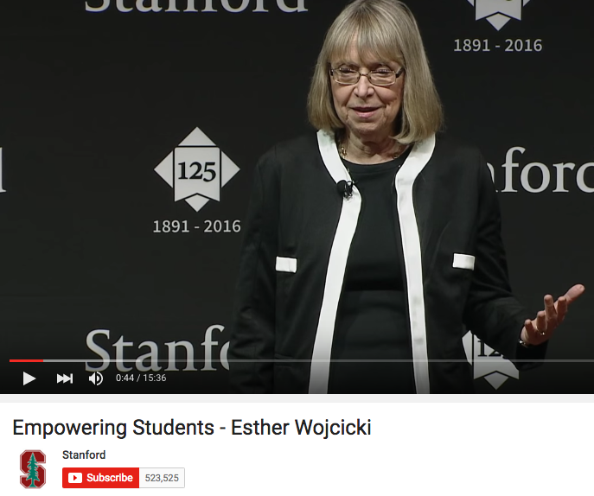
Esther Wojcicki – Palo Alto High School’s journalism program
Student newspaper, website, magazine, videos etc.
Videography
Photography
Deadlines
Collaboration
Inter-personal relations management
Design
Planning
Writing
Editing
Project-management
Printing
Budgeting
Formatting
Students are judged by more complex outputs over a longer period of time.

