Slide 1
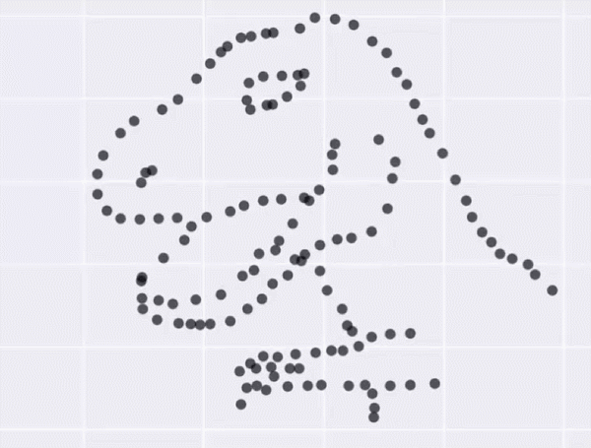


Guest lecture
How do you know the curriculum made a difference?
A brief look at evaluation
Nic Spaull
PGCE Curriculum: Guest Lecture
7 March 2019
Department of Economics
•
Faculty of Economic and Management Sciences

Slide 2

About the dinosaur…
https://www.autodeskresearch.com/publications/samestats

Slide 3
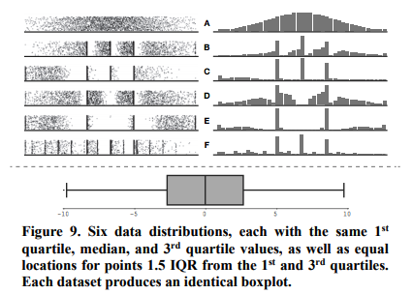
About the dinosaur…

Slide 4
Why do we care about evaluation?
We want to know:
  What works?

Slide 5
Curriculum
PROBLEM
  What is the problem we are trying to alleviate?
  Why has this problem remained a problem (i.e. recognizing that the status quo is an equilibrium of forces and not just a random shitty outcome)
AIM
  What are we hoping to achieve or change with funding XYZ?
THEORY OF CHANGE
  What are ALL our assumptions about (1) the problem, (2) the way the intervention addresses the problem.
MEASUREMENT & EVALUATION
  What will we know and be able to say after the evaluation?
  How will we know if it worked? (‘impact’)
  How will we know where & when it works? (‘external validity’)
  How long/much does it take for it to work? (‘dosage’)
  How sure will we be of the results? (evaluation methodology)
  How defensible are the results of the evaluation (‘independence’)
  What instrument are we using to measure? Is it legit/validated/used elsewhere?
  How comparable are these figures to others looking at the “same” thing?
COST
  What is our cost per learner/school/teacher per year?
  What in-kind costs (particularly human expertise/networks) have we not included?

Slide 6
Full credit to JPAL and Martin Abel for JPAL slides

Slide 7
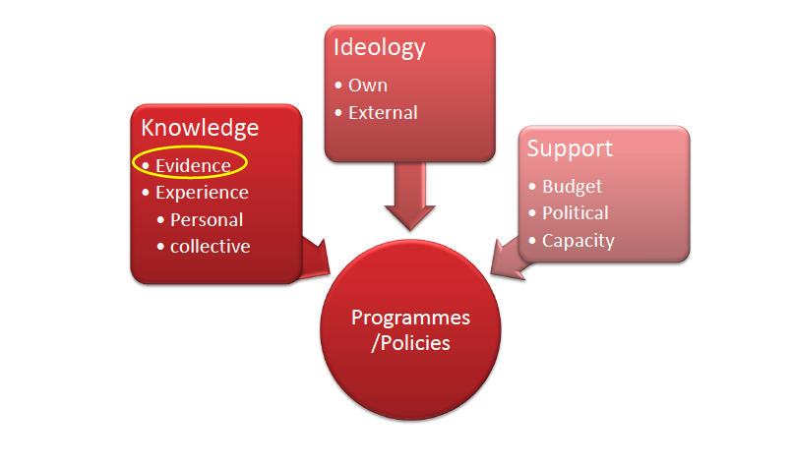
What goes into policymaking?
Source: JPAL 2017

Slide 8
What goes into policymaking?
Source: JPAL 2017

Slide 9
Evaluation
Typically we want to evaluate an intervention but not always:
  Do class sizes matter?
  Does paying teachers more improve learning outcomes?
  Does a reading-coach improve reading?
  Are public schools more effective than private schools?
Brief note on normative and positive statements
  We can typically evaluate positive statements (all of the above) but not normative statements (values) like:
    “Government should provide free higher education”
    ”History should be a compulsory subject”
    “We should be spending more on education and less on social grants”

Slide 10
Evaluations
Let’s assume for the purposes of this lecture that we are interested in positive questions that are measurable….
Does doing x improve y ?
“Does implementing XYZ reading curriculum improve reading outcomes?”

Slide 11
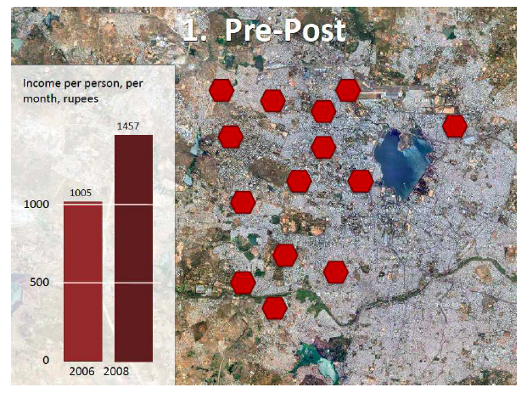
Options for evaluation
Reading outcomes

Slide 12
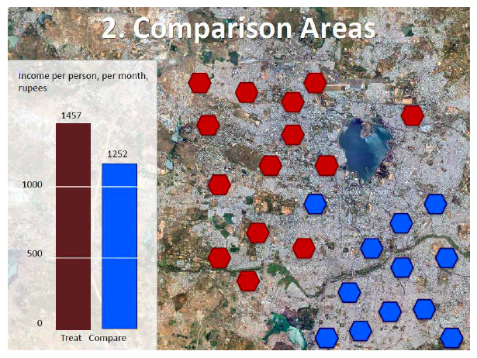
Options for evaluation
Reading outcomes

Slide 13
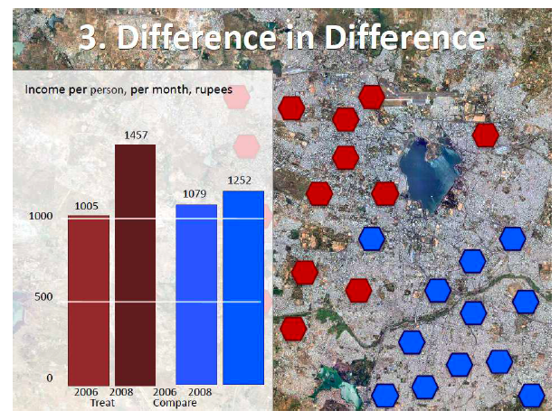
Options for evaluation
Reading outcomes

Slide 14
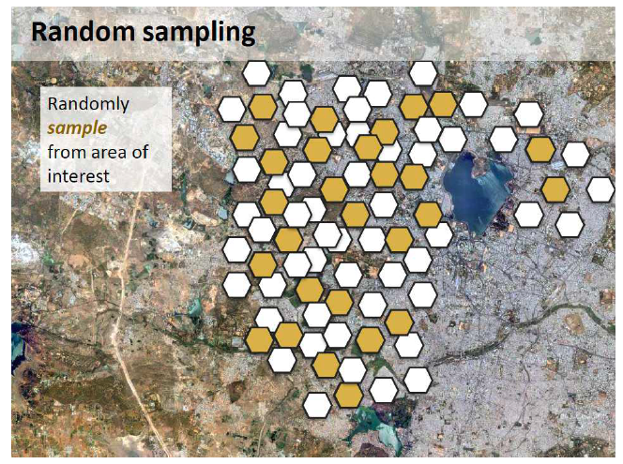
Options for evaluation

Slide 15
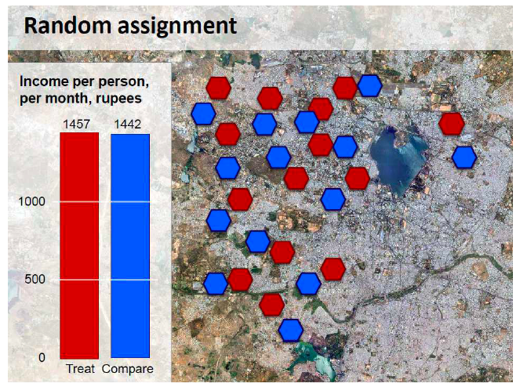
Options for evaluation
Reading outcomes

Slide 16

Real world example in SA?
Flesich et al 2017: RCUP https://www.ajol.info/index.php/saje/article/viewFile/152705/142295

Slide 17
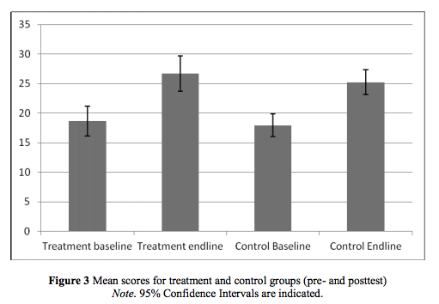
Real world example in SA?
Flesich et al 2017: RCUP https://www.ajol.info/index.php/saje/article/viewFile/152705/142295

Slide 18
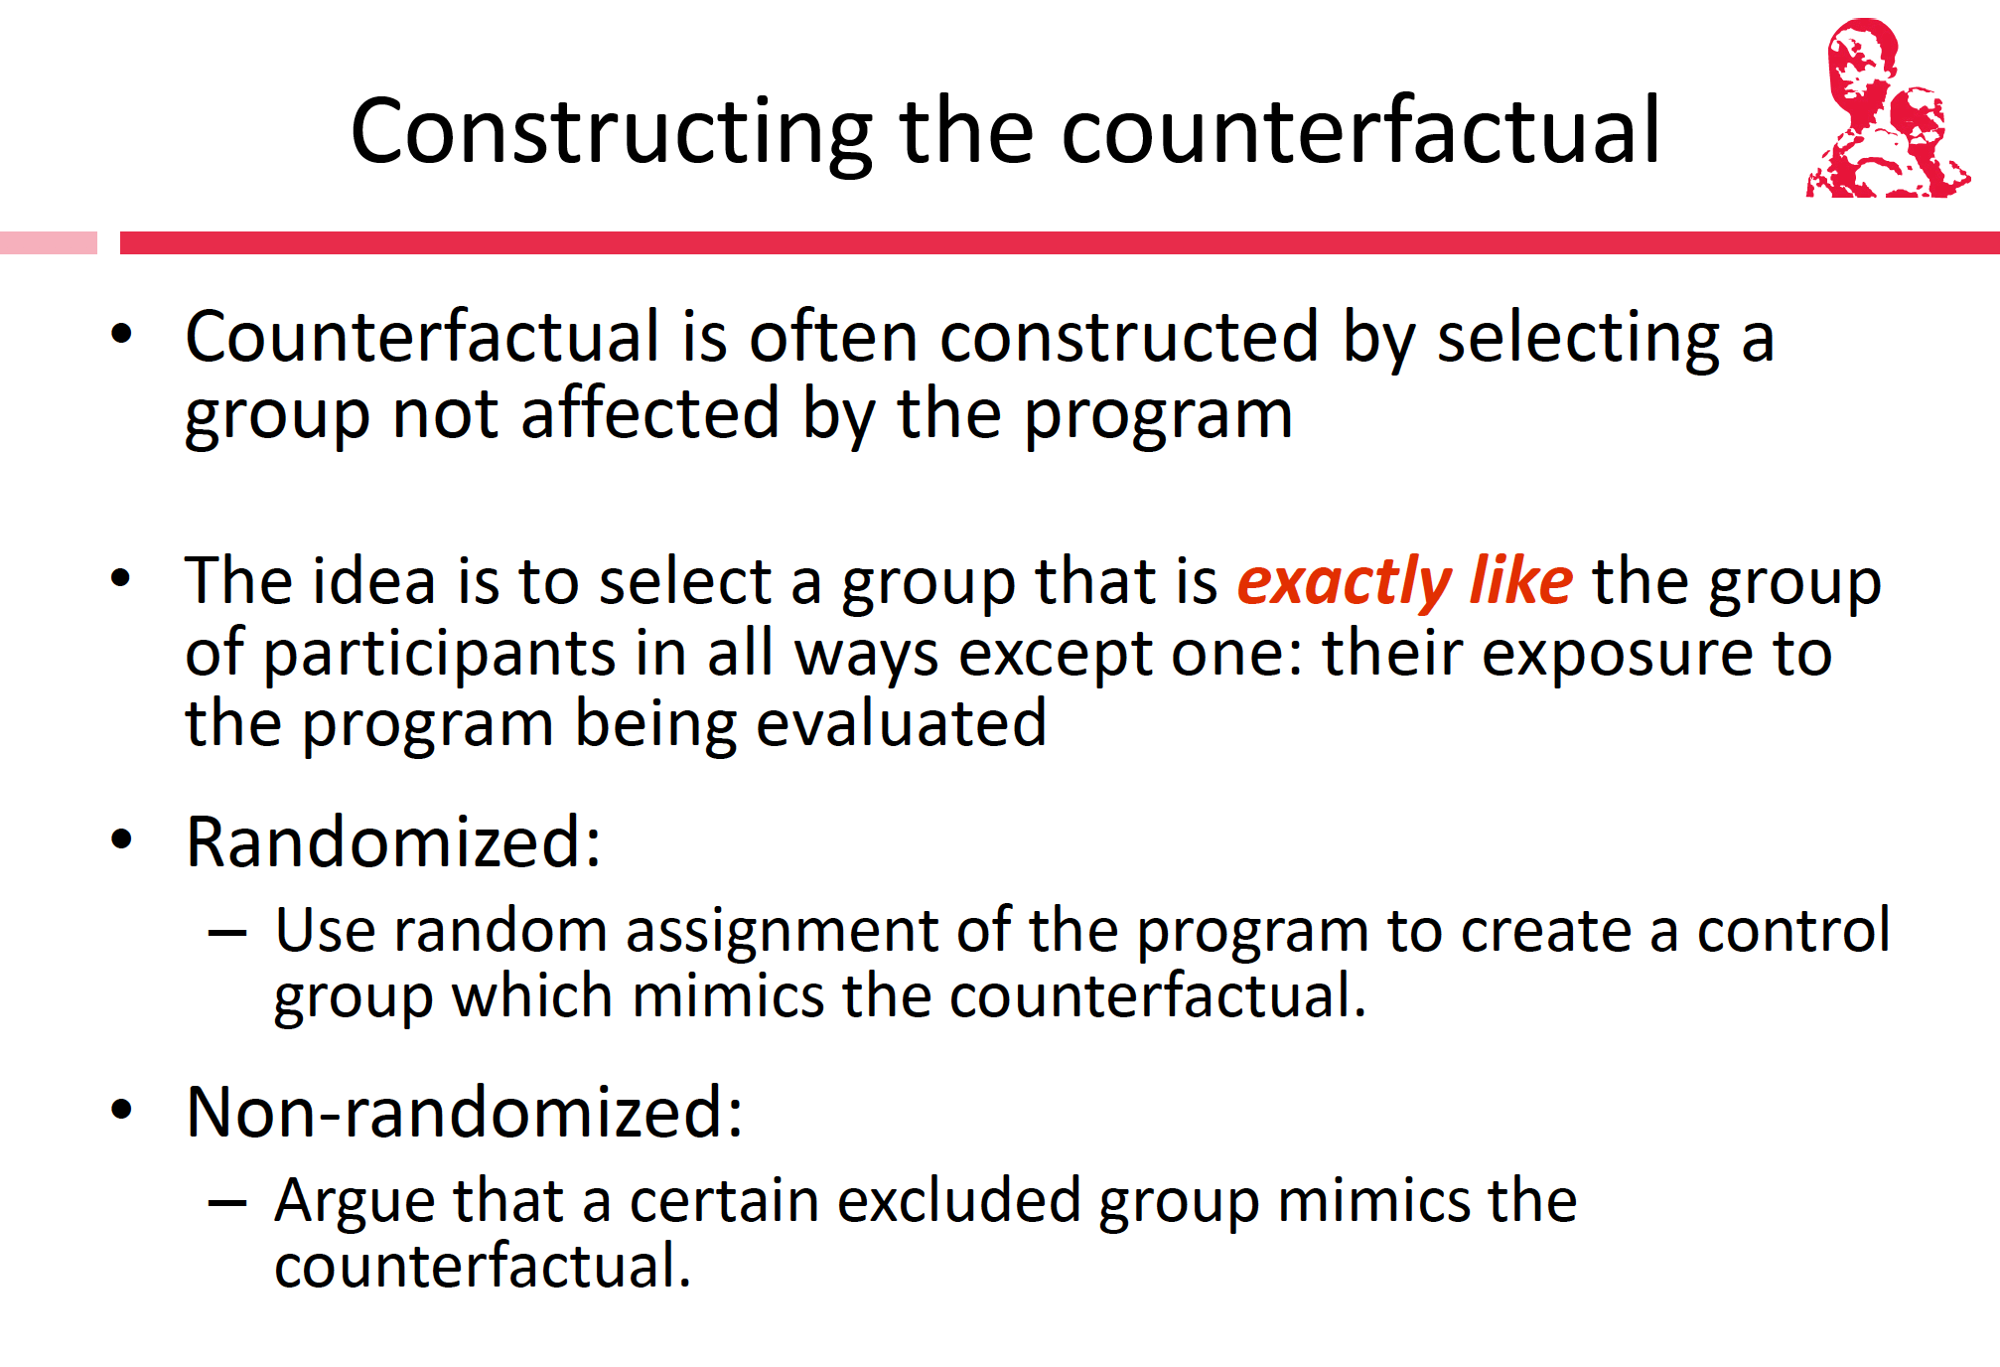

Slide 19
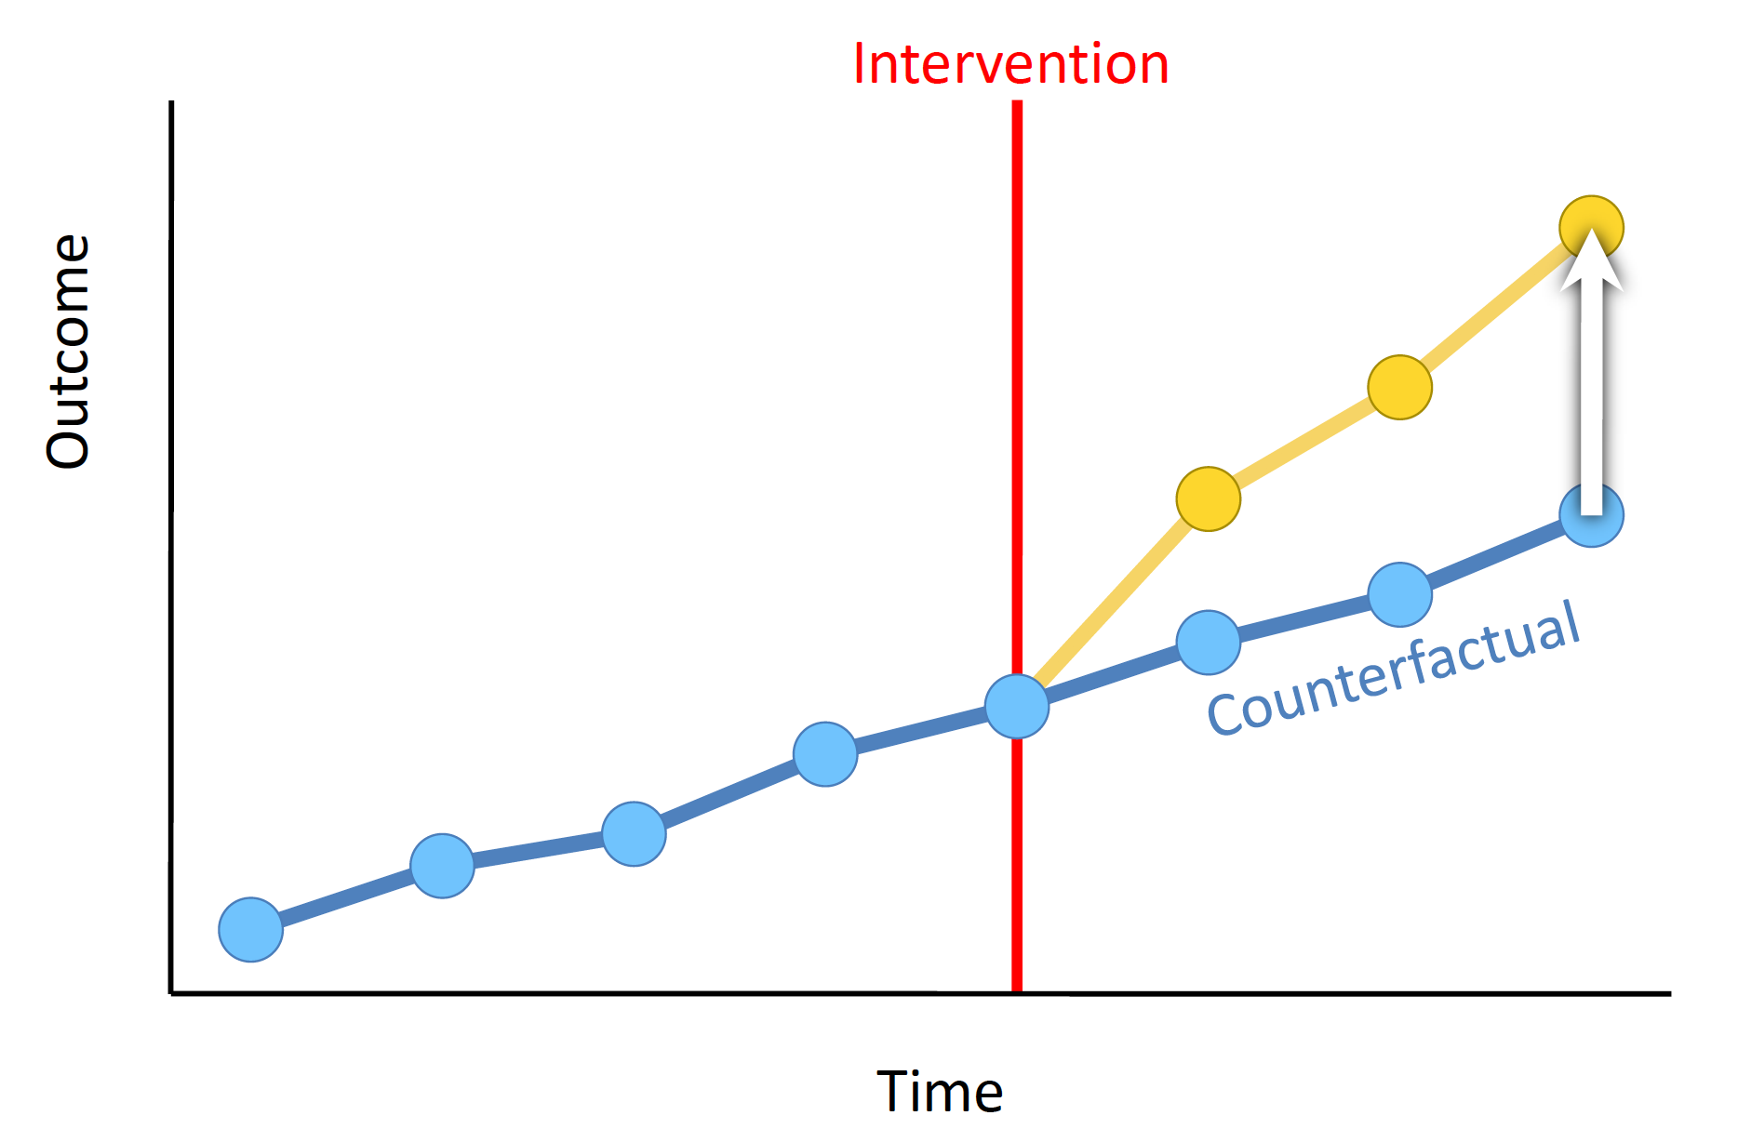

Slide 20
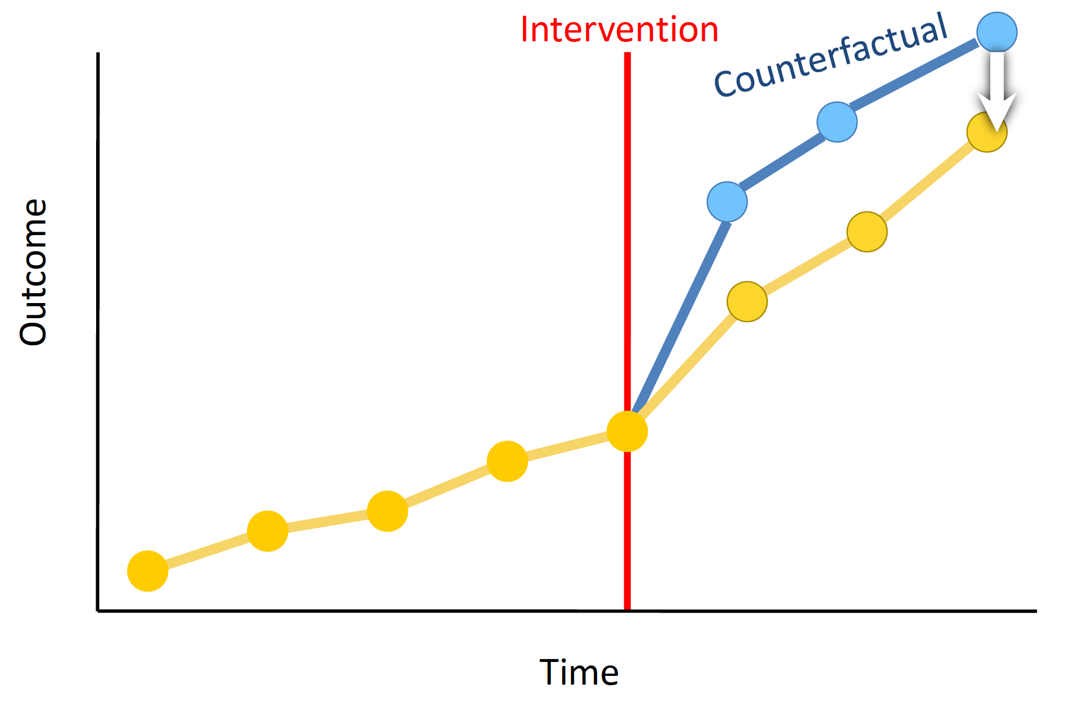

Slide 21


How can you measure ‘impact’ if you can’t randomize?

Slide 22
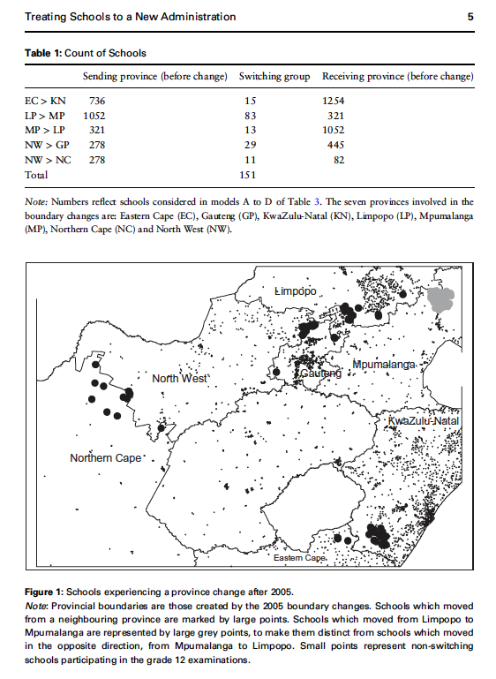
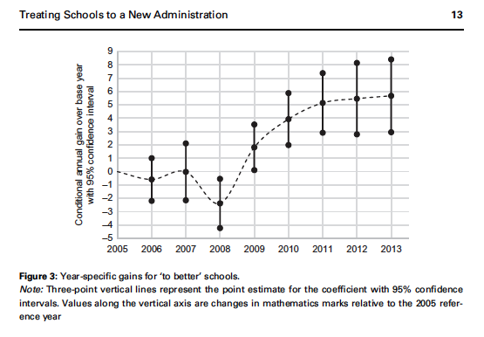

Slide 23
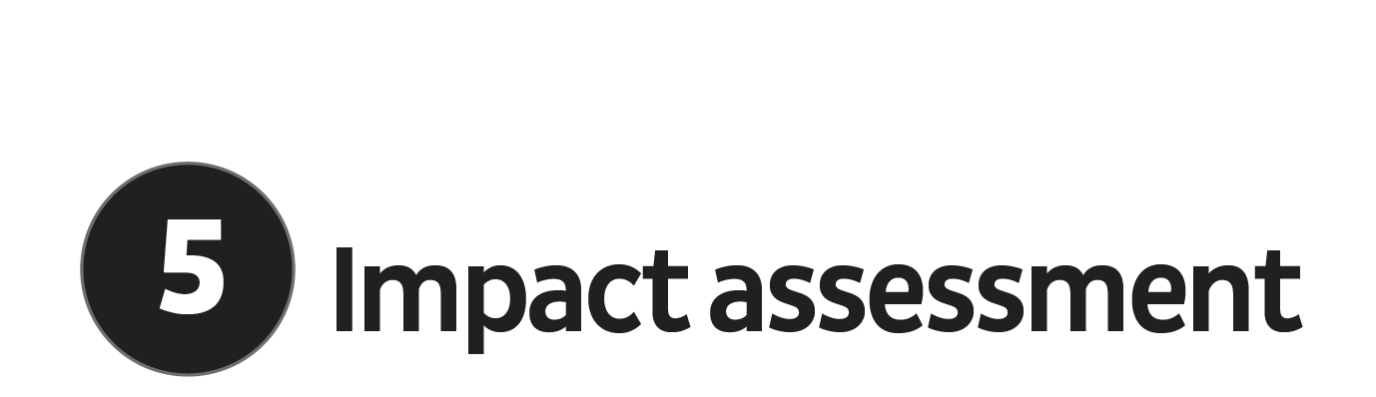
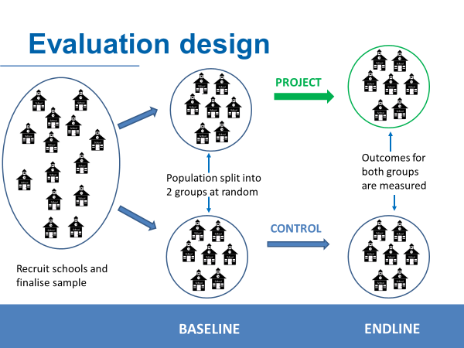
Randomised Control Trial (RCT)

Slide 24
Randomised Control Trial (RCT)
30
59
30
29
29

Slide 25
Randomised Control Trial (RCT)
30
59
30
Feb
2019
Nov 2020
29
29

Slide 26
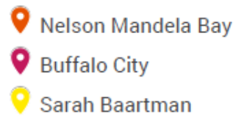

Slide 27
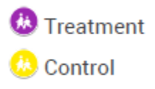

Slide 28
Baseline Assessment Results Grade 2
(Feb 2019)
30% of Gr2 children do not know the letters of the alphabet

Slide 29

30
59
30
Feb
2019
Nov 2019
Nov 2020
29
29
MIDLINE

Slide 30
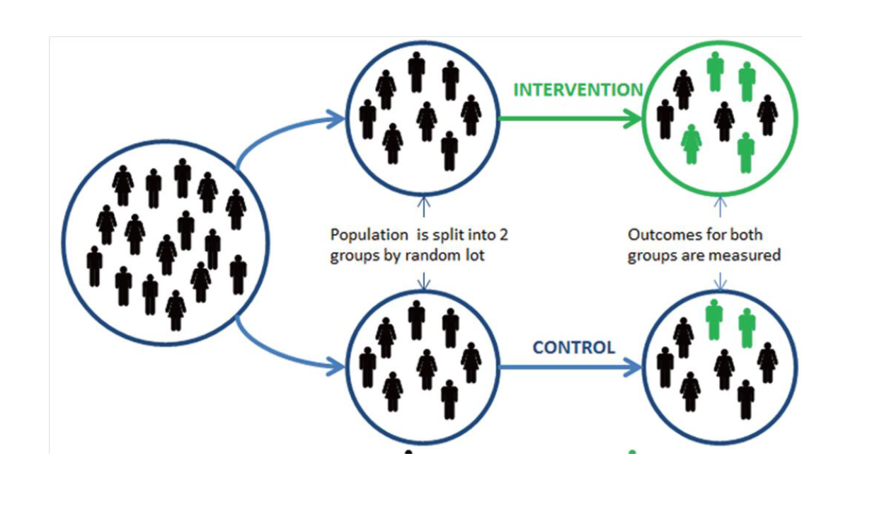
Randomised Control Trials
(note on generalizability)

Slide 31

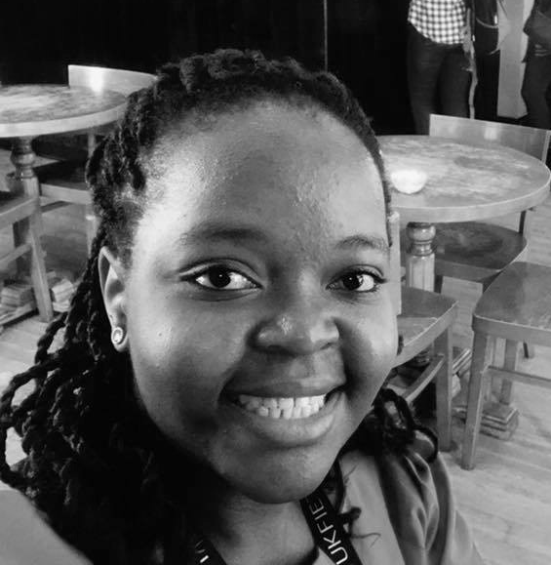

Slide 32
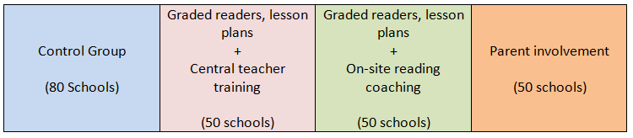
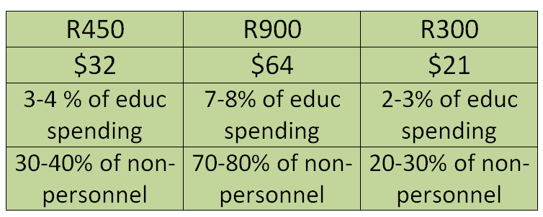

Description of Interventions
230 schools in North West
Per learner costs
Notes:
The point here is that we will look not only at impact but also at cost-effectiveness. The cost estimates are shown in relation to overall education spending per learner. While 7-8% of overall spending makes our most expensive intervention sound affordable especially if it substantially shifts learning. However, since about 90% of spending goes to salaries, the cost of this intervention is about 70-80% of existing non-personnel spending. In this light, it may be more expensive. Alternatively, it may need to be implemented through re-arranging the salary bill. The final point to make is that “scaling up” is not necessarily an all-or-nothing process. For a provincial department to target the programme to 100 schools, for example, would only cost about R8million, and this could easily be secured.

Slide 33
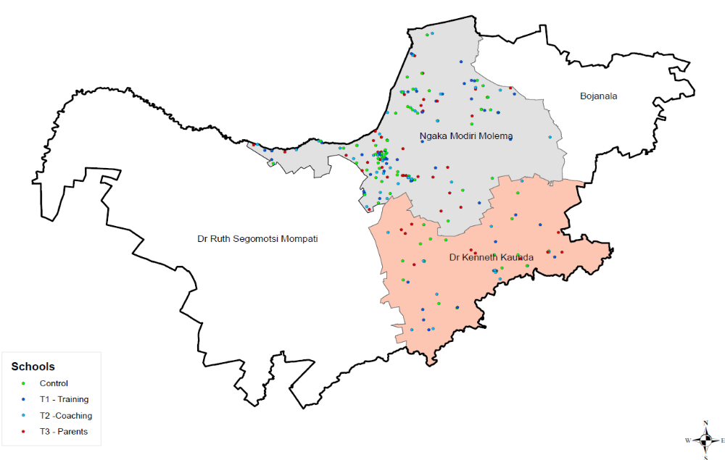
Sample: 230 schools in North West

Slide 34
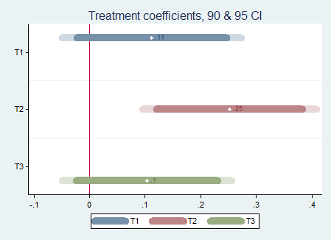
Main EGRS regression model: composite score
Centralised training
Coaching
Parental intervention
Notes:
This is the main effect of the interventions on the composite reading score depicted graphically. The results here are derived from a regression model which predicts grade 2 performance by treatment group and several other covariates (learner age and gender, and school and community poverty measures). Each bar shows the estimated impact of treatment relative to the control group (e.g. 0.25 standard deviations for on-site coaching), the 90% confidence interval (the dark shaded part of each bar) and the 95% confidence interval (which includes the light shaded part of each bar). Clearly, the on-site coaching intervention (T2) is having the largest impact, and we can be both 90% and 95% sure that the true population impact is greater than zero. The other two interventions have positive effect estimates but we cannot rule out the possibility of a zero impact with even 90% certainty.

Slide 35
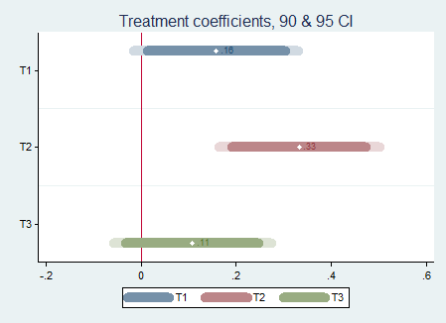
Main EGRS regression model:
Excluding repeaters
Centralised training
Coaching
Parental intervention
Notes:
This is the same as above, except that those children repeating grade 1 were excluded from the calculation. The rationale for this is that the grade 2 class was receiving the intervention in Year 2, so those who were repeating grade 1 had only received half the treatment in effect. In line with this rationale, we see larger estimated effects on those who were in grade 2 in 2016. We can now also be 90% sure that the central training intervention had a positive impact.

Slide 36
Context and scale
4
3
Context
1
2
5
25
250
1000
Scale

Slide 37

Cheat sheet: interventions
Proof of concept
  One site, multi-year, intensive, often costly/child
  Aim: putting the idea on the map
  Evidence: smorgasboard of measures)
  Main challenge: does it actually work?
  FYI: heavily dependent on individual champions (one funder, one leader, one academic)
Multi-site intervention
  5-50 sites,
  Aim: to show that “the ‘model’ works & tweak model
  Evidence: few core measures
  Main challenge: Maintaining fidelity at 5-50 & causality of evidence
  FYI: the one funder/founder may still be driving
Causal evidence
  250+ sites
  Aim: The ‘model’ works in multiple different contexts
  Evidence: few core measures
  Main challenge: Maintaining fidelity & causality & heterogeneous effects
  FYI: HR & technical expertise becoming a binding constraint
Scale-up & government implementation
  500+ sites
  Aim: The ‘model’ should become national policy
  Evidence: few core measures
  Main challenge: Maintaining fidelity when integrating into government
  FYI: politics, fidelity, external validity, unintended consequences

Slide 38
The Goldilocks Zone
A framework for thinking about evidence
Goldilocks zone for evidence
IDEAL
Goldilocks zone for policy
y
Measurement rigor
Consensus
Policy
Conclusive
5
Rigor of the Evidence
Causal
A
4
Small but rigorous
Confirming
3
Suggestive
☹
2
B
Large but weak evidence
Proof of concept
1
x
5
10
25
75
250
1500
5000+
Independence
Scale

Slide 39
y
C
A
Politics
B
x
Evidence

Slide 40
Understanding how evidence and policy-making interact.
Evidence…
Policy-change

Slide 41
How do things actually work?
Is evidence the binding constraint to improved policy on paper and improved implementation in practice?
  Probably not: “There is massive evidence that governments do not implement many many many projects/proposals/programs that are cost effective and do spend budget on items known to be not cost effective. The model of a benign social welfare planner hampered by lack of rigorous evidence on effectiveness whose behavior an RCT will change is complete whack nonsense. “ (Pritchett, 2018)
Primacy of politics
  Budget cycles → Feb/March splurge in SA
  Election cycles (new party/president/minister → new policy)
Role of culture, values and tradition
  The exact same evidence in US and Denmark will not have the same impact on policy (think about studies on (1) for-profit education, (2) competition/choice.)
Role of social networks
  Often policies are implemented or not implemented based on the Minister’s Whatsapp contacts or who’s in her calendar
Role of unpredictable factors
  Minister makes a trip overseas and loves the school(s) she sees. Changes policy.

Slide 42
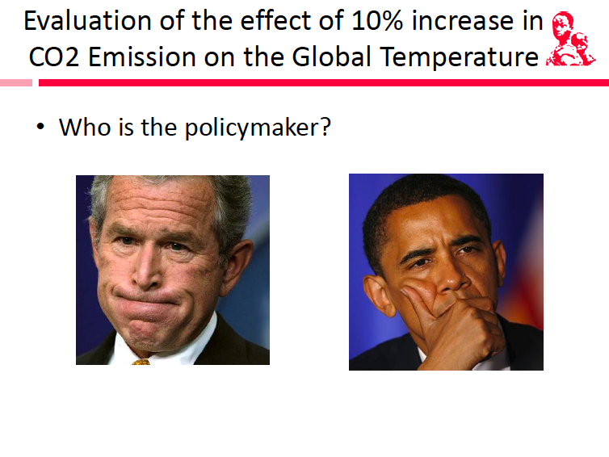

Slide 43
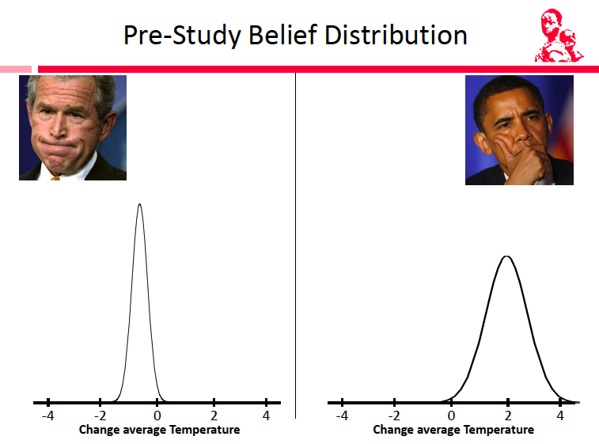

Slide 44
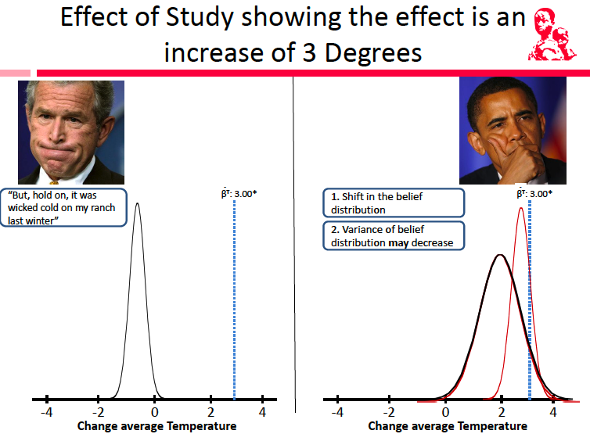

Slide 45
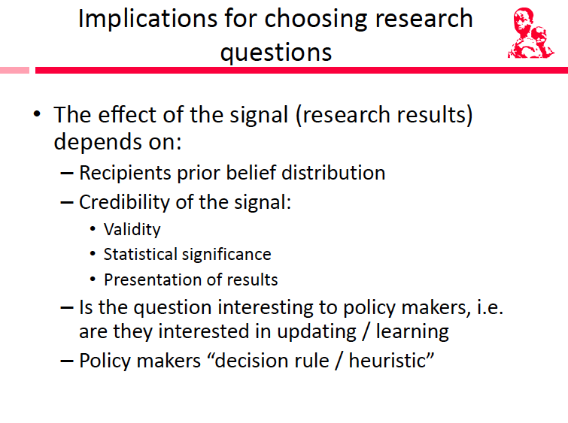
Most researchers do not think about these things explicitly (often implicitly). Politicians/PR consultants definitely do!

Slide 46
Not all evaluations are created equal
Independence
Sample-size
Causality
Measurement
Interpretation

Slide 47


Slide 48
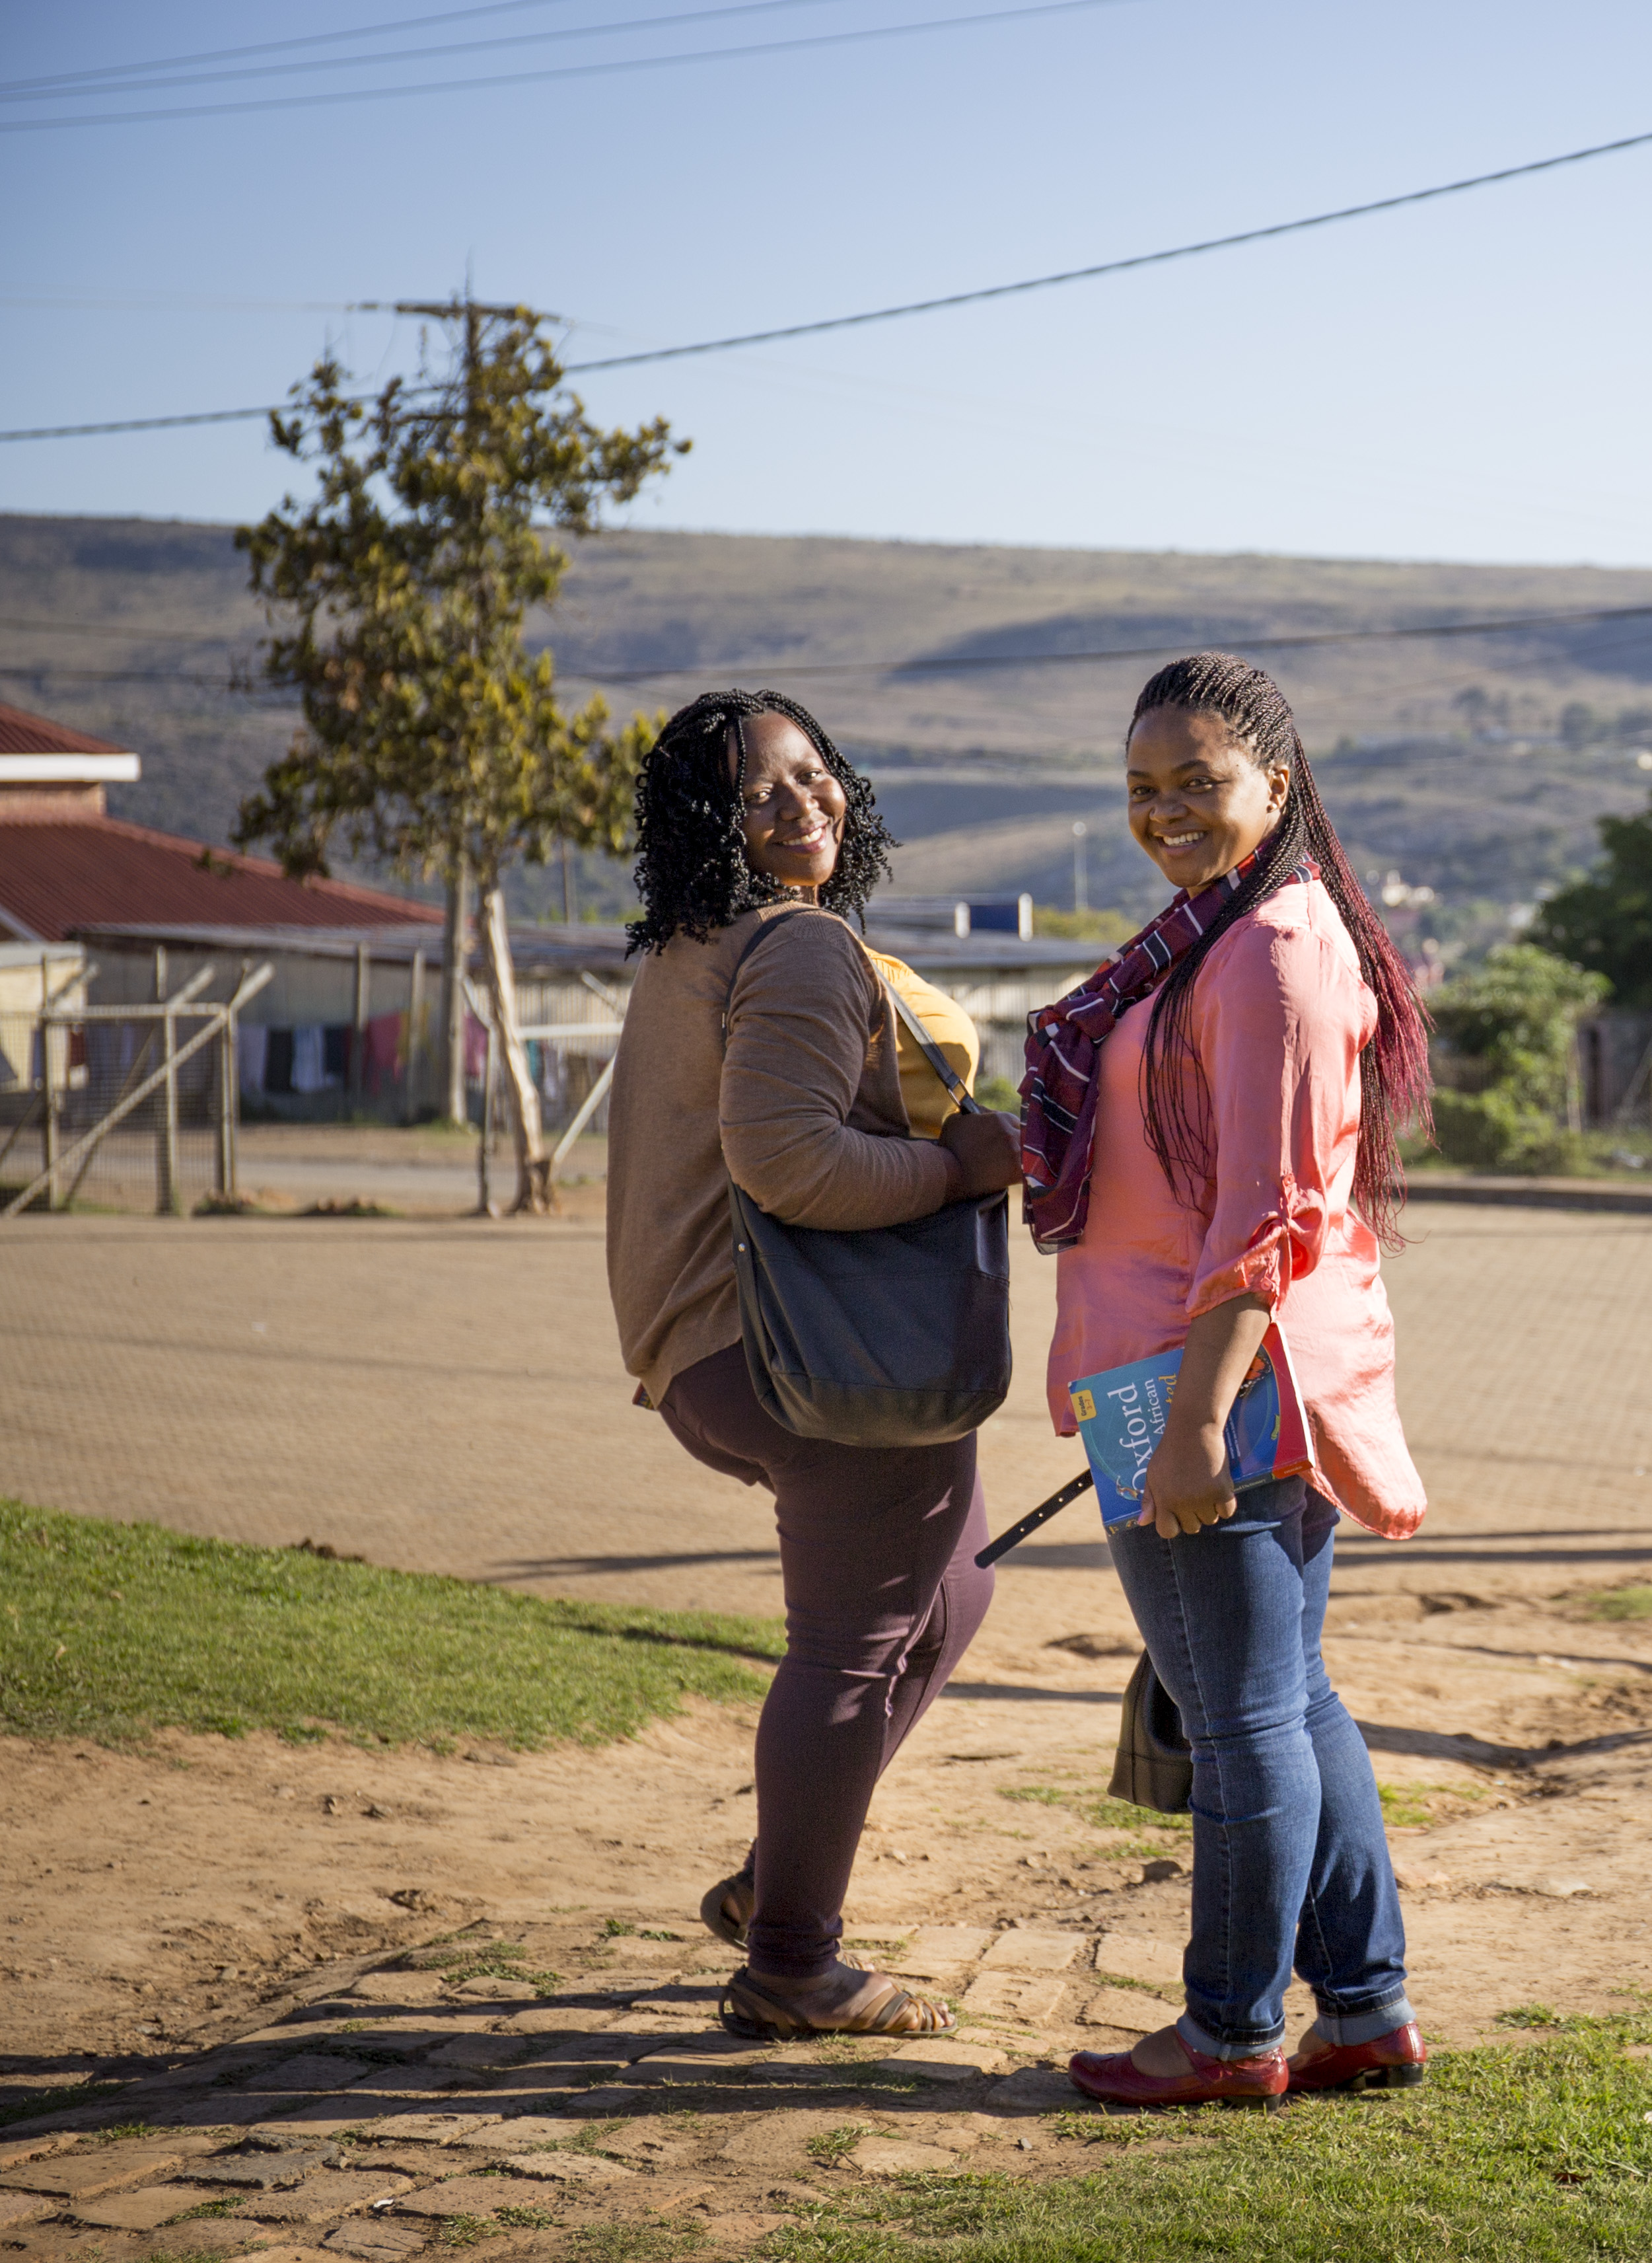




Comments / Questions?
NicSpaull@gmail.com

Slide 49
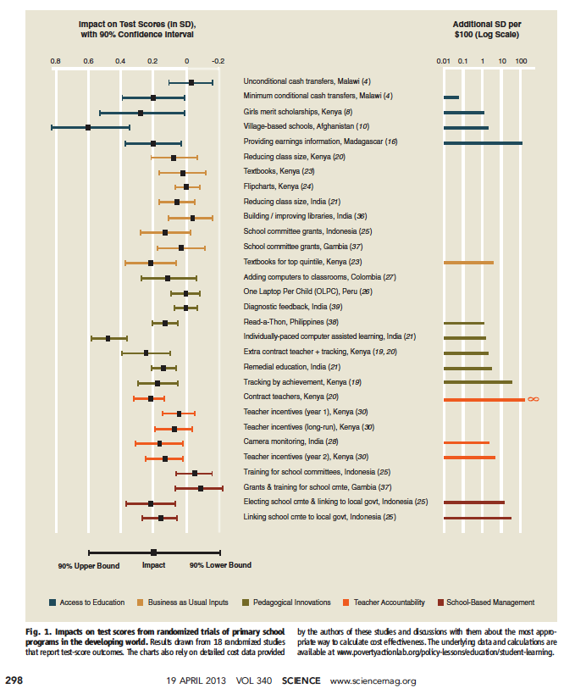
Kremer et al. 2013

Slide 50
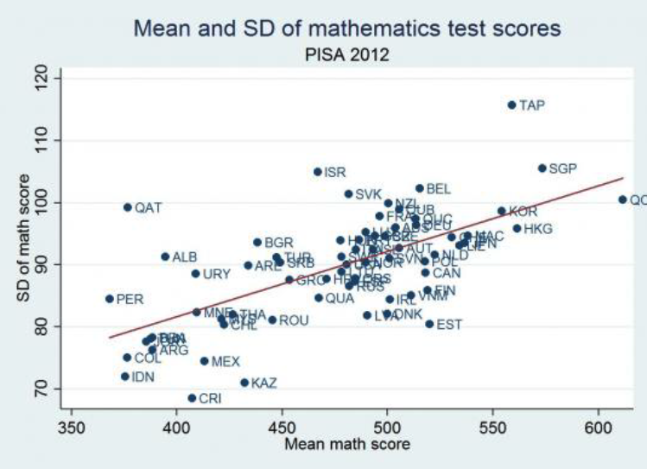
Means and standard deviations

Slide 51
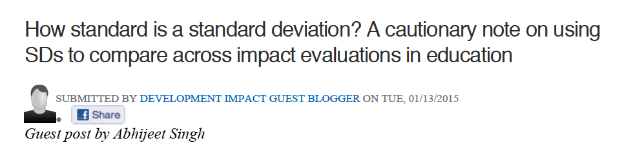
Source: Cain Rolleston (UCL)

Slide 52
