Slide 1



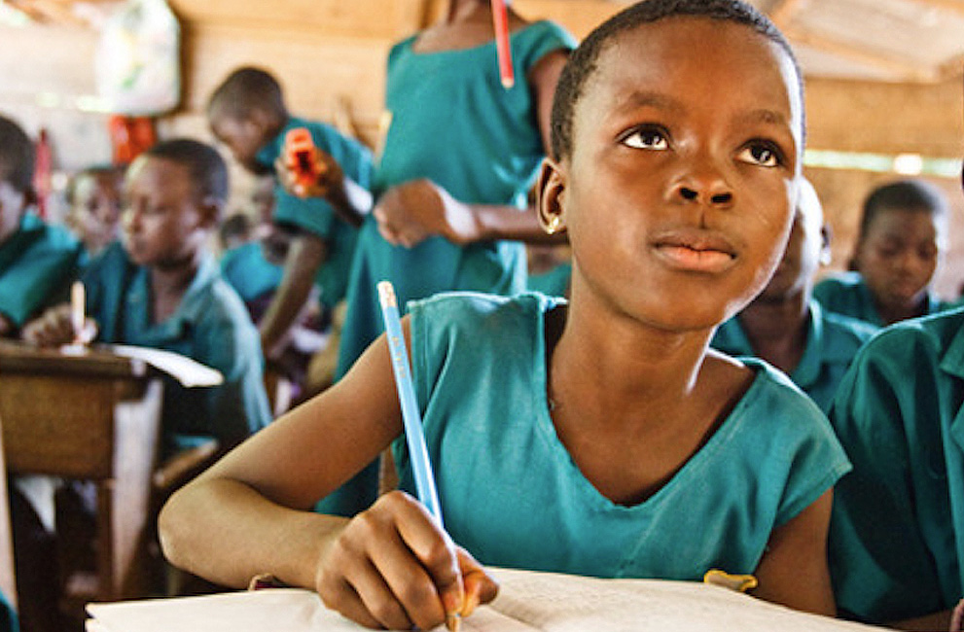
ASSESSING EARLY LITERACY OUTCOMES IN BURKINA FASO AND SENEGAL
Using DHS and PASEC to Combine Access and Quality
Nic Spaull & Adaiah Lilenstein
Stellenbosch University
CIES 2019 San Francisco
15 April 2019

Slide 2
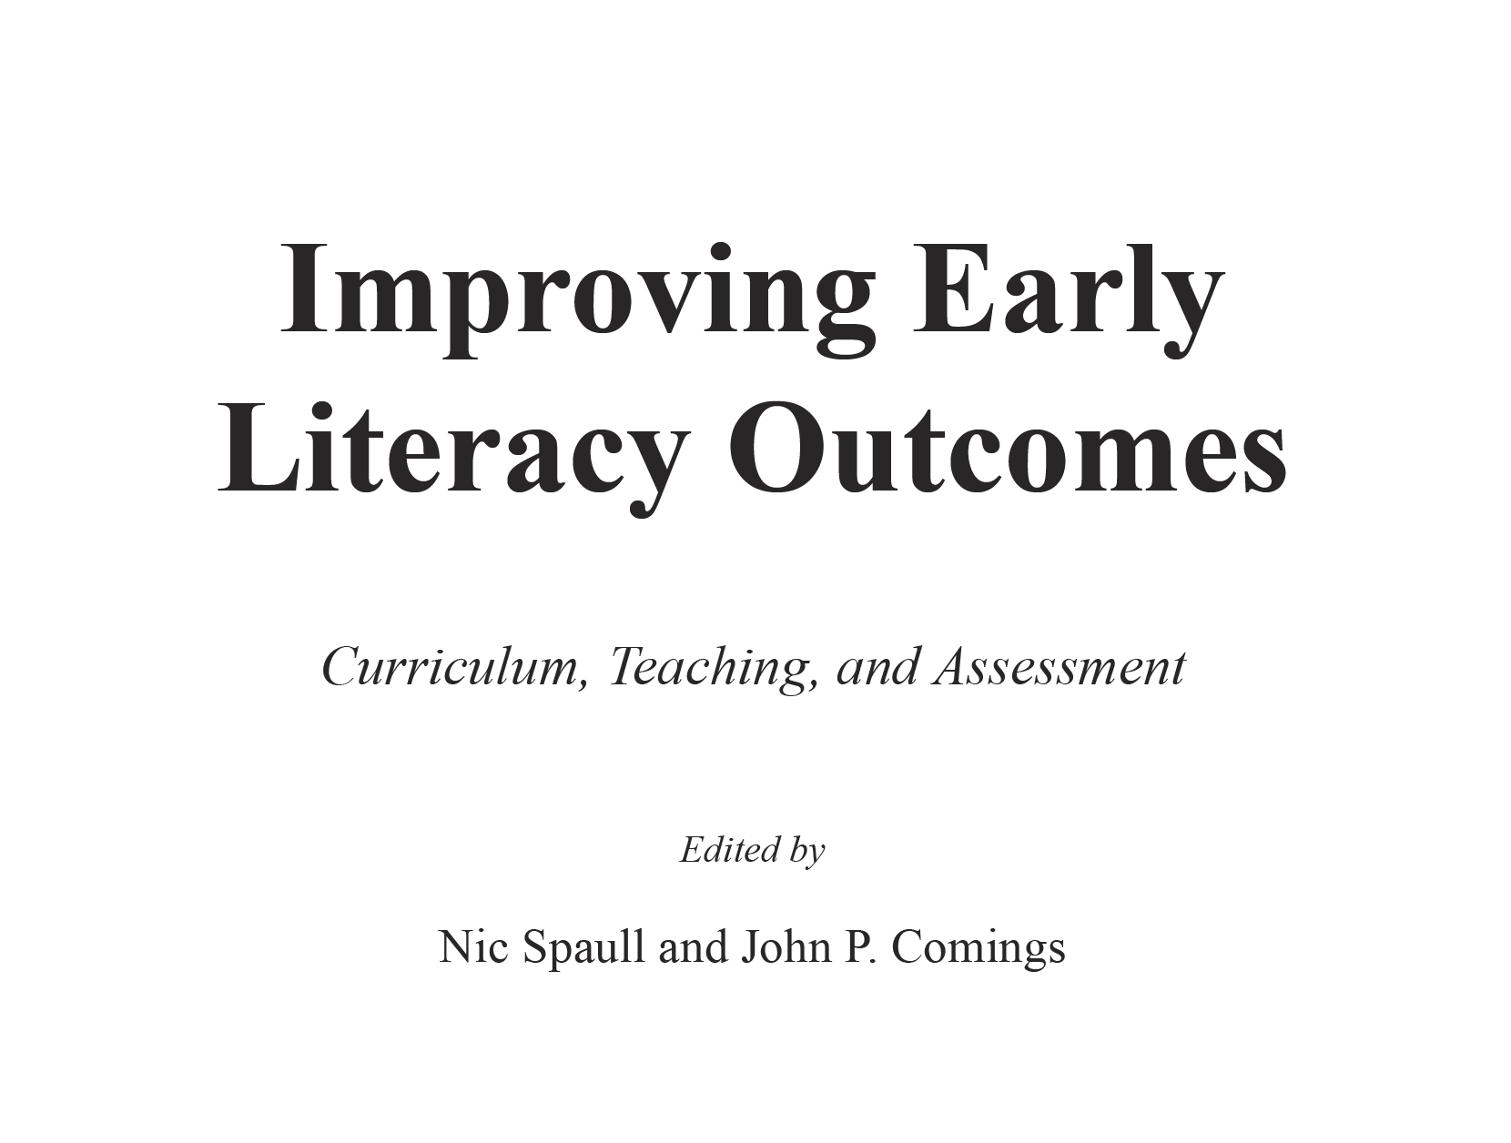

Slide 3
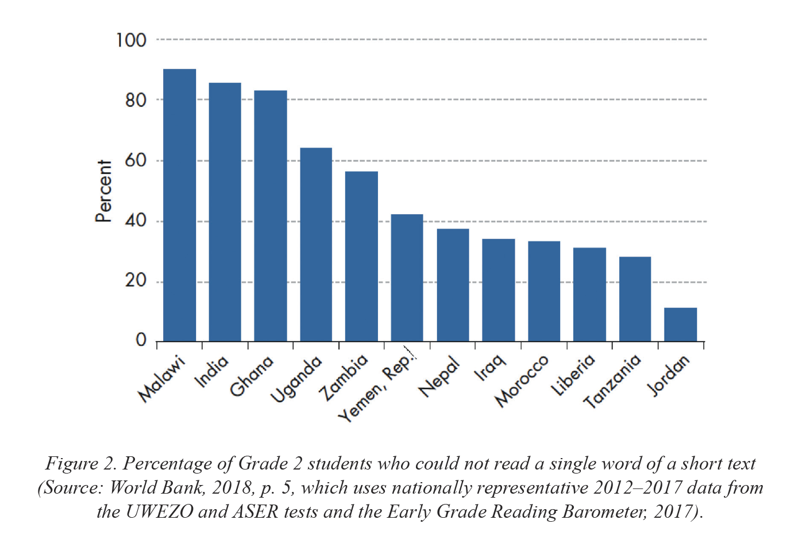
The need for this book?

Slide 4
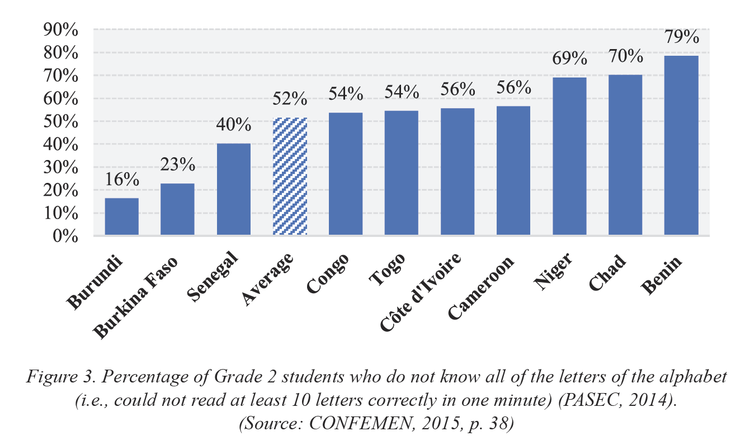
Additional focus on West Africa (IBE)
“…22% of primary school pupils were in schools that had no toilet facilities whatsoever (CONFEMEN, 2015, p. 104). In Togo, Chad, and Côte d’Ivoire, the figure is 40%. In Niger, the average Grade 2 class had 48 pupils in it, with much higher class sizes in Senegal (52 pupils per class), Benin (57 pupils per class), and a bewildering 80 Grade 2 pupils per class in Burkina Faso (CONFEMEN, 2015, p. 99)”

Slide 5
Arabic + Hindi + Bengali + Swahili = more than 1-billion people
69-70% of all article in the 3 journals are on Eng/French
6% of total (rounding).
Journal of Research in Reading,
Scientific Studies of Reading,
Reading Research Quarterly

Slide 6
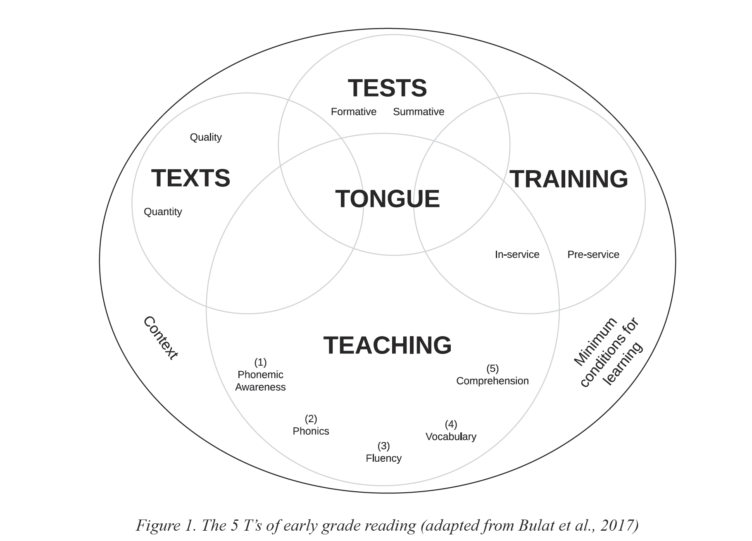
5 T’s of early literacy

Slide 7
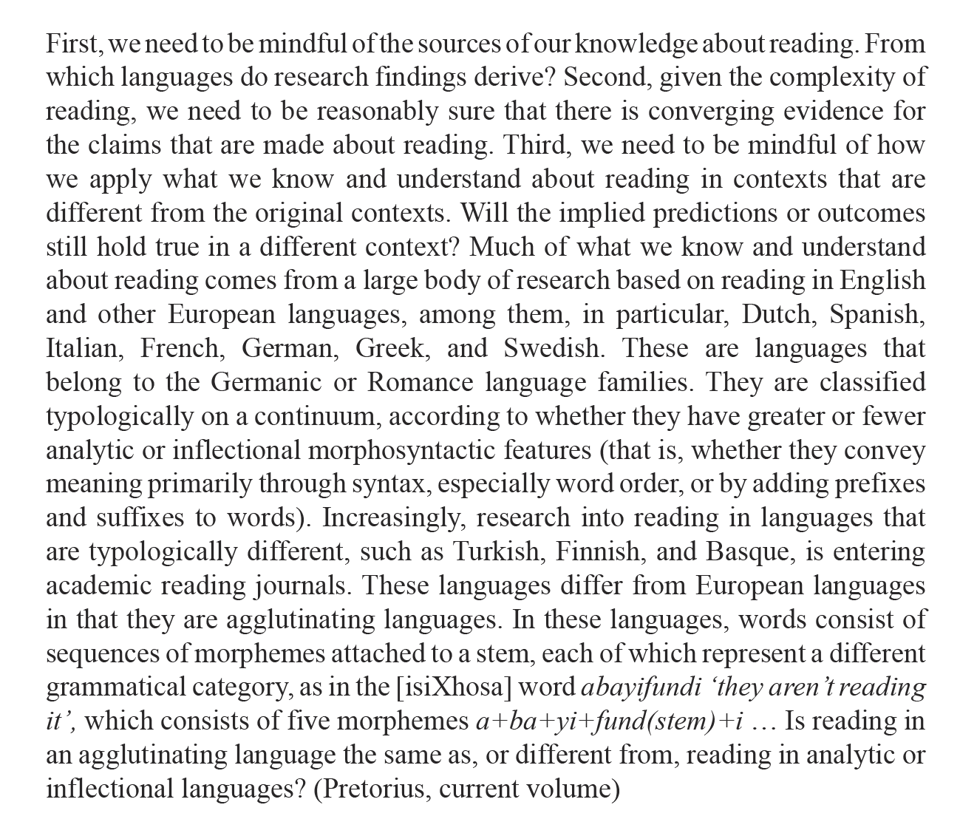
Pretorius 2019

Slide 8
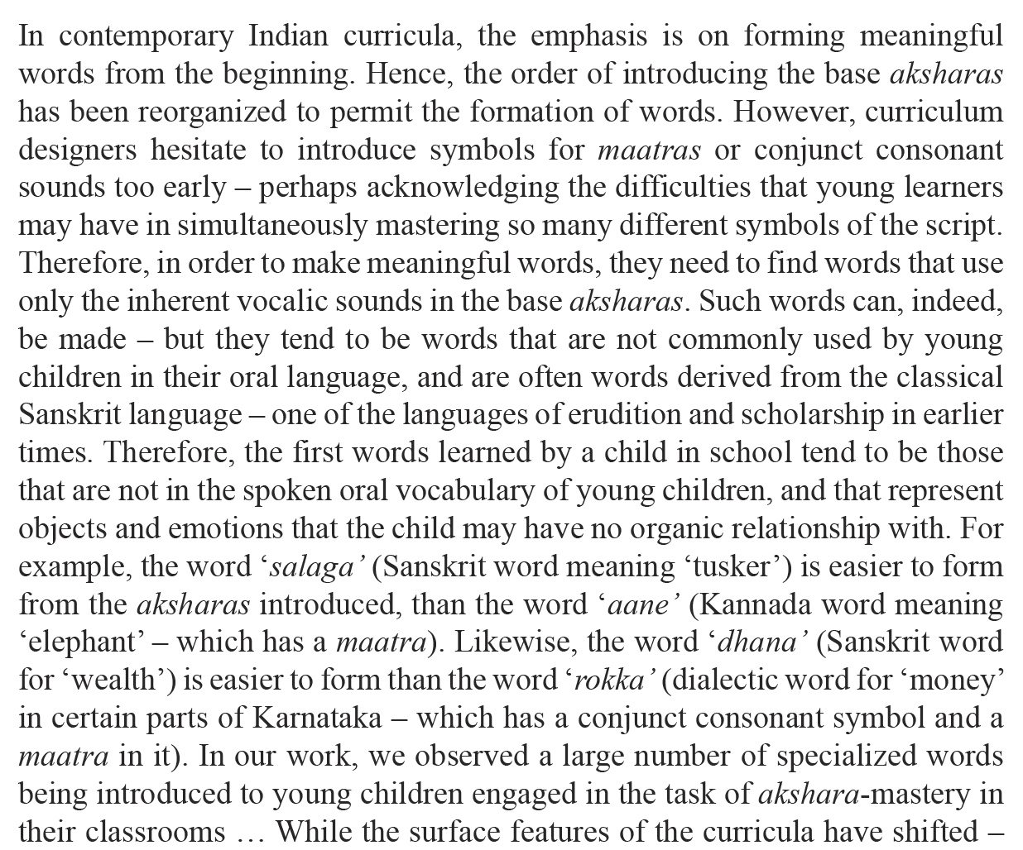
Menon et al 2019

Slide 9
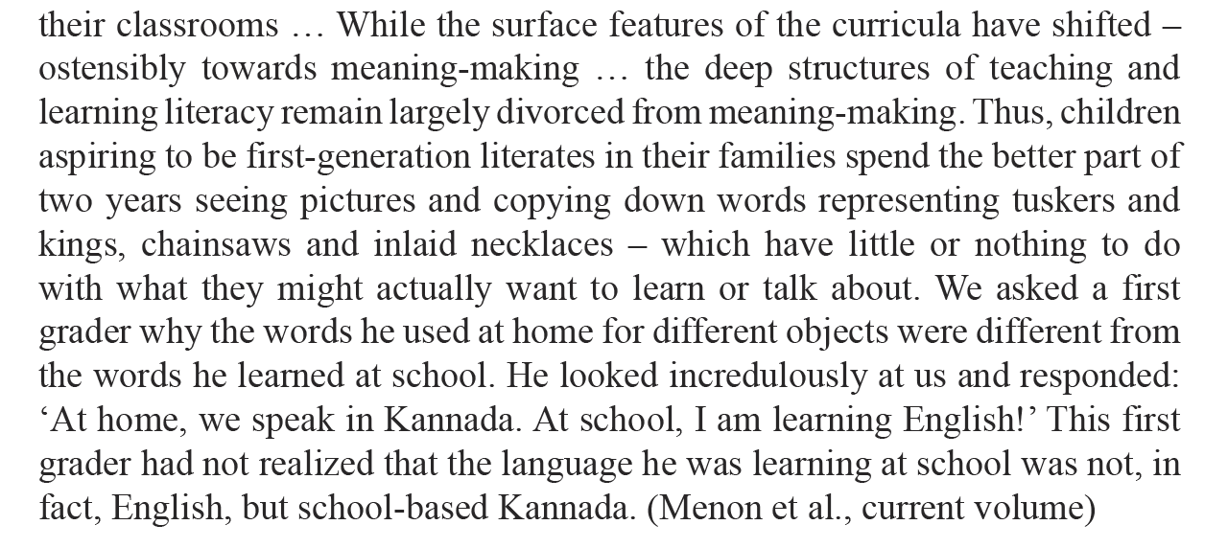
Menon et al 2019

Slide 10
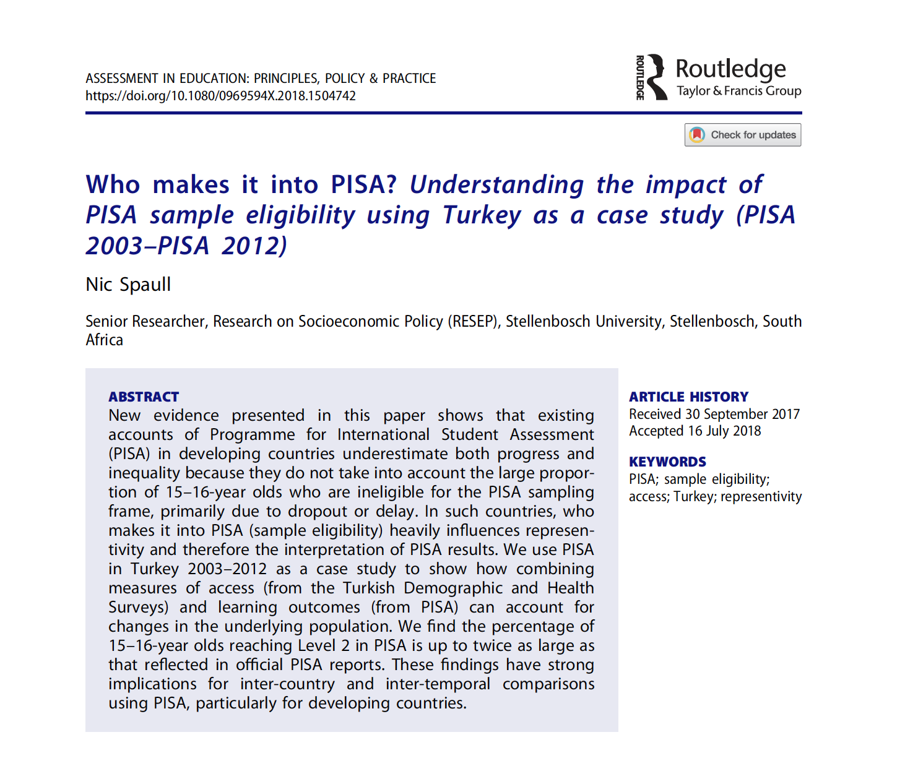
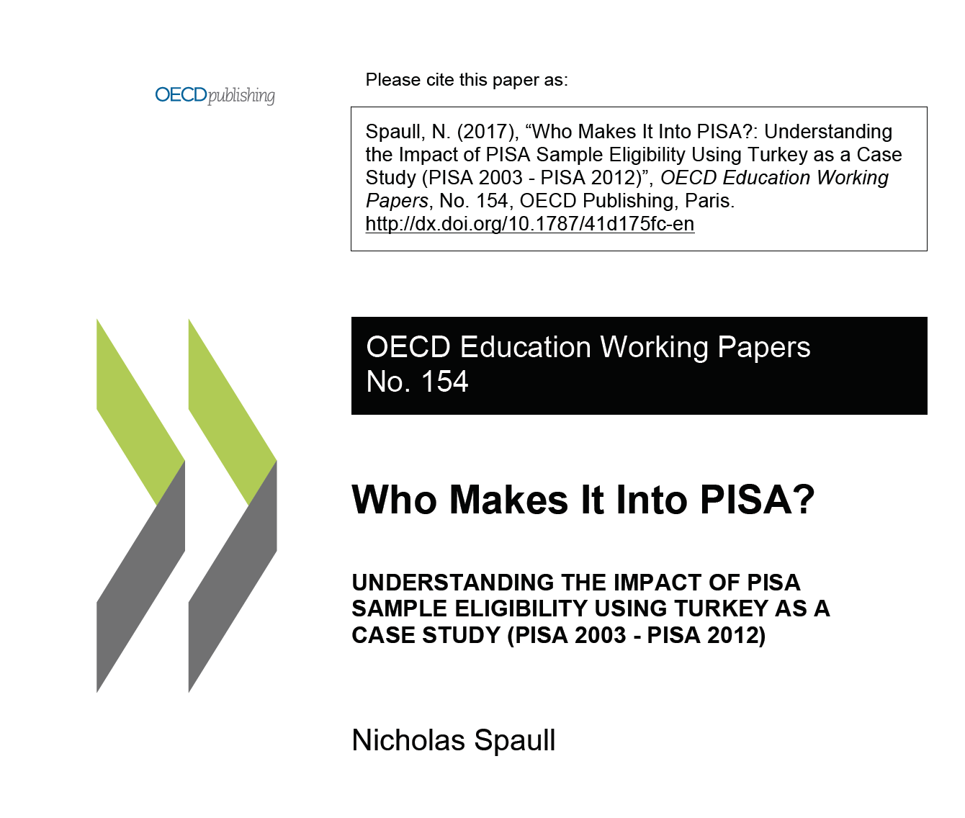
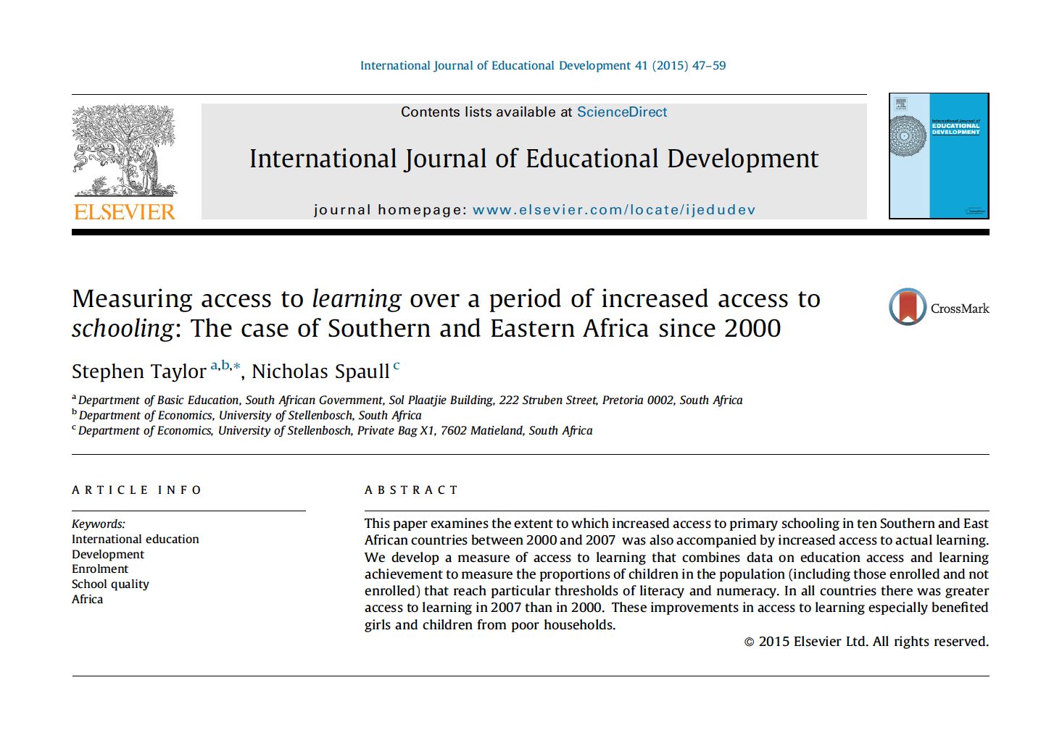
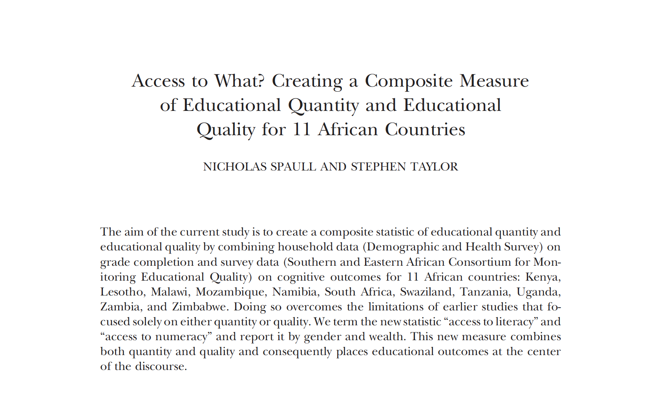
Geneaology of the work…
SACMEQ (Southern/East Africa) → PISA (Turkey) → now PASEC (Francophone W-Africa

Slide 11
Burkina Faso and Senegal

Slide 12
In this presentation we report on forthcoming research using more recent data (PASEC 2014) than that used in the IBE chapter. We also report on more countries than just Burkina Faso and Senegal.

Slide 13
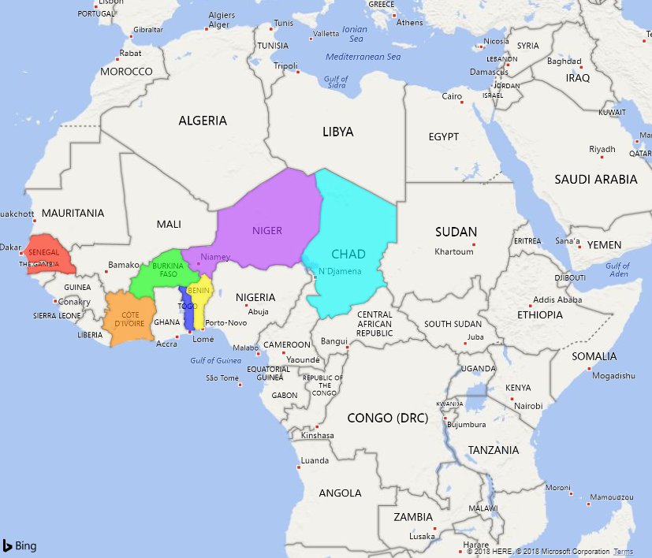
Countries
No research on combined measures of access and quality: Although some estimates of enrolment statistics, and learning outcomes from PASEC reports, no research exists which looks at access and quality simultaneously

Slide 14

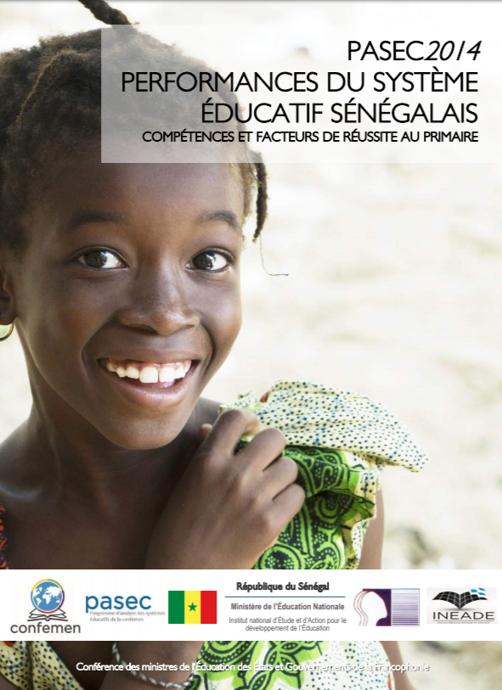
ACCESS - DHS
QUALITY - PASEC

Slide 15
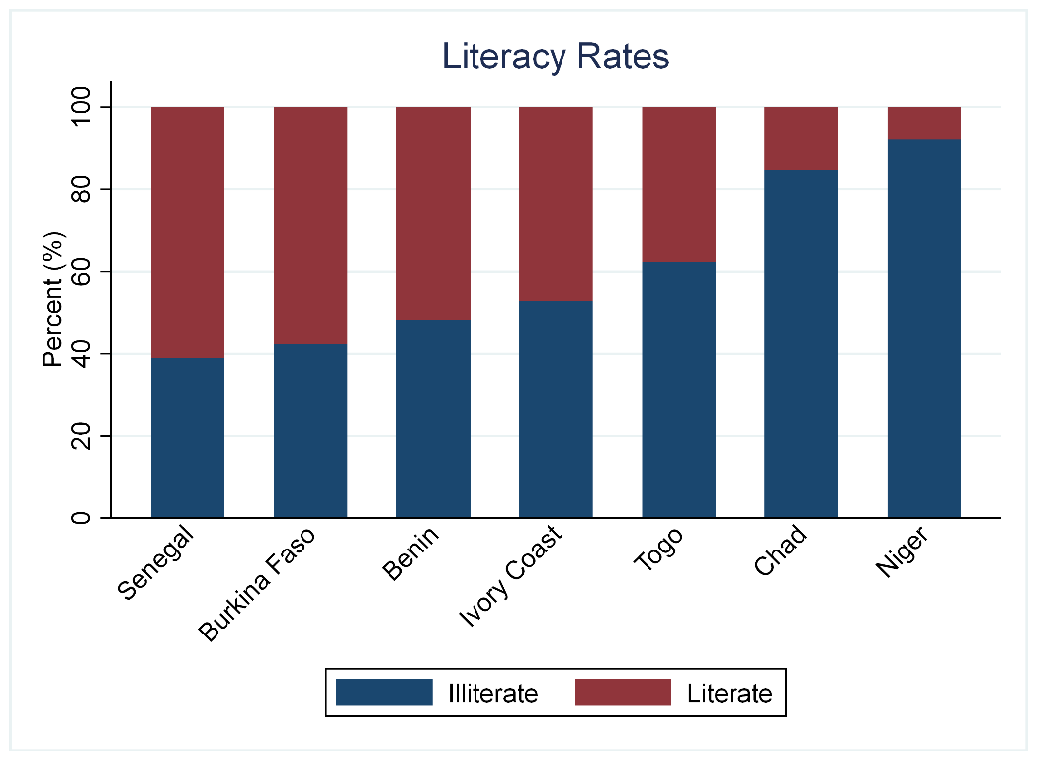
Quality
58%
15%
Burkina Faso > Chad?
Notes:
Use available data on access and learning
Combine
Access-to-learning

Slide 16
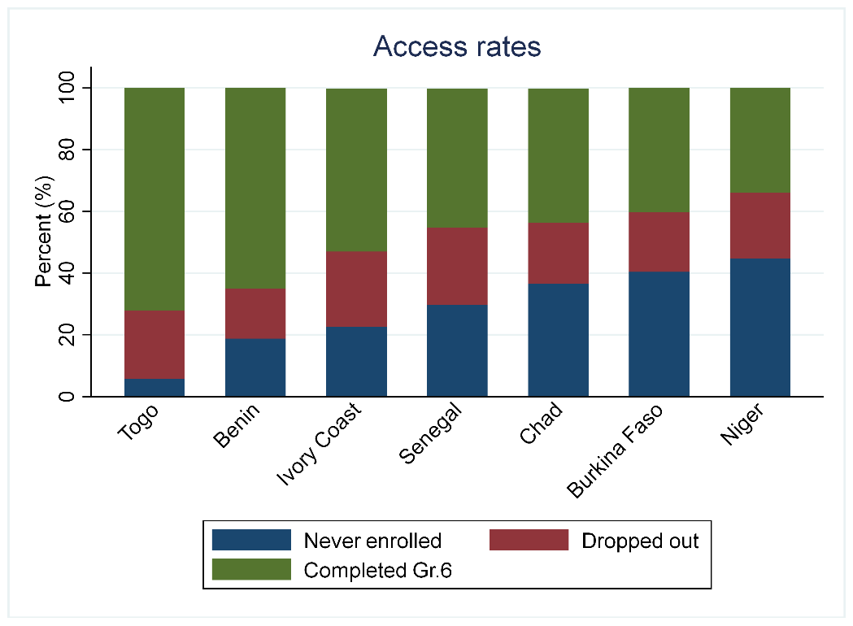
Access
36%
40%
Chad > Burkina Faso?
Notes:
Use available data on access and learning
Combine
Access-to-learning

Slide 17
Access and Quality
Chad? Burkina Faso?
Notes:
Use available data on access and learning
Combine
Access-to-learning

Slide 18
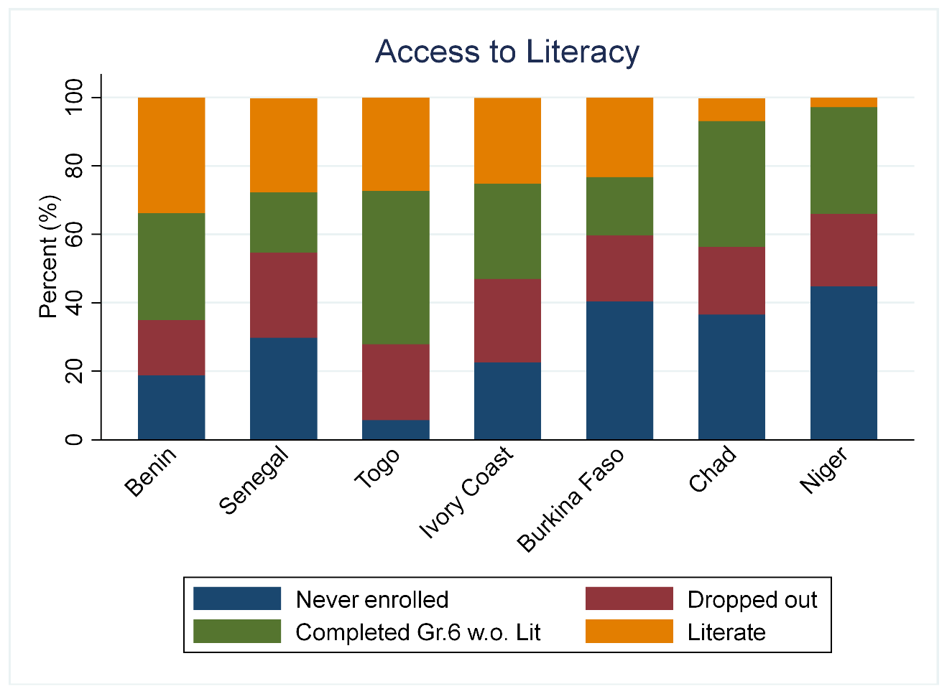
Access to Learning
23%
7%
Burkina Faso > Chad

Slide 19
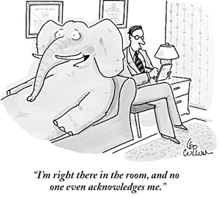
Motivation
this issue of expanding access and attainment has been one of the defining features of education systems in developing countries for the last two decades.
Access

Slide 20
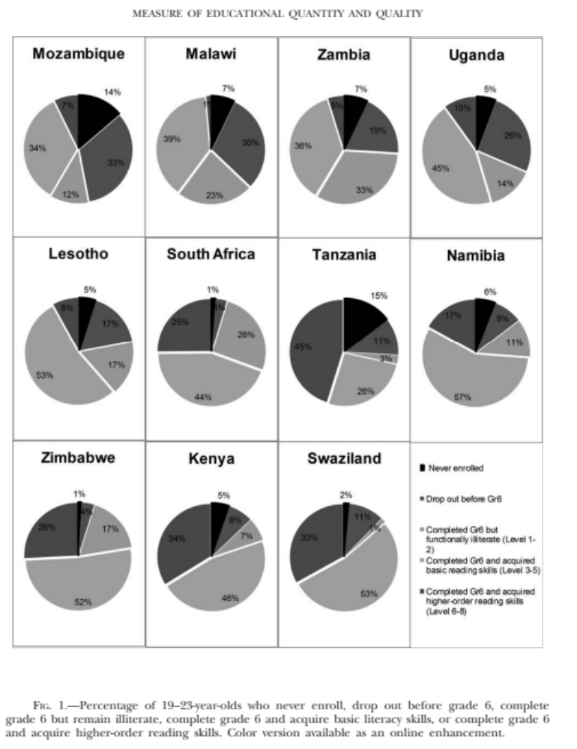
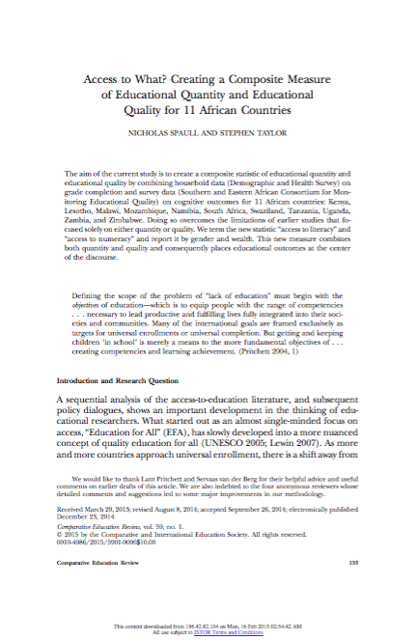
Anglophone
Sub-Saharan Africa
Spaull & Taylor, 2015

Slide 21
Data
  DHS
    Comparable
    Reliable
    Generally available
    “Highest year of education attained”
    Can be dated (2010-2014)
  PASEC
    2014
    Well developed assessment
    Released items are available… in French
Notes:
Add notes on IRT

Slide 22
DHS Data
Country | DHS year | Years dated by
Benin | 2011 | 3
Burkina Faso | 2010 | 4
Chad | 2014 | 0
Ivory Coast | 2011 | 3
Niger | 2012 | 2
Senegal | 2014 | 0
Togo | 2013 | 1

Slide 23
PASEC vs SACMEQ
PASEC
Pupils are able to combine two pieces of explicit information from a
document or can carry out simple inferences in a narrative or informative text.
They can extract implicit information from written material while giving meaning to implicit connectors, anaphora or referents. Pupils locate explicit information in long texts and discontinuous documents.
SACMEQ
Interprets meaning (by matching words and phrases, completing a sentence, or matching adjacent words) in a short and simple text by reading on or reading back

Slide 24
Method
Multiply completion rate by literacy/numeracy rate
Simple Multiplication
Notes:
Overestimate completion for poorest 80% of sample – up to 10 p.p.
Underestimate completion for richest 20% of samples – up to 10 p.p.

Slide 25
Method
Simple Multiplication
Multiply completion rate by literacy/numeracy rate
Example
50% Completed Gr6
60% Literate in school
= 0.5 x 0.6
= 30% access to literacy
Notes:
Overestimate completion for poorest 80% of sample – up to 10 p.p.
Underestimate completion for richest 20% of samples – up to 10 p.p.

Slide 26
Method
Simple Multiplication
Adjust for older DHS datasets
Use a younger cohort & apply estimated dropout rates
Notes:
Overestimate completion for poorest 80% of sample – up to 10 p.p.
Underestimate completion for richest 20% of samples – up to 10 p.p.

Slide 27
Method
 | PASEC | DHS
Benin | 2005 | 2011/12
Burkina Faso | 2006 | 2010
DRC | 2010 | 2013/14
Ivory Coast | 2009 | 2011/12
Senegal | 2006 | 2012/13
Togo | 2010 | 2013/14
Use a younger cohort & apply estimated dropout rates
Simple Multiplication
Adjust for older DHS datasets
Notes:
Overestimate completion for poorest 80% of sample – up to 10 p.p.
Underestimate completion for richest 20% of samples – up to 10 p.p.

Slide 28
Method
Simple Multiplication
Adjust for older DHS datasets
Adjust for late completion
Apply estimated dropout rates to those still enrolled in Gr.3-5
Notes:
Overestimate completion for poorest 80% of sample – up to 10 p.p.
Underestimate completion for richest 20% of samples – up to 10 p.p.

Slide 29
Method
Simple Multiplication
Adjust for older DHS datasets
Adjust for late completion
Adjust for underrepresentation of poor kids in schools
Apply estimated completion rates from DHS data to PASEC sample
Notes:
Overestimate completion for poorest 80% of sample – up to 10 p.p.
Underestimate completion for richest 20% of samples – up to 10 p.p.

Slide 30

Results (1): Access
72%
34%

Slide 31

Results (2): Quality
61%
8%

Slide 32
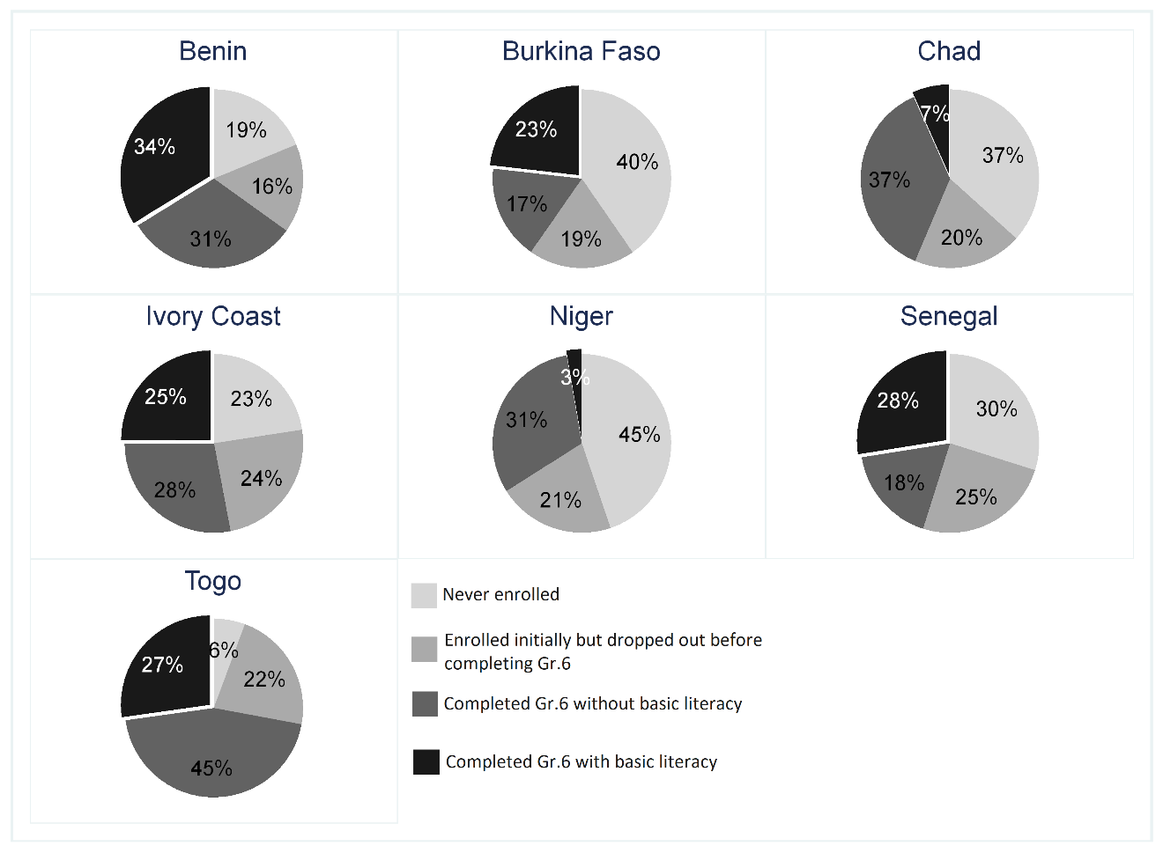
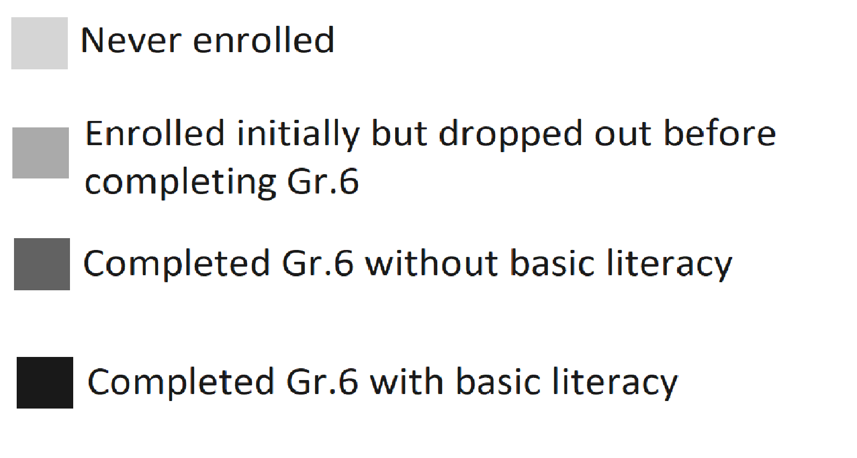
Results (3): National

Slide 33
Results (3): National

Slide 34
Results (3): National

Slide 35
Results (3): National

Slide 36
Results (3): National
<1/3 children reading in all countries
<1/10 children reading in Chad & Niger

Slide 38
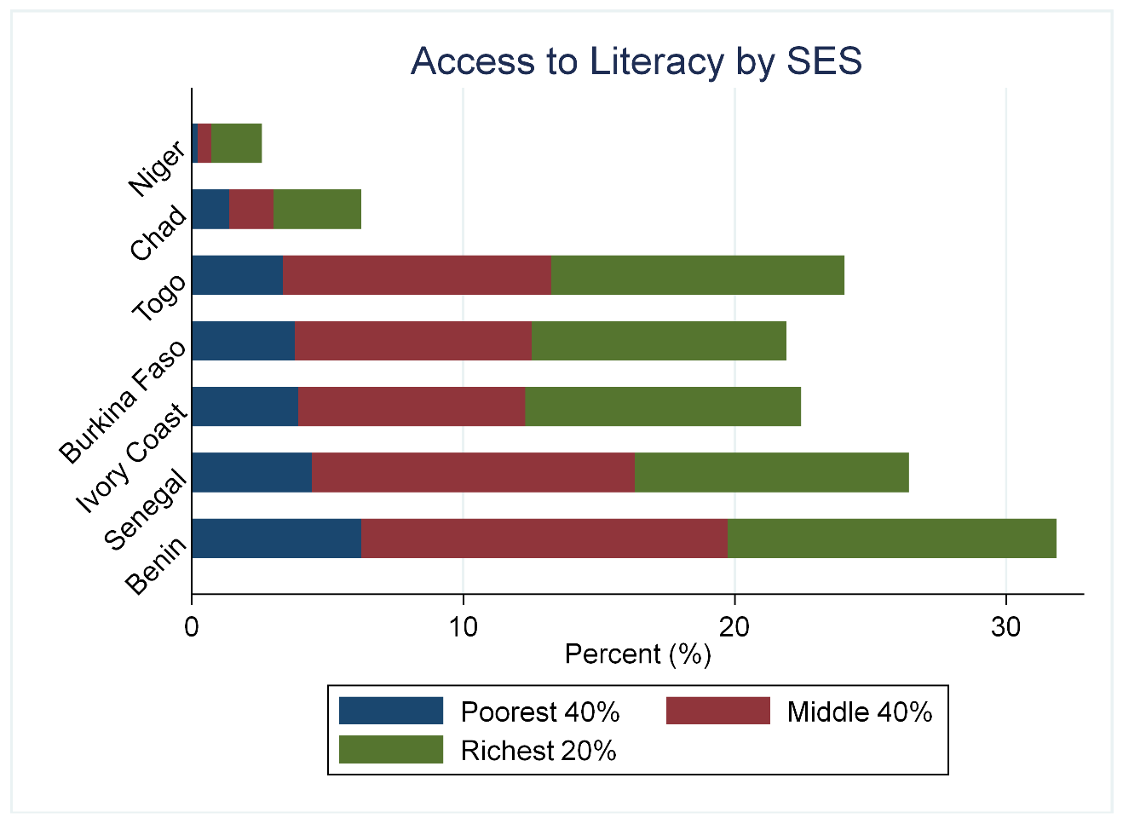
Results (4): SES

Slide 39
Results (4): SES
In Benin
2/5 literate children are wealthy
From the wealthiest 20% of the population
1/10 literate children are poor
From the poorest 40% of he population
Rich children are 4x more likely to be literate than the poorest
9%
41%
40%
Notes:
Generally statistically significant
Except Chad, Niger
IvC poor/mid

Slide 40

Results (4): SES
In Niger
7/10 literate children are weathy
From the richest 20% of the population
1% of the poorest 80% of children are literate
Rich children are 20x more likely to be literate than the poorest children
<1%
1%
9%
Notes:
Generally statistically significant
Except Chad, Niger
IvC poor/mid

Slide 41
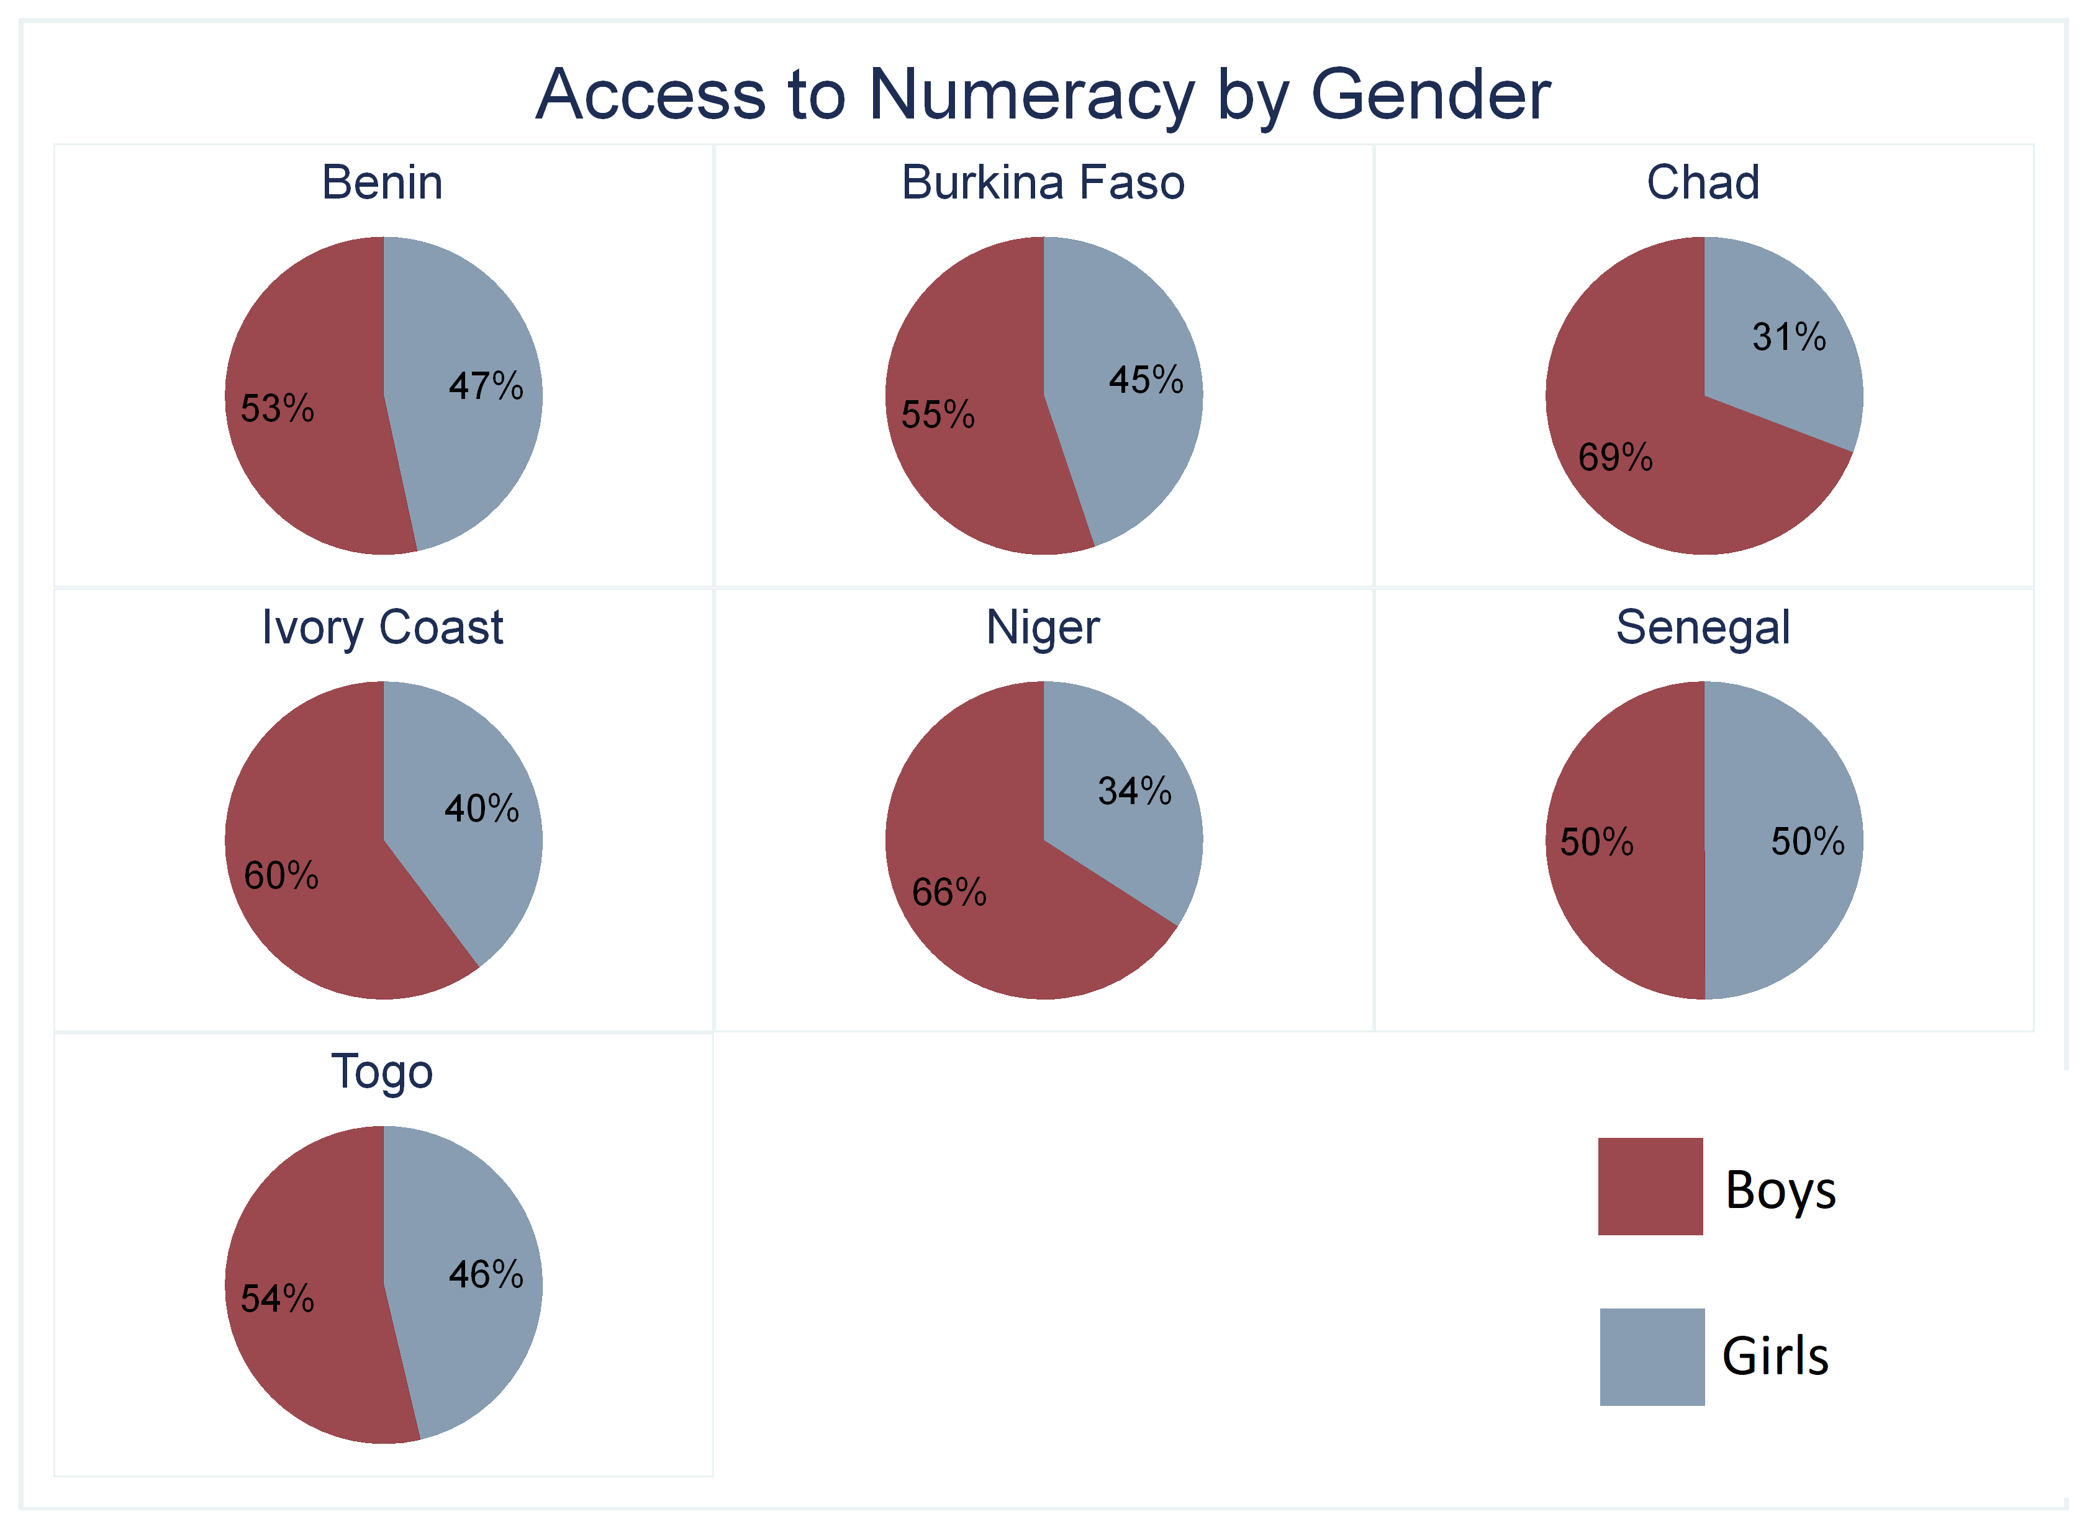
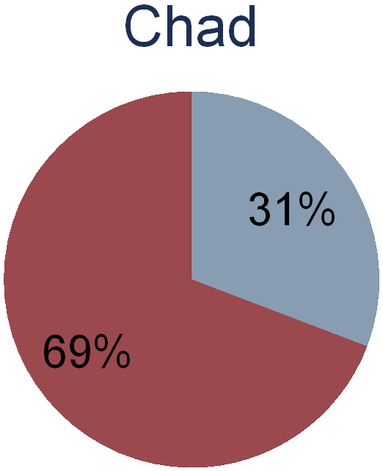
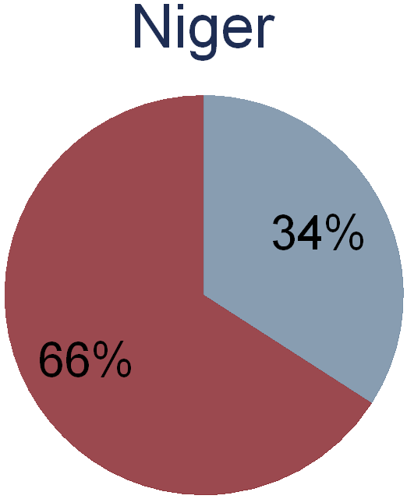

Slide 42



Results (6): SES & Gender
(1) <20% poor learn to read: Less than 20% of the poorest boys and girls will learn to read or do math at a basic level
(2) Poor boys > Poor girls: The poorest boys always have better outcomes than girls, except in Senegal, although differences are not statistically significant
(3) Total illiteracy for poorest girls: In 5 of 7 countries, standard errors mean that it’s possible that zero females are learning to read at a basic level

Slide 43
Take home points
Overall
(1) <1/3 literate or numerate in Benin, Burkina Faso, Ivory Coast, Senegal, Togo
(2) <1/10 literate or numerate in Chad, Niger
SES
(3) Vast socioeconomic inequalities In all countries
Gender
(4) Total illiteracy for poorest girls In 5 of 7 countries at lower confidence intervals

Slide 45
Thank you

Slide 46
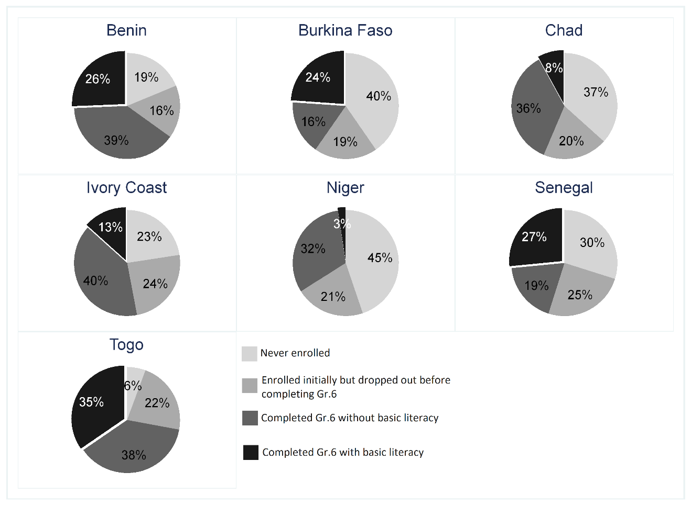
Numeracy (national)

Slide 47
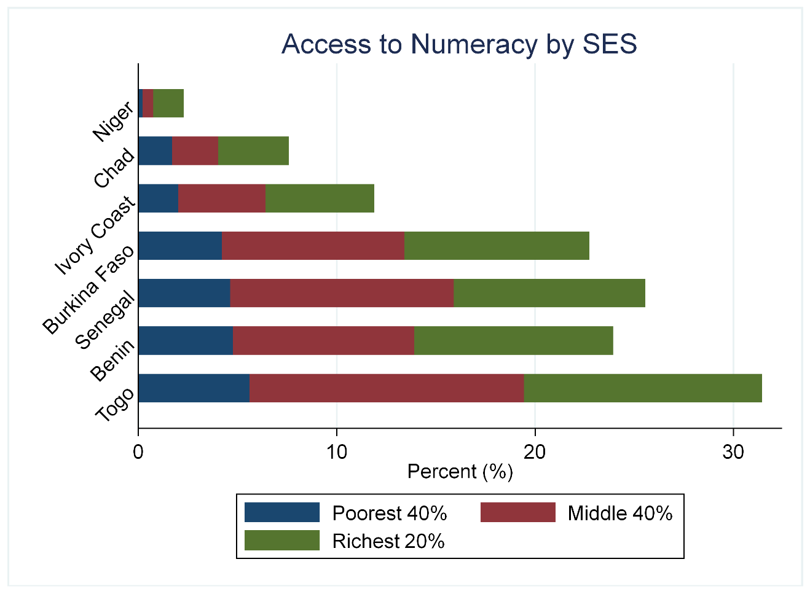
Numeracy by SES

Slide 48



Problem Statement
Problem 1: Generally misleading results Using small non-representative sub-samples as a proxy for a cohort of 15 year olds or an entire schooling system can lead to misleading results.
Problem 2: Inaccurate cross-country comparisons when using only PISA data, especially when countries have different levels of incomplete access or different proportions of delayed (& ineligible) students.
Problem 3: Underestimating progress of the real educational improvements over time for countries that have improved access/attainment.
Problem 4: Underestimating inequality When there is a sample selection process involved such that poorer students are more likely to be excluded from the sample, PISA will underestimate socioeconomic inequalities

Slide 49
Creating “access to numeracy”
Get estimates of:
  Percentage of 15-16 year-olds that are eligible for the PISA sample (enrolled and in Gr7+) (from DHS)
  (I choose to use 2 age years to increase the sample size and decrease the standard errors)
  Percentage of PISA sample that achieved Level 2+ in Maths (from PISA)
Multiply the two together, assuming that ineligible students would not have reached Level 2…
  eg 80% of 15-16 year-old girls reach Gr7+
  50% of girls in PISA reach Level 2+
    Access-to-numeracy = 0.8*0.5 = 40%
Correct for differential access-to-PISA-sample by SES…

Slide 50
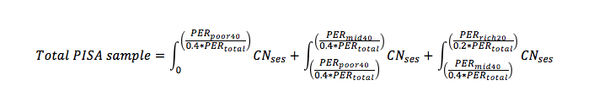
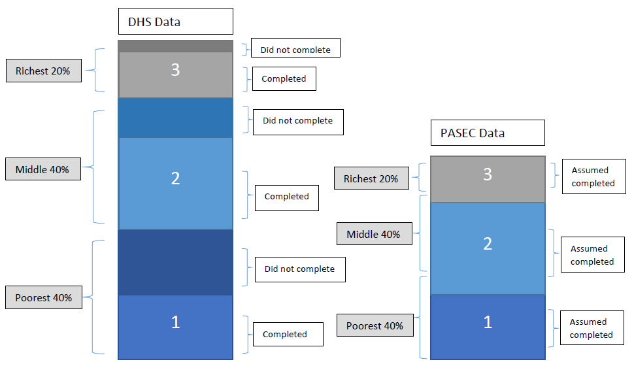
Adjusting PISA SES 40-40-20 categories to correspond with DHS categories
PISA Data

Slide 51

on quality AND access
^

Slide 52
Sensitivity Analysis & Limitations
Ineligible = illiterate? Large literature attesting to the fact that delayed students and those who drop out are more likely to come from poorer families, rural areas, be female and be low-performers prior to dropout (Lambin, 1995; Filmer & Pritchett, 1999; UNESCO, 2005; Lewin, 2007; Lewis & Lockheed, 2006)
Similar correlates in Turkey as shown in Köseleci’s (2015) review of the Turkish literature.
In PISA 2012, those delayed 2-3 grades 362 (Reading)
In PISA 2012, those ‘on-track’/modal-grade 500 (Reading)
(i.e. 1.6 SD’s lower)

Slide 53
Conceptual overview
Access & Quality – Post-SDG’s it is now a truism that we need to focus on both access and quality. But when Filmer, Hasan & Pritchett (2006) were arguing for it it wasn’t common cause. Coming from Sub-Saharan Africa this is a MAJOR issue. Comparing SACMEQ scores across countries for example (Spaull & Taylor, 2015)
Centre & periphery – While PISA was designed with OECD countries in mind, there has been a rapid expansion into ‘partner’ (typically developing) countries. PISA assumptions built on the ‘centre’ not the periphery
  “PISA provides an assessment of the cumulative yield of education and learning at a point at which most young adults are still enrolled in initial education” - OECD & UNESCO-UIS (2003, p. 249).
  Of the 88 economies/regions that have participated in PISA only 36 are OECD (https://www.oecd.org/pisa/aboutpisa/pisa-participants.htm).
Overlooking huge contextual differences - Problems that were initially overlooked as being overly technical or unimportant (sample selection & coverage) need to be revisited in light of changing PISA demographic. Much more nuanced analyses and interpretations are necessary for developing countries.

Slide 54

New PASEC Evaluation Tools:
2nd and 6th grade tests:
They are built upon :
Expected basic skills from students in 6th grade of primary school, essential for schooling continuation and recognized by the international community of researchers in pedagogy and education psychology,
Official curricula implemented in the countries.

Slide 55
Tests objectives at 6th grade are to :
Identify the proficiency level in writing comprehension and in the domain of mathematics (numeracy, measures, geometry) expected skills : decoding, extract information, deduce, analysing and giving opinion / to know, to implement, to reason in mathematics).
Spot education systems efficiency factors in primary school.
Enable students assets’ international comparison between all PASEC countries on one hand , but also with SACMEQ countries.
(2 hours test in maths and writing comprehension, 4 booklets -60 items- in the two disciplins with a block of common items)

Slide 56
Tests objectives at 2nd grade:
Detect students gaps , at the very beginning of the schooling, in order to adapt and re-orient teaching, curricula, pedagogy and practices, and more globally sector policy (at 2nd grade the comparison is possible only for countries sharing the same teaching language ).
Assess directly the students level upon unique competences and not upon a set of competences (one item = one competence assessed) in oral comprehension, reading, writing comprehension, numeracy
Individual test administration, orally to detect the real level in very targeted skills.

