Slide 1
FEMEF
Strategy Workshop
9 May 2019
Nic Spaull

Slide 2


Slide 3


78%
of Grade 4 children in South Africa can not read for meaning in any language (PIRLS-L 2016)
61%
of Grade 5 children in South Africa can not add and subtract whole numbers.

Slide 4
In SA: 22% of Gr4 kids can read
In US: 96% of Gr4 kids can read
Mullis et al. 2017

Slide 5

NEEDU Grade 5 Rural SA

Slide 6
Illustration of non-readers reading speed (NEEDU 2013)
Many
years
ago
Leopard
was
a
creature
with
no
spots.
Recommended rate at Gr5
One
day,
he
was
relaxing
in
the
shade
of
a
thorn
tree
when
Zebra
walked
past.
Many
years
ago
Leopard
was
a
creature
with
no
spots.
40% of SA rural Gr5 learners (<40WCPM) WCPM
One
day,
he
was
relaxing
in
the
shade
of
a
thorn
tree
when
Zebra
walked
past.
Draper, K., and Spaull, S. (2015). Examining oral reading fluency among grade 5 rural English Second Language (ESL) learners in South Africa: Analysis of NEEDU 2013. South African Journal of Childhood Education 5(2) pp.44-77.
Notes:
40 words in 60s = 1,5s/word
130 words in 60s = 0,46s/word

Slide 7

The problem starts early and is never overcome
New Solutions for a New Future
Insurmountable learning deficits
55% of Gr5 learners in no-fee schools (80% schools) cannot answer this question.
(NSES 2009)
Figure 10b: South African mathematics learning trajectories by national socioeconomic quintiles using a variable standard deviation for a year of learning (0.28 in grade 3 to 0.2 in grade 8 with interpolated values for in-between grades (Based on NSES 2007/8/9 for grades 3/4/5, SACMEQ 2007 for grade 6 and TIMSS 2011 for grade 9, including 95% confidence interval
(Spaull & Kotze, 2015)

Slide 8
(1) How should we frame our mission and goals?
→SMART Goals
(2) What will guide us in selecting which projects to fund & on what basis?
→ 6 Principles for wise social investing

Slide 9
SMART
GOALS

Slide 10
Option A
Opportunity:
Building opportunities and expanding horizons for young people.
SMART
GOALS
Option B
Employment & Earnings:
Before 2025, create 10,000 new jobs for 18-30 year olds that last for more than 2 years and pay R7,000 or more per month.

Slide 11
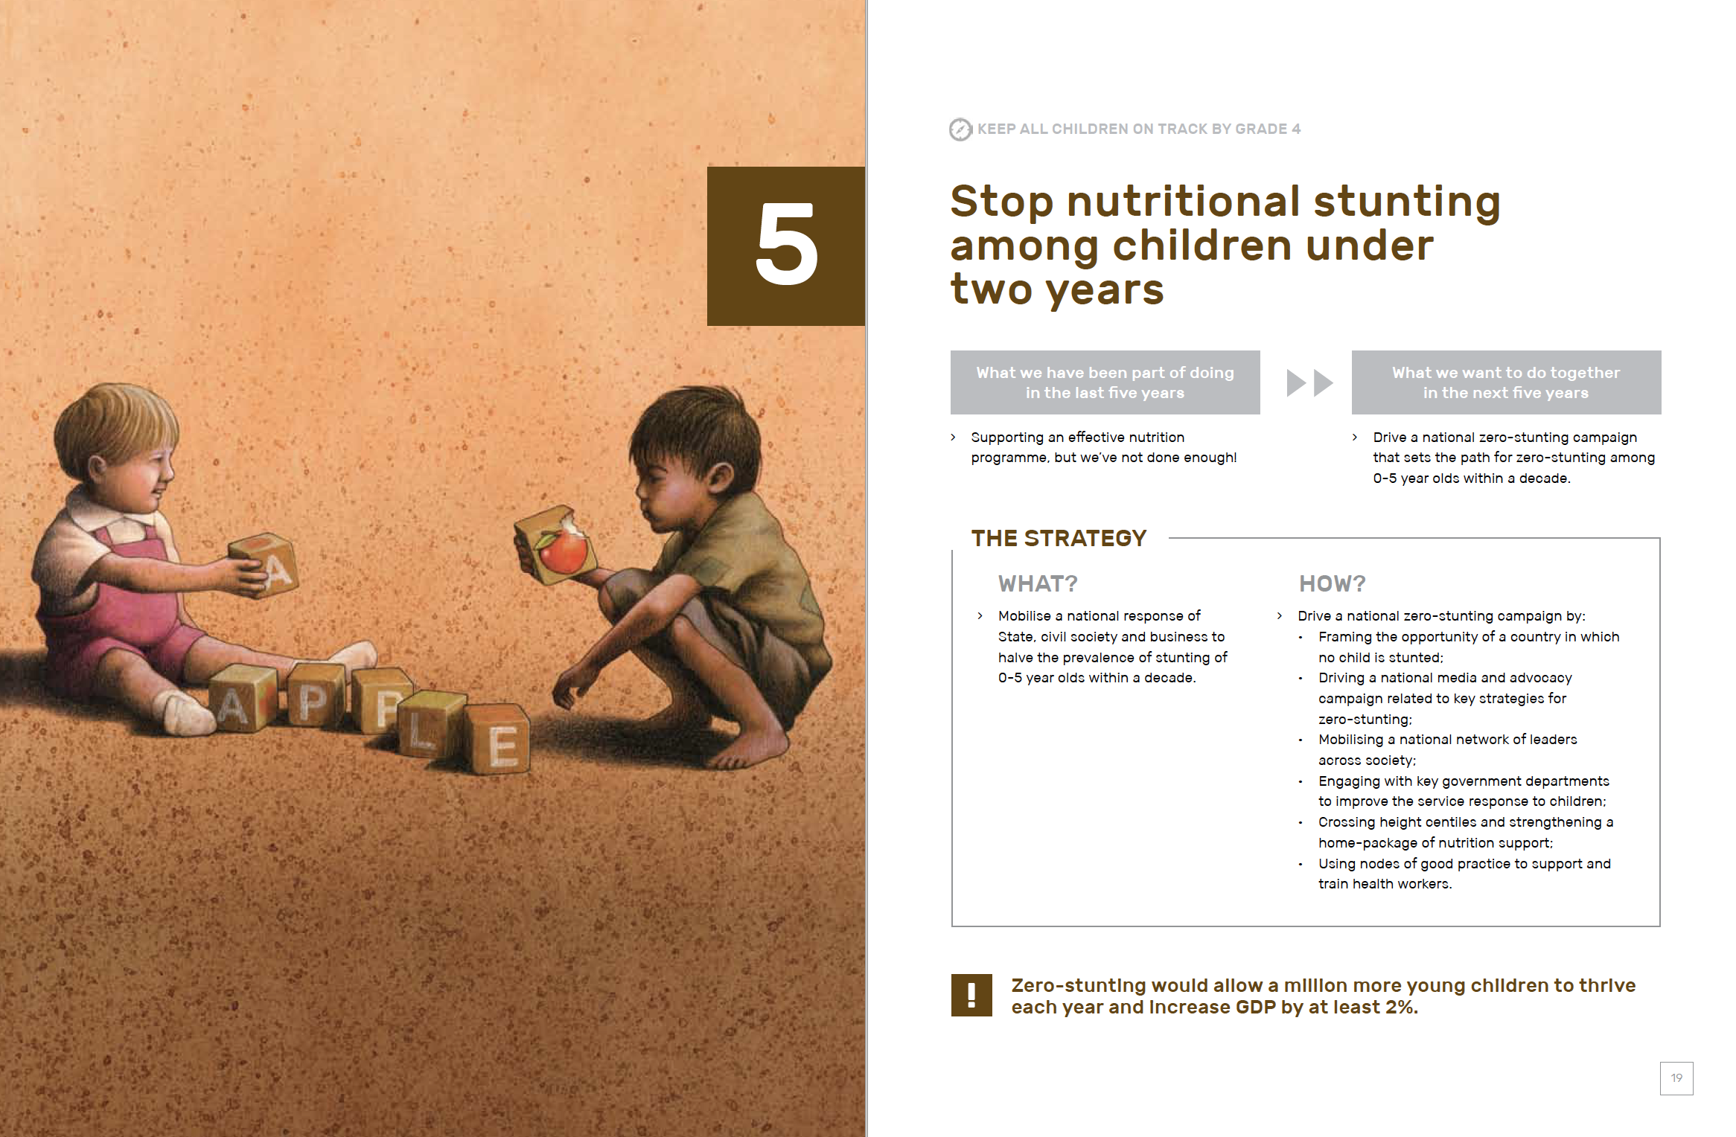

Slide 12

GOAL:
“By 2030, all children reading-for-meaning and calculating-with-confidence by age 9.”
(1) Ensure every child has the books and resources they need to learn to read for meaning and calculate with confidence.
(2) Ensure every Grade R-3 child has a motivated teacher that knows how teach reading and mathematics.”
SMART
GOALS

Slide 13

GOAL:
“Ensure that every primary school child that needs spectacles in South Africa gets them by 2025.”
(1) Diagnosis - who needs glasses? Every child in South Africa is screened for eyesight difficulties in Grade R-1
(2) Provisioning - how do we get glasses to those that need them? Identify low-cost, scalable methods of procuring and distributing spectacles to children that need them
SMART
GOALS
SMART
GOALS
There are many extremely worthy goals that ARE Specific, Measurable, Attainable, Relevant & Time-bound. Why risk going for a vague goal?

Slide 14
Leverage: The best use of private money is influencing how public money is spent. Work with government.
Impact at scale: There is a moral obligation to provide the largest impact to the largest number of children. Funding 10 kids to go to Hilton (R250,000/year) or 100 kids to go to a Model-C school (R25,000/year?)
Evidence: Submit to rigorous evidence about what works locally and internationally. Not all evidence/ evaluations/experts are equal. Take a long walk through the graveyard of failed interventions before thinking that “this time it will be different.”
Evaluation: Without evaluating what we are doing we have no way of knowing if it works, and how well it works (commit 5-10% of your budget to rigorous, independent evaluations).
Prevention is better than cure “The later in life we attempt to repair early deficits, the costlier the remediation becomes.” Prevention > Cure
Prioritisation: Do 3 things well rather than 10 things mediocrely. “What does FEMEF do?” “It does X”. Not “It sort of does this, and a little of that, and that, and that.” Ruthless prioritization.
FEMEF
6 Principles for
wise social investing

Slide 15
Thanks
nicspaull@gmail.com

