Slide 1


Working Twice as Hard for Half As Much
The Gender Gap in SA Learning Outcomes 1995-2018
Nicholas Spaull & Nwabisa Makaluza
Rhodes
14 May 2019

Slide 2

“Do girls perform better at school than boys?”
“Girls do better than boys in reading”
“Girls are more likely to drop out of school than boys”
“Boys do better in Engineering and Computer Science than girls”
“There are more boys getting undergraduate degrees than girls”
“Boys do better than girls at Maths & Physical Science”

Slide 3
“Do girls perform better at school than boys?”
“Girls do better than boys in reading”
“Girls are more likely to drop out of school than boys”
“Boys do better in Engineering and Computer Science than girls”
“There are more boys getting undergraduate degrees than girls.”
“Boys do better than girls at Maths & Physical Science”

Slide 4

Normative vs Positive questions…
Normative
  “Women & men should have equal maternity and paternity leave.” (currently 4 months maternity & 10 days paternity in SA)
Positive
  “Girls do worse than boys at maths.”
(bread and butter of Economics = positive research questions)

Slide 5
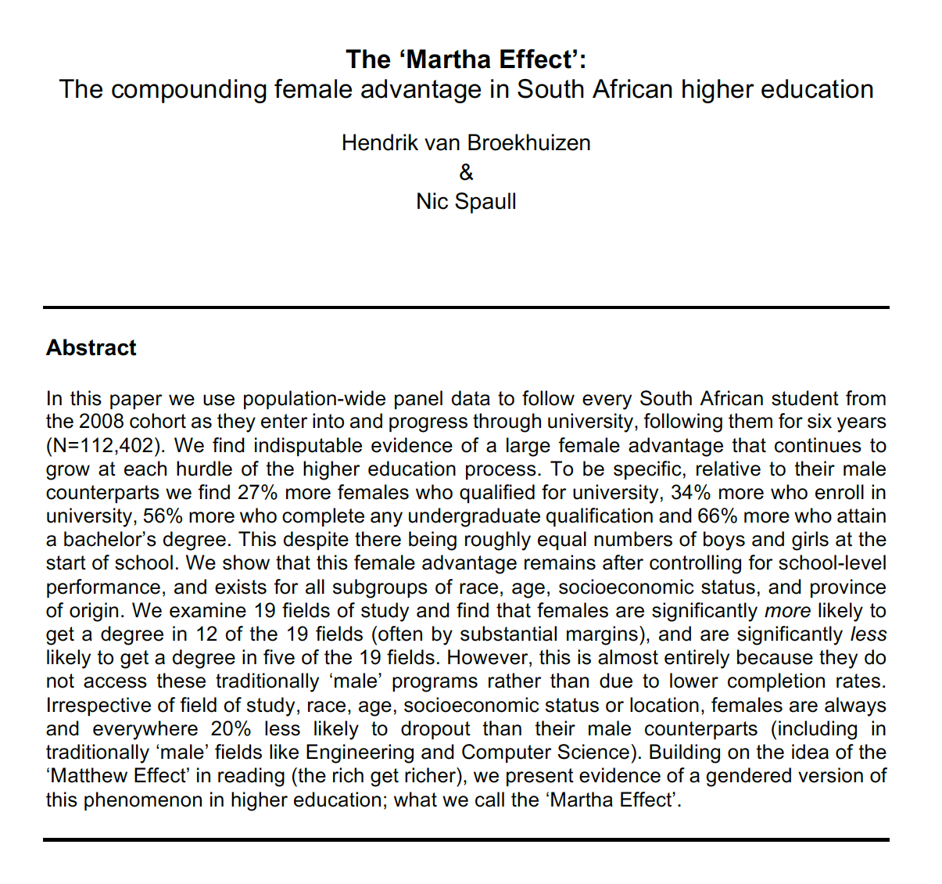
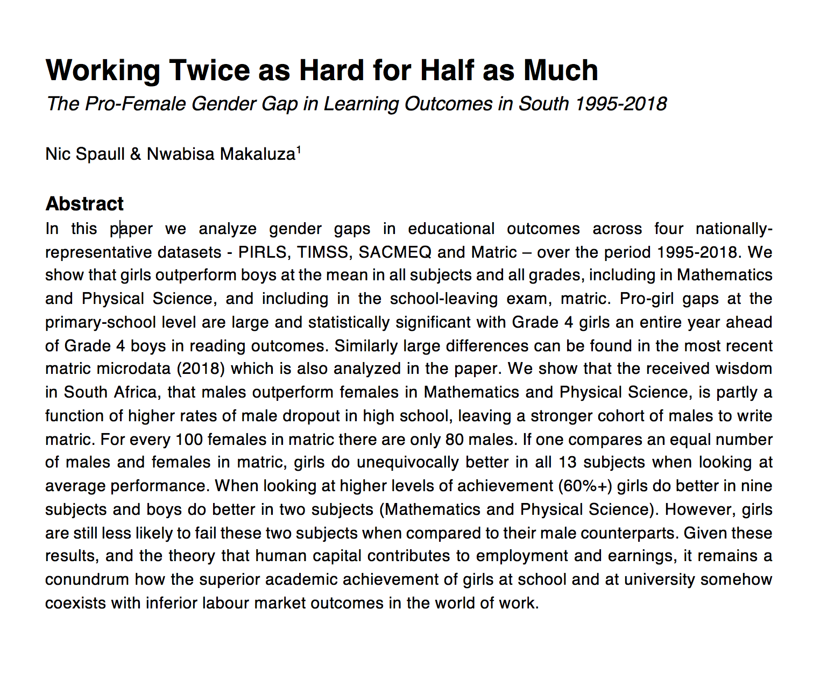
Two papers looking at this topic from an empirical point of view…
University
Schooling

Slide 6

Cf: Columbia University

Slide 7
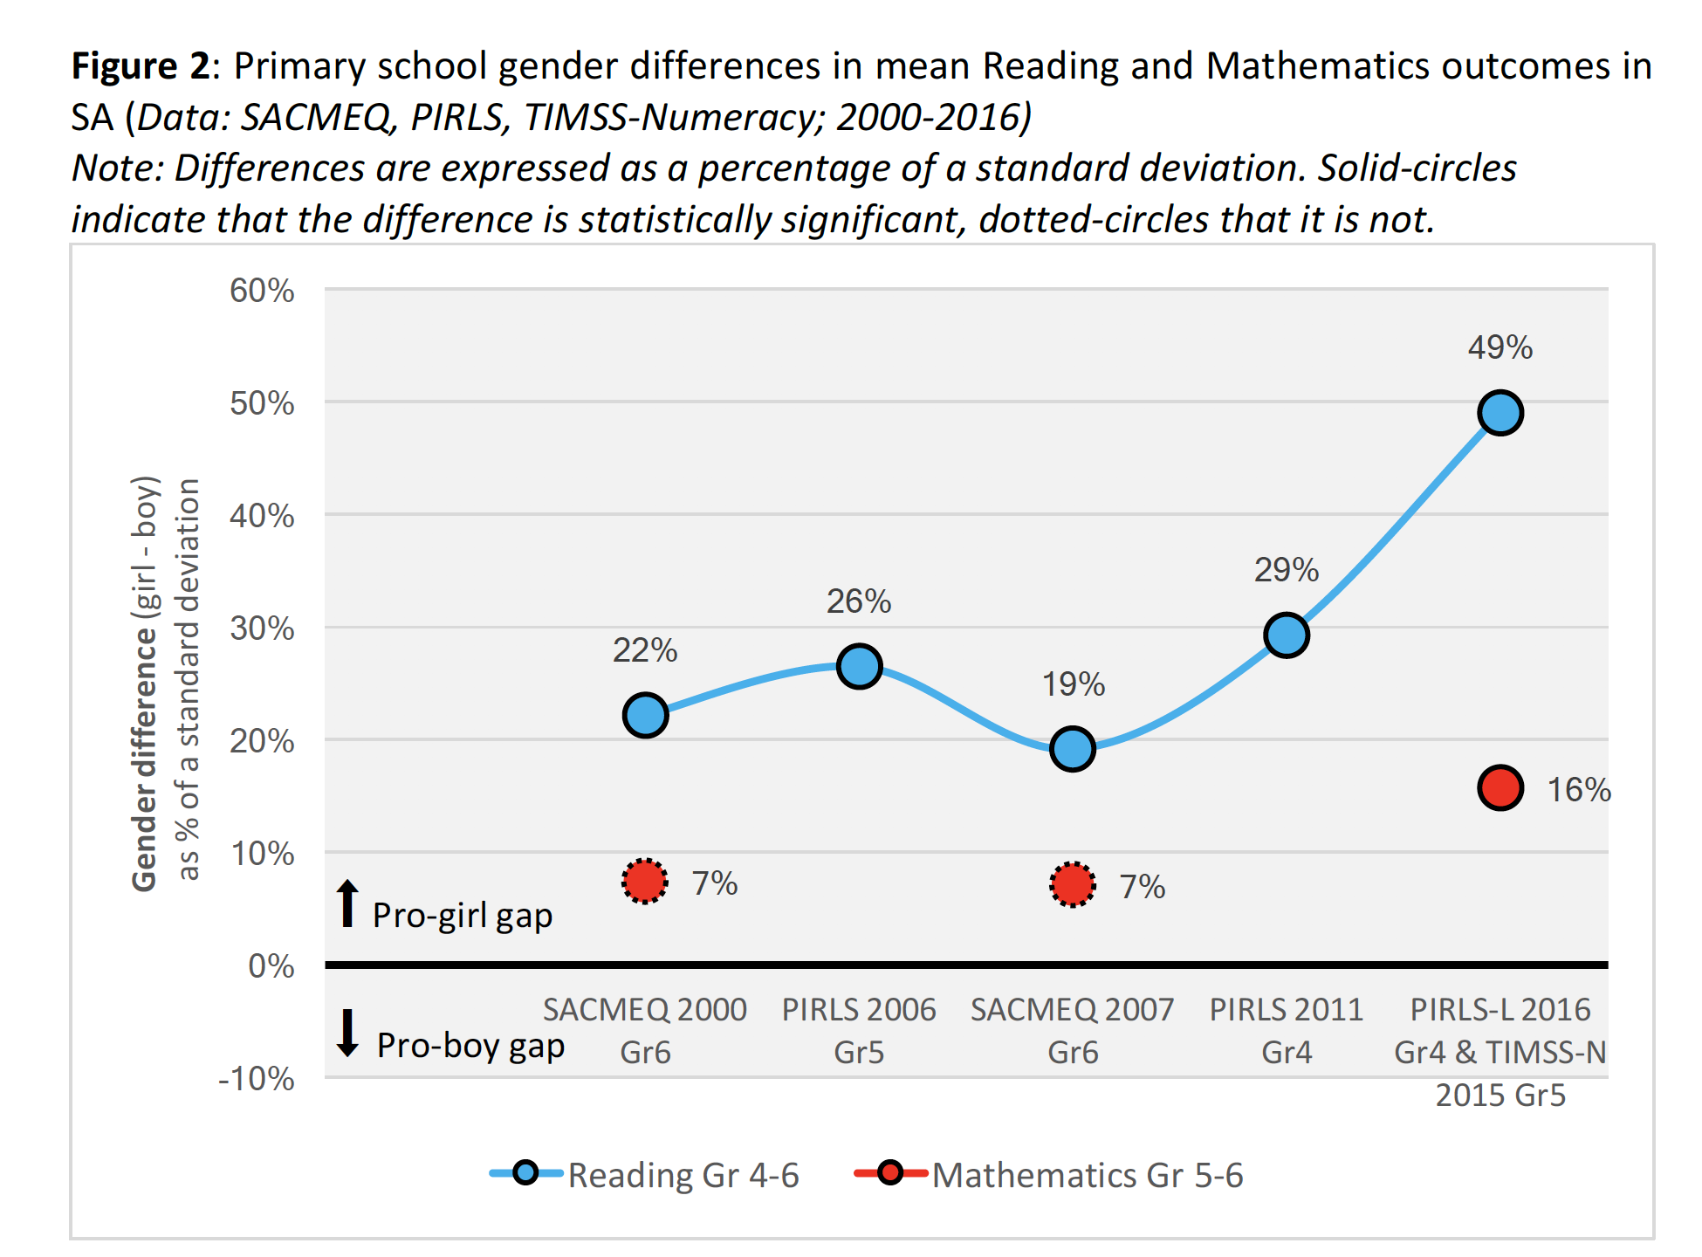
Do girls perform better than boys at the primary school level (Gr4-6 Reading & Maths)?

Slide 8
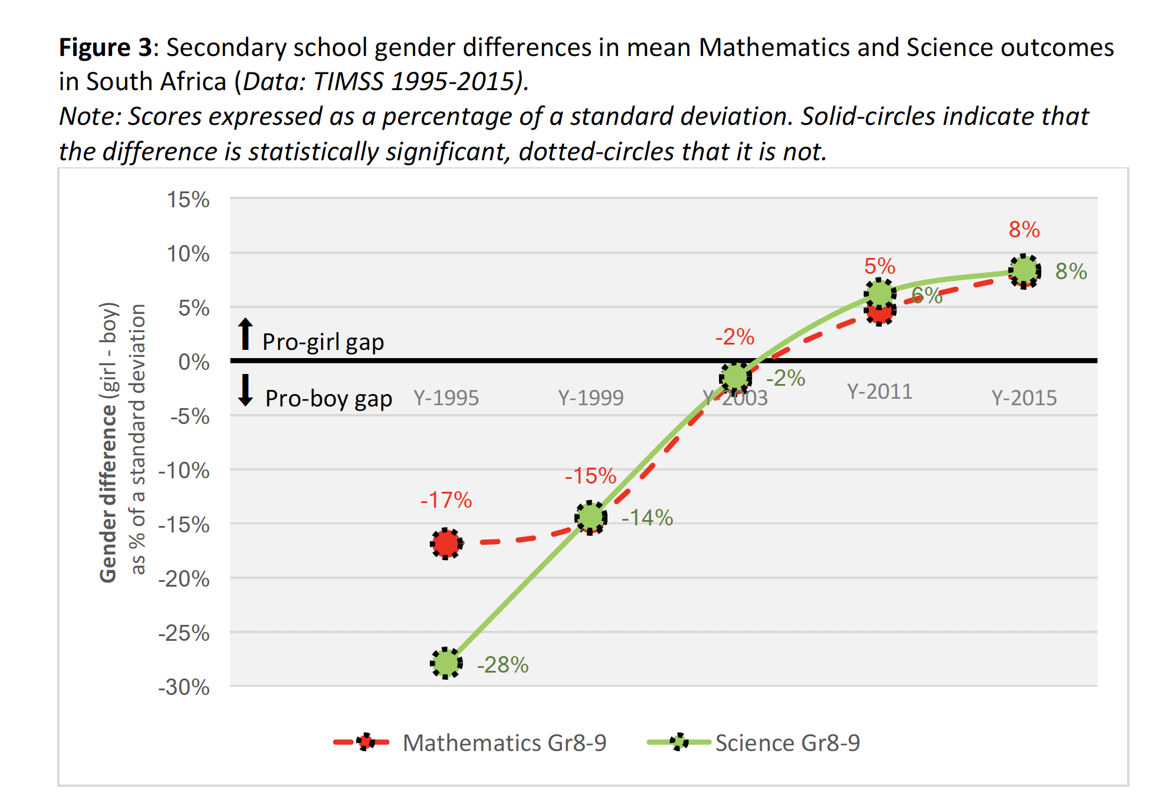
Do girls perform better than boys at the high school level (Gr9 Maths & Sci)?

Slide 9
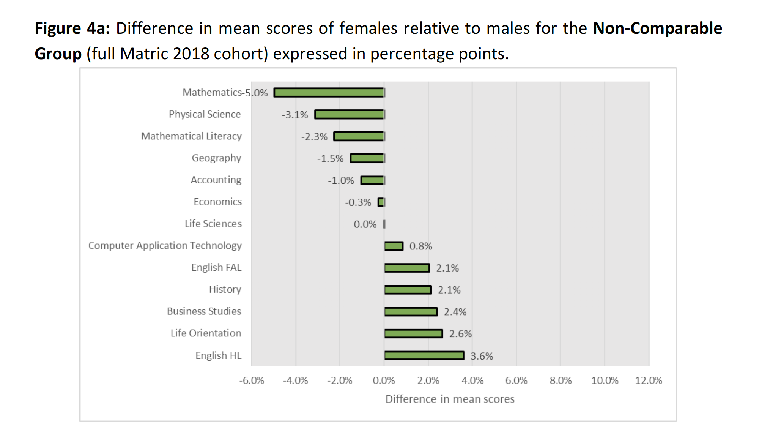
Do girls perform better than boys in matric? (Matric 2018)

Slide 10
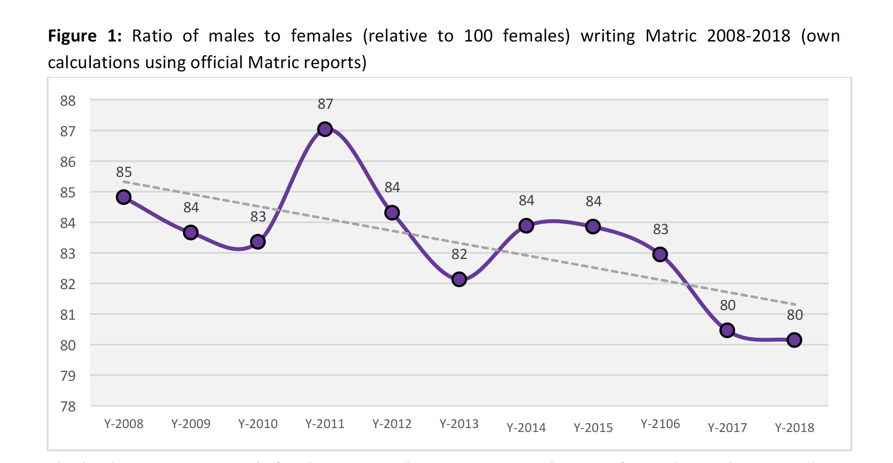

Can we really compare boys and girls in matric?
If not, why not?

Slide 11
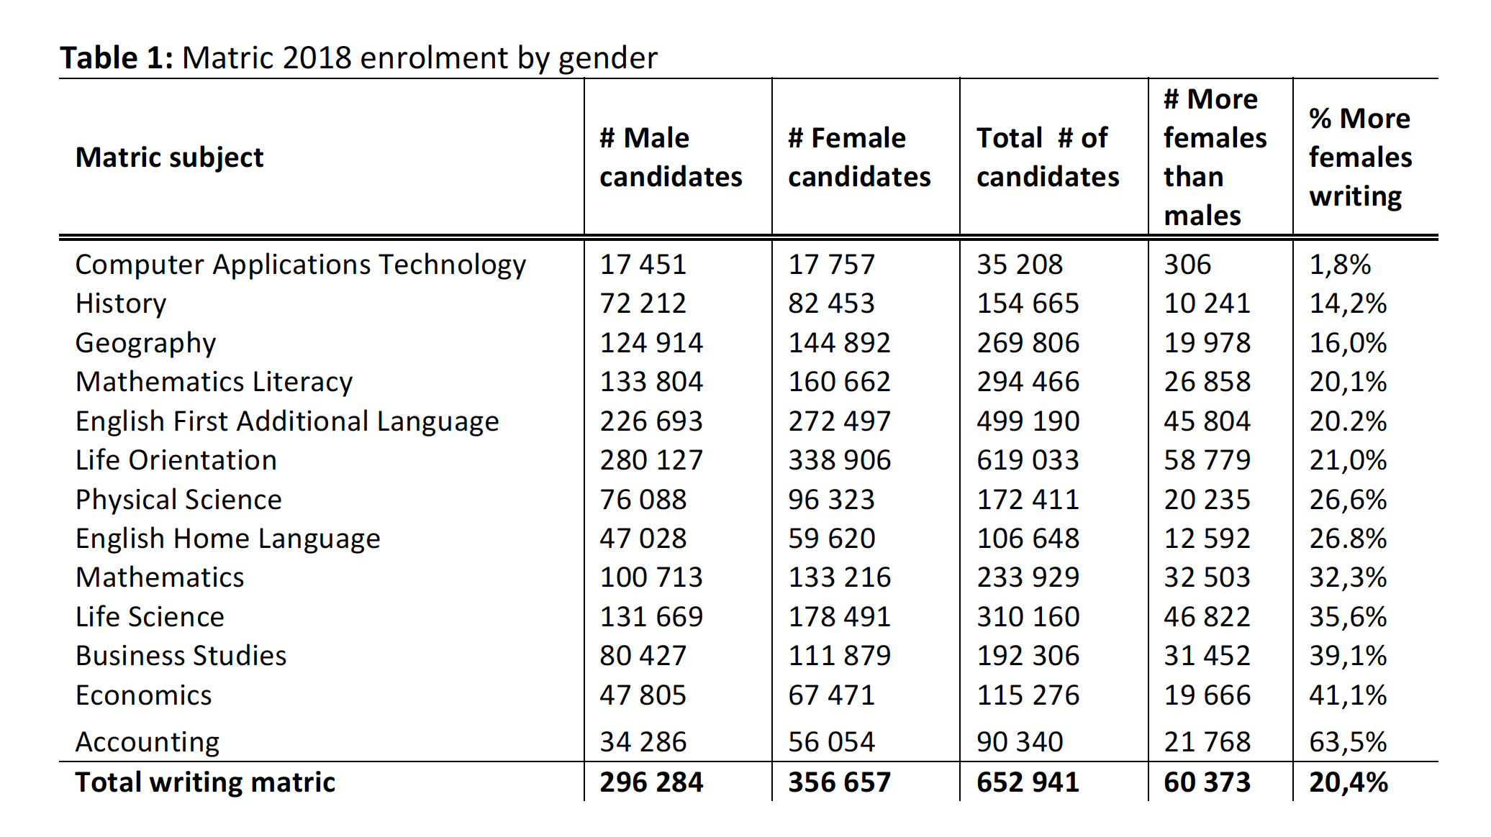
Can we compare boys and girls in matric?
If not, why not?

Slide 12
Sample selection
“The ‘under-representation’ of males in matric has important implications for analysing the matric data since those who drop out are, on average, weaker students (Lambin, 1995; Lewin, 2009). Given that males drop out at higher rates than females, the resulting male cohort in matric is a more selective one than the female cohort (Perry, 2003).”
(Spaull & Makaluza, 2019: p.3)
“Lam et al. (2010: 3) show that in the Western Cape “girls move through school faster than boys, with female schooling exceeding male schooling by about one full grade among recent African cohorts who have finished schooling.” Using population-wide panel data for the same province, Van Wyk et al. (2017: 20) follow all grade six learners in the Western Cape (N=77,633) over the period 2007-2013. They find that males are 29% more likely to have dropped out of school by 2013 compared to their female counterparts (male dropout rate: 48%, female dropout rate: 37%).” (p3)

Slide 13
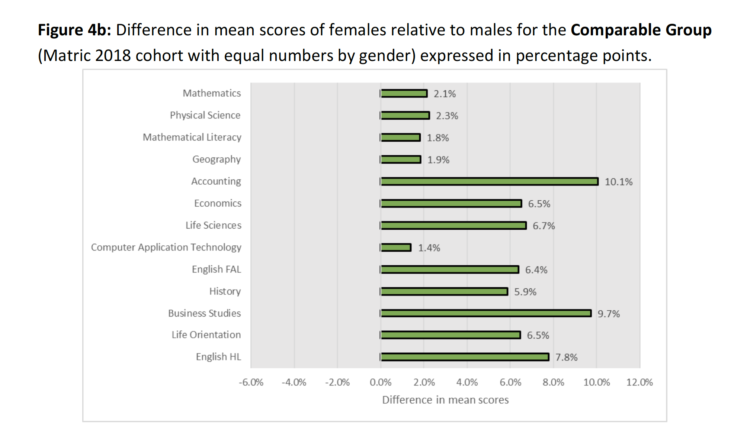
i.e. comparing the best performing 100,713 girls and the best performing 100,713 girls in mathematics

Slide 14
But this is at the “mean” (average)
What about at the bottom and the top?
Do the ‘bottom’ girls perform better/worse than the ‘bottom’ boys
Do the ‘top’ girls perform better/worse than the ‘top’ boys?

Slide 15
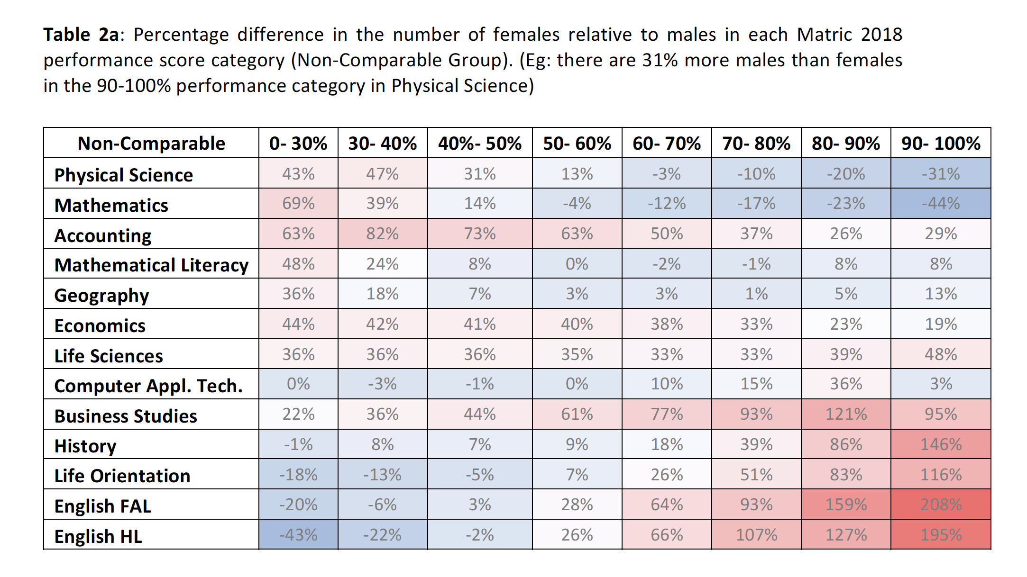
How do boys & girls perform at different parts of the performance distribution?
More boys in the top of the maths & science distribution
More girls failing
Blue = more boys
Red = more girls
195% more girls achieving 90-100% in English-HL than boys achieving 90-100% in English-HL

Slide 16
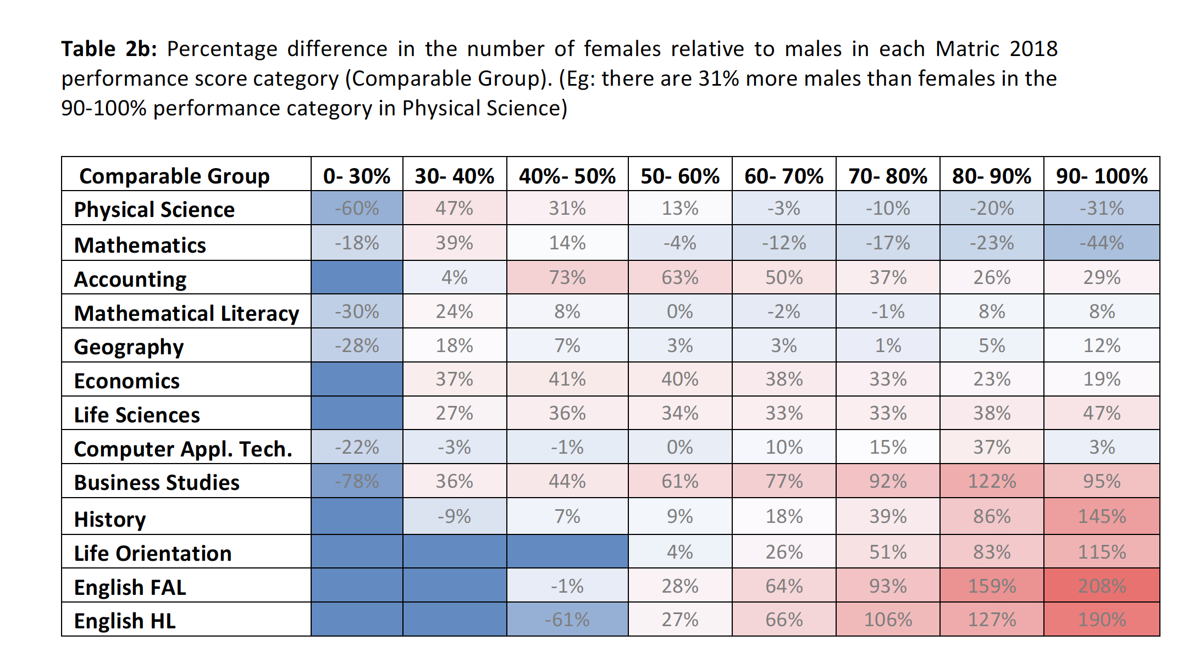
How do boys & girls perform at different parts of the performance distribution?
After making a comparable group of boys and girls we find that in Matric 2018, boys still outperform girls from the 60%+ level in mathematics and science.
Girls outperform boys virtually every else.

Slide 17
What about university?

Slide 18
High-level findings
Figure 1: The percentage more females than males from the 2008 NSC Cohort (N=112,402) attaining higher education outcomes (2009-2014) (For corresponding figures see Table 1)

Slide 19

Findings (1)
National HE outcomes by gender (2008 NSC cohort)
Figure 1: National higher education outcomes by gender (2008 NSC Cohort)

Slide 20
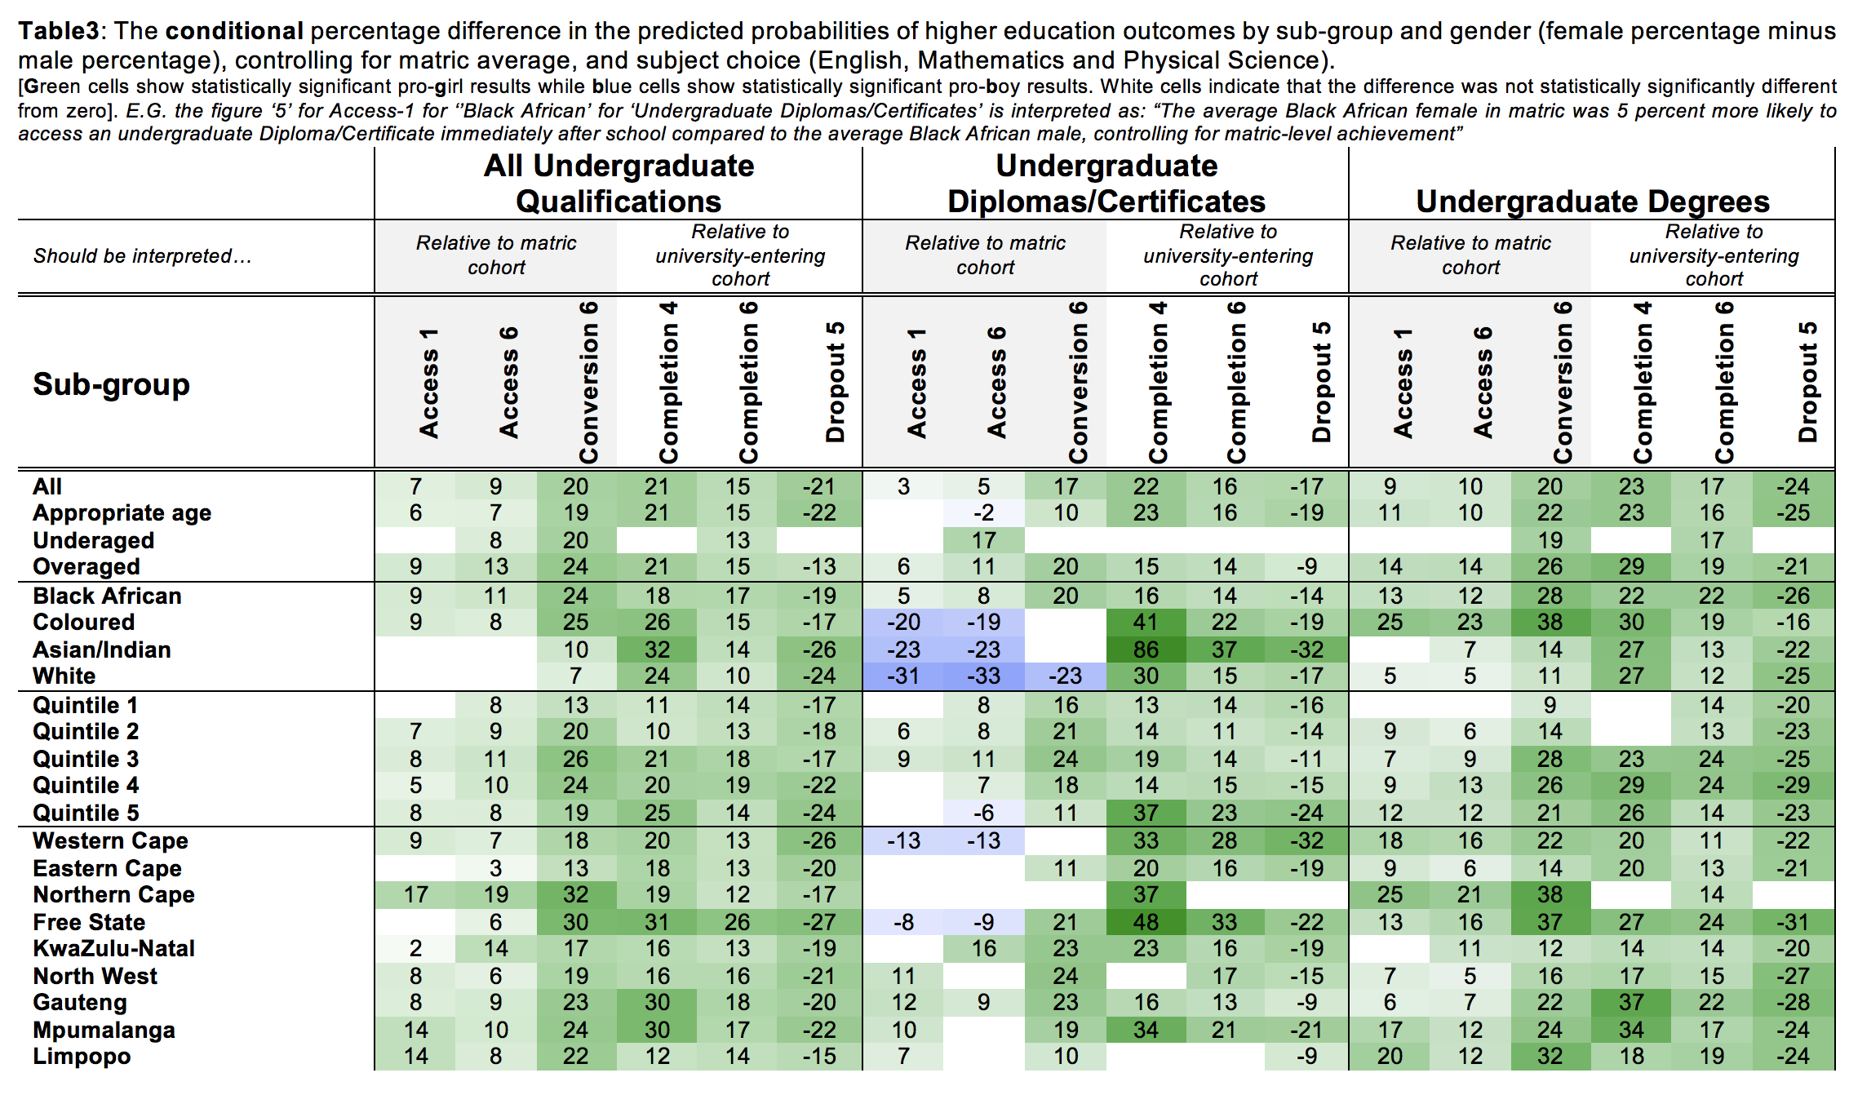
Conditional

Slide 21
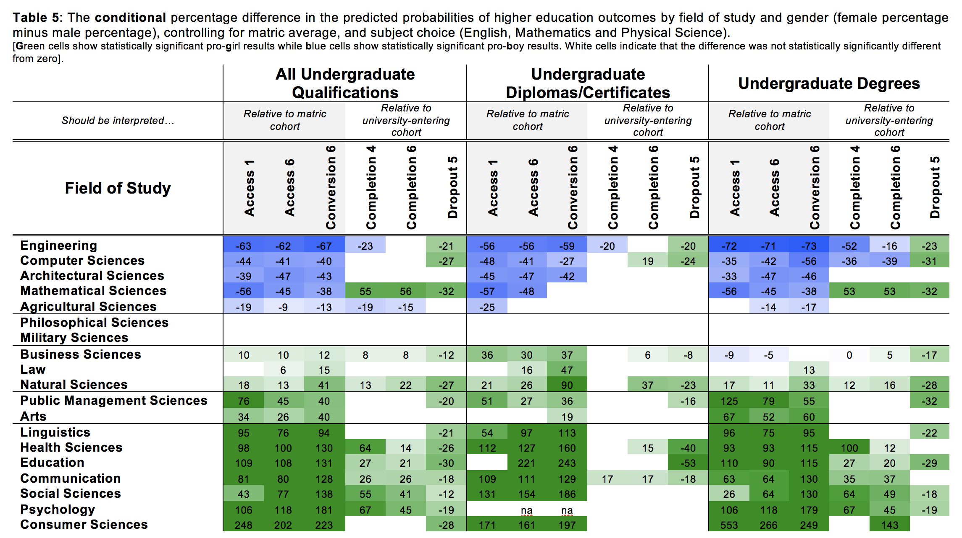
Conditional

Slide 22
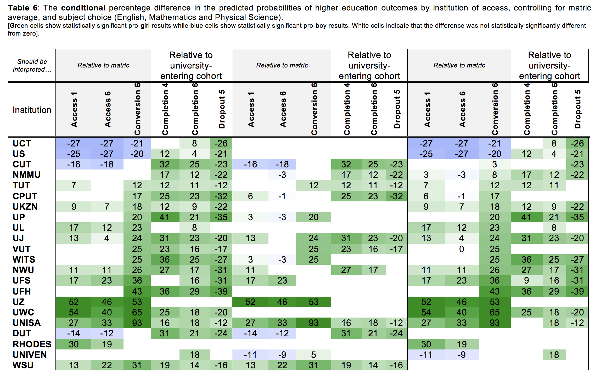

Slide 23
The gender conundrum in SA…
“It remains a conundrum how the superior academic achievement of females at school and university somehow coexists with inferior labour market outcomes, even in high-status programs like Law, Medicine and Business Studies where the female academic advantage is large and unequivocal.”
The labour-market:
The broad unemployment rate for women was 41% compared to 34% among men (StatsSA, 2018).
A recent study by Mosomi (2019) found that the median wage gap between men and women ranges from 23% to 35% over the period 1995 to 2015

Slide 24
Possible reasons for the disconnect?
“Firstly, it is possible that there are (1) High returns to non-academic attributes. If labour-market success is not primarily driven by human capital endowments (at least not endowments proxied by learning outcomes) and if wages and employment are driven by characteristics such as risk-tolerance, confidence and gendered social networks – this might explain part of the male premium in the labour market. (2) Gender discrimination in the workplace: Even if academic performance is a significant factor influencing employment and pay, it may be mitigated by gender discrimination in hiring practices and routes to promotion. Lastly, it is likely that (3) Patriarchal norms in society and gendered family roles affect who is hired and who is promoted in the workplace. In South Africa women are legally entitled to four months maternity leave while men are only entitled to 10 days paternity leave. Laws such as these codify who is removed from the labour market and when. Promotions typically begin (and continue) after 3-6 years in the working world, yet this is usually the same period that women are leaving the labour-market to care for new-born children.
While women are breast-feeding at home, men are promoted at work.
It is not our aim to prove these hypotheses, or to convince the reader of their veracity or plausibility, only to generate possible lines of future enquiry.

Slide 25
“I ask no favors for my sex. I surrender not our claim to equality. All I ask of our brethren is, that they will take their feet from off our necks, and permit us to stand upright on that ground which God designed us to occupy.”
-Sarah Grimké
Letter 2 (July 17, 1837).

Slide 26
What is the question you want to answer?
  Do girls do better than boys in learning outcomes at school & university?
Why should we care?
  Why is it that girls perform better at school but worse in the labour market?
What do you have to say about the problem that is new?
  Documenting the extent of pro-female achievement at school and university
Why should we believe you?
  Unless you don’t trust the data, this is simply reporting what the data shows.
How convinced should we be?
  Very ☺
In what way should we change or view of the world due to your work?
  Evidently female underperformance in the labour-market isn’t driven by female underperformance at school

Slide 27

Comments / Questions?
NicSpaull@gmail.com nicspaull.com/research
https://www.ekon.sun.ac.za/wpapers/2017

Slide 28
Literature
58% of bachelor’s degrees were awarded to women in OECD countries in 2014 (35 countries)
  European Union (60%)
  South Africa (61%) (OECD, 2016: 71).
Over 1985-2005 there was a 20% increase in % of women in higher education (Vincent-Lancrin (2008) (46%-55%)
In US driven by changing gender norms and rising female expectations of labor force participation (see also Diprete & Buchmann, 2006; Goldin, 2006).

Slide 29
Literature
Reasons for the increase?
Higher female post-secondary expectations (Fortin et al., 2014; OECD 2015)
Superior pre-university achievement (Conger & Long, 2010; Ewert, 2010)
Different choices in fields of study between men and women (Charles & Bradley, 2002; Alon & Gelbgiser, 2011).
Females have more and/or better non-cognitive* skills and thus have lower ‘total costs’ for education (Becker et al., 2010), Heckman et al., 2006: 420; Jacob, 2002; Duckworth & Seligman, 2005).
While this is interesting and important, this is NOT the focus of this paper. We want to measure it not explain it.
*Self-control, self-motivation, dependability, sociability, perceptions of self-worth, locus of control, time-preference and delayed gratification

Slide 30
Data
We use population-wide panel data to follow every South African student from the 2008 cohort as they enter into and progress through university, following them for six years (N=112,402).
Matric 2008: The 2008 National Senior Certificate (NSC) examinations data from the Department of Basic Education South Africa. This contains learner-level unit-record information for all grade 12 learners in South Africa who wrote the matric exam in 2008 (561,667 learners); and
HEMIS 2009-2014: Data on university outcomes for all learners who then accessed any type of higher education between 2009 and 2014 (112,402 learners), sourced from the Higher Education Management Information System (HEMIS) of the Department of Higher Education and Training South Africa (DHET).
If this is not a sample why are there standard errors? We see the 2008 matric cohort as a sample of all matric cohorts (and also we think there may be some measurement error).

Slide 31
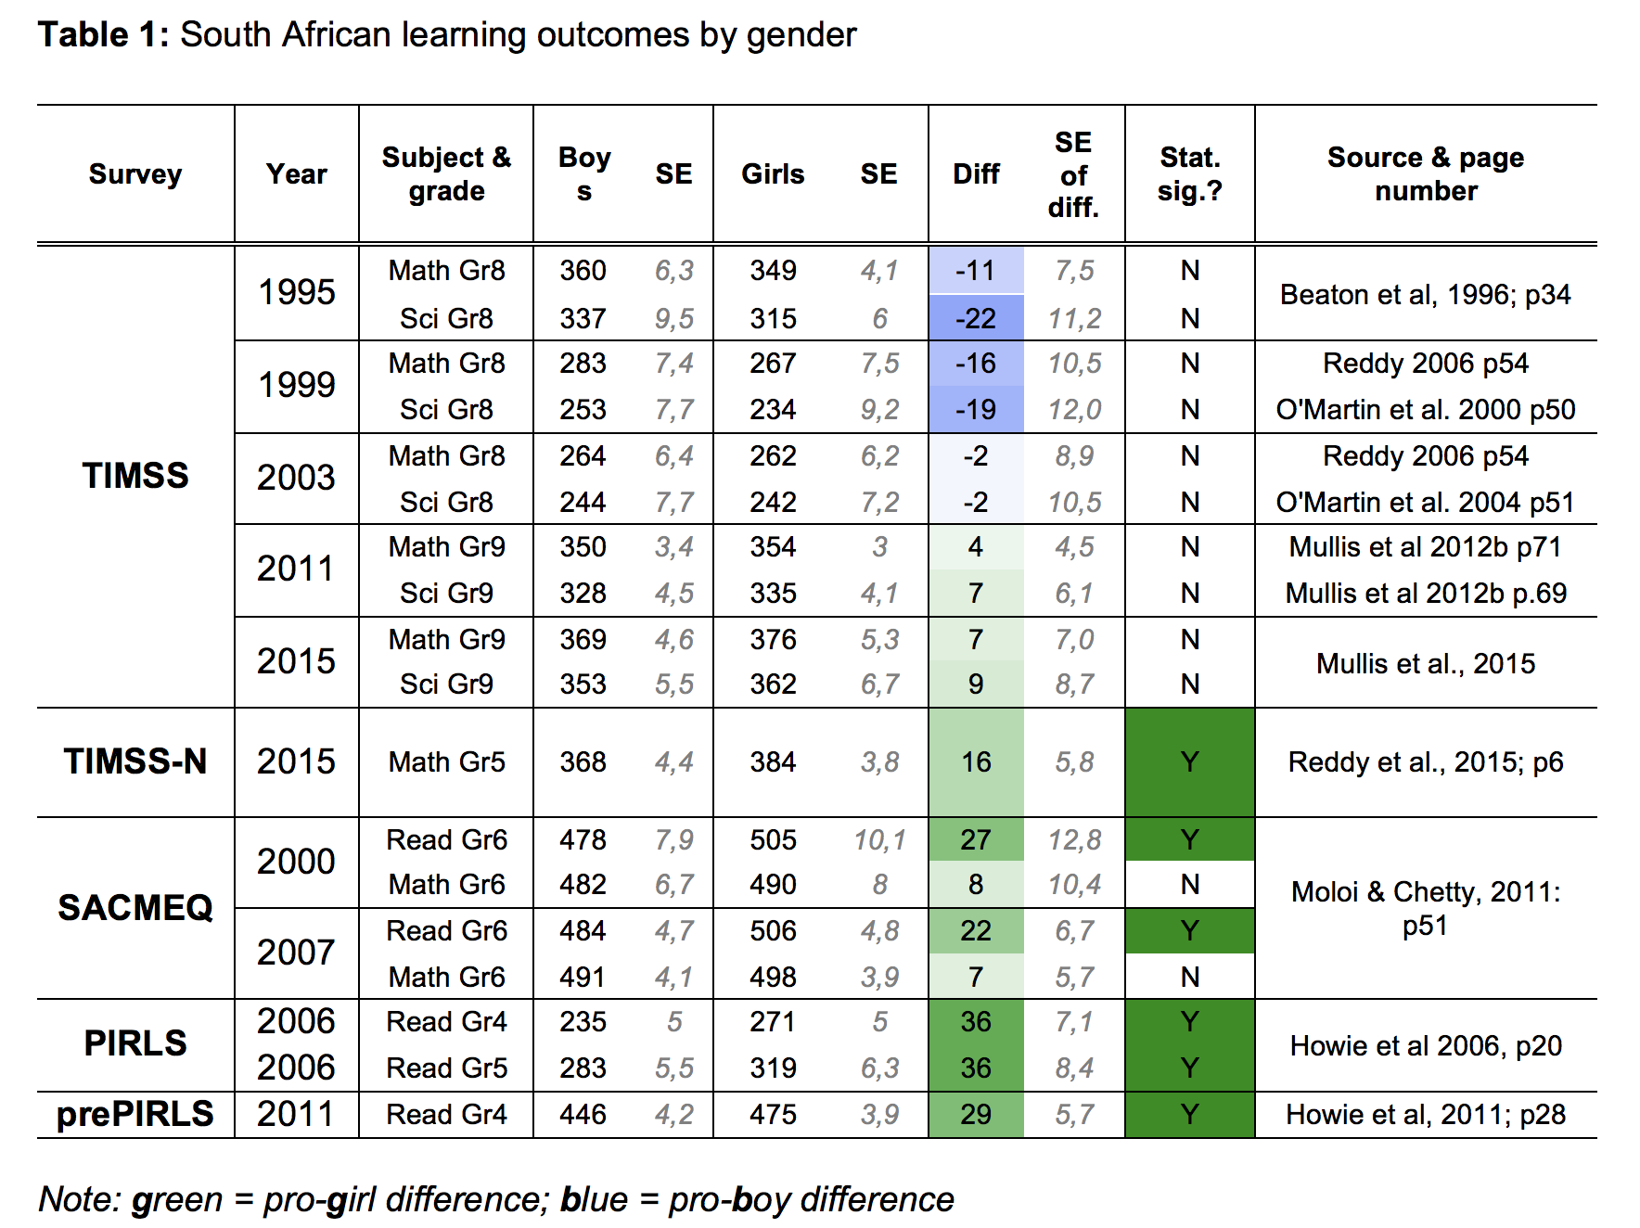
School-level differences by gender
Achievement in cross-national assessments

Slide 32
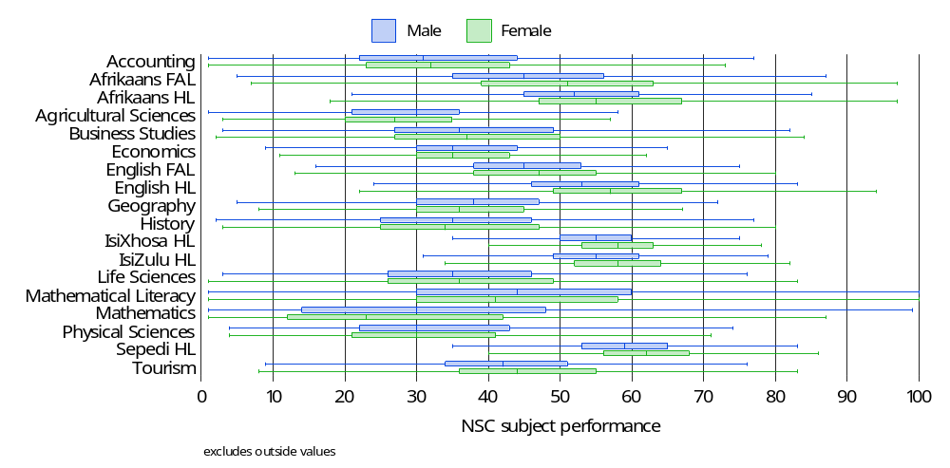
School-level differences by gender
Achievement in NSC 2008
Figure 1: Box plots of subject performance by gender in the 2008 NSC

Slide 33
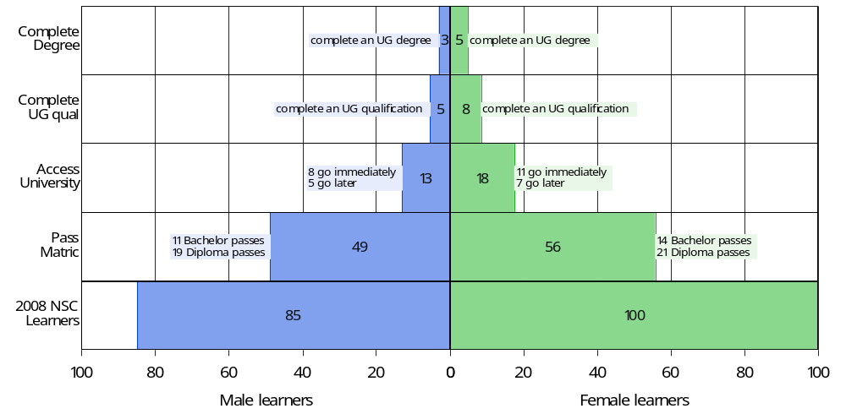
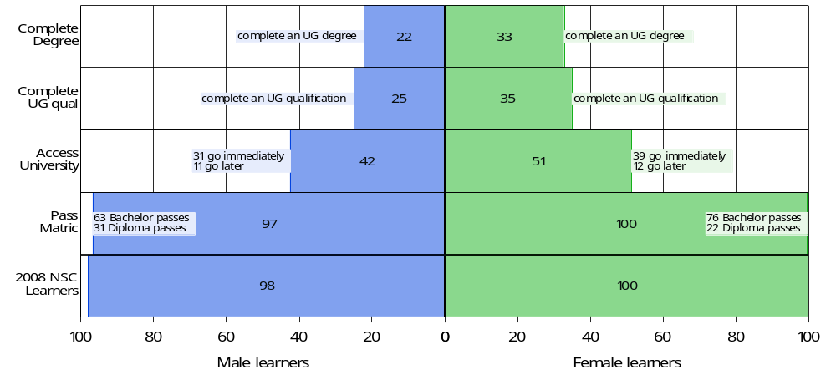
Black African cohort
White cohort

Slide 34
Acknowledgements
The authors would like to thank the Department of Basic Education (DBE) and the Department of Higher Education and Training (DHET) who were jointly responsible for the provision of the NSC and HEMIS databases used in this research.

Slide 35
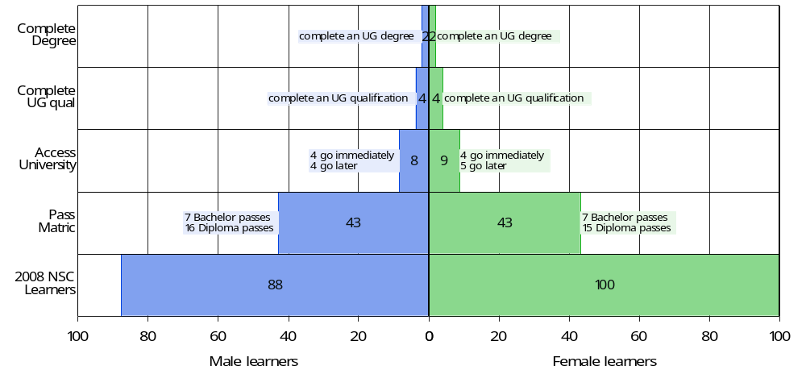
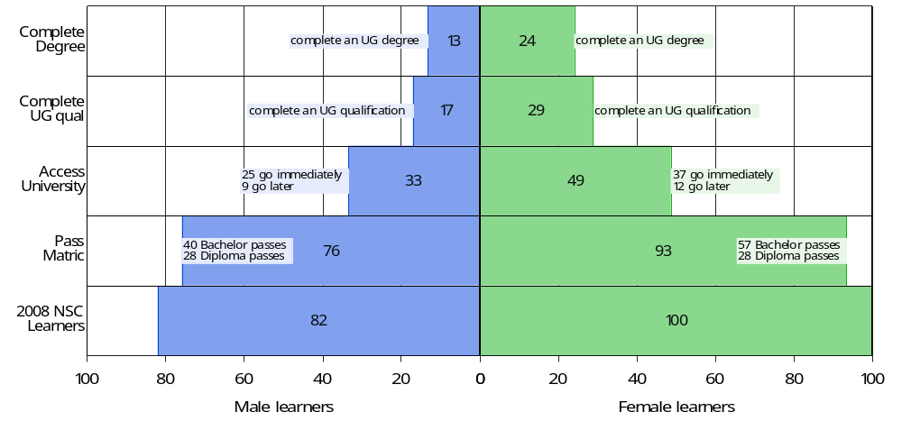
School Quintile 1 cohort
School Quintile 5 cohort

Slide 36
% of matric cohort attaining UG degrees

Slide 37
Defining higher education outcomes
One-year access rate (Access-1): the percentage of learners from the 2008 NSC cohort who accessed university immediately (2009) after finishing school (2008). [The average female matric learner in 2008 was 17 percent more likely to access university immediately after school than the average male matric learner.]
Six-year access rate (Access-6): the cumulative percentage of learners from the 2008 NSC cohort who accessed university at any time within the six-year period following matriculation in 2008, i.e. during 2009-2014. [The average female matric learner in 2008 was 14 percent more likely to access university within six years of finishing school than the average male matric learner.]
Six-year conversion rate (Conversion-6): The percentage of learners from the 2008 NSC cohort who enrolled in and completed an undergraduate university programme within six years (2009-2014). [The average female matric learner in 2008 is 33 percent more likely to access university and complete an undergraduate qualification within six years compared to the average male matric learner.]
Four-year completion rate (Completion-4): The percentage of students who accessed university in 2009 who complete their undergraduate programme within four years (2009-2012). [The average female university entrant in 2009 from the 2008 NSC cohort was 26% more likely to complete an undergraduate qualification within four years compared to the average male university entrant in 2009 from the 2008 NSC cohort.]
Six-year completion rate (Completion-6): The percentage of students who accessed university in 2009 who complete their undergraduate programme within six years (2009-2014). [The average female university entrant in 2009 from the 2008 NSC cohort was 16% more likely to complete an undergraduate qualification within six years compared to the average male university entrant in 2009 from the 2008 NSC cohort.]
Five-year dropout rate (Dropout-5): The percentage of students who accessed university in 2009 who drop out of the higher education system at some point in the subsequent five years (20010-2014). [The average female university entrant in 2009 from the 2008 NSC cohort was 20% less likely to dropout of university during the 2010-2014 period compared to the average male university entrant in 2009 from the 2008 NSC cohort.]

Slide 38
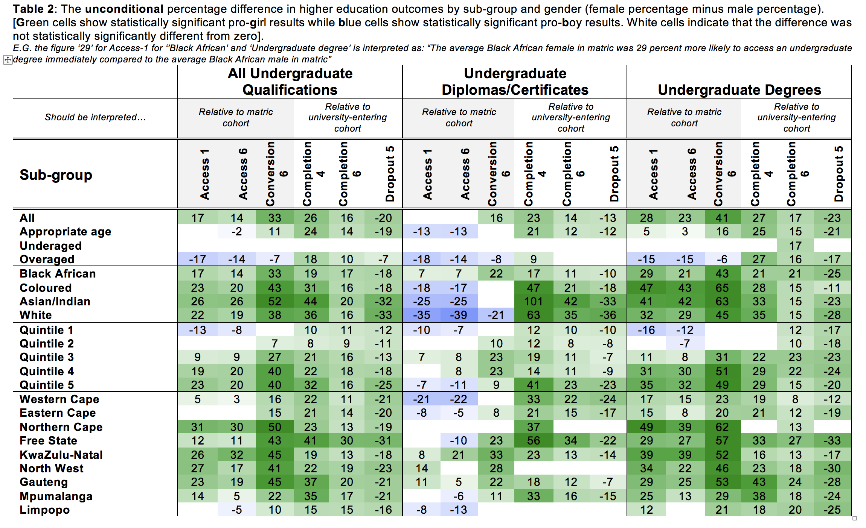
How we report the results:
For sake of space we only report DIFFERENCES between female rate and male rate
Note PERCENTAGE not PERCENTAGE POINTS
Unconditional estimates only report the percentage difference between males & females (females – males as %)
Example:
  Access1 males = 11,9%
  Access1 females = 13,9%
  Unconditional difference = (13,9% - 11,9%)/11,9% = 17%
i.e. females are 17% more likely to access an UG qualification immediately compared to their male counterparts
Throughout: green-cells = pro-girl and stat. sig.
blue cells = pro-boy and stat. sig.

Slide 39
Unconditional
Throughout: green-cells = pro-girl and stat. sig.
blue cells = pro-boy and stat. sig.

Slide 40
What happens after controlling for matric achievement?

Slide 41
In conditional predictions what are we controlling for?
The conditional results (Table 3 and Table 5) control for five variables:
  matric pass type,
    The five pass types in increasing order of achievement are (1) not achieved, (2) Pass National Senior Certificate (NSC), (3) Pass NSC with Higher Certificate endorsement, (4) Pass NSC with Diploma endorsement, and (5) Pass NSC with Bachelor endorsement.
  matric average (similar to the American Grade Point Average),
  whether one took Mathematics or Mathematics literacy,
  whether one took English Home Language or English First Additional Language, and
  whether one took Physical Science or not In this paper, the matric average refers to the average across the six highest marks that a learner achieved among the subjects that they took in the NSC exam, provided that those subjects collectively satisfy the requirements for the NSC as described by the Department of Basic Education (DBE, 2010: 3 – 5).

Slide 42
How we report the results:
396 sub-group regressions (6 outcomes, 22 sub-groups, qualification type)
342 field of study regressions (6 outcomes, 19 FOS, 3 qualifications types)
Conditional estimates report the percentage difference in the predicted probabilities of higher-education outcomes between males and females (females – males as a %)
Example:
  Predicted probability for Access1 males = 12,5%
  Access1 females = 13,4%
  Unconditional difference = (13,4 – 12,5%)/12,5% = 7%
i.e. after controlling for prior-achievement, females are 7% more likely to access an UG qualification immediately compared to their male counterparts
Unconditional

Slide 43
Unconditional
Conditional

Slide 44
Is it because of differences in choice of field of study?
(Charles & Bradley, 2002; Alon & Gelbgiser, 2011).

Slide 45
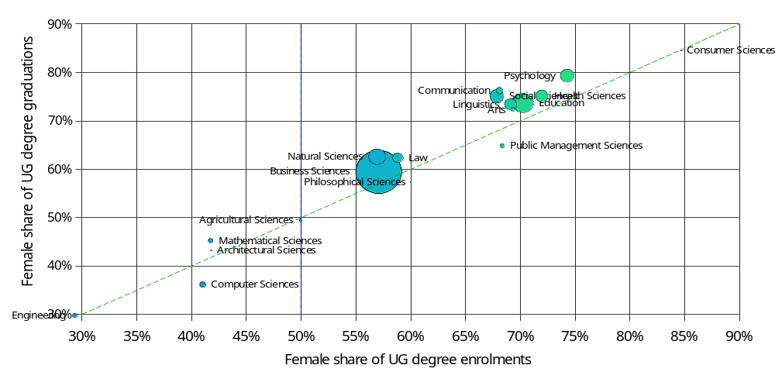
Is it because they enroll in different degrees?
Figure 9: Female share of undergraduate degree enrolments and graduations by field of study

Slide 46
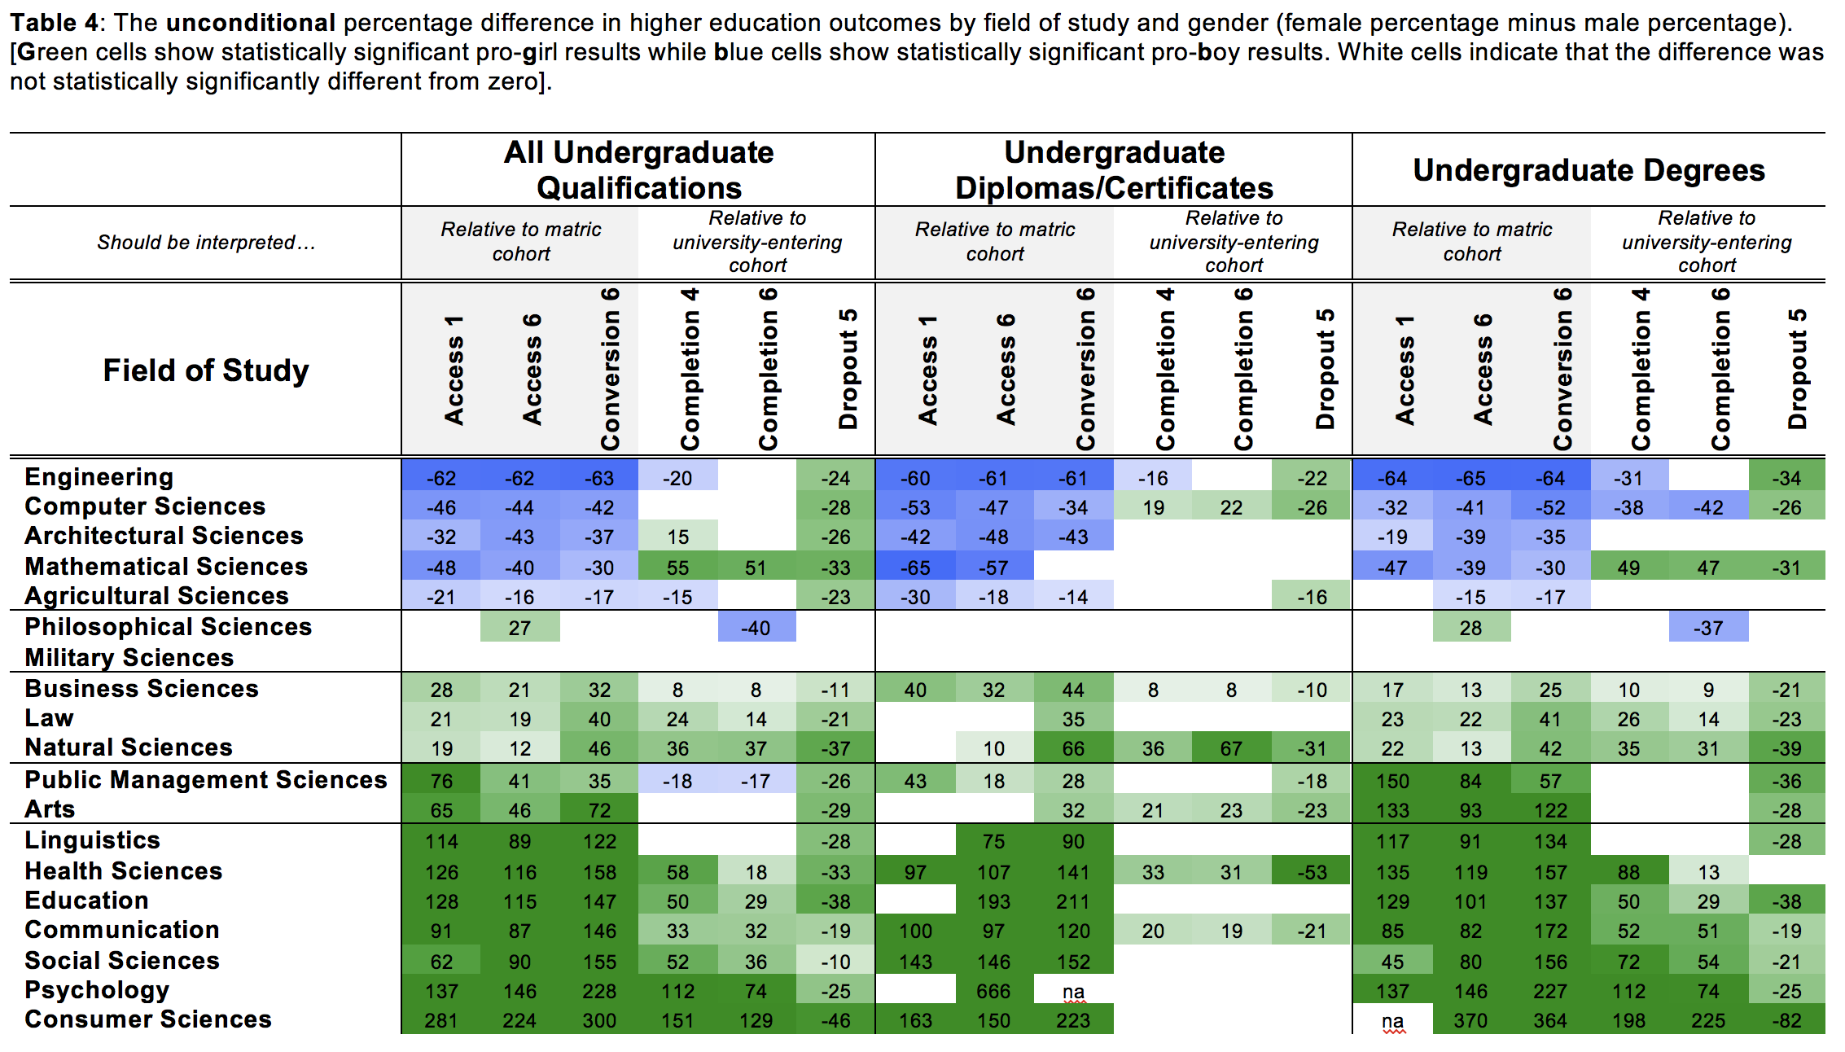
Unconditional

Slide 47
Unconditional
Conditional

Slide 48
6 Main findings
The six most important findings of the analysis are listed below:
Overall: After controlling for pre-university achievement females are 20% more likely to access university and graduate with an undergraduate degree in six years than are their male counterparts.
Gendered access: We find much stronger evidence of gendered access effects rather than gendered completion effects. This is both for sub-groups and for fields of study.
Dropout: Relative to their male counterparts, females are always and everywhere 20% less likely to drop out of university programmes. This is not affected by pre-university achievement.
Socioeconomic status: Among the quintiles of socioeconomic school socioeconomic status, only females from the poorest 20-30% of schools do not exhibit an advantage in accessing university. Most pro-female advantages are largest among the wealthiest groups.
Pre-university achievement: A third of the overall female advantage (Conversion-6) can be explained by school-level achievement. However, among the best-performing sub-groups the female advantage is almost entirely (77%) explained by superior school-level achievement.
Gendered fields of study: While it is true that fewer females graduate with a degree in traditionally male fields of study (Engineering, Computer Sciences, Architectural Sciences, Mathematical Sciences and Agricultural Sciences) this is largely because females do not enter these fields, not because they do not do well in them once enrolled.

Slide 49
Conclusions
Still tentative research, but…
Impacts on the labour market?
Understanding male disadvantage?
  School/curriculum structure and its interaction with unevenly distributed non-cognitive skills?
Caveat: This is specifically for those who access university immediately after school. Non-random group. But Access1 and Access4 suggest it won’t change the results massively.

Slide 50
What are the implications of this?
Esping-Anderson (2009: 1):
“The quiet revolution of women’s roles, as Claudia Goldin (2006) calls it, is arguably a close rival to new technologies in terms of its seismic aftershocks touching, directly and indirectly, all major social institutions. And like its rivals, it has not yet come to full maturation. Incomplete revolutions tend to be associated with major disequilibria.”

Slide 51
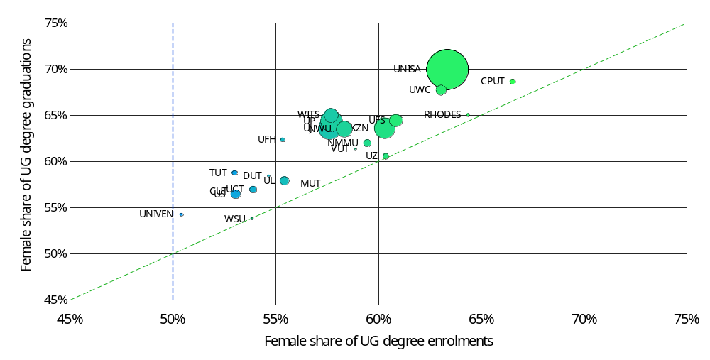
Does this differ by institution of access? (Degrees)
Figure 10: Female share of undergraduate degree enrolments and graduations by institution

Slide 52
School-level differences by gender
Dropout and progression
Western Cape longitudinal data:
Lam et al (2010: 3) find that “girls move through school faster than boys, with female schooling exceeding male schooling by about one full grade among recent African cohorts who have finished schooling.”
Van Wyk et al (2017: 20) use administrative data and follow all grade six learners in the Western Cape (N=77,633) over the period 2007-2013. They find that males are 29% more likely to have dropped out of school by 2013 compared to their female counterparts (male dropout rate: 47,8%, female dropout rate: 36,7%).
See also Perry (2003)

Slide 53
Abstract
In this paper we use population-wide panel data to follow every South African student from the 2008 cohort as they enter into and progress through university, following them for six years (N=112,402). We find indisputable evidence of a large female advantage that continues to grow at each hurdle of the higher education process. To be specific, relative to their male counterparts we find 27% more females who qualified for university, 34% more who enroll in university, 56% more who complete any undergraduate qualification and 66% more who attain a bachelor’s degree. This despite there being roughly equal numbers of boys and girls at the start of school. We show that this female advantage remains after controlling for school-level performance, and exists for all subgroups of race, age, socioeconomic status, province of origin or institution attended. We examine 19 fields of study and find that females are significantly more likely to get a degree in 12 of the 19 fields (often by substantial margins), and are significantly less likely to get a degree in five of the 19 fields. However, this is almost entirely because they do not access these traditionally ‘male’ programs rather than due to lower completion rates. Irrespective of field of study, race, age, socioeconomic status, location or institution, females are always and everywhere 20% less likely to dropout than their male counterparts (including in traditionally ‘male’ fields like Engineering and Computer Science). Building on the idea of the ‘Matthew Effect’ in reading (the rich get richer), we present evidence of a gendered version of this phenomenon in higher education; what we call the ‘Martha Effect’.

Slide 54
Findings (1)
Socioeconomic status
The poorest females are the only group not to exhibit an advantage in accessing degrees
Female access and completion advantages are largest for wealthiest students
Access
Half of the female access advantage is explained by prior-achievement
Racial differences in accessing Diplomas/Certificates
Provincial differences in accessing degrees

Slide 55
Findings (2)
Completion
The female completion advantage cannot be explained by prior academic achievement
Females are considerably more likely to complete their qualification in 4 years rather than 6 years
Conversion
A third of the overall female advantage can be explained by prior academic achievement and most of the female advantage (76-78%) among top-achieving females can be explained by school-level achievement

Slide 56
Findings (3)
Completion
The female completion advantage cannot be explained by prior academic achievement
Females are considerably more likely to complete their qualification in 4 years rather than 6 years
Conversion
A third of the overall female advantage can be explained by prior academic achievement and most of the female advantage (76-78%) among top-achieving females can be explained by school-level achievement
Dropout
Females are always considerably less likely to dropout (about 20%) and this cannot be explained by prior achievement

Slide 57
Findings (4)
Fields of study
WRT Undergrad degrees: In six of the 18 fields of study, the gender differences in access seen across fields of study do not reappear as completion differences.
Gender determines access more than it does ‘success’ in a degree
Only in Engineering and Computer Sciences are males significantly more likely to complete their degree in four or six years.

Slide 58
School-level differences by gender
Achievement in NSC 2008
Figure 1: Box plots of subject performance by gender in the 2008 NSC

