Slide 1
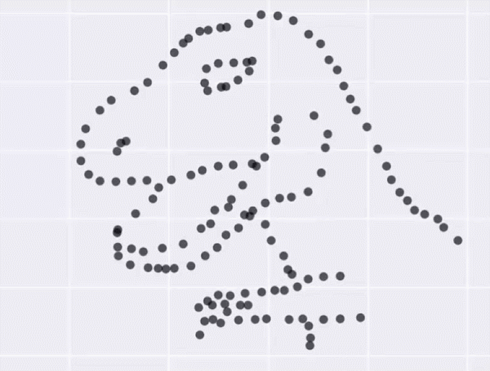
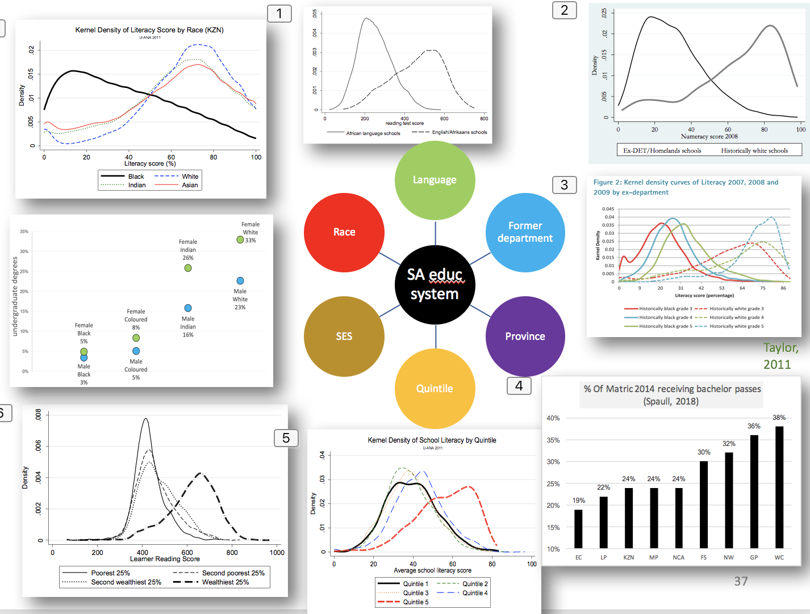
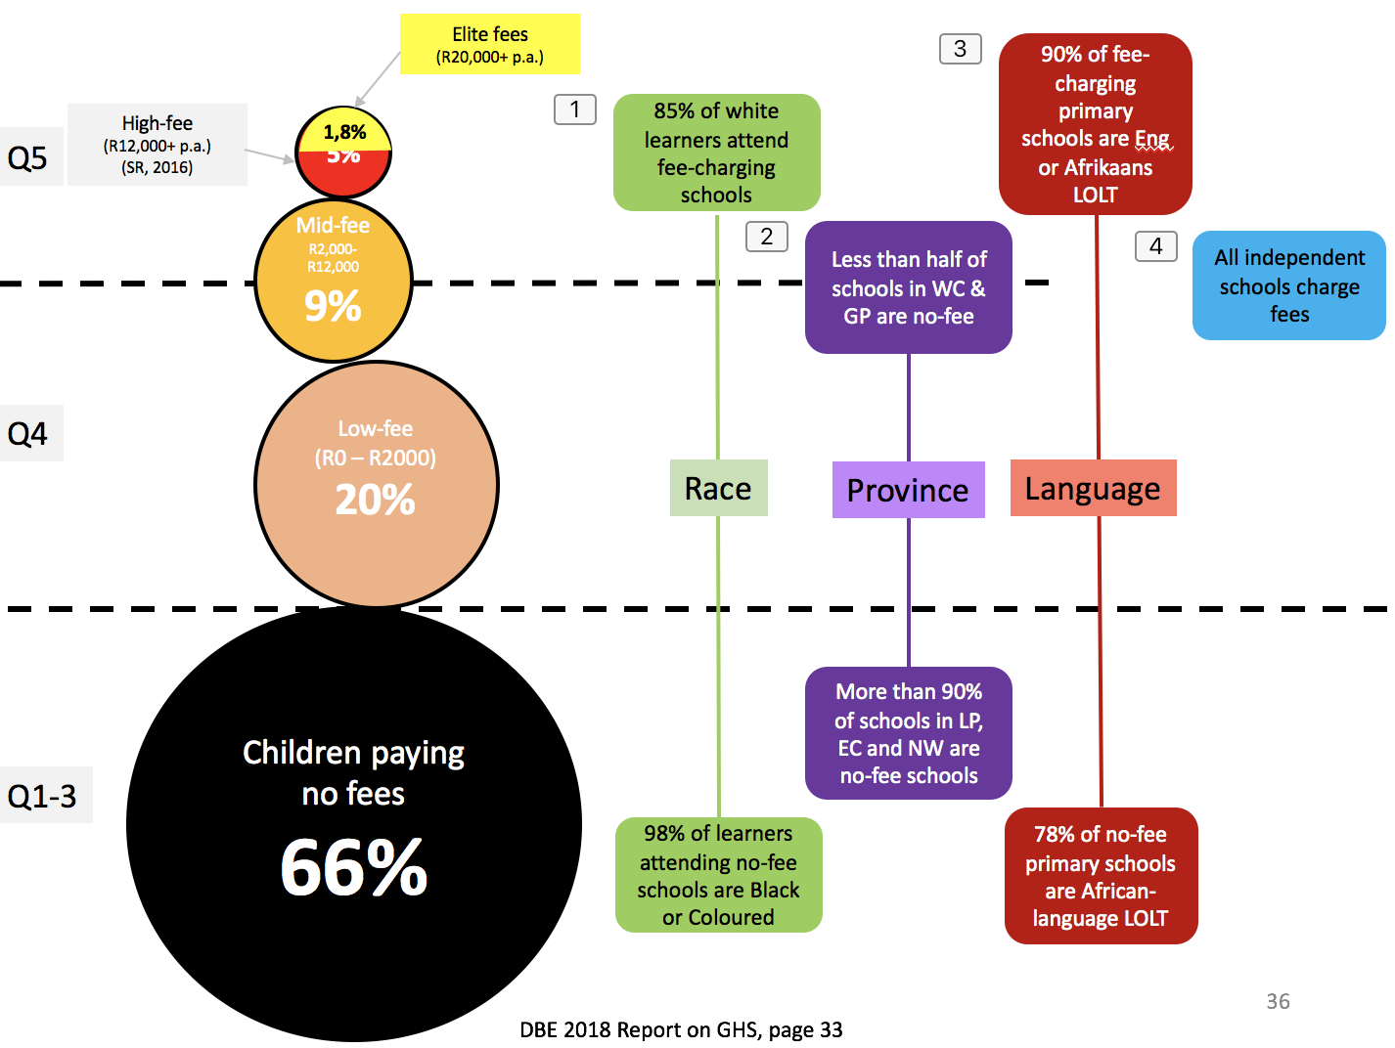


An overview of the SA education system
Nic Spaull
GTAC 2019 Winterschool Economics of Education
9 July 2019
Department of Economics
•
Faculty of Economic and Management Sciences

Slide 2
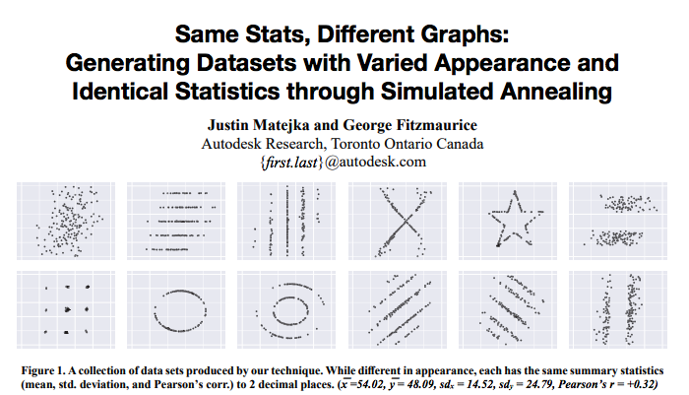
About the dinosaur…
https://www.autodeskresearch.com/publications/samestats

Slide 3
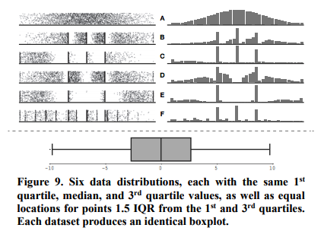
About the dinosaur…

Slide 4

Economics of Education
Bringing an analytical toolbox (and a particular way of thinking) to bear on questions we have about education.
Definition:
“Economics is what economists do.”
– Jacob Viner

Slide 5
Economics of Education:
Data-informed
  “Without data you are just another person with an opinion”
  – Andreas Schleicher
  Source: Does data exist on this? Where to find the data? (Van Wyk, 2015)
  Evaluate: Is it reliable? Is it representative?
  Literature: What publications and reports (public and private) exist on this?
  Methods: What methods have been used to try and answer this question locally and internationally?
  So many contentious positions in South Africa could be ruled out based on 2-hours of engagement with existing data/reports…
    BUT…..

Slide 6
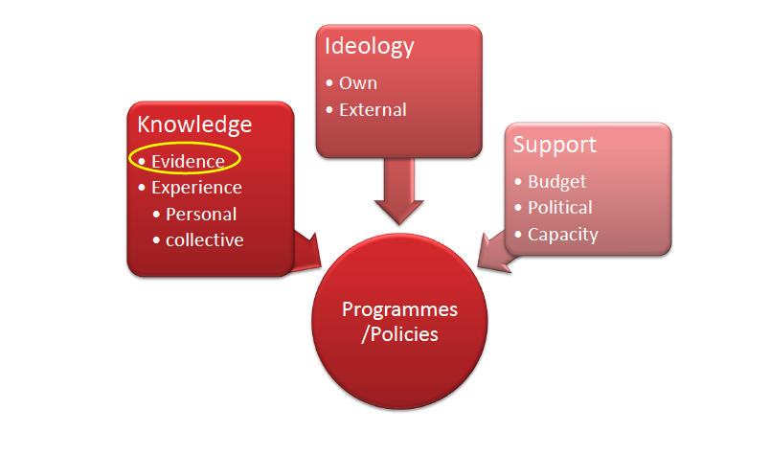
What goes into policymaking?
Knowledge
Ideology
Support
Policy/Programme
Source: JPAL 2017

Slide 7
Introduction – today’s lecture
#FeesMustFall
Learning outcomes
Refractions of the SA education system
Trends in SA post-apartheid
Declines in real per learner spending
Primacy of politics

Slide 8


#FeesMustFall

Slide 9

How many students actually make it to university?
How many of those who start school reach matric? Graduate with matric? Graduate with a degree?
New (2016) study followed the entire matric cohort of 2008 into university and tracked them 2009-2014
(Van Broekhuizen & Van der Berg, 2016)

Slide 10

How many students actually make it to university?

Slide 11

How many students actually make it to university?

Slide 12

How many students actually make it to university?

Slide 13

How many students actually make it to university?
Source: Van Broekhuizen & Van der Berg, 2016 (Higher Education Access and Outcomes for the 2008 National Matric Cohort)

Slide 14


New Solutions for a New Future
Higher Education in SA: Inequality: Who accesses university?
QUALITY
BASIC
Low quality schooling / home background / society
Note: This is for a full cohort not just matrics
Source: Van Broekhuizen & Van der Berg, 2016 (Higher Education Access and Outcomes for the 2008 National Matric Cohort)

Slide 15
How many students actually make it to university?
}
?
Source: Van Broekhuizen & Van der Berg, 2016 (Higher Education Access and Outcomes for the 2008 National Matric Cohort)

Slide 16
What does “low quality schooling” actually look like?

Slide 17
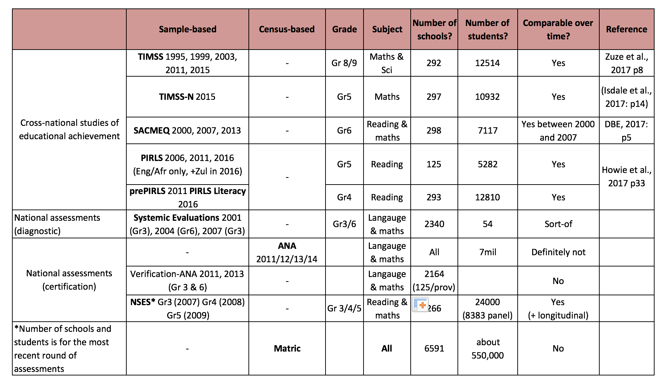
Assessments of learning outcomes

Slide 18
Main education datasets in SA
PIRLS Gr4/5 2006 (4&5) 2011 (5) 2016 (5)
PIRLS-L Gr4 2011 2016
TIMSS Gr 8/9 1995 1999 2002 2011 2015
TIMSS-N Gr5 2015
SACMEQ Gr6 2000 2007 2013
V-ANA (Gr3/6/9) 2011
ANA 2011 2012/13/142
NSES (Gr 3/4/5) 2007 2008 2009
WC SE Gr 3/6 2002/3/4/5/6 2007 2008 2009
WC SE Gr 3/6/9 2010 2011 2012 2013 2014 2015 2016 2017
TALIS 2018
EMIS (various)
Matric (annual)
Household surveys (various)

Slide 19
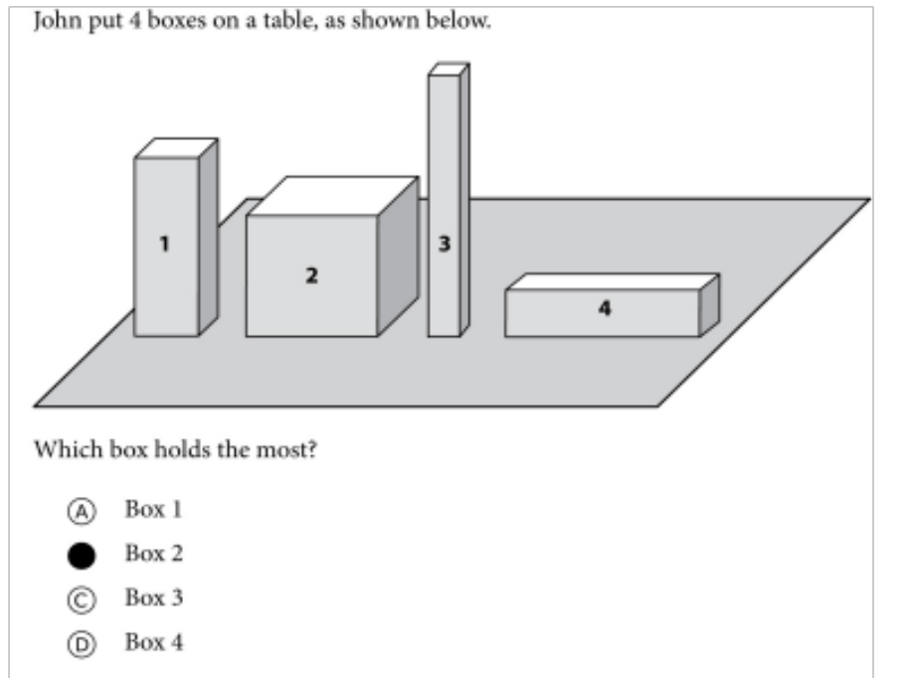

Mathematics
For this question:
Richest 10% SA schools = 94%
Poorest 10% SA schools = 34%
New Solutions for a New Future
TIMSS Gr5: Example questions from the test
2015 was the first time that SA participated in TIMSS Numeracy (Gr5)

Slide 20
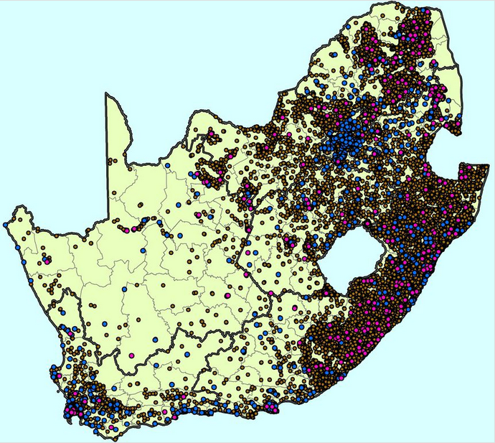
NSES 2007/8/9
Brown dots = former Black schools
Blue dots = former White schools
Purple dots = school included in NSES
(courtesy of Marisa Coetzee)

Slide 21

NSES question 42
NSES followed about 15000 students (266 schools) and tested them in Grade 3 (2007), Grade 4 (2008) and Grade 5 (2009).
Foundational numeracy
Grade 3 maths curriculum: “Can perform calculations using appropriate symbols to solve problems involving: division of at least 2-digit by 1-digit numbers”
Even at the end of Grade 5 most (55%+) quintile 1-4 students cannot answer this simple Grade-3-level problem.
“The powerful notions of ratio, rate and proportion are built upon the simpler concepts of whole number, multiplication and division, fraction and rational number, and are themselves the precursors to the development of yet more complex concepts such as triangle similarity, trigonometry, gradient and calculus” (Taylor & Reddi, 2013: 194)
(Spaull & Kotze, 2015)
Notes:
Taylor, N., & Reddi, B. (2013). Writing and learning mathematics. In N. Taylor, S. Van der Berg, & T. Mabogoane, Creating Effective Schools. Cape Town: Pearson.

Slide 22
Where should we be intervening?
New Solutions for a New Future
Insurmountable learning deficits
Figure 10b: South African mathematics learning trajectories by national socioeconomic quintiles using a variable standard deviation for a year of learning (0.28 in grade 3 to 0.2 in grade 8 with interpolated values for in-between grades (Based on NSES 2007/8/9 for grades 3/4/5, SACMEQ 2007 for grade 6 and TIMSS 2011 for grade 9, including 95% confidence interval
(Spaull & Kotze, 2015)

Slide 23
What about reading?

Slide 24


78%
22% can read for meaning
of Grade 4 children in South Africa can not read for meaning in any language.
PIRLS Literacy 2016 (Howie et al., 2017)

Slide 25
78%
How does this differ by school wealth?
Spaull & Pretorius (2018) Falling at the first hurdle. Springer.

Slide 26

What does this look like in reality?

Slide 27


FOUNDATIONS
Reading 40 Words Correct Per Minute
(starting point for reading comprehension in English)
NEEDU Grade 5 Rural SA

Slide 28
What does this look like in reality?
Many
years
ago
Leopard
was
a
creature
with
no
spots.
Recommended rate at Gr5
One
day,
he
was
relaxing
in
the
shade
of
a
thorn
tree
when
Zebra
walked
past.
Many
years
ago
Leopard
was
a
creature
with
no
spots.
40% of SA rural Gr5 learners (<40WCPM) WCPM
One
day,
he
was
relaxing
in
the
shade
of
a
thorn
tree
when
Zebra
walked
past.
Draper, K., and Spaull, S. (2015). Examining oral reading fluency among grade 5 rural English Second Language (ESL) learners in South Africa: Analysis of NEEDU 2013. South African Journal of Childhood Education 5(2) pp.44-77.
Notes:
40 words in 60s = 1,5s/word
130 words in 60s = 0,46s/word

Slide 29
How many students actually make it to university?
}
?
Source: Van Broekhuizen & Van der Berg, 2016 (Higher Education Access and Outcomes for the 2008 National Matric Cohort)

Slide 30

This matters a lot…
(Own calculations using Census 2011 data)

Slide 31
Labour Market
Uni
&
FET
High productivity jobs and incomes (17%)
Mainly professional, managerial & skilled jobs
Requires graduates, good quality matric or good vocational skills
Historically mainly white
6%
15%
Legislators, managers, assoc professionals
Unemployed
(Broad - 35%)
Unskilled
(18%)
Elementary occupations & domestic workers
Semi-Skilled (32%)
Clerks, service workers, shop personnel, skilled agric/fishery workers, plant and machinery operators)
13%
High quality secondaryschool
High SES background
+ECD
High quality primary school
? %
?
Minority (25%)
Unequal society
7%
Big demand for good schools despite fees
Some scholarships/bursaries
Majority (75%)
Vocational training
Affirmative action
Attainment
Quality
Type
Low quality secondary
school
Low productivity jobs & incomes
Often manual or low skill jobs
Limited or low quality education
Minimum wage can exceed productivity
Low SES background
Low quality primary school
QLFS 2014
Notes:
The QLFS classifies professions as follows: Highly skilled (legislators, senior officials and managers, professionals, technicians and associate profesionals); Semi-skilled (Clerks, service workers and shop and market personnel, skilled agricultural and fishery workers, craft and related trade workers, plant and machinery operators and assembly), Unskilled (Elementary occupations, domestic workers).

Slide 32
An overview of the system…

Slide 33
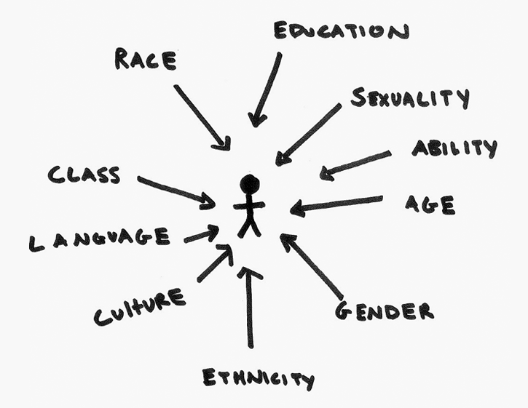
Refractions
We want to understand the underlying system/animal/geography.
Often we only see a slice of the system (representing one angle) and interpret it like it is the whole system.
Lots of ways of cutting up the data:
  Race
  Language
  Public vs private
  Quintile
  Fees
  Class
  Province
  Urban/rural
  Union membership
What is the underlying data-generating process?
A 3-D image in 2-D slices

Slide 34
The “system” in slices
SA educ system
Language
Former department
Province
Quintile
SES
Race

Slide 35
Wobbly snowman of fees
Elite fees
(R20,000+ p.a.)
High-fee
(R12,000+ p.a.)
(SR, 2016)
5%
Q5
1,8%
10% pay R5,000 + p.a.
Mid-fee
R2,000-R12,000
9%
Low-fee
(R0 – R2000)
20%
24% pay
R0→R5000 p.a.
Q4
Children paying
no fees
66%
Q1-3
DBE 2018 Report on GHS, page 33

Slide 36
Elite fees
(R20,000+ p.a.)
90% of fee-charging primary schools are Eng or Afrikaans LOLT
High-fee
(R12,000+ p.a.)
(SR, 2016)
5%
85% of white learners attend fee-charging schools
Q5
1,8%
Mid-fee
R2,000-R12,000
9%
Less than half of schools in WC & GP are no-fee
All independent schools charge fees
Low-fee
(R0 – R2000)
20%
Q4
Race
Province
Language
Children paying
no fees
66%
More than 90% of schools in LP, EC and NW are no-fee schools
Q1-3
98% of learners attending no-fee schools are Black or Coloured
78% of no-fee primary schools are African-language LOLT
DBE 2018 Report on GHS, page 33

Slide 37

The ‘bimodal’ system

Slide 38




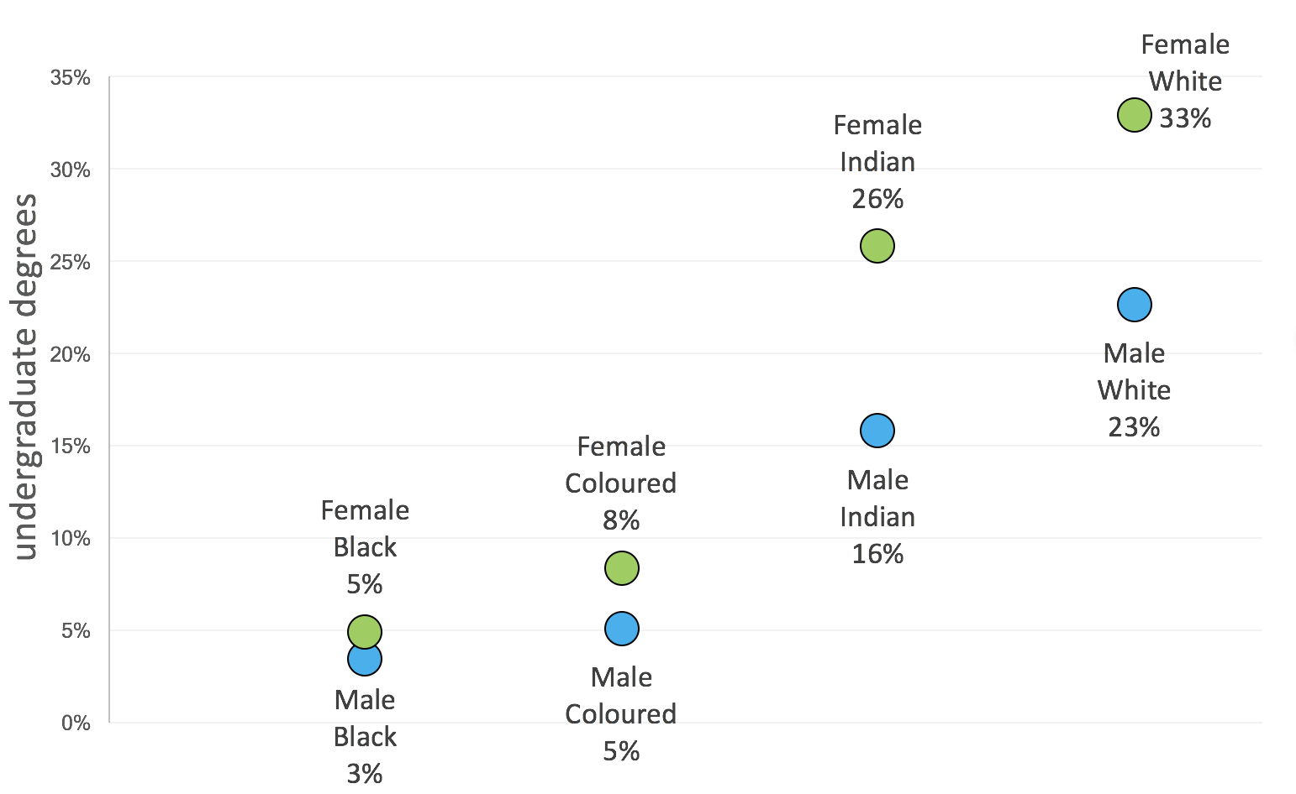
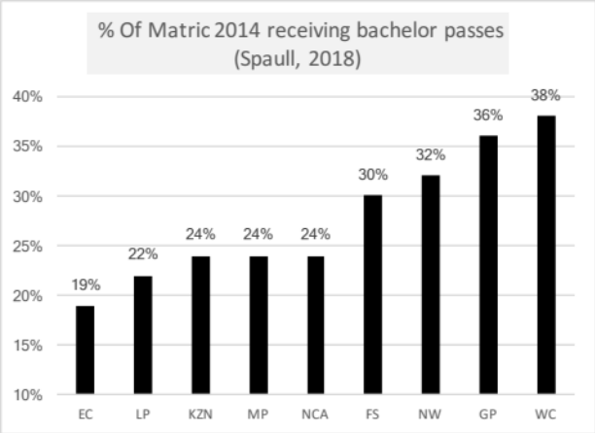
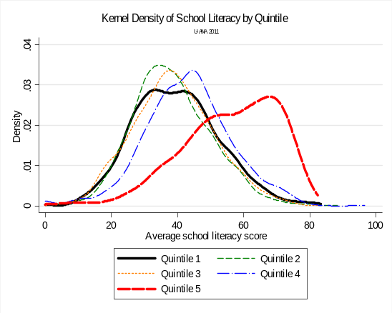
SA educ system
Language
Former department
Province
Quintile
SES
Race
Taylor, 2011

Slide 39
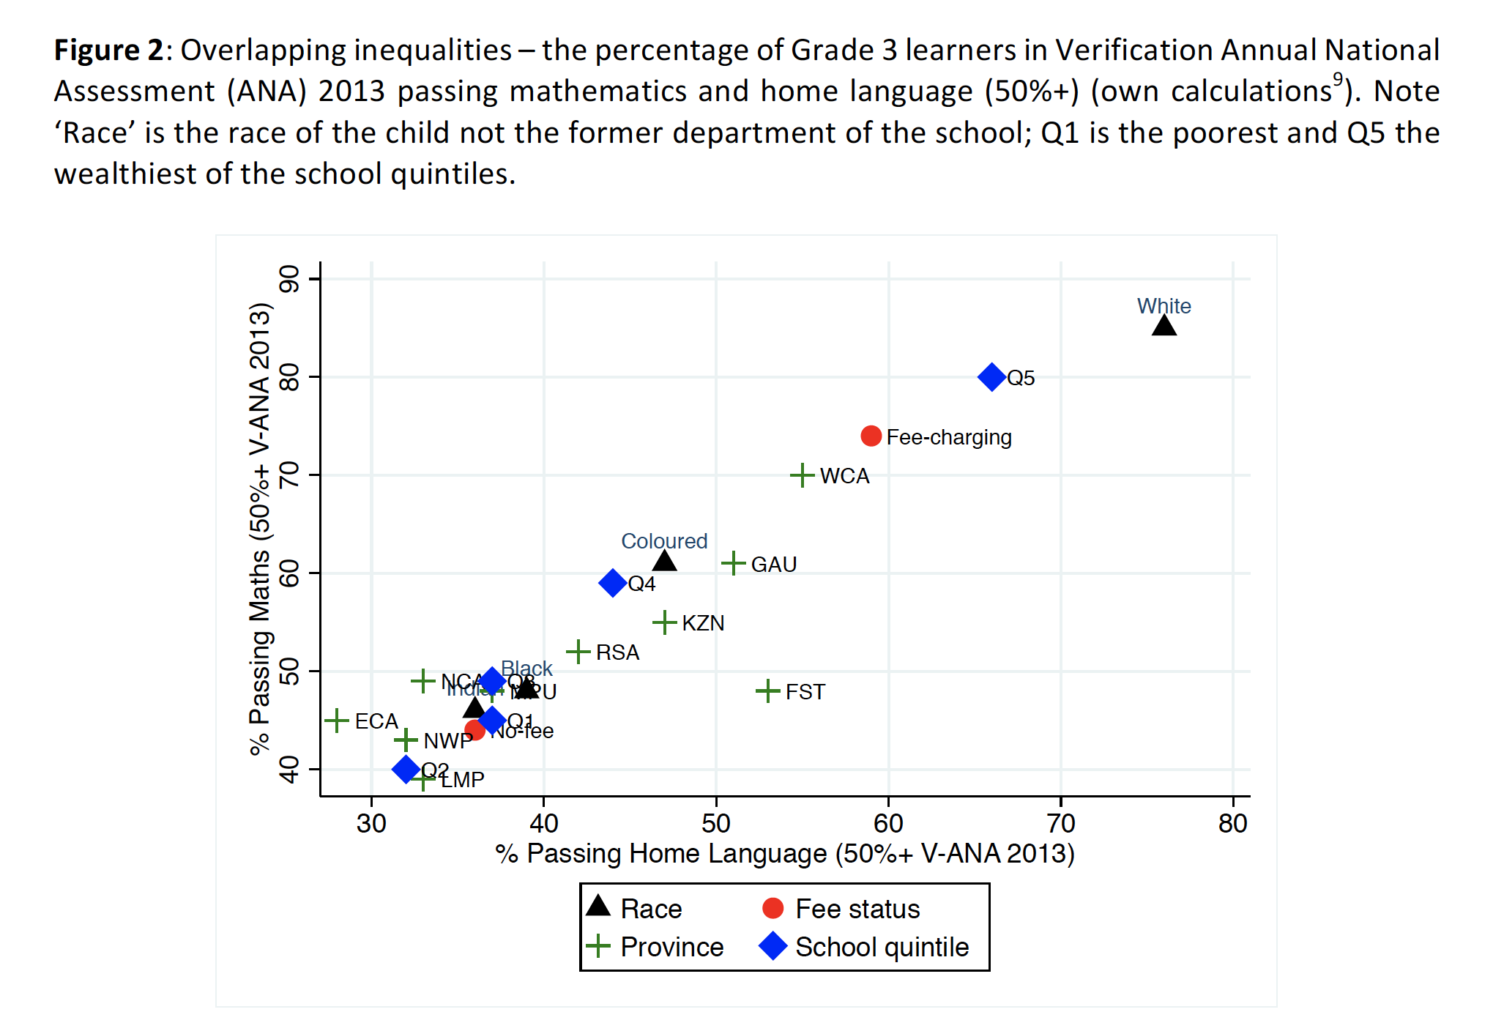
Overlapping inequalities
Spaull, 2018 – Springer Book

Slide 40
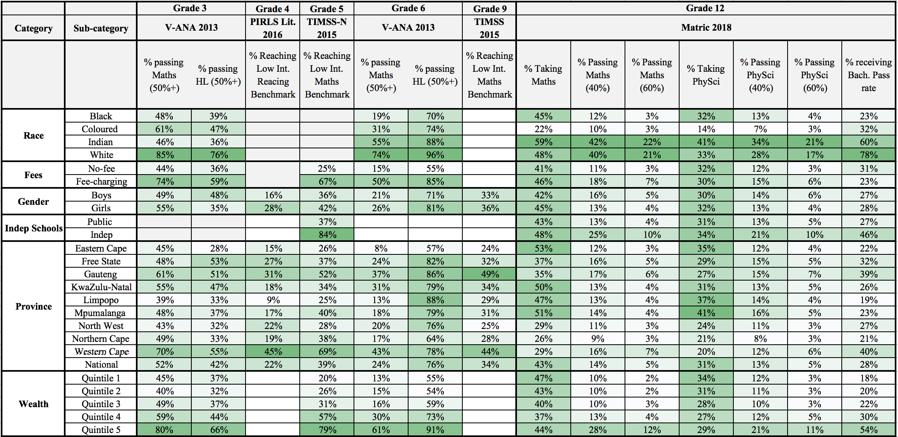
Learning outcomes
Spaull, N. (2019). Equity: A price too high to pay?. Framing chapter in Spaull, N & Jansen, J (eds) ‘South African Schooling: The Enigma of Inequality‘ Springer.

Slide 41
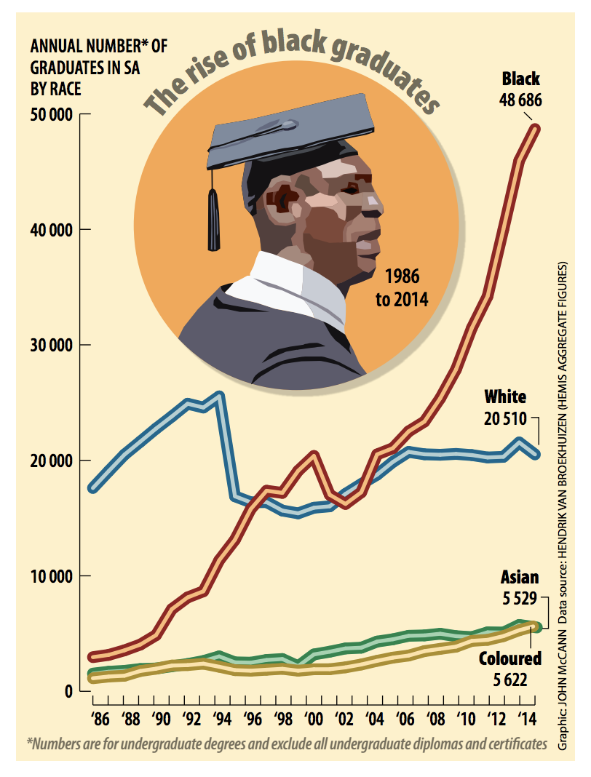
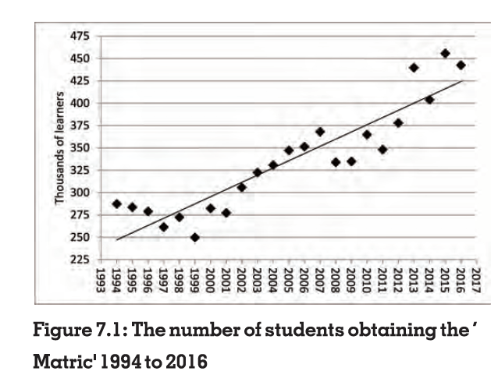
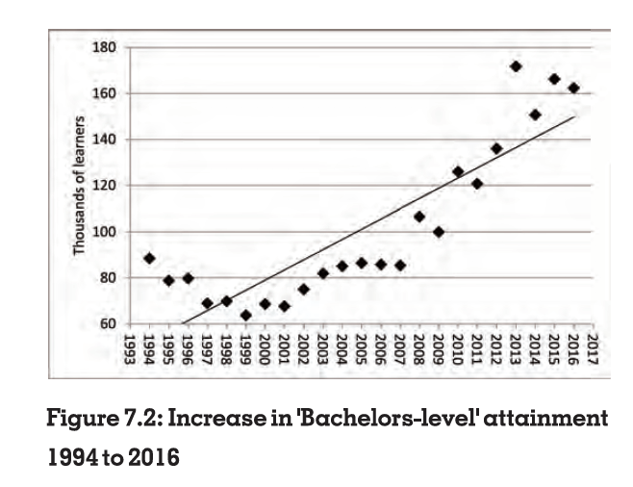
Not all doom and gloom ☺

Slide 42
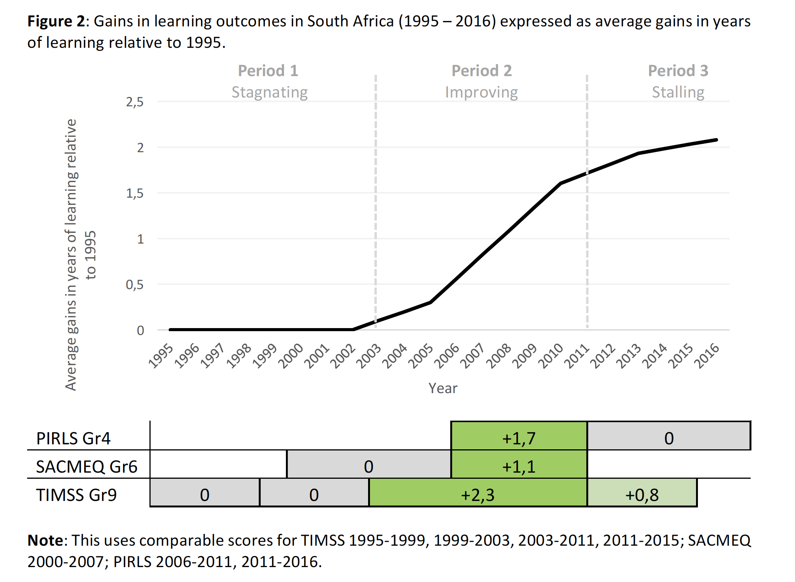
Learning outcomes
Between 2011 and 2015 food poverty (R14/day) ⬆ from 21% to 25% (StatsSA)
% sometimes experiencing hunger according to GHS went from 29% (2002) → 13% (2011) → 13% (2016)
Between 2009 and 2017 the unemployment rate ⬆ from 25% to 28%.
# of educators working in public schools ⬇ by 3% between 2013 and 2016
(Mweli, 2018: p78-79)
Between 2011 and 2016 # learners/class in PIRLS Gr4 classes ⬆ from 40 to 45 (Howie et al., 2018: 13, 127)
  Poorest 60%: 41-->48
  Richest 10%: 33-->35
(Spaull, 2019)
Spaull, 2019 – Springer Book

Slide 43
Decline in real per learner spending
2011/12 R20 113
2021/22 R17 280
-14%
Ongoing work with Adaiah Lilenstein

Slide 44
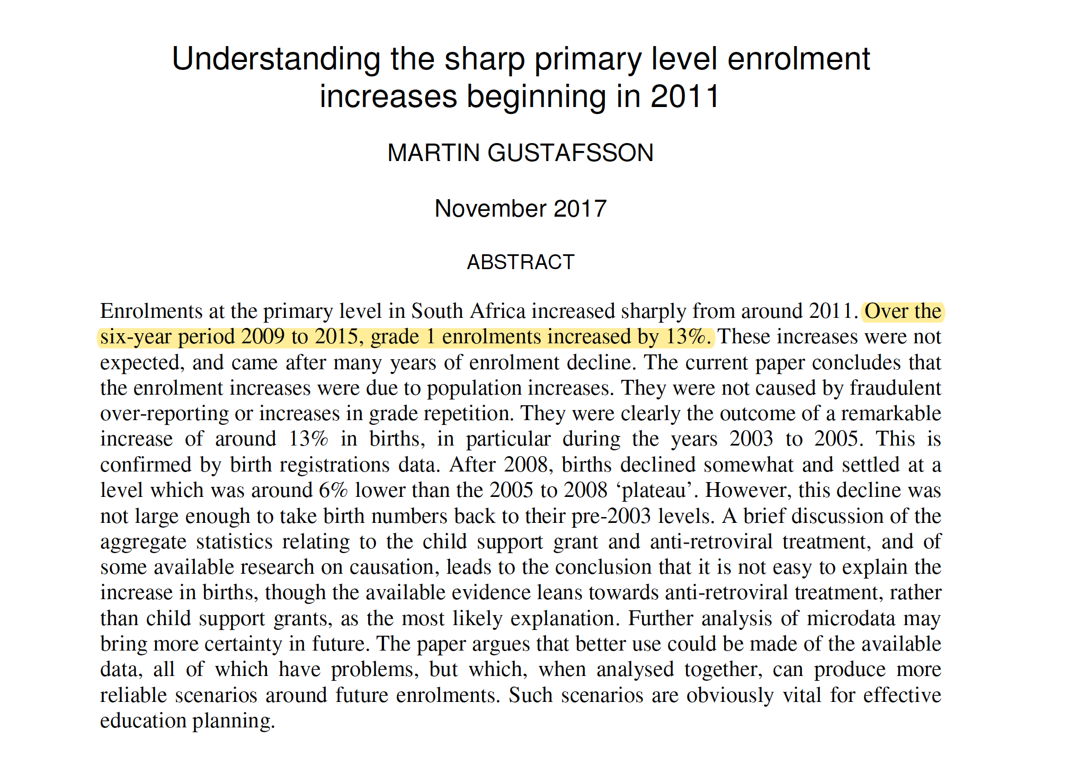
www.ekon.sun.ac.za/wpapers/2018/w082018
1
Increased enrolments
Table 6D. Wage to CPI inflation comparison
Year | Official wage increases (%) | CPI inflation (%) | Percentage point difference | Percentage difference
2008 | 11,50 | 11,58 | -0,08 | -1%
2009 | 13,00 | 6,60 | 6,40 | 49%
2010 | 8,50 | 4,28 | 4,22 | 50%
2011 | 7,80 | 4,95 | 2,85 | 37%
2012 | 8,00 | 5,66 | 2,34 | 29%
2013 | 7,60 | 5,74 | 1,86 | 24%
2014 | 8,40 | 6,15 | 2,25 | 27%
2015 | 8,00 | 4,55 | 3,45 | 43%
2016 | 8,6 | 6,30 | 2,30 | 27%
2017 | 8,3 | 5,32 | 2,98 | 36%
2018 | 8,13 | 4,66 | 3,47 | 43%
2019 | 8,61 | 4,8 | 3,81 | 44%
2020 | 8,44 | 5,3 | 3,14 | 37%
Average | 8,84 | 5,84 | 3,00 | 34%
2
Above inflation wage negotiations

Slide 45
Impact on class sizes?
Own calculations on prePIRLS 2011 and PIRLS-L 2016 data

Slide 46
What goes into policymaking?
Knowledge
Ideology
Support
Policy/Programme
Source: JPAL 2017

Slide 47
How do things actually work?
Is evidence the binding constraint to improved policy on paper and improved implementation in practice?
  Probably not: “There is massive evidence that governments do not implement many many many projects/proposals/programs that are cost effective and do spend budget on items known to be not cost effective. The model of a benign social welfare planner hampered by lack of rigorous evidence on effectiveness whose behavior an RCT will change is complete whack nonsense. “ (Pritchett, 2018)
Primacy of politics
  Budget cycles → Feb splurge in SA
  Election cycles (new party/president/minister → new policy)
Role of culture, values and tradition
  The exact same evidence in US and Denmark will not have the same impact on policy (think about studies on (1) for-profit education, (2) competition/choice.)
Role of social networks
  Often policies are implemented or not implemented based on the Minister’s Whatsapp contacts or who’s in her calendar
Role of unpredictable factors
  Minister makes a trip overseas and loves the school(s) she sees. Changes policy.

Slide 48
“
“
Prevention is better than cure
FOUNDATIONS
“The later in life we attempt to repair early deficits, the costlier the remediation becomes’’
Nobel Laureate James Heckman (2000, p. 5).

Slide 49
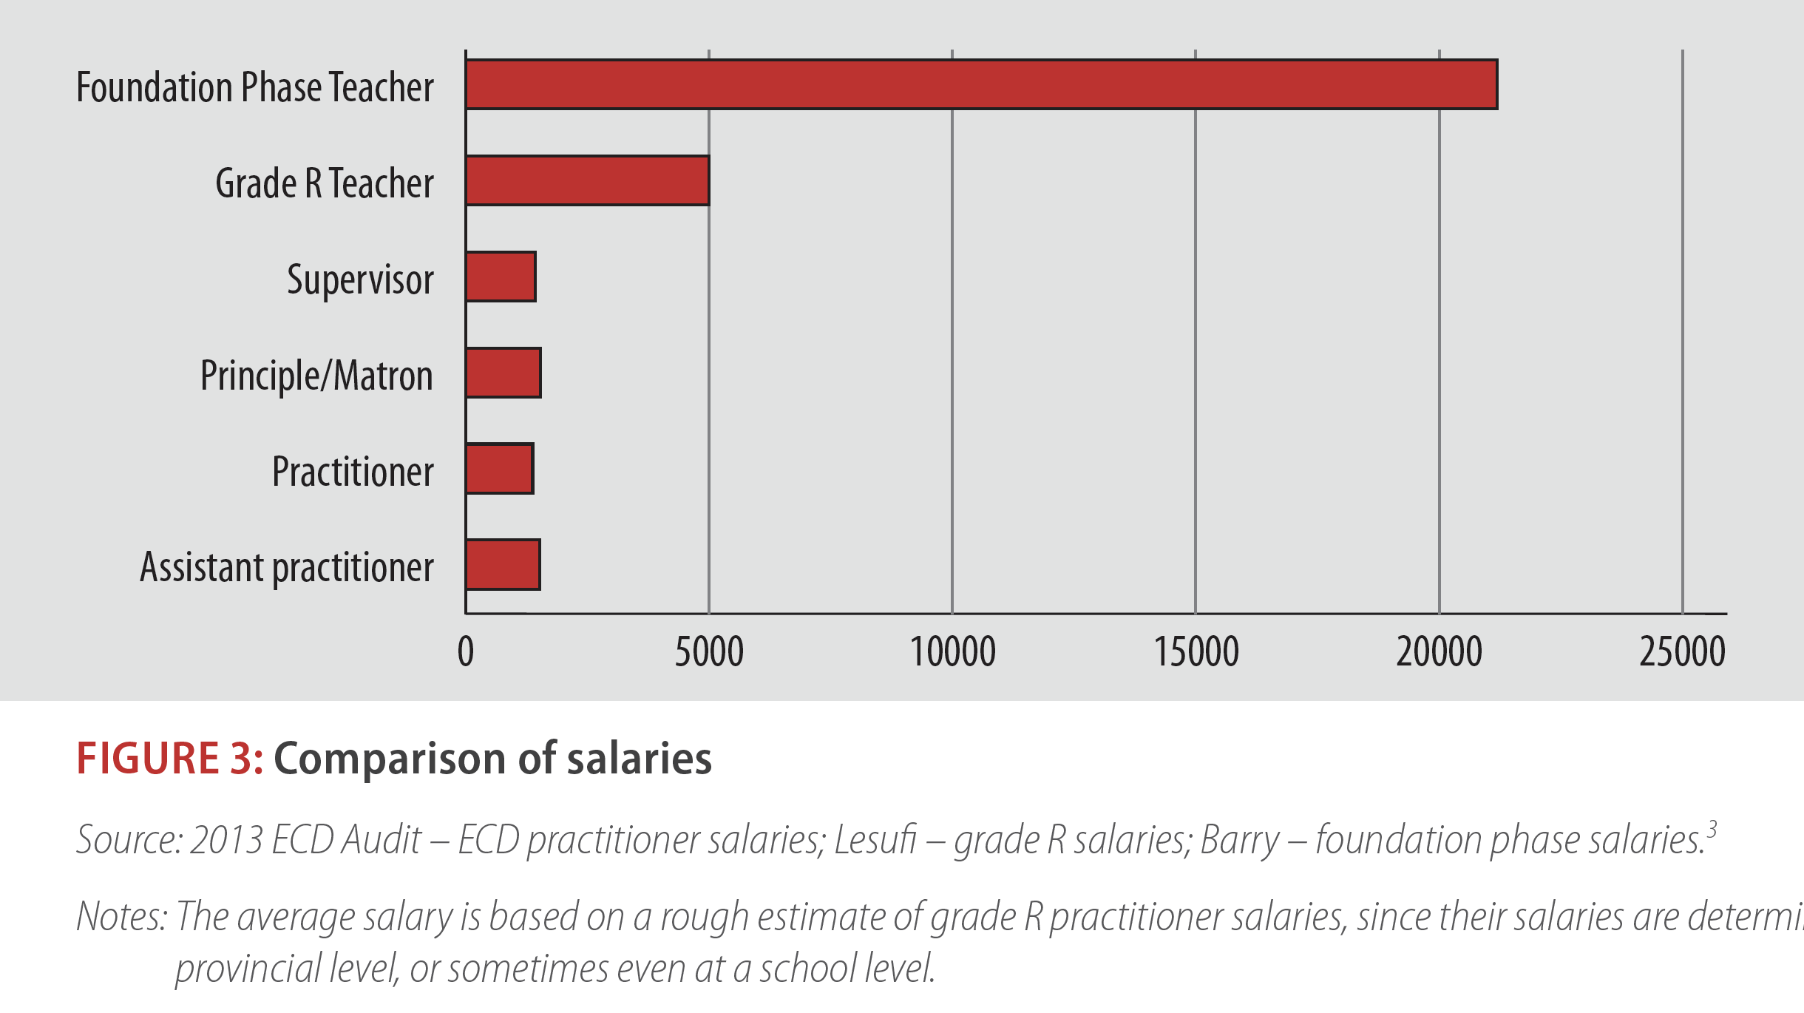
Importance of ECD in SA?
The people who teach our 3 and 4 year olds get paid 10% of the people that teach our 5/6 year olds?
🧐
Kotze, 2015, RESEP Policy Brief

Slide 50
4 Take-homes
Toolbox: Seeing economics as a tool to solve interesting and important questions.
Opportunity: Many areas of education/linguistics/health have been poorly researched by “in-discipline” researchers – huge opportunity for economists / quantitative social scientists.
Actually using your skill-set: McKinsey et al. = Excel.
South Africa: Opportunity to do empirical work that actually influences policy, funders, thinking on education and health in SA.

Slide 51
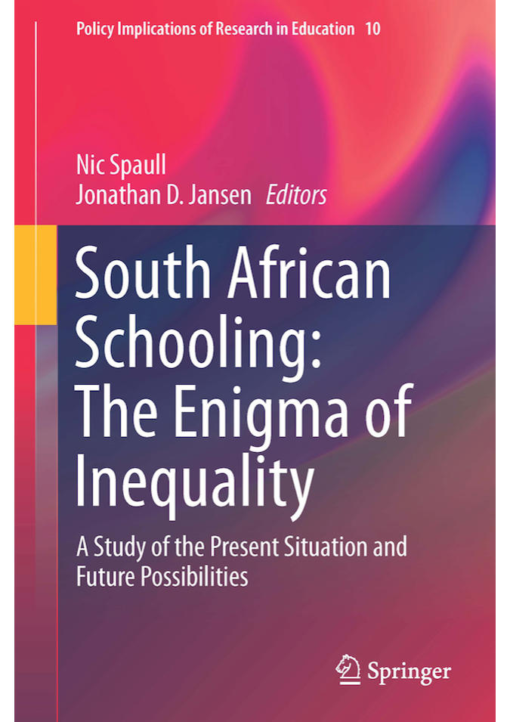
Available
Aug 2019

Slide 52

nicspaull@gmail.com
Thank you
Comments/questions?

Slide 53
The Goldilocks Zone
A framework for thinking about evidence
Goldilocks zone for evidence
IDEAL
Goldilocks zone for policy
y
Measurement rigor
Consensus
Conclusive
5
Rigor of the Evidence
Causal
A
4
Small but rigorous
Confirming
3
Suggestive
☹
2
B
Large but weak evidence
Proof of concept
1
x
5
10
25
75
250
1500
5000+
Independence
Scale

Slide 54
The Goldilocks Zone
A framework for thinking about evidence
Where are we on interventions about…
Early grade reading?
ECD?
Teacher development?
Teaching at the right level?
y
Sloppy!
Measurement rigor
Consensus
Conclusive
B
C
Rigor of the Evidence
Causal
Confirming
Suggestive
A
D
☹
Proof of concept
x
5
10
25
75
250
1500
5000+
Independence
Scale

Slide 55
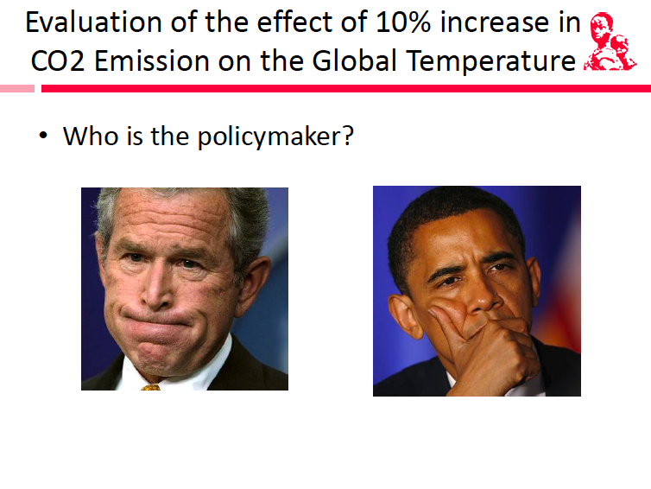
Slide credits: Martin Abel (JPAL)

Slide 56
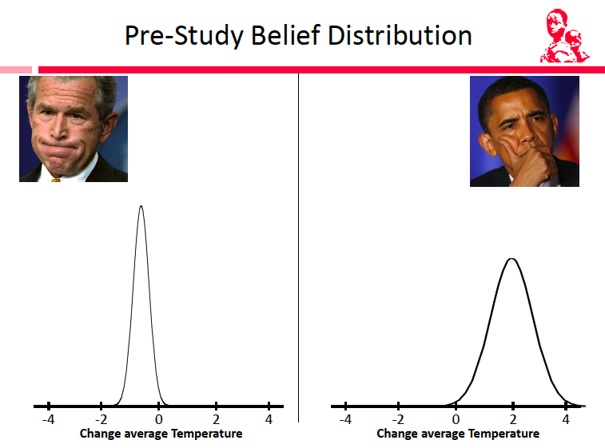
Slide credits: Martin Abel (JPAL)

Slide 57
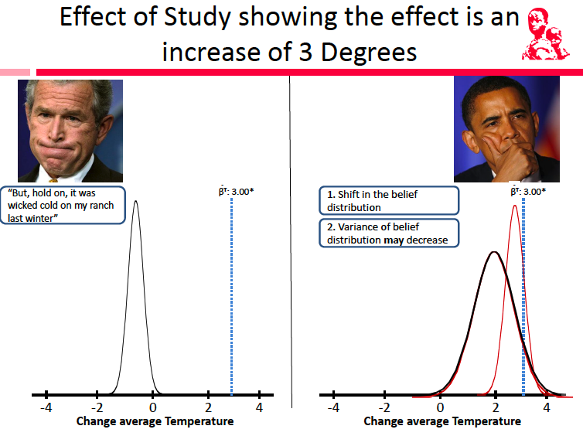
Slide credits: Martin Abel (JPAL)

Slide 58
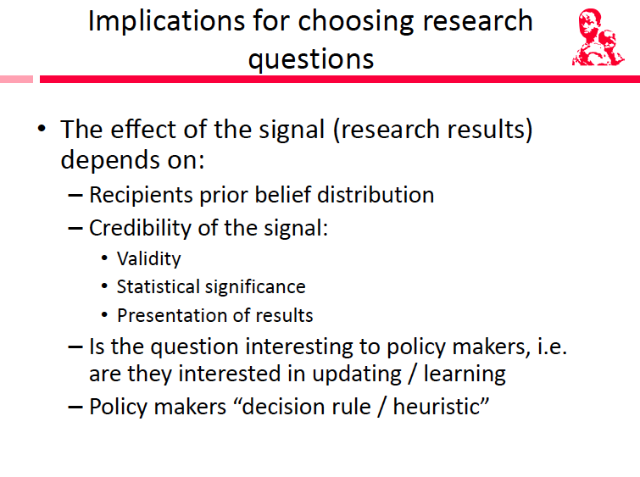
Most researchers do not think about these things explicitly (often implicitly). Politicians/PR consultants definitely do!
Slide credits: Martin Abel (JPAL)

Slide 59
Politics
We often think of SA politics as…
“
  ANC vs DA
  GP vs WC
Perhaps more productive to think of it as:
  ANC-GP vs ANC-other

Slide 60

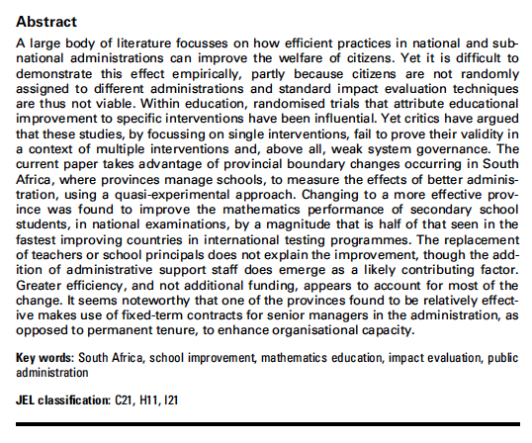
How can you measure ‘impact’ if you can’t randomize?

Slide 61
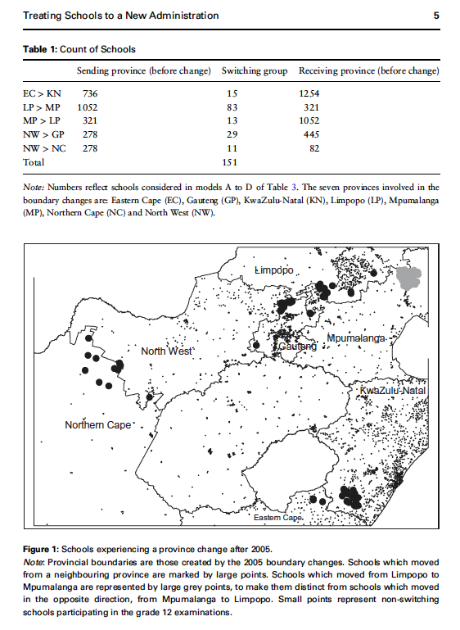
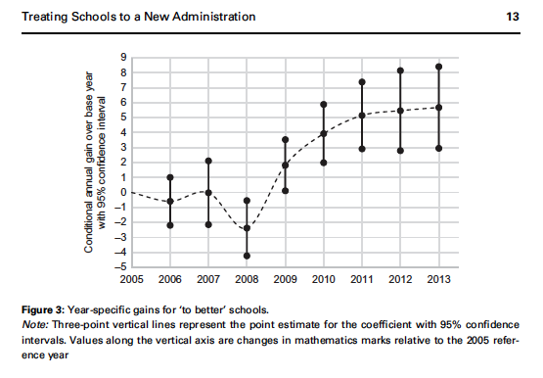

Slide 63
SA education in numbers
School Realities 2016
Learners= 12,932,565
  Public = 12,342,213 (95%)
  Indep = 590,352 (5%)
Schools = 25,574
  Public = 23,719 (93%)
  Indep = 1,855 (7%)
Teachers = 418,613
  Public = 381,394 (91%)
  Indep = 37,219 (9%)
69%
Total learner enrolment by province (School Realities 2016)

Slide 64
Language by grade
More than 70% of SA children learn to read in an African language before switching to English in Grade 4
Pretorius & Spaull, 2016 (ANA 2013)

Slide 65
Language - achievement

Slide 66
Province and language

Slide 67
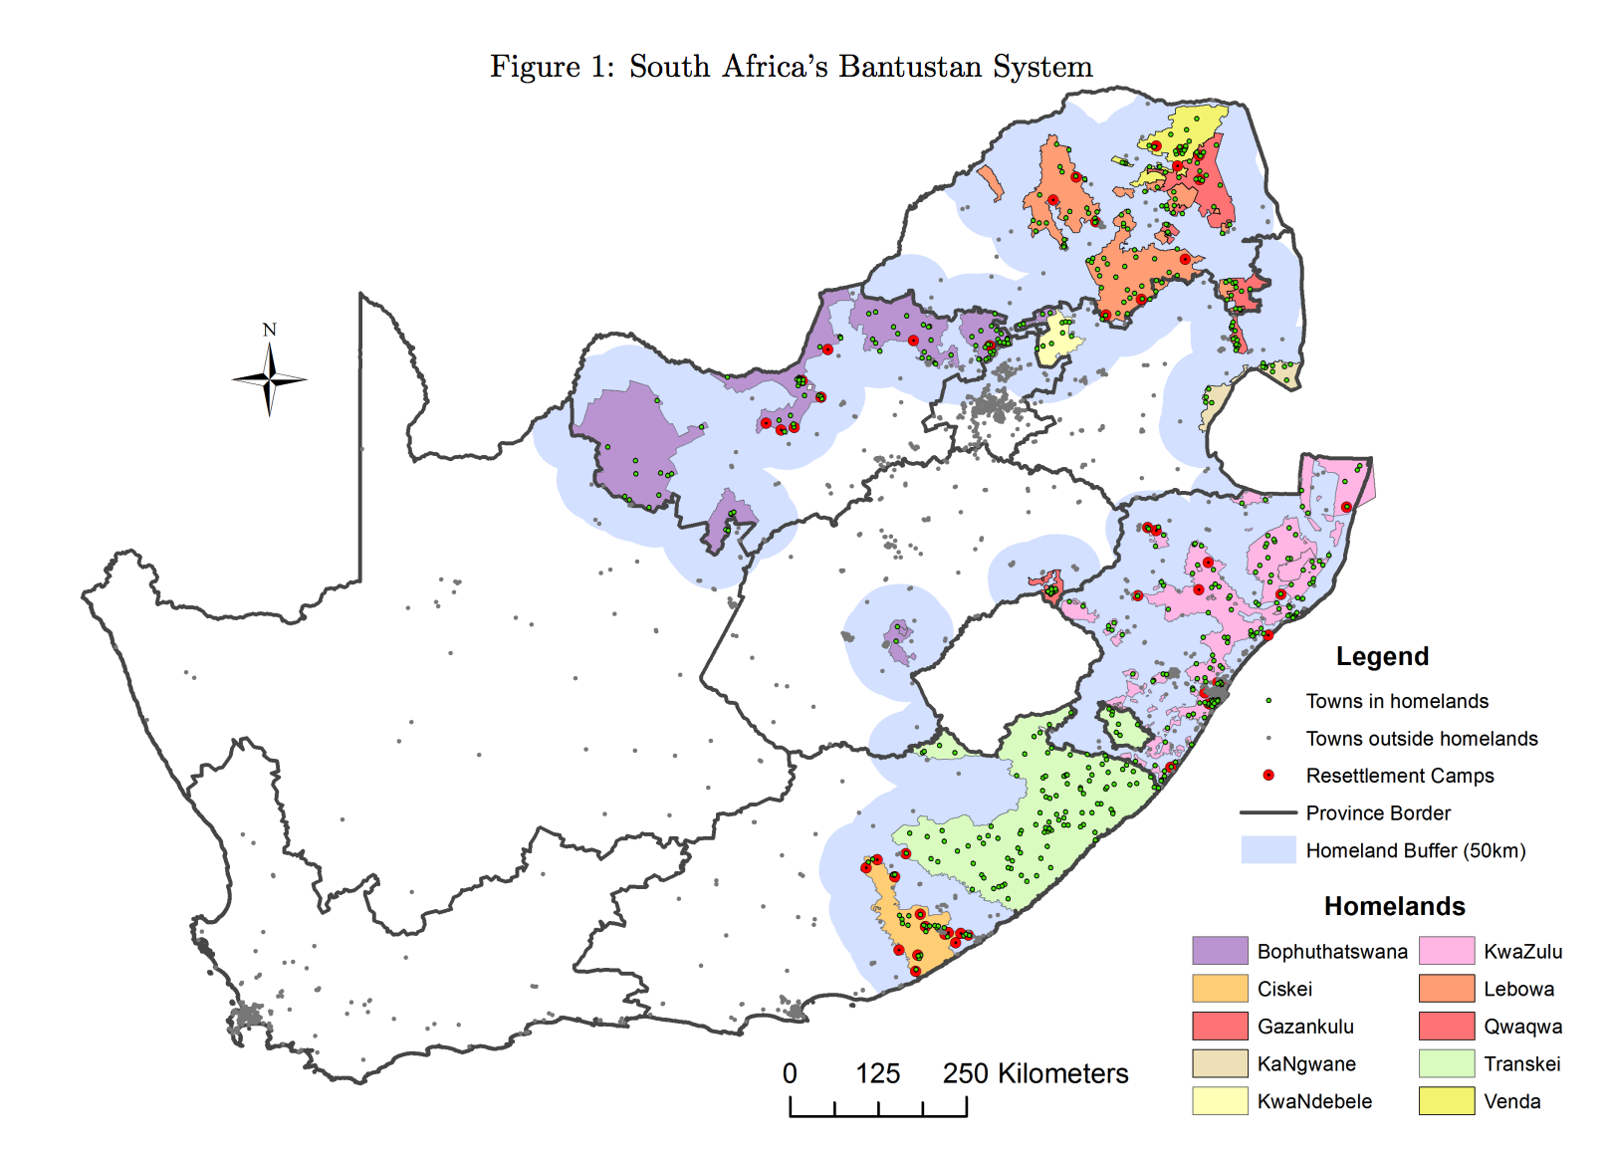
Province and language

Slide 68
Province and quintile
No fee | Fee-charging
Sources: Motala & Carel, 2019, using EMIS National Ordinary Schools 2016 Quarter 4 (Department of Basic Education); 2015 SNAP Survey of Ordinary Schools. Own analysis of the microdata.

Slide 69
Teachers and principals
Figure: Gender composition at different post levels, 2016
Source: Wills (2018) analysis of Persal November 2016. Notes: Educators included are not just limited to those that could be linked to schools in 4th quarter Persal - consider all with rank related to teaching, hod, deputy or principal.

Slide 70
Principals
Figure: Principal qualifications (REQV), 2012
(Masters+)
Source: Wills (2018) → Persal-EMIS matched dataset, own calculations. Notes: …Percentages add up to 100 per cent in each sub-group.

Slide 71
SADTU membership

Slide 73
y
C
A
Politics
B
x
Evidence

Slide 74
Thoughts…
How have your ‘priors’ changed since before the lecture?
Is the current SA schooling ‘equilibrium’ and ‘progress trajectory’ the only one? The optimal one?
  What would a different equilibrium look like?
  How would we get there?
  At what costs?
Why don’t more people know/care about this?

Slide 75
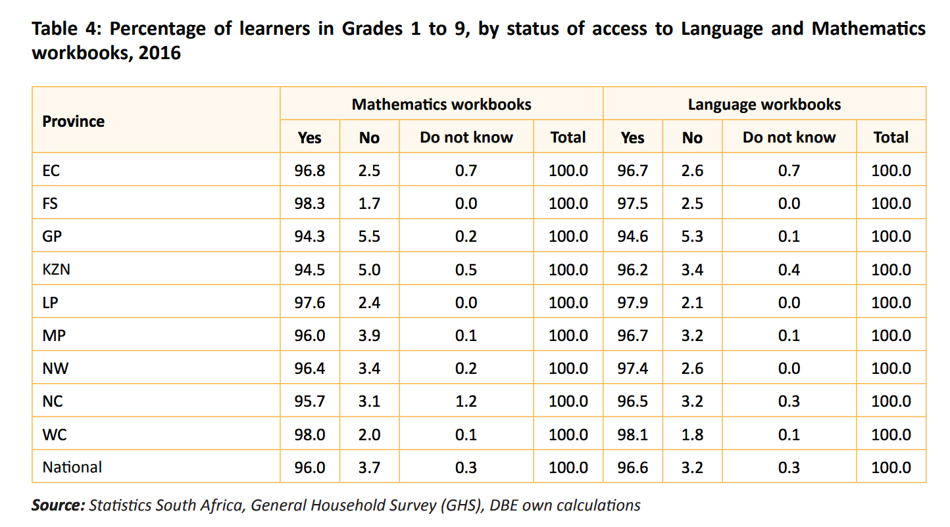
Resources
Access to language and mathematics workbooks (Grades 1-9) (GHS 2016)
DBE 2018 Report on GHS, page 24
Notes:
2018 DBE report on GHS - https://www.education.gov.za/LinkClick.aspx?fileticket=qt02-dal3BE%3D&tabid=92&portalid=0&mid=4362&forcedownload=true

Slide 76
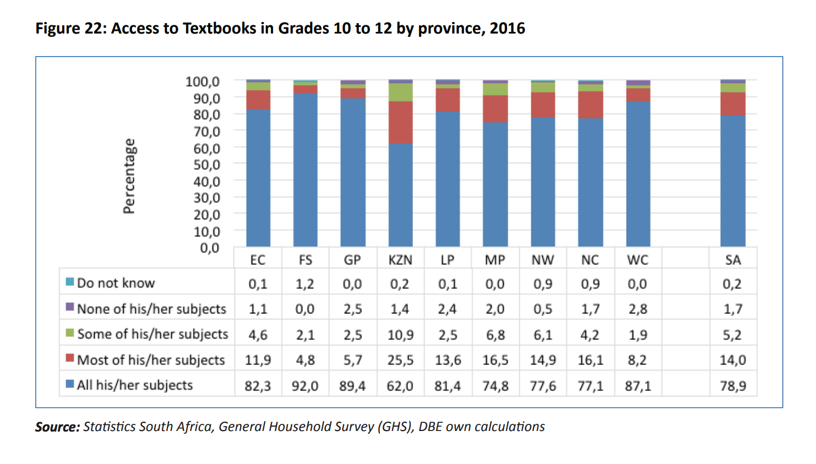
Resources
Access to textbooks in Grades 10-12 by province (GHS 2016)
DBE 2018 Report on GHS, page 25
Notes:
2018 DBE report on GHS - https://www.education.gov.za/LinkClick.aspx?fileticket=qt02-dal3BE%3D&tabid=92&portalid=0&mid=4362&forcedownload=true

Slide 77
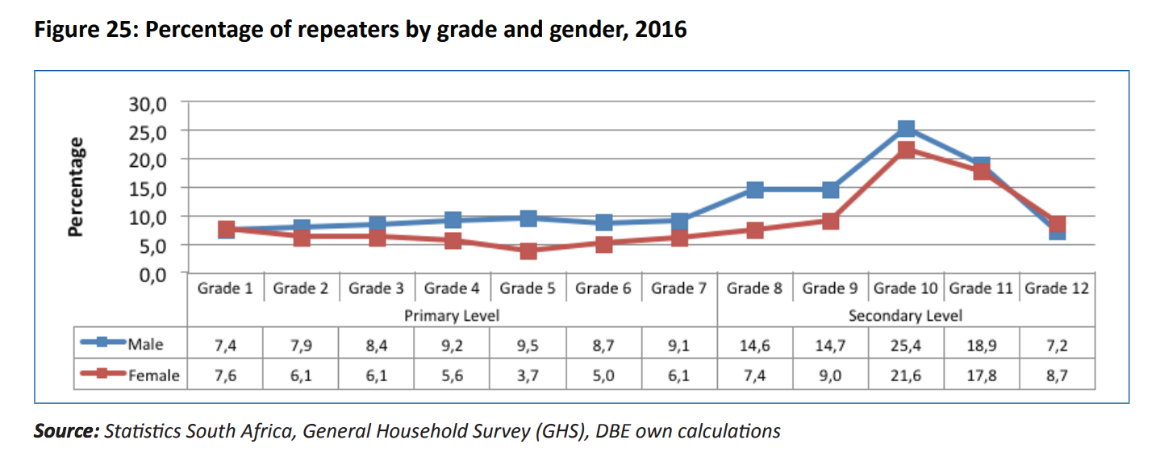
Grade repetition
DBE 2018 Report on GHS, page 28
Notes:
2018 DBE report on GHS - https://www.education.gov.za/LinkClick.aspx?fileticket=qt02-dal3BE%3D&tabid=92&portalid=0&mid=4362&forcedownload=true

Slide 78
Teachers & unions
Breakdown as at 31 December 2012 (Audited stats for December 2013 will be available mid-year)
These Stats include educators and a small numebr of support staff
Union | EC | GP | FS | KZN | LP | MP | NC | NW | WP | TOTAL
SADTU | 45968 | 29307 | 13853 | 57086 | 43706 | 25750 | 5826 | 18572 | 12944 | 253012
NAPTOSA | 12508 | 14805 | 4171 | 7346 | 687 | 2701 | 934 | 3335 | 9651 | 56138
SAOU | 2957 | 8090 | 4925 | 1244 | 1174 | 2452 | 1581 | 2242 | 4197 | 28862
PEU | 380 | 2807 | 71 | 193 | 7824 | 1728 | 128 | 1210 | 0 | 14341
NATU | 380 | 580 | 416 | 25424 | 55 | 1334 | 0 | 284 | 0 | 28473
TOTALS | 62193 | 55589 | 23436 | 91293 | 53446 | 33965 | 8469 | 25643 | 26792 | 380826
Thanks to Mike Myburgh (NAPTOSA) for supplying data
Notes:
There are two sources for the data: the main one is the PSCBC – Public Service Co-ordinating Bargaining Council (this is the forum where all of the public sector unions, including educator unions, bargain with the State on matters of mutual interest) And secondly the ELRC – Education Labour Relations Council (this is specifically for educator unions and the DBE to negotiate on matters not part of the PSCBC). Both conduct audits on an annual basis. These are not without errors! I tried to correct one or two of the significant figures and as indicated added in the Ind Sch and SGB members for NAPTOSA. SAOU may have about 2000 such members in addition to their State employed members (not certain of this though).

Slide 79
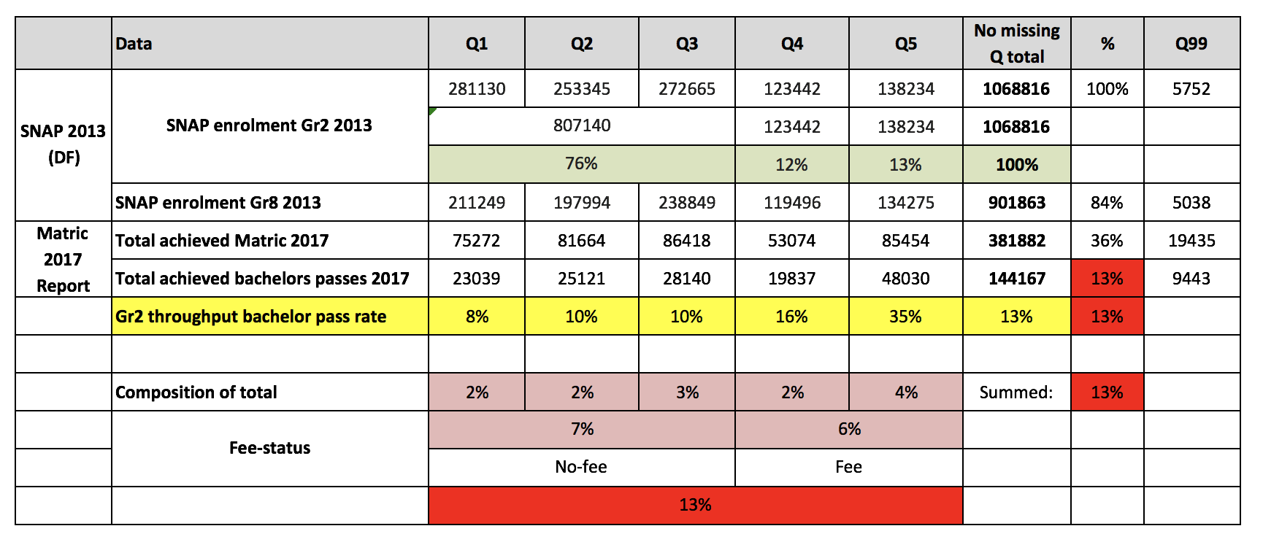
Nuance in the 2-school systems bimodal narrative:
About half (45%) of all high-level maths passes come from Q1-4 schools
66% of bachelor’s passes come from Q1-4 schools
All about PROBABILITIES!!
Source: Van Broekhuizen & Van der Berg, 2016 (Higher Education Access and Outcomes for the 2008 National Matric Cohort)

Slide 80

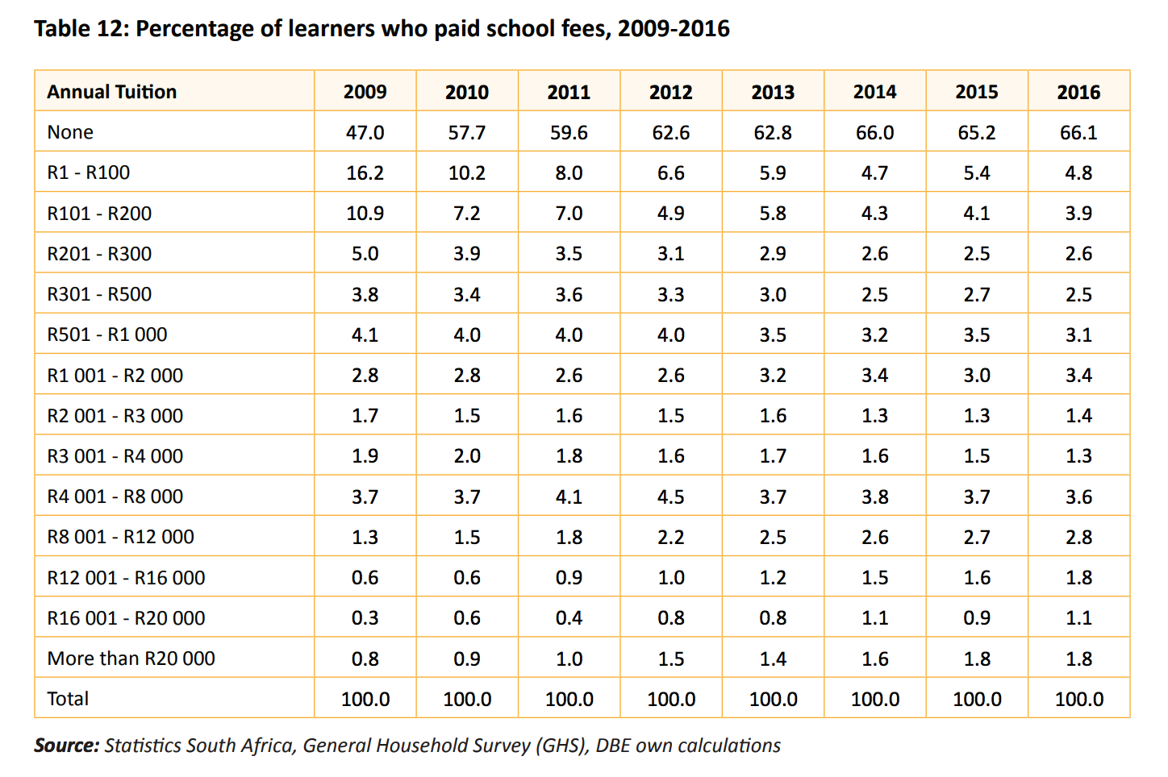



Fees
Sea Point High School
Sea Point High School
R14,400 p.a
De Kuilen High School
De Kuilen High School
R17,500 p.a
Brackenfell High School
Brackenfell High School
R20,100 p.a
Westerford High School
Westerford High School
R36,170 p.a
Only 5% of children in SA pay R12,000 p.a. or more in school fees
Rondebosch Boys High School
Rondebosch Boys High School
R49,000 p.a
DBE 2018 Report on GHS, page 33
Notes:
http://www.brakkies.co.za/wp-content/uploads/2017/03/Schoolfees-Circular-2018.pdf http://www.rondebosch.com/prep/admissions/fees.php http://www.dekuilen.com/files/dekuilen-schoolfees-letter.pdf

Slide 81
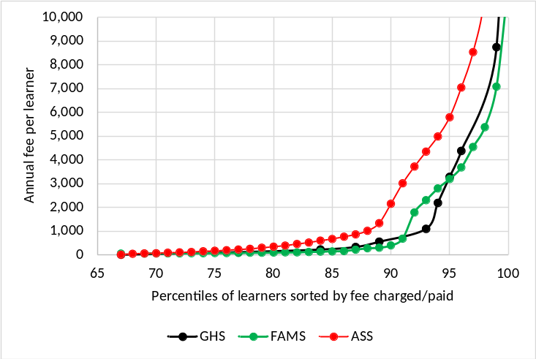
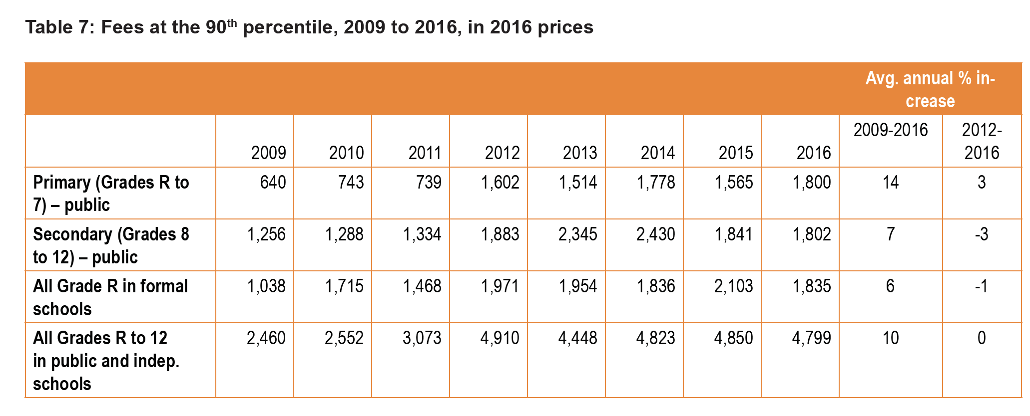
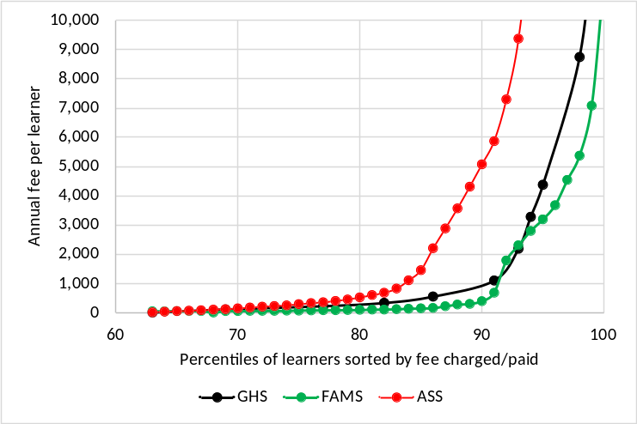
Fees
Figure 26: GHS versus other sources in public grades R to 7 (2011)
(Mweli, 2018: 89)
FAMS is the Funding and Management Survey which was a nationally representative sample of public schools conducted in 2009. It is not publicly available. To make it comparable to 2011 figures for GHS and ASS it has been inflated using CPI.
Figure 27: GHS versus other sources in public grades 8 to 12 (2011)
(Mweli, 2018: 87)
Notes:
Mweli, M. (2018). Basic Education’s Role in Tackling Poverty. Basic Education Matters (2018: 1). Journal of the Department of Basic Education.

Slide 82
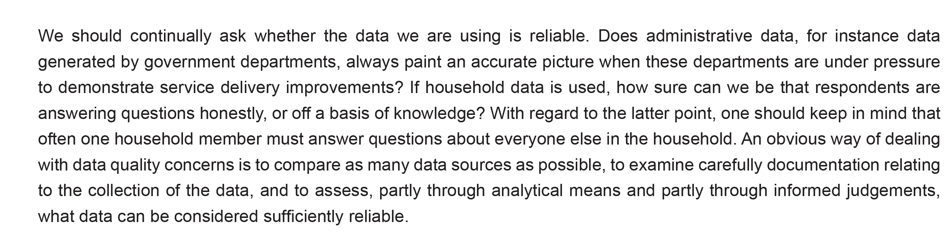
Data
(Mweli, 2018: p77)

Slide 83
% of 2008 matric cohort attaining undergraduate degrees by race
Van Broekhuizen & Spaull (2017)

