Slide 1

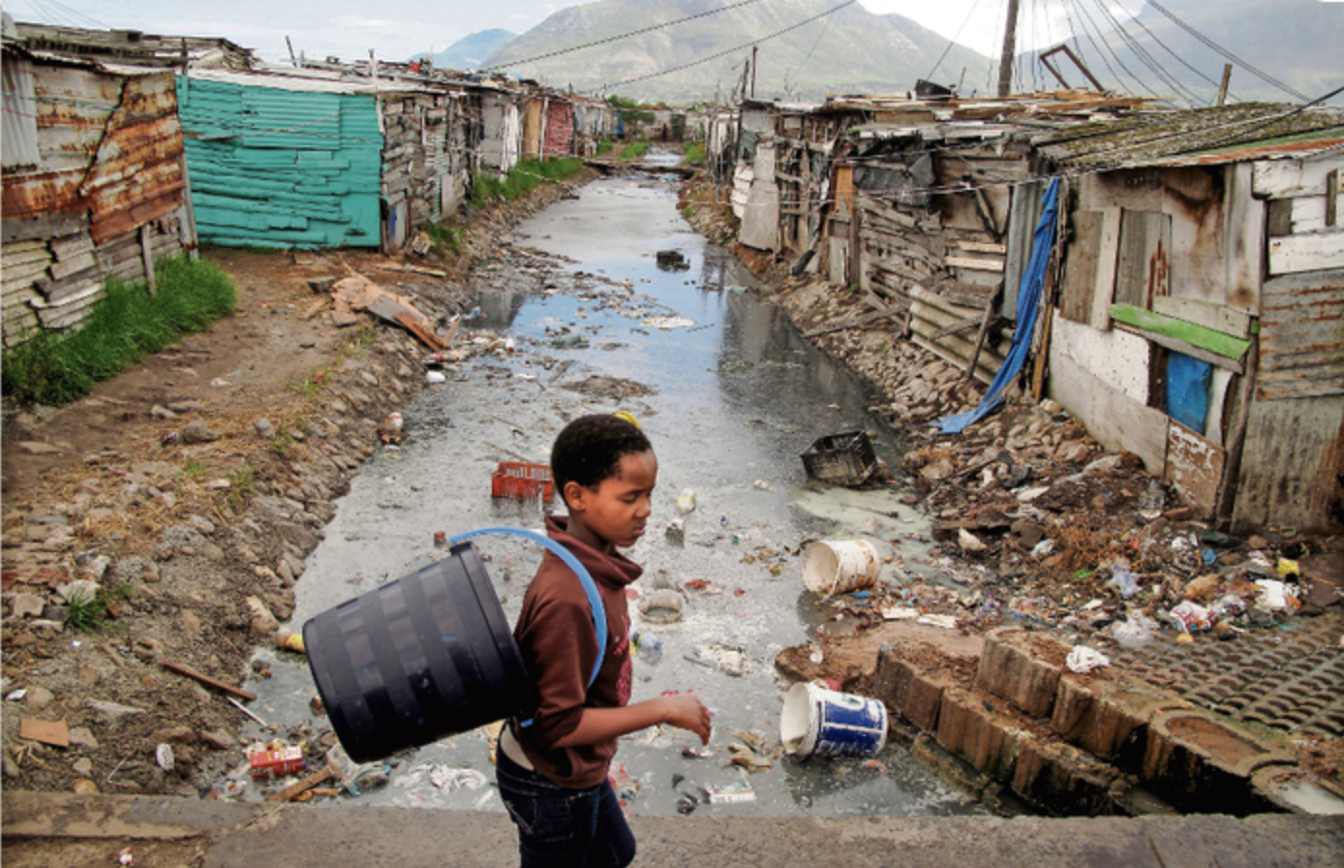

SA Schooling & Inequality
Nic Spaull | UCT GSB EMBA| 1 July 2019

Slide 2
Wealth inequality in South Africa
5%
10% of the population own 90-95% of the wealth
(Orthofer, 2016)
using SARS tax data

Slide 3
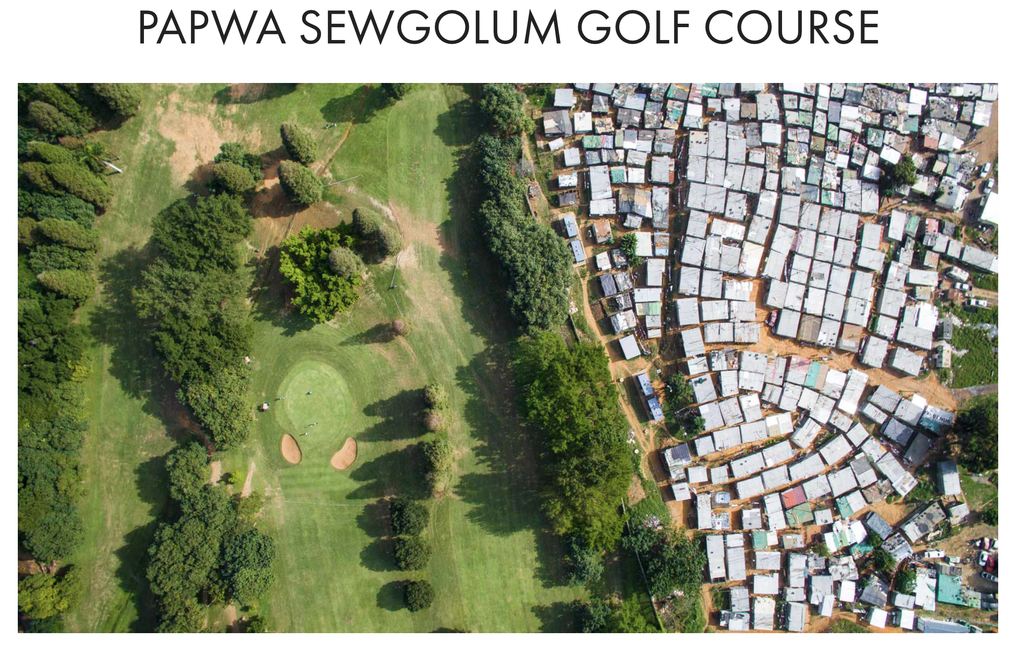
https://unequalscenes.com

Slide 4
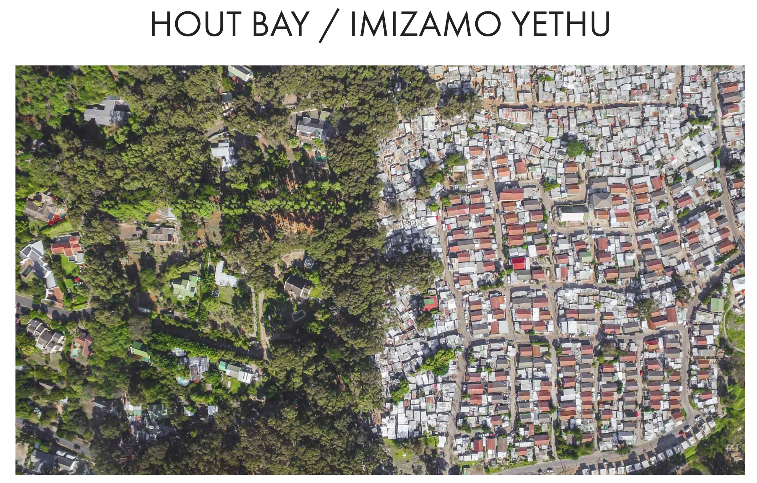
https://unequalscenes.com

Slide 5
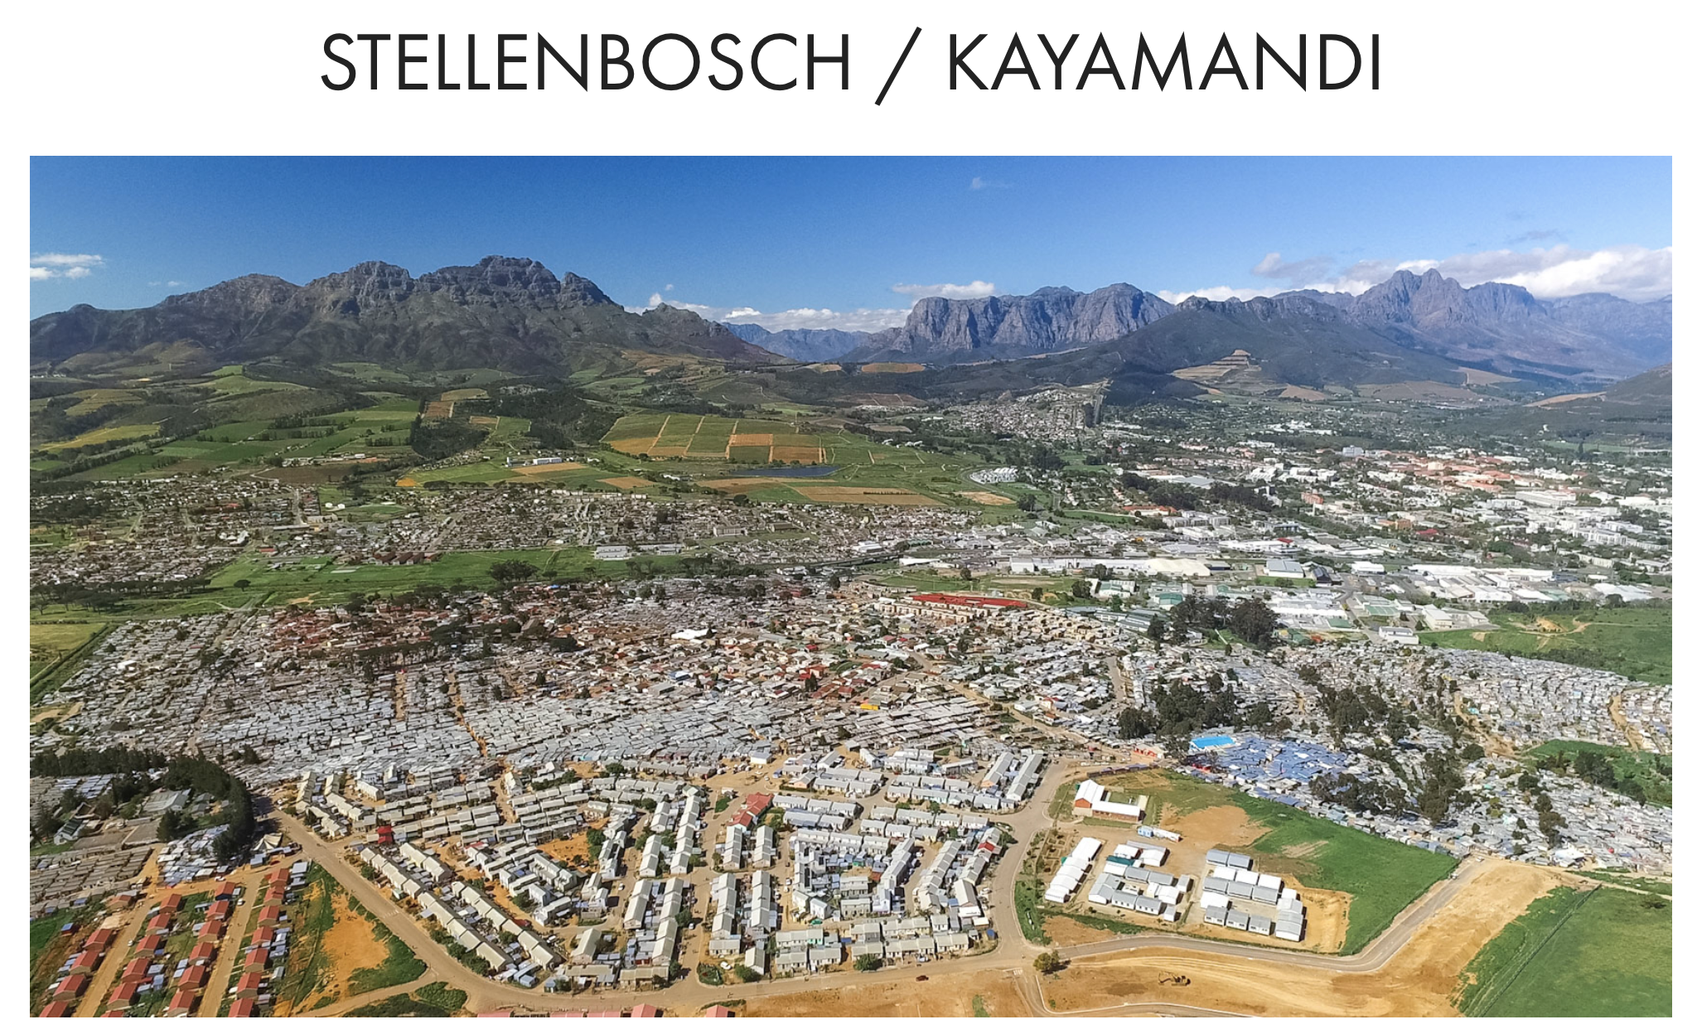
https://unequalscenes.com

Slide 6
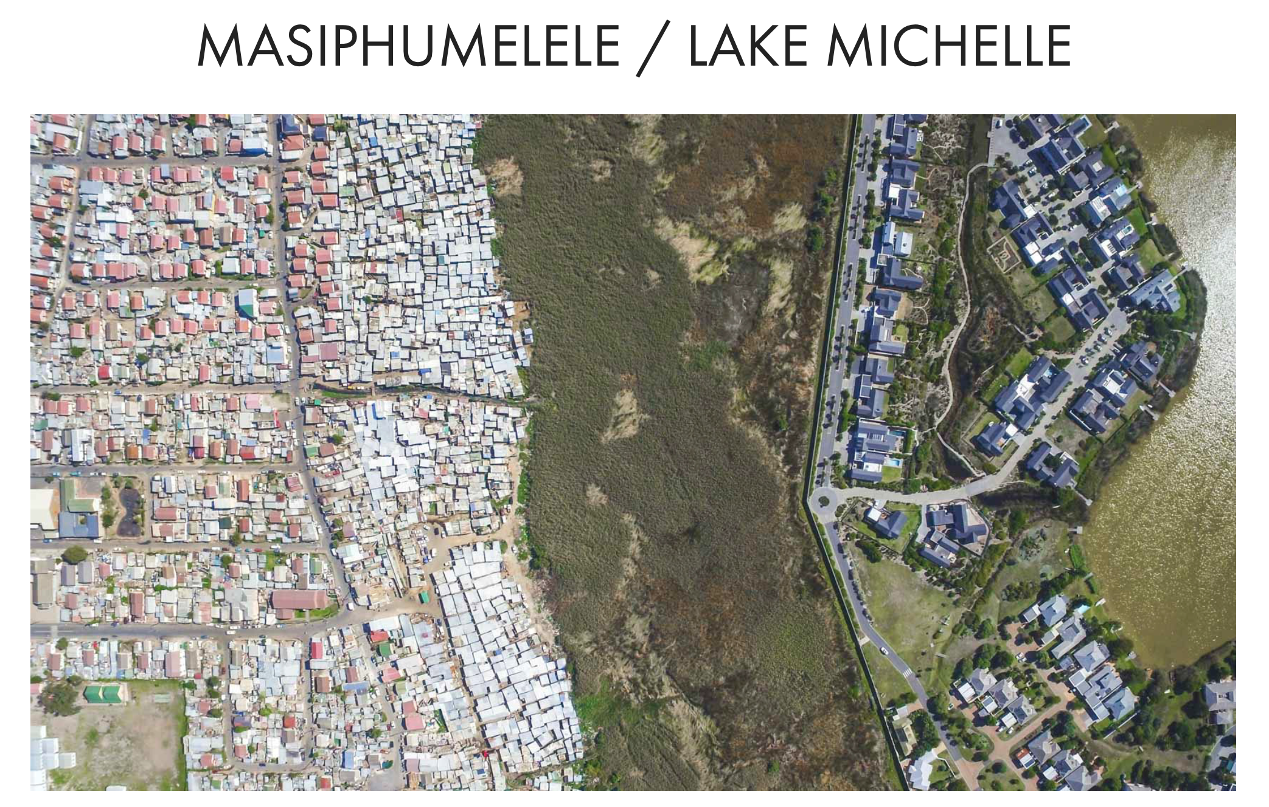
https://unequalscenes.com

Slide 7
South African Society
(NIDS 2009-2014/15) (values per person per month)
Schottee, Zizzamia & Leibbrandt (2017) Social Stratification, life chances and vulnerability to poverty in South Africa

Slide 8
Racial composition of South Africa’s ‘classes’
(NIDS 2008-2014/15)

Slide 9
“Inequality in every country needs to be justified. You need to tell a story about why this level of inequality is acceptable or unacceptable.”
Thomas Picketty

Slide 10


Inequality & education

Slide 11

The ‘bimodal’ system

Slide 12




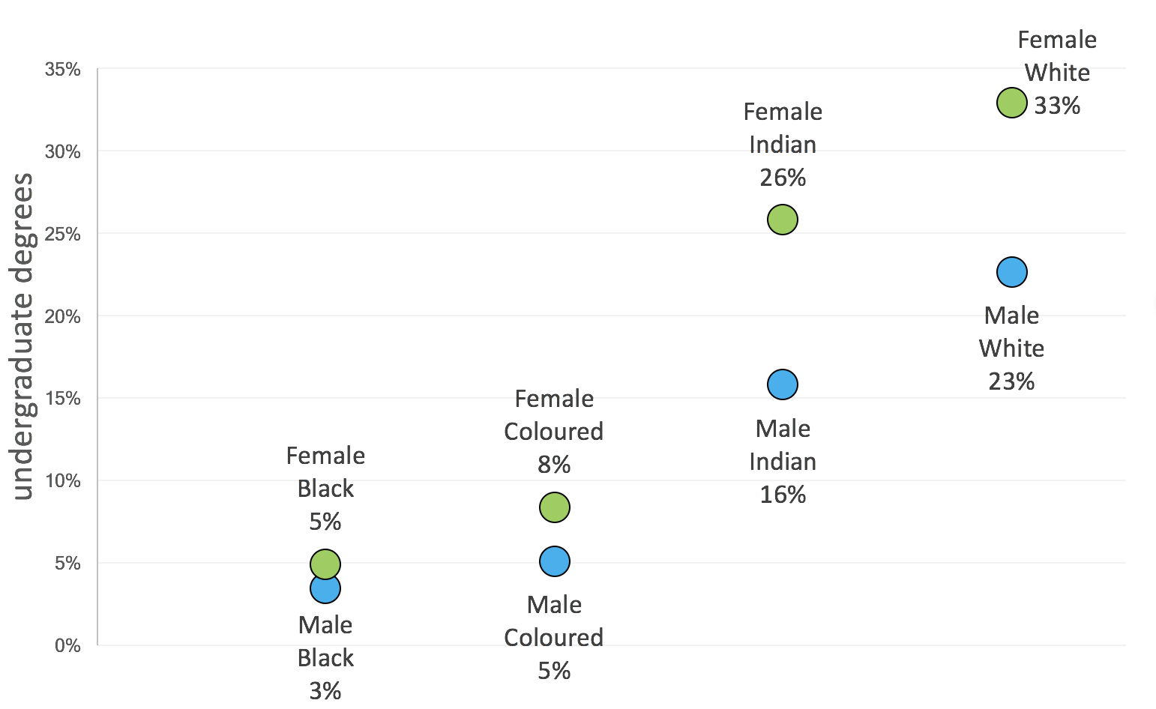
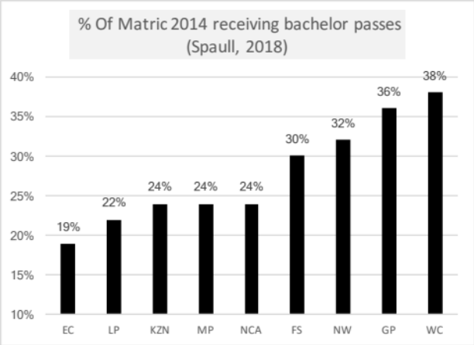
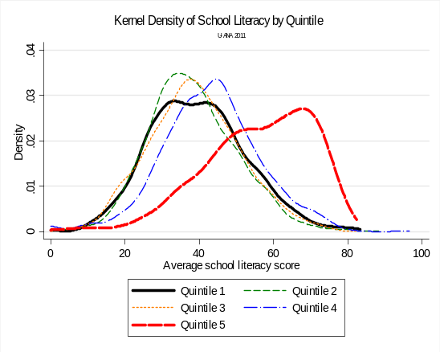
SA educ system
Language
Former department
Province
Quintile
SES
Race
Taylor, 2011

Slide 13
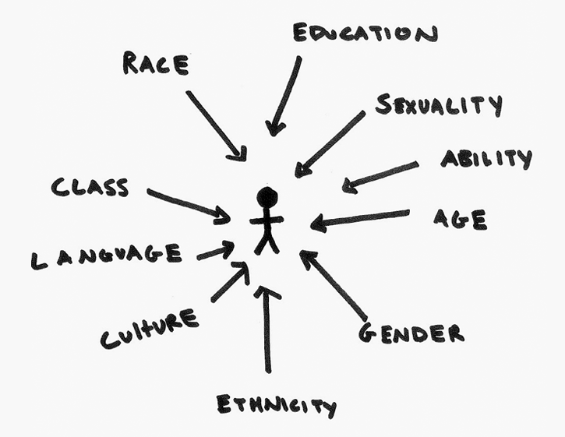
Refractions
We want to understand the underlying system/animal/geography.
Often we only see a slice of the system (representing one angle) and interpret it like it is the whole system.
Lots of ways of cutting up the data:
  Race
  Language
  Public vs private
  Quintile
  Fees
  Class
  Province
  Urban/rural
  Union membership
What is the underlying data-generating process?
A 3-D image in 2-D slices

Slide 14
Wobbly snowman of fees
Elite fees
(R20,000+ p.a.)
High-fee
(R12,000+ p.a.)
(SR, 2016)
5%
Q5
1,8%
10% pay R5,000 + p.a.
Mid-fee
R2,000-R12,000
9%
Low-fee
(R0 – R2000)
20%
24% pay
R0→R5000 p.a.
Q4
Children paying
no fees
66%
Q1-3
DBE 2018 Report on GHS, page 33

Slide 15
Elite fees
(R20,000+ p.a.)
90% of fee-charging primary schools are Eng or Afrikaans LOLT
High-fee
(R12,000+ p.a.)
(SR, 2016)
5%
85% of white learners attend fee-charging schools
Q5
1,8%
Mid-fee
R2,000-R12,000
9%
Less than half of schools in WC & GP are no-fee
All independent schools charge fees
Low-fee
(R0 – R2000)
20%
Q4
Race
Province
Language
Children paying
no fees
66%
More than 90% of schools in LP, EC and NW are no-fee schools
Q1-3
98% of learners attending no-fee schools are Black or Coloured
78% of no-fee primary schools are African-language LOLT
DBE 2018 Report on GHS, page 33

Slide 16
Uganda
NewGanda?
New Zealand

Slide 17


#FeesMustFall

Slide 18

How many students actually make it to university in SA?
How many of those who start school reach matric? Graduate with matric? Graduate with a degree?
New (2016) study followed the entire matric cohort of 2008 into university and tracked them 2009-2014
(Van Broekhuizen & Van der Berg, 2016)

Slide 19

How many students actually make it to university?

Slide 20

How many students actually make it to university?

Slide 21

How many students actually make it to university?

Slide 22

How many students actually make it to university?
Source: Van Broekhuizen & Van der Berg, 2016 (Higher Education Access and Outcomes for the 2008 National Matric Cohort)

Slide 23
How many students actually make it to university?
}
?
Source: Van Broekhuizen & Van der Berg, 2016 (Higher Education Access and Outcomes for the 2008 National Matric Cohort)

Slide 24


New Solutions for a New Future
Higher Education in SA: Inequality: Who accesses university?
Note: This is for a full cohort not just matrics
Source: Van Broekhuizen & Van der Berg, 2016 (Higher Education Access and Outcomes for the 2008 National Matric Cohort)

Slide 25
% of 2008 matric cohort attaining undergraduate degrees by race
Van Broekhuizen & Spaull (2017)

Slide 26

New Solutions for a New Future
That’s higher education, what about schooling?
Source: Van Broekhuizen & Van der Berg, 2016 (Higher Education Access and Outcomes for the 2008 National Matric Cohort)

Slide 27

PIRLS 2016 Low International Benchmark
If a learner can reach the PIRLS Low International Benchmark then they can
“locate and retrieve explicitly stated information, actions or ideas;
make straightforward inferences about events and reasons for actions; or
begin to interpret story events and central ideas” (Mullis et al, 2017; p.53).
  South Africa: 22%
  Finland: 98%
  United States: 96%
Mullis et al. 2017, p.55

Slide 28


78%
of Grade 4 children in South Africa can not read for meaning in any language.
PIRLS Literacy 2016 (Howie et al., 2017)

Slide 29
SA PIRLS 2016 results in context
Mullis et al. 2017

Slide 30


SA Gr4
Released passage from PIRLS Literacy 2016
40%
40%
32%
Mullis et al. 2017

Slide 31
PIRLS Literacy 2016
Figure 1: The percentage of Grade 4 learners who can read at a basic level (the PIRLS Low International Benchmark) by deciles of average school wealth. (Data: PIRLS Literacy 2016 with 95% confidence intervals, own calculations).
1 in 5
What does this look like in reality?

Slide 32

Draper, K., and Spaull, S. (2015). Examining oral reading fluency among grade 5 rural English Second Language (ESL) learners in South Africa: Analysis of NEEDU 2013. South African Journal of Childhood Education 5(2) pp.44-77.

Slide 33
What does this look like in reality?
Many
years
ago
Leopard
was
a
creature
with
no
spots.
Recommended rate at Gr5
One
day,
he
was
relaxing
in
the
shade
of
a
thorn
tree
when
Zebra
walked
past.
Many
years
ago
Leopard
was
a
creature
with
no
spots.
40% of SA rural Gr5 learners (<40WCPM) WCPM
One
day,
he
was
relaxing
in
the
shade
of
a
thorn
tree
when
Zebra
walked
past.
Draper, K., and Spaull, S. (2015). Examining oral reading fluency among grade 5 rural English Second Language (ESL) learners in South Africa: Analysis of NEEDU 2013. South African Journal of Childhood Education 5(2) pp.44-77.
Notes:
40 words in 60s = 1,5s/word
130 words in 60s = 0,46s/word

Slide 34
Labour Market
Uni
&
FET
High productivity jobs and incomes (17%)
Mainly professional, managerial & skilled jobs
Requires graduates, good quality matric or good vocational skills
Historically mainly white
6%
15%
Legislators, managers, assoc professionals
Unemployed
(Broad - 35%)
Unskilled
(18%)
Elementary occupations & domestic workers
Semi-Skilled (32%)
Clerks, service workers, shop personnel, skilled agric/fishery workers, plant and machinery operators)
13%
High quality secondaryschool
High SES background
+ECD
High quality primary school
? %
?
Minority (25%)
Unequal society
7%
Big demand for good schools despite fees
Some scholarships/bursaries
Majority (75%)
Vocational training
Affirmative action
Attainment
Quality
Type
Low quality secondary
school
Low productivity jobs & incomes
Often manual or low skill jobs
Limited or low quality education
Minimum wage can exceed productivity
Low SES background
Low quality primary school
QLFS 2014
Notes:
The QLFS classifies professions as follows: Highly skilled (legislators, senior officials and managers, professionals, technicians and associate profesionals); Semi-skilled (Clerks, service workers and shop and market personnel, skilled agricultural and fishery workers, craft and related trade workers, plant and machinery operators and assembly), Unskilled (Elementary occupations, domestic workers).

Slide 35
What is business’ role in all of this?

Slide 36
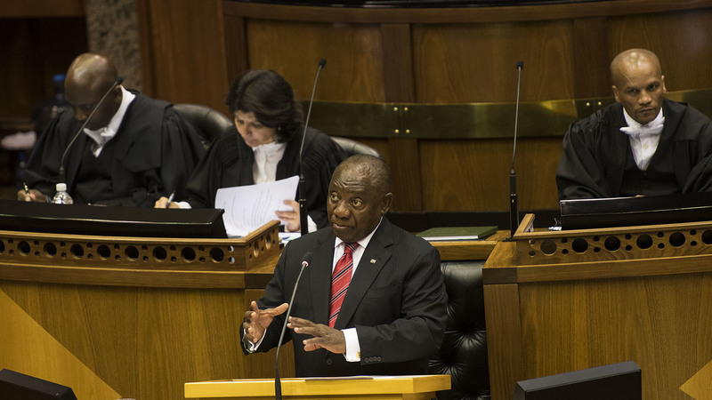
“We agree on five fundamental goals for the next decade….let us agree, as a nation and as a people united in our aspirations, that within the next 10 years we will have made progress in tackling poverty, inequality and unemployment, where:
No person in South Africa will go hungry.
Our economy will grow at a much faster rate than our population.
Two million more young people will be in employment.
Our schools will have better educational outcomes and every 10 year old will be able to read for meaning.
Violent crime will be halved.
Let us make these commitments now – to ourselves and to each other – knowing that they will stretch our resources and capabilities, but understanding that if we achieve these five goals, we will have fundamentally transformed our society.”
- President Cyril Ramaphosa (SONA, 21 June 2019)

Slide 37
Ramaphosa’s Big 5
Economic Growth
Youth Employment
Early Grade Reading
Violent Crime
Hunger

Slide 38
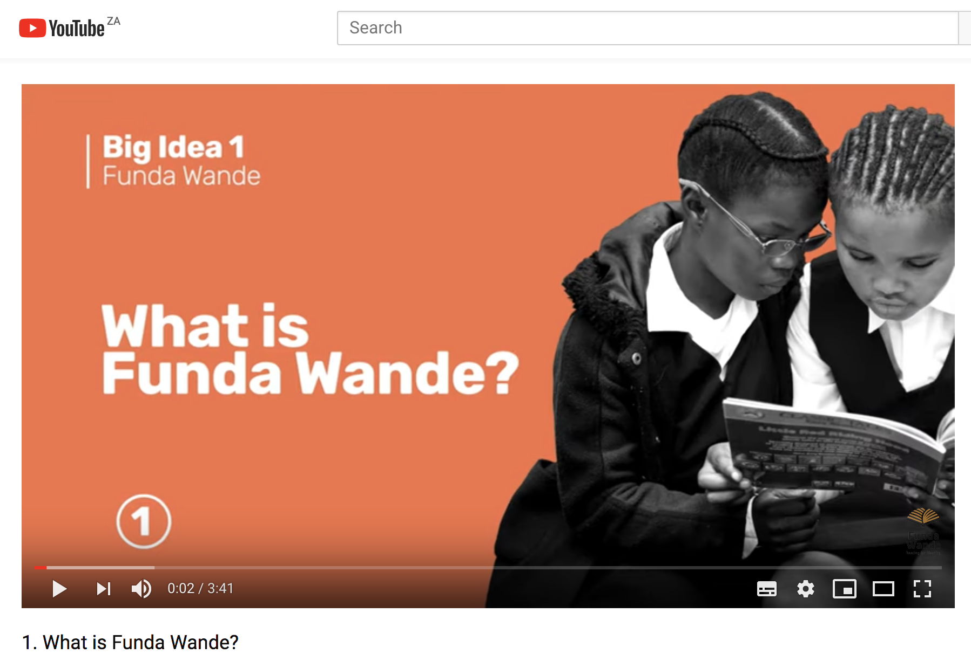

Slide 39
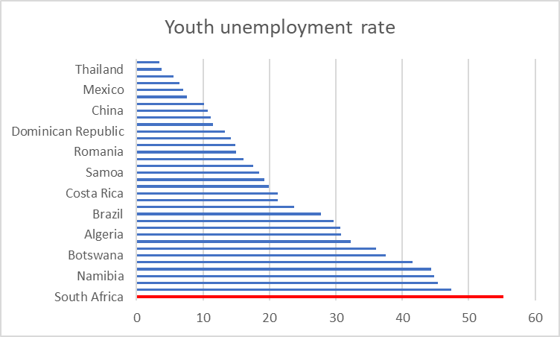
Youth unemployment in SA

Slide 40
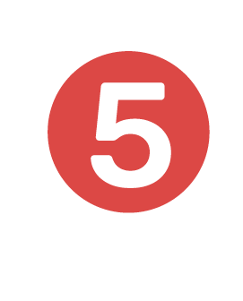
76%
of Limpopo youth aged 15-25 are unemployed.
Unemployment in SA (Q1 2019)
(Broad Definition of Unemployment)
National
Youth
  (15-25 year olds)
Limpopo youth
    (15-25 year olds)
How bad is the youth unemployment problem in SA?

Slide 41



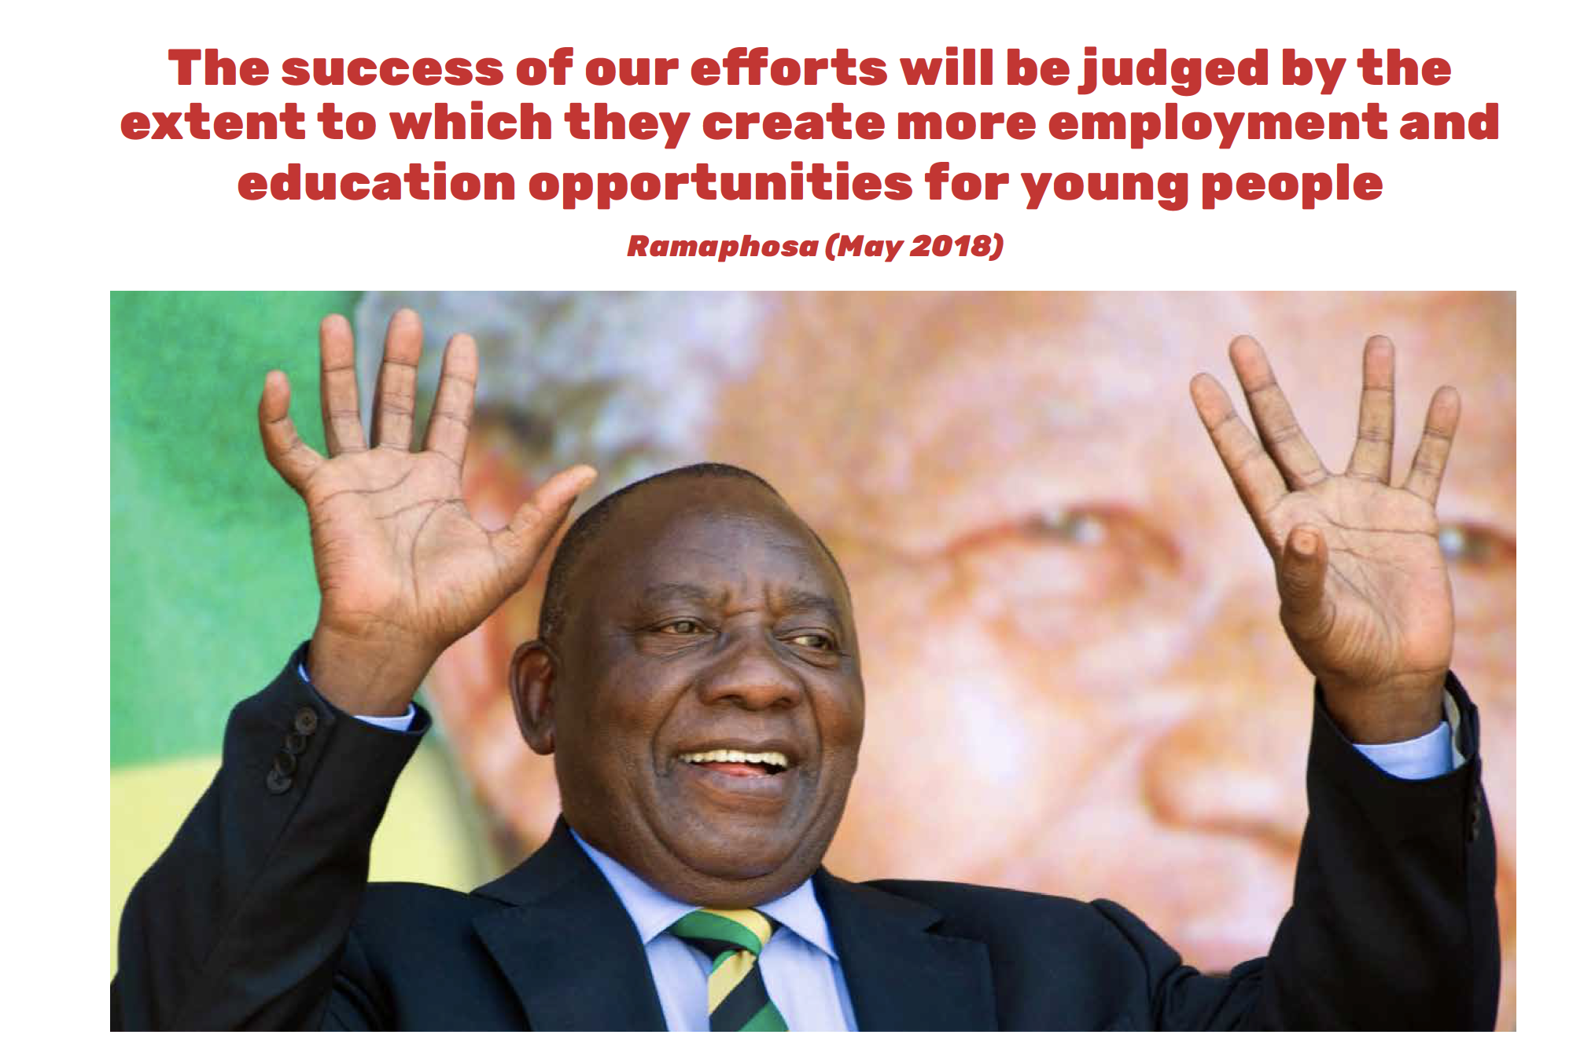

Slide 42
How does social change happen?

Slide 43
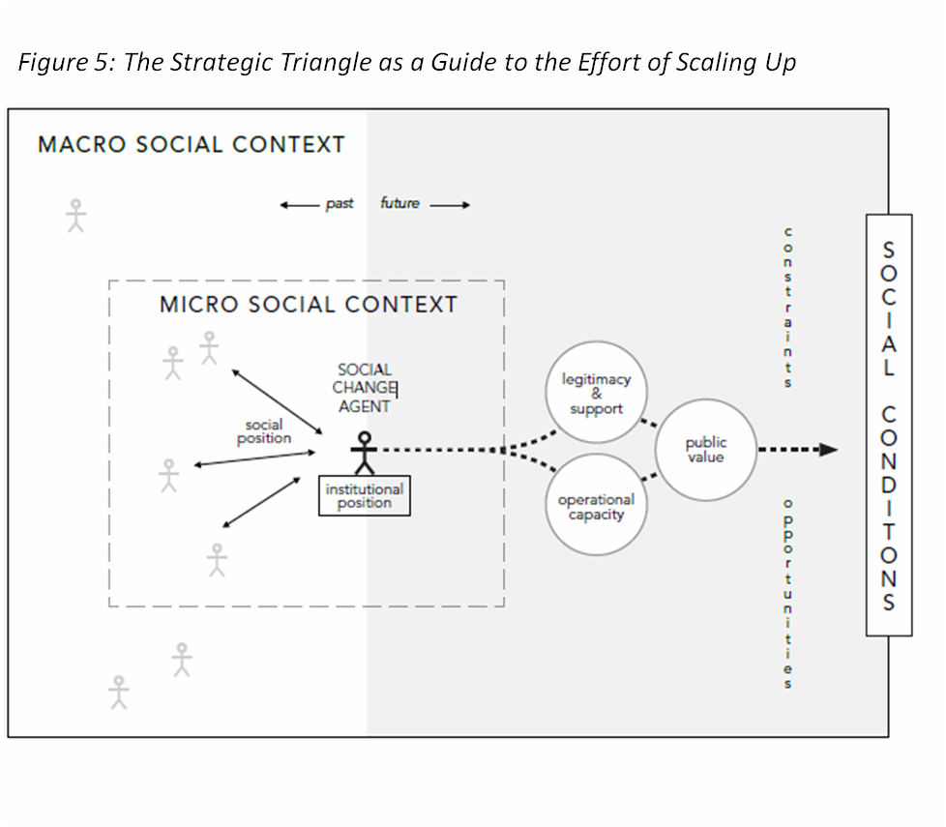
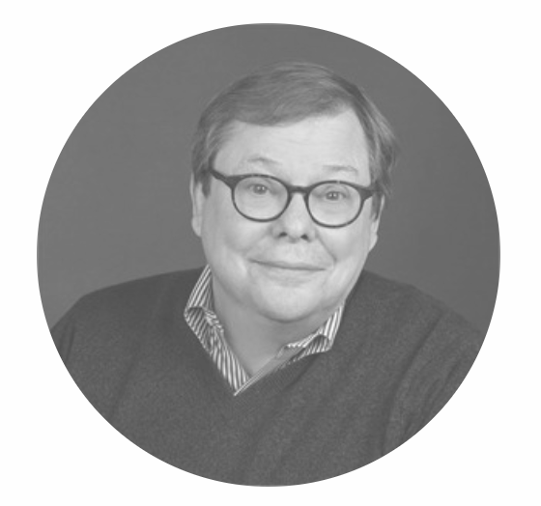
Prof Mark Moore
Harvard

Slide 44
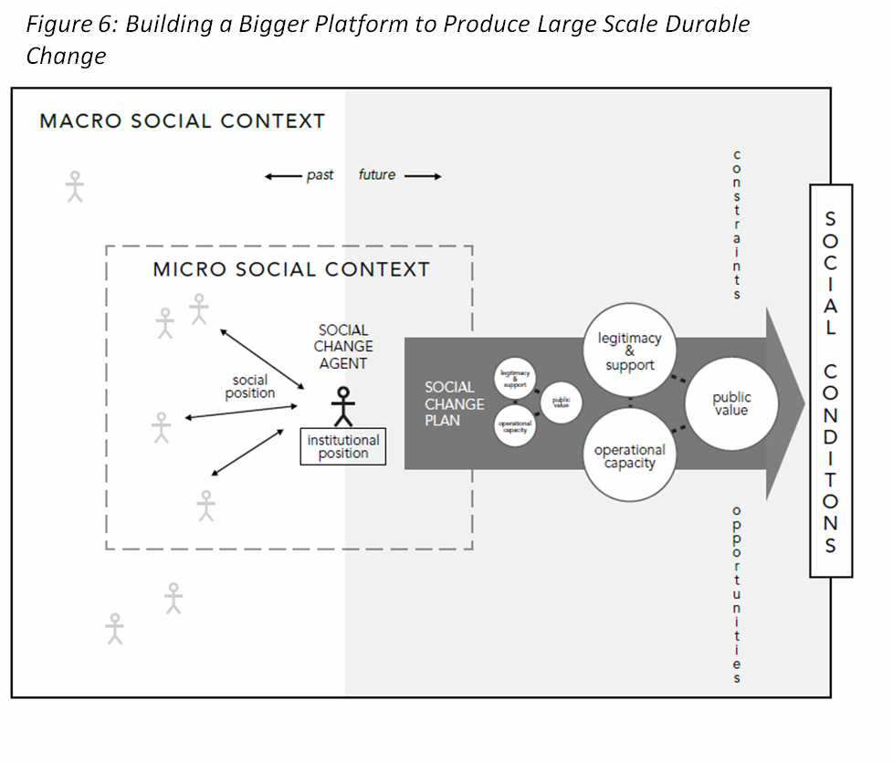

Prof Mark Moore
Harvard

Slide 45
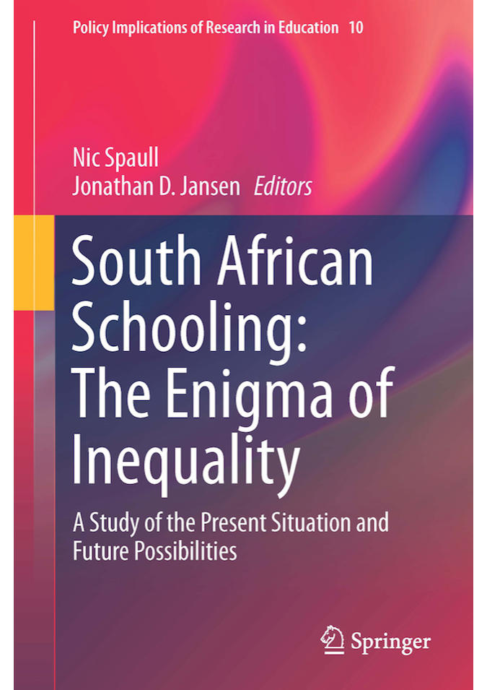
Equity: A Price too high to pay?

Slide 46
No peace without justice
“Justice requires not only the ceasing and desisting of injustice but also requires either punishment or reparation for injuries and damages inflicted for prior wrongdoing. The essence of justice is the redistribution of gains earned through the perpetration of injustice. If restitution is not made and reparations not instituted to compensate for prior injustices, those injustices are in effect rewarded. And the benefits such rewards conferred on the perpetrators of injustice will continue to “draw interest,” to be reinvested, and to be passed on to their children … Consequently, injustice and inequality will be maintained across the generations as will their deleterious social, economic, and political outcomes.”
Amos Wilson

Slide 47

Comments
&
Questions?
Nicspaull.com/presentations nicspaull@gmail.com

Slide 48

Labour Market
15%
Legislators, managers, assoc professionals
Unemployed
(Broad - 35%)
Unskilled
(18%)
Elementary occupations & domestic workers
Semi-Skilled (32%)
Clerks, service workers, shop personnel, skilled agric/fishery workers, plant and machinery operators)
University/FET
Type of institution (FET or University)
Quality of institution
Type of qualification (diploma, degree)
Field of study (Engineering, Arts etc.)
High quality secondaryschool
High SES background + ECD
High quality primary school
ECD
Minority (20%)
Some motivated, lucky or talented students make the transition
Unequal society
Why education?
Big demand for good schools despite fees
Some scholarships/bursaries
Majority (80%)
Quality
Low quality secondary
school
Attainment
Type
Low socioeconomic status background
Low quality primary school
ECD
None or
low-quality
Statistics from Quarterly Labour Force Survey (QLFS) 2014 Q4
Notes:
The QLFS classifies professions as follows: Highly skilled (legislators, senior officials and managers, professionals, technicians and associate profesionals); Semi-skilled (Clerks, service workers and shop and market personnel, skilled agricultural and fishery workers, craft and related trade workers, plant and machinery operators and assembly), Unskilled (Elementary occupations, domestic workers).

Slide 49
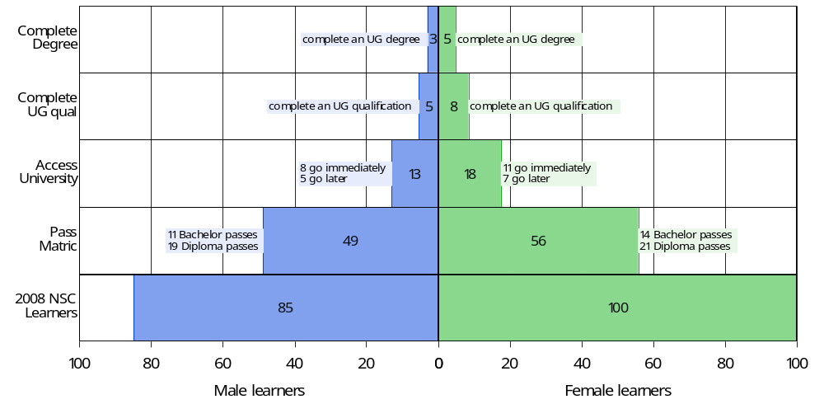
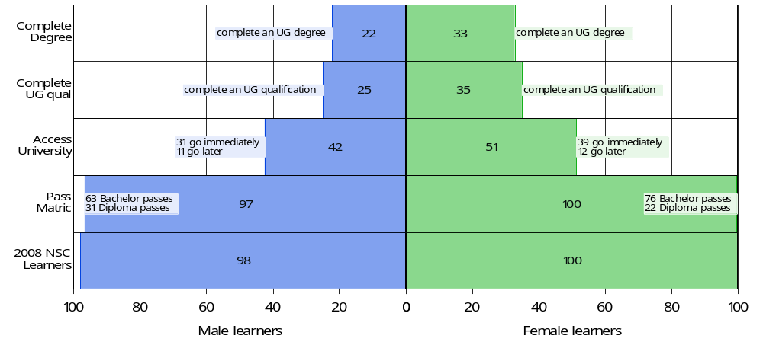
Black African cohort
White cohort

Slide 50

Findings (1)
National HE outcomes by gender (2008 NSC cohort)
Figure 1: National higher education outcomes by gender (2008 NSC Cohort)

Slide 51
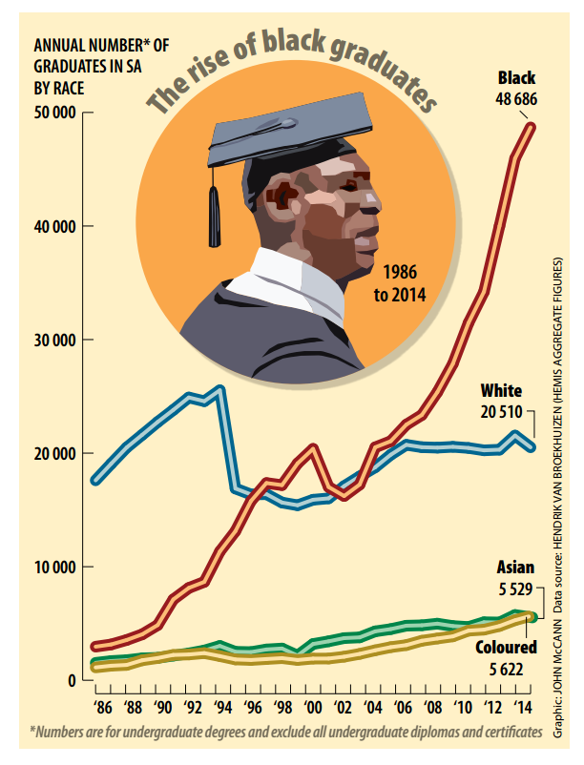
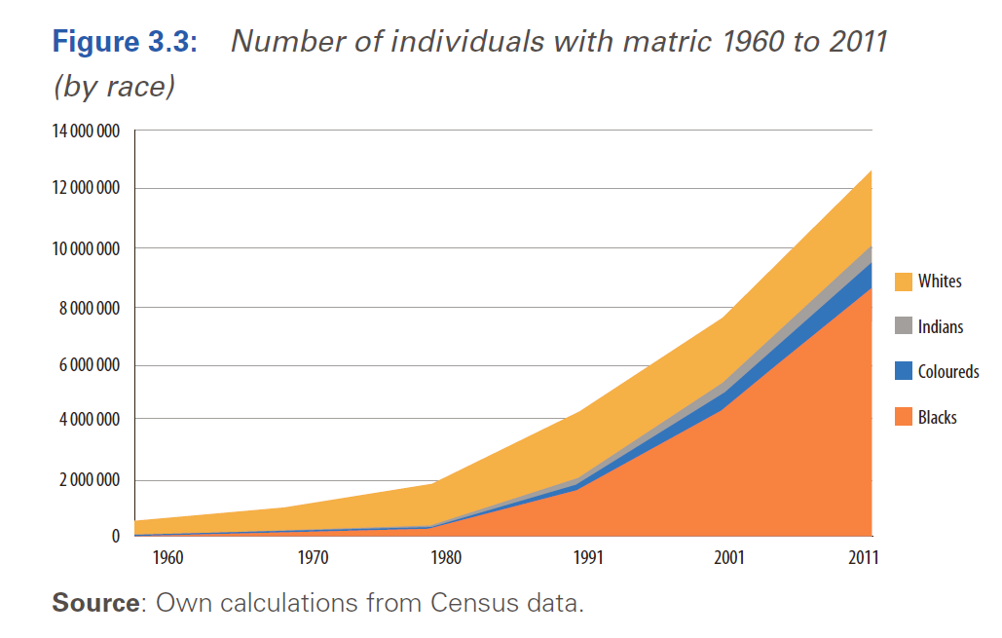
Higher Education in South Africa
New Solutions for a New Future
According to HEMIS between 1994 and 2014, the number of black graduates with degrees being produced each year has
increased by 429%,
from about 11 339 (in 1994) to 20513 (in 2004) and 48686 graduates (in 2014)
https://nicspaull.files.wordpress.com/2016/05/spaull-mg-13-may.pdf
(Moses et al 2017)

