Slide 1

4 ways to
stay safe online
With the growing presence and sophistication of online threats like viruses, ransomware, and phishing scams, it’s important to have the right protection. Office 365 Home and Office 365 Personal give you advanced security tools to help keep your information secure and private.
Getting Reading Right
Nic Spaull
WCED MSED | 6 September 2019

Slide 2
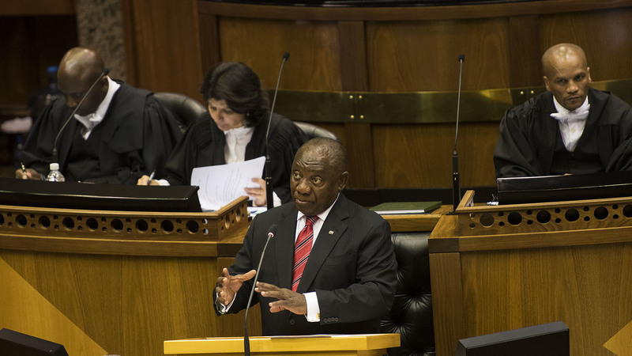
“We agree on five fundamental goals for the next decade….let us agree, as a nation and as a people united in our aspirations, that within the next 10 years we will have made progress in tackling poverty, inequality and unemployment, where:
No person in South Africa will go hungry.
Our economy will grow at a much faster rate than our population.
Two million more young people will be in employment.
Our schools will have better educational outcomes and every 10 year old will be able to read for meaning.
Violent crime will be halved.
Let us make these commitments now – to ourselves and to each other – knowing that they will stretch our resources and capabilities, but understanding that if we achieve these five goals, we will have fundamentally transformed our society.”
- President Cyril Ramaphosa (SONA, 21 June 2019)

Slide 3
Ramaphosa’s Big 5
Economic Growth
Youth Employment
Early Grade Reading
Violent Crime
Hunger

Slide 4


#FeesMustFall

Slide 5

How many students actually make it to university in SA?
How many of those who start school reach matric? Graduate with matric? Graduate with a degree?
New (2016) study followed the entire matric cohort of 2008 into university and tracked them 2009-2014
(Van Broekhuizen & Van der Berg, 2016)

Slide 6

How many students actually make it to university?

Slide 7

How many students actually make it to university?

Slide 8

How many students actually make it to university?

Slide 9

How many students actually make it to university?
Source: Van Broekhuizen & Van der Berg, 2016 (Higher Education Access and Outcomes for the 2008 National Matric Cohort)

Slide 10
How many students actually make it to university?
}
?
Source: Van Broekhuizen & Van der Berg, 2016 (Higher Education Access and Outcomes for the 2008 National Matric Cohort)

Slide 11


New Solutions for a New Future
Higher Education in SA: Inequality: Who accesses university?
?
Note: This is for a full cohort not just matrics
Source: Van Broekhuizen & Van der Berg, 2016 (Higher Education Access and Outcomes for the 2008 National Matric Cohort)

Slide 12
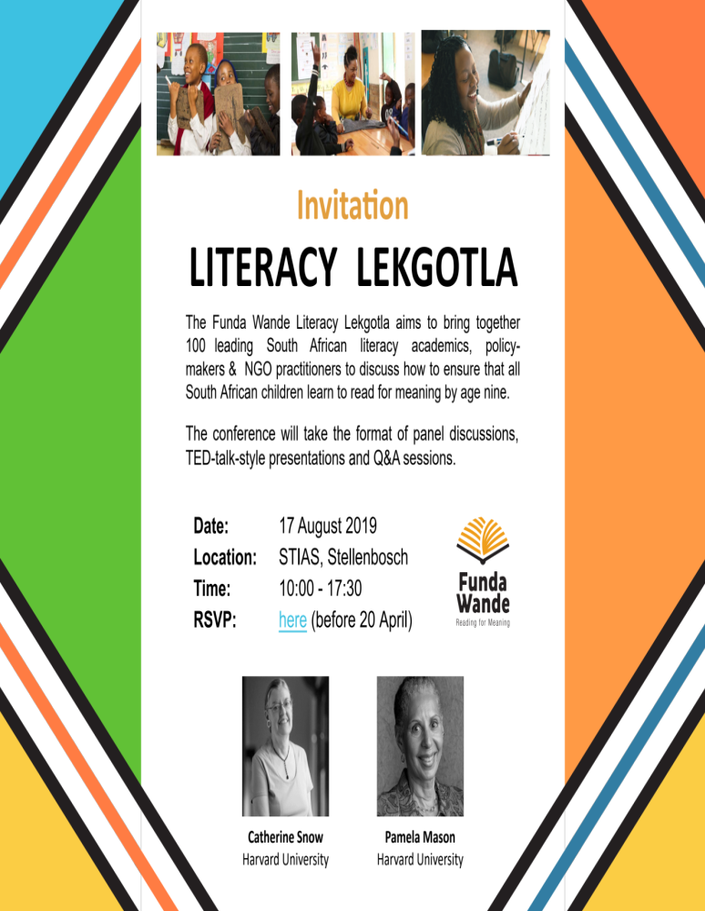
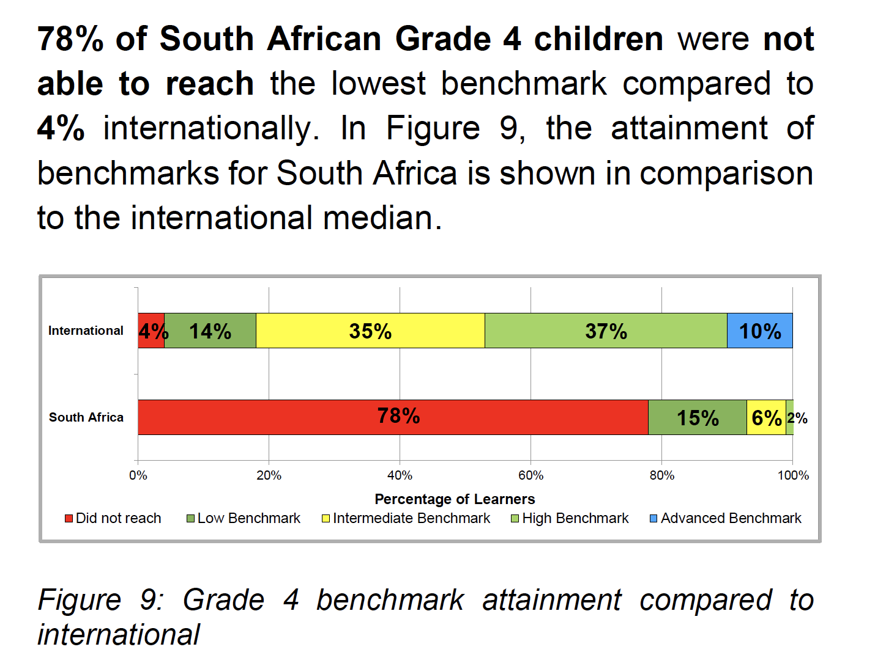
What do we know about reading comprehension in SA?
78%
of South African Gr4 learners cannot read for meaning in any language

Slide 13
What do we know about reading comprehension in SA?
% reaching the PIRLS 2016 Low International Benchmark

Slide 14

40
WCPM
Words Correct Per Minute

Slide 15
What does this look like in reality?
Many
years
ago
Leopard
was
a
creature
with
no
spots.
Recommended rate at Gr5
One
day,
he
was
relaxing
in
the
shade
of
a
thorn
tree
when
Zebra
walked
past.
Many
years
ago
Leopard
was
a
creature
with
no
spots.
40% of SA rural Gr5 learners (<40WCPM) WCPM
One
day,
he
was
relaxing
in
the
shade
of
a
thorn
tree
when
Zebra
walked
past.
Draper, K., and Spaull, S. (2015). Examining oral reading fluency among grade 5 rural English Second Language (ESL) learners in South Africa: Analysis of NEEDU 2013. South African Journal of Childhood Education 5(2) pp.44-77.
Notes:
40 words in 60s = 1,5s/word
130 words in 60s = 0,46s/word

Slide 16
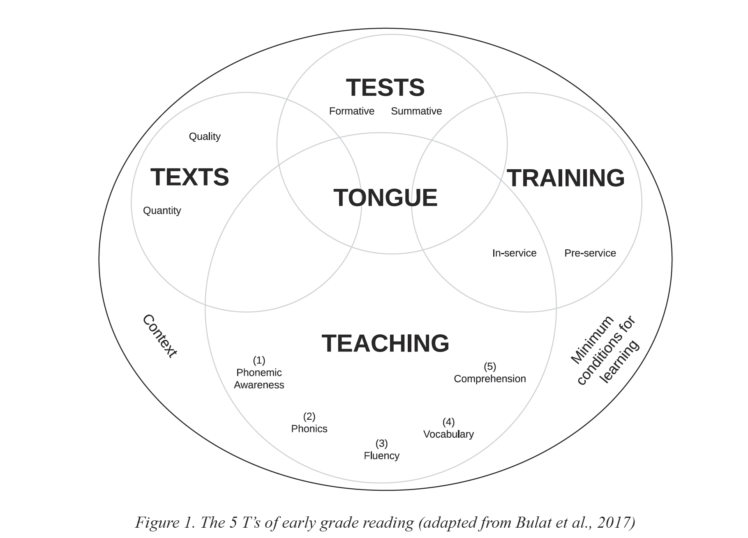
5 ‘Ts’ model
Spaull, 2019: BRILL-IBE: Improving Early Literacy Outcomes

Slide 17
5 ‘Ts’ model
When and how should children be assessed? What should the results be used for?
4 ways to
stay safe online
With the growing presence and sophistication of online threats like viruses, ransomware, and phishing scams, it’s important to have the right protection. Office 365 Home and Office 365 Personal give you advanced security tools to help keep your information secure and private.
What resources & texts do teachers need in order to teach reading for meaning?
What training do we need to give pre-service and in-service teachers to equip them to teach reading for meaning?
What language(s) should children be taught in, when should they be introduced, how, & for how long?
How can we address each of the 5T’s in ways that see children and their languages as assets and in ways that are socio-culturally relevant & fiscally possible?
What should we teach children (components) and how should we teach it (pedagogy)?
What are the minimum conditions for learning & how do we ensure they are met? Realistic but non-negotiable.

Slide 18
4 ways to
stay safe online
With the growing presence and sophistication of online threats like viruses, ransomware, and phishing scams, it’s important to have the right protection. Office 365 Home and Office 365 Personal give you advanced security tools to help keep your information secure and private.
“Funda Wande aims to equip teachers with the knowledge, resources and support they need to teach reading for meaning by age 10.”

Slide 19
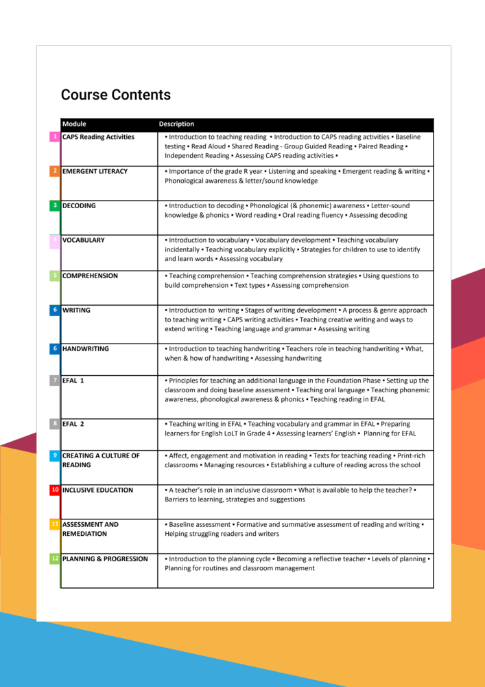
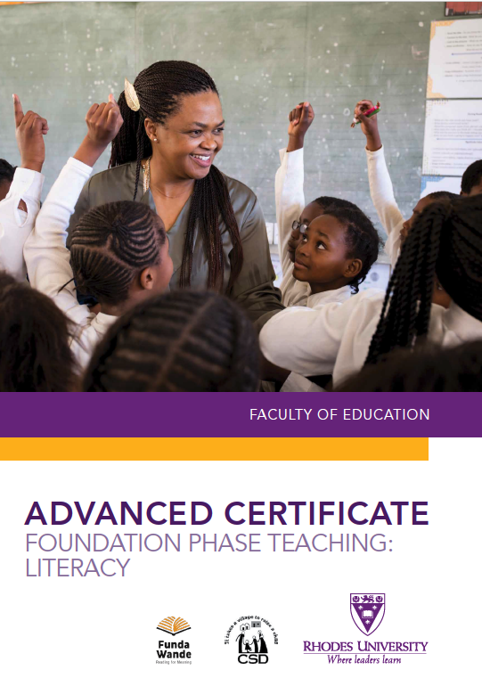

Slide 20

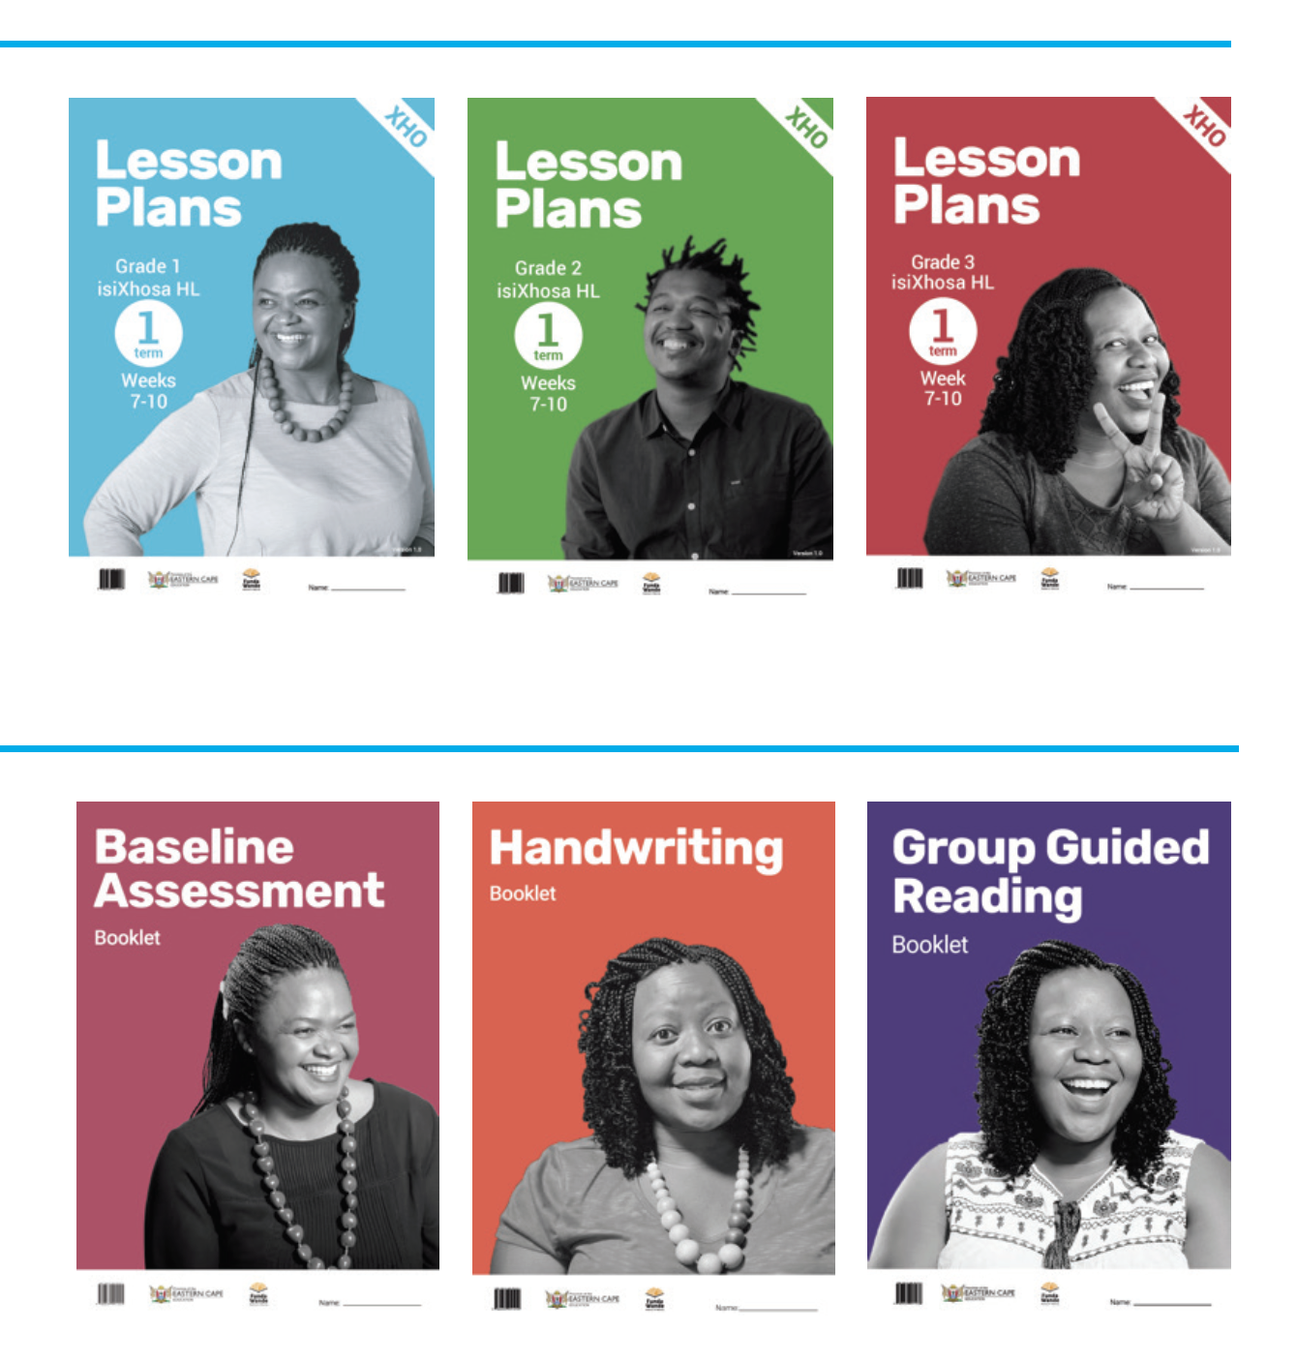
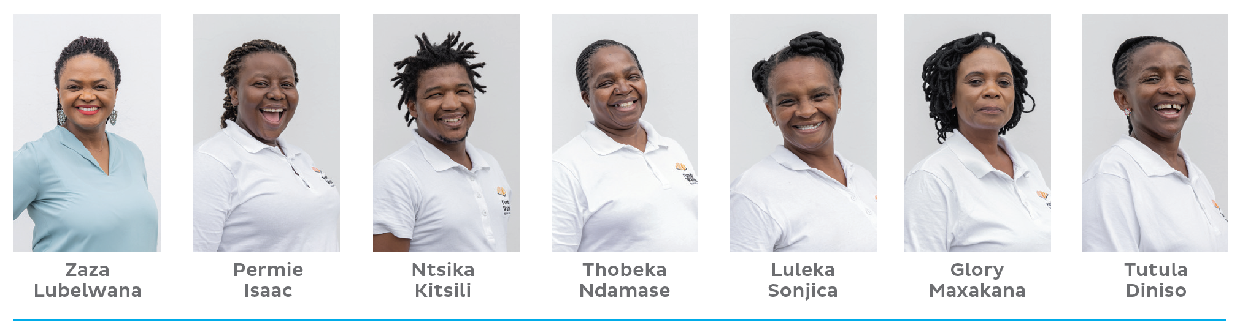

Slide 21
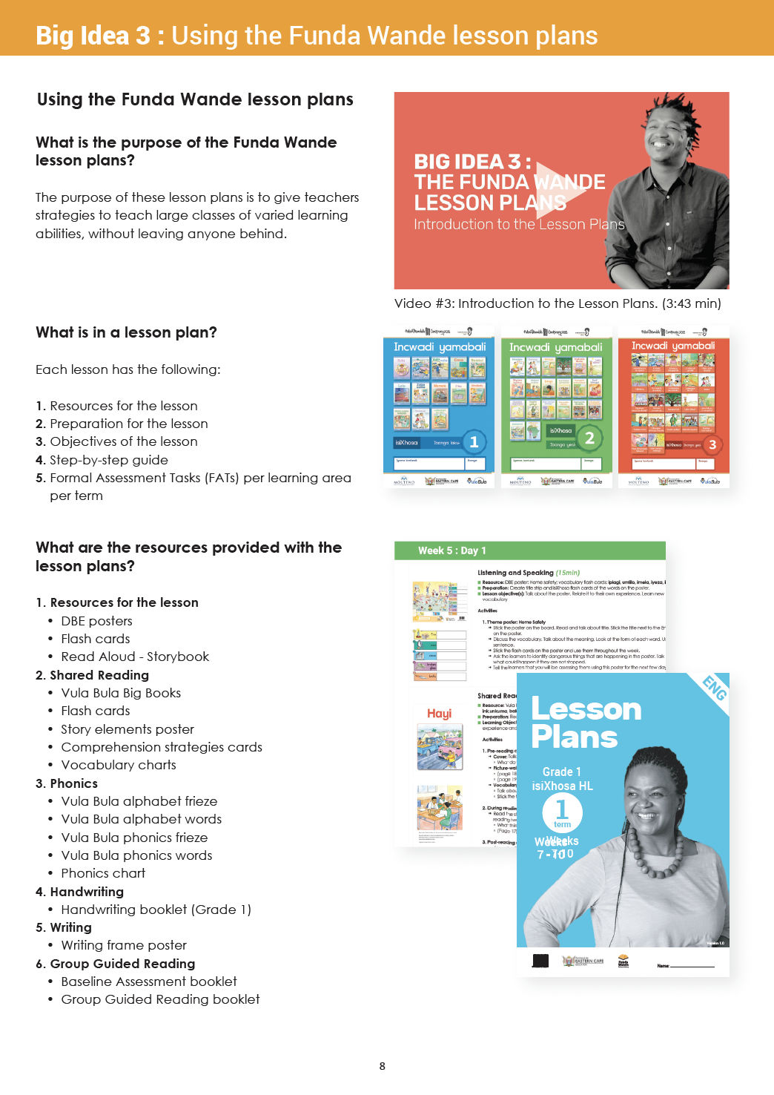
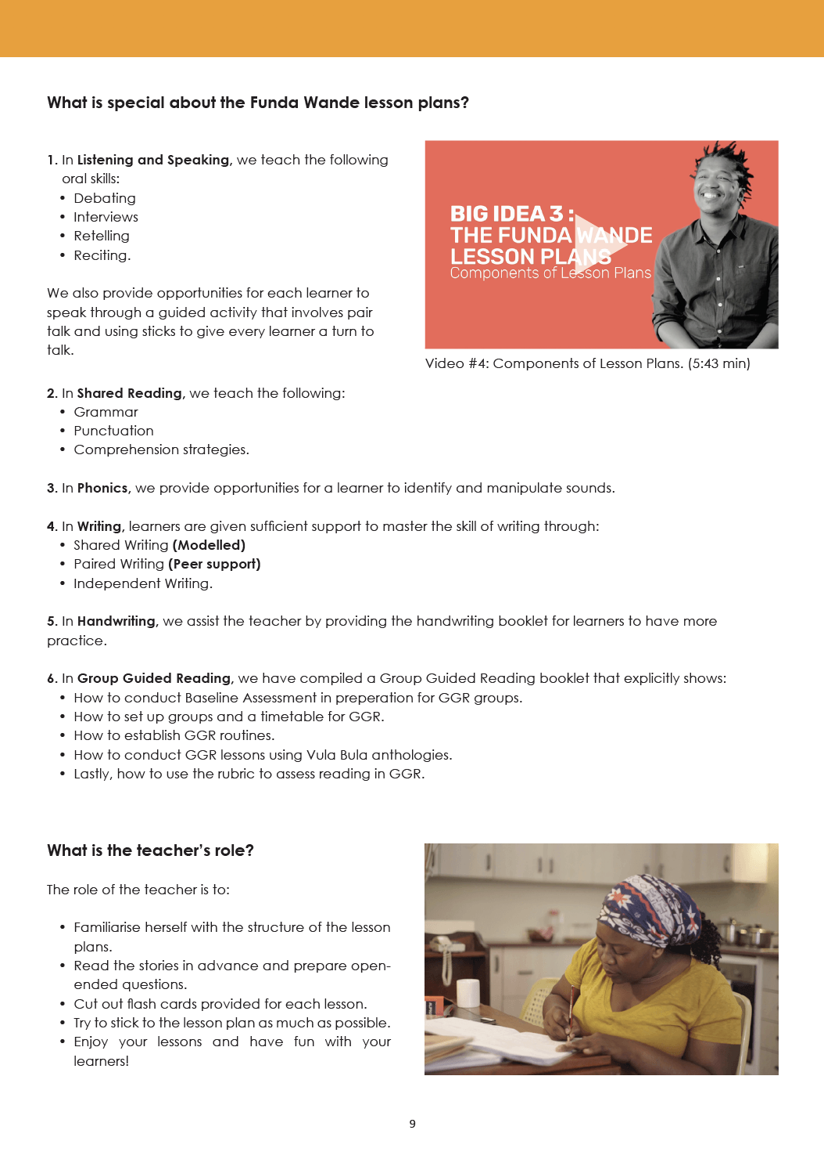

Slide 22
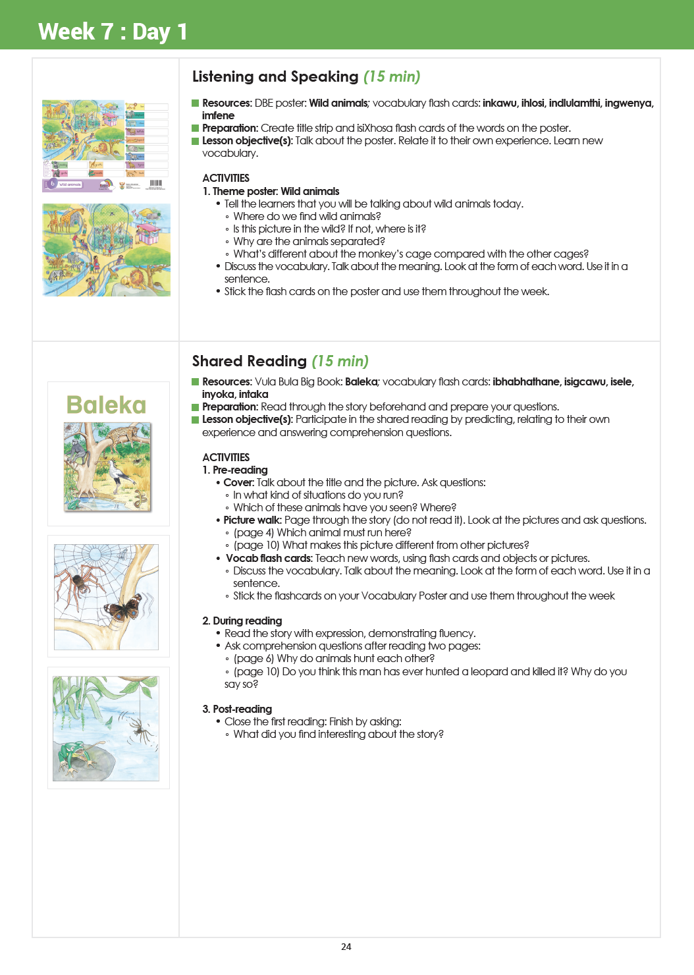
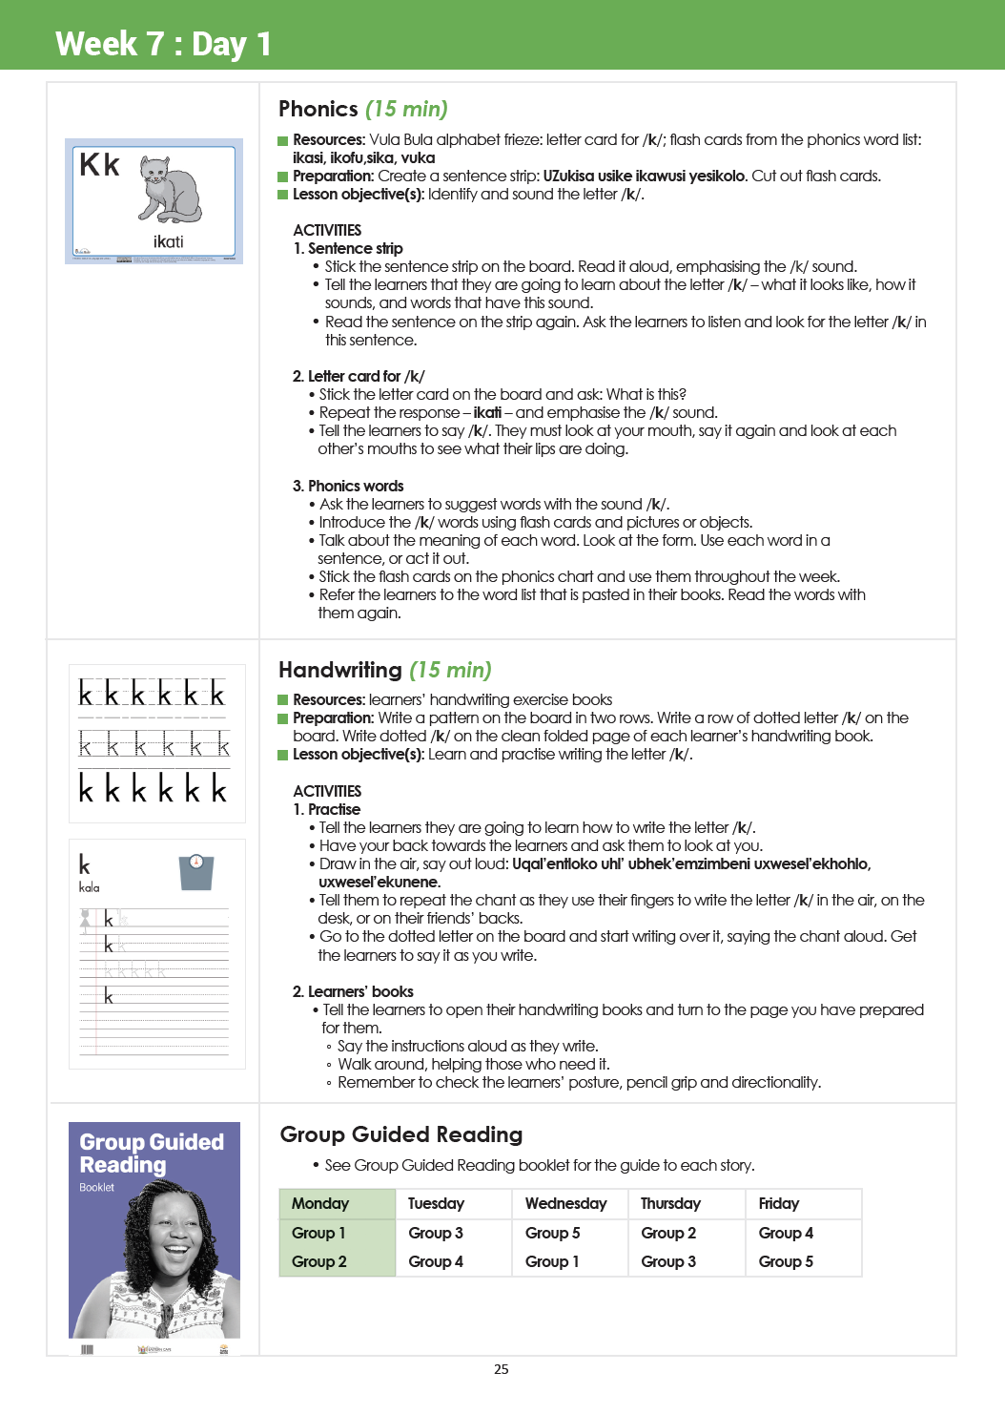

Slide 23
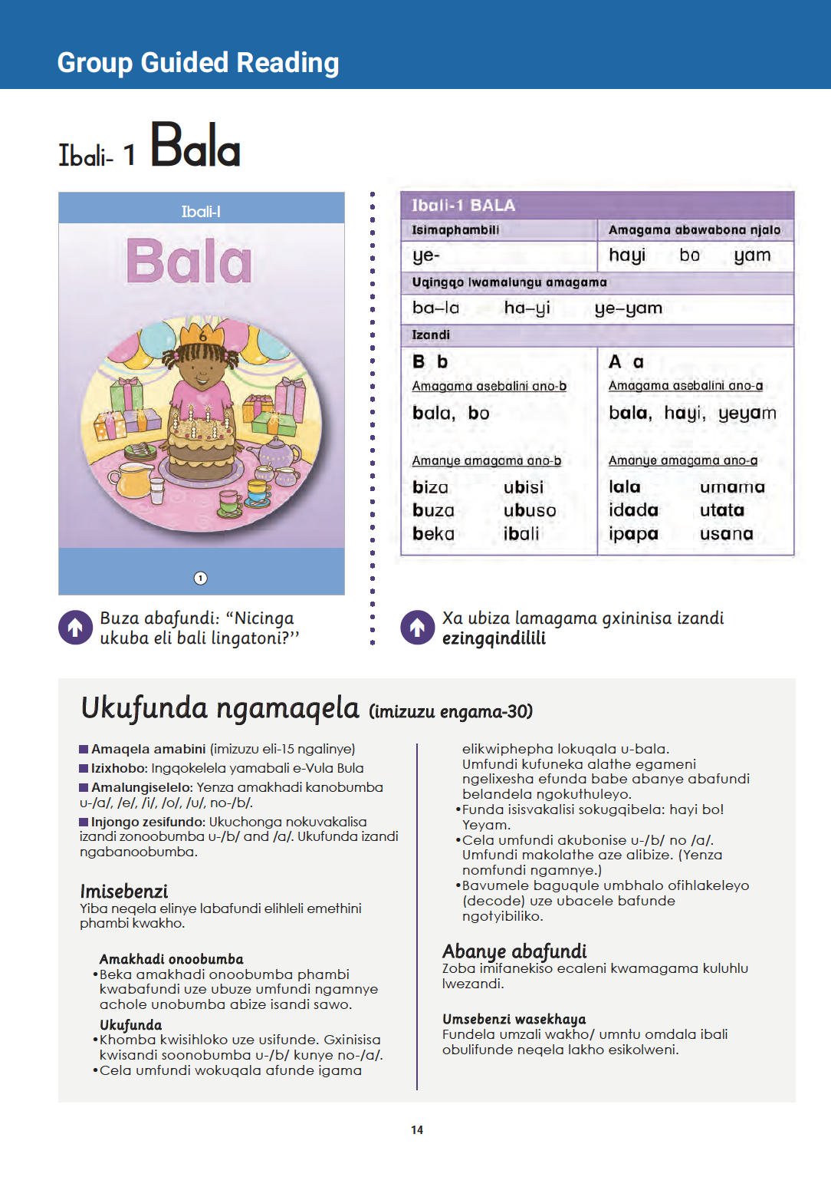
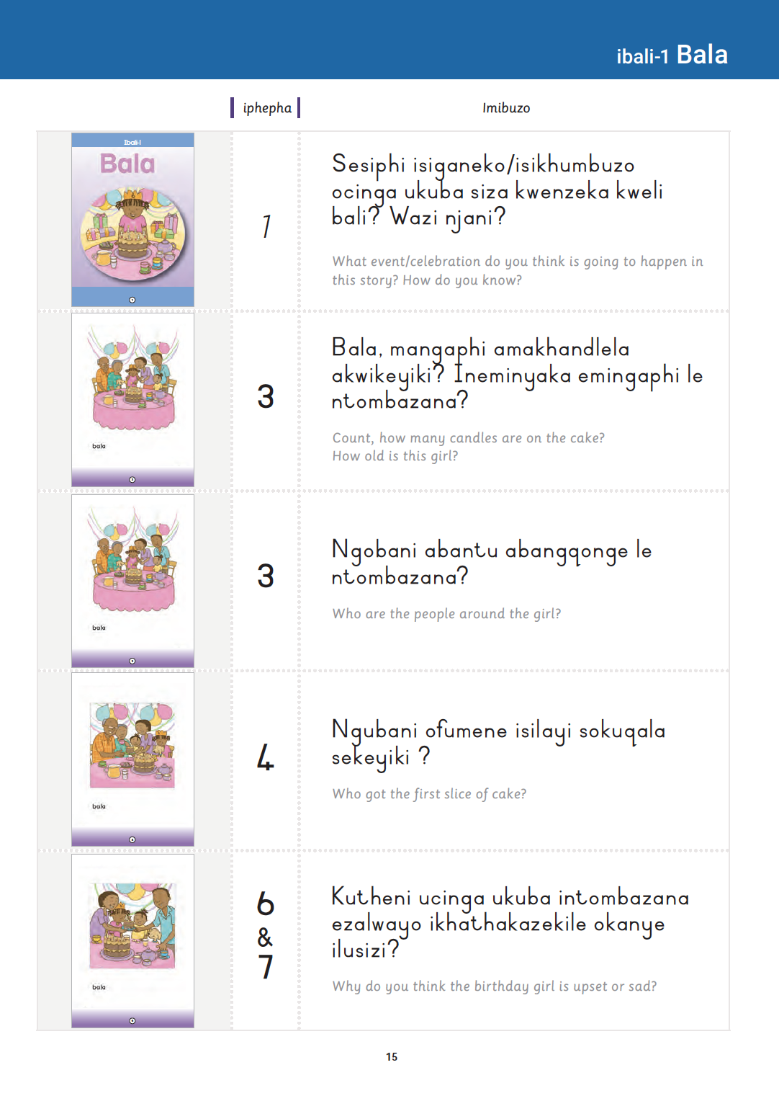

Slide 25
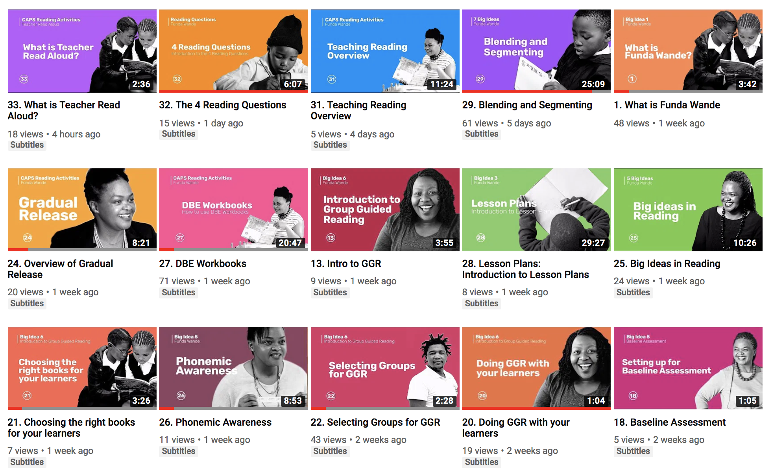

Slide 26
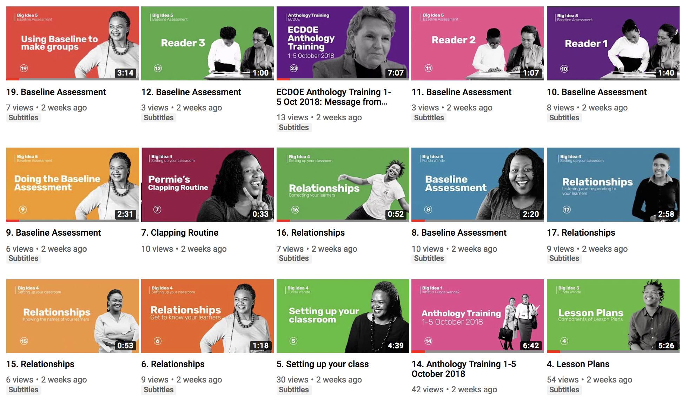

Slide 27

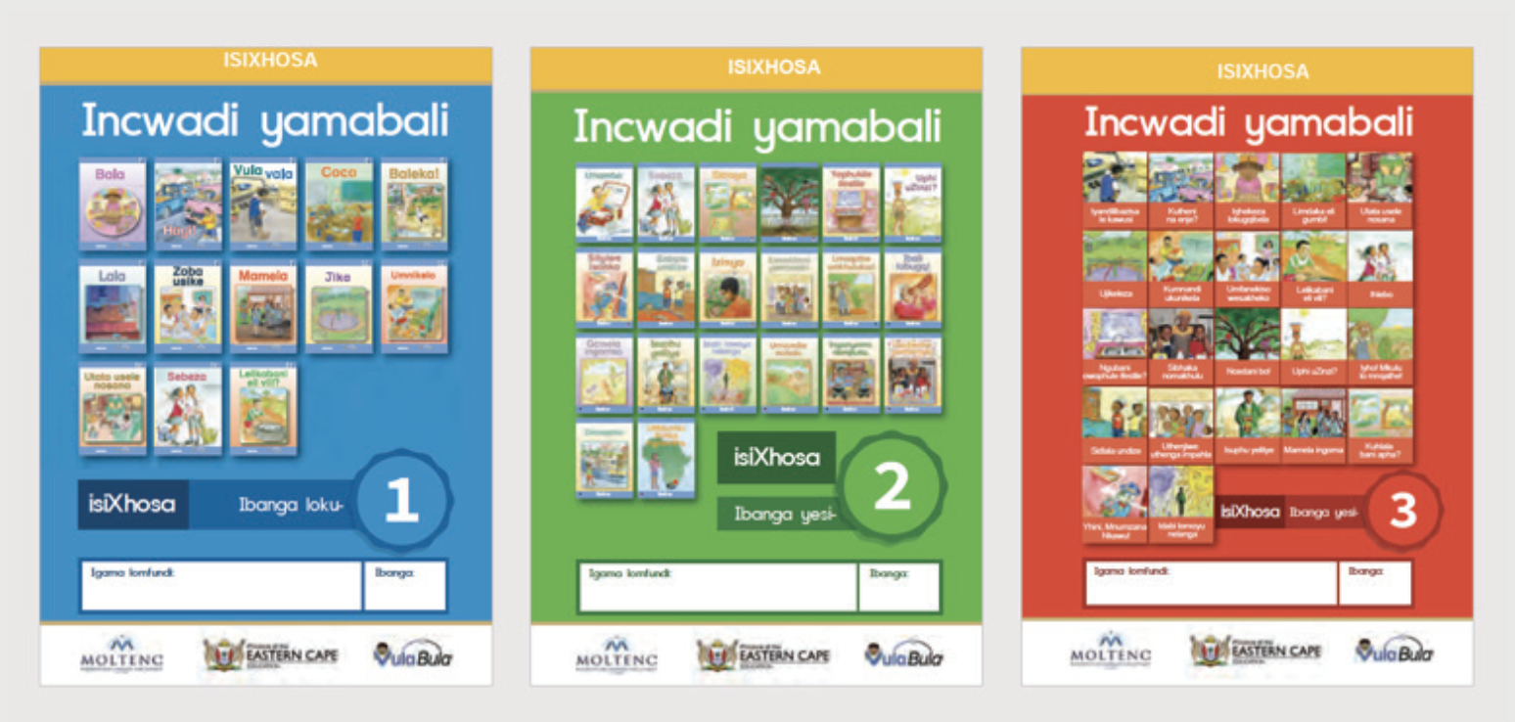
824,345 anthologies printed and distributed by ECDOE.

Slide 28

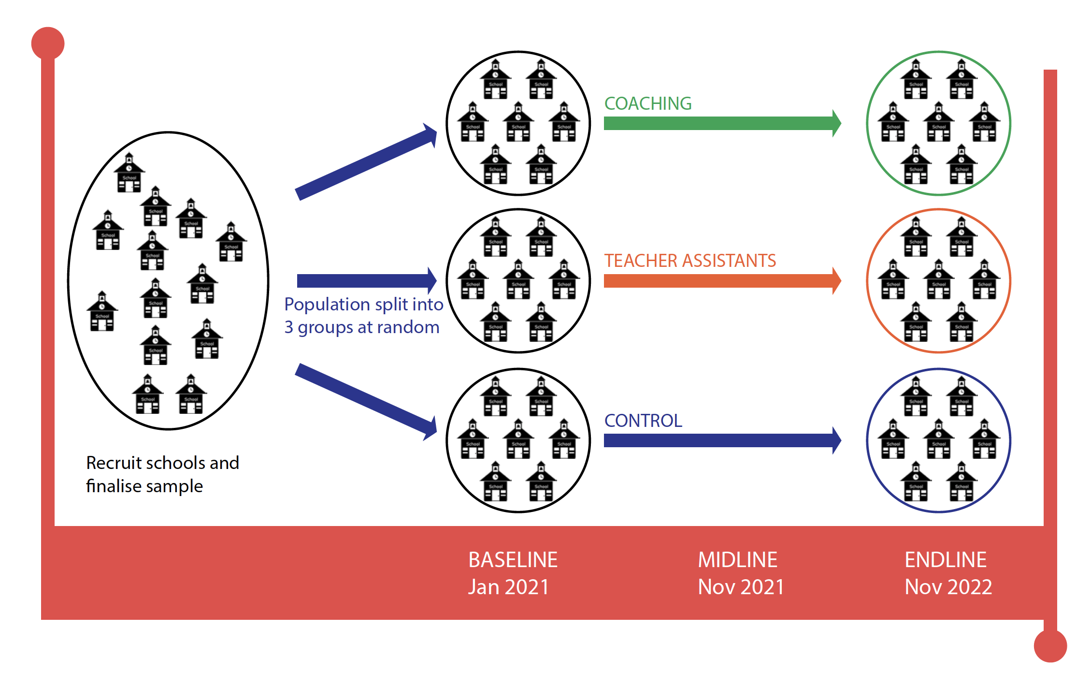
Limpopo 2021-2022
Prof Cally Ardington
(UCT & JPAL)

Slide 29
Limpopo 2021-2022
Prof Cally Ardington
(UCT & JPAL)
40
40
120
40
40
40
40

Slide 30


Getting Reading Right
Prioritize FP Literacy & Numeracy!

Slide 31
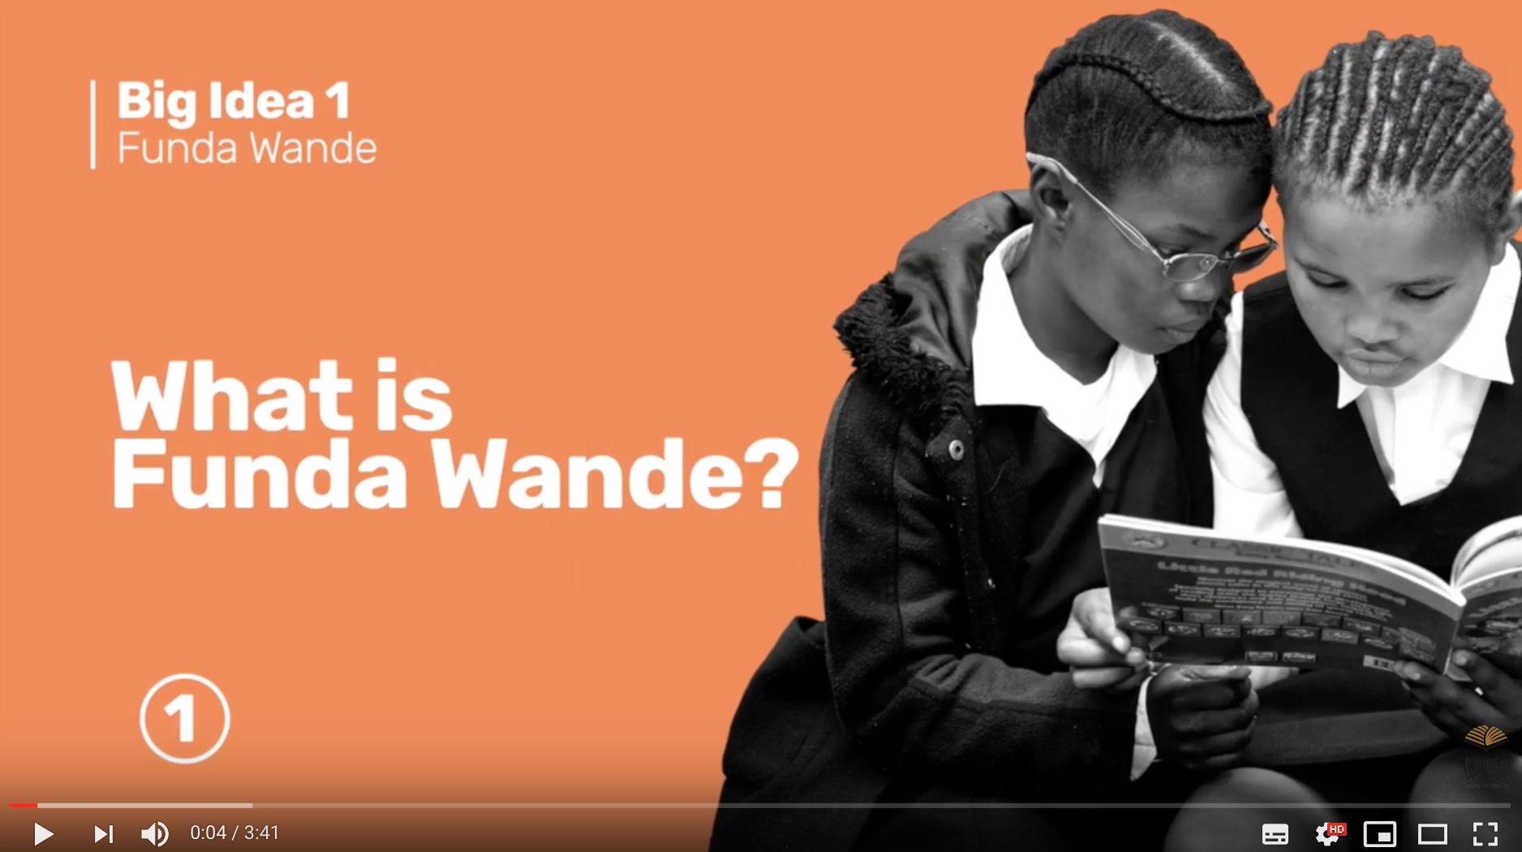

Slide 32
4 ways to
stay safe online
With the growing presence and sophistication of online threats like viruses, ransomware, and phishing scams, it’s important to have the right protection. Office 365 Home and Office 365 Personal give you advanced security tools to help keep your information secure and private.
“Funda Wande aims to equip teachers with the knowledge, resources and support they need to teach reading for meaning by age 10.”

Slide 33
What do we know about reading comprehension in SA?
NO
improvement
1,4 year improvement

Slide 34
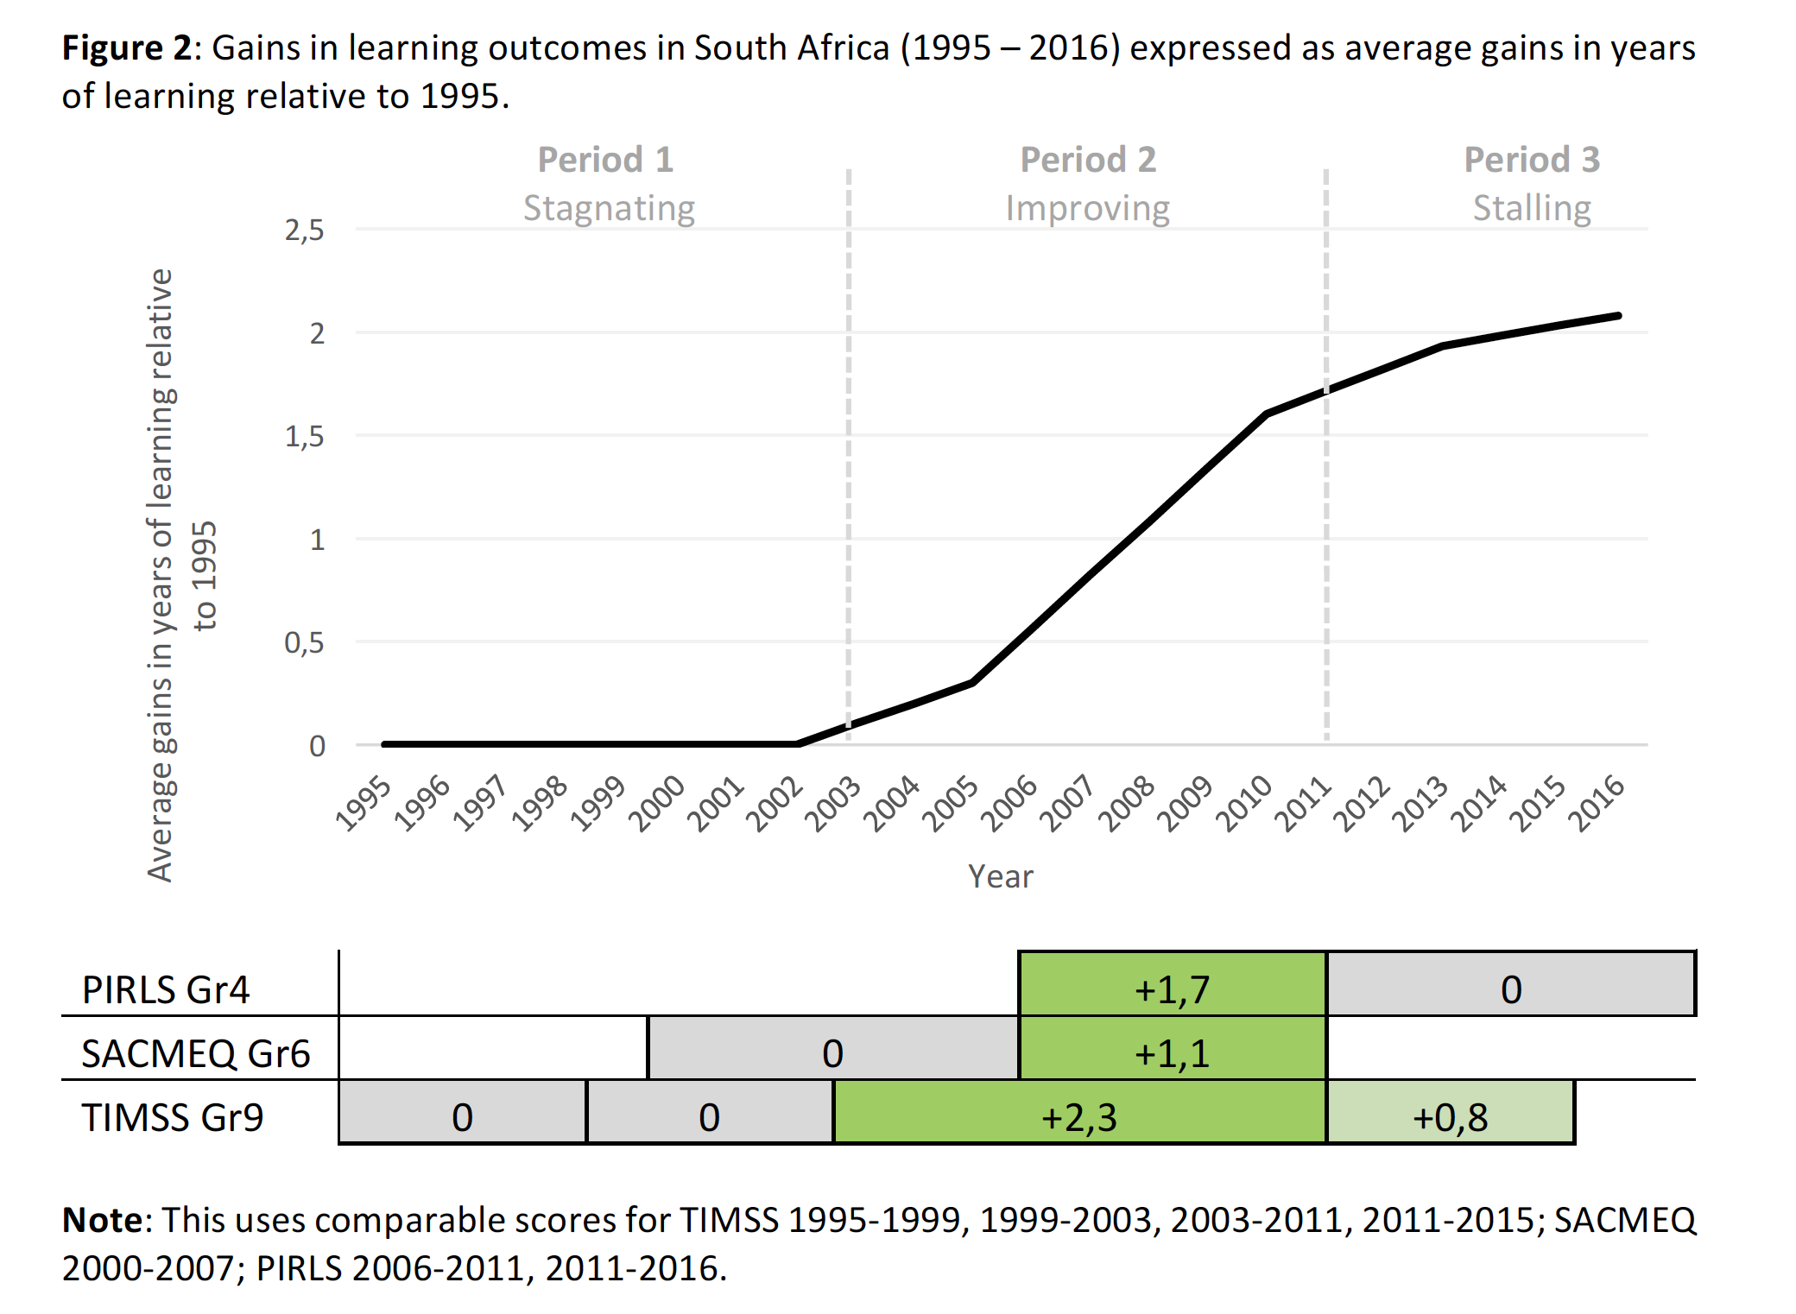
Stagnating improvement
Spaull, 2018 – Springer Book

Slide 35
SIRP 2019 report on 12 HEI’s in SA:
“This survey reveals that only a few of the HEIs focus specifically on language literacy and even fewer on teaching reading with comprehension in particular. Seemingly, only a few HEIs teach “learning to read”. The focus is rather on honing already existing reading skills or on advanced reading skills. While a number of HEIs have included some of the components of teaching reading in their curriculum, none of them have included all of them…None of the HEIs refers to the “Big Five” of reading.”
(See also ITREP report)
4 ways to
stay safe online
With the growing presence and sophistication of online threats like viruses, ransomware, and phishing scams, it’s important to have the right protection. Office 365 Home and Office 365 Personal give you advanced security tools to help keep your information secure and private.

Slide 36
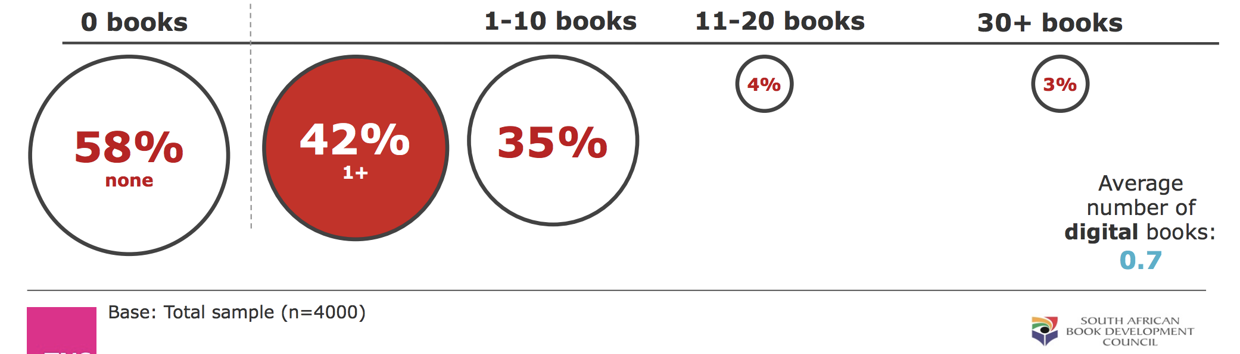
4 ways to
stay safe online
With the growing presence and sophistication of online threats like viruses, ransomware, and phishing scams, it’s important to have the right protection. Office 365 Home and Office 365 Personal give you advanced security tools to help keep your information secure and private.
2016 SA Reader Survey
(Book Council & DGMT)
58% of adult South Africans (16+) have no printed books in their home.
7% of adult South Africans (16+) have more than 10 printed books in their home.
93% of adult South Africans (16+) have less than 11 printed books in their home.
2017 School Monitoring Survey
(DBE)
61% of primary schools have access to a central school library or mobile library. (Q1:49%; Q5: 88%) (SMS 2017)
The 2018 report of the National Education Infrastructure Management System (NEIMS) indicates that while 5,423 schools out of 23,471 have libraries (30%), only 3,304 were actually stocked (17%) (Department of Basic education, 2018, p. 5).

Slide 37
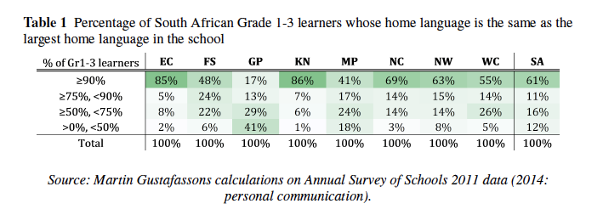
4 ways to
stay safe online
Annual Survey of Schools (2011)
In 70% of schools, at least 70% of FP learners speak the same home language.
Gauteng is a massive outlier.
(Martin Gustafsson)
With the growing presence and sophistication of online threats like viruses, ransomware, and phishing scams, it’s important to have the right protection. Office 365 Home and Office 365 Personal give you advanced security tools to help keep your information secure and private.

Slide 38
4 ways to
stay safe online
With the growing presence and sophistication of online threats like viruses, ransomware, and phishing scams, it’s important to have the right protection. Office 365 Home and Office 365 Personal give you advanced security tools to help keep your information secure and private.
Testing
There is currently no nationally-standardised exam before the school leaving exam in matric.
“Practically all SADC country tests or examines every primary-level learner through some national system. The exception is Angola, which is still building its education system in the wake of its civil war.” (Martin Gustafsson report on Testing).
In 70% of 68 developing countries there is a national primary school exam (UNESCO).

Slide 39
4 ways to
stay safe online
With the growing presence and sophistication of online threats like viruses, ransomware, and phishing scams, it’s important to have the right protection. Office 365 Home and Office 365 Personal give you advanced security tools to help keep your information secure and private.

Slide 41
Forces for change
“78% of Gr4 learners cannot read for meaning in any language”
(PIRLS 2016)
Government Policy
“We need different policies!”
Law & Litigation
“There oughta be a law! A Right to Read.”
Professional Norms, Knowledge, Ideology
“We need to train teachers how to teach reading!”
Market Forces (Supply & Demand)
“The State is failing, we need new schools”
Social & Political Movements
“This is intolerable & unjust, we need to mobilize”
Philanthropy, Interventions & Volunteerism
“We need better ideas!”
(Mark Mason, HKS)

Slide 42
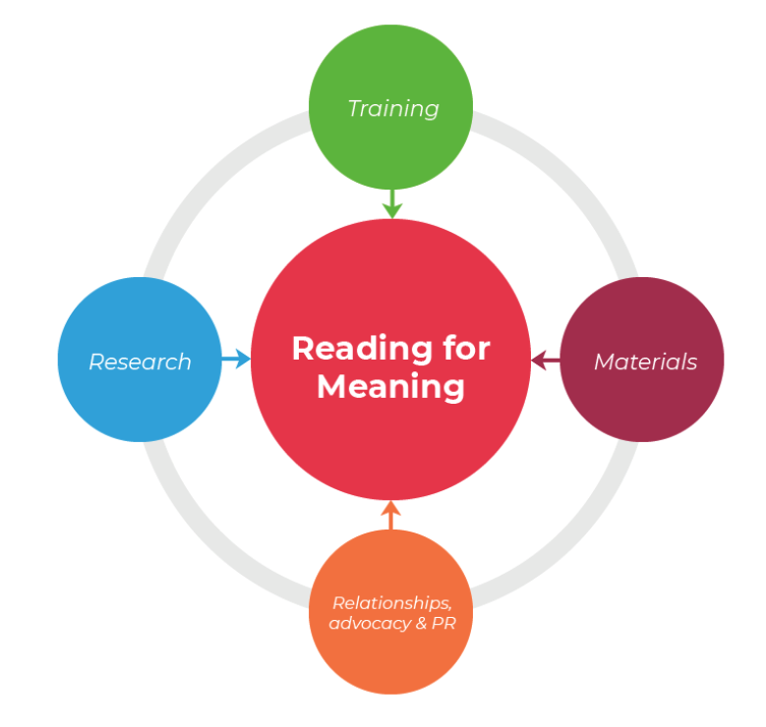
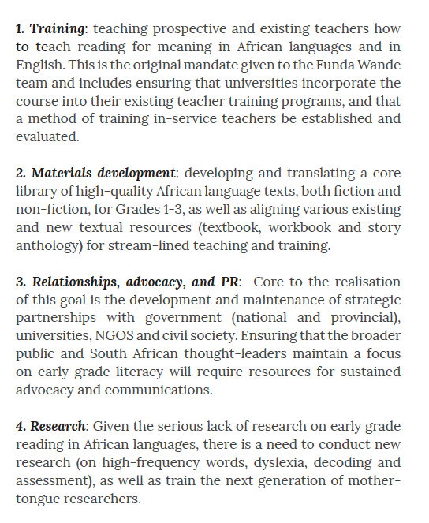
4 Program Areas

Slide 43
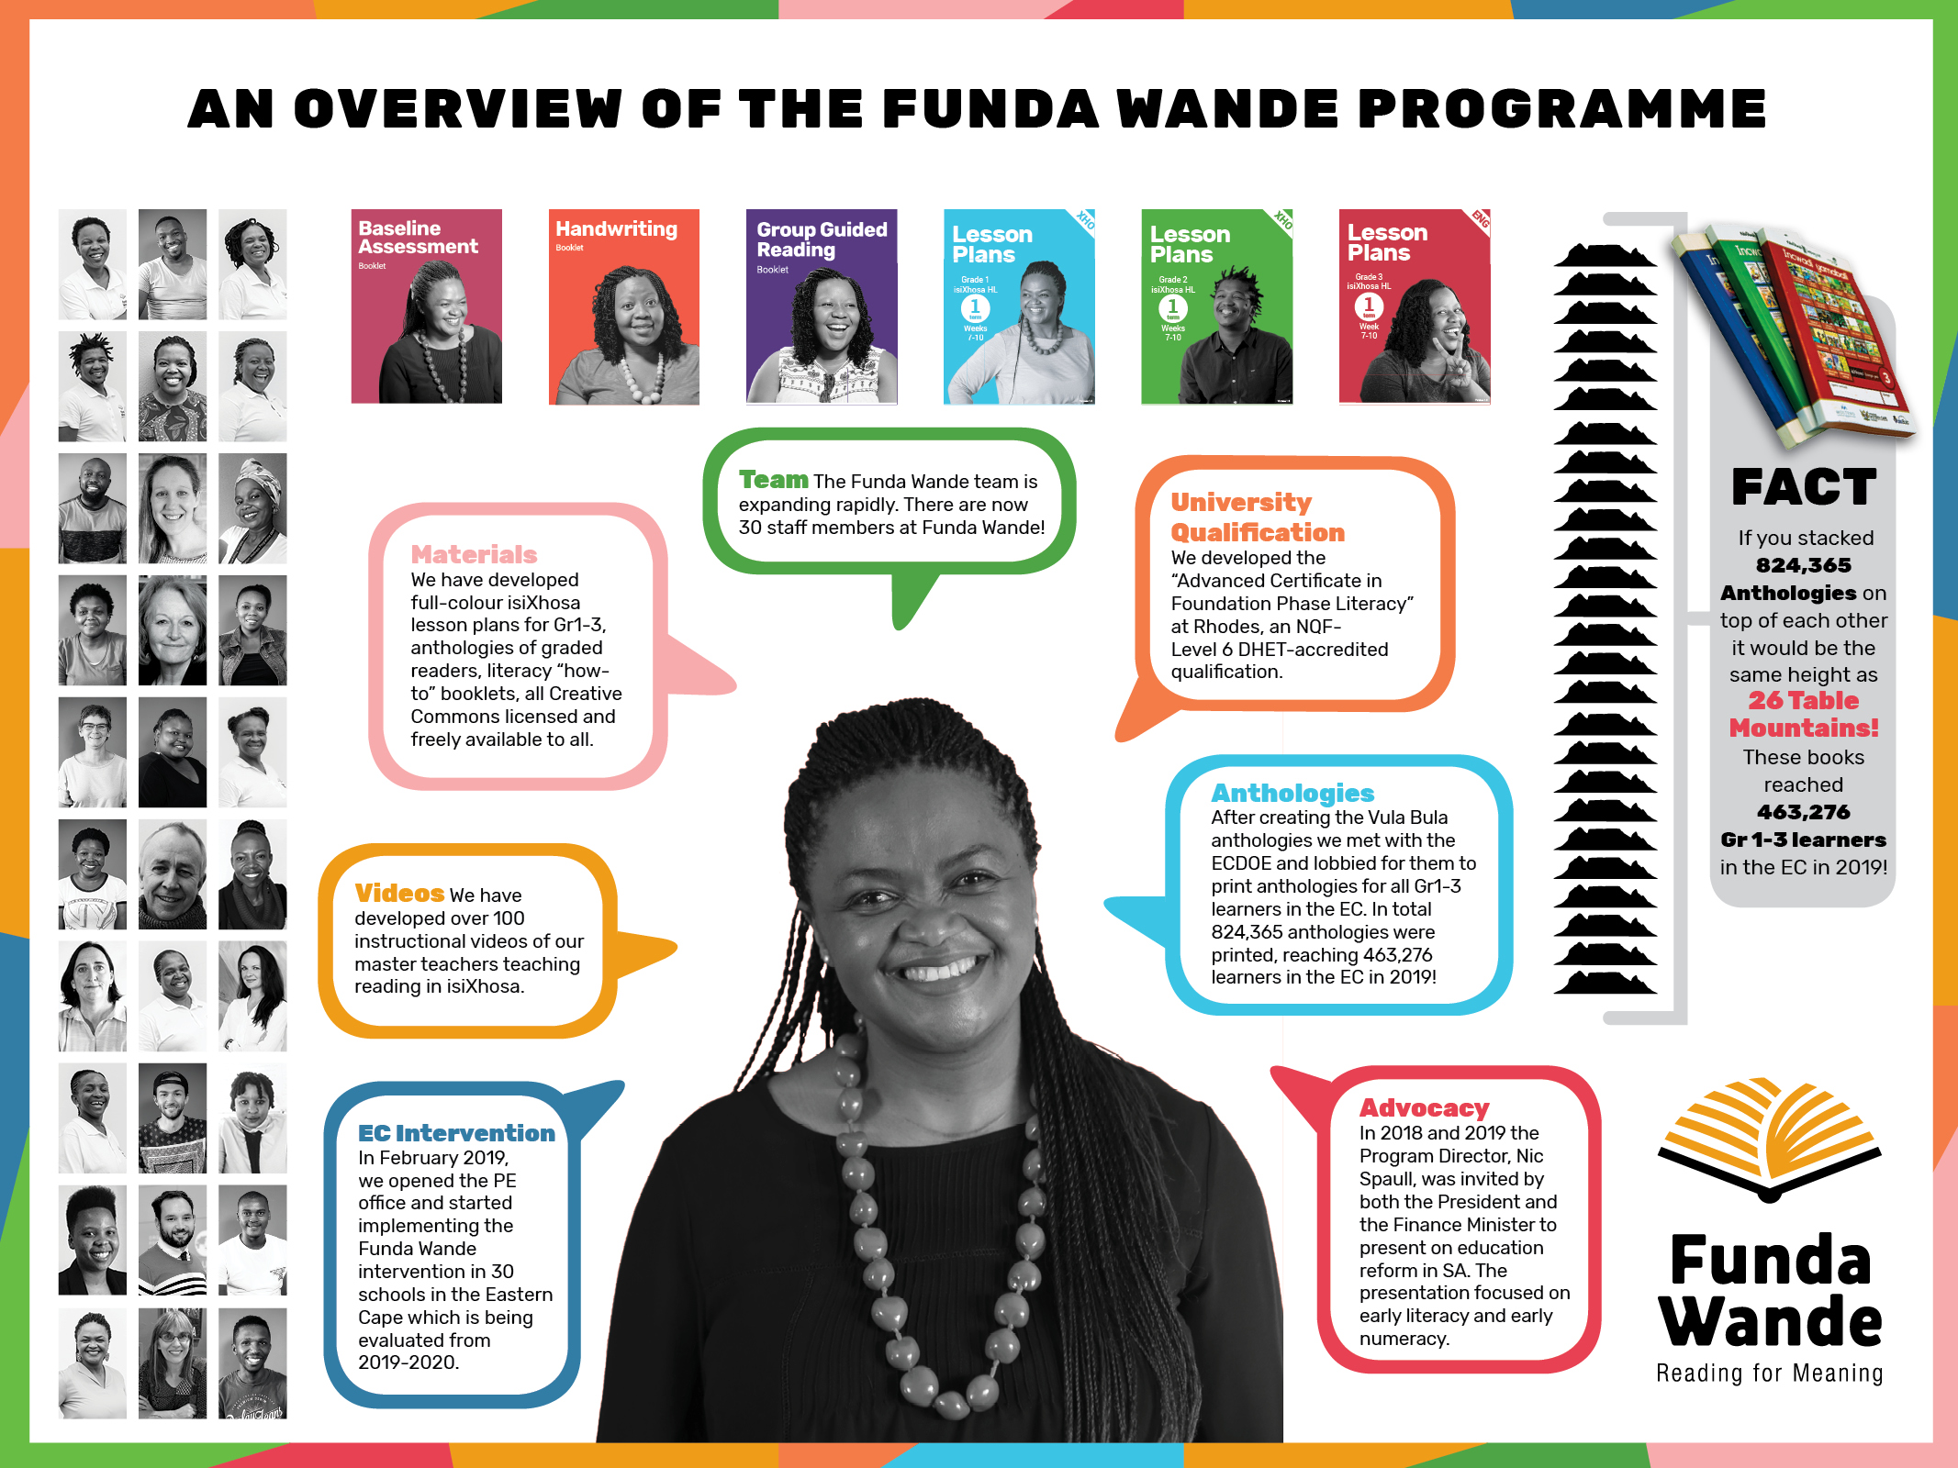

Slide 44
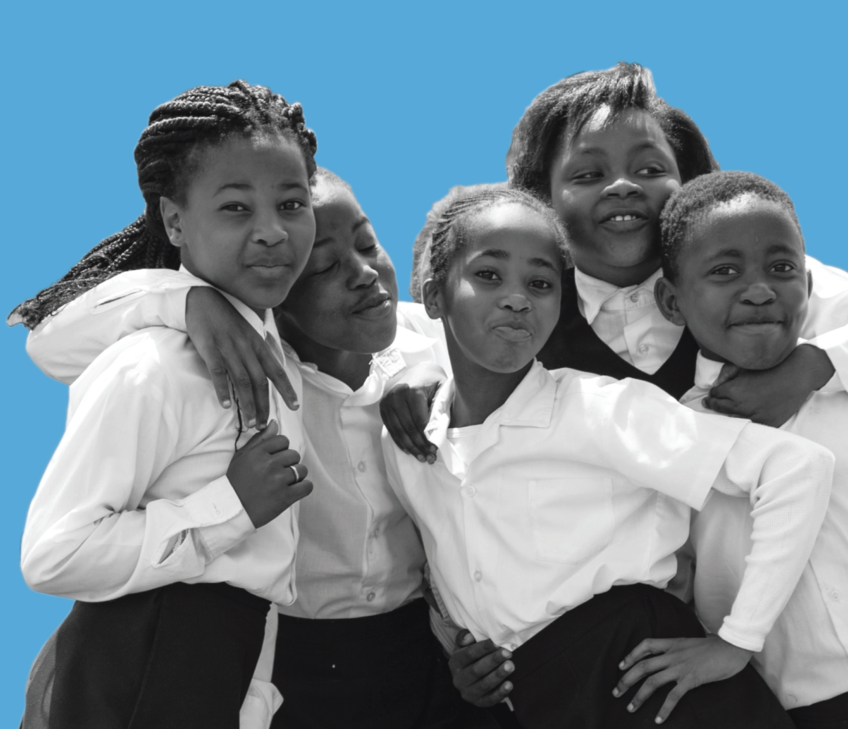
Thanks!

Slide 46
(4) If our organization were given an extra R500-million to spend on ensuring all children learn to read for meaning by age 10 we would do the following 3 things:
Replace with image
FUNDER PANEL

Slide 47
Things we agree on
Resources:
  The government and philanthropic sector should fund the development of more African language non-fiction, fiction and graded-readers for Gr1-6 and make them available in all FP classes.
  All FP classes need an essential classroom library of books.
Representation
  Black researchers need to play a more prominent role in positions of power and influence in the reading space
  More funding should be allocated to the development of Black researchers
  More funding for interventions and research should be allocated to research agenda, f
Replace with image
FUNDER PANEL

Slide 48
Arabic + Hindi + Bengali + Swahili = more than 1-billion people
6% of total.
70% of all article in the 3 journals are on Eng/French
Journal of Research in Reading, Scientific Studies of Reading, Reading Research Quarterly
Spaull, 2019: BRILL-IBE: Improving Early Literacy Outcomes

Slide 49
21 June 2019
State of the Nation
“Fellow South Africans,
If we are to ensure that within the next decade, every 10 year old will be able to read for meaning, we will need to mobilise the entire nation behind a massive reading campaign. Early reading is the basic foundation that determines a child’s educational progress, through school, through higher education and into the work place. All other interventions – from the work being done to improve the quality of basic education to the provision of free higher education for the poor, from our investment in TVET colleges to the expansion of workplace learning – will not produce the results we need unless we first ensure that children can read. It is through initiatives like the National Reading Coalition that we will be able to coordinate this national effort. All foundation and intermediate phase teachers are to be trained to teach reading in English and the African languages, and we are training and deploying a cohort of experienced coaches to provide high quality on-site support to teachers. We are implementing the Early Grade Reading Programme, which consists of an integrated package of lesson plans, additional reading materials and professional support to Foundation Phase teachers.”
– President Ramaphosa (21 June 2019)

