Slide 1

Mind the Gap: Income inequality in post-apartheid South Africa
7 August 2019
Ingrid Woolard
Notes:
Good evening, friends, family, colleagues
Thank you so much for all being here this evening. It’s an enormous privilege – and also rather daunting– to have so many different groups of people here tonight - family, friends, former colleagues, current colleagues. While it is the case that my current primary appointment at SU is as Dean of the FEMS, it is very important to my sense of belonging and academic identity that I also have an academic home. Tonight is therefore a very welcome opportunity to set aside my role as administrator and speak to you as a new member of the department of economics.
I’m going to talk at a very high level about income inequality and some of the things we’ve learnt about this topic in SA over the past 25 years. I should say at the outset that my work in this area (much of which has been done with several people here this evening – Murray Leibbrandt, Julian May, SvDB and Chris Woolard) has been descriptive and diagnostic, rather than policy prescriptive. While our work provides some pointers as to what issues need to be tackled, we tend to stop short of suggesting specific policy interventions. I don’t say this as a criticism or with regret, I actually think this is a strength of our work – we don’t over-reach into trite “policy conclusions” but rather put effort into ensuring that we describe the extent and nature of inequality as accurately and consistently as possible as a first step in the policy-making process.

Slide 2

“Countries around the world provide frightening examples of what happens to societies when they reach the level of inequality toward which we are moving. It is not a pretty picture: countries where the rich live in gated communities, waited upon by hordes of low-income workers; unstable political systems where populists promise the masses a better life, only to disappoint. Perhaps most importantly, there is an absence of hope.
In these countries, the poor know that their prospects of emerging from poverty, let alone making it to the top, are minuscule. This is not something we should be striving for.”
Joseph Stiglitz, 2012
Notes:
It is not difficult to relate the SA situation to the picture of a vastly unequal society provided by Joe Stiglitz. These photos from Johnny Miller are a sobering visual representation of the inequality which stares us in the face every way we turn in our daily lives. It is evident where we work, where our children go to school, in the places where we live.

Slide 3
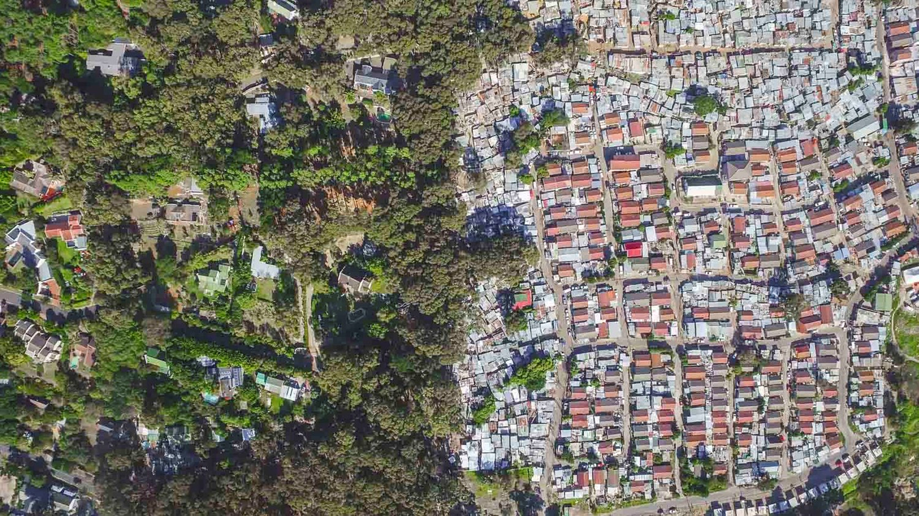
Notes:
These photos from Johnny Miller (unequal spaces) are a sobering visual representation of the inequality which stares us in the face every way we turn in our daily lives. It is evident where we work, where our children go to school, in the places where we live.
Imzamo Yethu

Slide 4
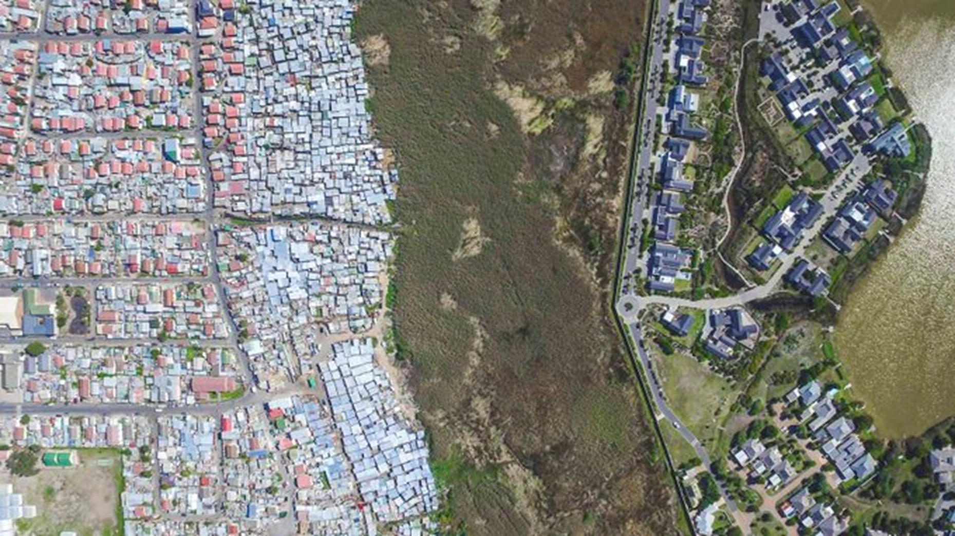
Notes:
Masiphumelele

Slide 5
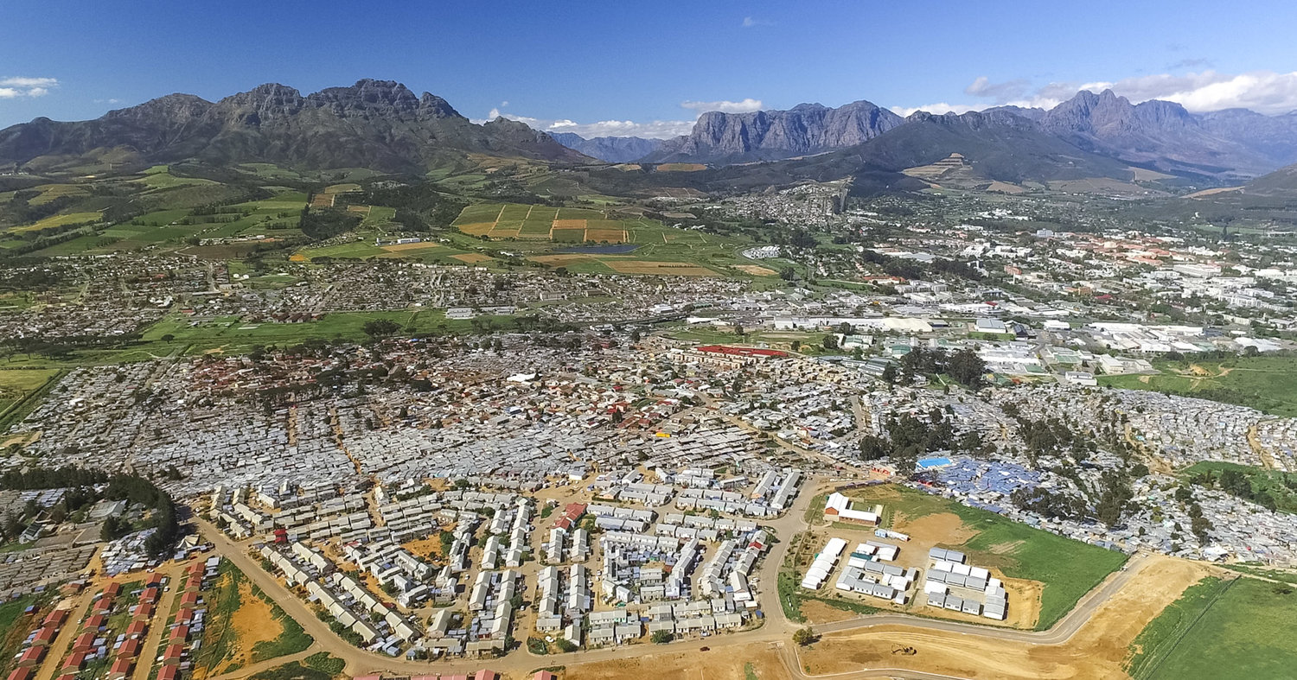
Notes:
Stellenbosch

Slide 6

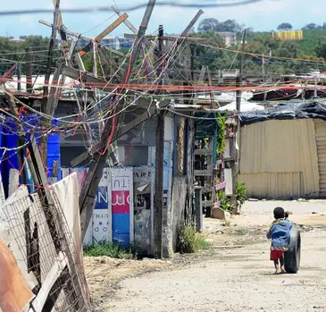
The price of inequality
Intrinsically:
  Unfair (conceptions of justice)
  Pervasive inequality aversion reduces measured well-being
Instrumentally:
  Brake on poverty reduction
  Reduces future economic growth
  Promotes other inequalities (in health, education, political power)
  Promotes conflict, disaffection, and strife
  Limits economic mobility of younger generations
  Reduces future economic growth
Notes:
So why does inequality matter? That is a topic well beyond the scope of tonight’s lecture, but let me seed a few ideas with you.
We know that high income and wealth inequality retard social progress (intrinsically and instrumentally) in terms of improvements in wellbeing for people and the promotion of social cohesion. While some social and economic differentiation is tolerable and even desirable, high inequality in resources, opportunities, or capabilities runs counter to most theories of justice which view such inequalities as inherently 'unfair'. In addition, inequality is perceived to be undesirable by the vast majority of most societies, is particularly a burden on the well-being of the poor, and is associated with lower intergenerational social mobility.
Instrumentally, high inequality increases poverty, it lowers the impact of economic growth on poverty reduction, it promotes social conflict, disaffection, and protest, it affects behavior that can trap poor people in a state of poverty, and economic inequalities often promote social and political inequality (and vice versa), High economic inequality tends to lead to large inequalities in health and education. Finally, we now know that high levels of inequality are associated with lower subsequent economic growth.

Slide 7
Where does data come from?
Notes:
Determine sample size, draw a sample, design a questionnaire, translate, train fieldworkers, conduct the fieldwork, capture the data, clean the data, impute missing values, construct aggregate variables, creating weights, curate the data….

Slide 8
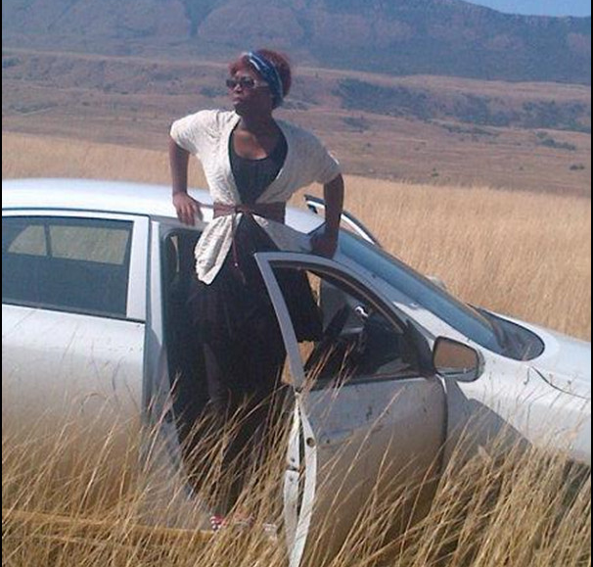
Fieldwork
South Africa is a very large country
Notes:
Mbali Mohlamonyane – NIDS Wave 3

Slide 9
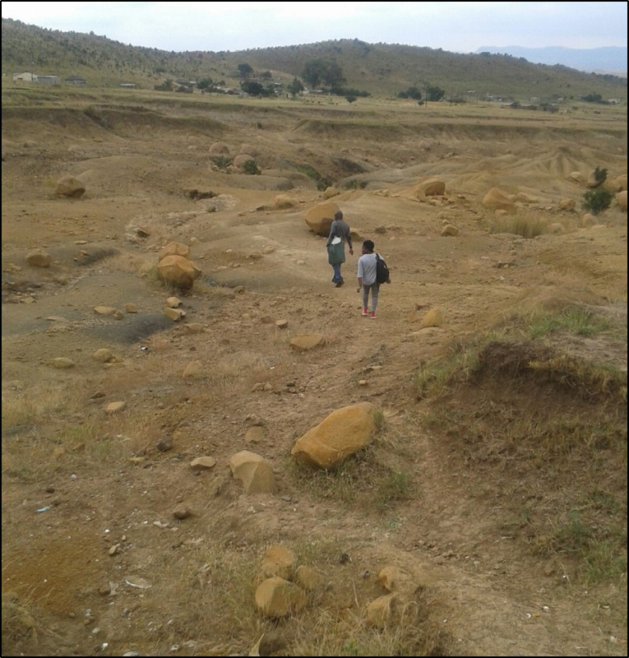
Fieldwork
Gruelling and sometimes dangerous work
Notes:
NIDS Wave 3

Slide 10
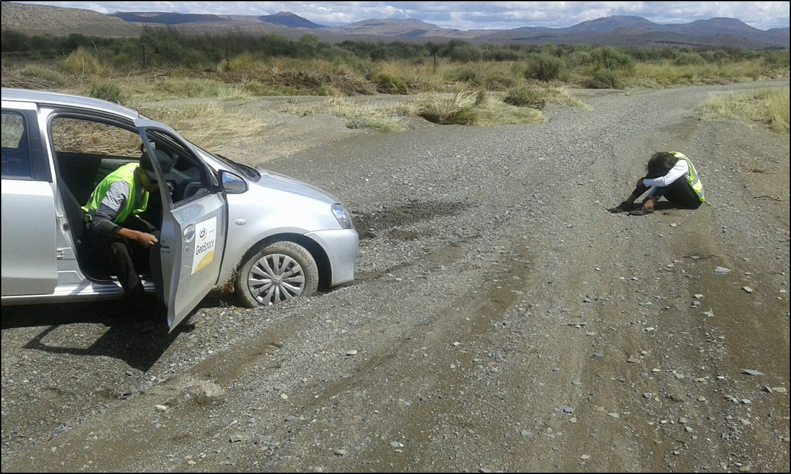
Fieldwork
Notes:
Fieldwork is just one small piece of the process…

Slide 11
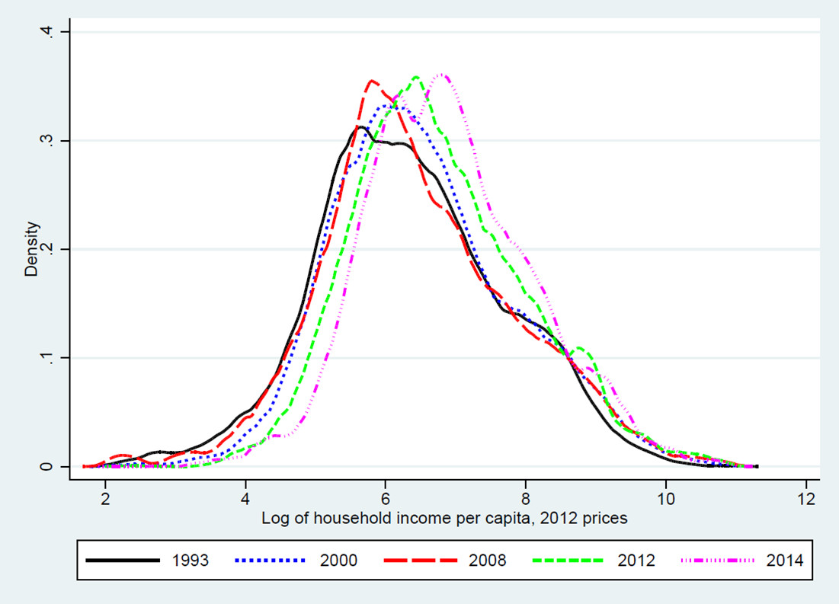
Poverty has fallen since 1993 …
PSLSD, 1993; IES 2000;
NIDS Waves 1 to 4
Notes:
This data cost in the order of 250 m. What we have here are kernel density plots for 5 data periods

Slide 12
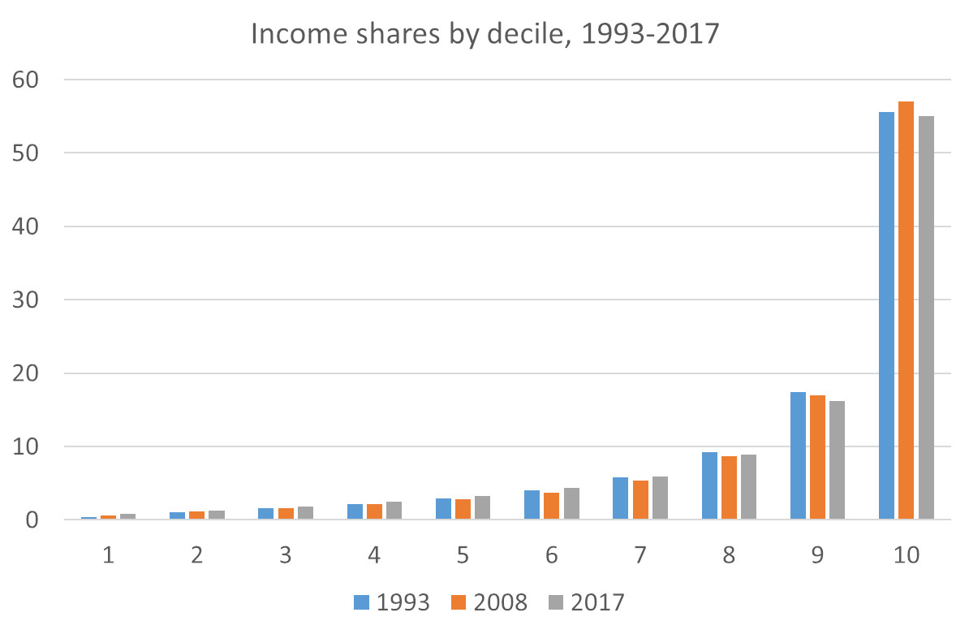
But the pattern of income inequality now is much the same
Note:
  Measure of wellbeing is per capita household income after direct taxes and transfers
  Deciles contain equal numbers of people
  Census weights have been applied
PSLSD, 1993; NIDS Wave 1; NIDS Wave 5
Notes:
deciles 1 to 4 5% → 6% ; D10 56%; 57%, 55%

Slide 13
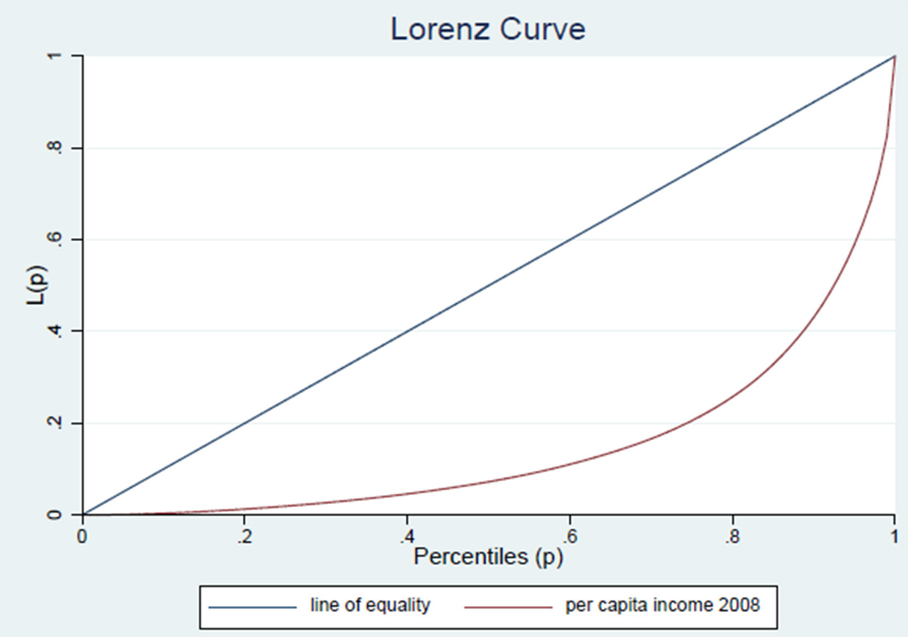
Gini coefficients
1993 - 0.67
2008 - 0.67
2017 - 0.65
NIDS Wave 1
Notes:
The Gini coefficient is the most commonly cited inequality statistic but you might not all know how it is actually calculated
One first has to draw a curve called a Lorenz curve
What one does is one ranks every person from poorest to richest and then plots the cumulative percentage of income against the cumulative percentage of the corresponding population.
In a country where everyone has equal income one would be on the blue line – the line of perfect equality.
The extent to which the curve sags below the line of perfect equality indicates the degree of inequality of distribution.
The Gini is then the area….

Slide 14
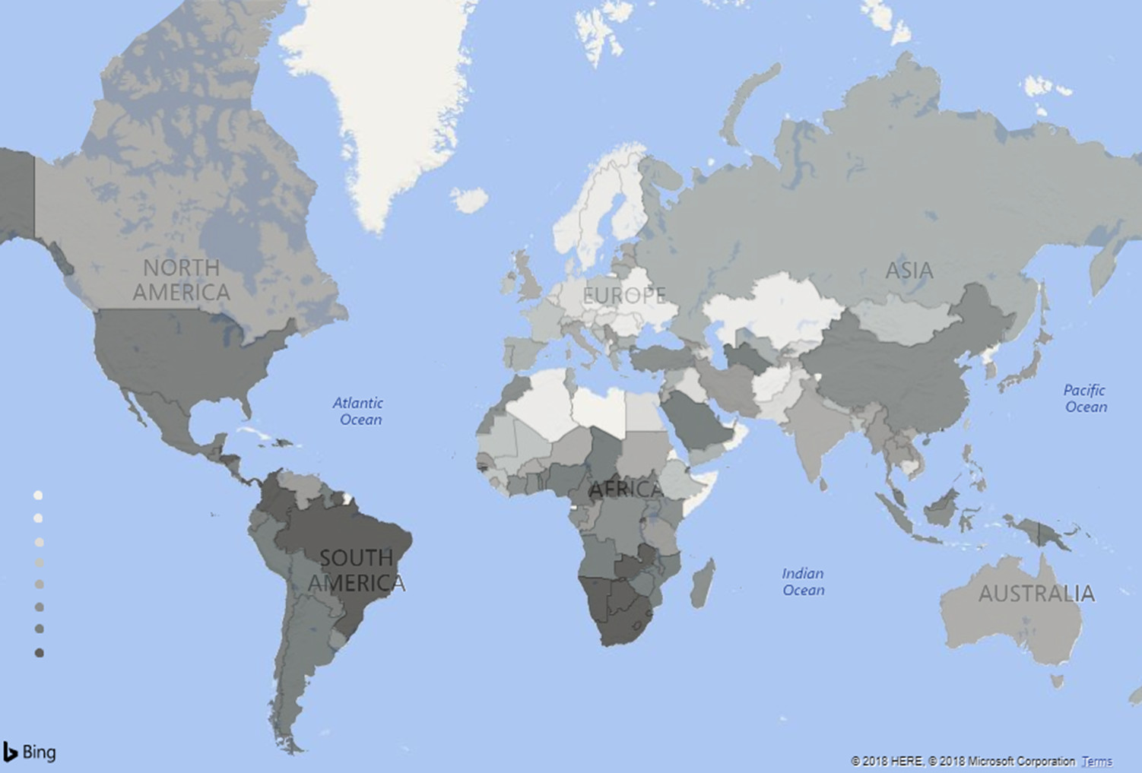
SA and the global context
More equal
Less equal
South Africa has the highest measured inequality in the world

Slide 15
The role of fiscal policy in reducing
income inequality
Notes:
Explain the CEQ project

Slide 16
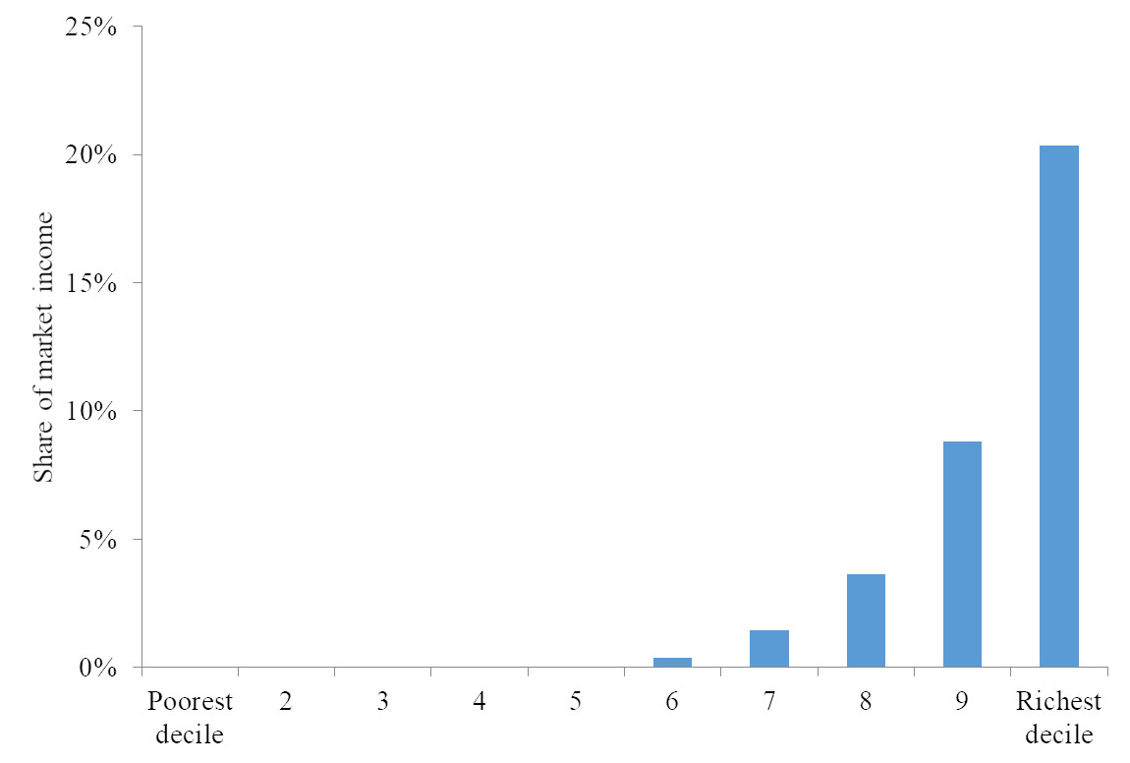
Personal income taxes are progressive in relative terms
Maboshe and Woolard (2018), ‘Revisiting the impact of direct taxes and transfers on poverty and inequality in South Africa’
Notes:
PIT is one third of tax revenue

Slide 17
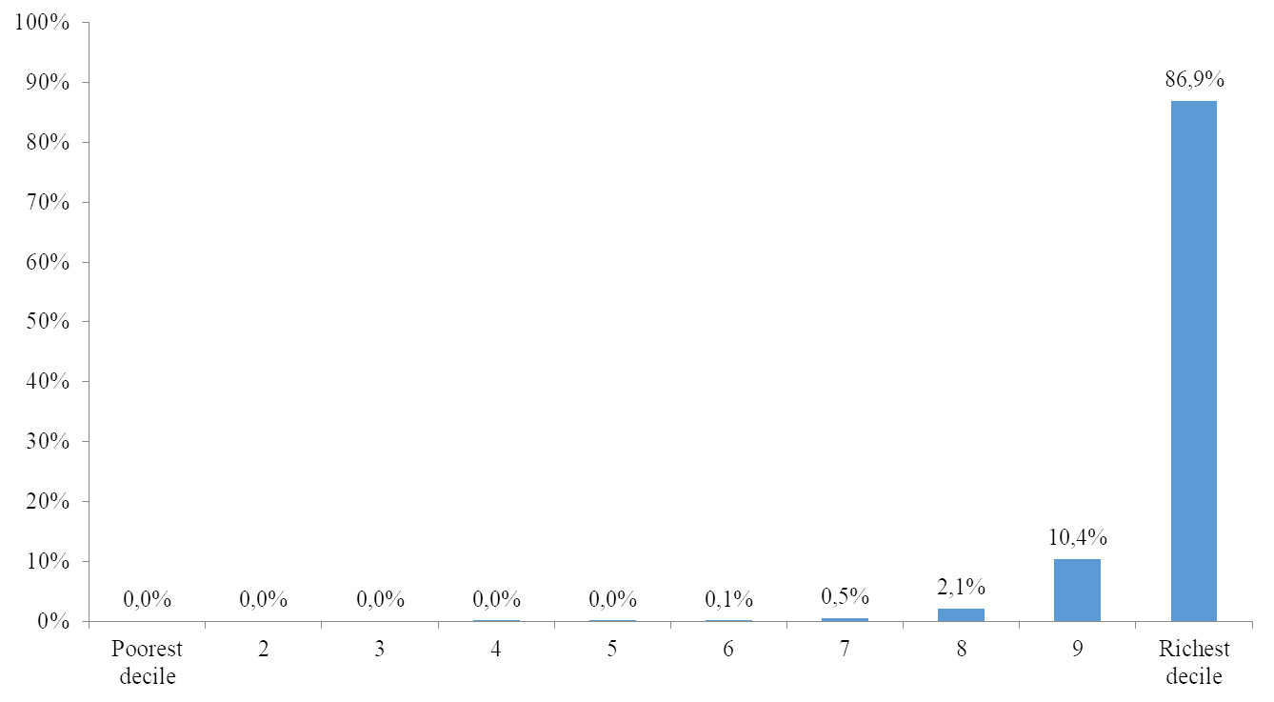
In absolute terms
Maboshe and Woolard (2018), ‘Revisiting the impact of direct taxes and transfers on poverty and inequality in South Africa’
Notes:
We can do the same for indirect taxes

Slide 18
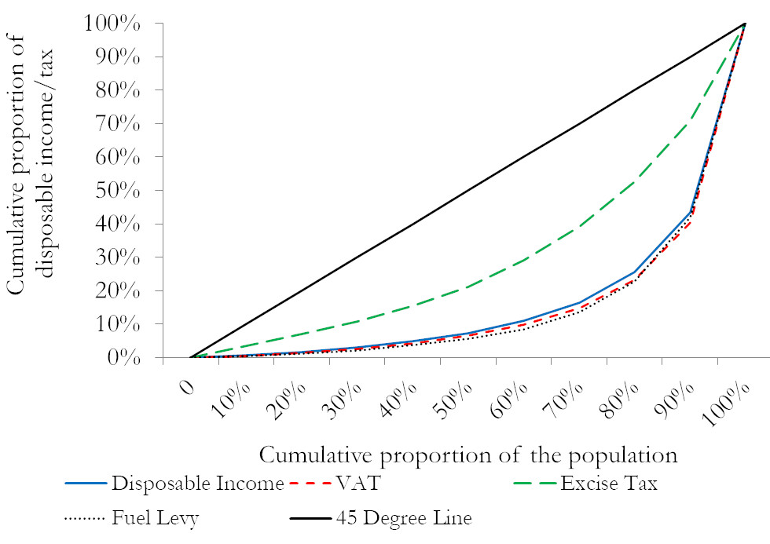
By contrast, indirect taxes (overall) are somewhat regressive
Inchauste, Lustig, Maboshe, Purfield, and Woolard (2015), ‘The distributional impact of fiscal policy in South Africa’

Slide 19
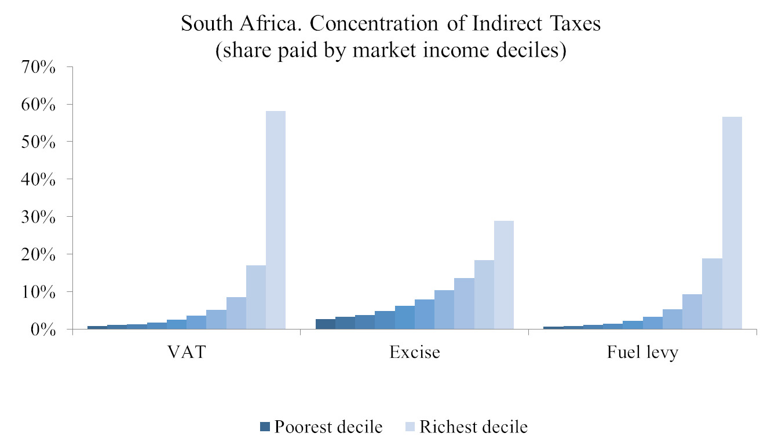
Although richer households contribute the most
Inchauste, Lustig, Maboshe, Purfield, and Woolard (2015), ‘The distributional impact of fiscal policy in South Africa’

Slide 20
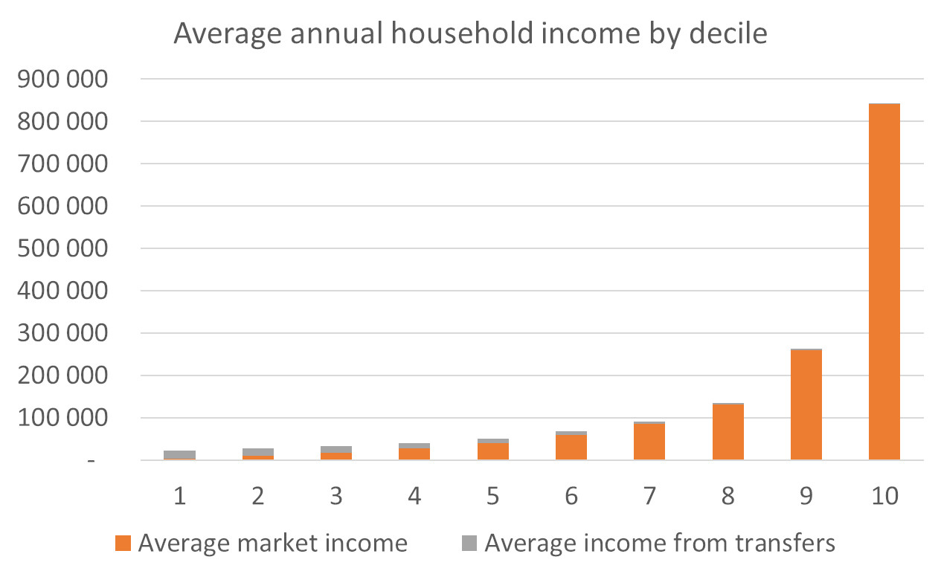
Cash transfers are well-targeted
Maboshe and Woolard (2018), ‘Revisiting the impact of direct taxes and transfers on poverty and inequality in South Africa’
Notes:
16m people receive social grants…. 3.3% of GDP

Slide 21
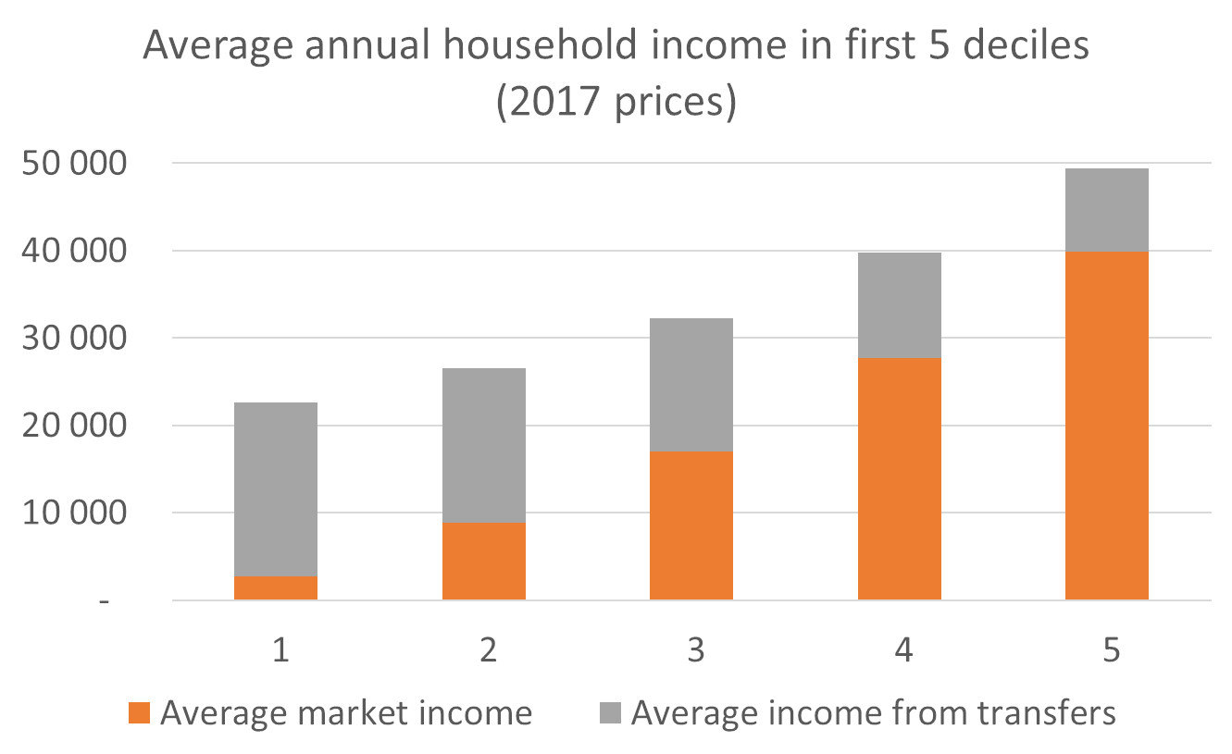
Cash transfers are well-targeted
Maboshe and Woolard (2018), ‘Revisiting the impact of direct taxes and transfers on poverty and inequality in South Africa’

Slide 22
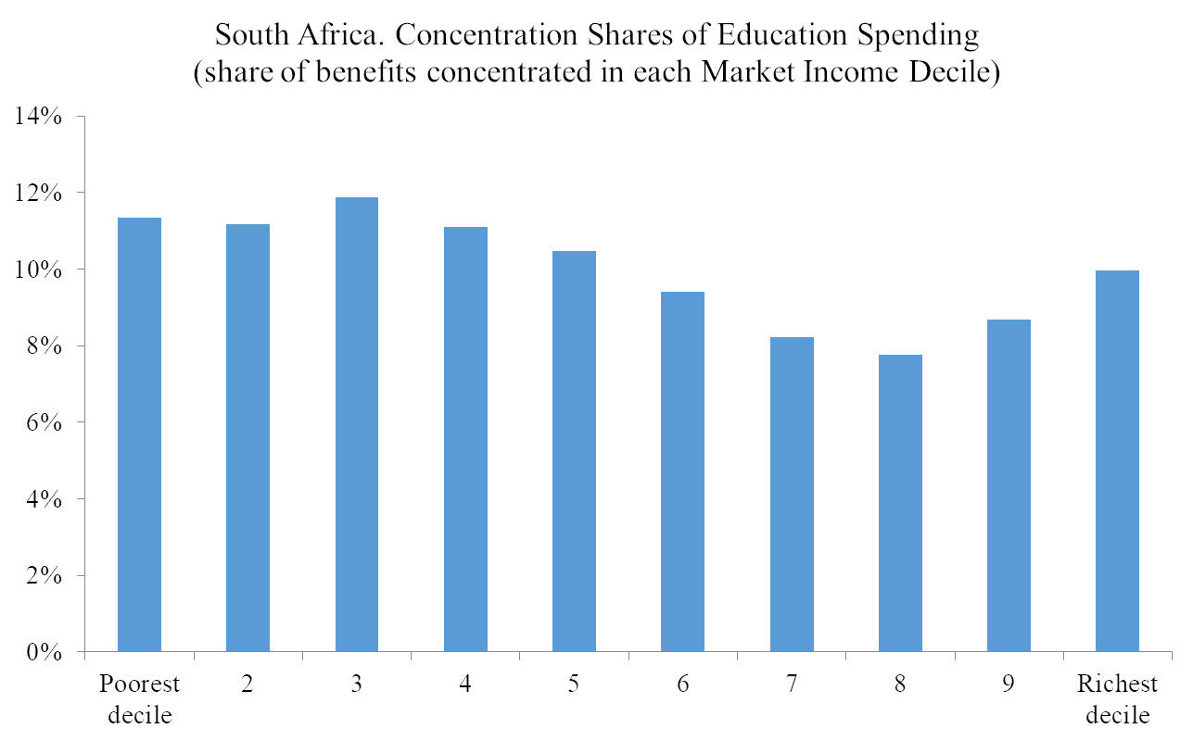
Education spending is somewhat pro-poor
Inchauste, Lustig, Maboshe, Purfield, and Woolard (2015), ‘The distributional impact of fiscal policy in South Africa’

Slide 23
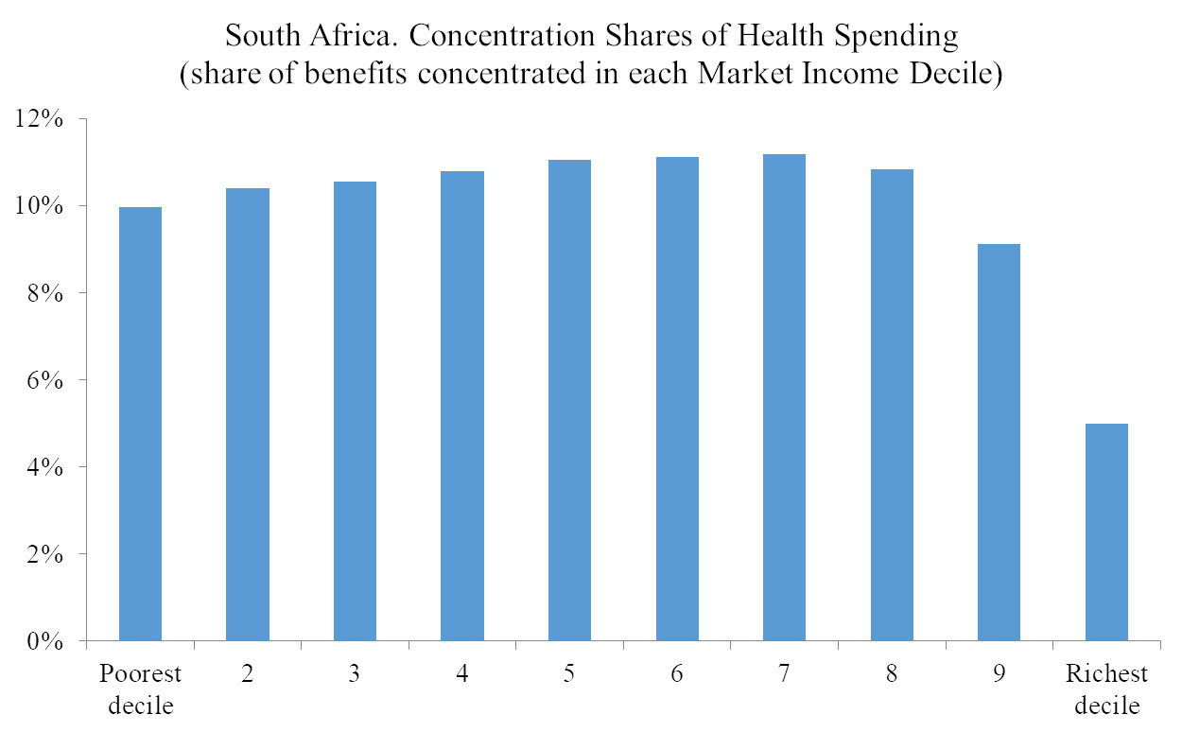
And healthcare spending more so
Inchauste, Lustig, Maboshe, Purfield, and Woolard (2015), ‘The distributional impact of fiscal policy in South Africa’

Slide 24
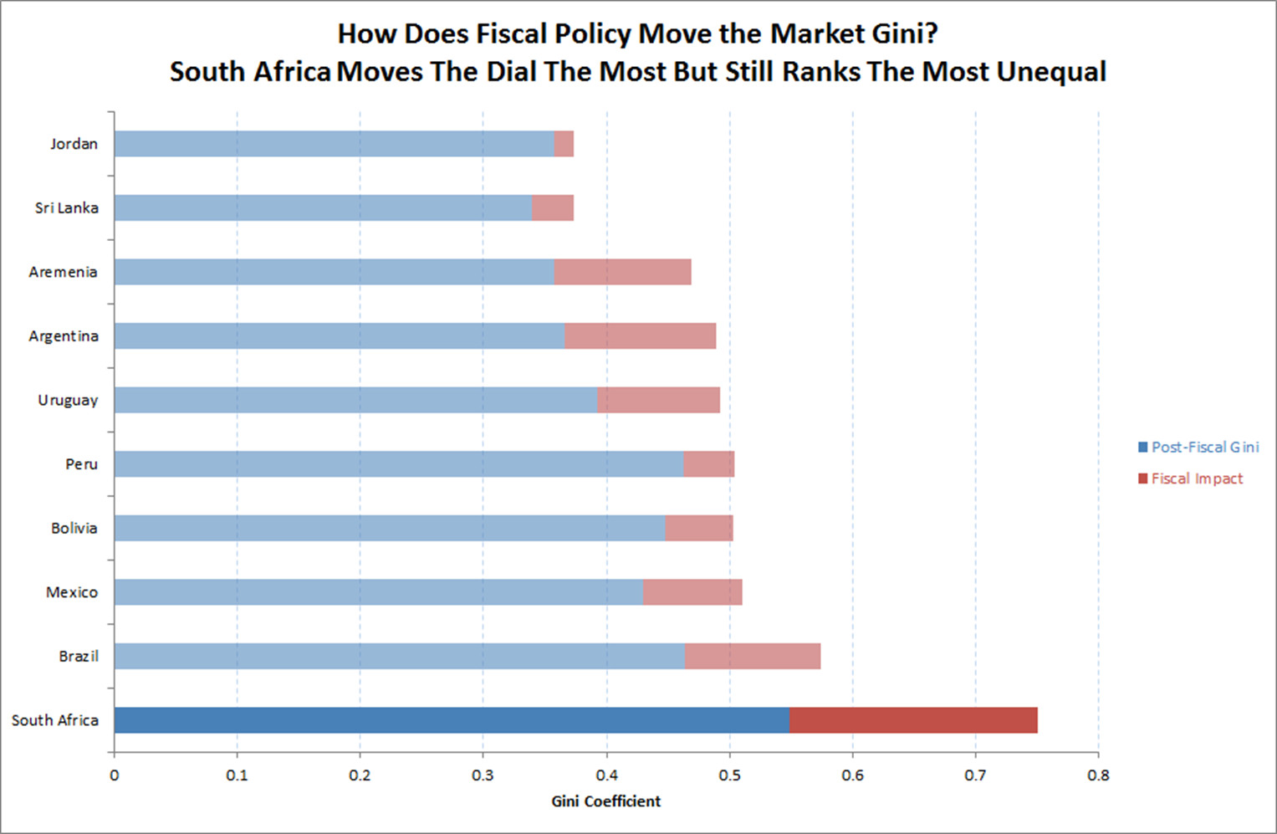
Fiscal policy and the Gini
Sources: For Latin America see: Lustig and Pessino, 2014; Paz et al., 2014, Higgins and Pereira, 2014; Scott, 2014; Jaramillo, 2014, Bucheli et al., 2014; Lustig et al., 2014. Preliminary results for Armenia (Younger et al., 2014) Ethiopia (Hill et al., 2014), Jordan (Serajuddin et al., 2014), Sri Lanka (Arunatilake et al., 2014), and Incahuste, Lustig, Maboshe, Purfield and Woolard, 2015
Notes:
Morning after

Slide 25
Understanding labour market inequality

Slide 26
Decomposing the Gini by income share
In all years, more than a third of this “earnings inequality” actually comes from households having zero income
Sources
Leibbrandt, Woolard & Woolard (2009), ‘Poverty and inequality dynamics in South Africa: Post-apartheid developments in the light of the long-run legacy’
Leibbrandt, Finn & Woolard (2012), ‘Describing and decomposing post-apartheid income inequality in South Africa’
Hundenborn, Leibbrandt & Woolard (2016), ‘Drivers of inequality in South Africa’
Year | Contribution of labour earnings to overall Gini
1993 | 84.4%
2008 | 87.2%
2014 | 90.2%

Slide 27





Unemployment
29% narrow unemployment rate, 2019
6.6 million South Africans are unemployed
Unemployment is highest for women, youth, and African Black South Africans
Gender
Age
Race
Women
Men
15-24
25-34
African
Indian/Asian
31%
27%
56%
36%
33%
11%
35-44
45-54
Coloured
White
23%
17%
23%
7%
55-64
11%

Slide 28
The distribution of jobs matters
Lilenstein, Woolard & Leibbrandt (2018), ‘In-work poverty in South Africa: the impact of income sharing in the presence of high unemployment’
 | % share of population | % in poverty | % share of poor
NEA: Age 0-14 | 30% | 57% | 39%
NEA: Age 15-64 | 28% | 52% | 33%
NEA: Age 65+ | 5% | 35% | 4%
Unemployed | 10% | 61% | 13%
Employed | 28% | 17% | 11%
All individuals | 100% | 44% | 100%
Household where no-one is working | 31% | 59% | 59%
Household where at least one person is working | 69% | 19% | 41%
All households | 100% | 31% | 100%
Notes:
Individual level … much higher probability of being poor if you personally are ue. But roughly the same number of poor working and not working
HH level – having no connection to the LM highly correlated with the HH being poor
You are poor if your HH is poor

Slide 29
Not all jobs are equal
Lilenstein, Woolard & Leibbrandt (2018), ‘In-work poverty in South Africa: the impact of income sharing in the presence of high unemployment’
Employment type | % share of workers | % workers in poverty | % share of poor workers
Private household | 11% | 42% | 29%
Primary sector | 10% | 18% | 11%
Secondary sector | 17% | 19% | 20%
Tertiary sector | 61% | 10% | 40%
Regular paid worker | 81% | 12% | 60%
Casual worker | 11% | 45% | 22%
Self-employed worker | 8% | 26% | 18%
All workers | 100% | 17% | 100%
Notes:
Primary sector is agric and mining
Secondary sector is construction & manufacturing
Tertiary is retail, finance, services – 61% of employment but only comprises 10% of poor workers

Slide 30
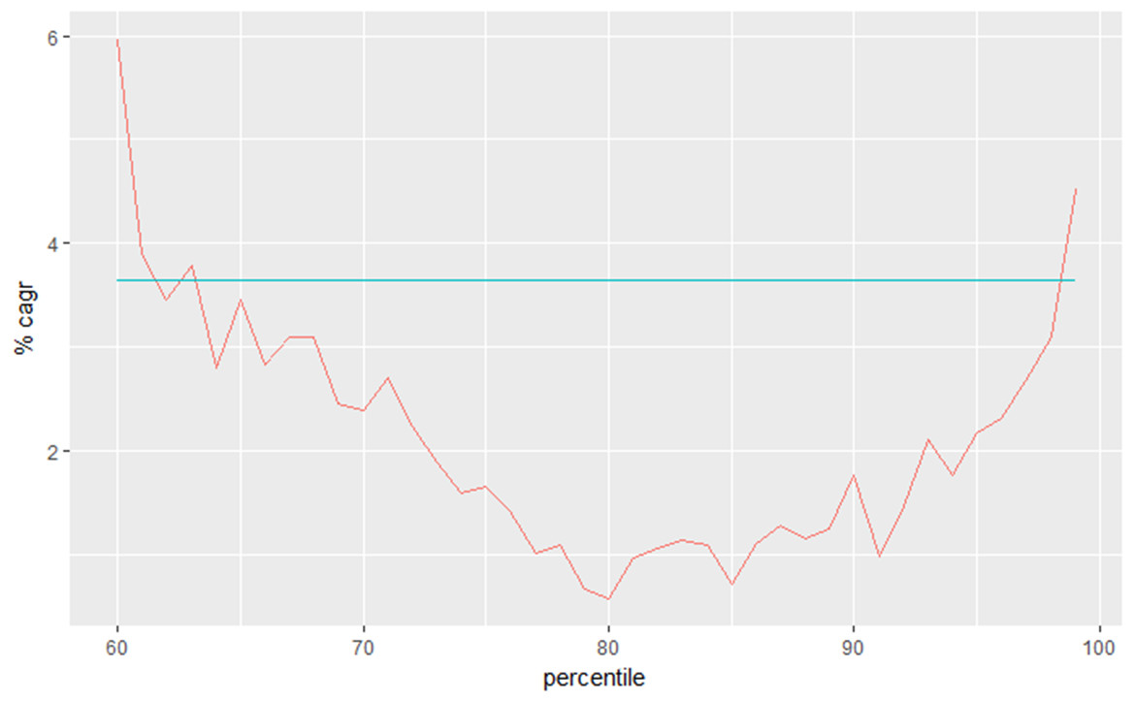
Changing patterns of earnings inequality
Average annualised change in individual earnings, 2003 to 2015
Bassier & Woolard (2018), ‘Exclusive growth? Rapidly increasing top incomes amidst low national growth in South Africa’ [updated]
Notes:
Move to thinking about the earnings of the individual (not within the HH)
Top percentiles are missing as we don’t think the HH survey data is reliable

Slide 31
The top 5%
Notes:
Why do HH surveys miss the very rich?
Tax data for 2011 and 2014. Tax threshold was R120k in 2011 and R250k in 2014.
In 2011: 50 million South Africans, 34.6 million ‘tax units’ (persons aged 15+), 14.6 million had labour market income, 10.3 million were registered for PIT; 5.5 million submitted tax returns; 2.8 million were above the threshold for submitting a tax return

Slide 32
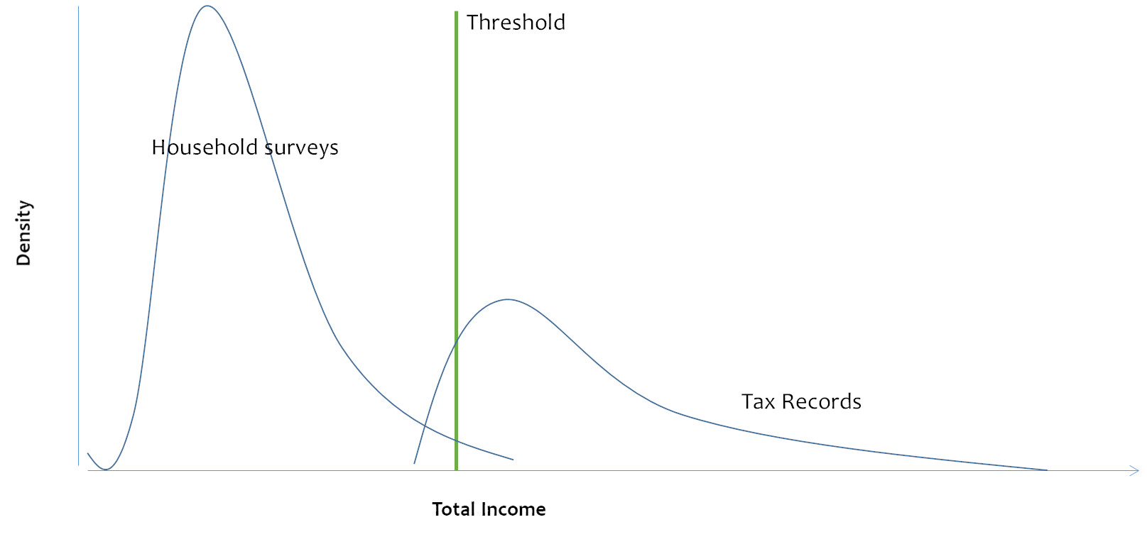
Using tax data

Slide 33
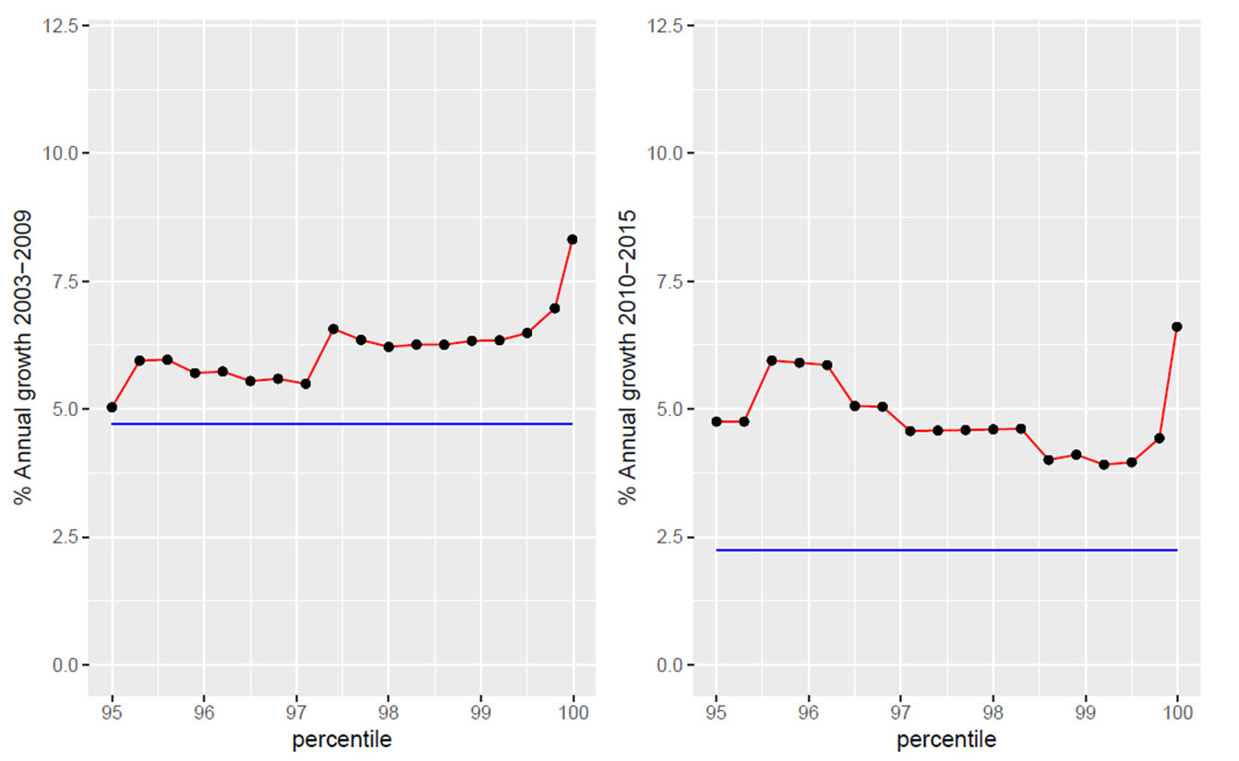
Growth incidence curves for the top 5%, 2003-2015
Bassier & Woolard (2018), ‘Exclusive growth? Rapidly increasing top incomes amidst low national growth in South Africa’ [updated]
Notes:
95th percentile is about R400k (taxable income); 99th percentile is just under R1m [NB this is 350,000 people];
top 0.1% is R2,8 m

Slide 34
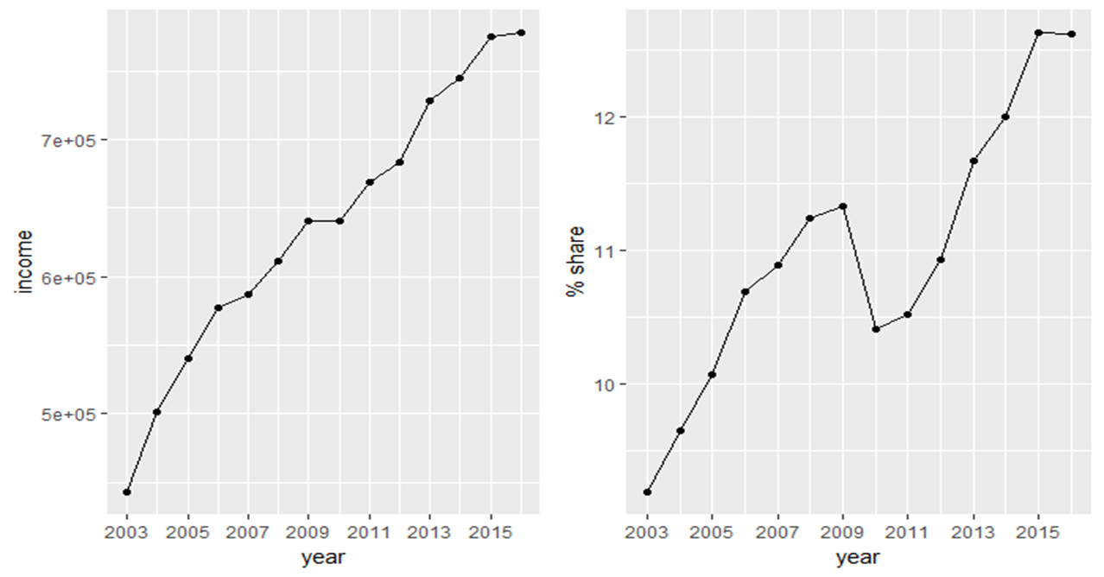
What is happening at the very top of the distribution?
The incomes of the top 1% continue to grow
Bassier & Woolard (2018), ‘Exclusive growth? Rapidly increasing top incomes amidst low national growth in South Africa’ [updated]
Notes:
Top 1% is about 350,000 people.
Share of income has grown from about 8.5% in 2003 to more than 12% in 2015.

Slide 35
Combining household survey data and income tax records
Gini for earnings changes from:
0.82 to 0.83
Hundenborn, Woolard & Jellema (2019), ‘‘The Effect of Top Incomes on Inequality in South Africa’.

Slide 36
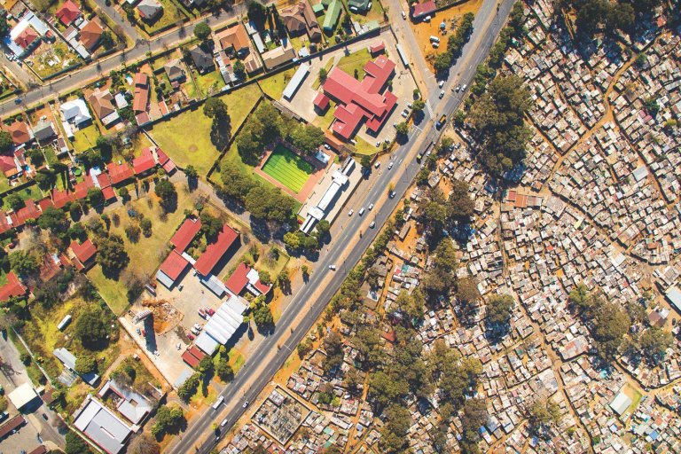
Drivers of inequality
Deep drivers of inequality make change difficult
  Inequality has self-sustaining path dependency
  Deep-seated social stratification sustains inequality
  Norms regarding inequality and redistribution durable
  Strong link between economic and political inequality
  Presence/absence of social movements important
  Demographic dynamics can exacerbate inequality
Notes:
Where does all of this leave us, either as academic researchers who work on inequality or as concerned individuals who would like to make a contribution to reducing the unacceptably high levels of inequality? As researchers, inadequately answered questions remain about the roles and importance of assets and wealth in perpetuating the high levels of inequality. The new work on the very top end of the income and earnings distribution shows very clearly that those at the top end have flourished even in times of low overall economic growth. They have done this by being able to draw on a far broader array of income sources and physical, financial, and human assets. But we need to know much more about exactly how wealth is transferred inter-generationally and, more generally, about the drivers of social mobility.
Another key question that remains inadequately answered is why the South African labour market continues to display such extraordinary levels of unemployment. This requires a better grasp of the demand for labour, in conjunction with more sophisticated understanding of market structure and market power.
Finally, let me loop back to where I started by emphasizing that while measurement matters, inequality is not a technical problem and resolving it will require going beyond the identification and application of technical solutions. The trends in inequality are related to deep-rooted factors that change slowly. The deep drivers of inequality include strong path dependency, enduring social stratification that creates persistent group-based inequalities, deep-seated norms and preferences regarding redistribution, the particular role of social movements within a specific context, the strong link between economic and political inequality, and demographic dynamics with large inequality implications. These are topics which economists are inadequately trained to investigate, let alone address. Making progress on inequality reduction requires much greater collaborative efforts with colleagues from other disciplines – historians, political scientists, lawyers, demographers and sociologists.

Slide 37
“South Africans should not be polite about inequality”
Ben Turok, 2019
Notes:
In closing, let me leave you with this thought from Prof. Ben Turok…

Slide 38


