Slide 1
“How do we ensure that universal access to ECD is of ‘quality’?”
Nic Spaull
RESEP | ECD Molenvliet Workshop | 5 Feb 2020

Slide 2
Quality Early Childhood Development
Funding
Training
Measurement
Time & Trade-offs
Cautionary note

Slide 3
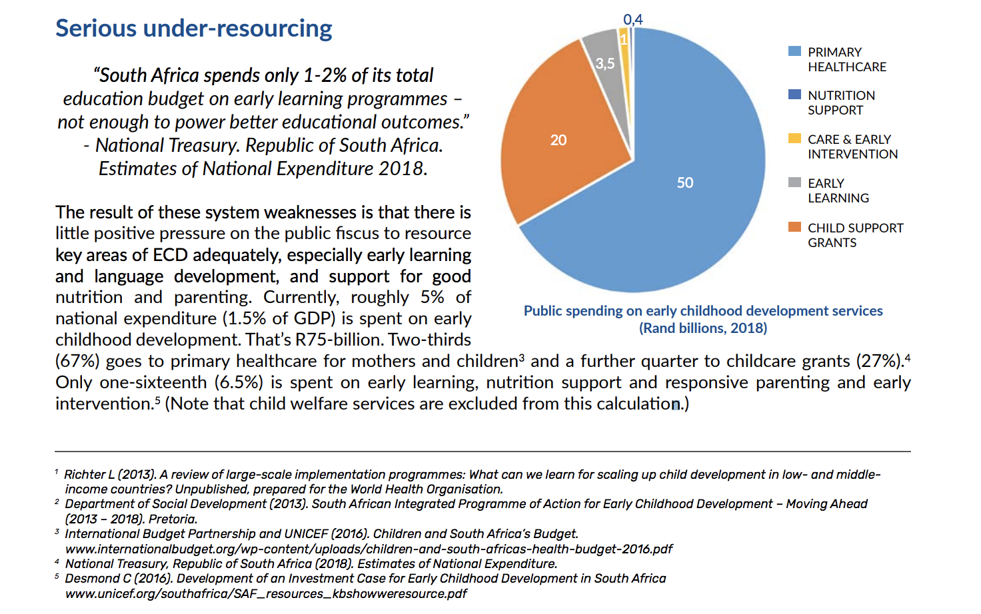
(1) Funding for ECD
1-2%
of the total education budget is spent on early learning.
(ECD Vision 2018, p.3)

Slide 4
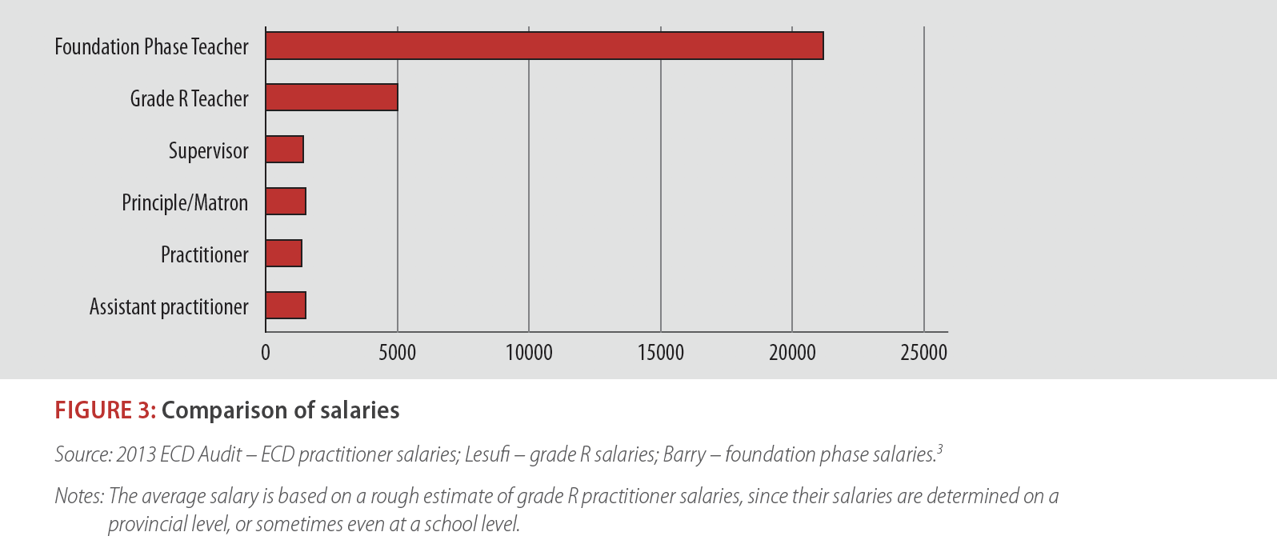
(1) Funding for ECD
1/10th
Adults teaching our 3-5 year-olds are paid 1/10th of what adults teaching our 6-9 year-olds are paid, and < minimum wage (R1400-R2000 p.m.)
(Kotze, 2015: p.4)

Slide 5
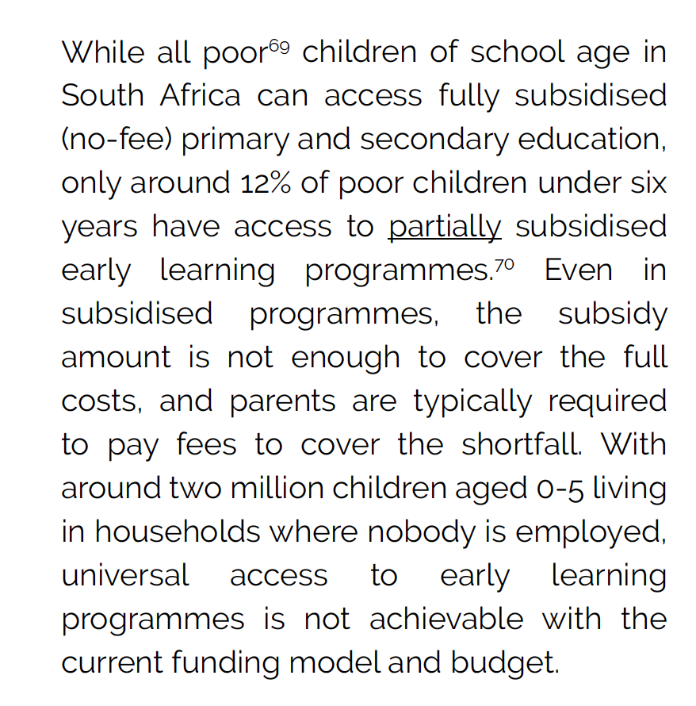
(1) Funding for ECD
<20%
of children aged 3-4 are the recipients of tax-funded support for their ECD.
  700,000 children access Early Childhood Education (SONA, 7/2/2019)
  Roughly a million kids per age-year
(South African Early Childhood Review 2019, p.38)

Slide 6
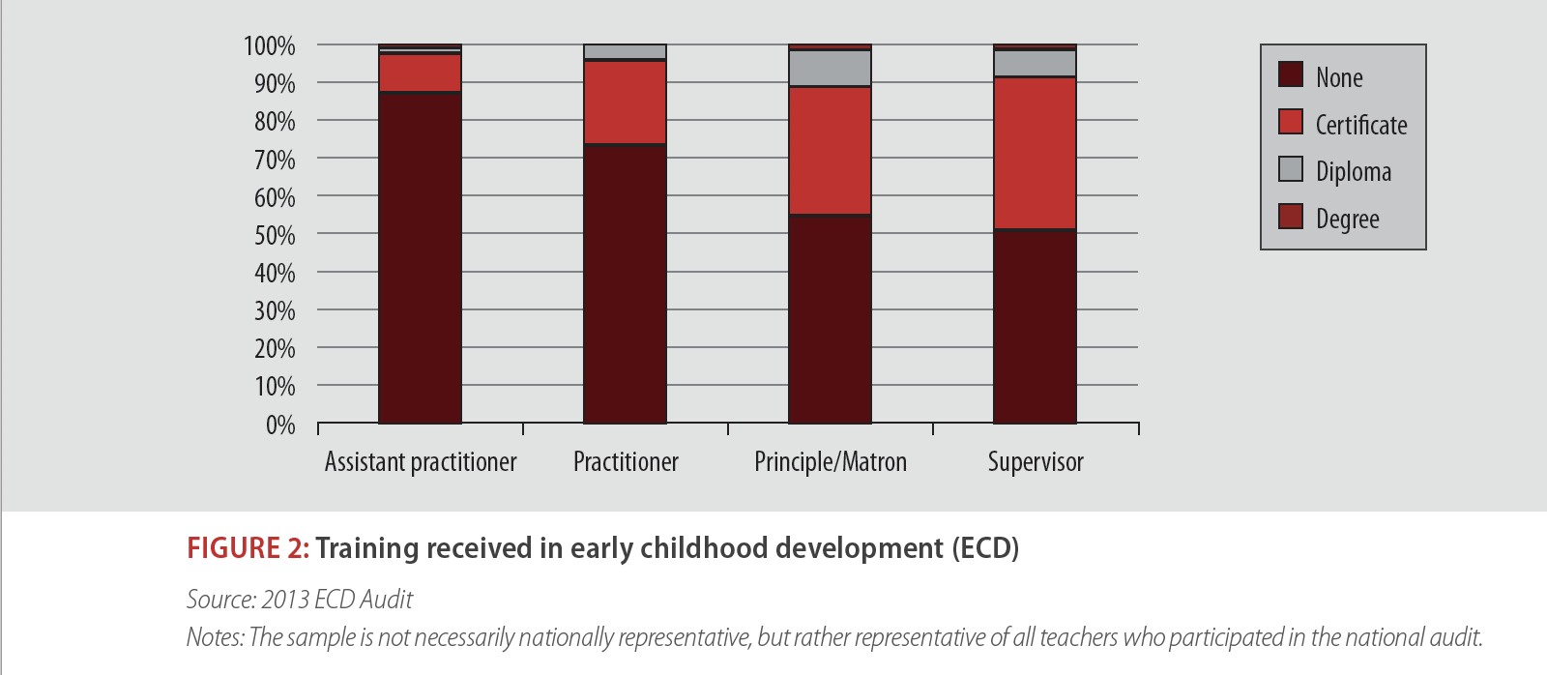
(2) Training
70%+
of ECD practitioners have no training or qualifications whatsoever.
(Kotze, 2015: p.4)

Slide 7
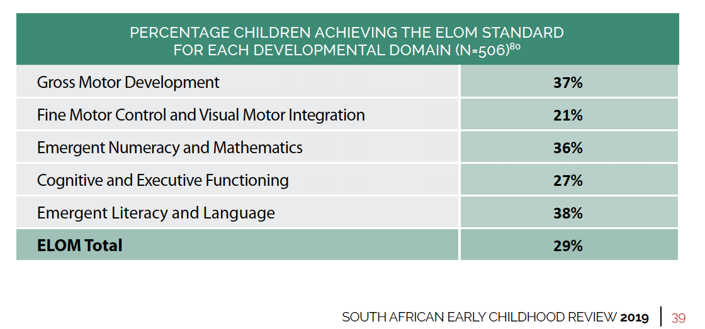
(3) Measurement
“What gets measured gets managed”
Unless we can reliably measure the outcomes we want to achieve and see how these (1) change over time, and (2) are distributed across provinces and sites …we won’t know if we are achieving our goals or not.

Slide 8
(4) Time & Trade-offs
Quality takes time.
Training & Certification, Systems, Funding, Piloting and scaling up, Measurement, Evaluation all take time.
What dictates our time-frames?
  Politics?
  Funding?
  Capacity?
Is there an acceptance that there is actually a trade-off between access and quality?
What are our time frames?
What should our time frames be?

Slide 9
Quality
Is funding the binding constraint to expanding access to quality ECD?
State-funded quality ECD is impossible with current levels of funding (1-2% of education budget).
Is there appetite (/ability) from Treasury/ANC to radically increase funding for ECD.
  We would need to reprioritize (from where?) or increase taxes to fund this (ECD tax?)
  Are statements by President/ANC just “unfunded mandates”?

Slide 10


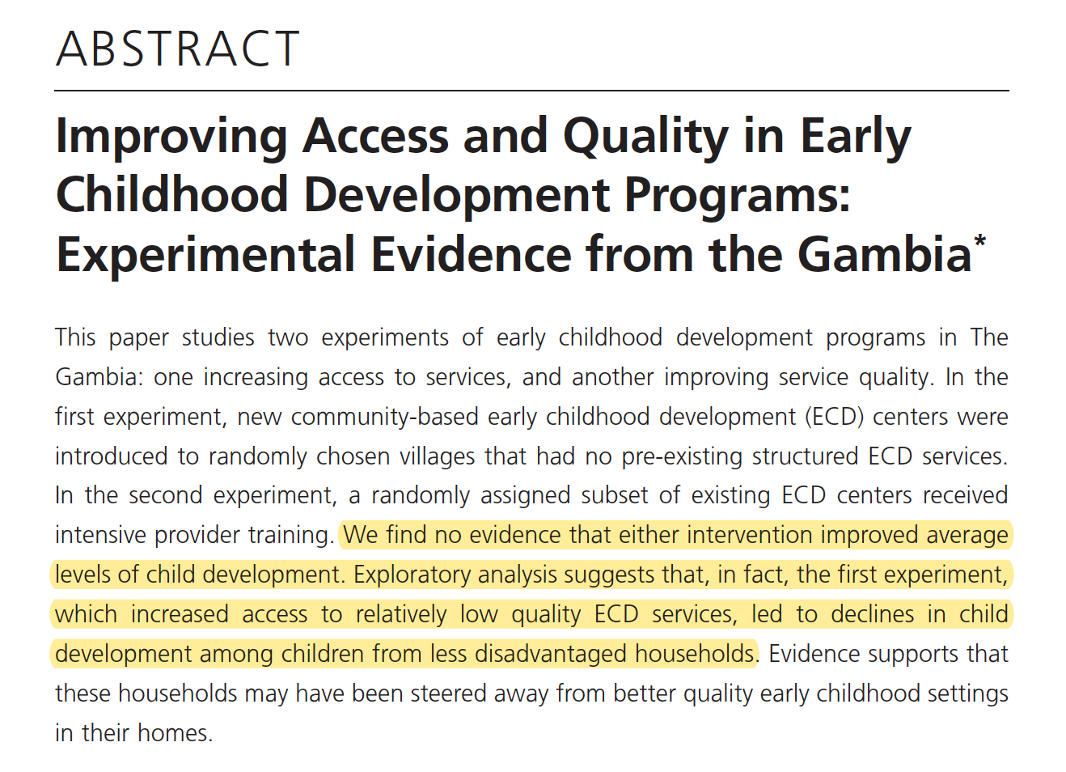
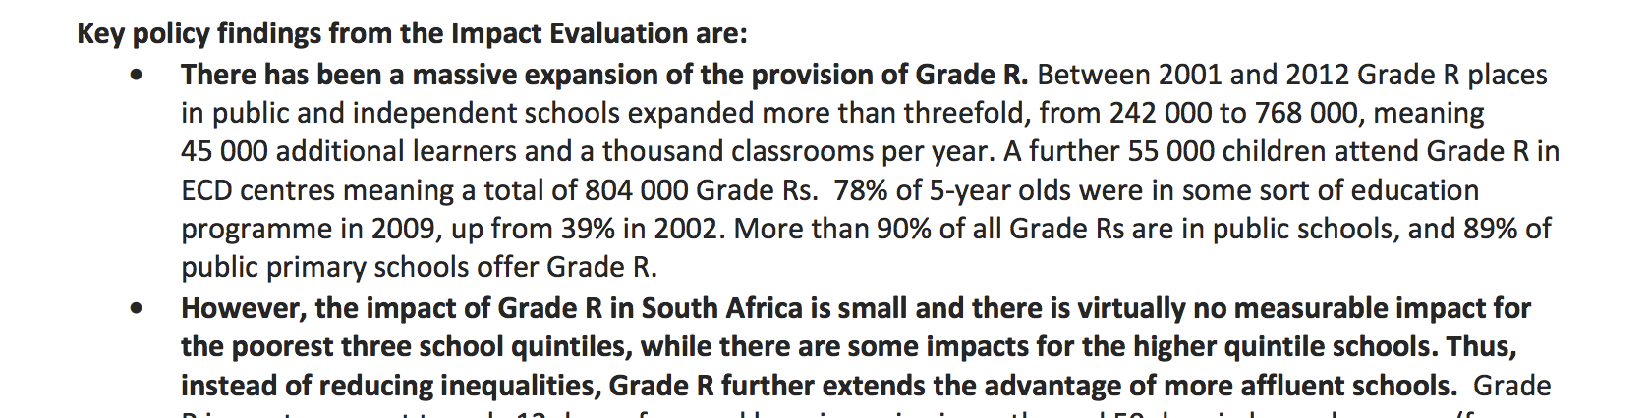

Slide 11
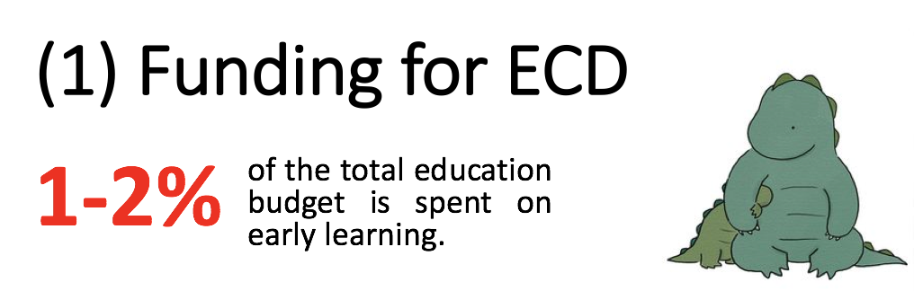
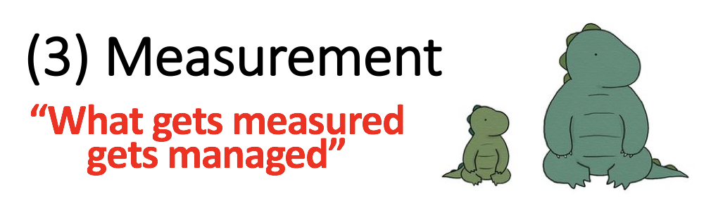


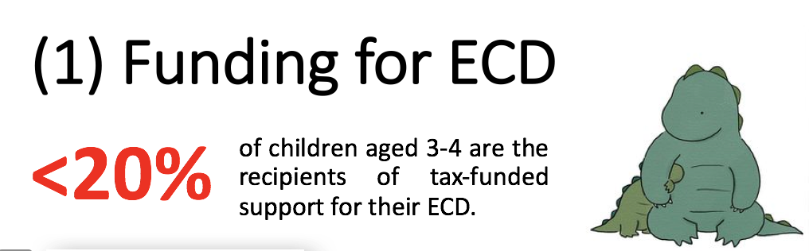
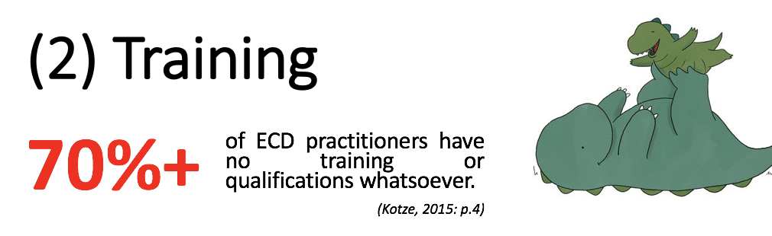
If the choice is between:
(a) low-quality full-access, and
(b) medium-quality medium-access, which is preferable?
“Is funding the binding constraint to expanding access to quality ECD?”

