Slide 1
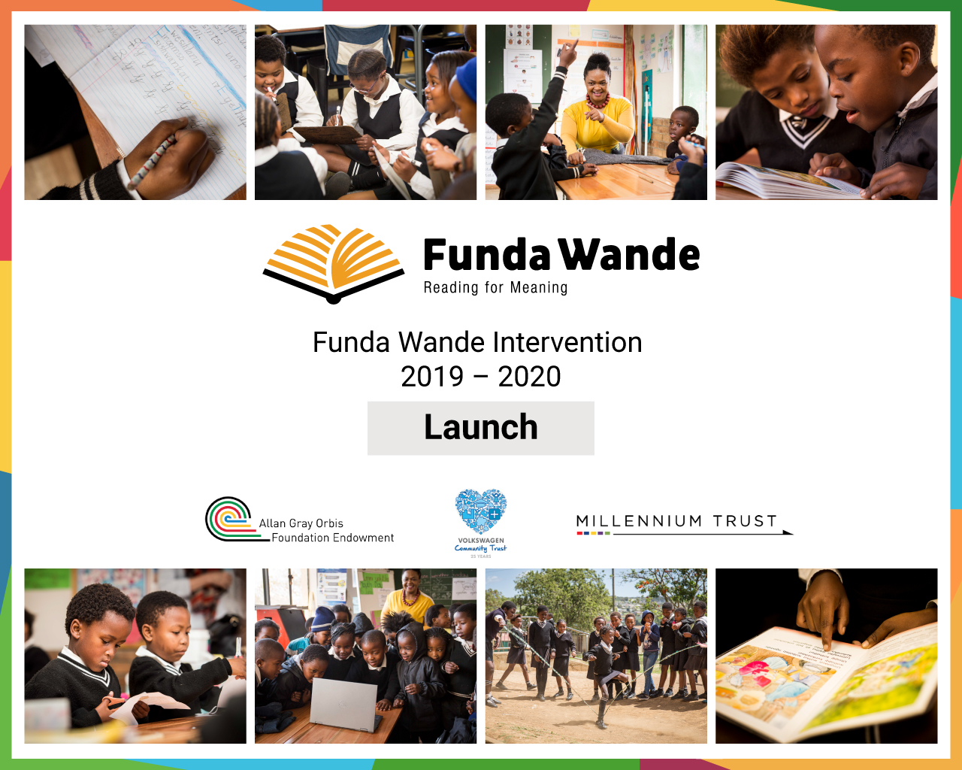
4 ways to
stay safe online
With the growing presence and sophistication of online threats like viruses, ransomware, and phishing scams, it’s important to have the right protection. Office 365 Home and Office 365 Personal give you advanced security tools to help keep your information secure and private.
Alignment & Coherence
Components of professional development and LTSM alignment to
ensure all children learn to read for meaning by age 10
Nic Spaull & Portia October
9 September 2019

Slide 2


78%
Why are we here?
of Grade 4 children in South Africa can not read for meaning in any language (PIRLS-L 2016)
61%
of Grade 5 children in South Africa can not add and subtract whole numbers.

Slide 3
PIRLS Literacy 2016
45% of Gr4 children in WC can read for meaning
% reaching the PIRLS 2016 Low International Benchmark
(Howie et al., 2017)

Slide 4
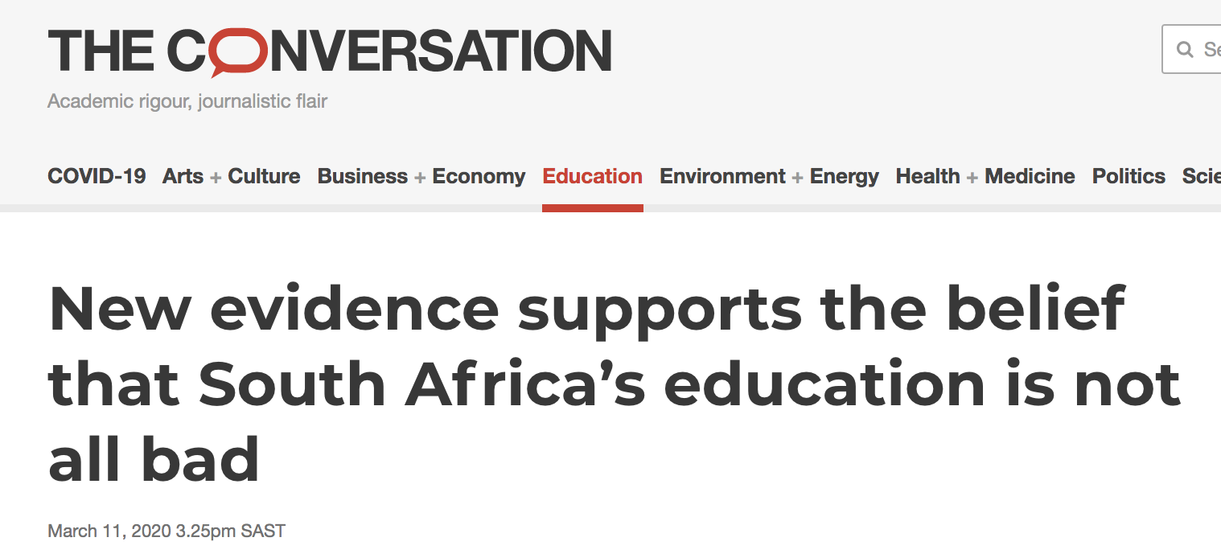
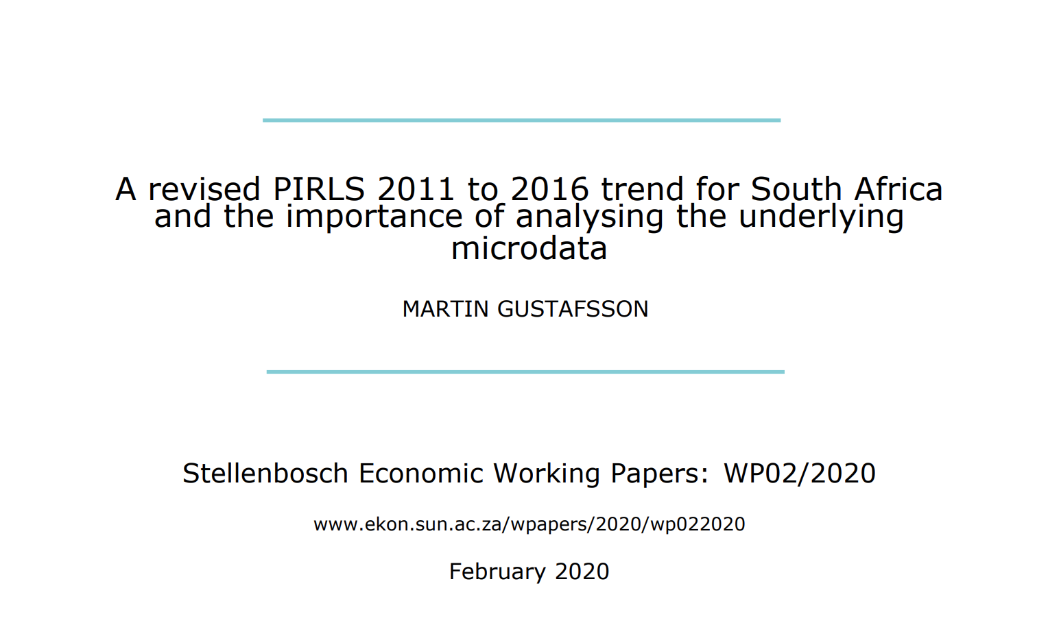
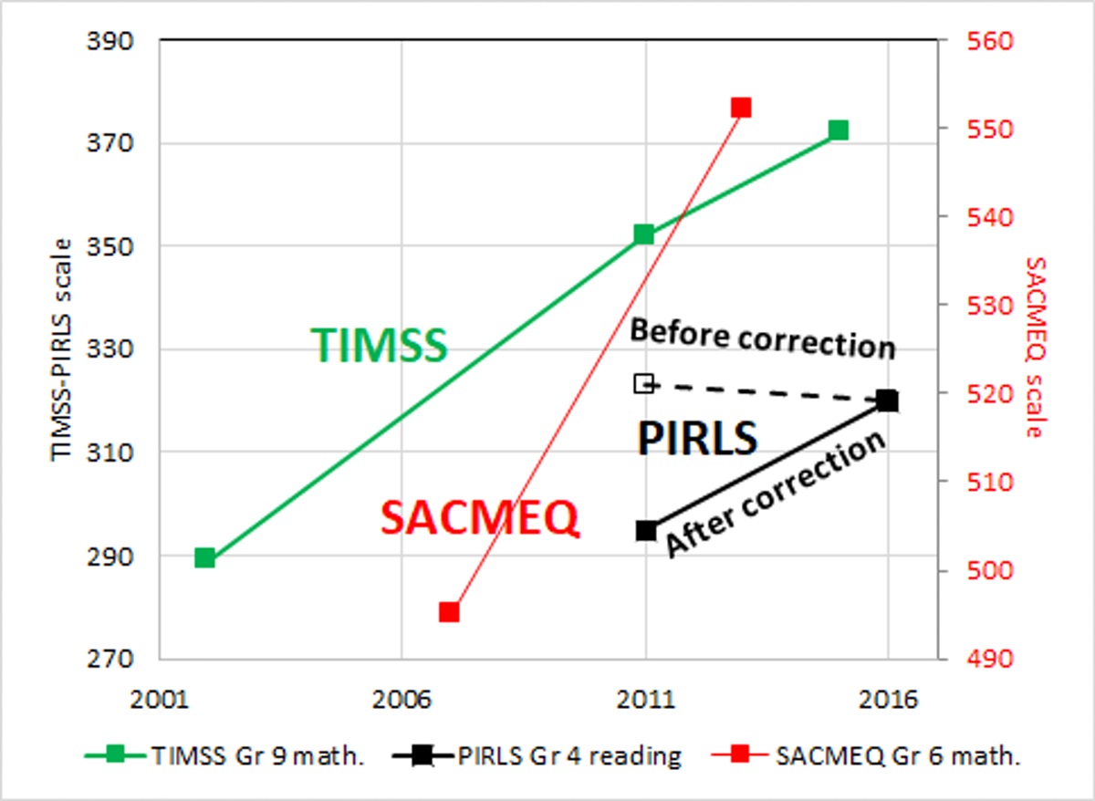
Some
(very recent) good news… ☺
According to PIRLS SA reading scores have been improving consistently from 2006→2011→2016
“The classical scores, in contrast, pointed to a large increase over the 2011 to 2016 period, from around 32% correct to 42% correct. Of 43 countries with a 2011 to 2016 trend, South Africa’s trend was the third-steepest increase, after those of Morocco and Oman. If correctly calculated, the item response theory scores should have pointed to a similar gain.” (Martin Gustafsson 2020)
https://theconversation.com/new-evidence-supports-the-belief-that-south-africas-education-is-not-all-bad-132280
https://www.ekon.sun.ac.za/wpapers/2020/wp022020

Slide 5
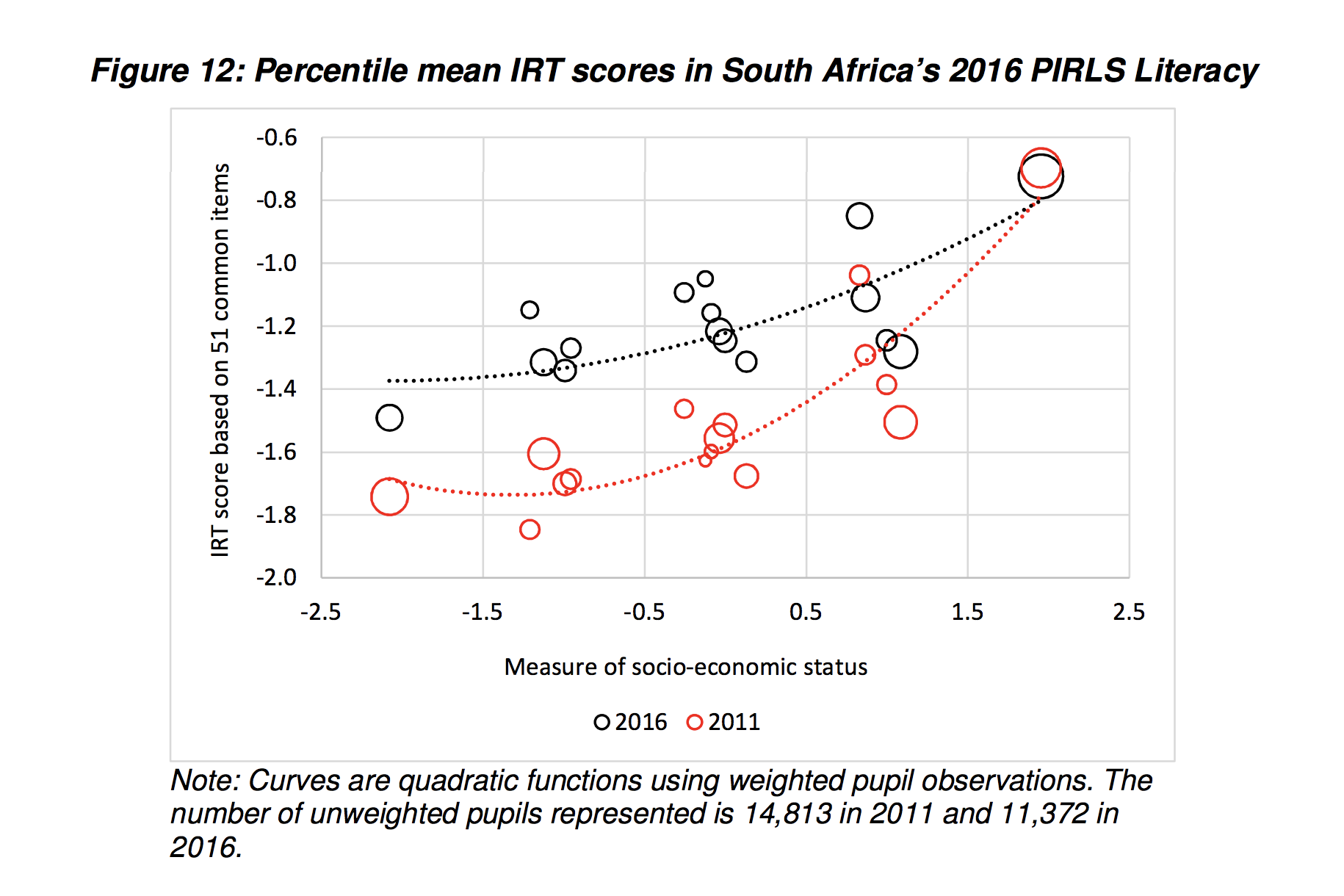
Between 2011 and 2016 the largest gains in SA were seen among poorest learners

Slide 6
Alignment & Coherence
Components of professional development and LTSM alignment to ensure all children learn to read for meaning by age 10
(1) Standards: What children need to know
(2) LTSM:
What materials we use to teach them
(3) Pedagogy: How we teach it to them
(5) Training:
In-service & pre-service training
(4) Assessments: How we know if they’ve learnt it

Slide 7
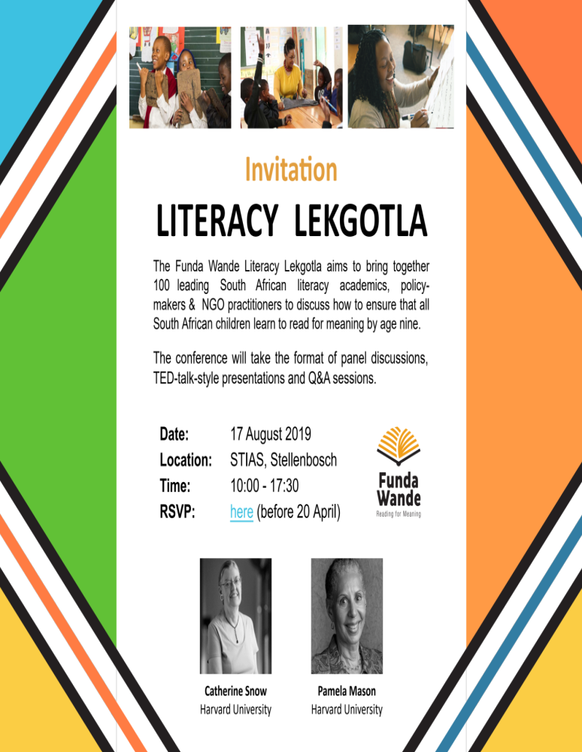
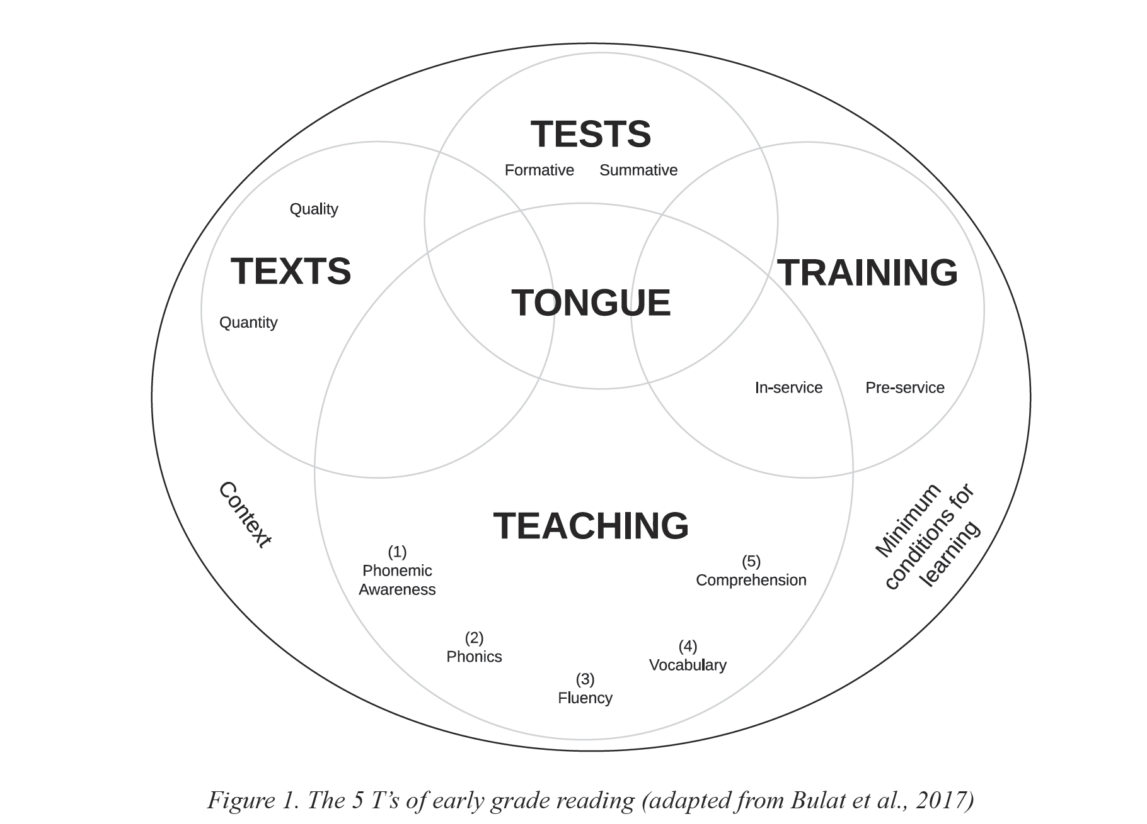
5 ‘Ts’ model
Spaull, 2019: BRILL-IBE: Improving Early Literacy Outcomes

Slide 8
4 ways to
stay safe online
With the growing presence and sophistication of online threats like viruses, ransomware, and phishing scams, it’s important to have the right protection. Office 365 Home and Office 365 Personal give you advanced security tools to help keep your information secure and private.
“Funda Wande aims to equip teachers with the knowledge, resources and support they need to teach reading for meaning by age 10.”

Slide 9
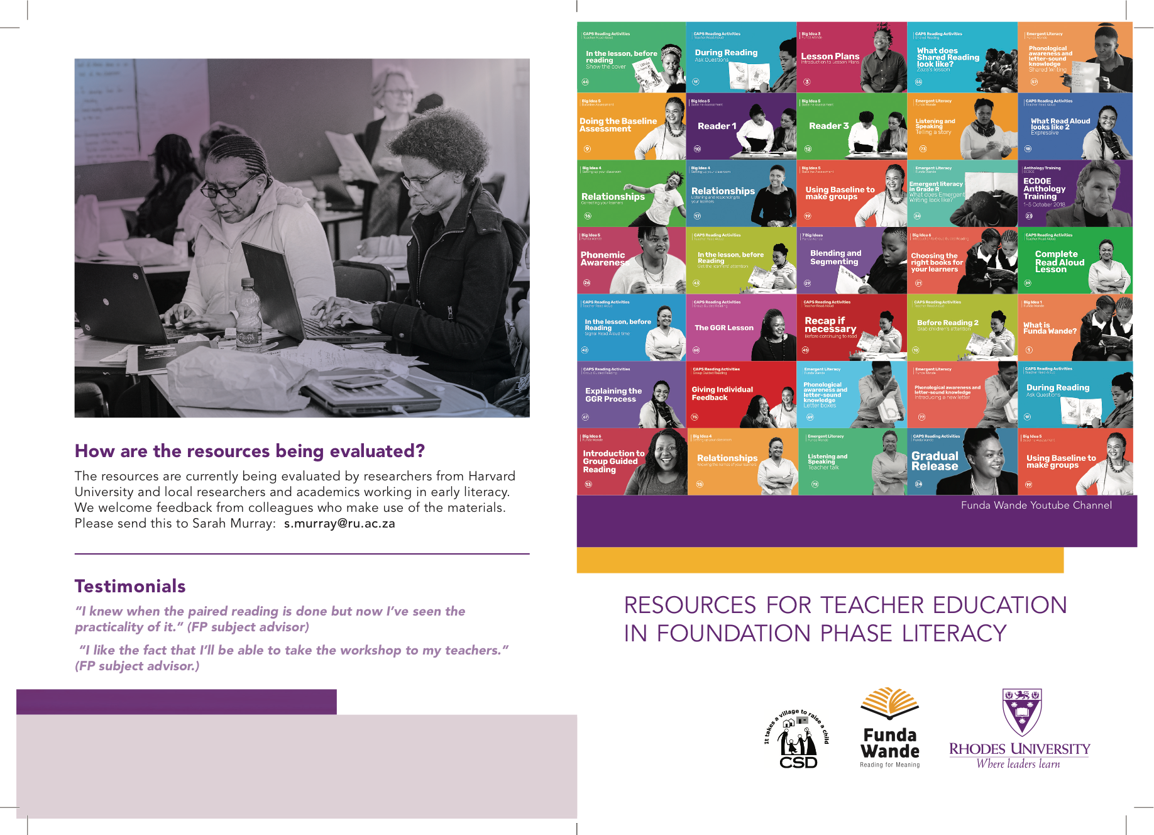
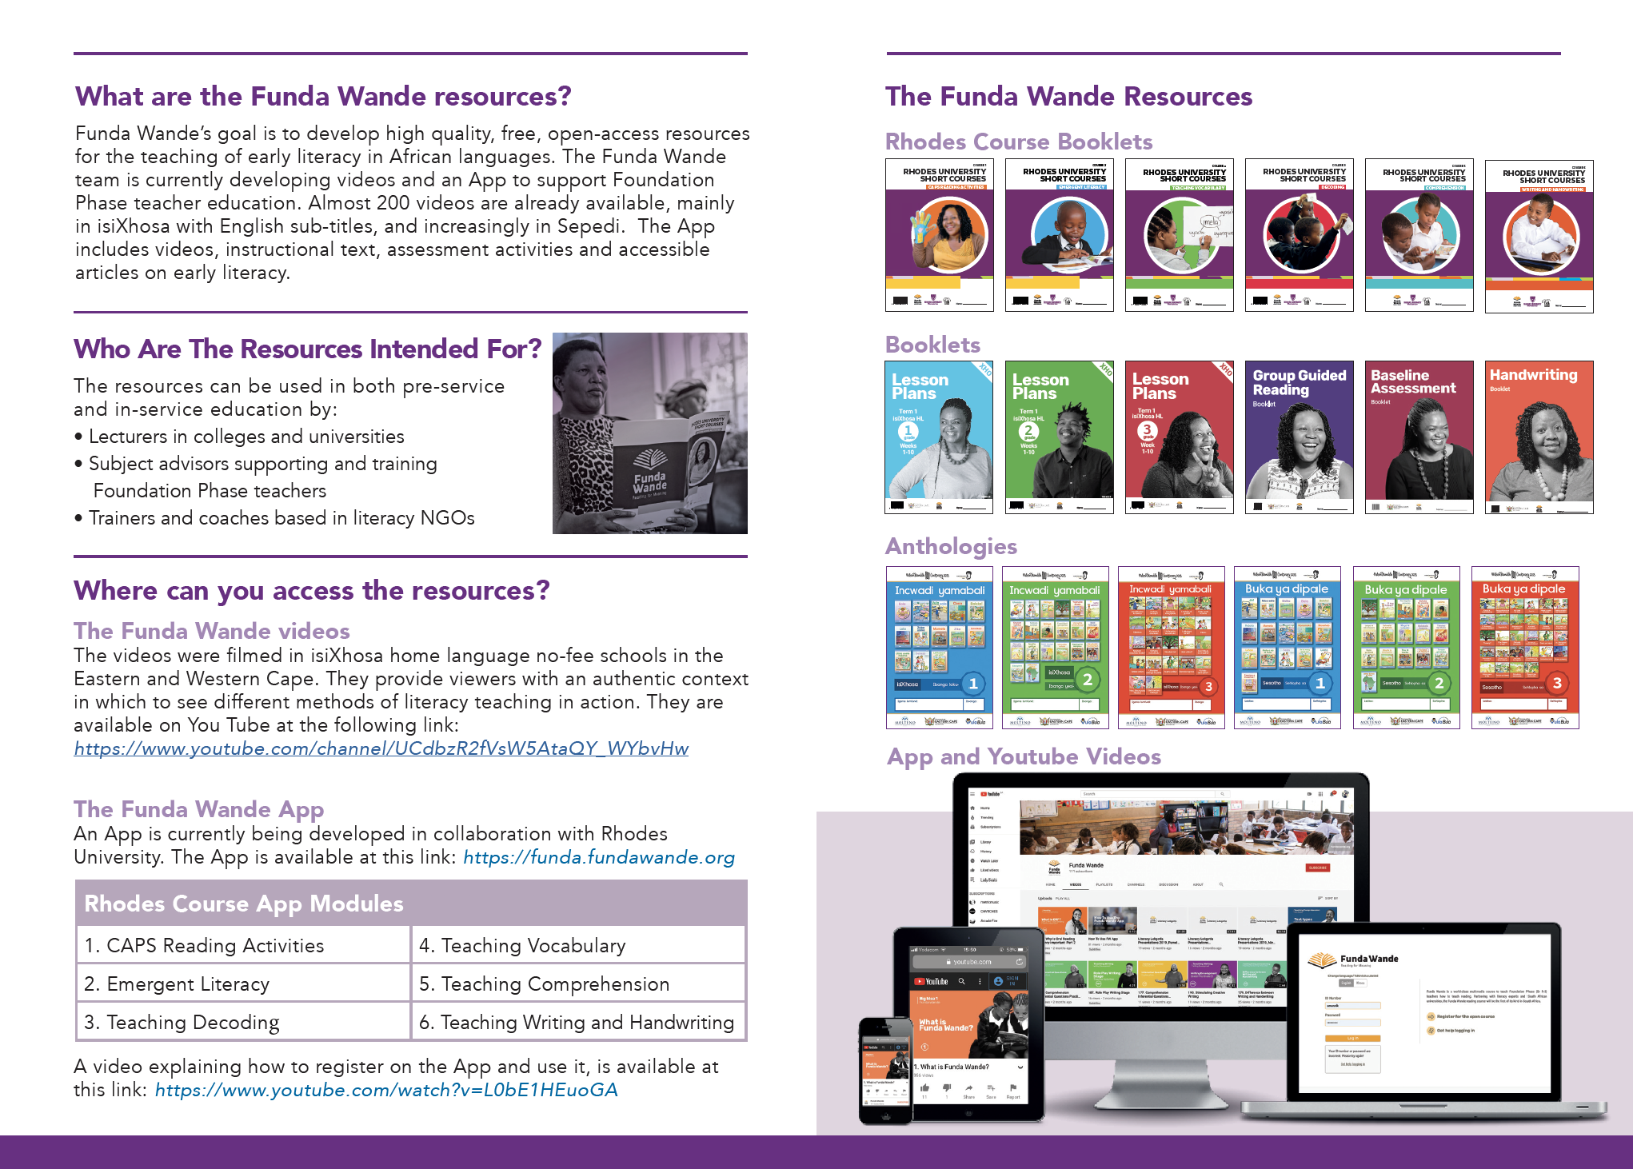
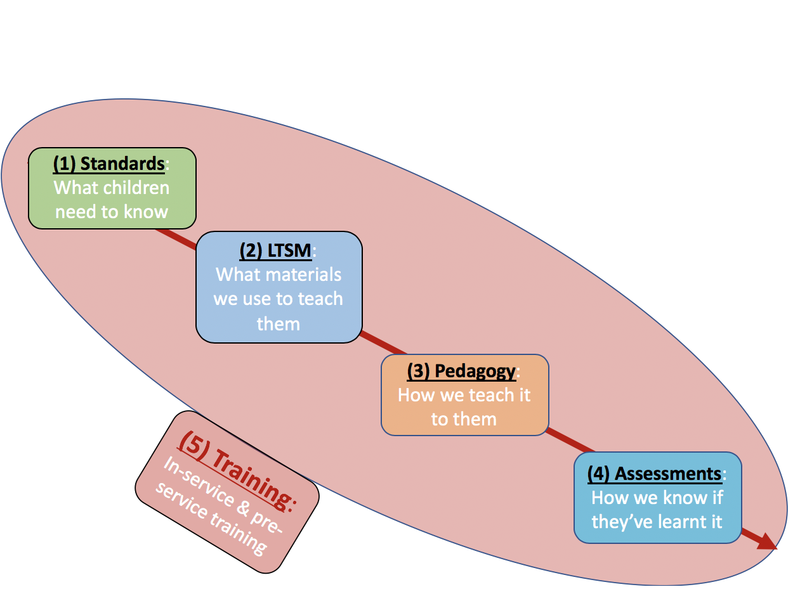
(2) LTSM:
What materials we use to teach them
(3) Pedagogy: How we teach it to them
(4) Assessments: How we know if they’ve learnt it
WC Systemics + EGRA

Slide 10
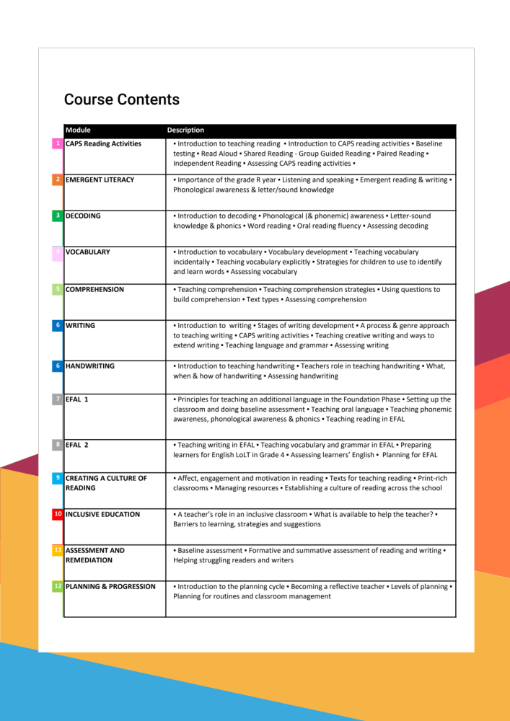
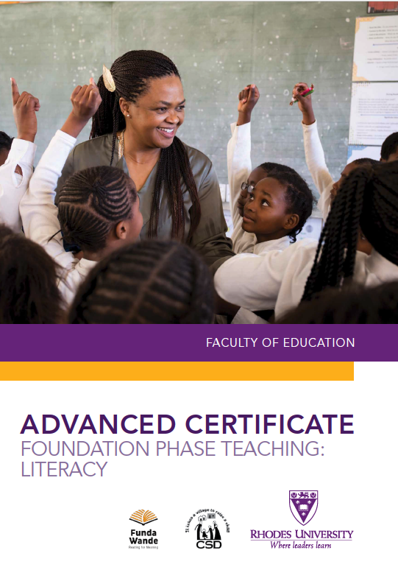
(5) Training:
In-service & pre-service training

Slide 11
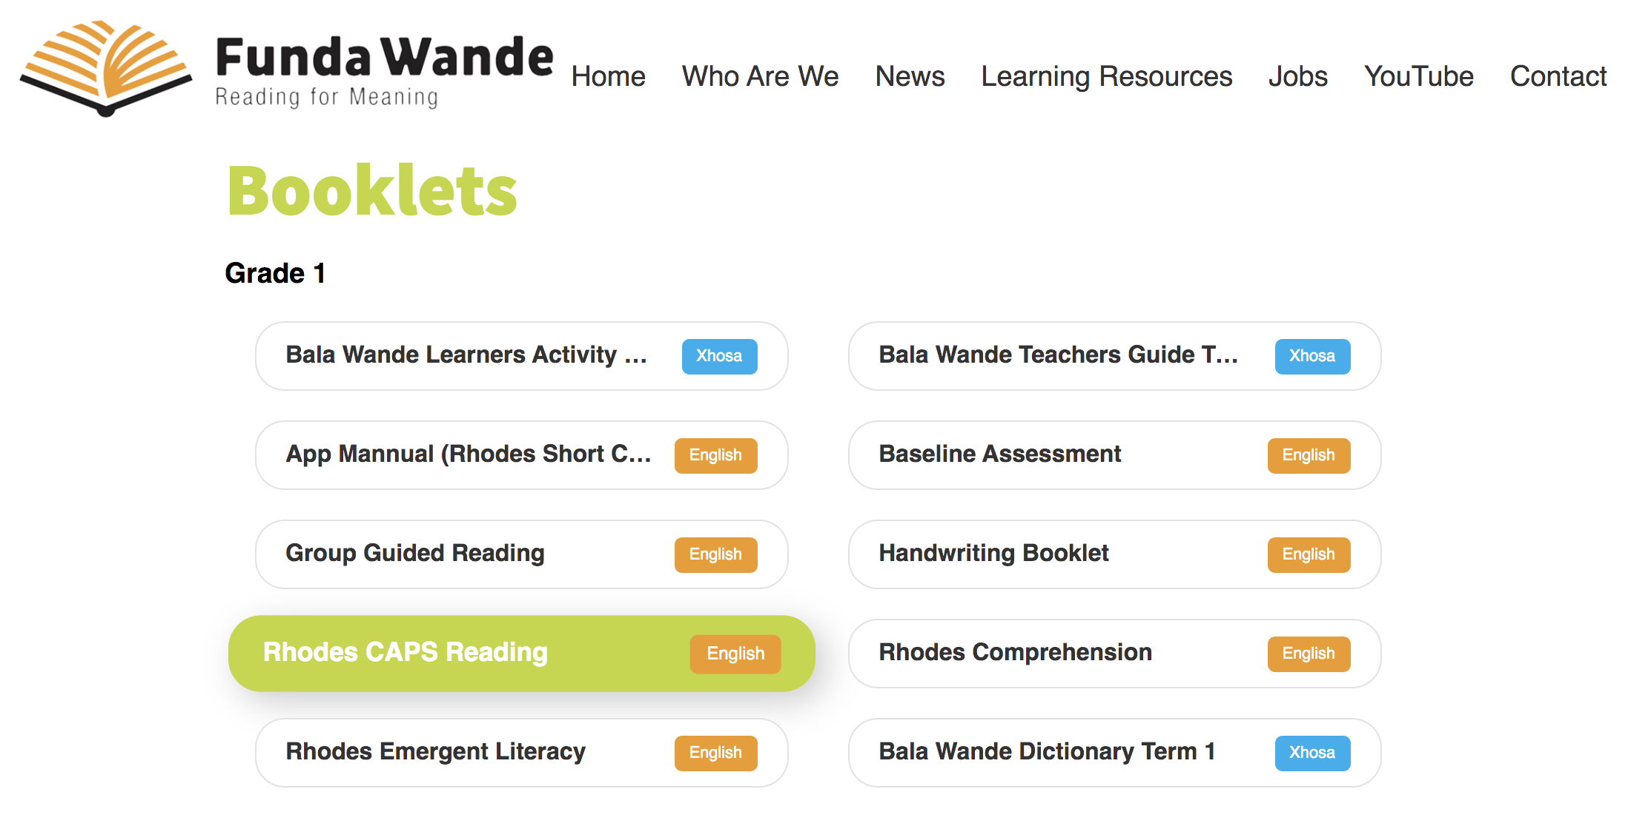
https://fundawande.org/learning-resources

Slide 12
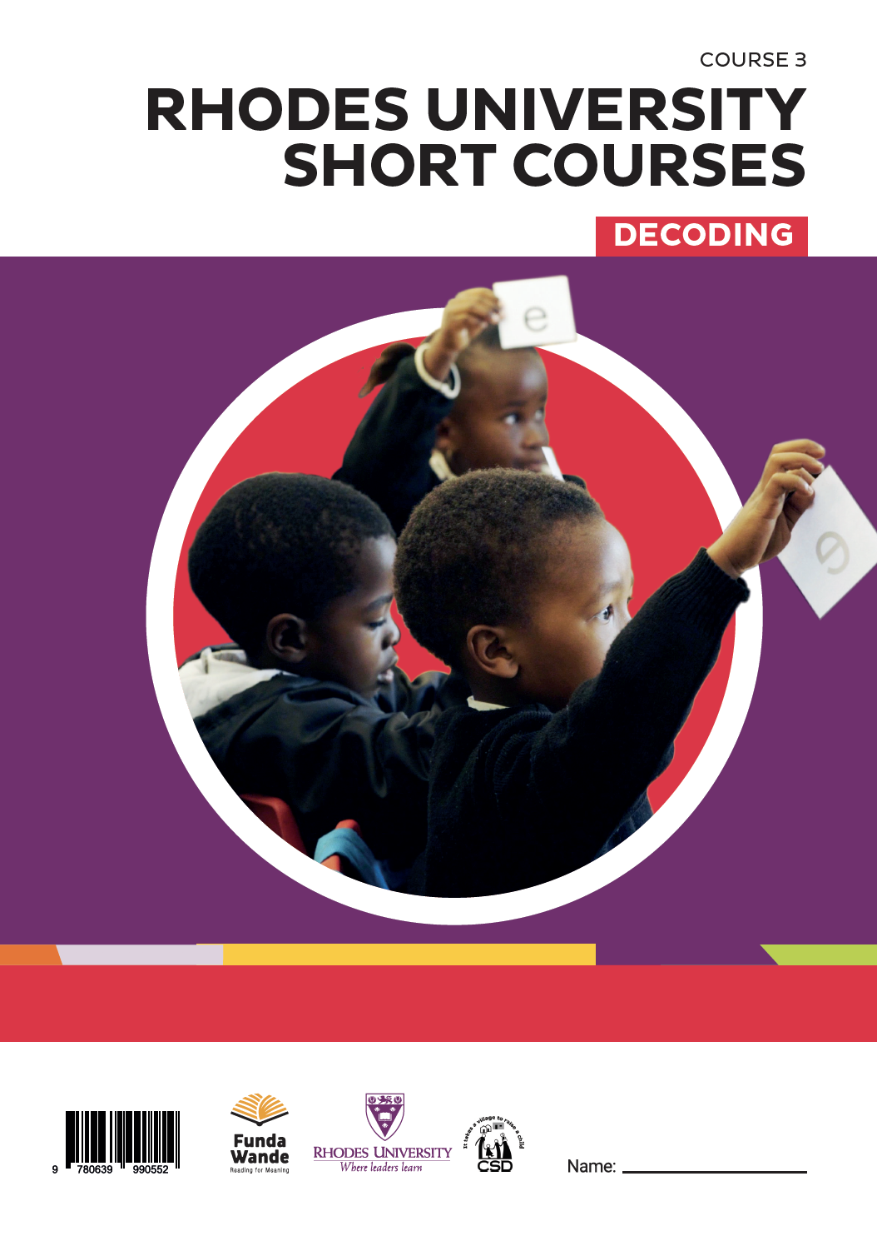

Slide 13
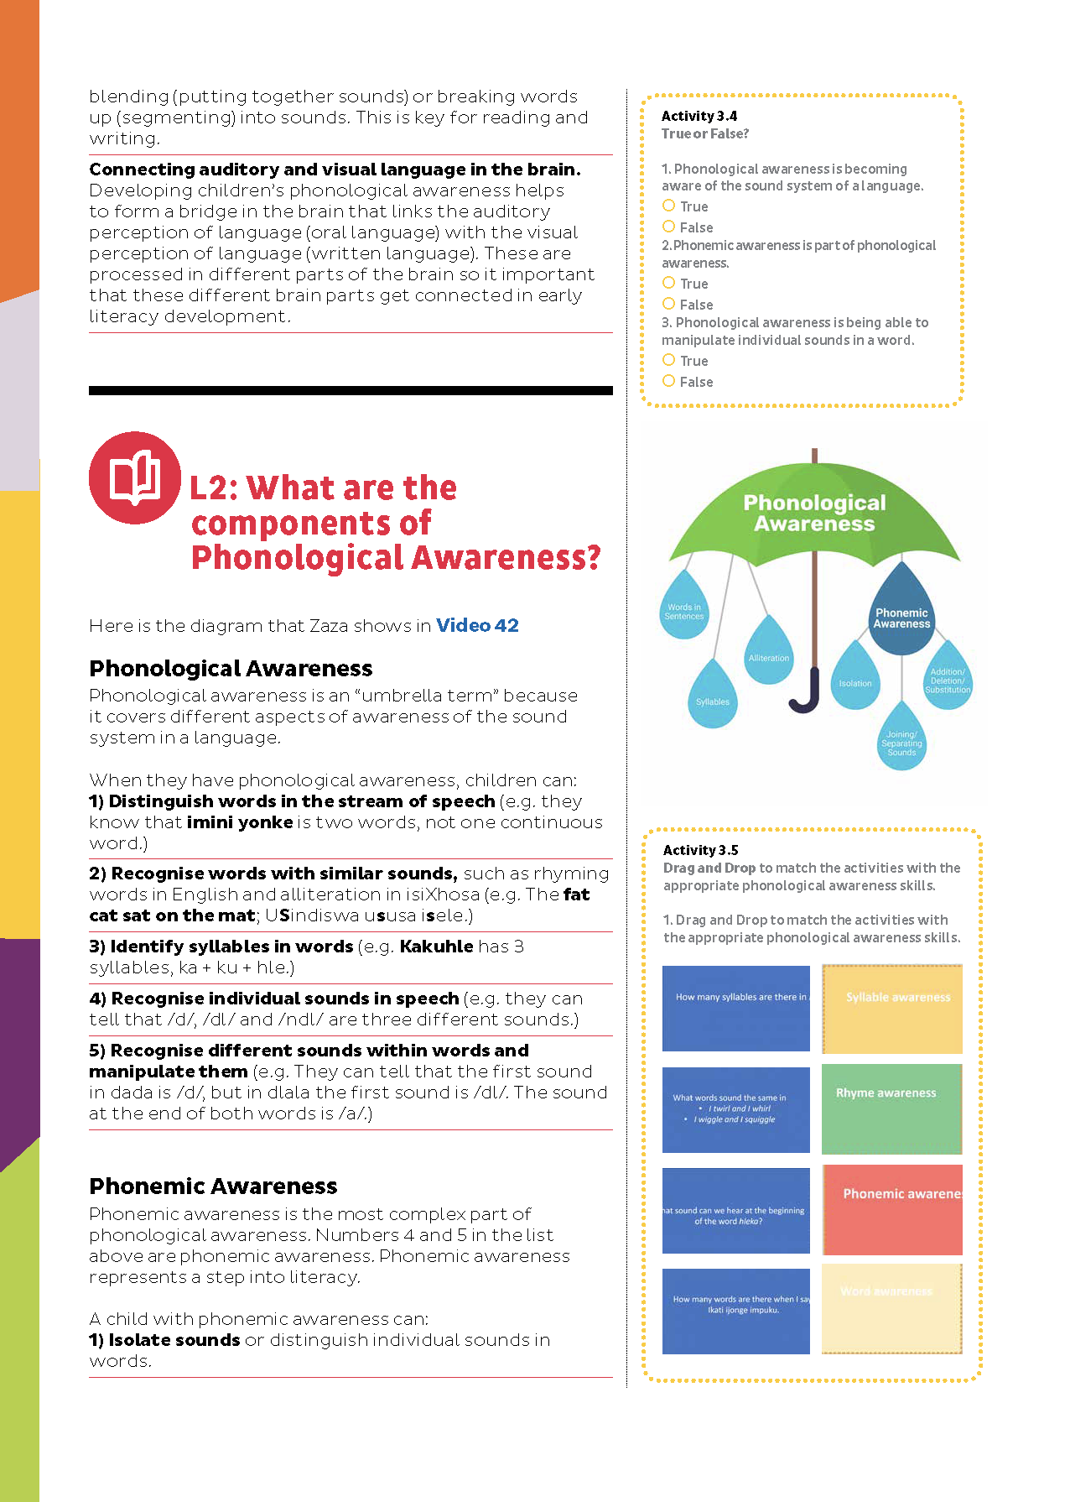
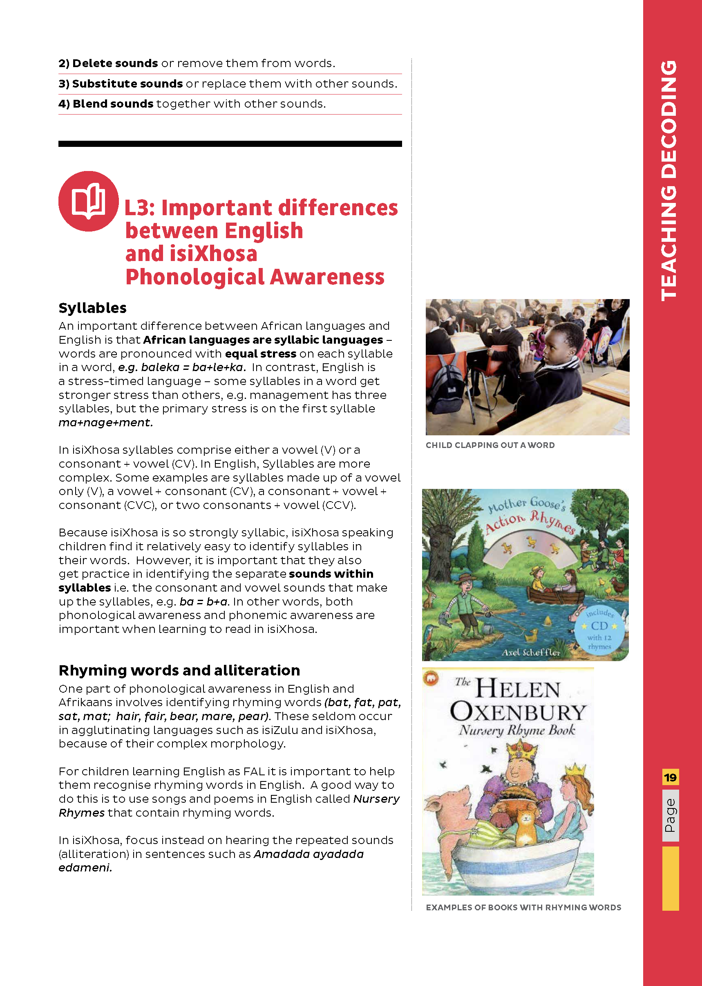

Slide 14
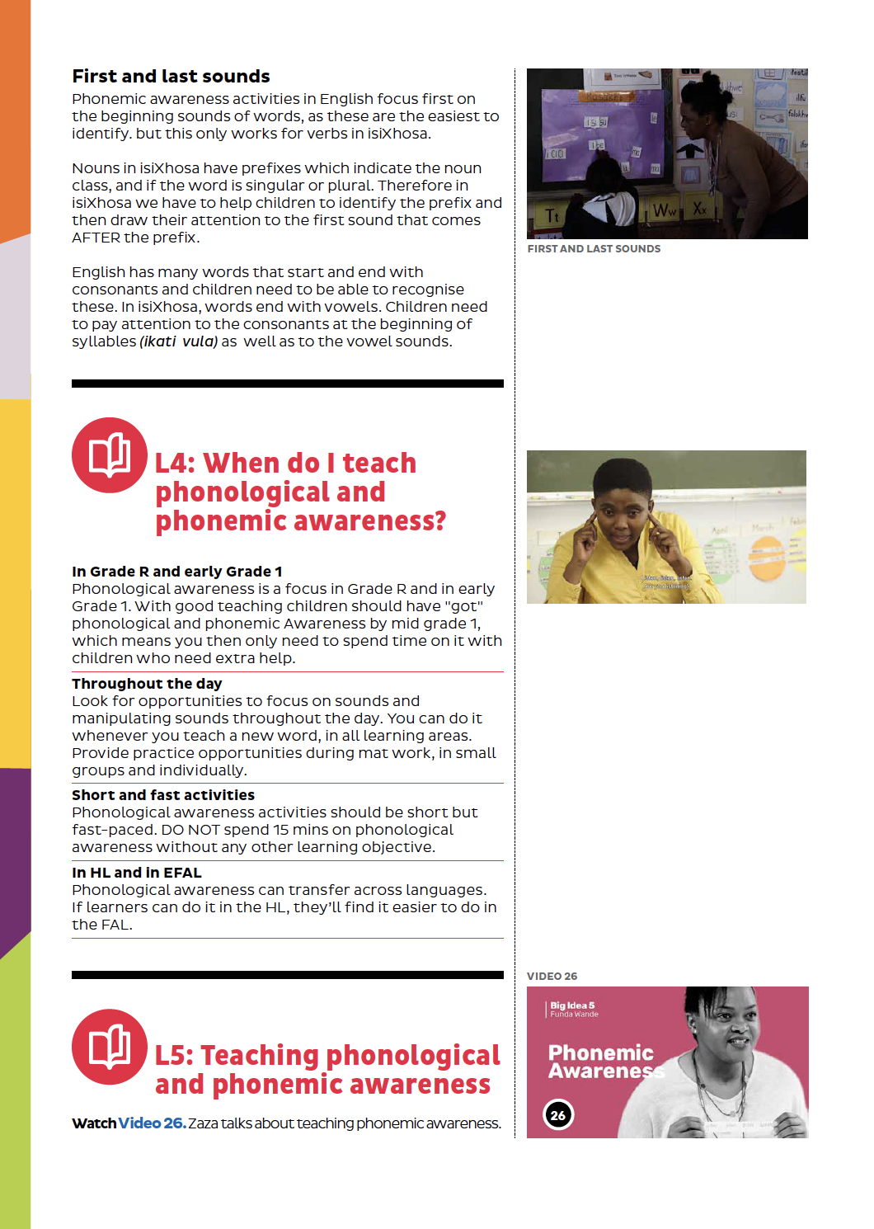
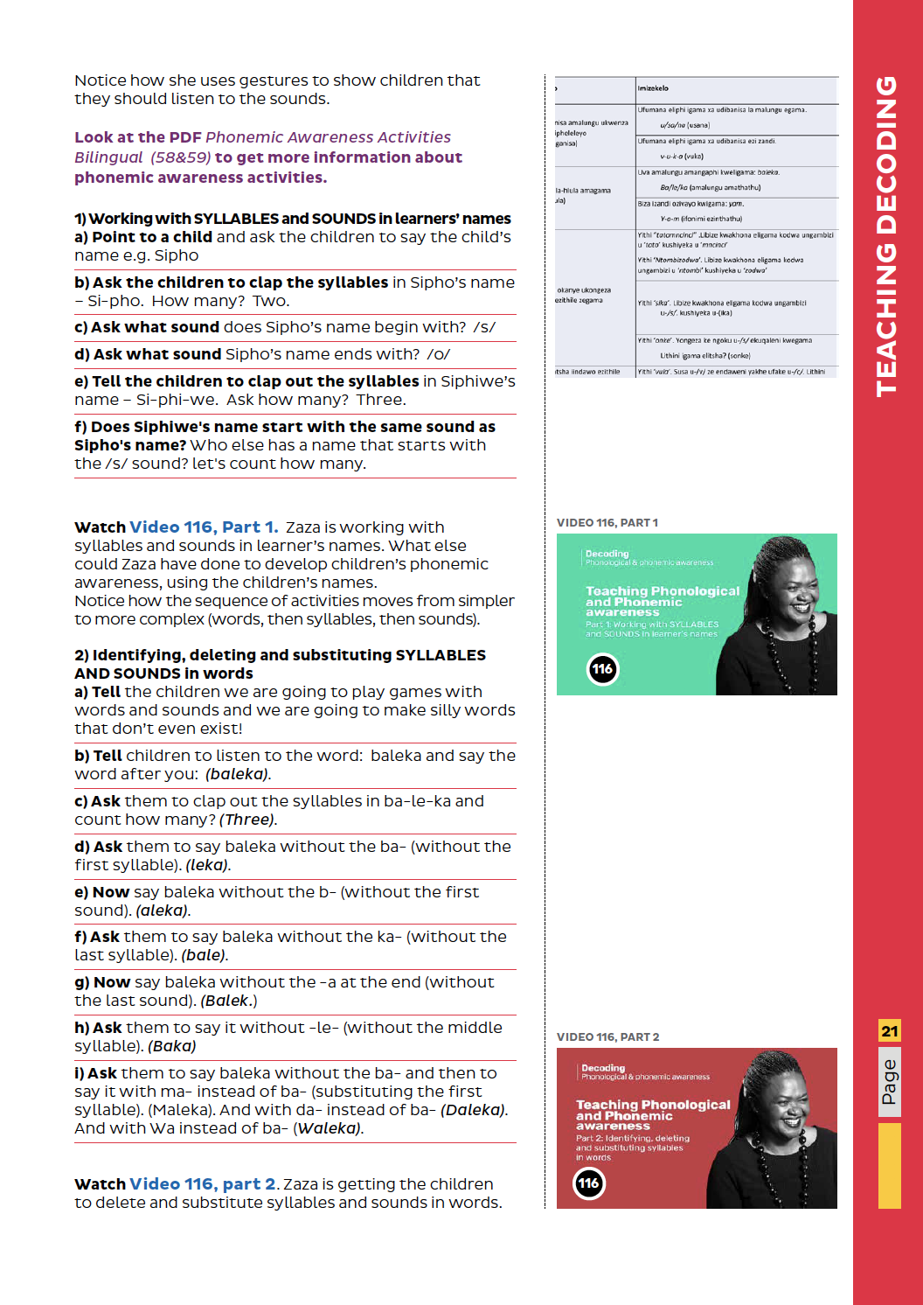

Slide 15
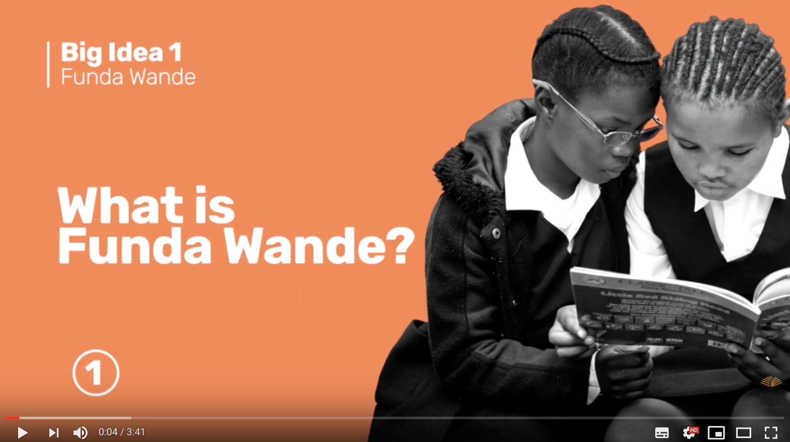

Slide 16
www.fundawande.org/resources

Slide 18
Everything produced by Funda Wande is CC-licensed and is freely available for download, editing and use by anyone ☺

Slide 19

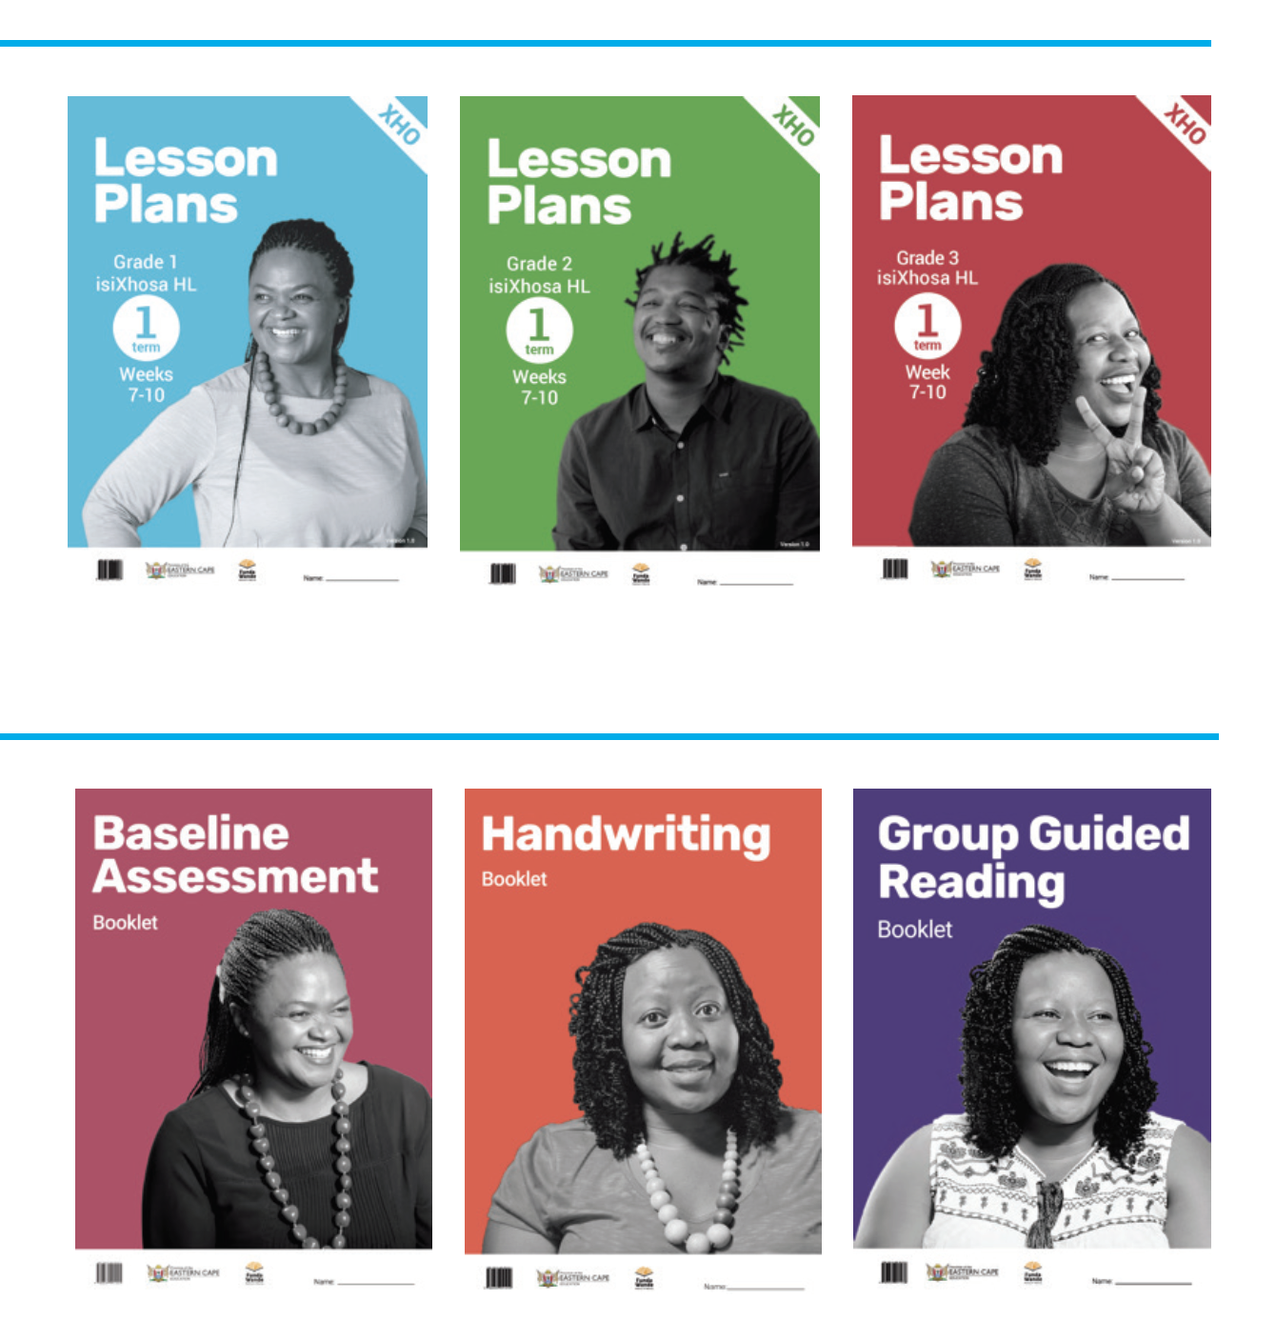
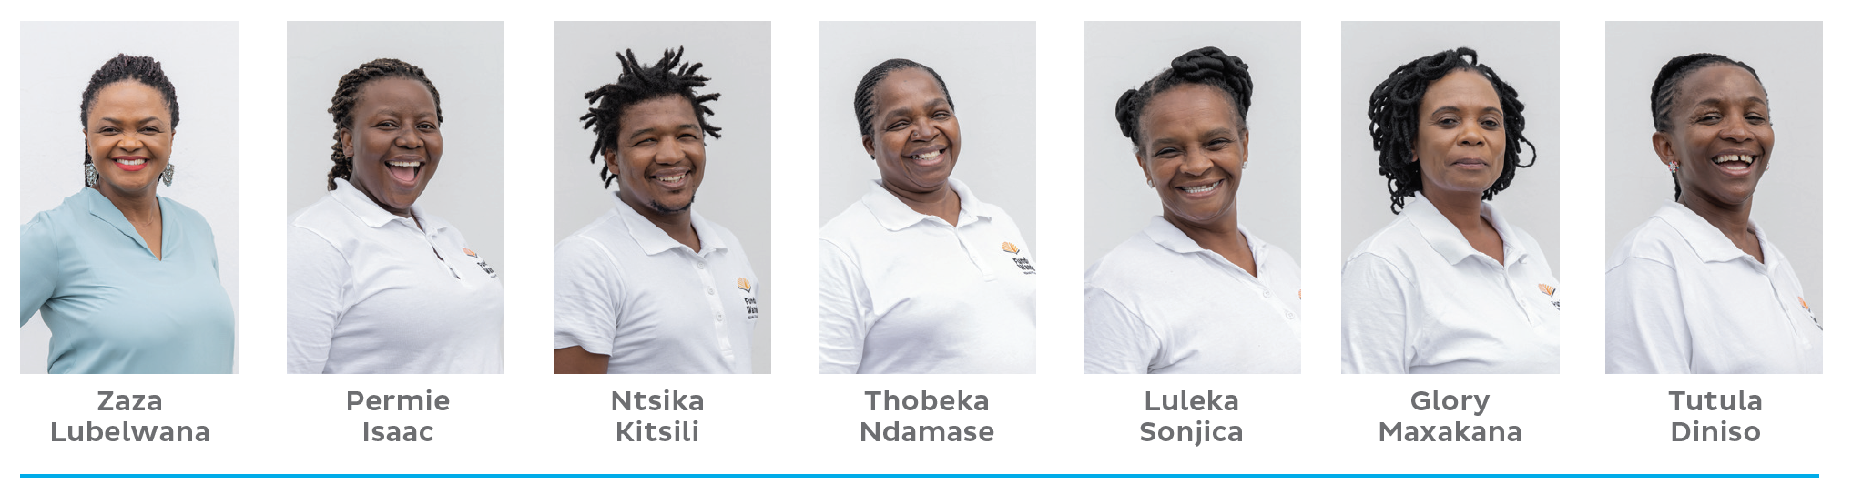

Slide 20
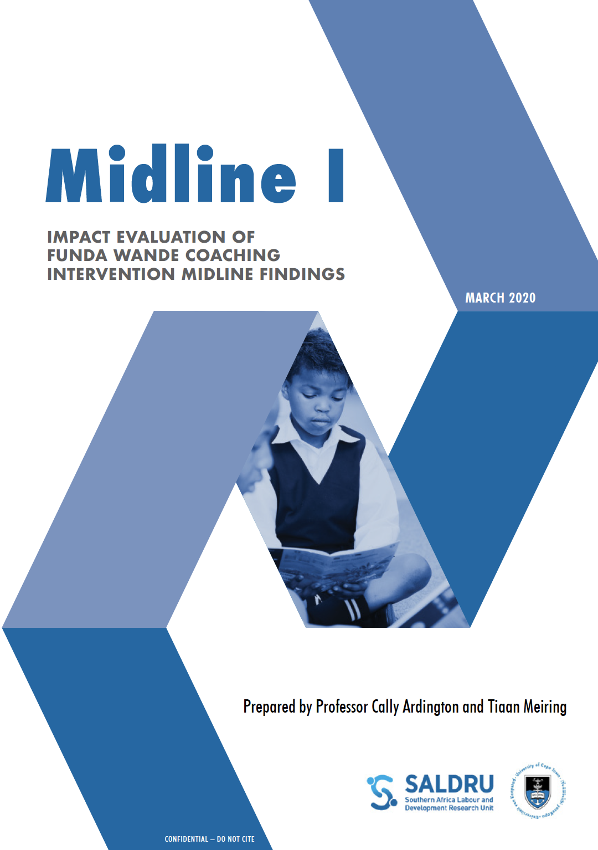
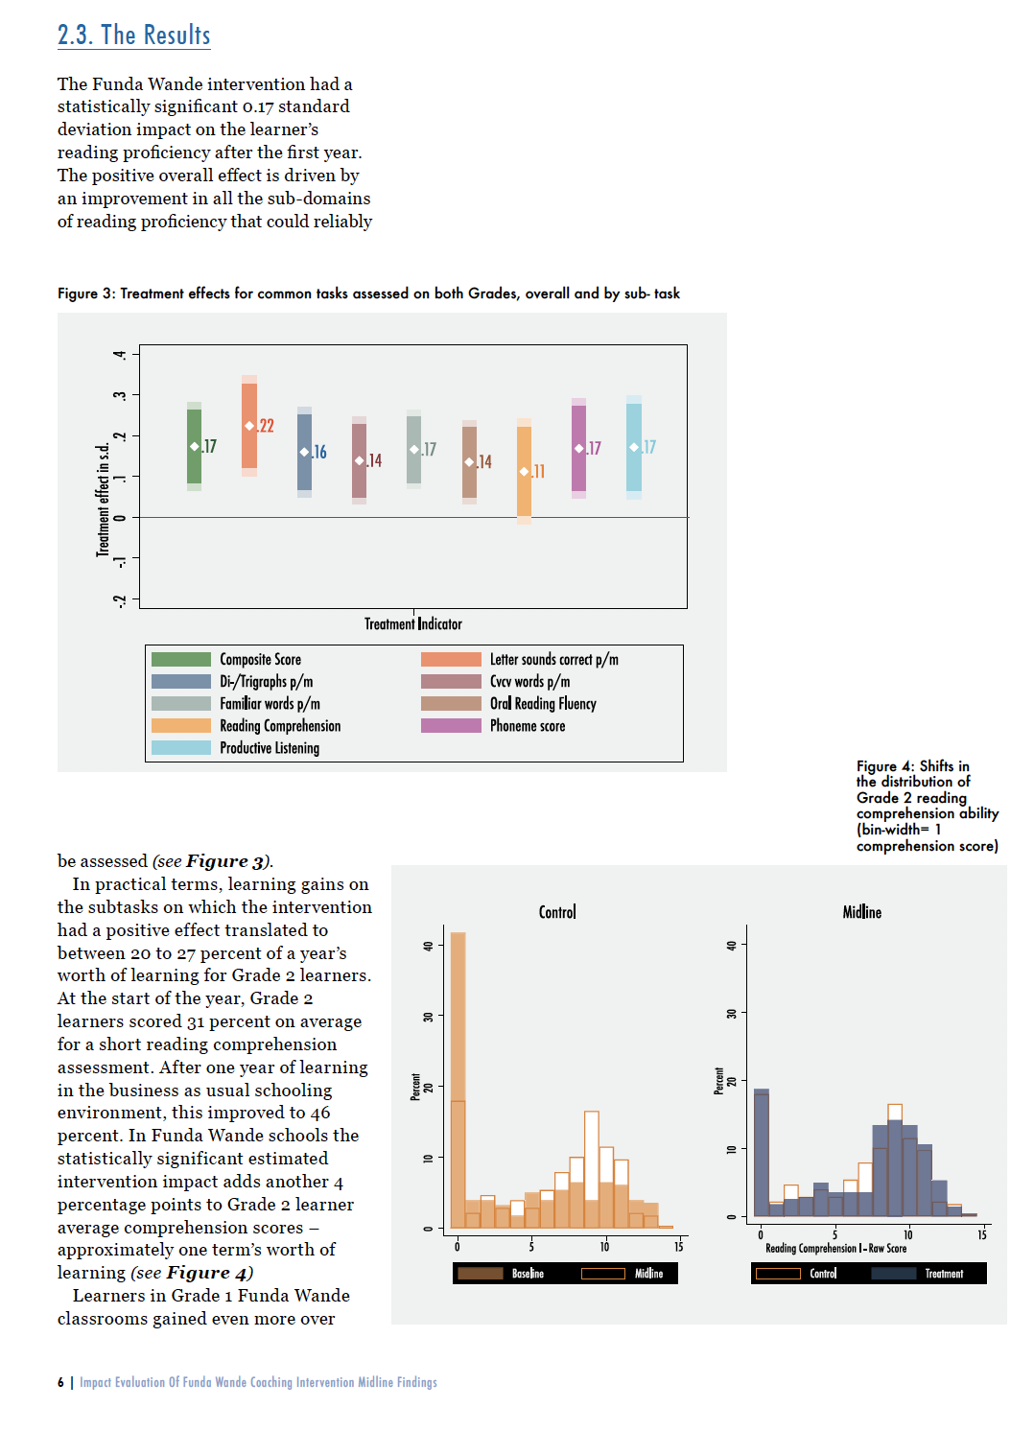

Slide 21
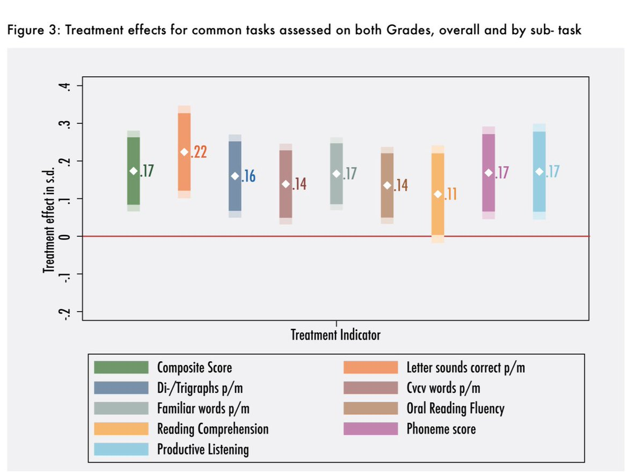
“…improvement in all the sub-domains of reading proficiency that could reliably be assessed… [this amounts to] approximately one term’s worth of [additional] learning”

Slide 22
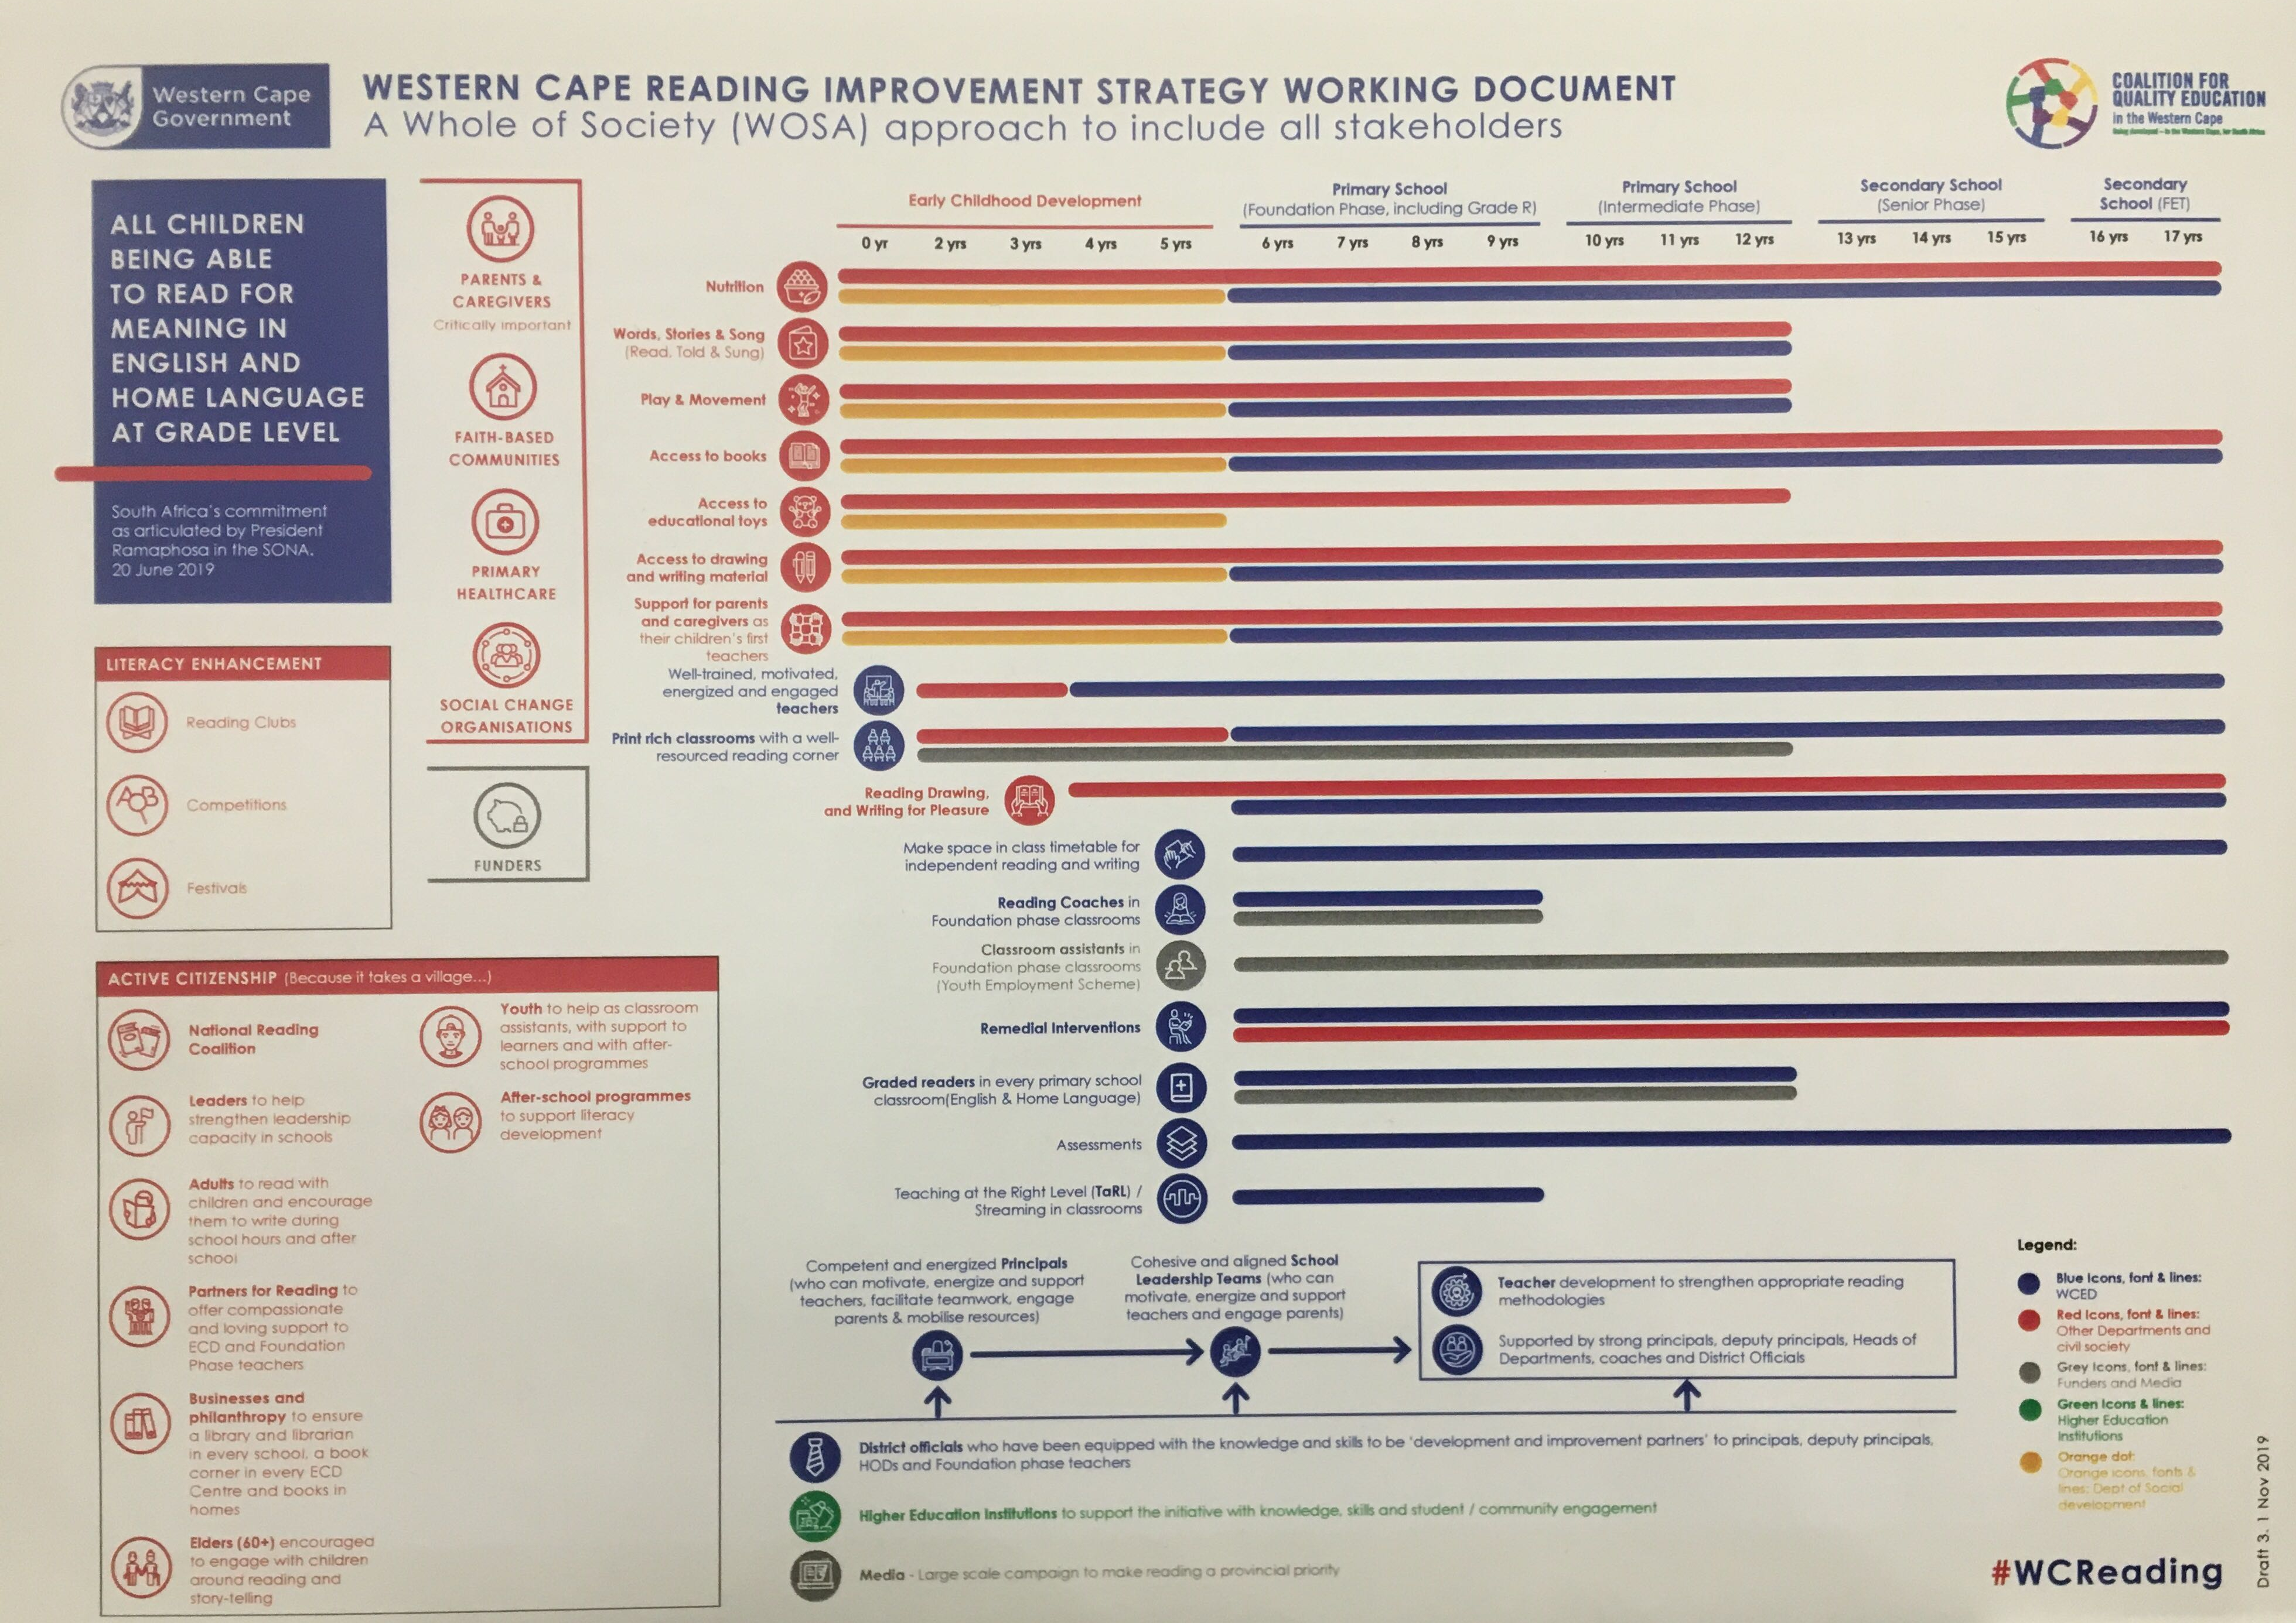

Slide 23
Alignment & Coherence
Components of professional development and LTSM alignment to ensure all children learn to read for meaning by age 10
(1) Standards: What children need to know
(2) LTSM:
What materials we use to teach them
(3) Pedagogy: How we teach it to them
(5) Training:
In-service & pre-service training
(4) Assessments: How we know if they’ve learnt it

Slide 24
?

Slide 25
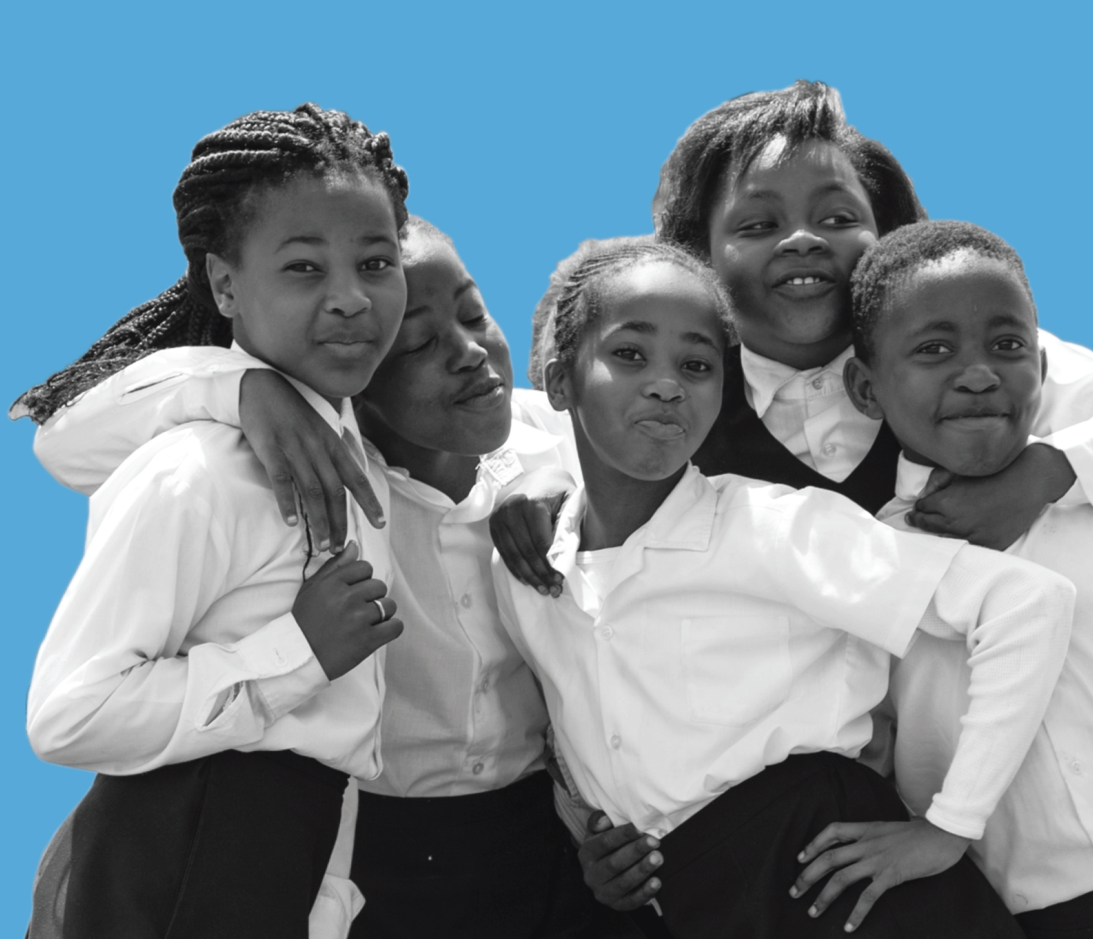
Thanks!

Slide 26
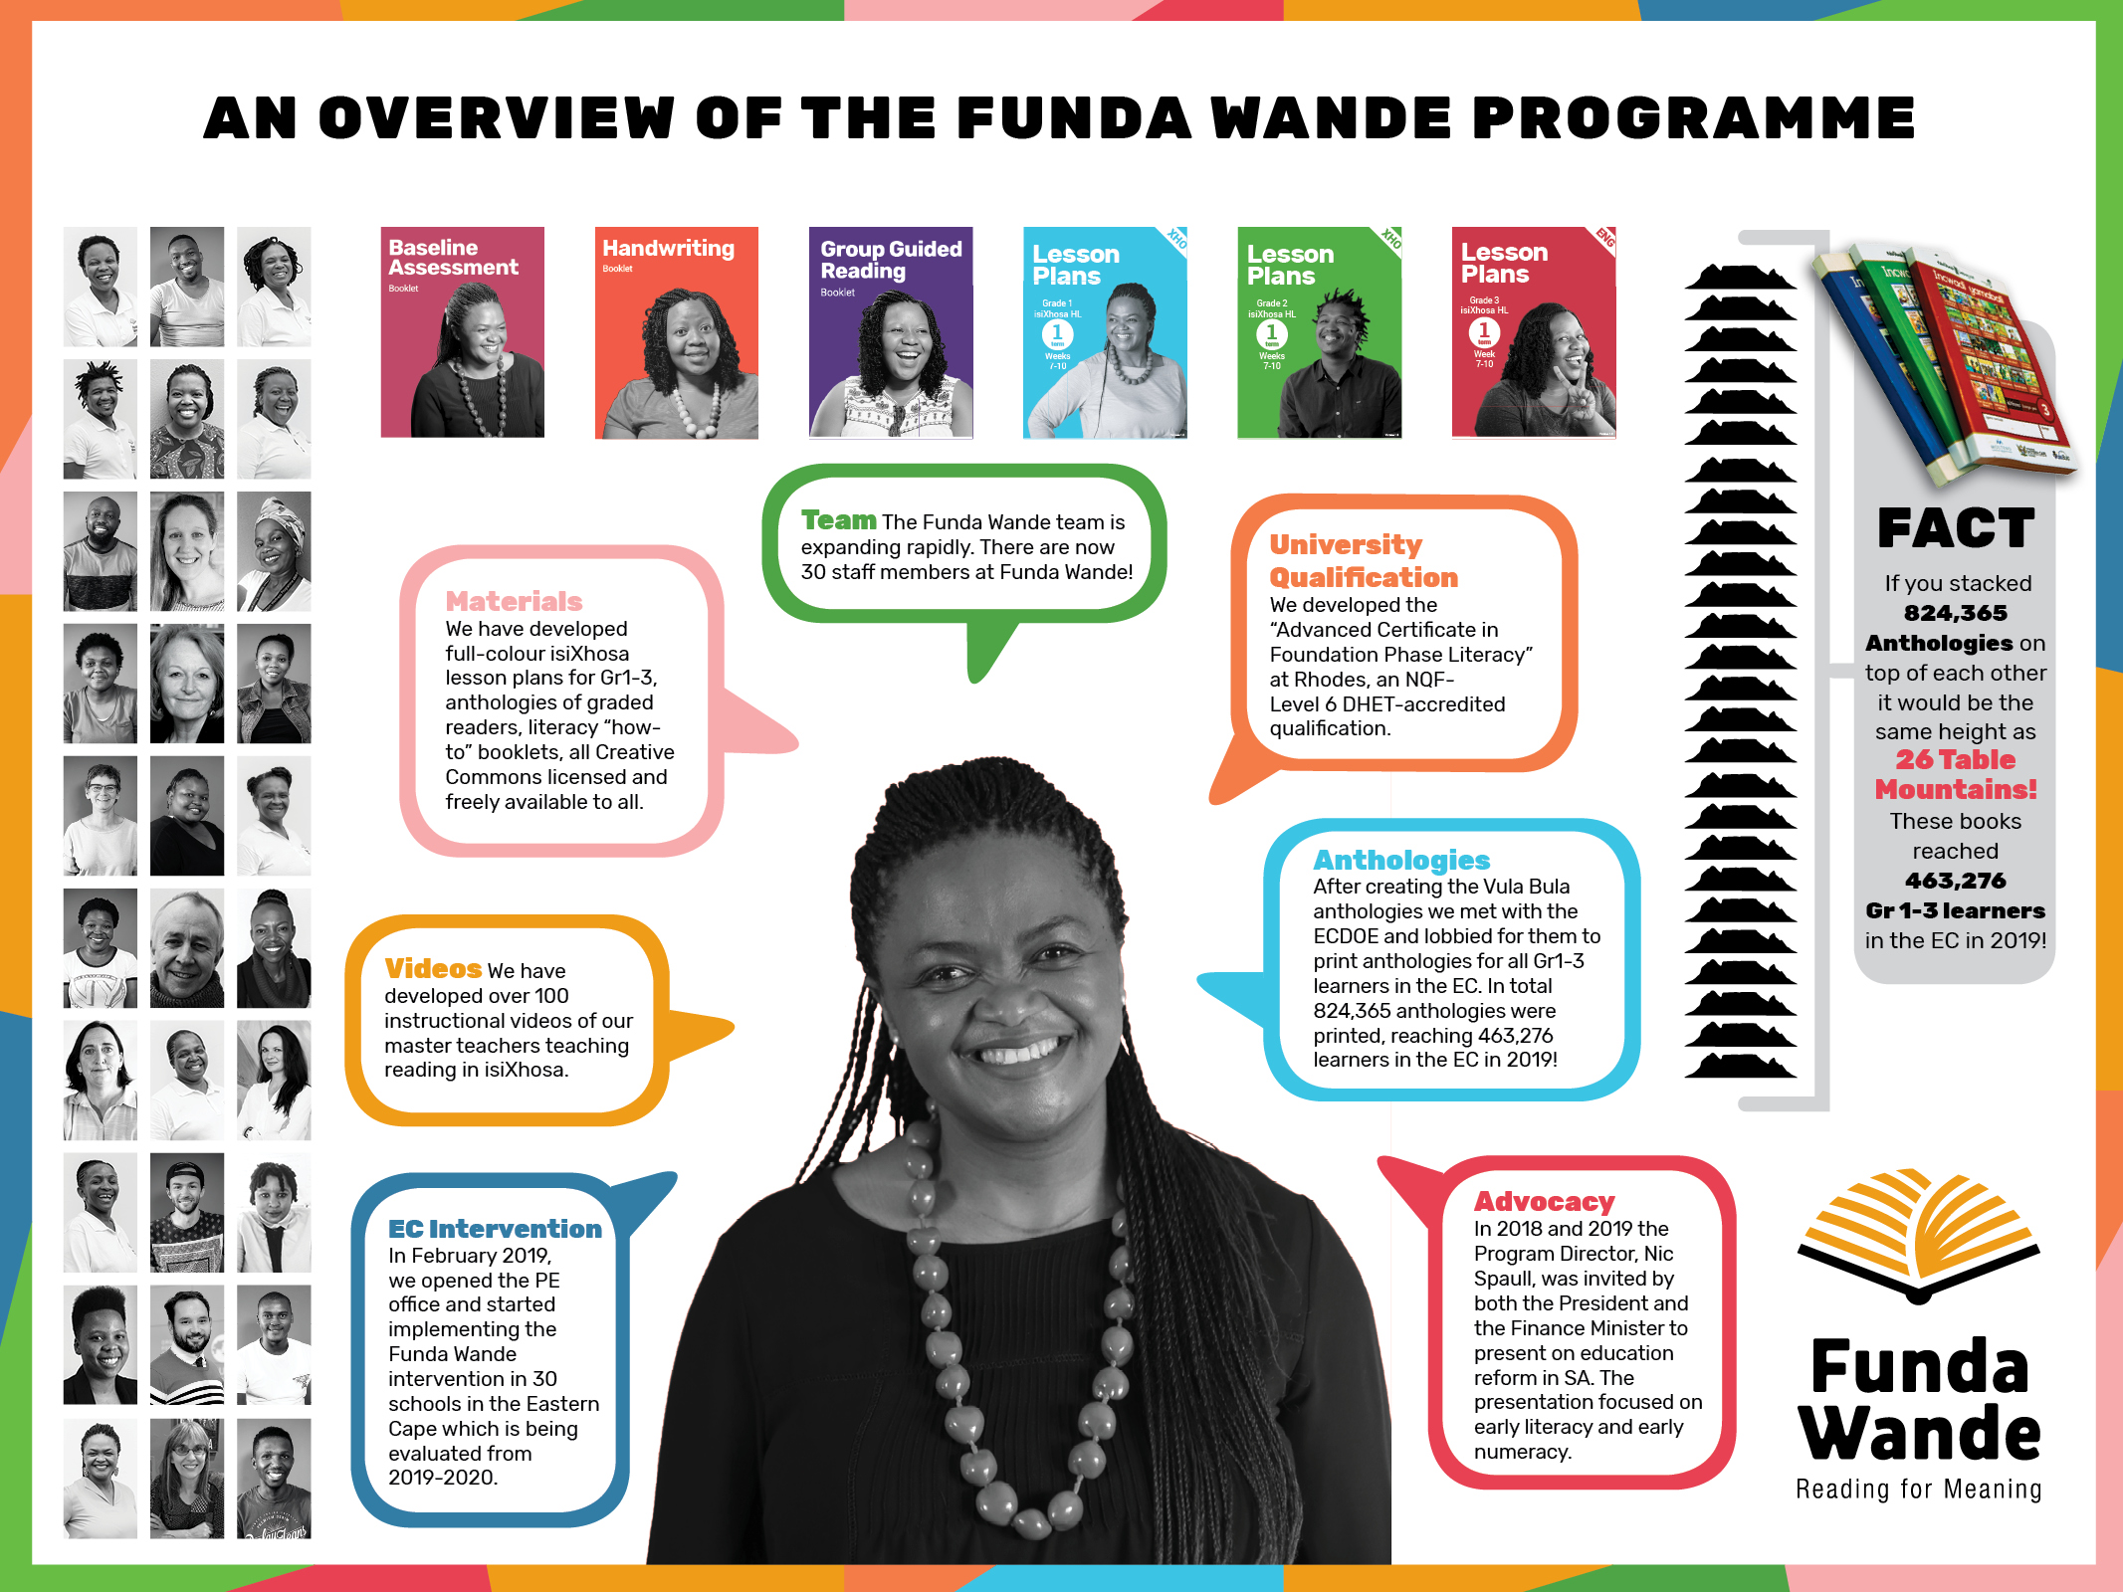

Slide 28
(4) If our organization were given an extra R500-million to spend on ensuring all children learn to read for meaning by age 10 we would do the following 3 things:
Replace with image
FUNDER PANEL

Slide 29
Things we agree on
Resources:
  The government and philanthropic sector should fund the development of more African language non-fiction, fiction and graded-readers for Gr1-6 and make them available in all FP classes.
  All FP classes need an essential classroom library of books.
Representation
  Black researchers need to play a more prominent role in positions of power and influence in the reading space
  More funding should be allocated to the development of Black researchers
  More funding for interventions and research should be allocated to research agenda, f
Replace with image
FUNDER PANEL

Slide 30
Arabic + Hindi + Bengali + Swahili = more than 1-billion people
6% of total.
70% of all article in the 3 journals are on Eng/French
Journal of Research in Reading, Scientific Studies of Reading, Reading Research Quarterly
Spaull, 2019: BRILL-IBE: Improving Early Literacy Outcomes

Slide 31
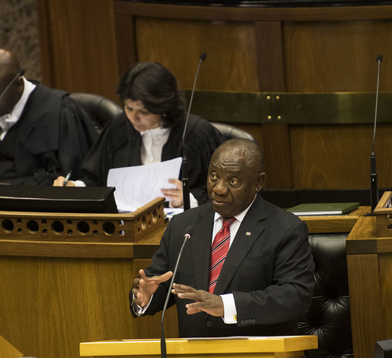
21 June 2019
State of the Nation
“Fellow South Africans,
If we are to ensure that within the next decade, every 10 year old will be able to read for meaning, we will need to mobilise the entire nation behind a massive reading campaign. Early reading is the basic foundation that determines a child’s educational progress, through school, through higher education and into the work place. All other interventions – from the work being done to improve the quality of basic education to the provision of free higher education for the poor, from our investment in TVET colleges to the expansion of workplace learning – will not produce the results we need unless we first ensure that children can read. It is through initiatives like the National Reading Coalition that we will be able to coordinate this national effort. All foundation and intermediate phase teachers are to be trained to teach reading in English and the African languages, and we are training and deploying a cohort of experienced coaches to provide high quality on-site support to teachers. We are implementing the Early Grade Reading Programme, which consists of an integrated package of lesson plans, additional reading materials and professional support to Foundation Phase teachers.”
– President Ramaphosa (21 June 2019)

