Slide 1


Slide 2

NIDS-CRAM
Wave 1 Launch
Overview & Findings
15 July 2020
Dr Nic Spaull
University of Stellenbosch
National income Dynamics Study (NIDS) Coronavirus Rapid Mobile Survey (CRAM)

Slide 3
BACKGROUND
NIDS-Wave 5 (2017)
  Existing panel study 2008-2017: The National Income Dynamics Study. NIDS is a panel study that began in 2008 as a nationally representative survey with the same individuals and their descendants being re-interviewed every 2-3 years between 2008 and 2017. It has been used in over 100 academic articles
NIDS-CRAM (2020)
  7000 individuals surveyed in NIDS-CRAM: In total 17,568 randomly selected individuals from NIDS were called and of these, 7,073 were interviewed in NIDS-CRAM
  Details of the telephonic survey:
    50 call centre agents phoning from 7 May to 27 June 2020
    20-minute survey (available in 10 languages, from Wave 2, all 11 languages)
    R20 airtime given to respondents to thank them for participation.
    Questions on demographics, migration, grant-receipt, employment, income, hunger + COVID-19 risk perceptions and behaviour
  Wave 1 (May/June), Wave 2-5 (July – December 2020)

Slide 4



Background
Who funded NIDS-CRAM?
  The Allan & Gill Gray Philanthropy, the FEM Education Foundation, the Michael & Susan Dell Foundation
Who will have access to the data?
  All NIDS-CRAM data is immediately made freely available to the public and other researchers on the DataFirst platform (15 July 2020). We encourage others to analyze the data for their own purposes and to replicate our results (we have also posted our do files so people can replicate our analysis.

Slide 5
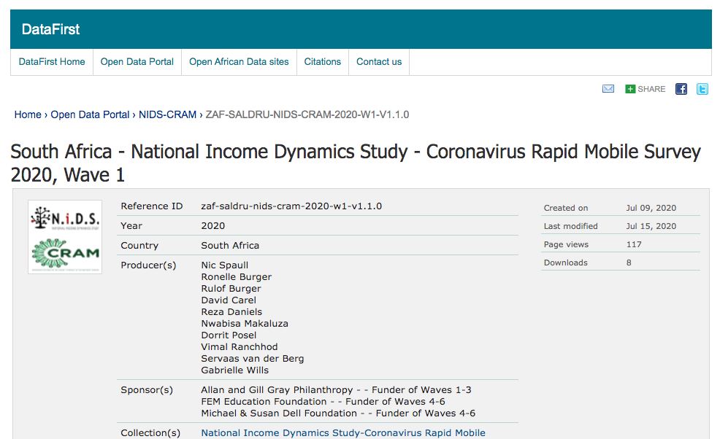

Slide 6
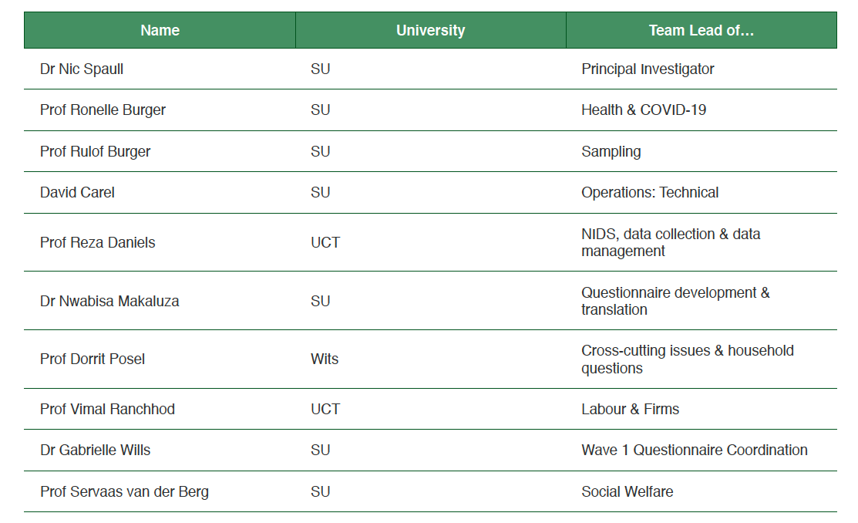
Background
Who was the leadership team?

Slide 7

Background
Who is on the Steering Committee?

Slide 8







Background
Who are the researchers involved in the project?

Slide 9


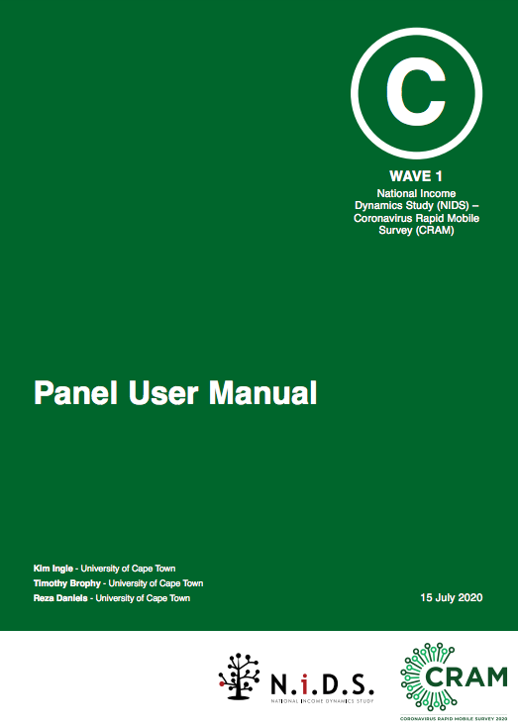
Background
What background reports are available?
https://cramsurvey.org/reports/

Slide 10
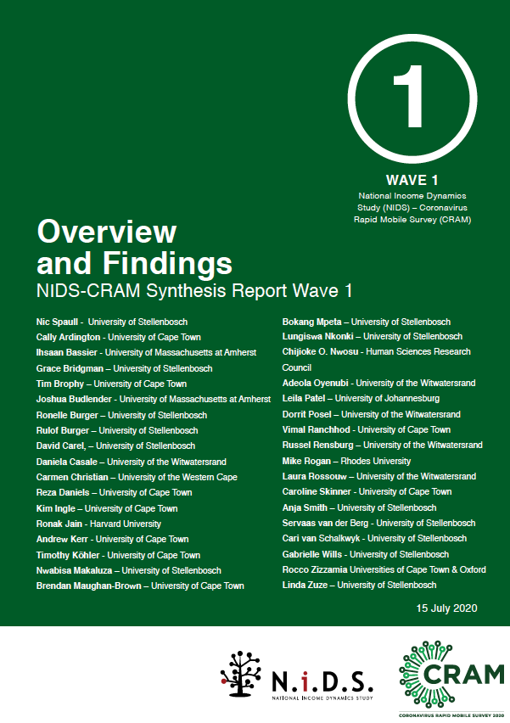
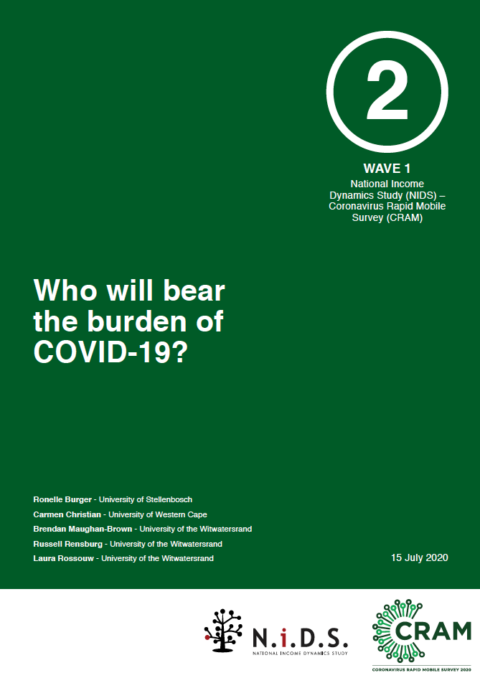
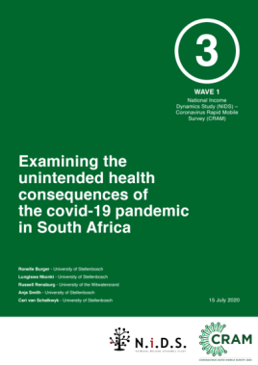
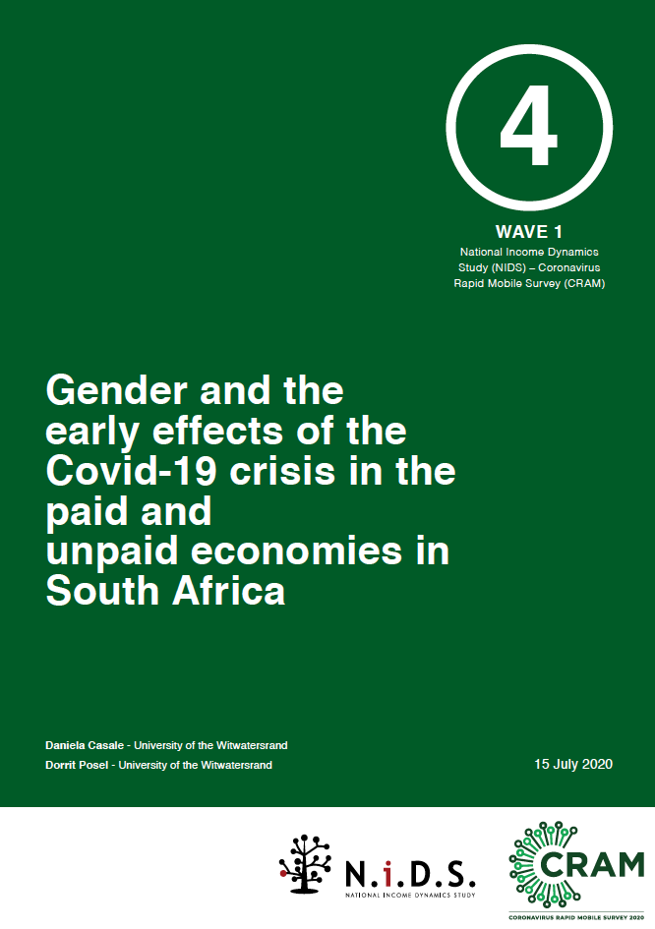
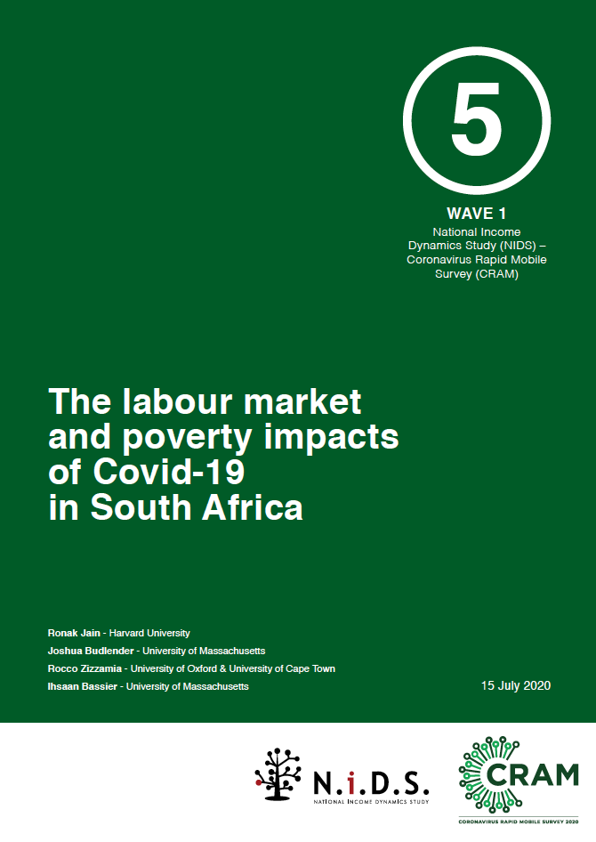
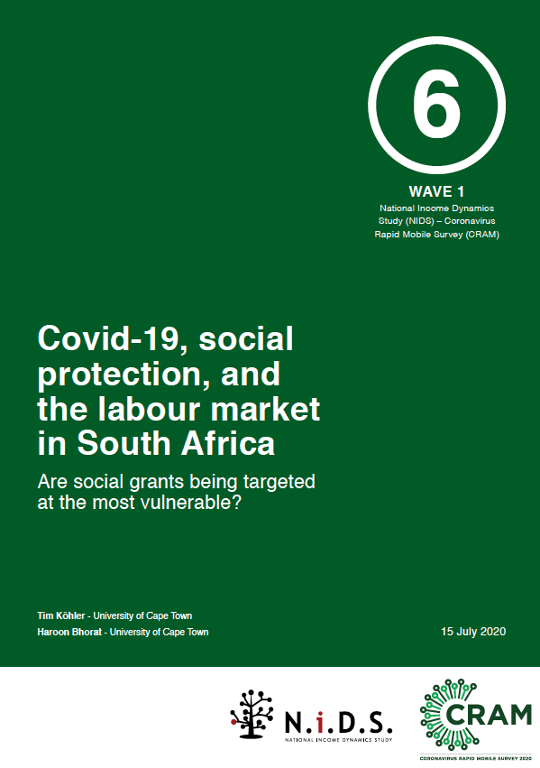
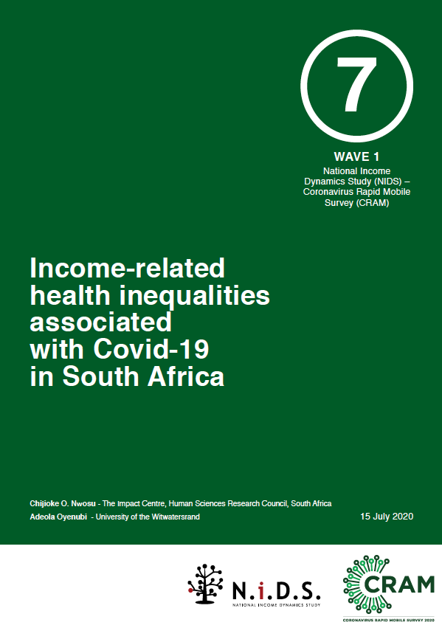
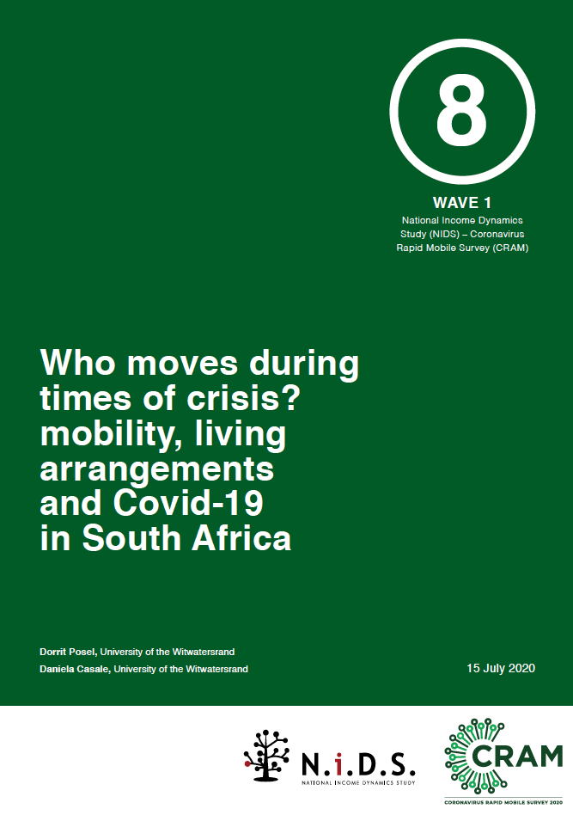
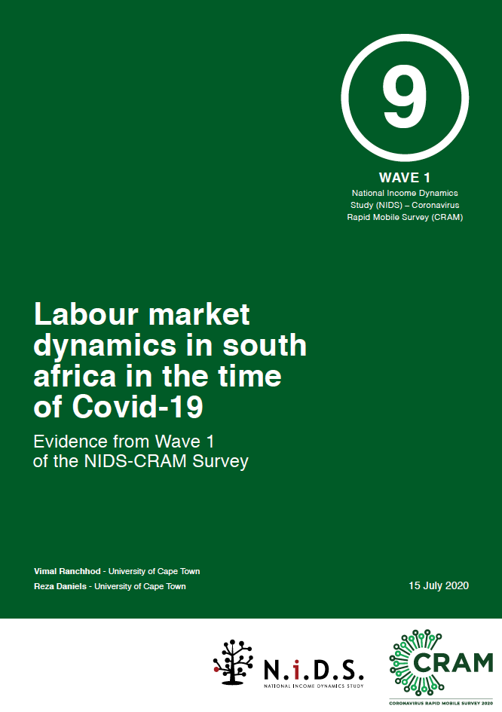
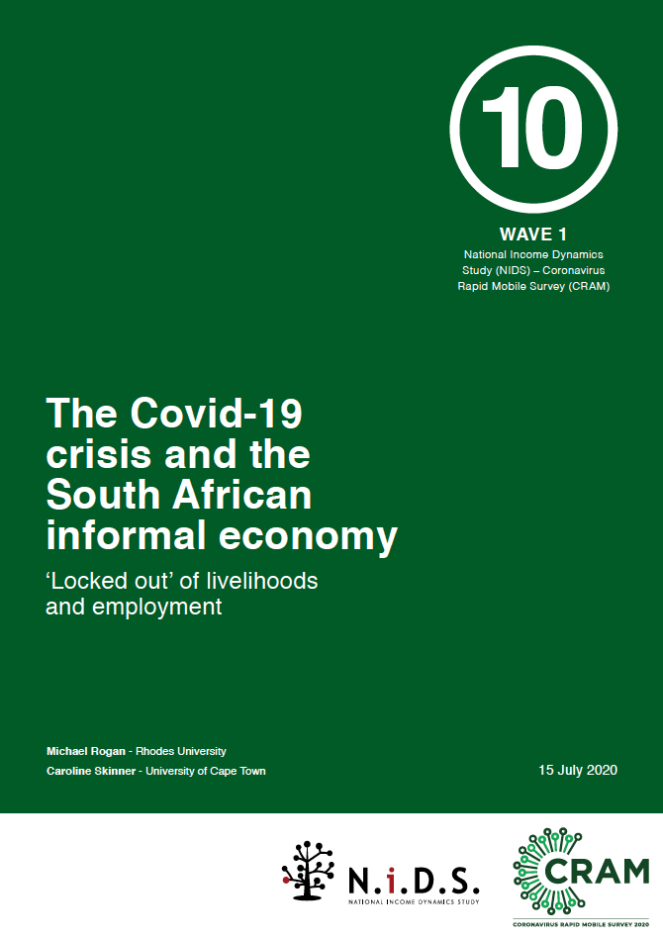

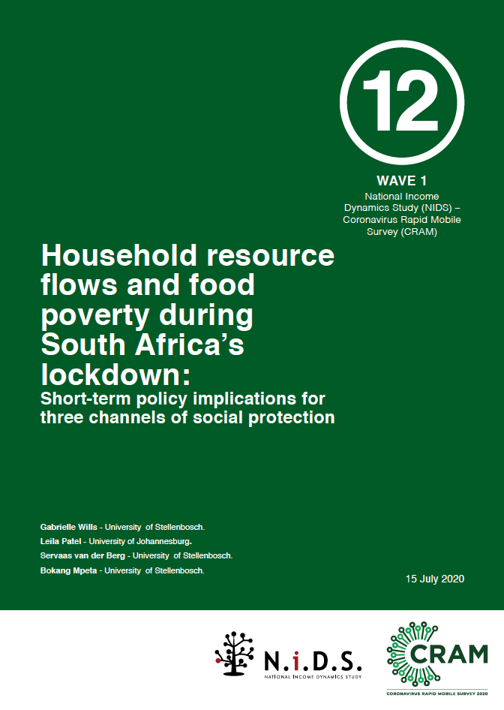
Background
When will the papers be available? Now.
https://cramsurvey.org/reports/

Slide 11
FINDINGS
What are the
4 main findings from Wave 1?

Slide 12
Sobering results, first caveats
The following should be kept in mind:
  Some limitations to telephonic surveys: There are limitations to surveying respondents telephonically, including length of the survey (20min), comparability to in-person survey results etc.
  NIDS-2017 slightly higher employment than QLFS: The respondents in NIDS-2017 had a higher rate of employment compared to other surveys like the QLFS
      54% in NIDS 2017 (18-64 years).
      47% in QLFS 2017 (18-64 years).
  Results do reflect underlying employment an welfare dynamics in SA: Notwithstanding these caveats, we believe that researchers and policy-makers can feel confident that the results from NIDS-CRAM are broadly representative and are speaking to the real underlying labour market and welfare dynamics in South Africa at this time.

Slide 13
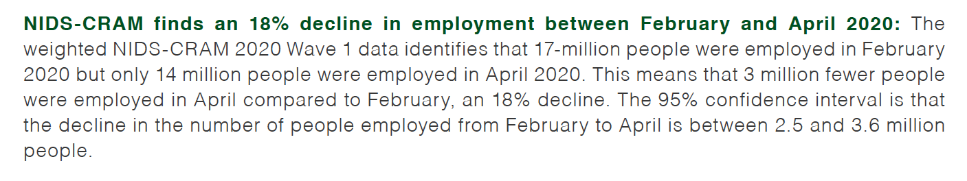
FINDINGS: (1) Profound job loss
Our weighted sample indicates that…
  3-million people lost their jobs since February 2020
  18% decline in employment (Feb→ April)

Slide 14
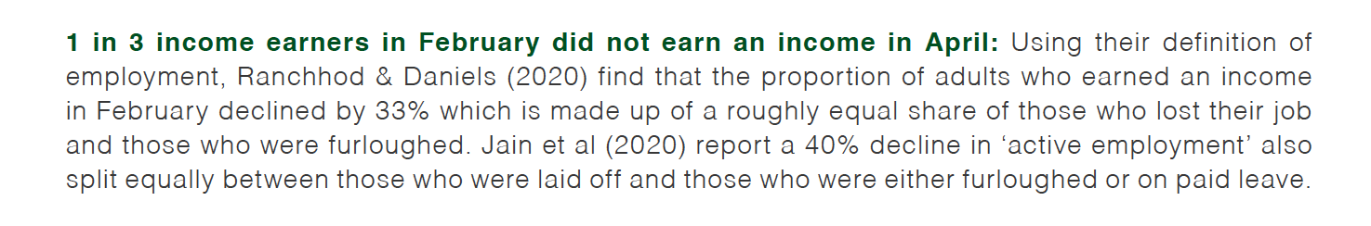
FINDINGS: (2) Even greater income losses
Our weighted sample indicates that…
1-in-3 lost their income: 33% of those who earned an income in Feb 2020 did not earn an income in April 2020.
At least 1,5-million had jobs, but no pay: In addition to the 3-million people who lost their job, an additional 1,5-million (9%) reported zero pay although a job to return to.

Slide 15
FINDINGS: (3) Exacerbating inequality
Pre-existing inequalities have grown: Job losses and income losses heavily concentrated among those who were already disadvantaged in the labour market; Black Africans, low-wage earners, manual labourers, and women experiencing the greatest losses.
Women borne the brunt of job losses: Of the 3-million job losses 2-million were women. Among those groups of people that were already disadvantaged in the labour market, and already faced a disproportionate share of job losses from the pandemic (the less educated, the poor, Black Africans and informal workers), women in these groups faced even further job losses putting them at a ‘double disadvantage.’

Slide 16
FINDINGS: (4) Hunger is now widespread
Half of households (47%) ran out of money to buy food in April: 1-in-2 respondents indicated that their household had run out of money to buy food in the month of April.
1-in-5 (22%) said that someone in the HH went hungry in the last week, and 1-in-7 respondents that a child went hungry in the last week. 7% of adults and 4% of children were perpetually hungry (hunger ‘every day’ or almost every day’).
Figure 1: Reported hunger in the last seven days (asked separately for ‘anyone in the household’ and for ‘children (<18 years) (NIDS-CRAM Wave 1, weighted)

Slide 18
Guidelines
Hashtag #NIDSCRAM
Use Q&A → Authors will be answering live throughout

Slide 19
Closing remarks about the scale of what we are talking about
NIDS-CRAM shows 3-million job losses Feb→Apr
Job loss from the financial crisis?
  QLFS-PALMS and the job loss was 5.7% between the end of 2008 and the end of 2009. (800 000 jobs).
  SARB macro data suggests 6.7% (Fedderke, 2012) which would be 940,000 jobs. PALMS is more reliable than SARB
  NIDS-CRAM shows 3-million job losses

Slide 20
So, what are the main take-homes?
Since February this year 3 million South Africans lost their jobs, and 4,5-million people lost their incomes: Of those who were employed in February 18% lost their jobs and a further 9% lost their incomes (were furloughed), i.e. the number of employed people went down from 17-million in February to 14-million in April, with a further 1,5-million people reporting no income despite having a job to return to.
Women account for 2-million of the 3-million job losses, i.e. two-thirds: Those who were already disadvantaged in the labour market (informal workers, low-wage earners and Black Africans) have all borne the brunt of the job losses, but women in these groups faced a 'double disadvantage.'
The poor were 8-times more likely to lose their jobs compared to the rich: Black people were three times more likely to lose their job (28%) compared to White people (11%), and that those earning less than R3,000 a month were eight times more likely to lose their job (38%) compared to those earning more than R24,000 a month (5%).
Half of households (47%) reported running out of money to buy food in April: The data clearly shows that million of South Africans now face hunger on a weekly basis. 47% of respondents indicated that their household had run out of money to buy food.
1-in-4 adults in SA went hungry in the last week. 1-in-4 respondents (22%) reported that someone in the household went hungry in the last 7 days. 7% of respondents (1-in-14) report that someone in the household went hungry ‘Almost every day’ or ‘Every day’ in the last 7 days. Using the NIDS-CRAM weights these respondents represent 2,2-million individual’s in South Africa.
1-in-7 children in SA went hungry in the last week: 15% of respondents (1-in-7) reported that in the last 7 days a child had gone hungry in their household. 1-in-25 children (4%) went hungry 'every day or almost every day'.

Slide 21
Hunger – MATCH data
“Of the 2,214 pregnant and new mothers who answered both questions, 350 (16%) reported that they had gone to bed hungry at least once in the past week. More worryingly, 11% reported going to bed hungry for one to two nights, and 5% reported going to bed hungry for three or more nights in the previous seven.”
Figure 1: Feelings of depressed mood disaggregated by frequency of reported hunger (MATCH 2020 data, 2214 pregnant and new mothers)
In the last 7 days have you felt hopeless, down or depressed?

