Slide 1




The Race Between Expectations & Realities…
Dr Nic Spaull
Think Tank 2021:3 - NSFAS and the funding of tertiary education: How do we balance free higher education with the challenges facing the South African economy?

Slide 2
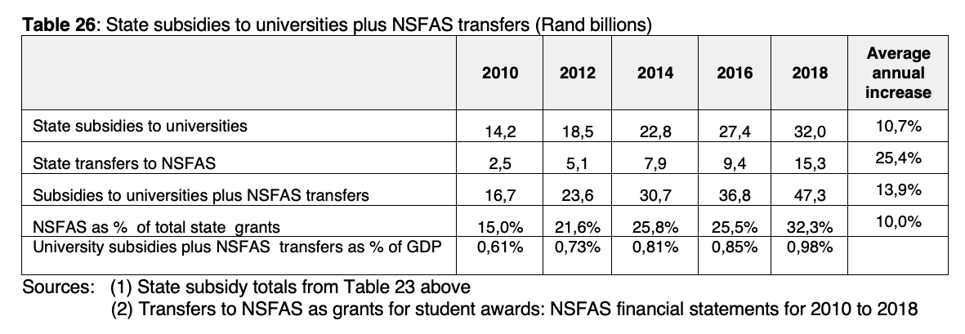
Why are we talking about NSFAS?
“In 2019, over one third of university students, and just over half of TVET college students benefitted from a NSFAS bursary.” (DHET, 2021: p.18)
Source: Nico Cloete, Forthcoming, personal communication

Slide 3

How many students actually make it to university?
How many of those who start school reach matric? Graduate with matric? Graduate with a degree?
New (2016) study followed the entire matric cohort of 2008 into university and tracked them 2009-2014
(Van Broekhuizen & Van der Berg, 2016)

Slide 4

How many students actually make it to university?

Slide 5

How many students actually make it to university?

Slide 6

How many students actually make it to university?

Slide 7

How many students actually make it to university?
Source: Van Broekhuizen & Van der Berg, 2016 (Higher Education Access and Outcomes for the 2008 National Matric Cohort)

Slide 8
How many students actually make it to university?
}
?
Source: Van Broekhuizen & Van der Berg, 2016 (Higher Education Access and Outcomes for the 2008 National Matric Cohort)

Slide 9
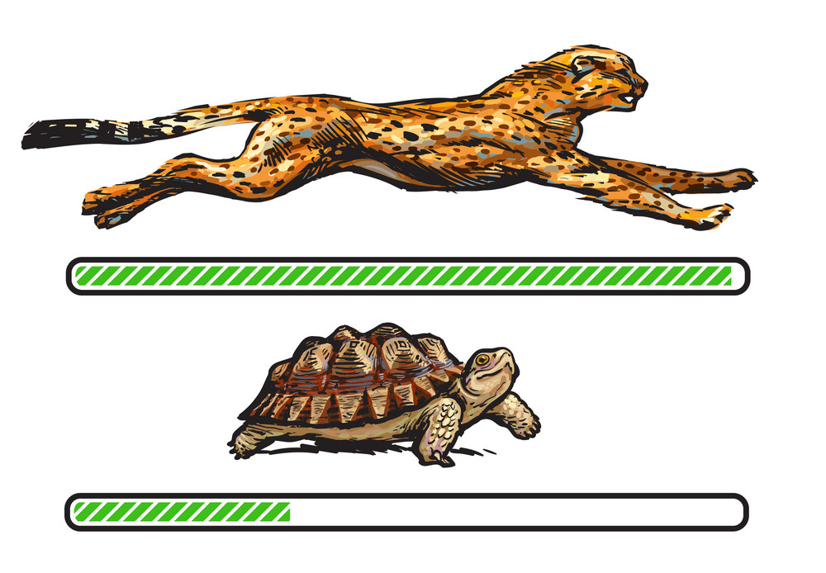
Understanding one factor contributing to the increase in university enrolment-related protests…
The schooling system and the higher education system are moving at different speeds

Slide 10
Average annual increase in bachelor passes (2011→2020)
⬆ 7%
Average annual increase in…
University enrolment (2011→2019)
…⬆ 2.6%
TVET enrolment (2012→2019):
…⬆ 0,6%

Slide 11
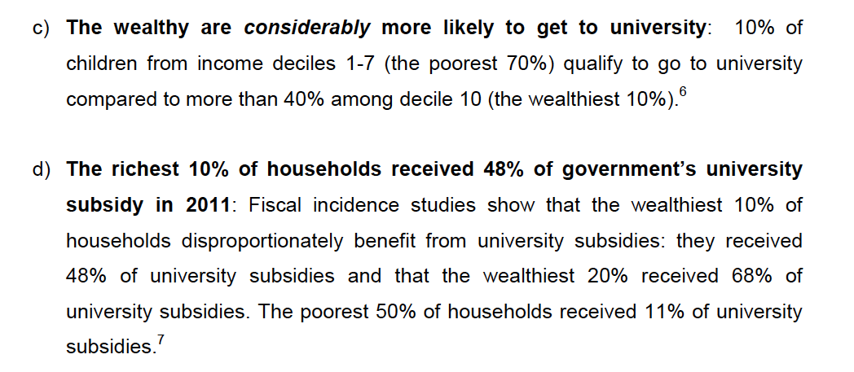


Who accesses university?
Source: Davis Tax Commission Submission on Free Higher Education p.2
Note: This is for a full cohort not just matrics
Source: Van Broekhuizen & Van der Berg, 2016 (Higher Education Access and Outcomes for the 2008 National Matric Cohort)

Slide 12
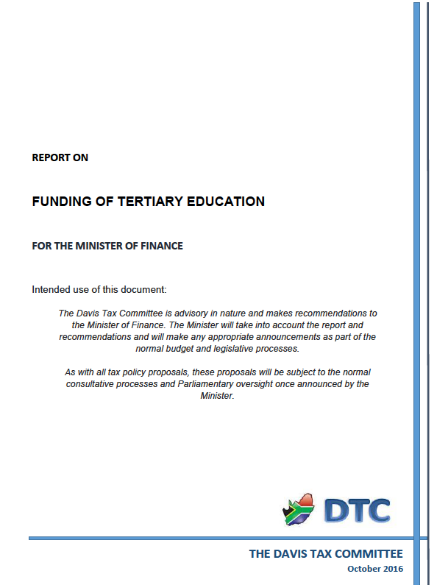
Asking the distributional questions… Davis Tax Committee
“Moving from ideological demands to workable models
It is our view that the conversation needs to shift from an ideological approach: (1) “How do we pay for a no-fee higher education system?” to a pragmatic one that addresses the same underlying issue as well as the budget constraint: (2) “How do we ensure that no student is excluded from university because they cannot pay the fees?” Currently there is a large number of students who are not eligible for NSFAS and do not qualify for a traditional loan from a bank – these are the students in the “missing middle.” Furthermore, the existing NSFAS grants do not, in most instances, sufficiently cover the cost of basic necessities (food, accommodation, books, fees etc.). In both cases students are excluded from university (either initially or subsequently) on purely financial grounds despite being academically deserving. This is unacceptable and is at the root of the righteous indignation of the protesting students and those that support them.
Unfortunately South Africa cannot afford to provide comprehensive university grants to all students that qualify to go to university. Doing so would require a reduction (in absolute or inflation-adjusted terms) in existing budgets such as health, basic education and social grants or if these expenditures are kept constant, then finding at a conservative estimate, an additional R60 billion in tax revenue which at 1,5% of GDP is unrealistic. Raising R 60 billion annually holds the following implications which we illustrate by way of relatively conservative estimates: VAT would have to be increased by about 3%. That has obvious retrogressive implications as it does, at least in the short term, for growth and inflation. A 1% increase in PIT for the top income tax rates provides approximately R 3.4 billion; thus the rate would have to be increased by about 17% to 58%. CGT could be increased as well but this is unlikely to produce more than another R 2 billion. A 1% skills levy increase would generate approximately R 15 billion. But if we had to leave VAT alone, increase the skills levy and CGT plus enforce estate duty per the Committee’s recommendations it would still require at least increasing the marginal rate from R 750 000 taxable income to about 53%. Alternatively an increase in CIT by a further 2% could reduce the increase PIT to approximately 49%. And, of course, there would be no further revenue available for NHI or other socio-economic goods including pre-primary education were this to be adopted.”

Slide 13
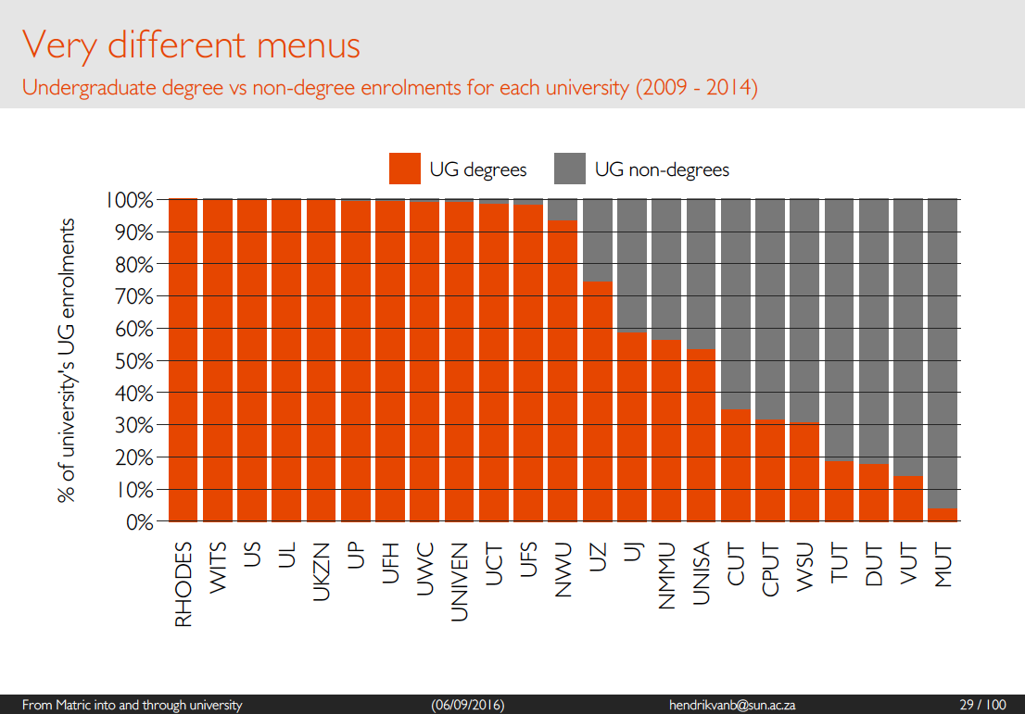

Slide 14
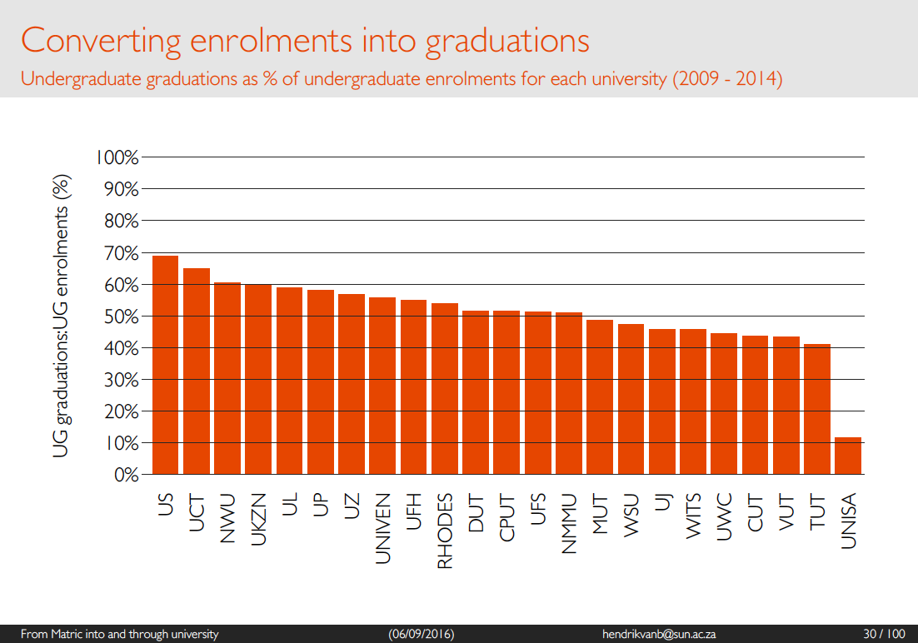

Slide 15
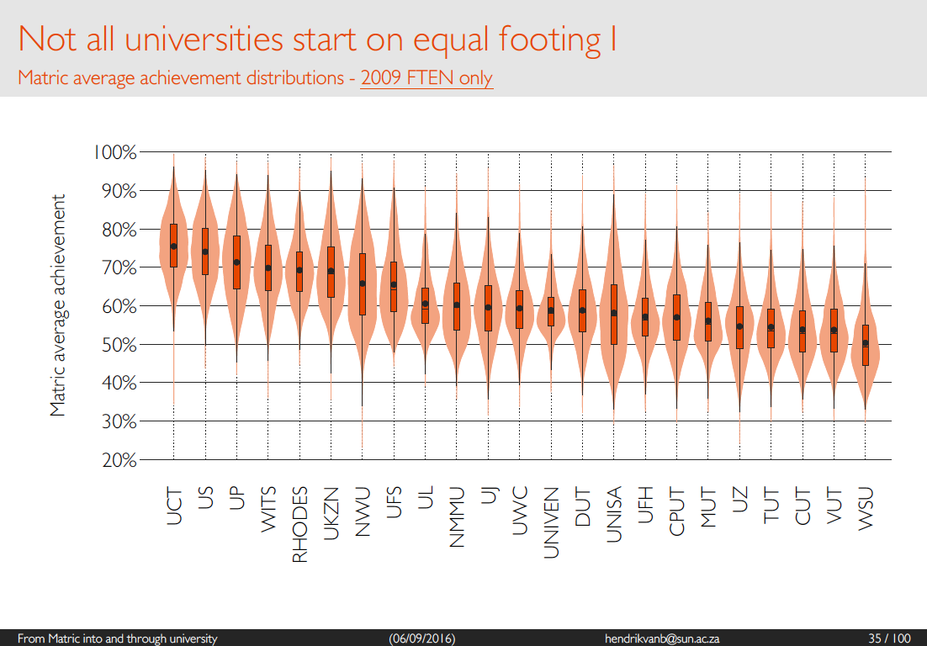

Slide 16
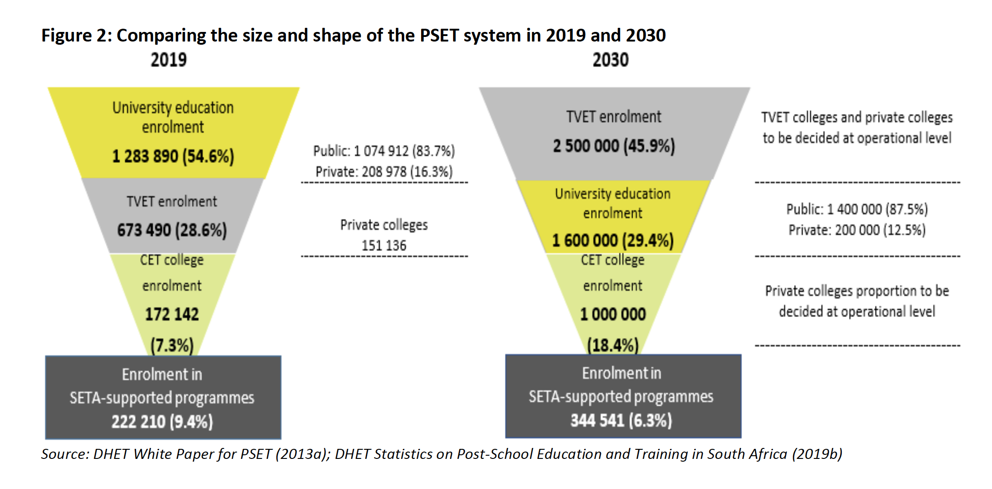
Source: DHET 2021 Macro Indicators Report p.23

Slide 17
% of 2008 matric cohort attaining undergraduate degrees by race
Van Broekhuizen & Spaull (2017)

Slide 18
