Slide 1

Investing in Education in SA
New Learnings & possibilities for pivoting
16 April 2021
Nic Spaull
Presentation to Allan Gray

Slide 2


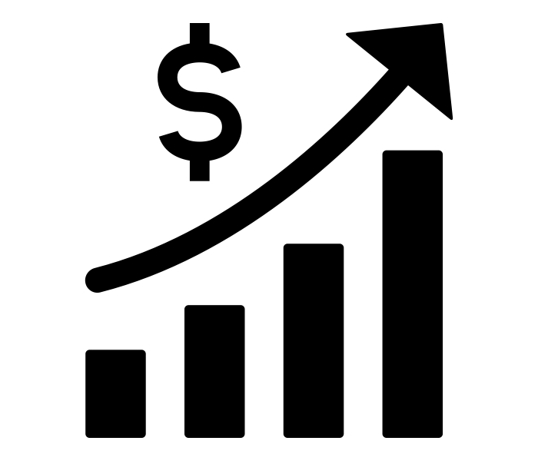


Principles for social investment in South Africa
LEVERAGE
PRIORITISE
EVALUATE
FOUNDATIONS
1
2
3
4

Slide 3
“
The best use of private money is influencing how public money is spent.
“
LEVERAGE
R351 Billion
R4,5 Billion
(1,2%)
2018 SA Government expenditure on education
Trialogue estimate of
all education CSI in SA

Slide 4
“
What is the binding constraint to progress in this area?
“
PRIORITISE
“The binding constraints approach is based on the idea that not all constraints bind equally, and that a sensible and practical strategy consists of identifying the most serious constraints at work”
- Professor Dani Rodrik (2009: 6)

Slide 5

“The volume in the first barrel depends on the sum of the width of all slabs. Increasing the width of any slab will increase the volume of the barrel. So a strategy on improving anything you can, when you can, while you can, would be effective.”
(Hausmann, Klinger, & Wagner, 2008, p. 17).

Slide 6
“The volume in the second barrel is determined by the length of the shortest slab. Two implications of the second barrel are that the impact of a change in a slab on the volume of the barrel depends on whether it is the binding constraint or not. If not, the impact is zero”
(Hausmann, Klinger, & Wagner, 2008, p. 17).

Slide 8

Understanding the shape of the SA education system…
How many of those who start school reach matric? Graduate with matric? Graduate with a degree?
New (2016) study followed the entire matric cohort of 2008 into university and tracked them 2009-2014
(Van Broekhuizen & Van der Berg, 2016)

Slide 9

Understanding the shape of the SA education system…

Slide 10

Understanding the shape of the SA education system…

Slide 11

Understanding the shape of the SA education system…

Slide 12

Understanding the shape of the SA education system…
Source: Van Broekhuizen & Van der Berg, 2016 (Higher Education Access and Outcomes for the 2008 National Matric Cohort)

Slide 13
Understanding the shape of the SA education system…
}
?
Source: Van Broekhuizen & Van der Berg, 2016 (Higher Education Access and Outcomes for the 2008 National Matric Cohort)

Slide 14
Where should we be intervening?
New Solutions for a New Future
Insurmountable learning deficits
Figure 10b: South African mathematics learning trajectories by national socioeconomic quintiles using a variable standard deviation for a year of learning (0.28 in grade 3 to 0.2 in grade 8 with interpolated values for in-between grades (Based on NSES 2007/8/9 for grades 3/4/5, SACMEQ 2007 for grade 6 and TIMSS 2011 for grade 9, including 95% confidence interval
(Spaull & Kotze, 2015)

Slide 15

Falling at the first hurdle…
If children do not learn-to-read in Grades 1-3, they cannot read-to-learn in Grade 4 onwards
Spaull & Pretorius (2018) Falling at the first hurdle: Early grade reading in South Africa. Springer.

Slide 16


78%
of Grade 4 children in South Africa can not read for meaning in any language.
PIRLS Literacy 2016 (Howie et al., 2017)

Slide 17
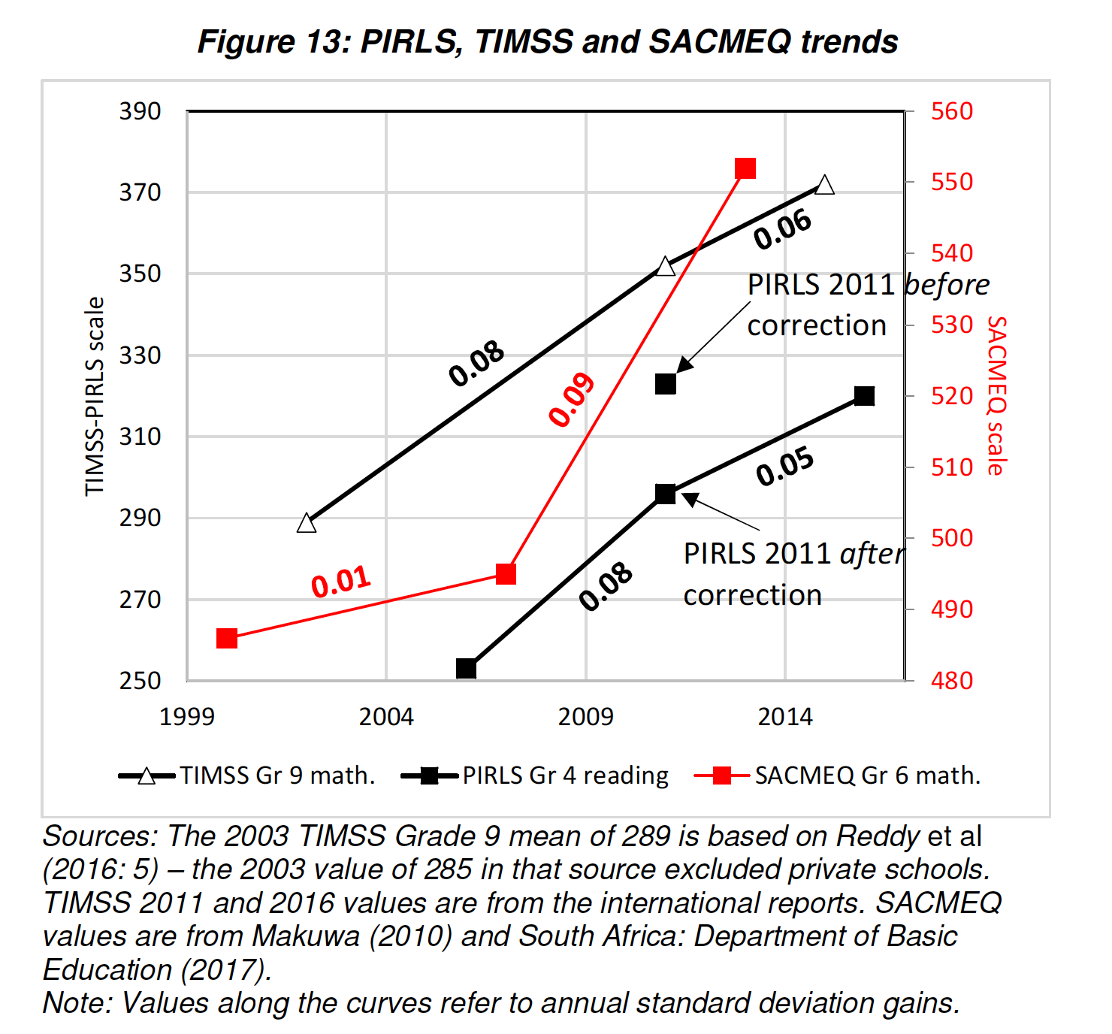
Not all doom and gloom…
% that can read for meaning (PIRLS LIB)
22%
18%
13%
At this rate when will at least 50% of SA Gr4’s learn to read?
2044
Martin Gustafsson 2020. A revised PIRLS 2011 to 2016 trend for South Africa and the importance of analysing the underlying microdata

Slide 18

Possibilities to pivot…

Slide 19
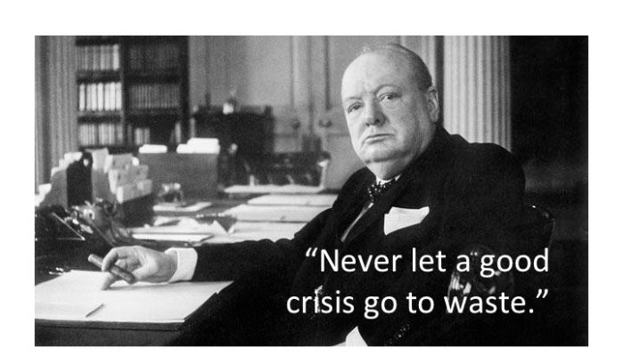

Slide 20
“
“
Prevention is better than cure
FOUNDATIONS
“The later in life we attempt to repair early deficits, the costlier the remediation becomes’’
Nobel Laureate James Heckman (2000, p. 5).

Slide 21
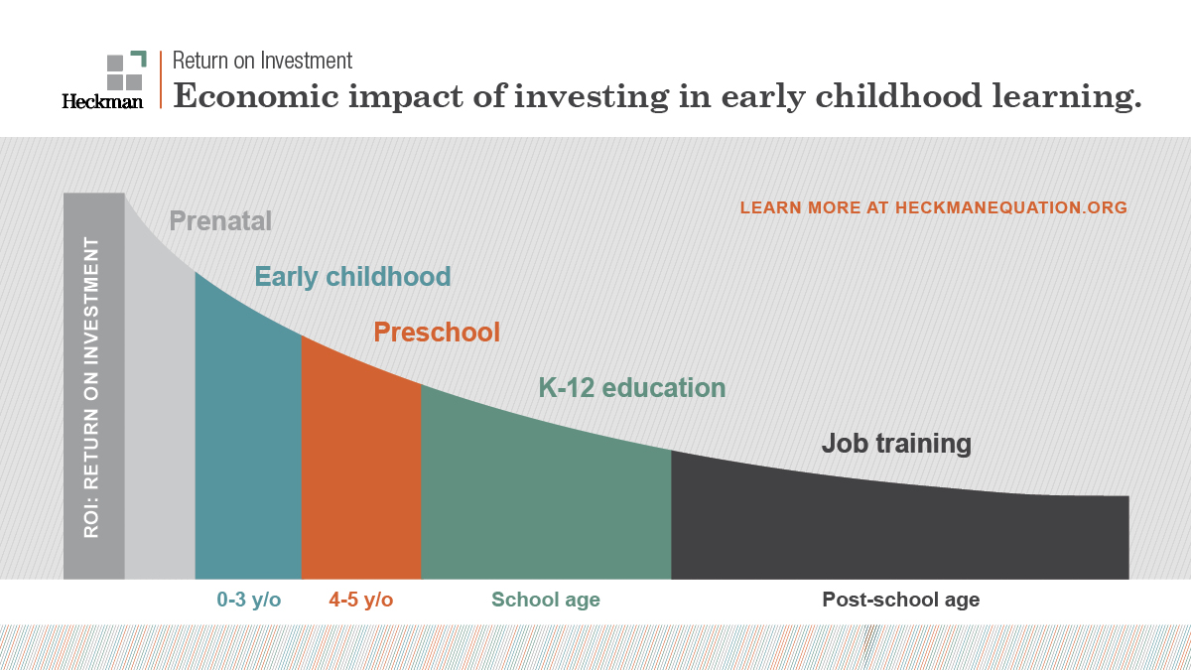
FOUNDATIONS

Slide 22
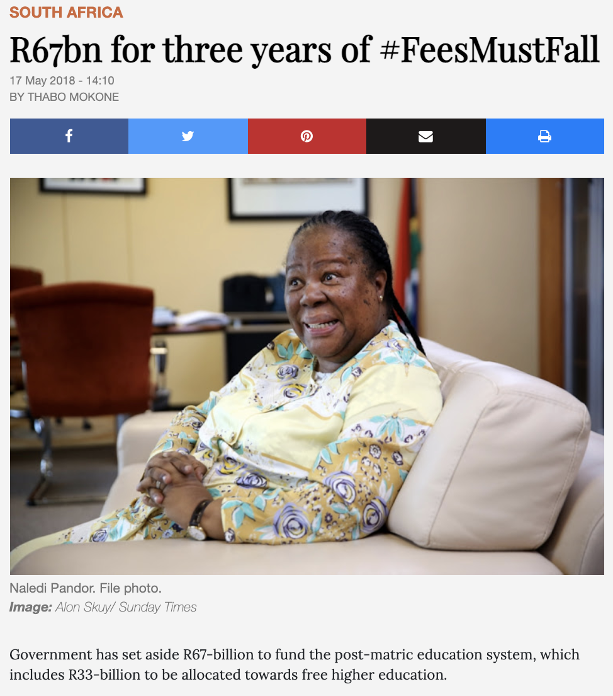
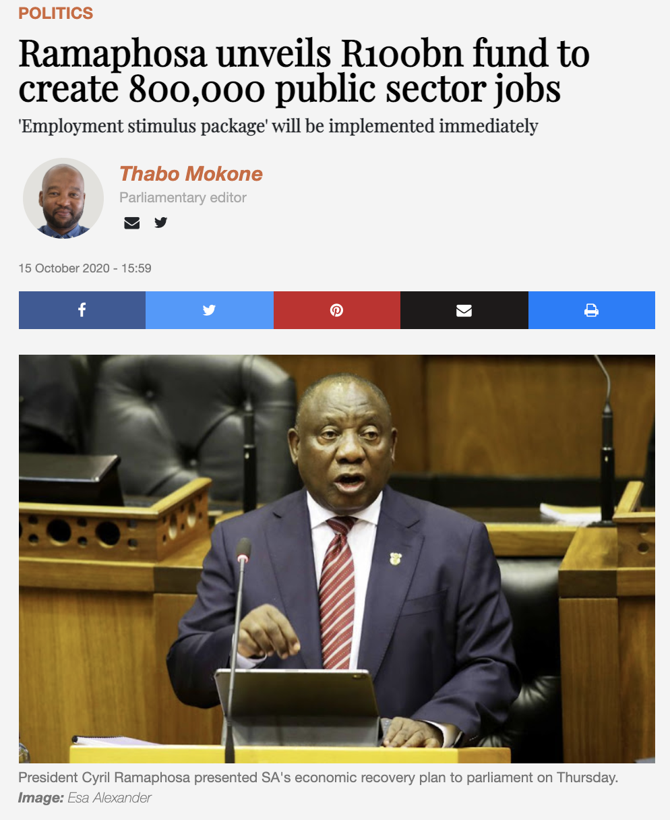
FOUNDATIONS

Slide 23
“What are the binding constraints to quality ECD for all children?”

Slide 24
Quality Early Childhood Development
Funding
Training
Measurement

Slide 25
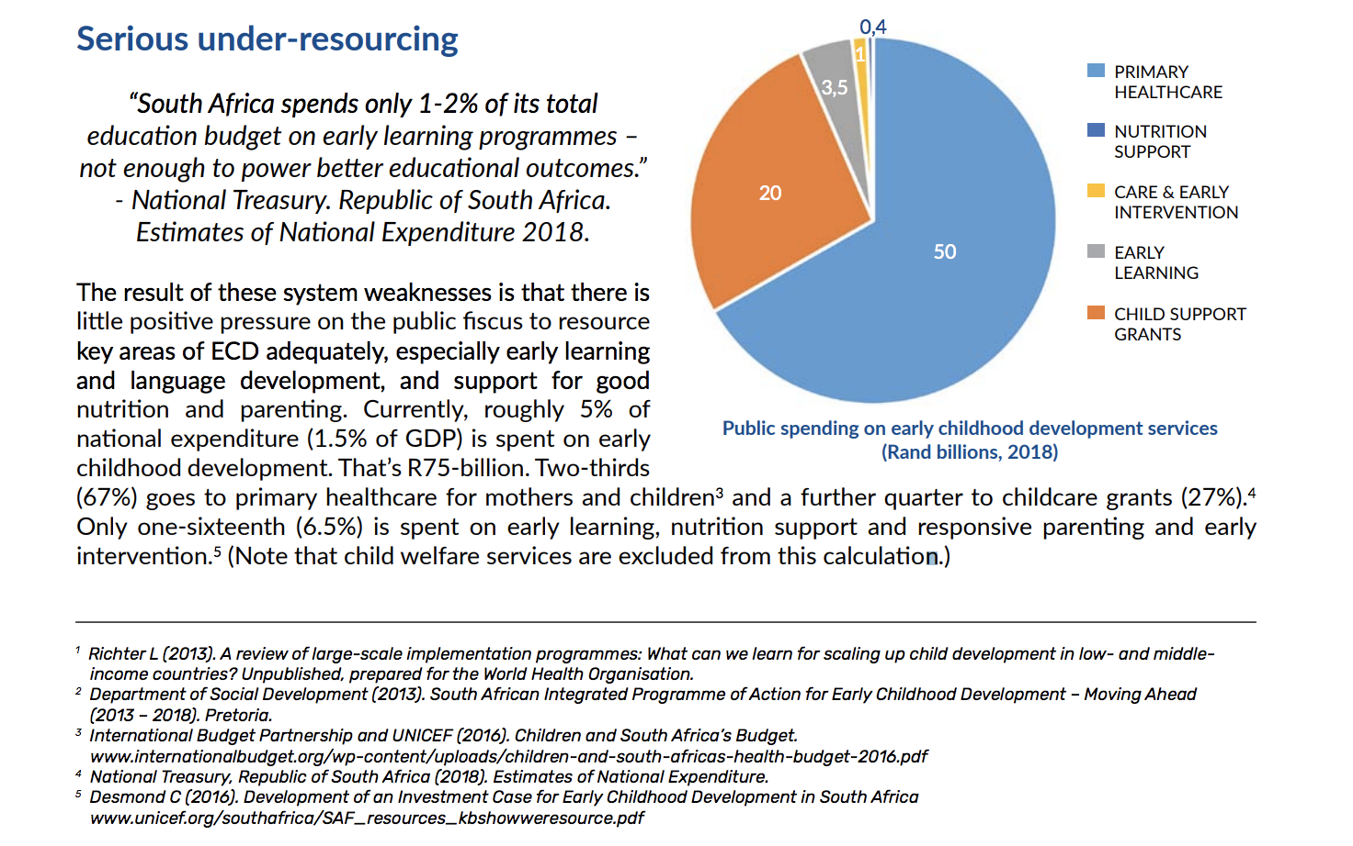
(1) Funding for ECD
1-2%
of the total education budget is spent on early learning.
(ECD Vision 2018, p.3)

Slide 26
Spending on Basic and higher Education compared to spending on early learning (ECD) in SA…
LEVERAGE
R351 Billion
R3,5 Billion
(1%)
2018 SA Government expenditure on education
2018 Spending on early learning, care and early interventions

Slide 27
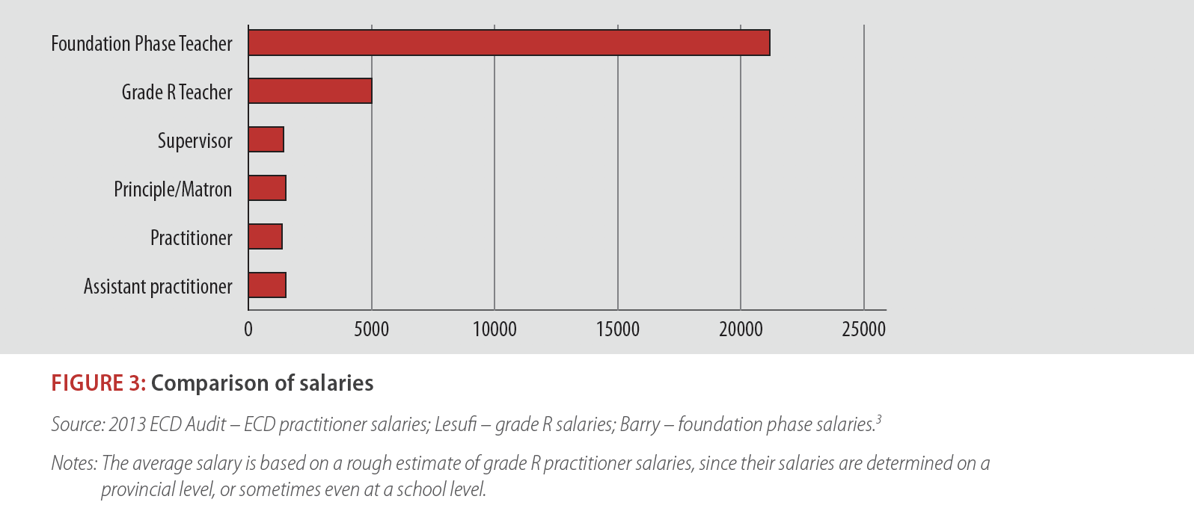
(1) Funding for ECD
LEVERAGE
1/10th
Adults teaching our 3-5 year-olds are paid 1/10th of what adults teaching our 6-9 year-olds are paid, and < minimum wage (R1400-R2000 p.m.)
(Kotze, 2015: p.4)

Slide 28
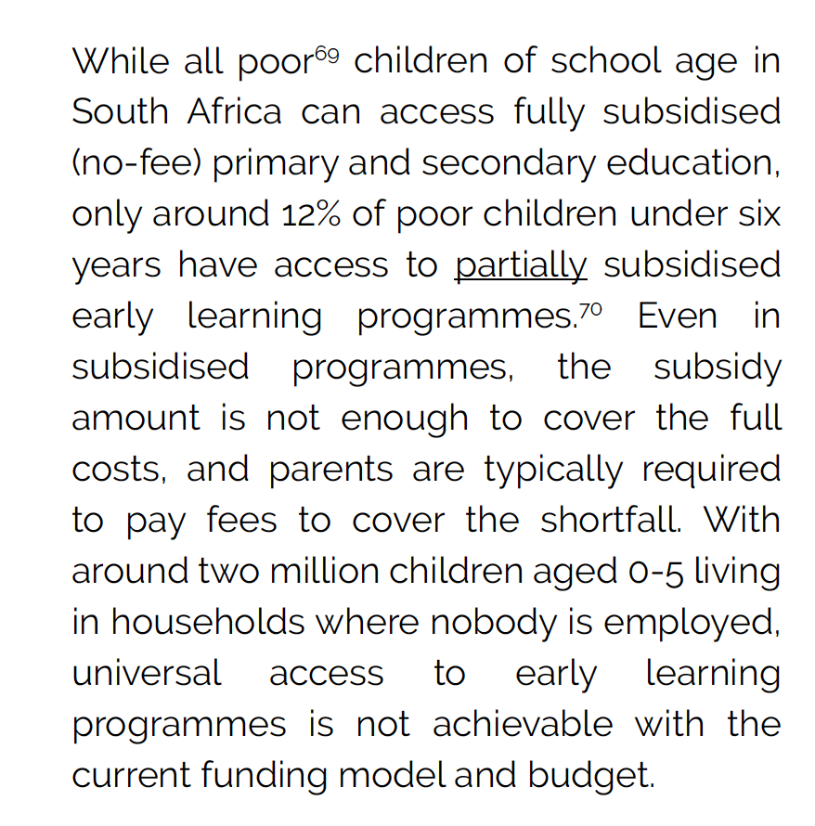
(1) Funding for ECD
LEVERAGE
<20%
of children aged 3-4 are the recipients of tax-funded support for their ECD.
  700,000 children access Early Childhood Education (SONA, 7/2/2019)
  Roughly a million kids per age-year
(South African Early Childhood Review 2019, p.38)

Slide 29
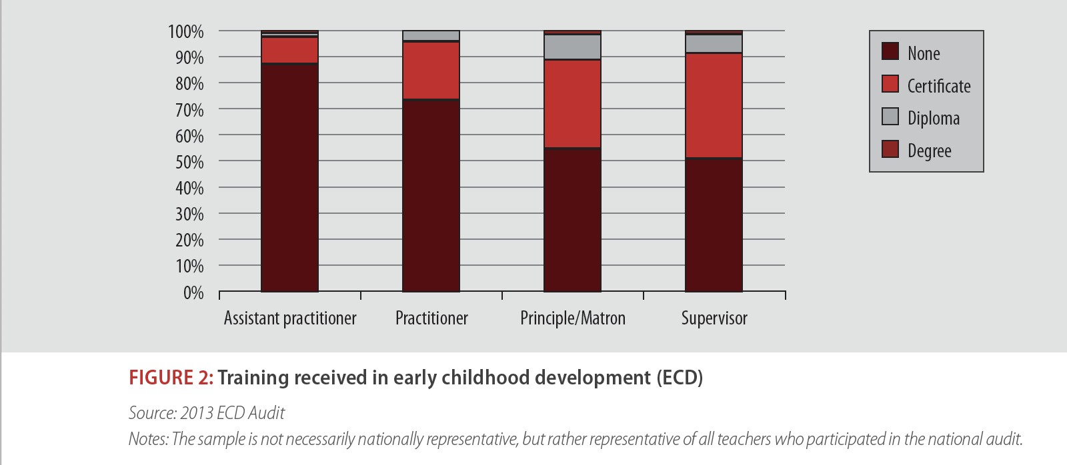
(2) Training
LEVERAGE
70%+
of ECD practitioners have no training or qualifications whatsoever.
(Kotze, 2015: p.4)

Slide 30
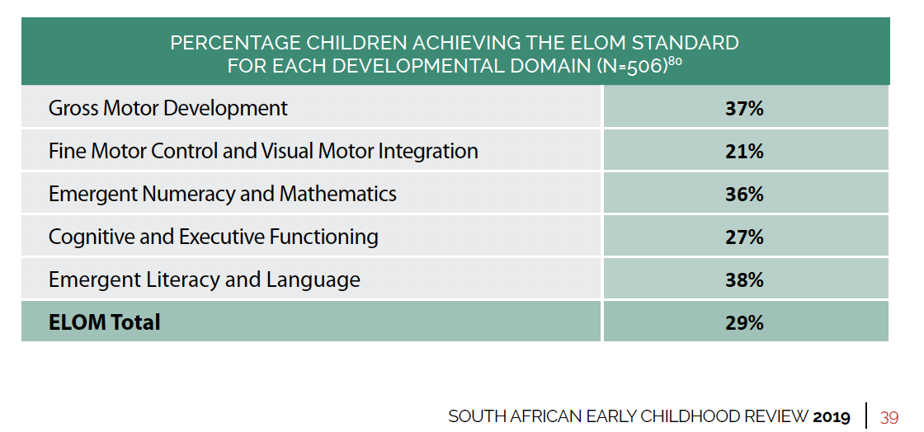

(3) Measurement
LEVERAGE
“What gets measured gets managed”
Unless we can reliably measure the outcomes we want to achieve and see how these (1) change over time, and (2) are distributed across provinces and sites …we won’t know if we are achieving our goals or not.

Slide 31

ECD
Figure 1: ECD attendance rates of children aged 0-6 from 2002-2018 (GHS) against 2020 NIDS-CRAM
estimates
ECD attendance rates doubled from 15% in July/August 2020 to 31% in Nov/December 2020, although still lower than pre-pandemic levels. Among NIDS-CRAM respondents interviewed in November/December and living with children aged 0-6, 28% reported at least one child attending an ECD programme in the past 7 days. This is up from just 7% reporting attendance in July/August. Extrapolating these NIDS-CRAM individual level responses to the level of the child suggests that about 31% of children aged 0-6 were enrolled in ECD programmes by November/December, compared to at most 15% in July/August. ECD attendance in November/December (28%) is still lower than pre-pandemic reported attendance in February (39%).
Source: Wills et al 2021

Slide 32
The case for ECD…
Strong case to be made for significant social investment in ECD…
The government is currently neglecting ECD despite strong evidence of high returns to high quality ECD. Need for systemic solutions not throwing back starfish…
Leverage and influence rather than throwing back starfish (case of EE, EELC, Section27 court case around school feeding, NSNP, as great example of leveraged impact)

Slide 33

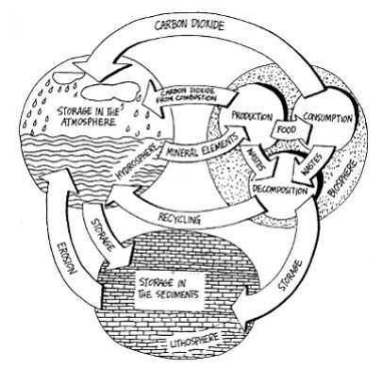
Starfish approach?
Systemic
approach?

Slide 34










Slide 35
SMART
GOALS

Slide 36

Thank you

