Slide 1

Understanding South African Schooling
Presentation to Acorn Education
Nic Spaull
21 May 2021

Slide 2
Overview…
South African priorities
Understanding flow-throughs
Where should we be intervening?
Reading and Mathematics
How does the Western Cape perform?

Slide 3
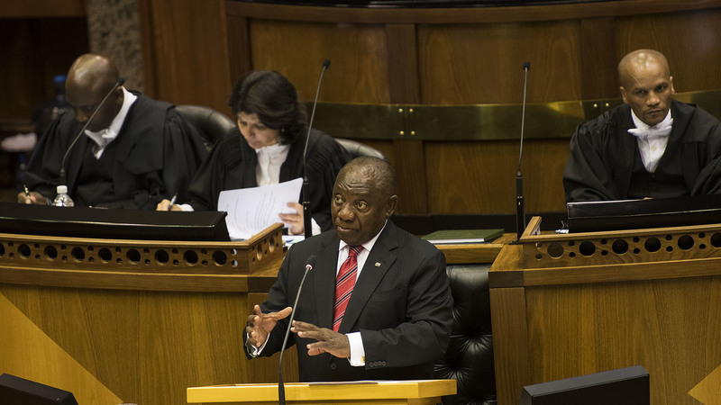
“We agree on five fundamental goals for the next decade….let us agree, as a nation and as a people united in our aspirations, that within the next 10 years we will have made progress in tackling poverty, inequality and unemployment, where:
No person in South Africa will go hungry.
Our economy will grow at a much faster rate than our population.
Two million more young people will be in employment.
Our schools will have better educational outcomes and every 10 year old will be able to read for meaning.
Violent crime will be halved.
Let us make these commitments now – to ourselves and to each other – knowing that they will stretch our resources and capabilities, but understanding that if we achieve these five goals, we will have fundamentally transformed our society.”
- President Cyril Ramaphosa (SONA, 21 June 2019)

Slide 4
Ramaphosa’s Big 5
Economic Growth
Youth Employment
Early Grade Reading
Violent Crime
Hunger

Slide 5

How many students actually make it to university in SA?
How many of those who start school reach matric? Graduate with matric? Graduate with a degree?
New (2016) study followed the entire matric cohort of 2008 into university and tracked them 2009-2014
(Van Broekhuizen & Van der Berg, 2016)

Slide 6

How many students actually make it to university?

Slide 7

How many students actually make it to university?

Slide 8

How many students actually make it to university?

Slide 9

How many students actually make it to university?
Source: Van Broekhuizen & Van der Berg, 2016 (Higher Education Access and Outcomes for the 2008 National Matric Cohort)

Slide 10
How many students actually make it to university?
}
?
Source: Van Broekhuizen & Van der Berg, 2016 (Higher Education Access and Outcomes for the 2008 National Matric Cohort)

Slide 11
Where should we be intervening?
New Solutions for a New Future
Insurmountable learning deficits
Figure 10b: South African mathematics learning trajectories by national socioeconomic quintiles using a variable standard deviation for a year of learning (0.28 in grade 3 to 0.2 in grade 8 with interpolated values for in-between grades (Based on NSES 2007/8/9 for grades 3/4/5, SACMEQ 2007 for grade 6 and TIMSS 2011 for grade 9, including 95% confidence interval
(Spaull & Kotze, 2015)

Slide 12
Reading

Slide 13


78%
22% can read for meaning
of Grade 4 children in South Africa can not read for meaning in any language.
PIRLS Literacy 2016 (Howie et al., 2017)

Slide 14
78%
How does this differ by school wealth?
Spaull & Pretorius (2018) Falling at the first hurdle. Springer.

Slide 15

Putting things in context…
PIRLS 2016 Low International Benchmark
If a learner can reach the PIRLS Low International Benchmark then they can
“locate and retrieve explicitly stated information, actions or ideas;
make straightforward inferences about events and reasons for actions; or
begin to interpret story events and central ideas” (Mullis et al, 2017; p.53).
  South Africa: 22%
Mullis et al. 2017, p.55

Slide 16


SA Gr4
WC Gr4
Released passage from PIRLS Literacy 2016
40%
55%
40%
55%
32%
33%
Mullis et al. 2017

Slide 17
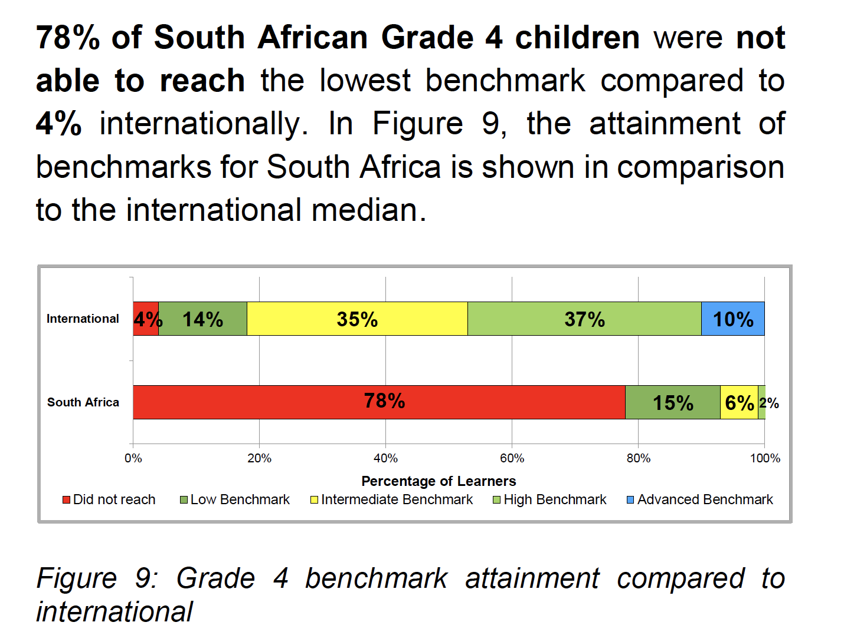
78%
of South African Gr4 learners cannot read for meaning in any language
Source: SA PIRLS Literacy 2016 report

Slide 18
SA PIRLS 2016 results in context
% reaching the PIRLS 2016 Low International Benchmark
Mullis et al. 2017

Slide 19
55%
of Grade 4’s in the WC cannot read at the most basic level in any language
(PIRLS Literacy 2016)

Slide 20

40
WCPM
Words Correct Per Minute

Slide 21
What does this look like in reality?
Many
years
ago
Leopard
was
a
creature
with
no
spots.
Recommended rate at Gr5
One
day,
he
was
relaxing
in
the
shade
of
a
thorn
tree
when
Zebra
walked
past.
Many
years
ago
Leopard
was
a
creature
with
no
spots.
40% of SA rural Gr5 learners (<40WCPM) WCPM
One
day,
he
was
in
25%
of rural WC Grade 5 learners
relaxing
the
shade
of
a
thorn
tree
when
Zebra
walked
past.
Draper, K., and Spaull, S. (2015). Examining oral reading fluency among grade 5 rural English Second Language (ESL) learners in South Africa: Analysis of NEEDU 2013. South African Journal of Childhood Education 5(2) pp.44-77.
Notes:
40 words in 60s = 1,5s/word
130 words in 60s = 0,46s/word

Slide 22
What about Maths?

Slide 23

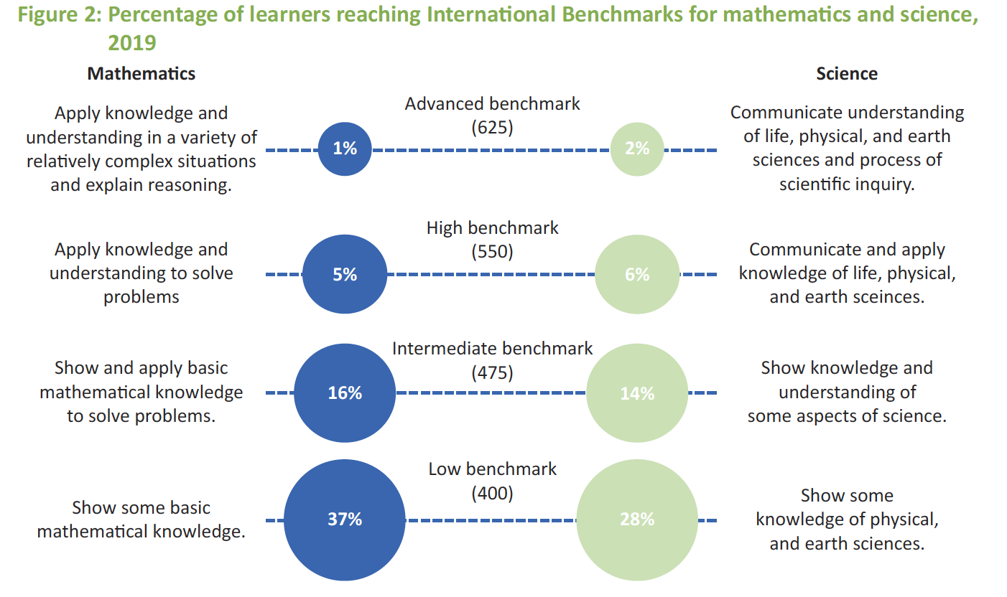
Example questions from TIMSS 2019 Gr5:
700 – 28 = ____ [MN11128 – CAPS Gr3]
5 x 25 = ___ [MN11136 – CAPS Gr4]
(SA: 25%)
(SA: 38%)

Slide 24

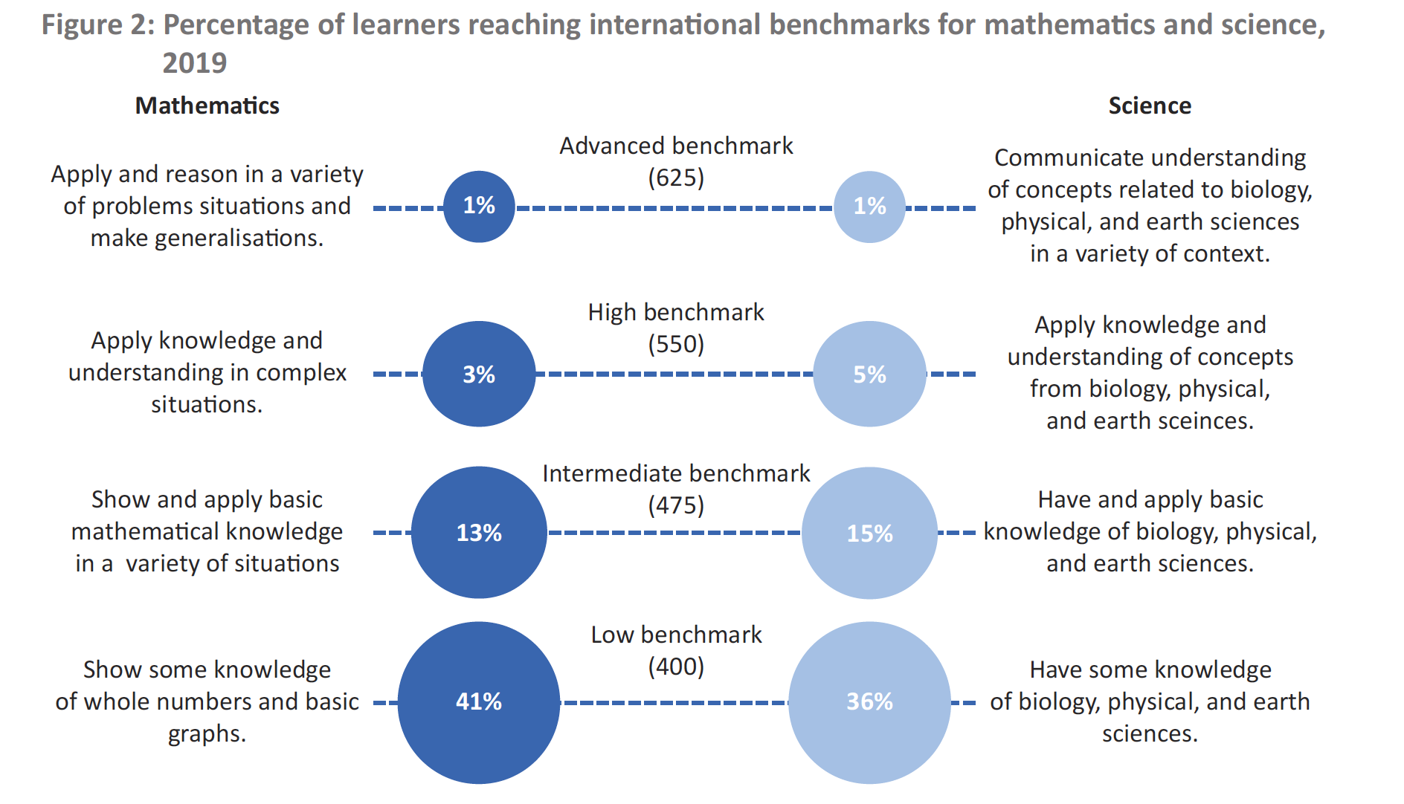

Slide 25


Slide 26
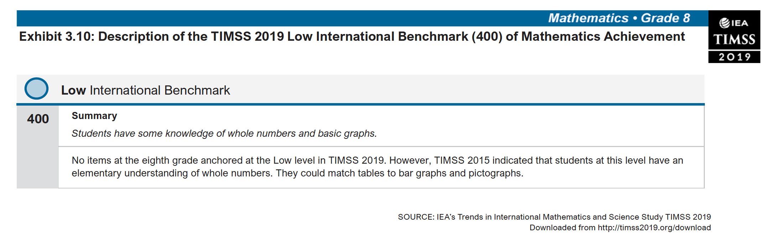
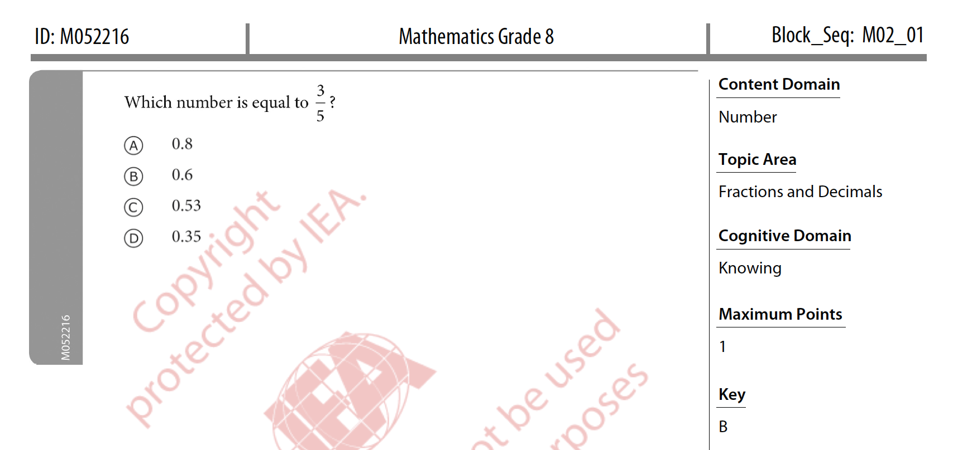
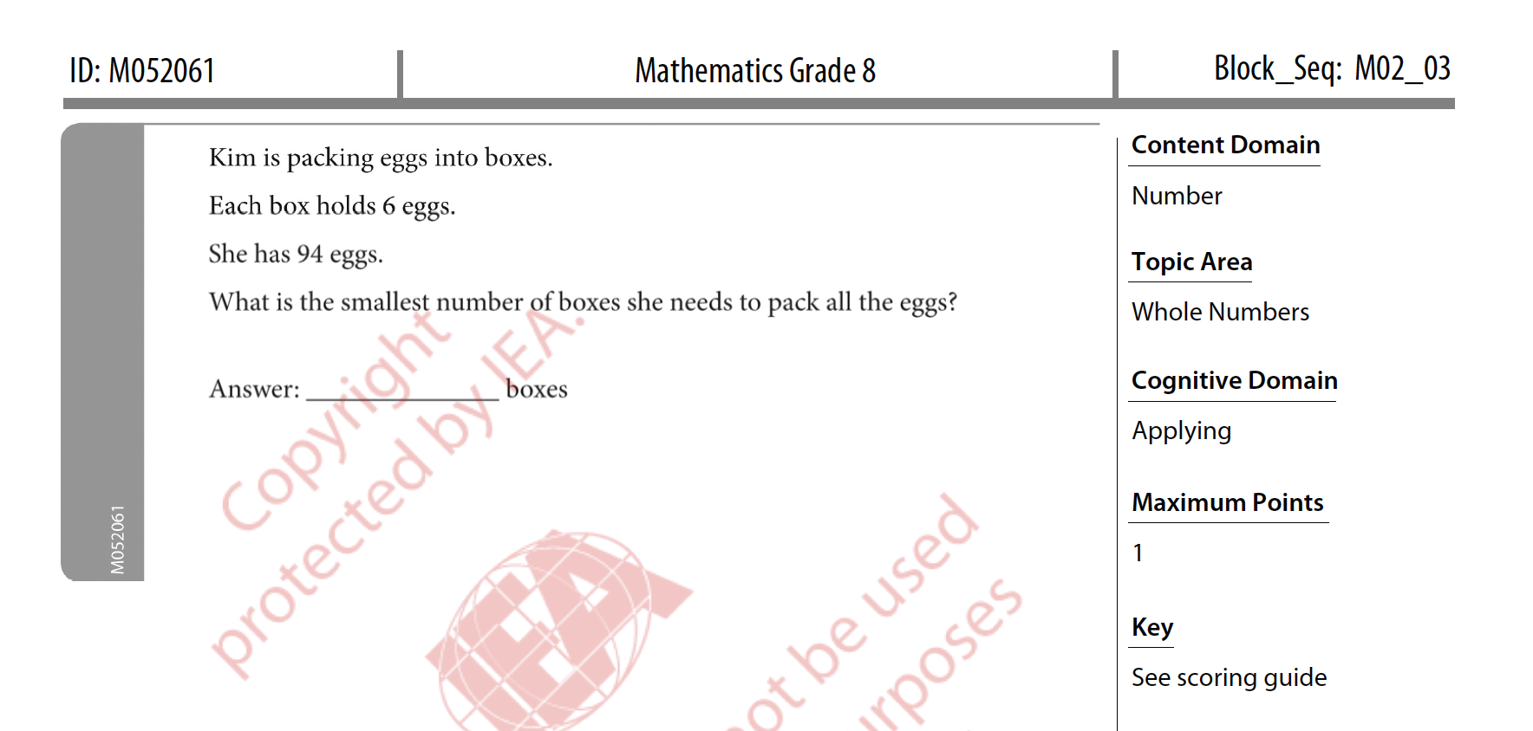
Low International Benchmark

Slide 27
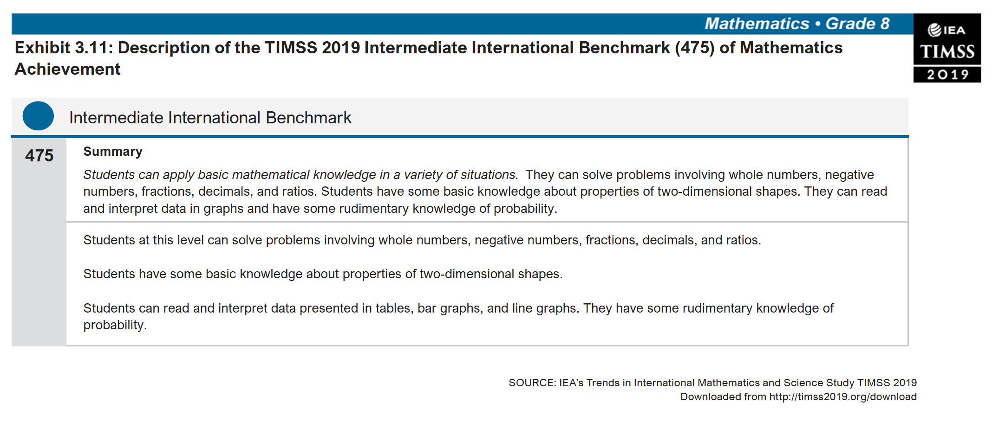
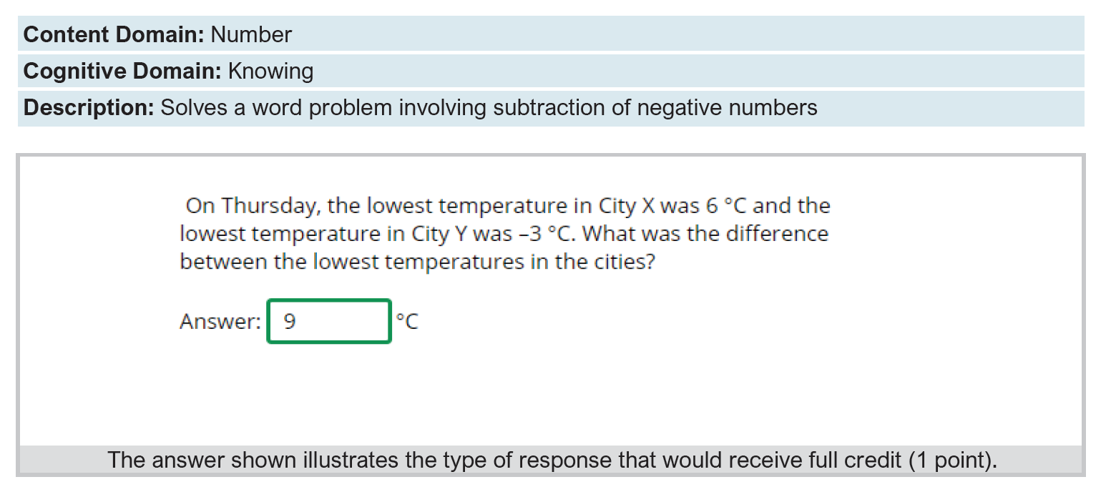
Intermediate International Benchmark

Slide 28

Falling at the first hurdle…
If children do not learn-to-read in Grades 1-3, they cannot read-to-learn in Grade 4 onwards
Spaull & Pretorius (2018) Falling at the first hurdle: Early grade reading in South Africa. Springer.

Slide 29
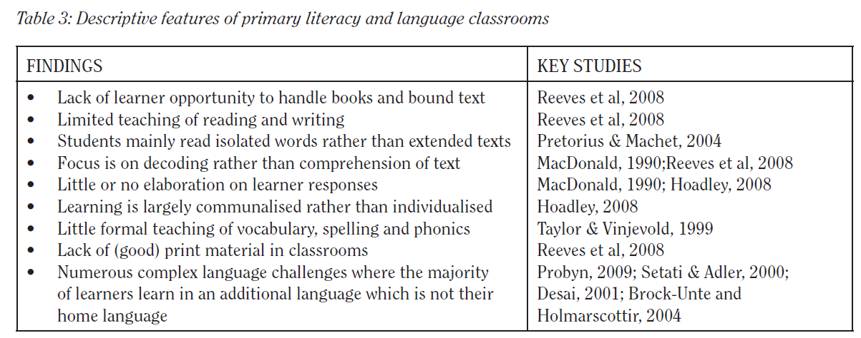
Do teachers know how to teach reading?
“South African learners’ performance in the PIRLS assessments accentuates the need for reading instruction practices aimed at addressing the difficulties South African learners encounter in both the Foundation Phase & Intermediate Phases … the qualifications that teachers do have, have not prepared them to teach reading literacy or … these teachers are not able to implement strategies they have gleaned from professional training.”
Prof Sarah Howie et al. (2008: 48)
Hoadley 2012 review of the literature

Slide 30
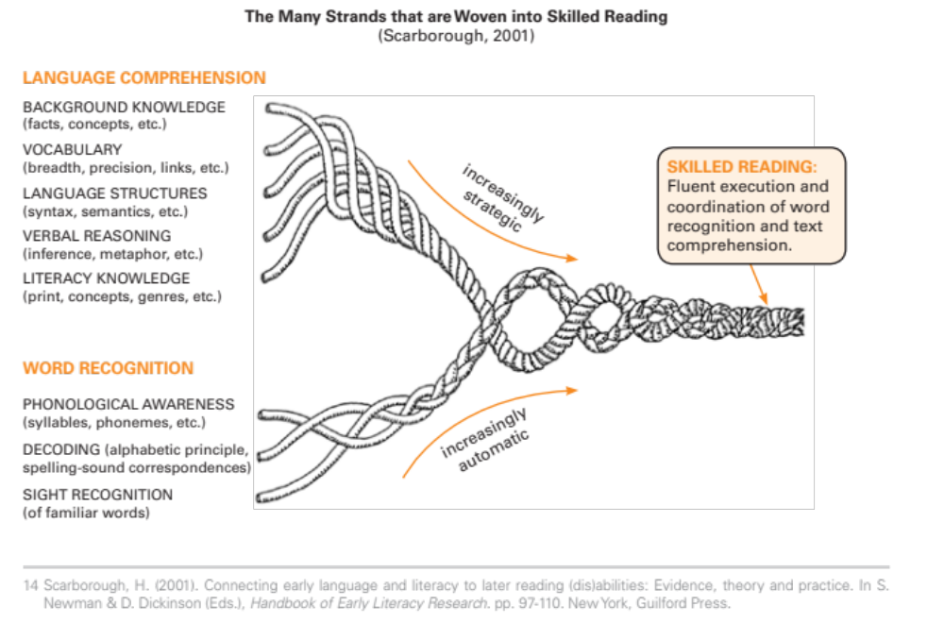
What can we do about this?
All of the top education systems in the world ensure that all children master the basics of reading for meaning and using the four operations & the base number ten system effectively.
Not possible without high quality professional development
Learning to read for meaning is not ‘easy’ but there is a lot of scientific evidence showing what the components of reading are and how to teach them

Slide 31
Alignment & Coherence
Components of professional development and LTSM alignment to ensure all children learn to read for meaning by age 10
(1) Standards: What children need to know
(2) LTSM:
What materials we use to teach them
(3) Pedagogy: How we teach it to them
(5) Training:
In-service & pre-service training
(4) Assessments: How we know if they’ve learnt it

Slide 32

4 ways to
stay safe online
With the growing presence and sophistication of online threats like viruses, ransomware, and phishing scams, it’s important to have the right protection. Office 365 Home and Office 365 Personal give you advanced security tools to help keep your information secure and private.
“Funda Wande aims to equip teachers with the knowledge, resources and support they need to teach reading for meaning by age 10.”

Slide 33
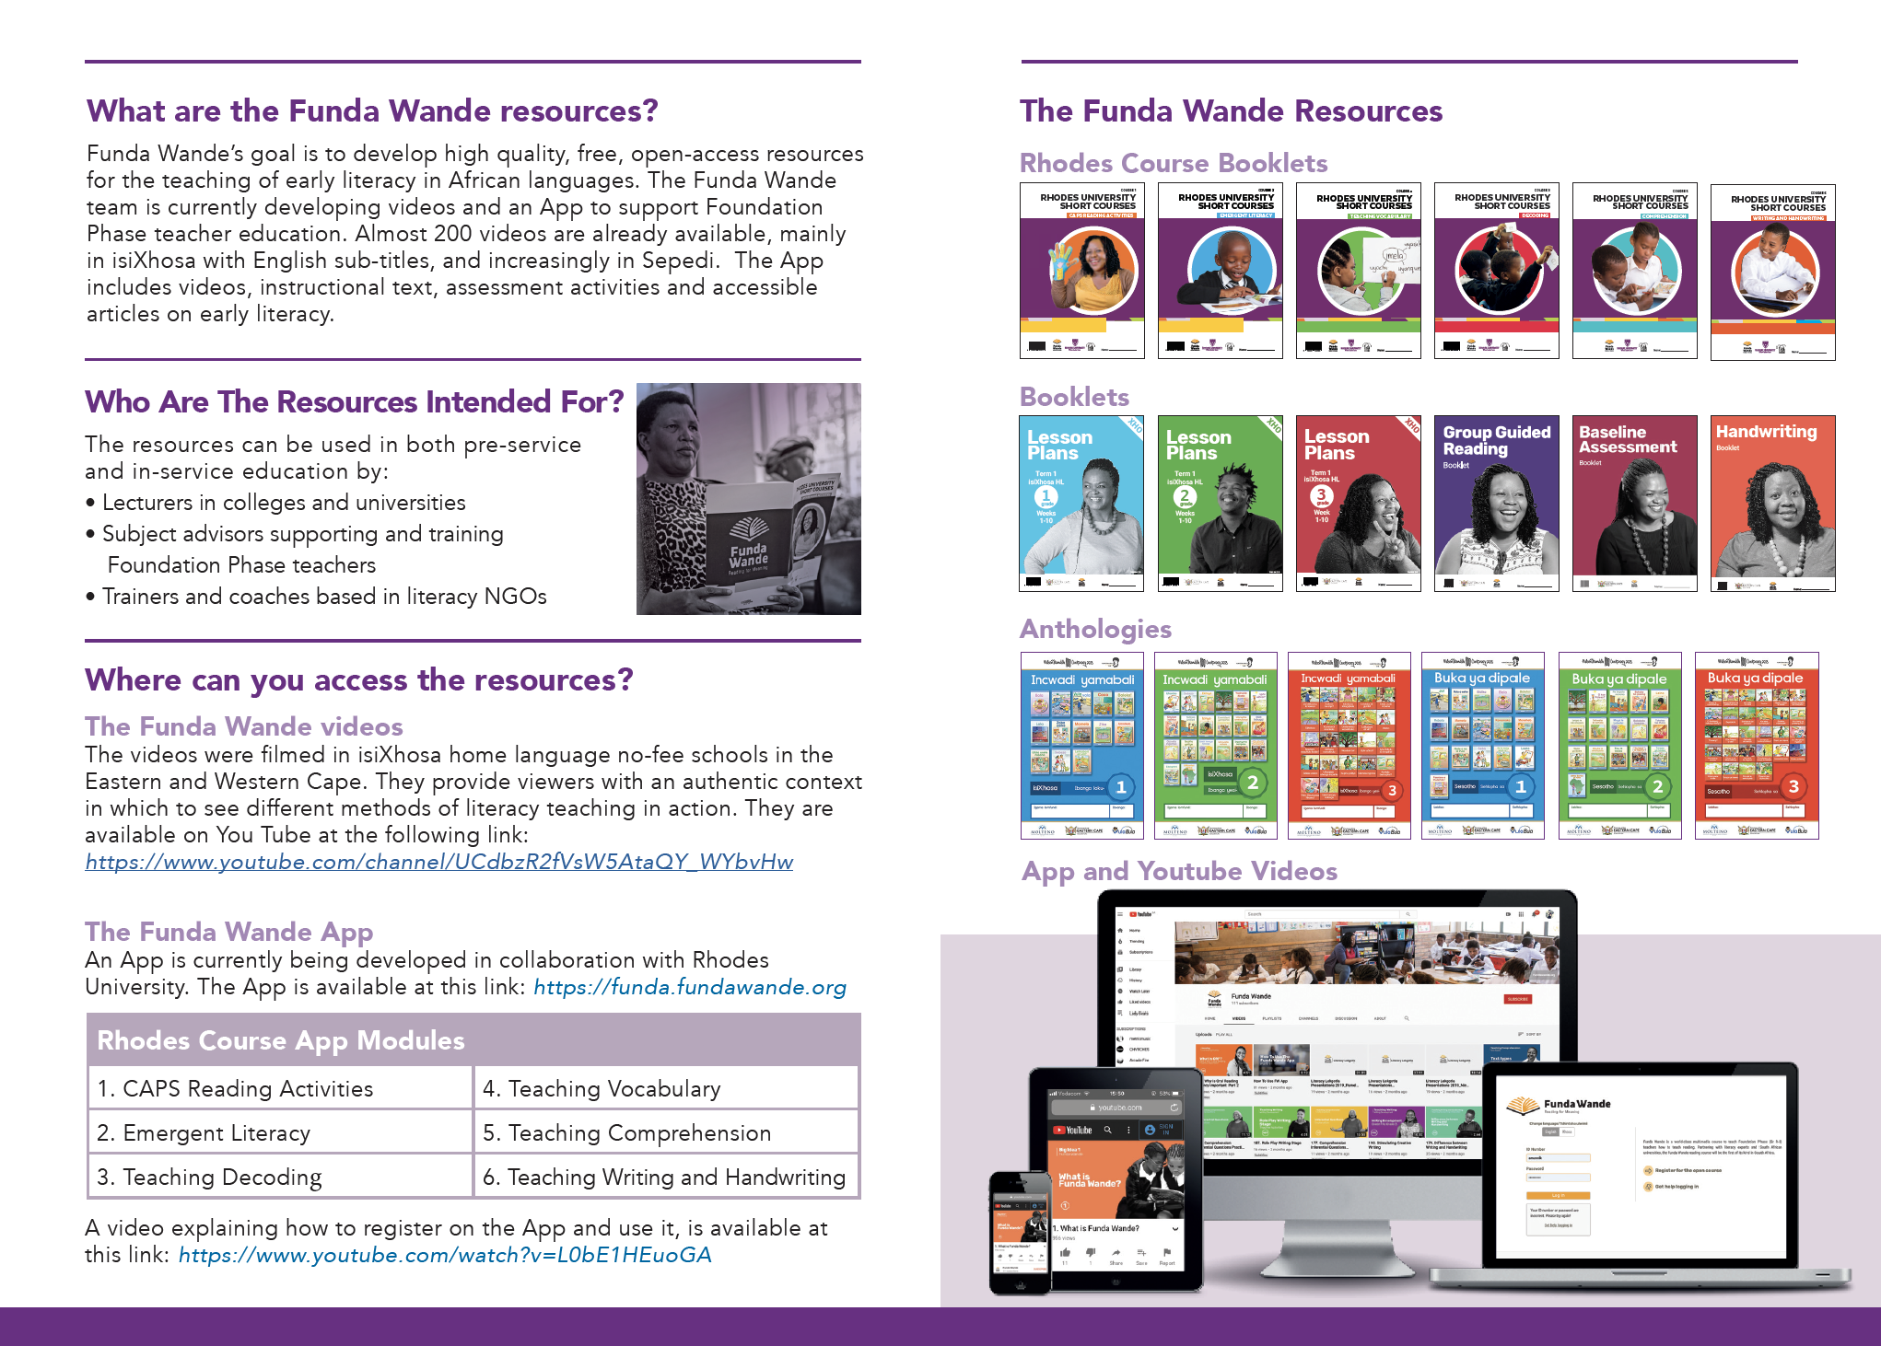

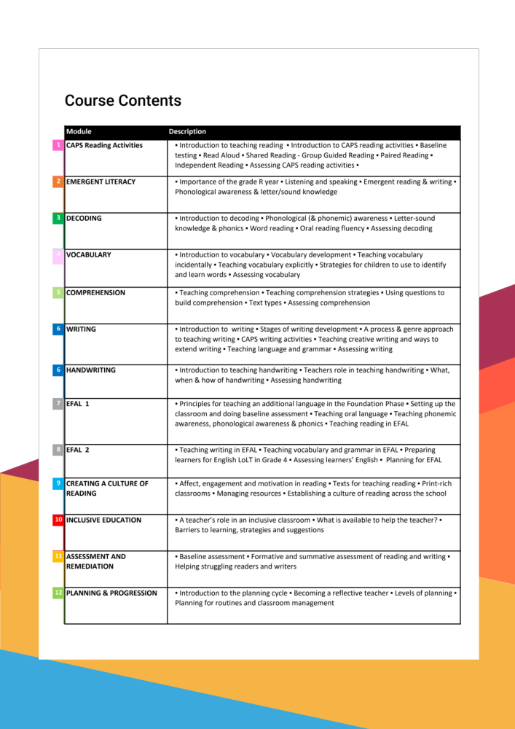

Slide 34
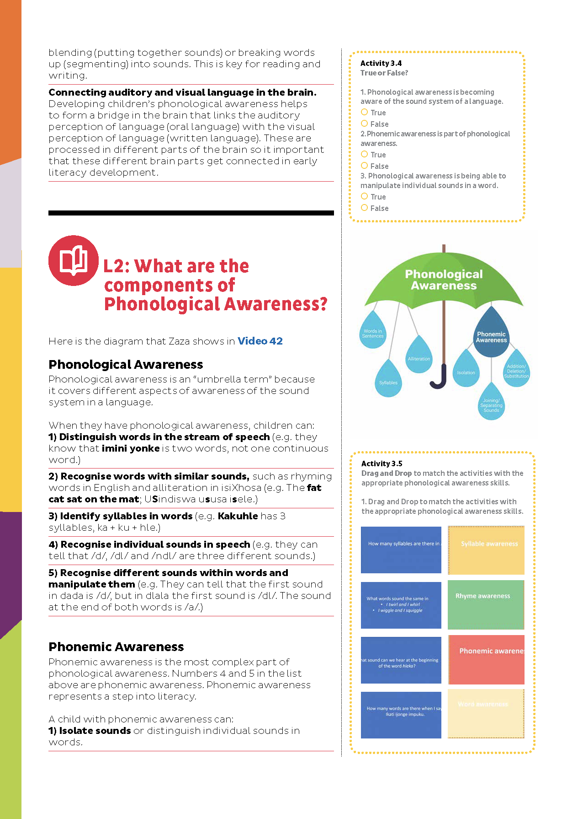
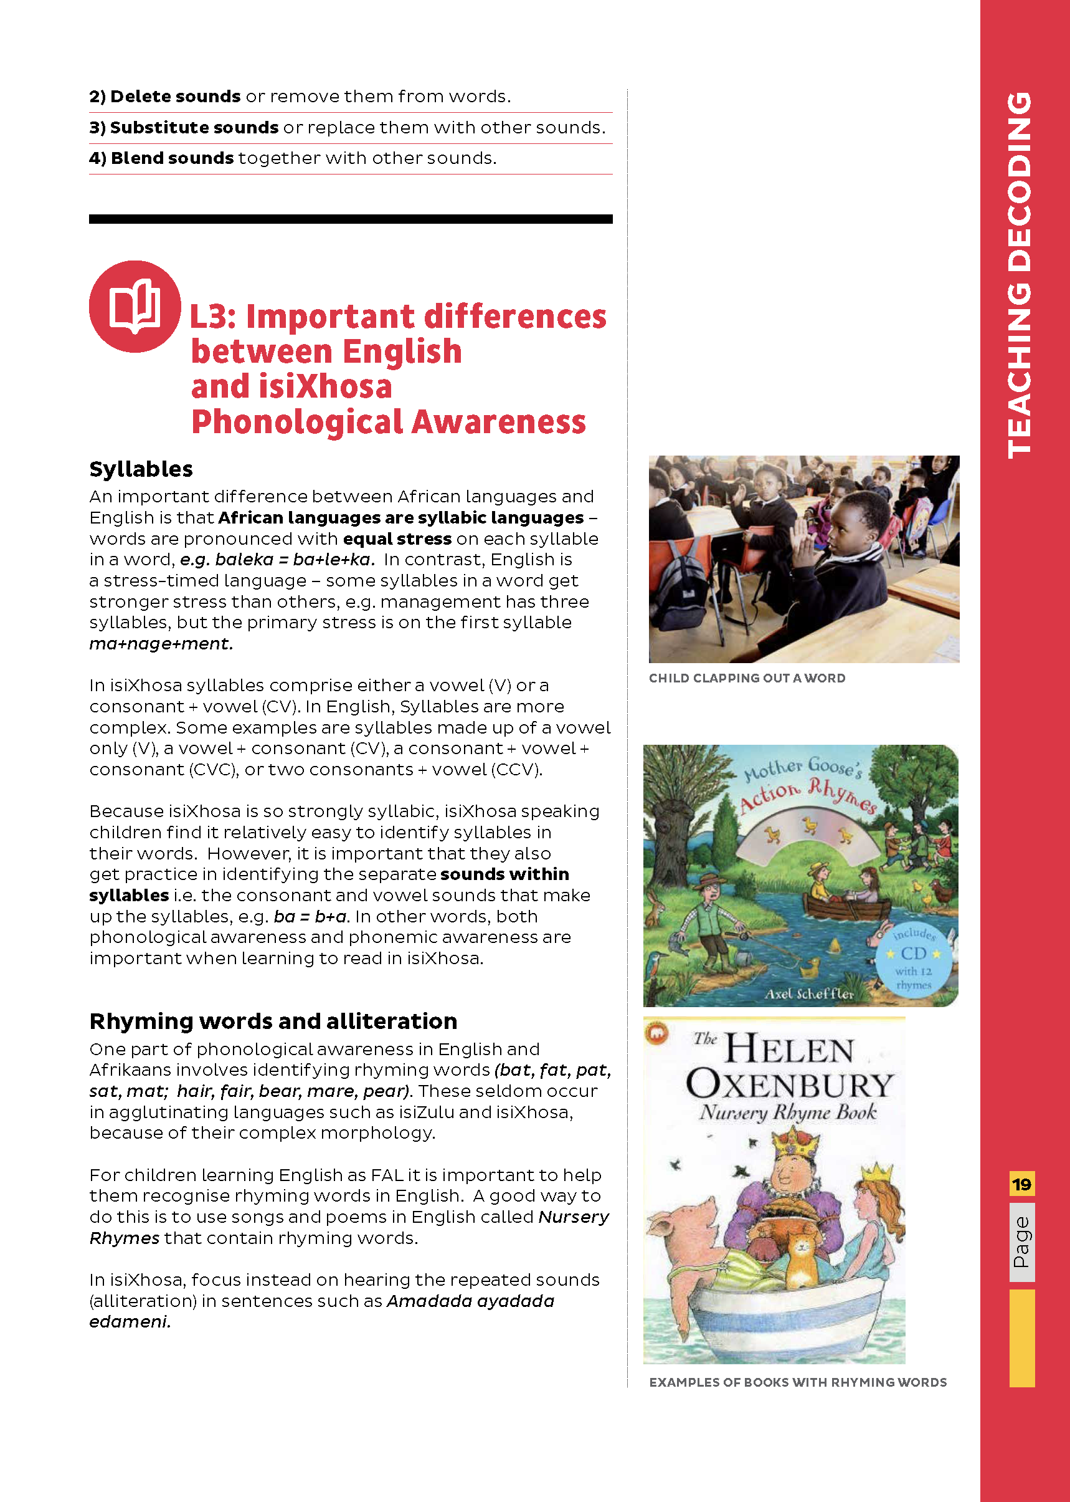

Slide 35
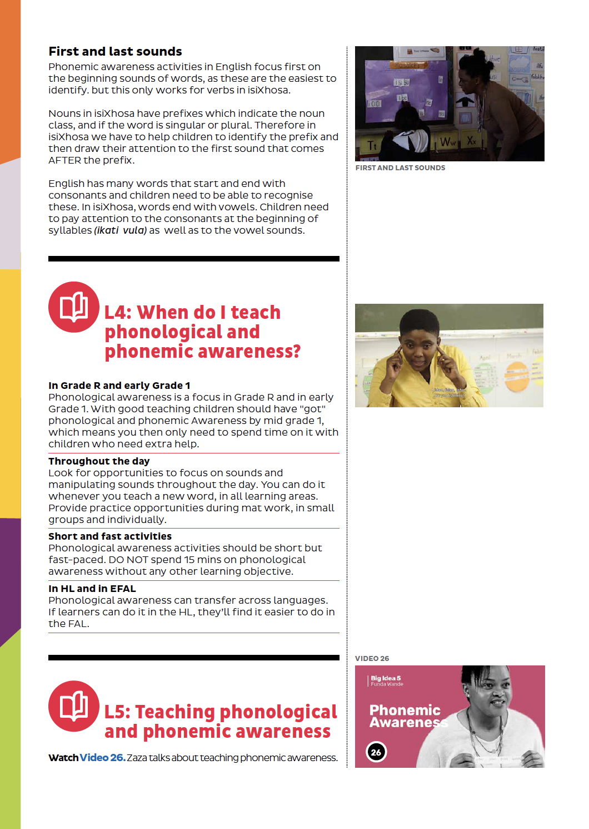
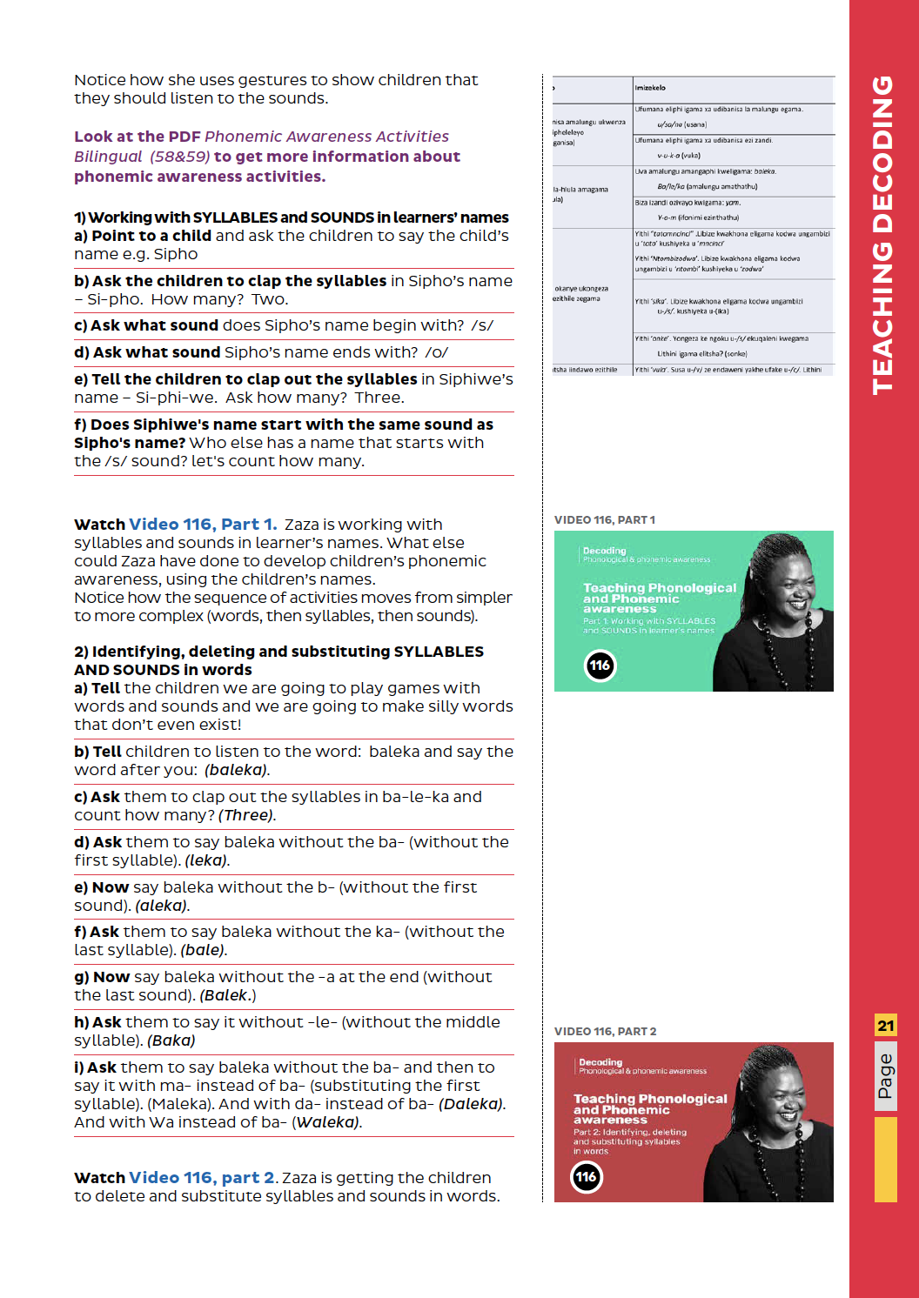

Slide 36
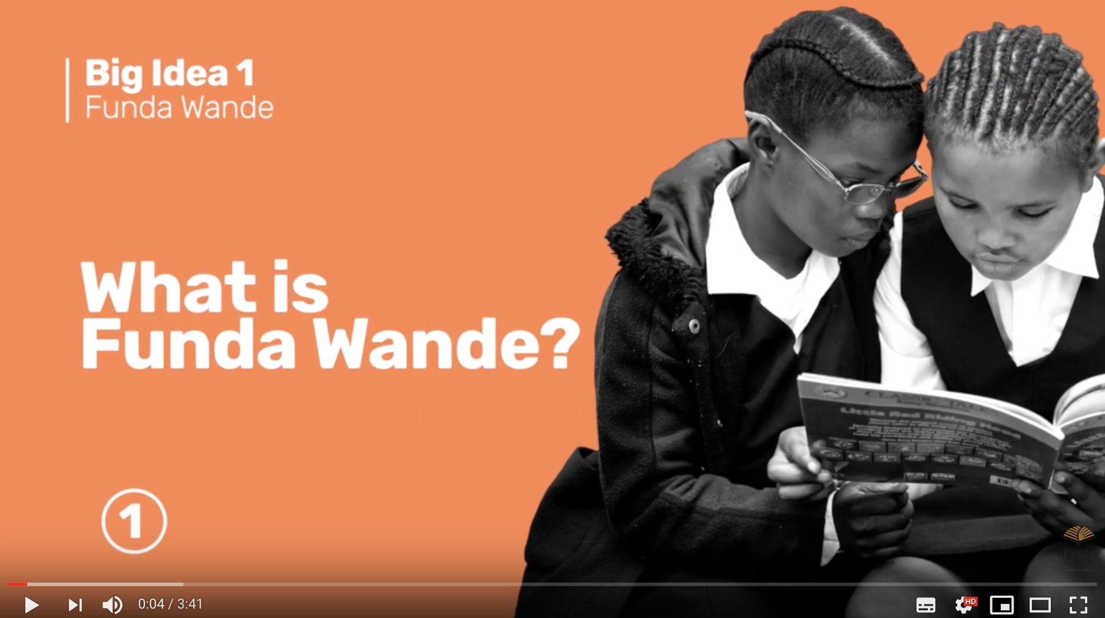

Slide 37
www.fundawande.org/resources

Slide 38


Slide 39
Everything produced by Funda Wande is CC-licensed and is freely available for download, editing and use by anyone ☺

Slide 40
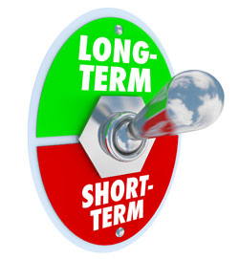
In it for the long haul…
“Problems that are easily solved are, in the long-run, trivial and not that important.”
– James Hollis

Slide 41
“
The best use of private money is influencing how public money is spent.
“
R351 Billion
R4,5 Billion
(1,2%)
2018 SA Government expenditure on education
Trialogue estimate of
all education CSI in SA

Slide 42
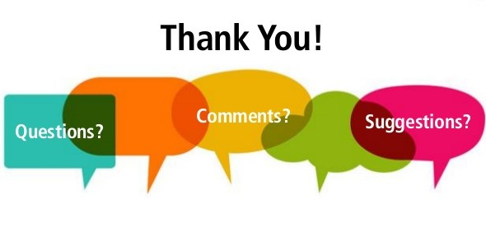

Slide 43
