Slide 1

Education expenditure
+
Learning Losses
25 May 2021
Nic Spaull
Stellenbosch University

Slide 2
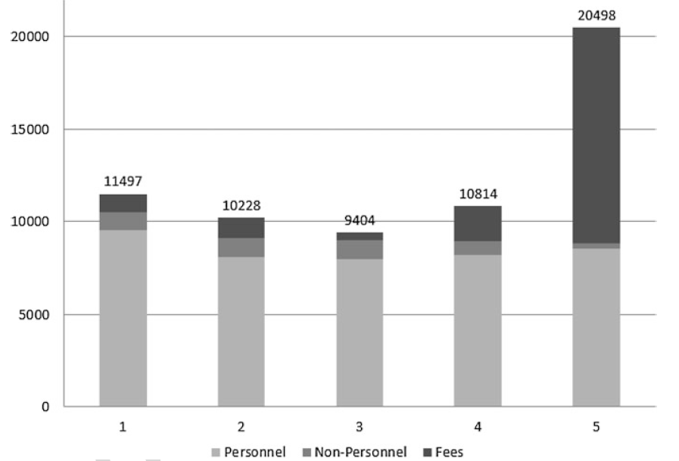
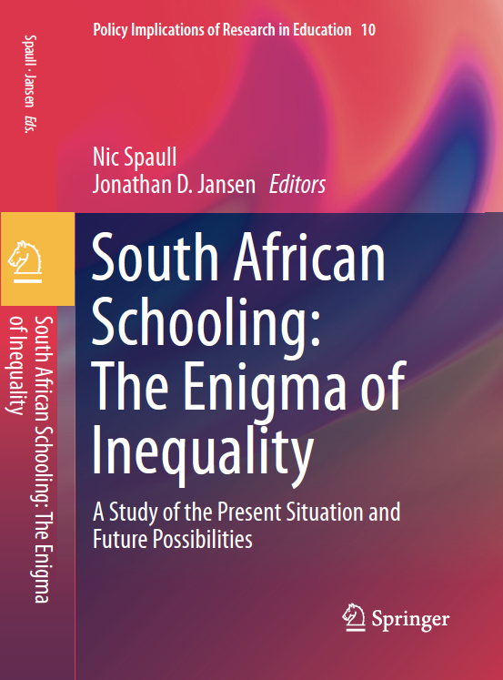
WC Quintile 1-5
Motala & Carel 2019
Fig. 4.3 Non-personnel expenditure, personnel expenditure, and private fees by quintile in the Western Cape (per learner). (Sources: Provincial Gazette; Persal 2016; Western Cape EMIS; EMIS National Ordinary Schools 2016 Quarter 4. Own analysis of the microdata)

Slide 3

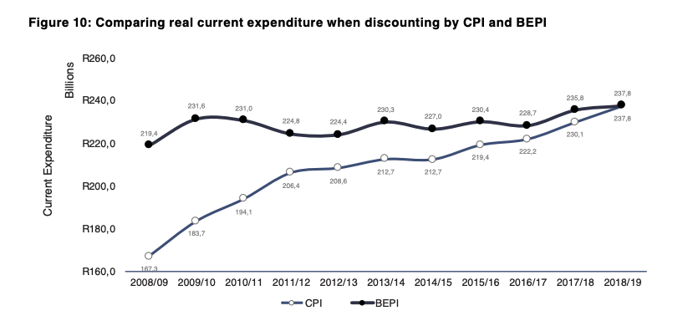
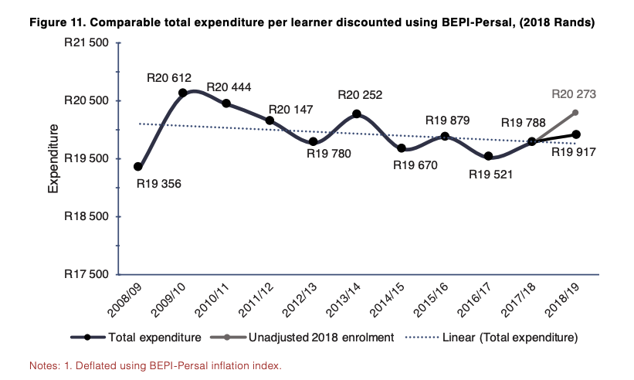
Notes:
https://resep.sun.ac.za/wp-content/uploads/2020/06/spaull-lilenstein-carel-2020-the-race-between-teacher-wages-and-inflation-19jun20-1.pdf

Slide 4
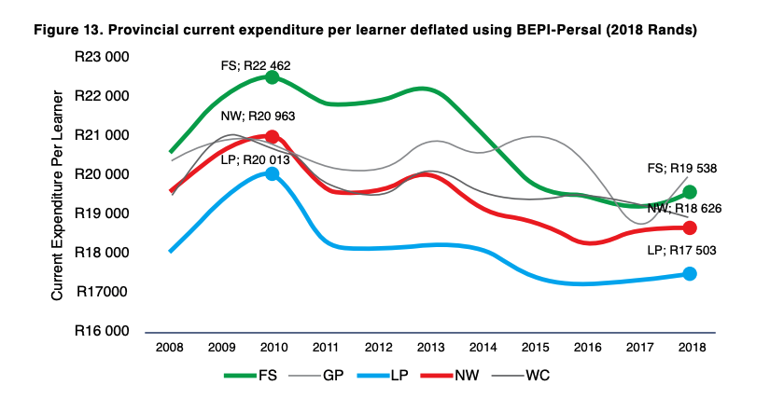
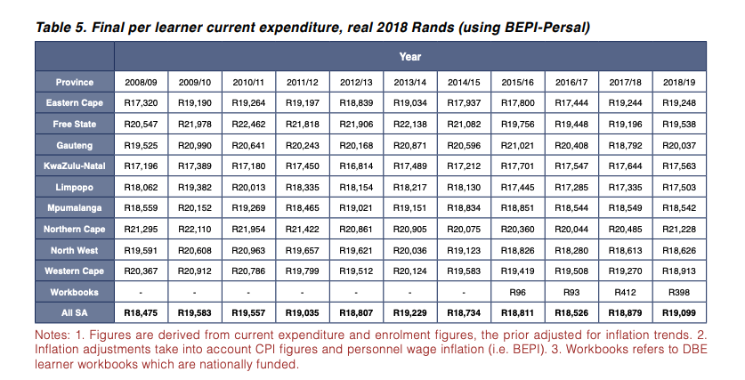

Slide 5

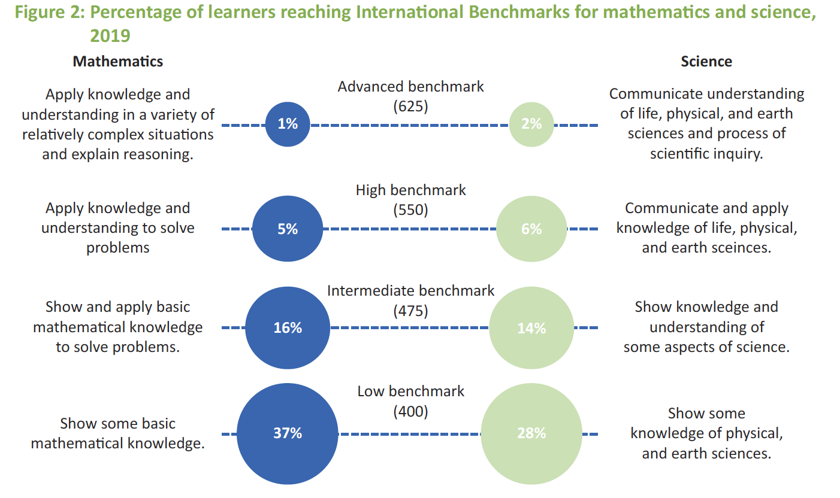
Example questions from TIMSS 2019 Gr5:
700 – 28 = ____ [MN11128 – CAPS Gr3]
5 x 25 = ___ [MN11136 – CAPS Gr4]
(SA: 25%)
(SA: 38%)

Slide 6
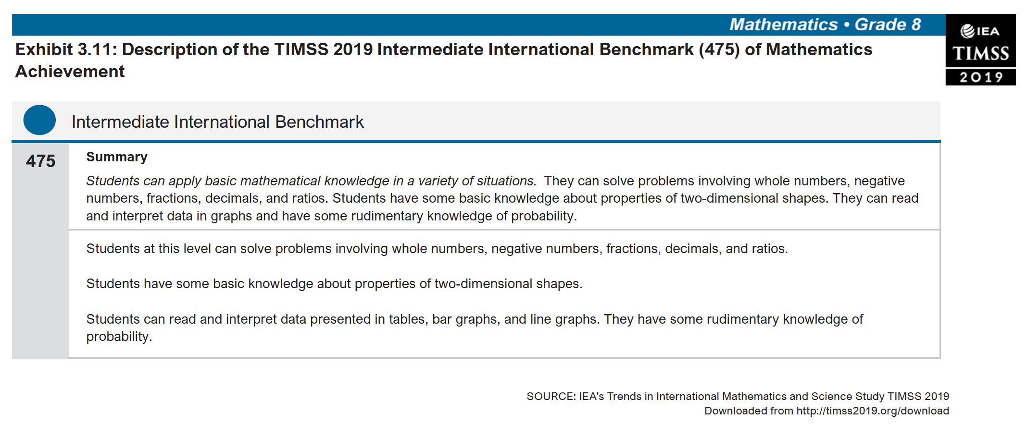
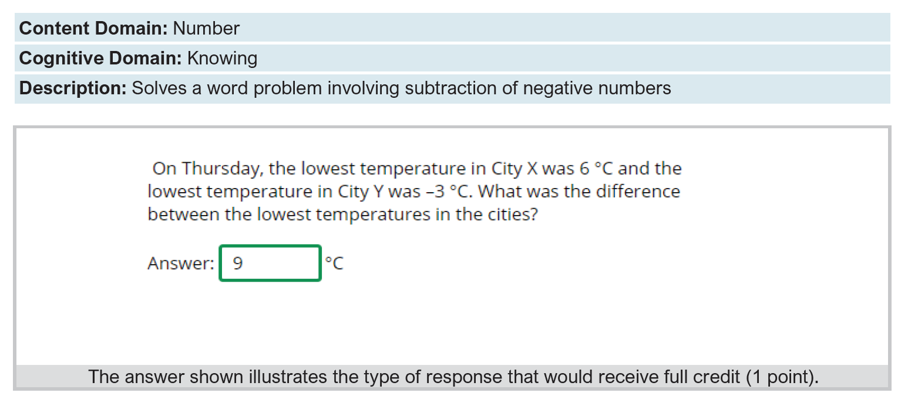
Intermediate International Benchmark

Slide 7
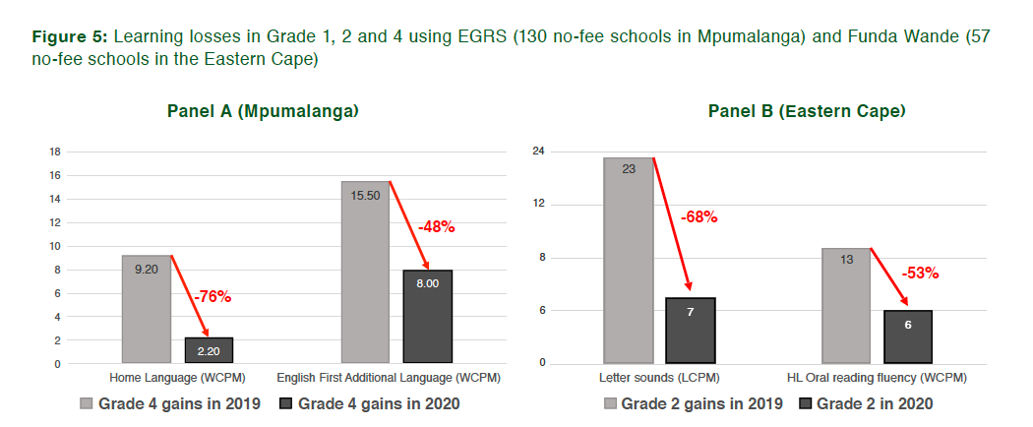
Learning losses
Children in no-fee schools have learnt 50-75% less
in 2020 compared to what they normally learn.
Source: Shepherd et al (2021) for Mpumalanga and Ardington (2021) for Eastern Cape

Slide 8
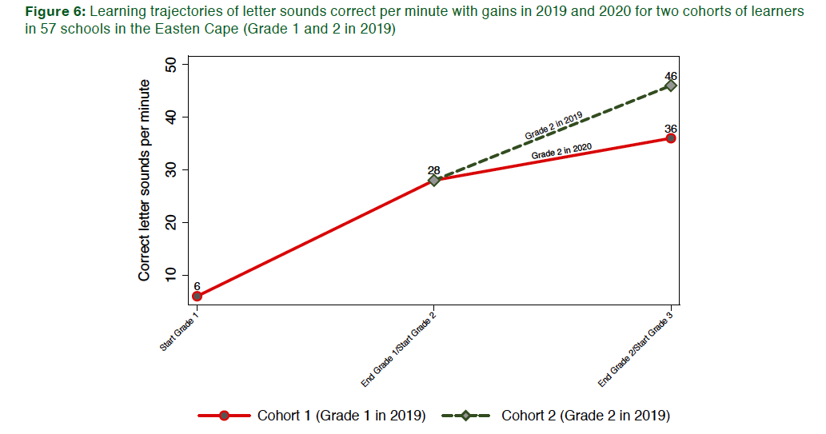
Learning trajectories
Flattening learning trajectories.
Grade 1 in 2019
Source: Ardington (2021) analyzing 57 no-fee schools in the Eastern Cape

Slide 9

How many students actually make it to university?
}
?
Source: Van Broekhuizen & Van der Berg, 2016 (Higher Education Access and Outcomes for the 2008 National Matric Cohort)

Slide 10
Where should we be intervening?
New Solutions for a New Future
Insurmountable learning deficits
Figure 10b: South African mathematics learning trajectories by national socioeconomic quintiles using a variable standard deviation for a year of learning (0.28 in grade 3 to 0.2 in grade 8 with interpolated values for in-between grades (Based on NSES 2007/8/9 for grades 3/4/5, SACMEQ 2007 for grade 6 and TIMSS 2011 for grade 9, including 95% confidence interval
(Spaull & Kotze, 2015)

