Slide 1


Overview of Findings
NIDS-CRAM Wave 2
30 September 2020
Dr Nic Spaull
University of Stellenbosch
National income Dynamics Study (NIDS) Coronavirus Rapid Mobile Survey (CRAM)

Slide 2

BACKGROUND
NIDS-Wave 5 (2017)
  Existing panel study 2008-2017: The National Income Dynamics Study. NIDS is a panel study that began in 2008 as a nationally representative survey with the same individuals and their descendants being re-interviewed every 2-3 years between 2008 and 2017. It has been used in over 100 academic articles
NIDS-CRAM (2020)
  Wave 1: ~ 7000 individuals surveyed in NIDS-CRAM Wave 1: In total 17,568 randomly selected individuals from NIDS were called and of these, 7,073 were interviewed in NIDS-CRAM
  Wave 2: ~5700 responses (80% response rate – same individuals
  Details of the telephonic survey:
    Managed by SALDRU at UCT
    50 call centre agents phoning from 13 July to 13 August 2020
    20-minute survey (available in all 11 languages)
    R20 airtime given to respondents to thank them for participation.
    Questions on demographics, migration, grant-receipt, employment, income, hunger + COVID-19 risk perceptions and behaviour + (W2) education, ECD, mental health
  Wave 3-5 (Oct 2020 – July 2021) – includes sample top-up

Slide 3




BACKGROUND
Who funded NIDS-CRAM?
  The Allan & Gill Gray Philanthropy, the FEM Education Foundation, the Michael & Susan Dell Foundation
Who will have access to the data?
  All NIDS-CRAM data is immediately made freely available to the public and other researchers on the DataFirst platform. W2 data is now up. We encourage others to analyze the data for their own purposes and to replicate our results (we have also posted our do files so people can replicate our analysis.

Slide 4
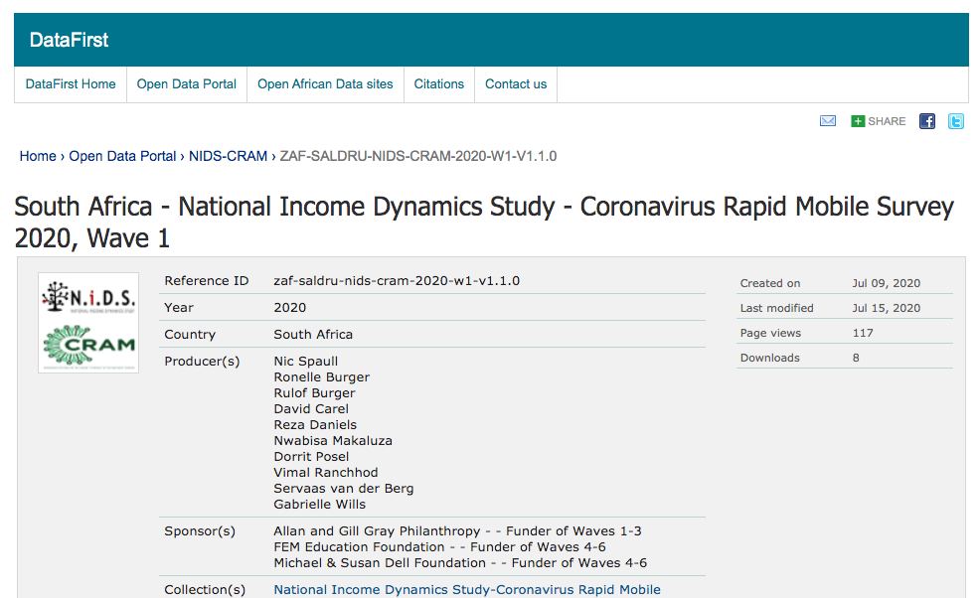

Slide 5
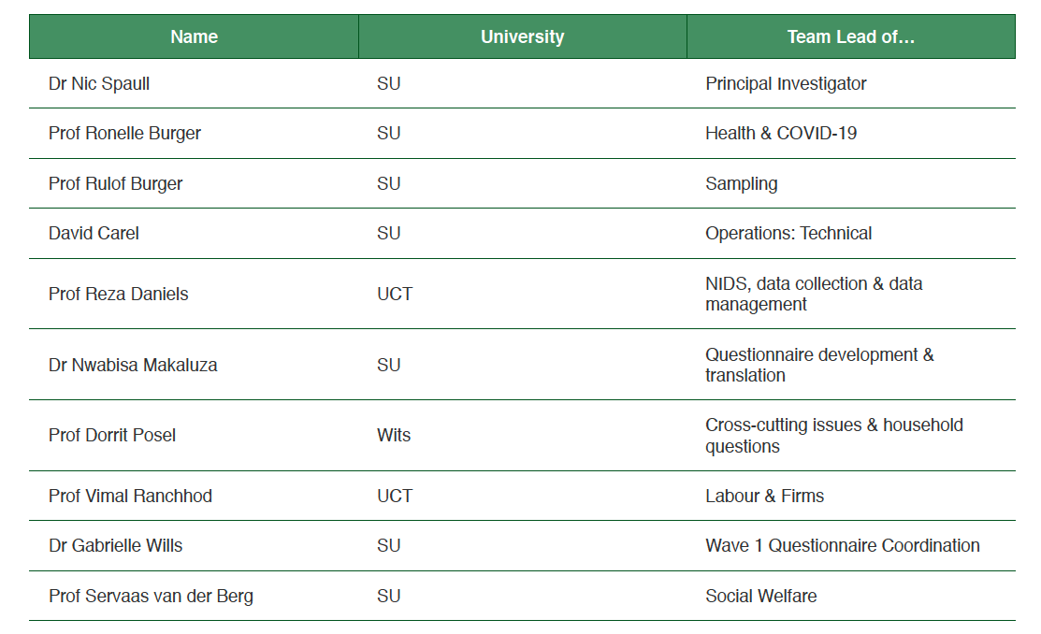
Background
Who was the leadership team?

Slide 6








(2) Researchers & SteerCo

Slide 7
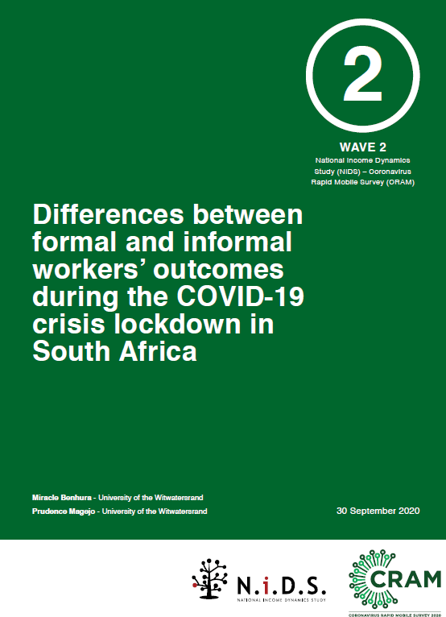
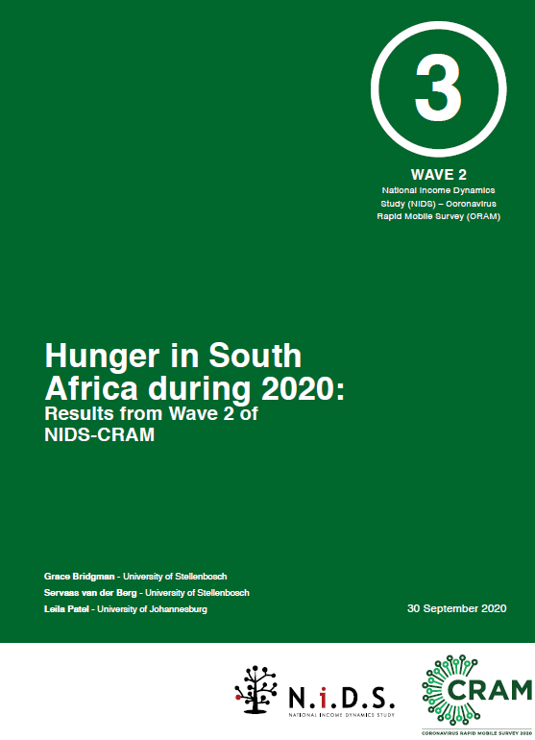
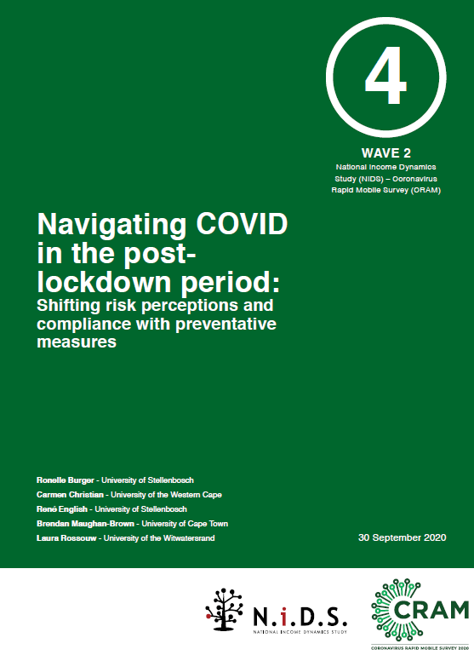
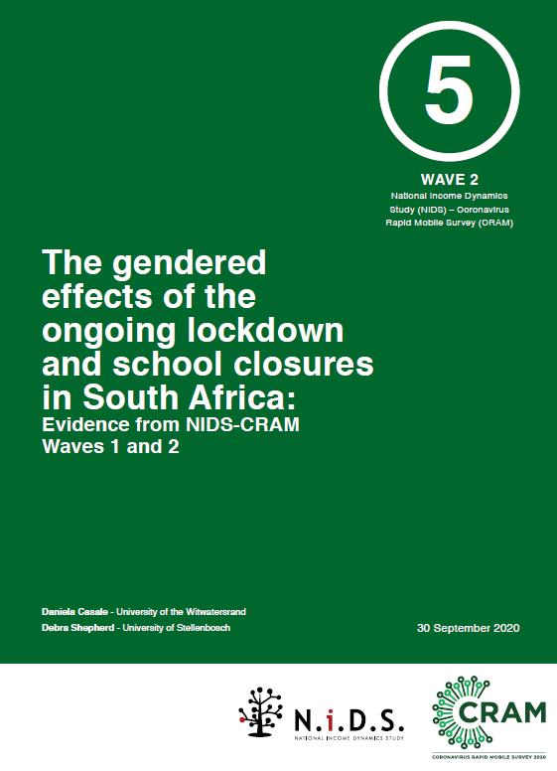
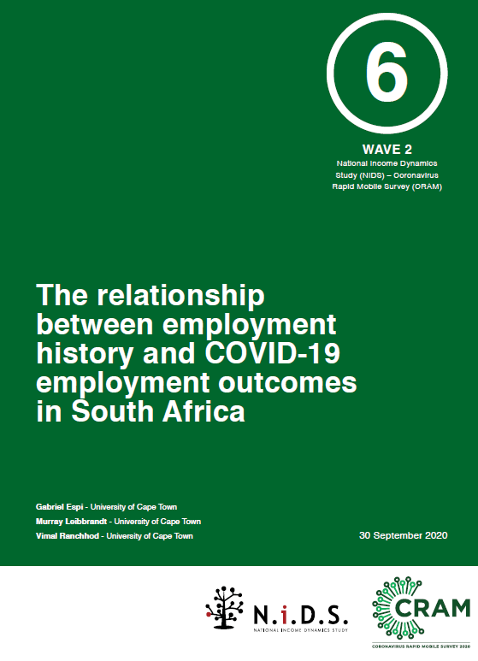
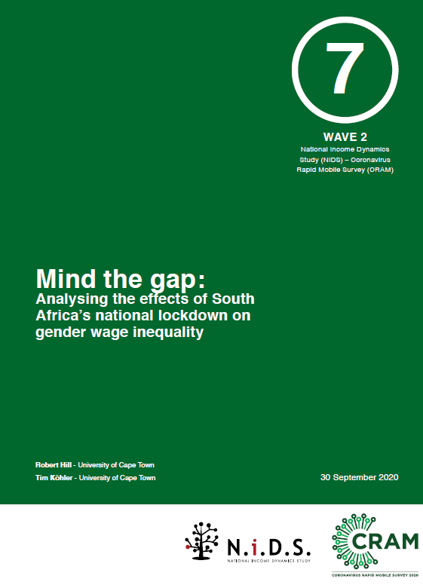
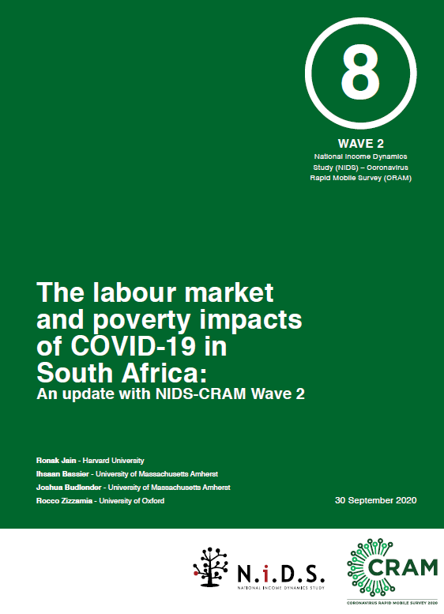
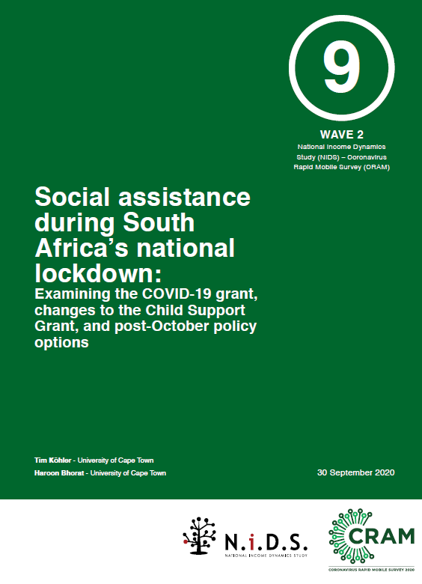
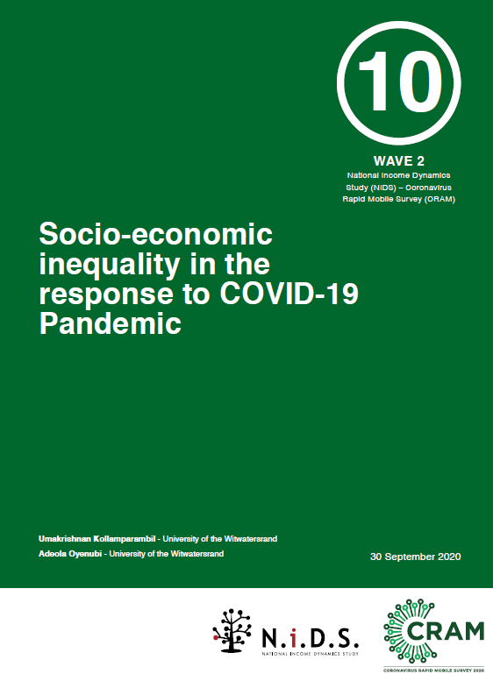
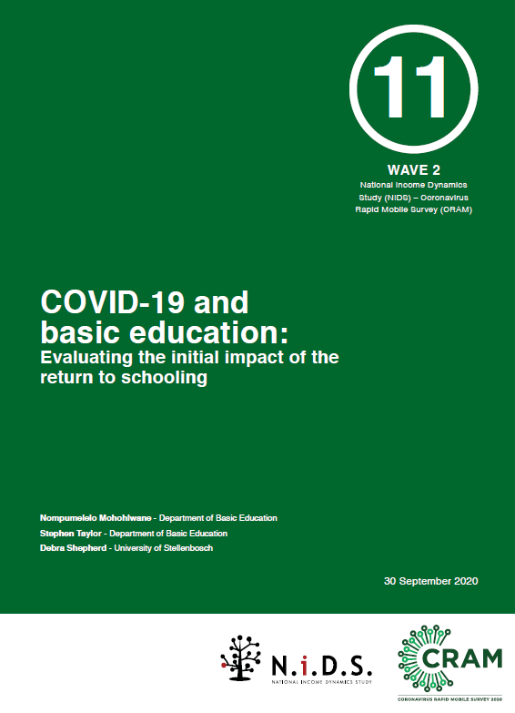
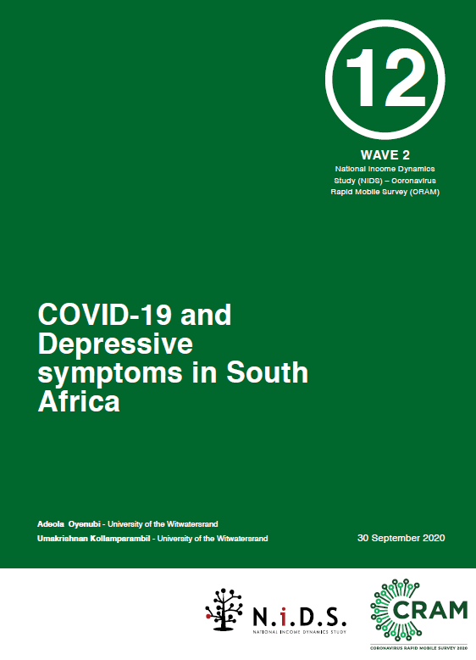
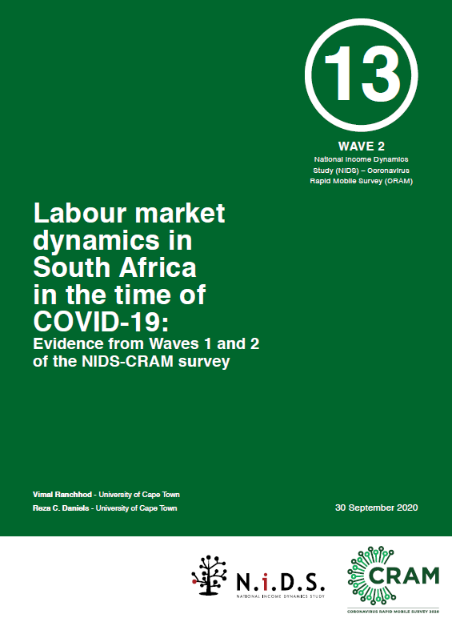
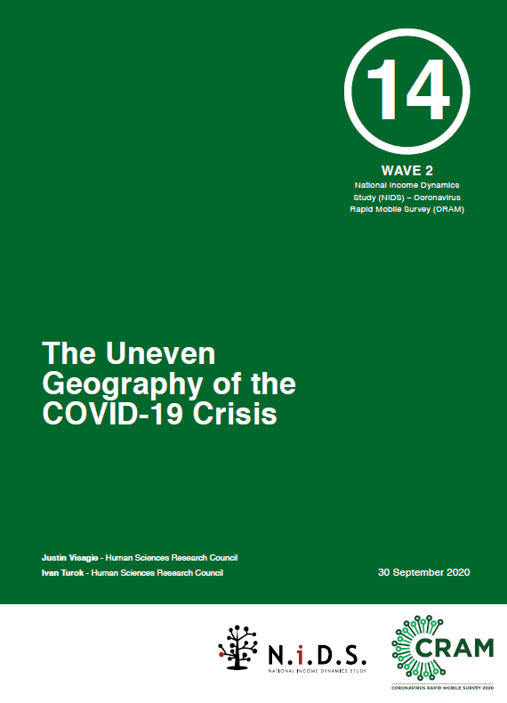
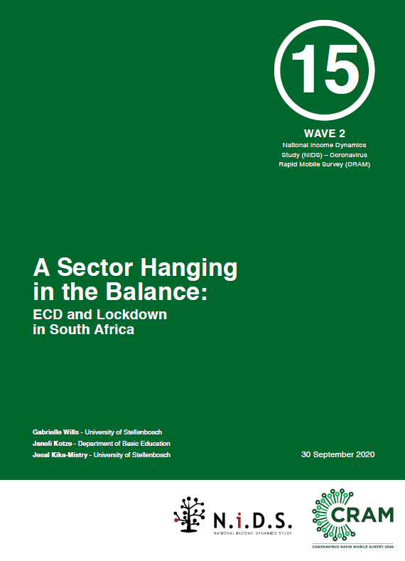
Wave 2: 15 papers
https://cramsurvey.org/reports/

Slide 8




Wave 2: Technical reports

Slide 9
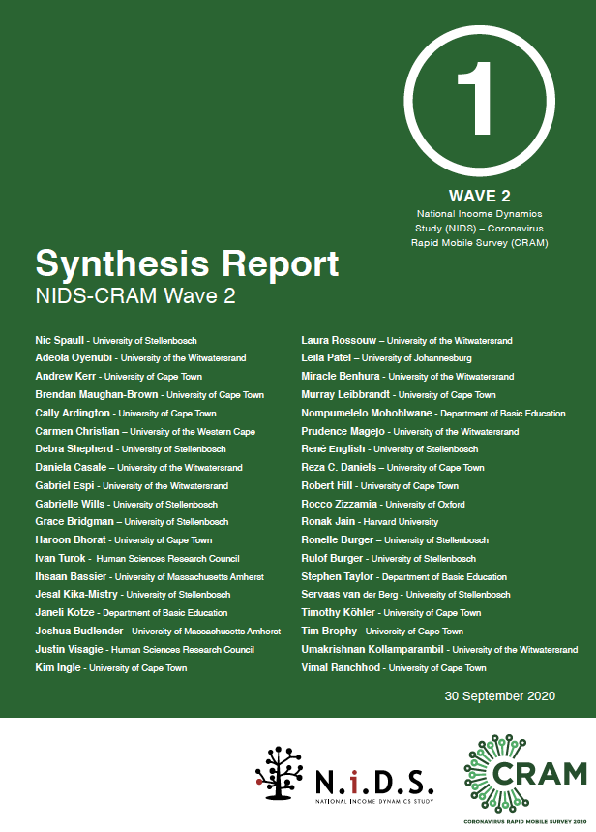
Findings
What are the main findings from Wave 1?

Slide 10
Sobering results, first caveats
  Some limitations to telephonic surveys: There are limitations to surveying respondents telephonically, including length of the survey (20min), comparability to in-person survey results etc.
  NIDS-2017 slightly higher employment than QLFS: The respondents in NIDS-2017 had a higher rate of employment compared to other surveys like the QLFS
      54% in NIDS 2017 (18-64 years).
      47% in QLFS 2017 (18-64 years).
  Results do reflect underlying employment an welfare dynamics in SA: Notwithstanding these caveats, we believe that researchers and policy-makers can feel confident that the results from NIDS-CRAM are broadly representative and are speaking to the real underlying labour market and welfare dynamics in South Africa at this time.
  “Taken as a whole, the general results are supportive of the NIDS-CRAM data being valid and not subject to major non-response bias” (Ardington, 2020).

Slide 11
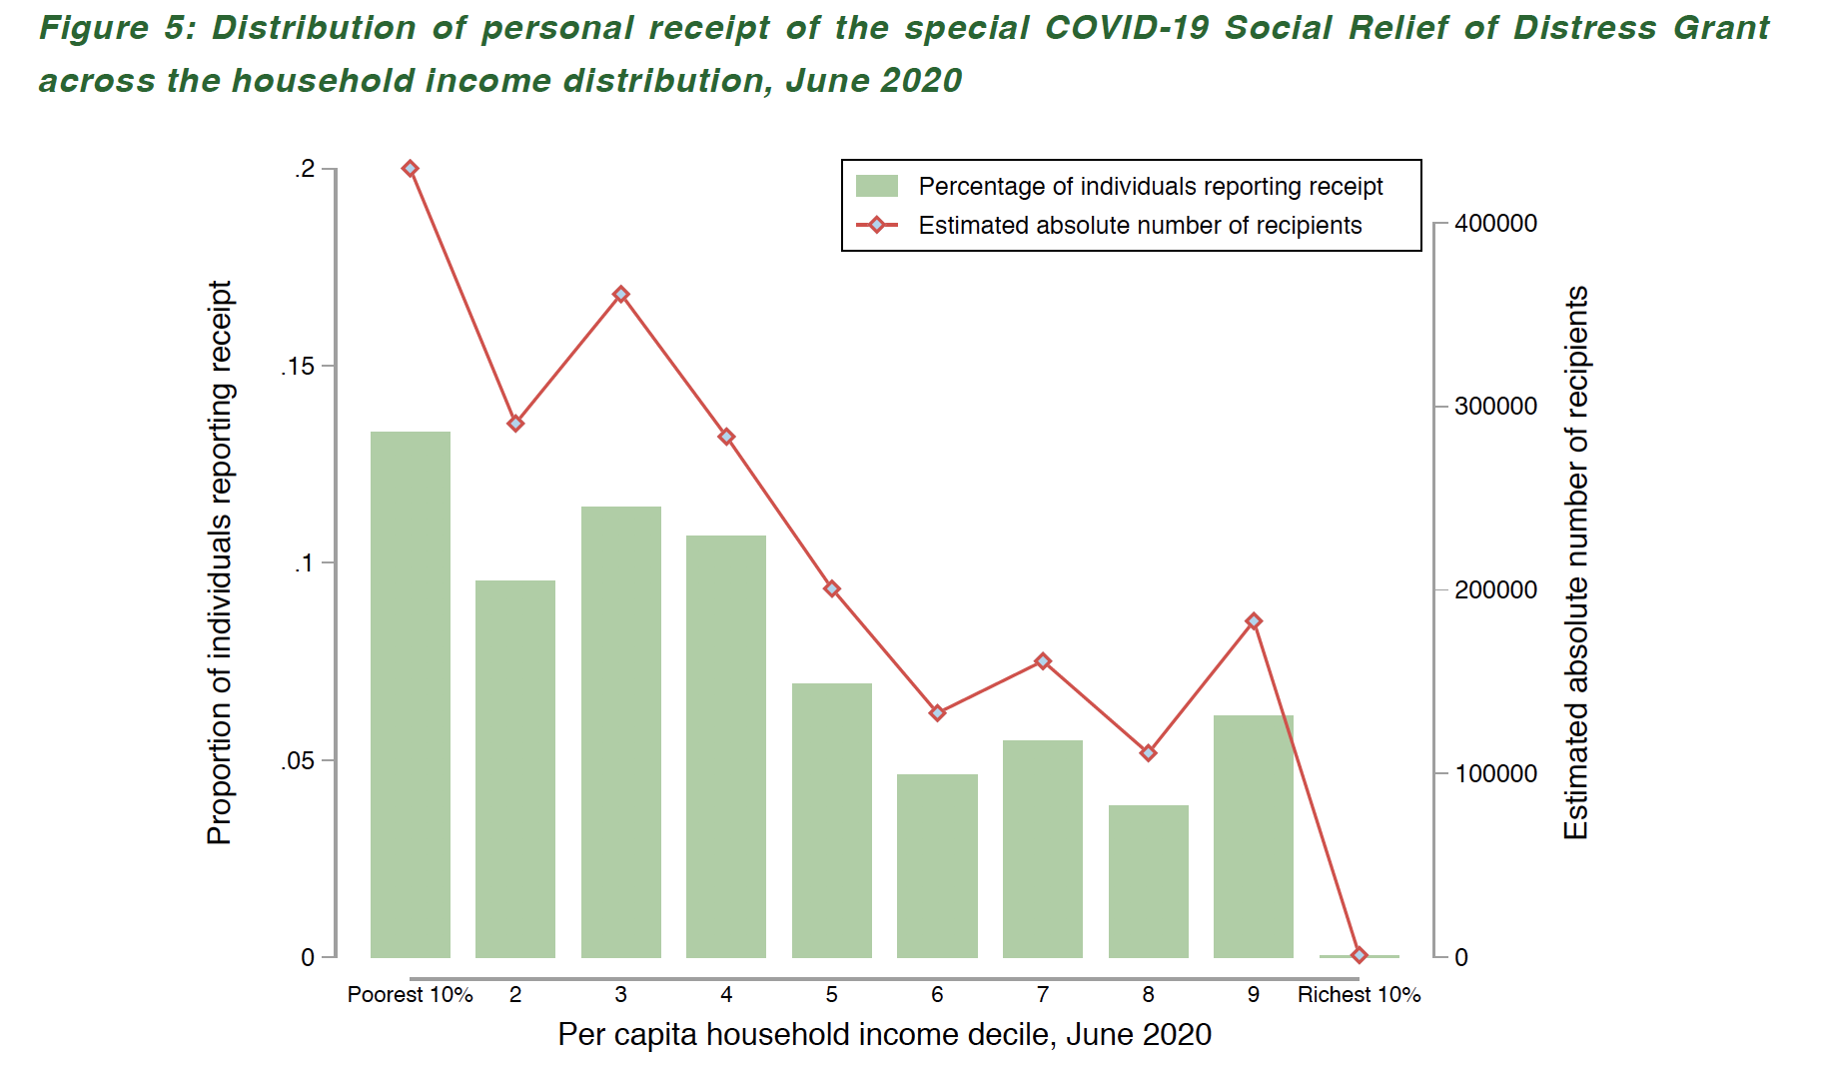
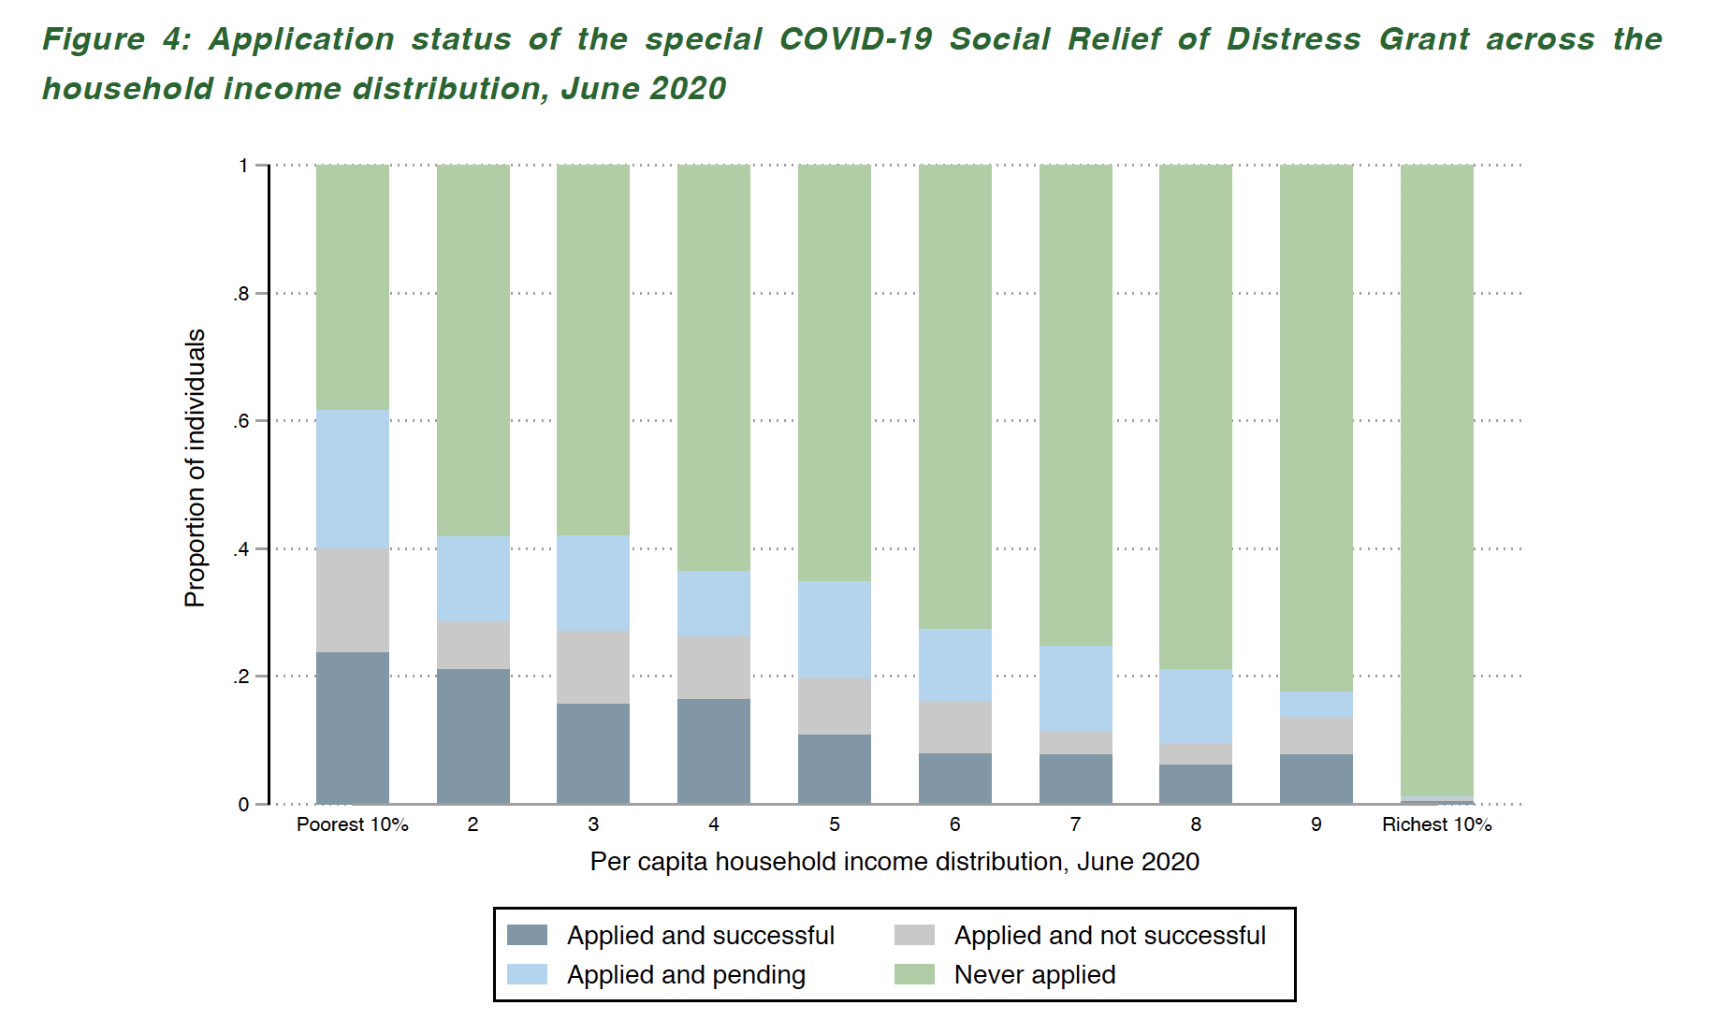
1. Grants
COV-19 SRD Grant
  Brought millions of previously unreached individuals into the system.
  Application for and receipt have been relatively pro-poor.
  ~4,3-million recipients by July/Aug (SASSA reports 4,4mil)
Source for both: Kohler & Bhorat, 2020

Slide 12

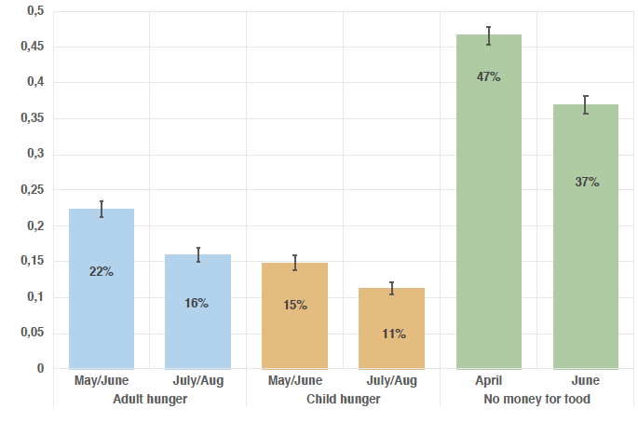
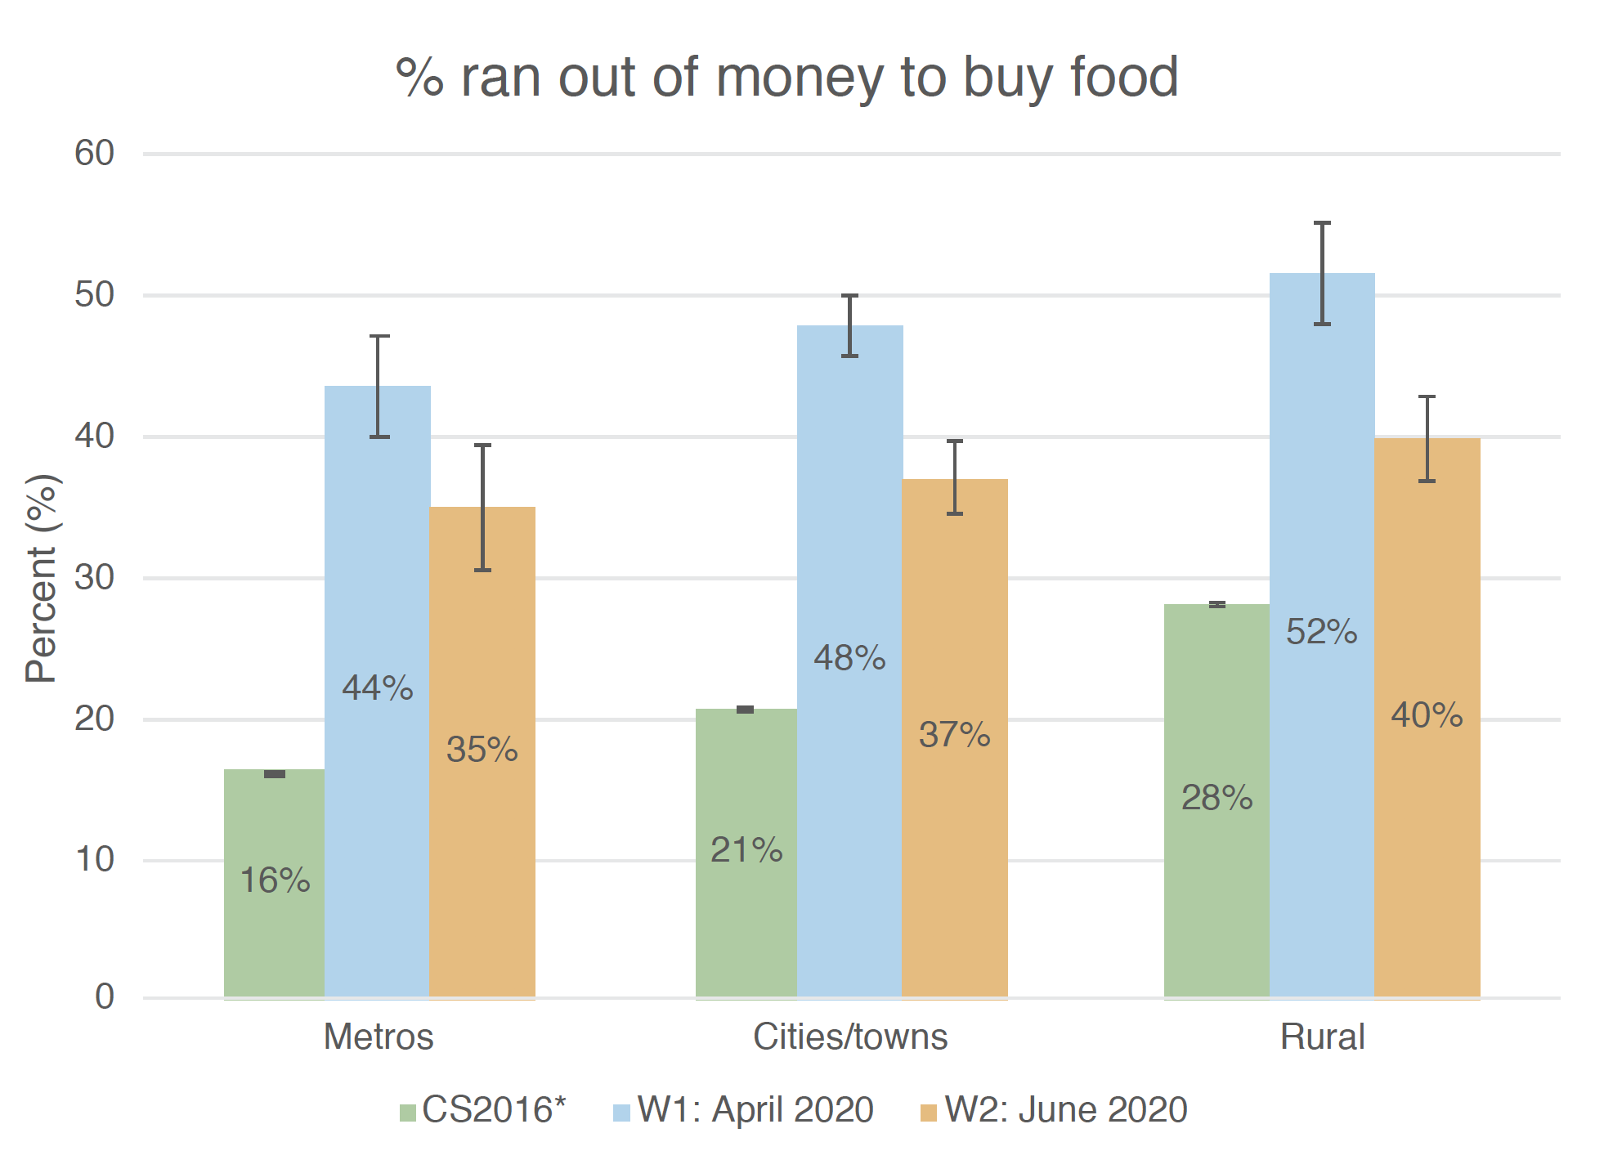
2. Hunger
27% decline in child & HH hunger April→June 2020
  Due to grants, UIF/TERS, previously furloughed workers
  Monthly figures still 2x annual figures from 2016 (Community Survey)
Source: Bridgman et al (2020)
Source: Visagie & Turok (2020)

Slide 13
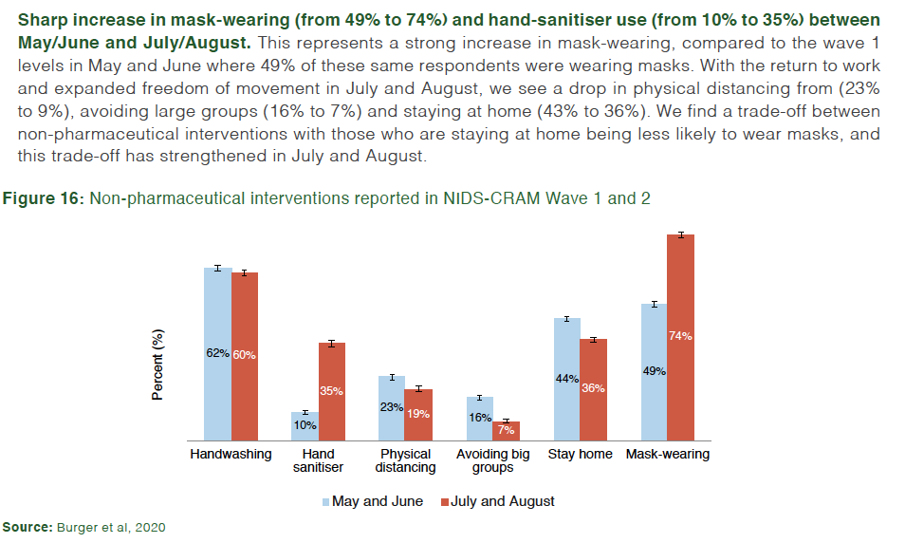
3. Health

Slide 14
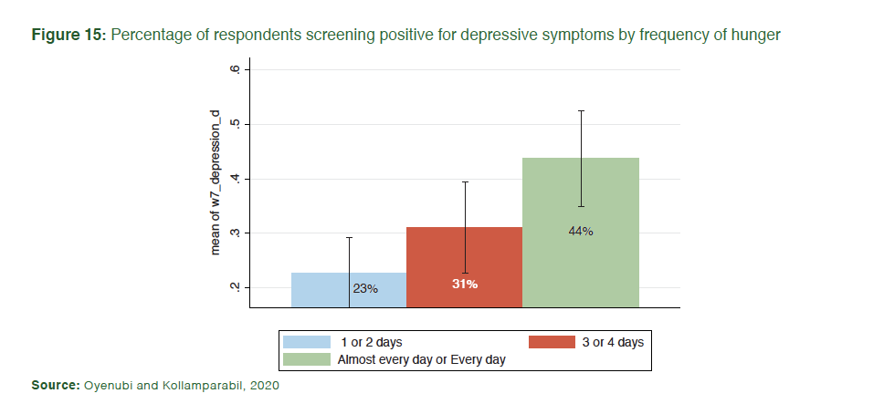

4. Mental health
The prevalence of depressive symptoms seems to have doubled between 2017 and June 2020 (COVID-19 era), from 12% to 24% of individuals. Using their cut-off for depressive symptoms, Oyenubi & Kollamparabil (2020) find that while 12% of South Africans screened positive for depressive symptoms in NIDS 2017, when those same individuals were resurveyed in NIDS-CRAM Wave 2 (June/July 2020) this had increased to 24%. (Note ‘depressive symptoms’ are not the same as ‘depression’ – the latter is a medical diagnosis).
Those reporting extreme hunger (hunger ‘Every day’ or ‘Almost every day’) were twice as likely to screen positive for depressive symptoms. In addition to experiencing any hunger, those respondents reported perpetual hunger (‘Every day’ or ‘Almost every day’) had twice the prevalence of depressive symptoms (44%) compared to those who experienced hunger 1-2 days a week or not at all (about 23%).

Slide 15
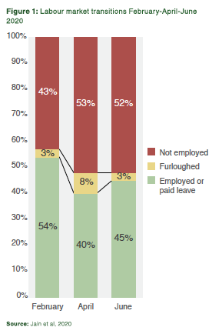
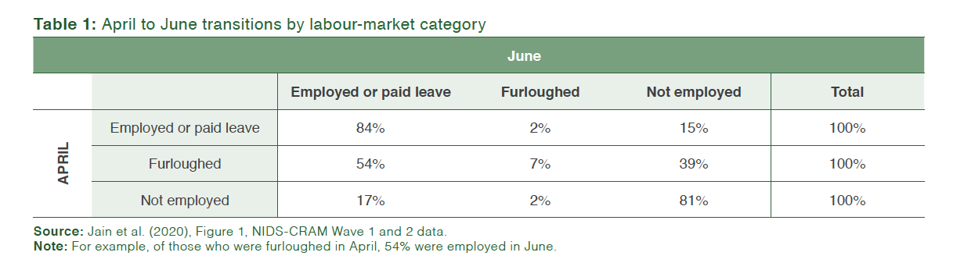
5. Employment
Jobs: 2.8-million jobs lost between February and April have not returned by June
Furlough: The # of furloughed workers has returned to pre-COVID levels with half of furloughed workers being ‘re-employed’ and about 40% becoming unemployed

Slide 16
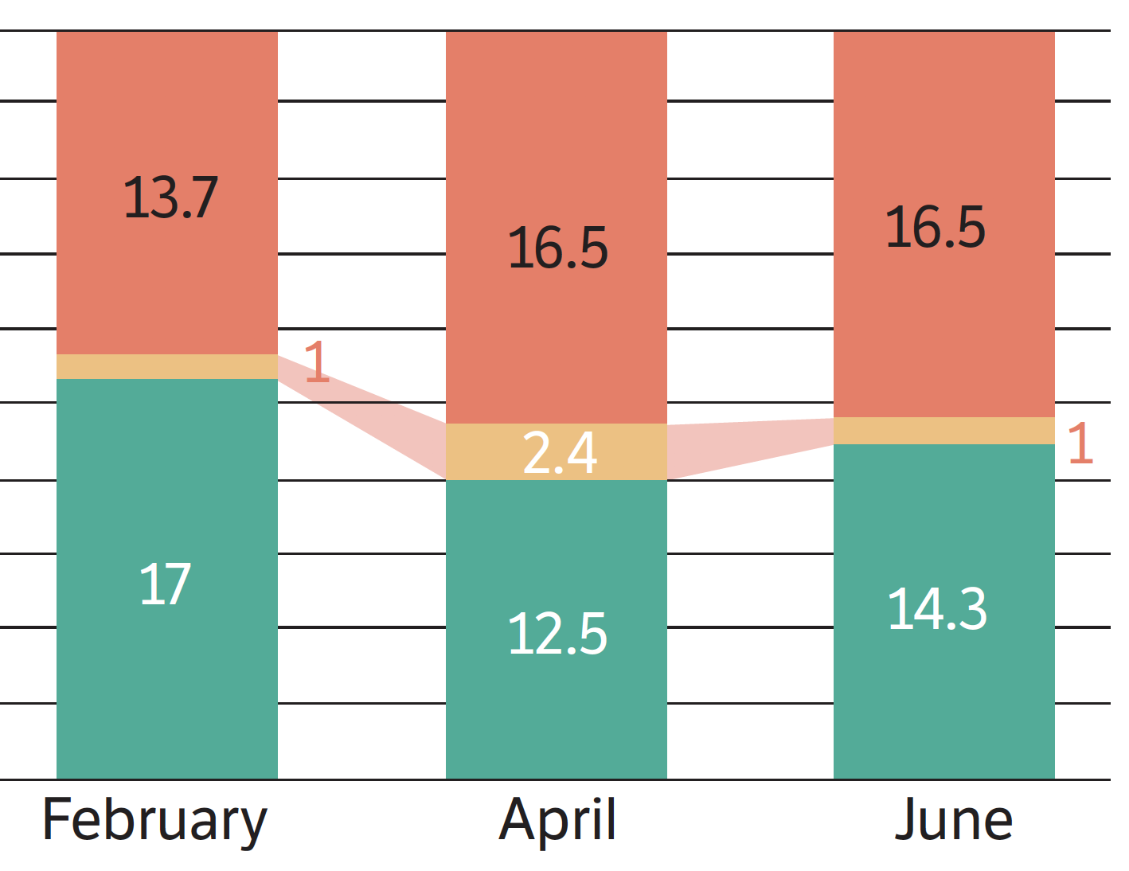

Using NIDS-CRAM weights…
(-2.2-million jobs lost Q1→Q2 2020 StatsSA QLFS)
-2.8-million jobs lost Feb→June 2020
(millions)

Slide 17

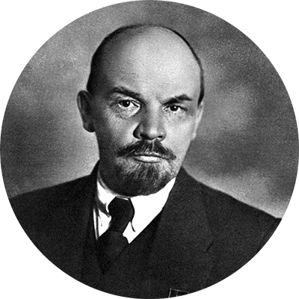
“There are decades where nothing happens and weeks where decades happen.”
- Lenin

Slide 18
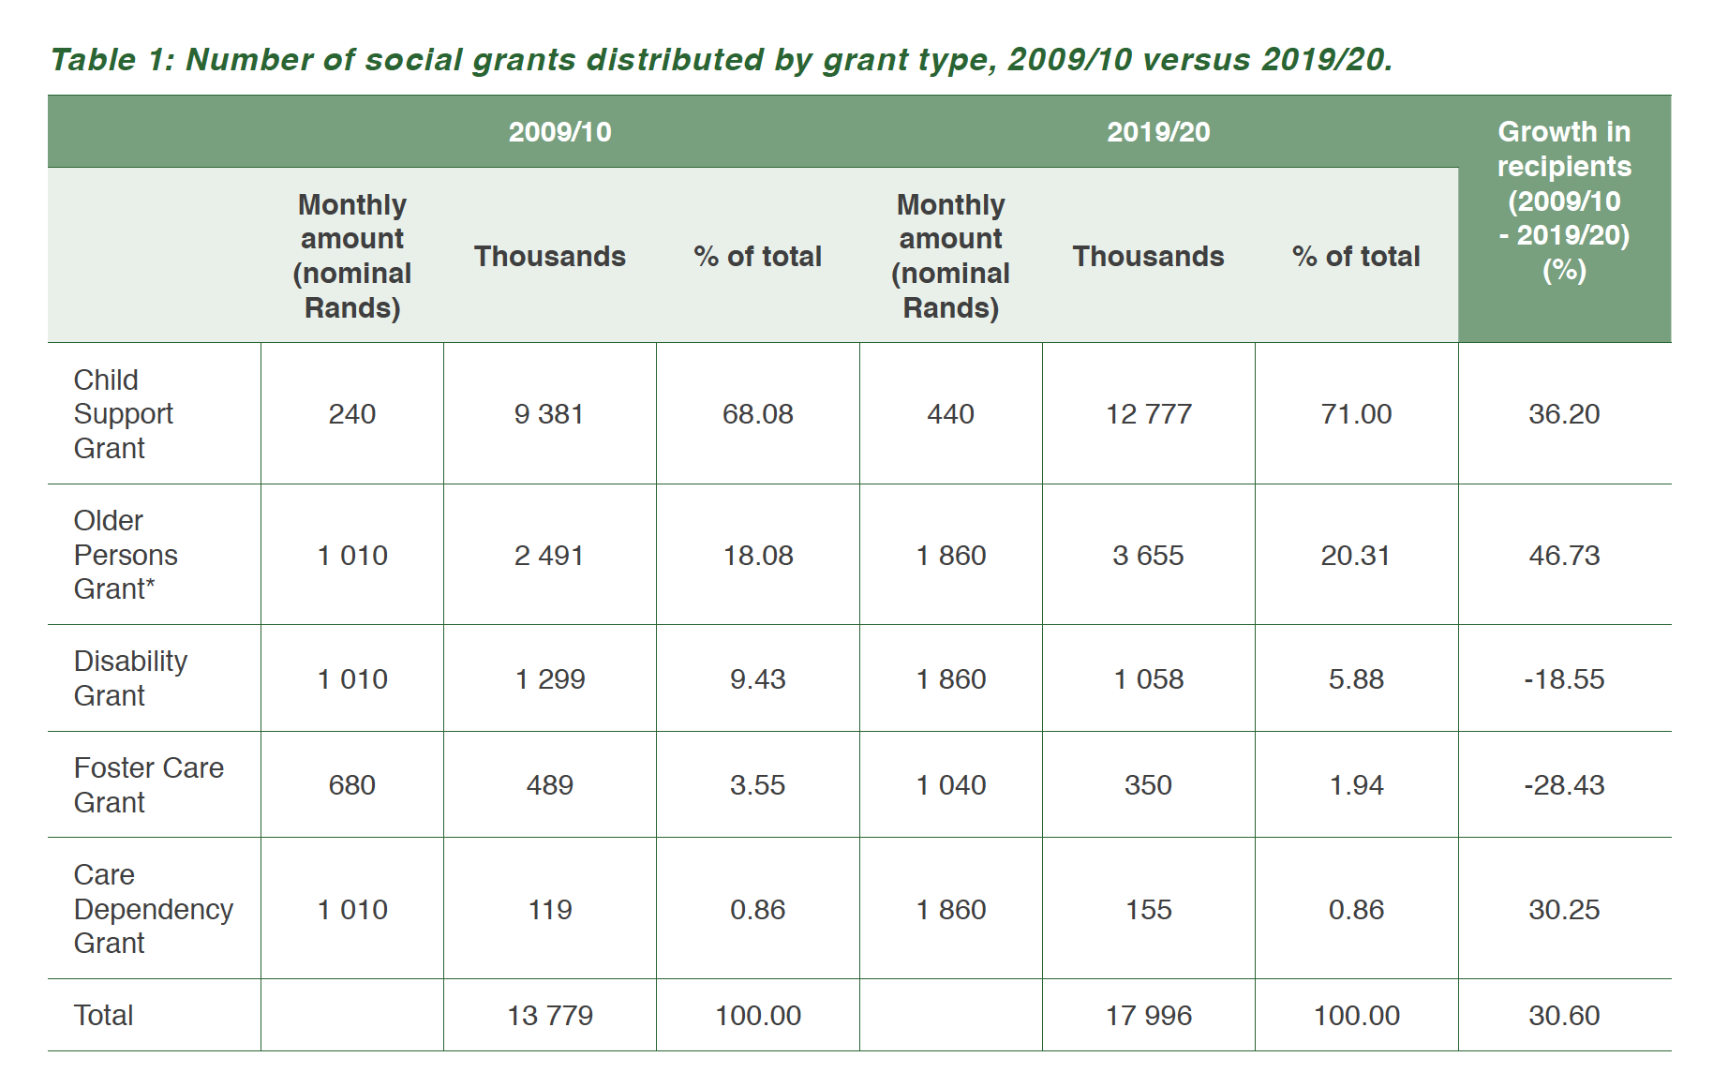
A decade’s worth of grant-growth accomplished in 6-months?
10 years: Between 2009 and 2019 the total number of grants paid out in SA grew from 14mil to 18mil (+4mil) (Kohler & Bhorat 2020)
4 months: By July/August 4,2-mil people had received COV-19 SRD grants. (SASSA reports 4,3mil recipients)
…grants
+4mil
Source: Kohler & Bhorat, 2020

Slide 19
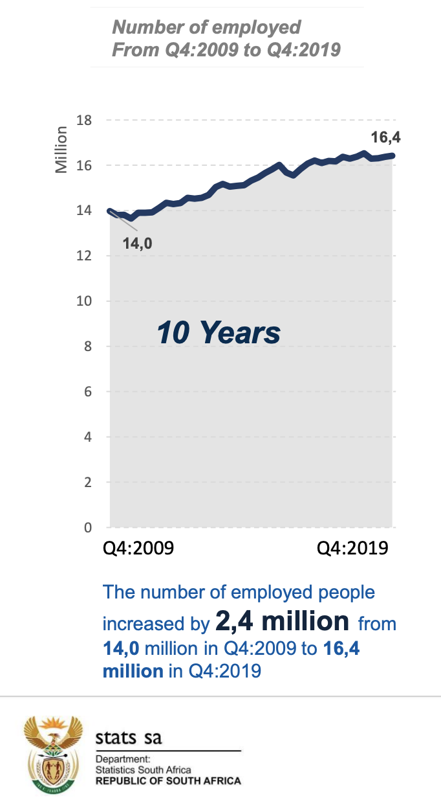
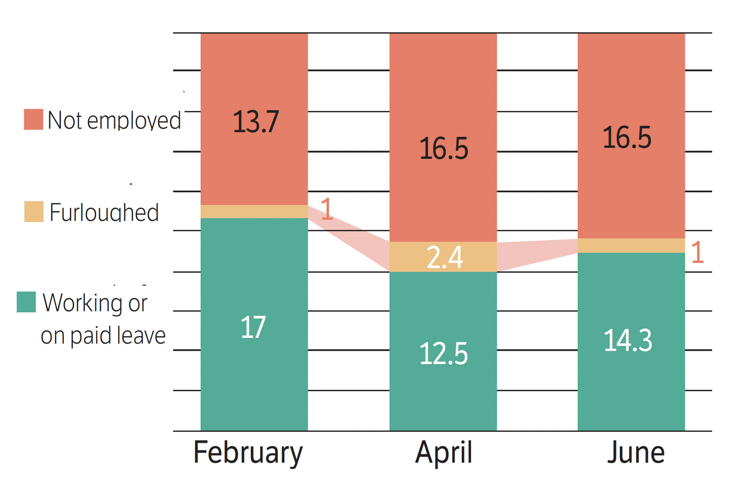
A decade’s worth of job-growth lost in 6-months?
NIDS-CRAM 2020
-2.8-million net jobs lost Feb→June 2020
QLFS 2020:
-2.2-million net jobs lost Q1→Q2
Weighted NIDS-CRAM Wave 1+2 (millions)
…jobs
Notes:
http://www.statssa.gov.za/publications/P0211/Presentation%20QLFS%20Q4_2019.pdf

Slide 20
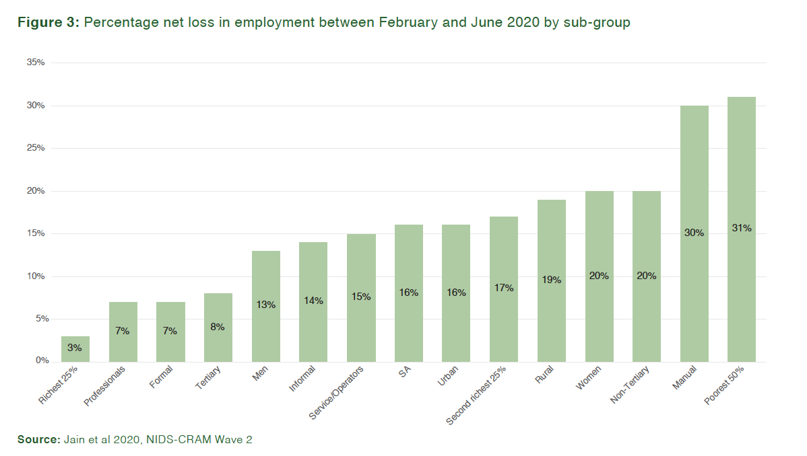
Employment
From February to June 2020 workers who were poor, rural, female, unskilled and less educated have experienced the largest declines in employment. The poorest 50% of workers and manual laborer’s were ten times more likely (31% net loss) to lose their job between February and June compared to the richest 25% of workers (3% net loss). Informal workers were twice as likely to lose their jobs (14%) compared to formal sector workers (7%).

Slide 21
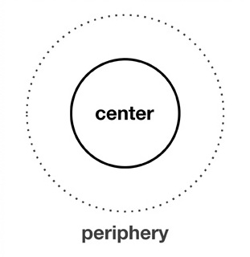

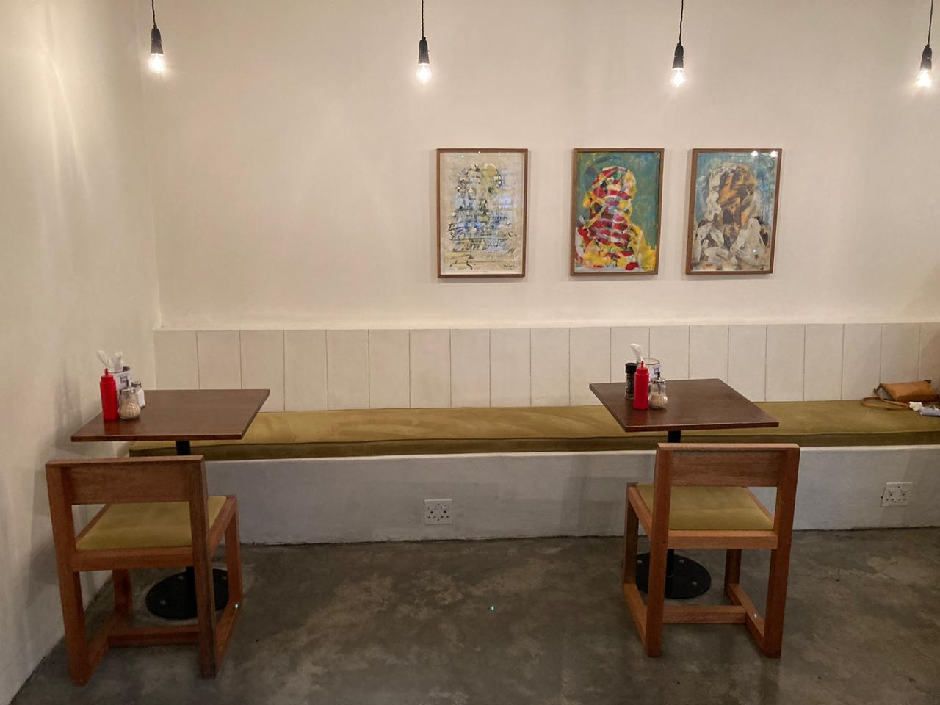
Will these jobs come back?
“Bounce-back” or “Restructuring” of the labour market ?
Shrinking center (jobs) and
a growing periphery (grants)?

Slide 22
Wave 2: 15 papers
https://cramsurvey.org/reports/

Slide 23
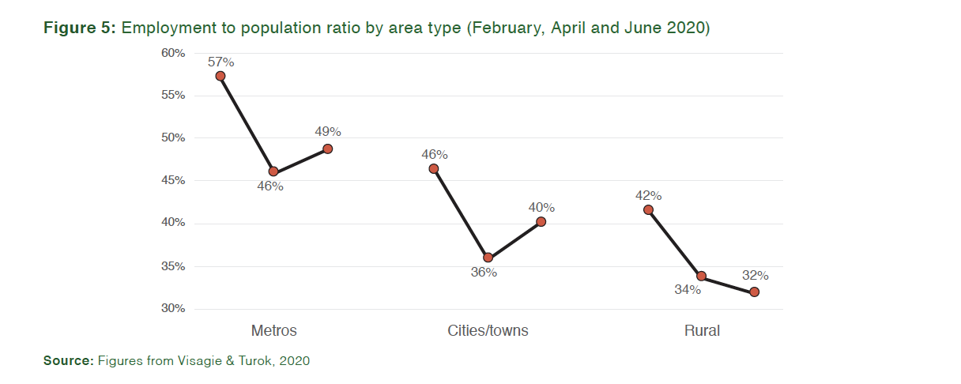
2. Location
Rural areas have been more affected by job losses than urban areas.

Slide 24
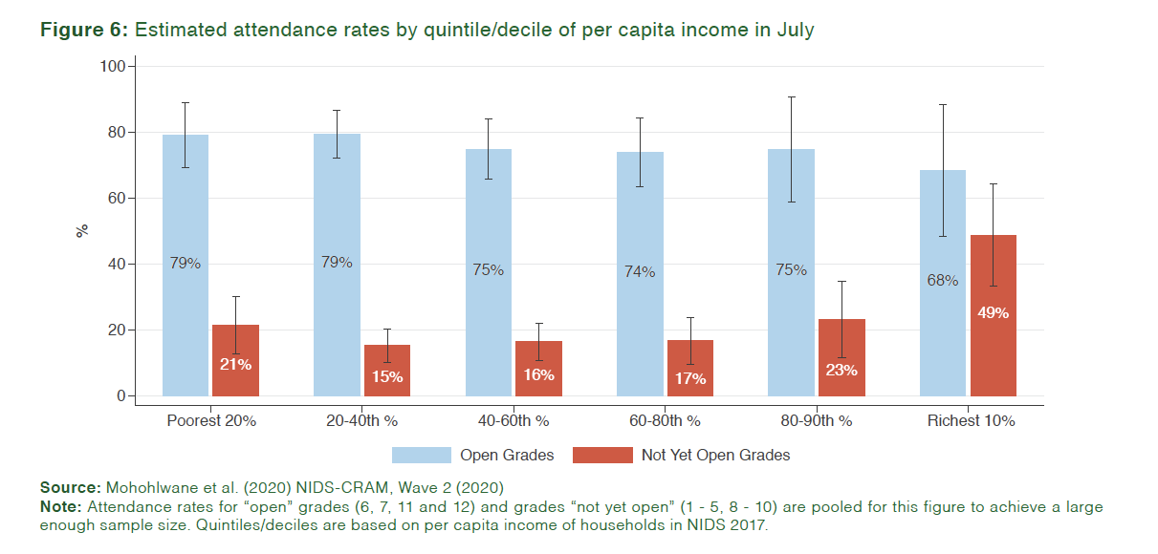
3. Education
Increasing educational inequality during lockdown

Slide 25
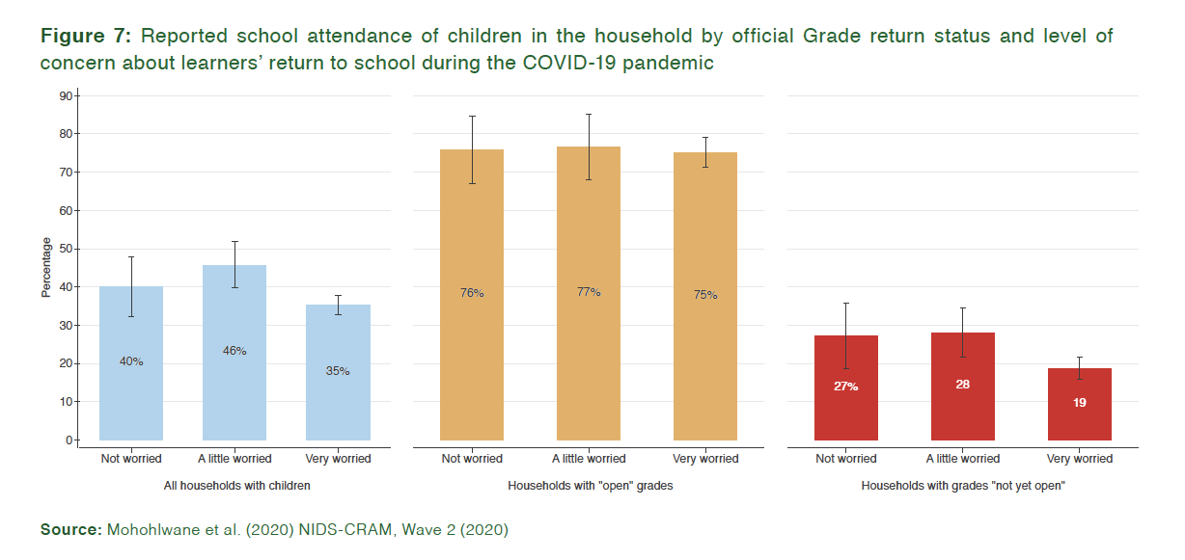
3. Education
Parents sent their children back to school irrespective of their reported rates of worry:

Slide 26
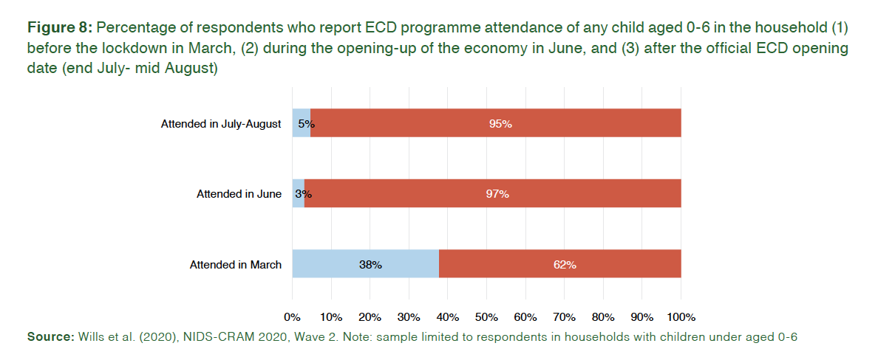
4. ECD
The Early Childhood Development (ECD) sector was operating at just a quarter of its pre-crisis levels a month after programmes could reopen. Only 13% of children aged 0-6 were attending ECD programmes by mid-July to mid-August compared to 47% in 2018.

Slide 27
Some further points…
Pivot from jobs to grants?
  Jobs
    2009-2019 +2,4mil jobs
    Feb→June -2,8mil jobs
  Grants
    2009→2019 +4mil grant recipients (14→18mil)
    April→July +4mil grant recipients (SRD grant)
  Growth
    The IMF, SARB and NT all estimate that the economy will shrink by about 7,3% in 2020. This is the equivalent of having the 2009 recession four times in one year. (The SA economy shrunk by 1.8% in 2009 following the Financial Crisis, according to Treasury).

Slide 28


An overview of the NIDS-CRAM findings:
EMPLOYMENT
15 July 2020
Prof Vimal Ranchhod
University of Cape Town, SALDRU
National income Dynamics Study (NIDS) Coronavirus Rapid Mobile Survey (CRAM)

Slide 29




NIDS-CRAM Employment papers

Slide 30
BACKGROUND
THIS IS WHERE YOU CAN TALK ABOUT WHATEVER YOU WANT, QUESTIONNAIRE, SAMPLING, WHATEVS.

Slide 31
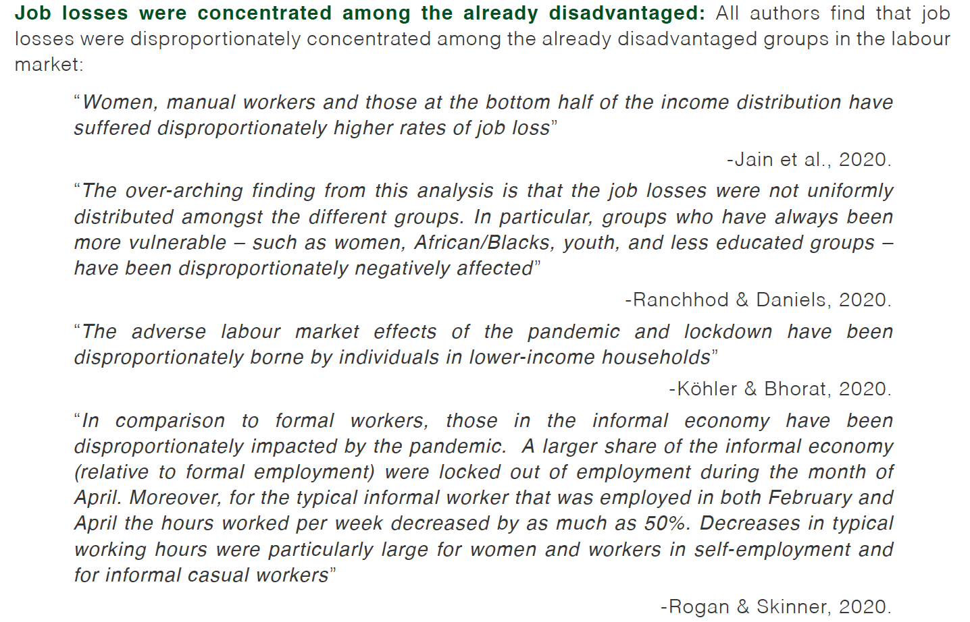
FINDINGS: (1) Exacerbating inequality

Slide 32
FINDINGS: (1) Exacerbating inequality
For example, Jain et al (2020) find that while only 5% of professionals lost their jobs, 24% of manual labourers lost their jobs

Slide 33
FINDINGS: (1) Exacerbating inequality
Vimal if you want to use the graph that I made for my FM Op Ed that draws from your and Reza’s paper here it is. I have even done the animations for you ☺

Slide 34
Findings: (3)

Slide 35
Findings: (4)

Slide 36
Policy suggestions:
YOU DON’T HAVE TO HAVE THIS SLIDE BUT IF YOU WANT TO MAKE POLICY SUGGESTIONS AND/OR SUMMARISE THE POLICY SUGGESTIONS FROM YOUR PAPER OR YOUR SECTIONS’ PAPERS DO THAT HERE

Slide 37


An overview of the NIDS-CRAM findings:
HUNGER & WELFARE
15 July 2020
Prof Servaas van der Berg
University of Stellenbosch, RESEP
National income Dynamics Study (NIDS) Coronavirus Rapid Mobile Survey (CRAM)

Slide 38


NIDS-CRAM Hunger & Welfare papers

Slide 39
bb
Figure 1: Reported hunger in the last seven days (asked separately for ‘anyone in the household’ and for ‘children (<18 years) (NIDS-CRAM Wave 1, weighted)

Slide 40

An overview of the NIDS-CRAM findings:
GENDER & MOBILITY
15 July 2020
Prof Daniela Casale
University of the Witwatersrand
National income Dynamics Study (NIDS) Coronavirus Rapid Mobile Survey (CRAM)

Slide 41
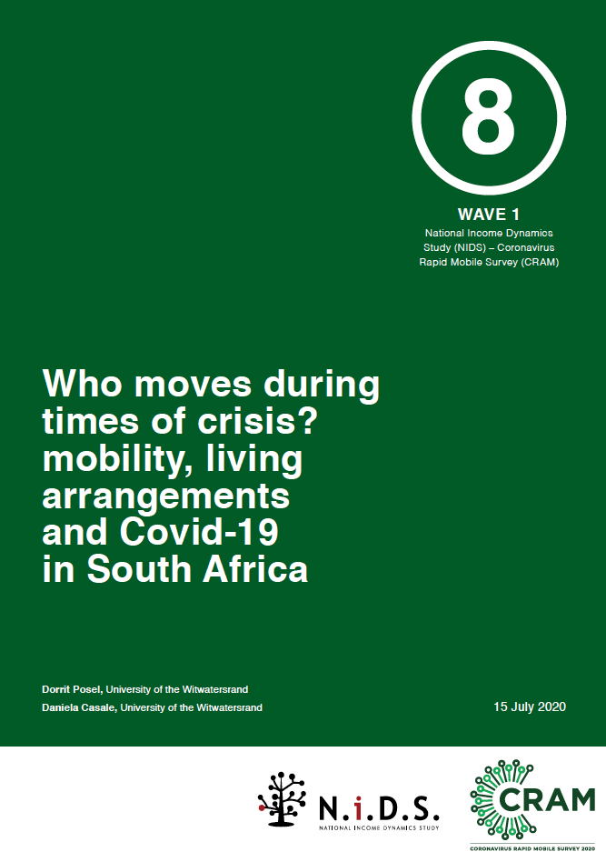
NIDS-CRAM Gender & Mobility papers

Slide 42
An overview of the NIDS-CRAM findings:
HEALTH
15 July 2020
Prof Ronelle Burger
University of the Stellenbosch
National income Dynamics Study (NIDS) Coronavirus Rapid Mobile Survey (CRAM)

Slide 43

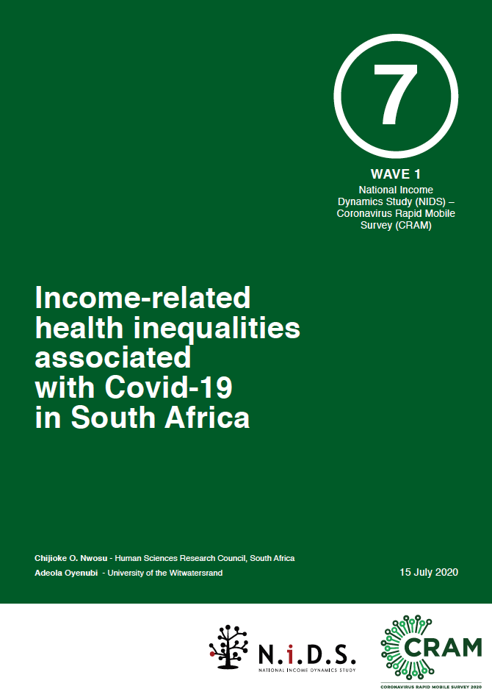
NIDS-CRAM Health papers

Slide 44
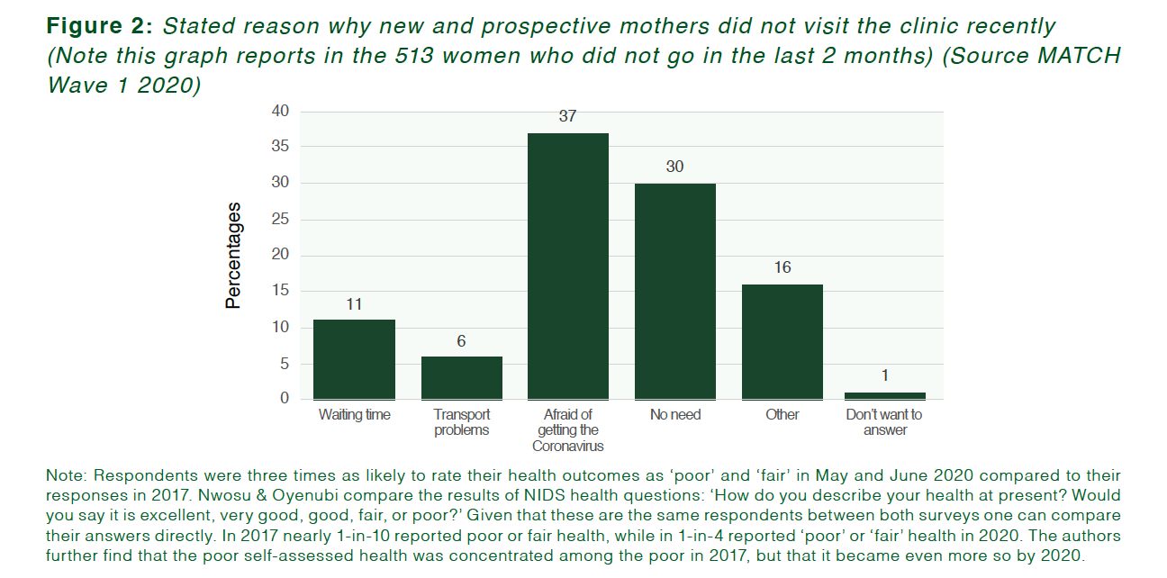
bb

Slide 45
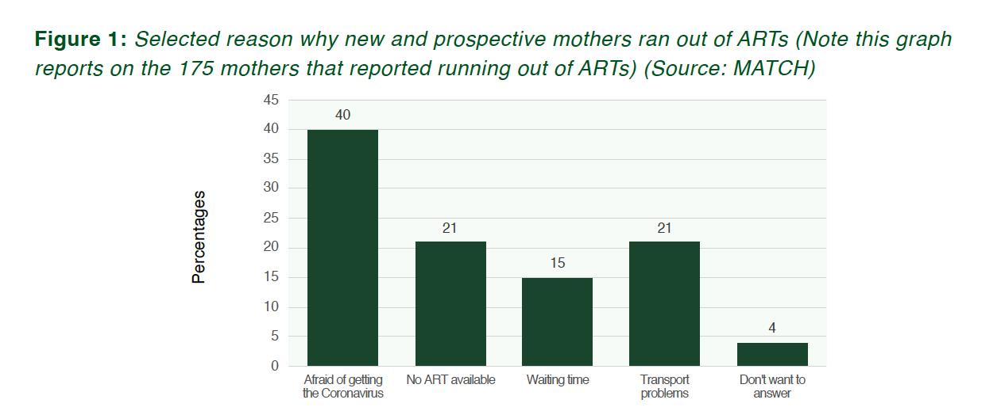
bb

