Slide 1


NIDS-CRAM Wave 4 Launch
12 May 2021 (10am)
  Nic Spaull (SU) Overview
  Tim Köhler (UCT) Vaccines
  Charles Wiysonge (SAMRC) - Respondent
  David Harrison (DGMT) - Respondent
  Nompumelelo Mohohlwane (DBE) - Schooling
  Servaas van der Berg (SU) - Hunger
  Reza Daniels (UCT) - Employment
  Open Q&A - Authors + Audience
(10-minutes per speaker)

Slide 2
NIDS-CRAM Wave Launch
12 May 2021
Nic Spaull
Stellenbosch University
National income Dynamics Study (NIDS) Coronavirus Rapid Mobile Survey (CRAM)

Slide 3



NIDS-CRAM is a public good
Data: All data (Waves 1-4) are freely available for download at DataFirst (https://www.datafirst.uct.ac.za/)
Research: All 52 Working Papers from Waves 1-4 are freely available for download at the NIDS-CRAM website (www.cramsurvey.org)
  Do Files: All STATA do-files from all Working Papers are also available on the NIDS-CRAM website next to each paper. Important for replicability, and ease of others analysing NIDS-CRAM data correctly
Translated questionnaires: Questionnaires for all waves (and translations into 11 official SA languages) are available in Excel on the NIDS-CRAM website.

Slide 4


Slide 5
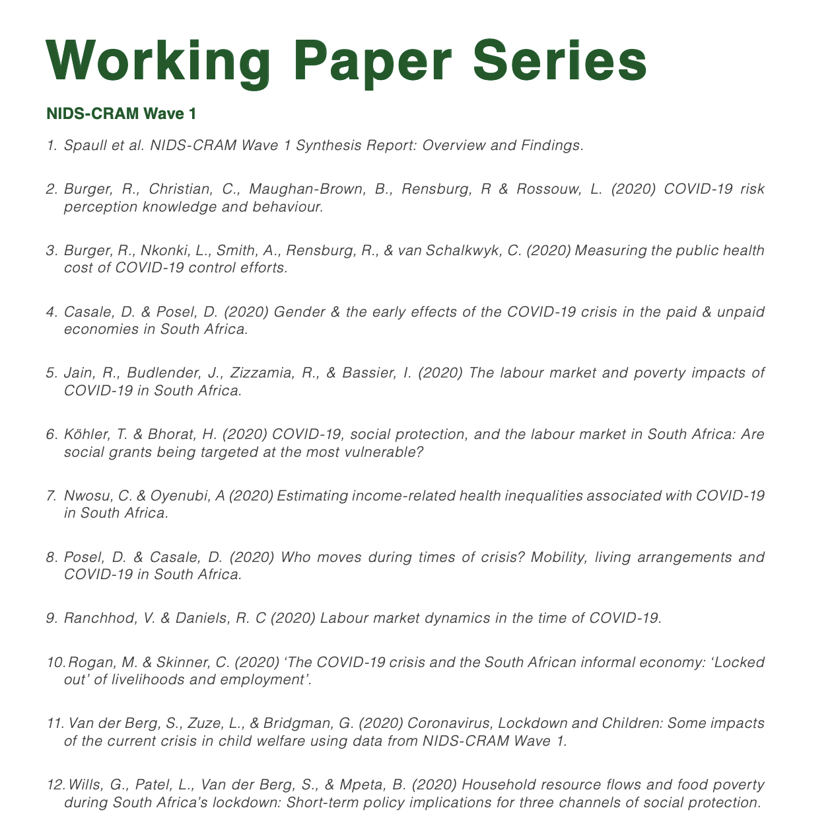
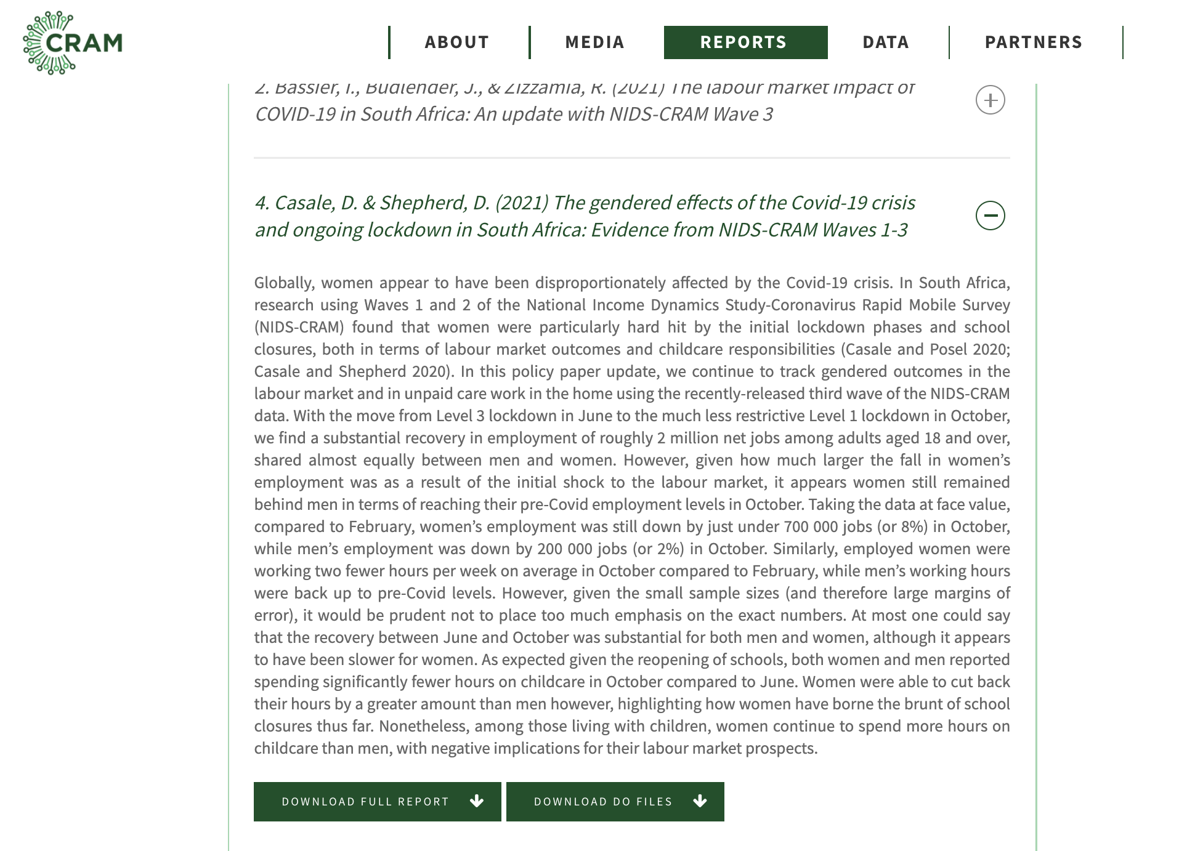


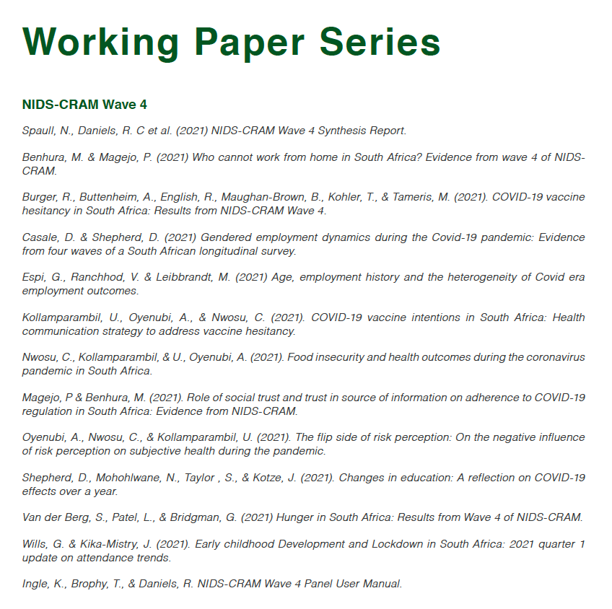
52 Working Papers

Slide 6

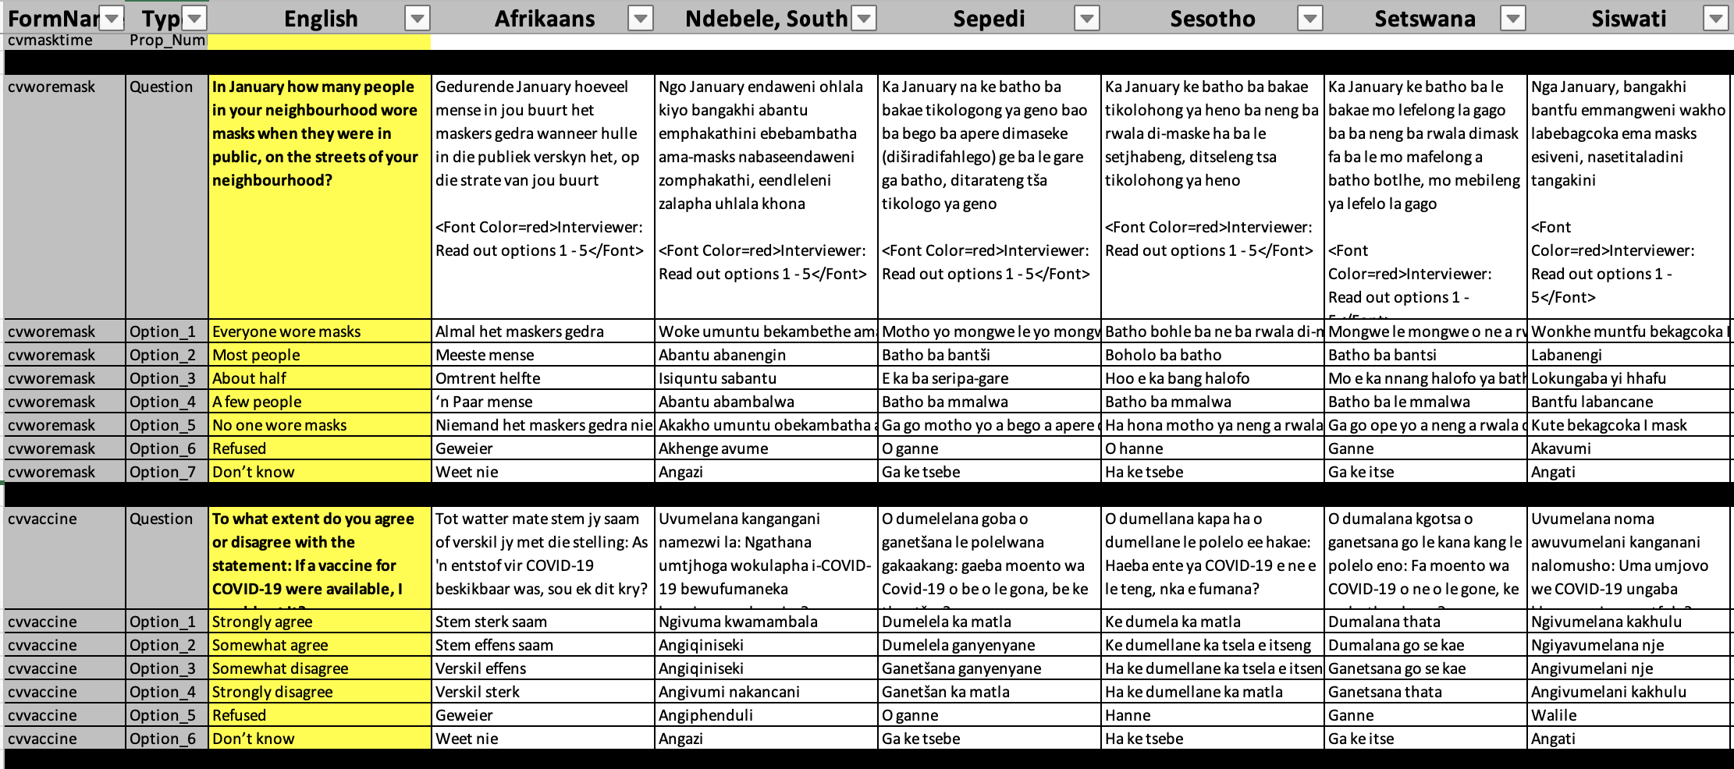
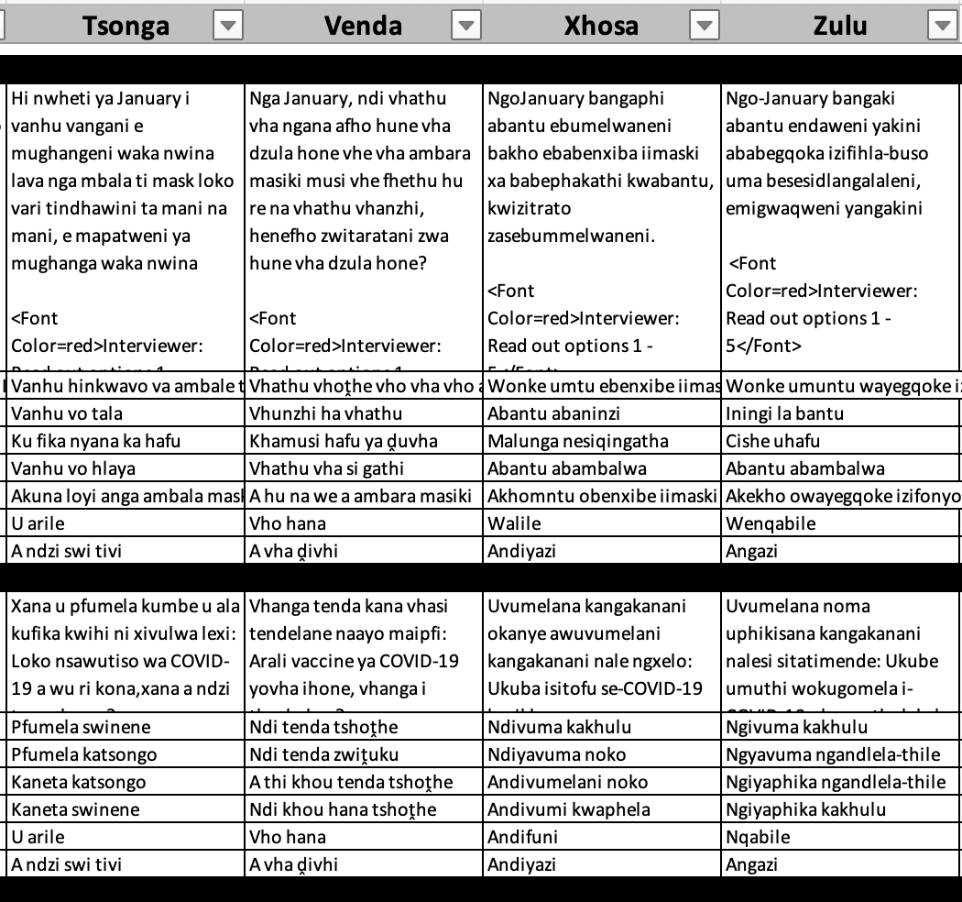
Questionnaires + translations
- All four waves x 11 official SA languages

Slide 7

SALDRU team
World-class panel-data team: Expertise, professionalism and diligence!

Slide 8




Funders and the SteerCo

Slide 9


Slide 10
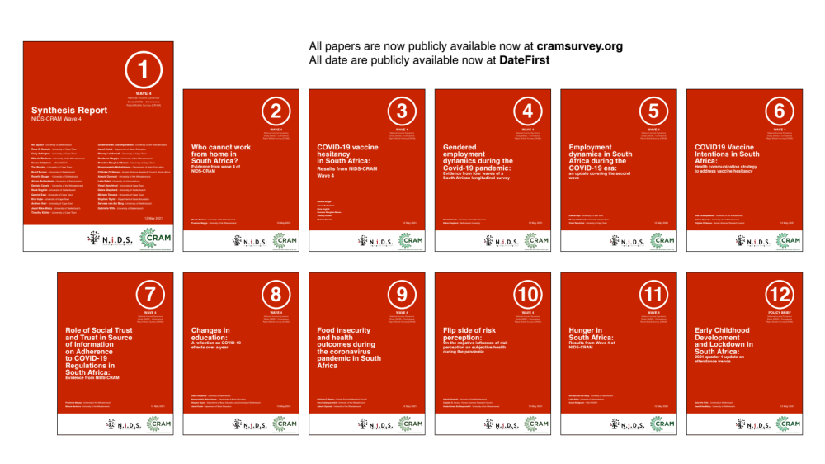
12 NIDS-CRAM Wave 4 Working Papers. Available at cramsurvey.org

Slide 11
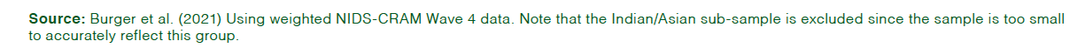
1. Vaccines
71% of South African adults say they would get vaccinated if a COVID-19 vaccine was available.
29%

Slide 12
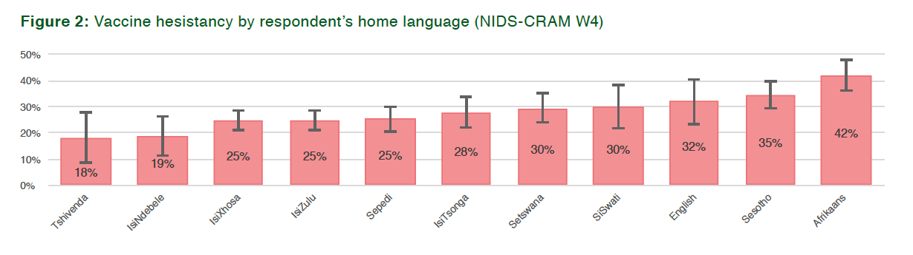
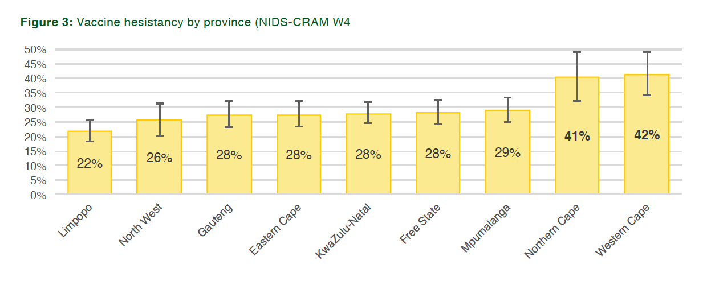
2. Vaccines
Although NIDS-CRAM is not provincially representative, in light of the language results and the predominance of Afrikaans in the Western Cape and Northern Cape, it is also clear that respondents from these provinces had higher vaccine hesitancy on average.

Slide 13
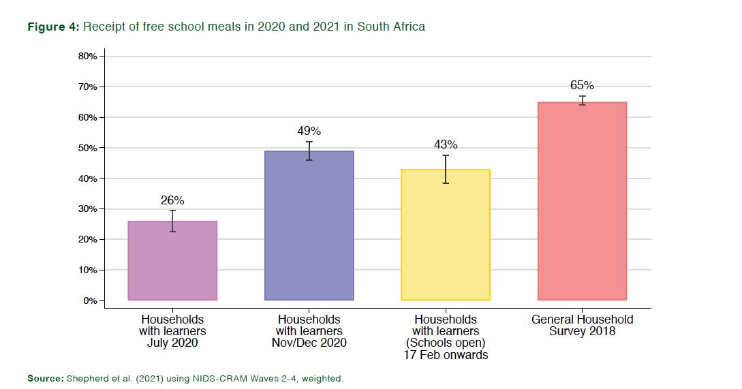
3. School meals
Less than half of respondents (43%) reported their child received a school meal in the last 7 days in Feb March 2021 (while schools were open). (NB 58% of parents support going back to school every day (W3)

Slide 14
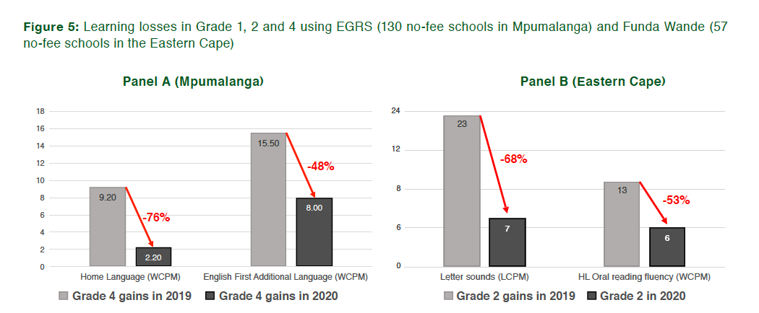
4. Learning losses
Children in no-fee schools have learnt 50-75% less
in 2020 compared to what they normally learn.
Source: Shepherd et al (2021) for Mpumalanga and Ardington (2021) for Eastern Cape

Slide 15
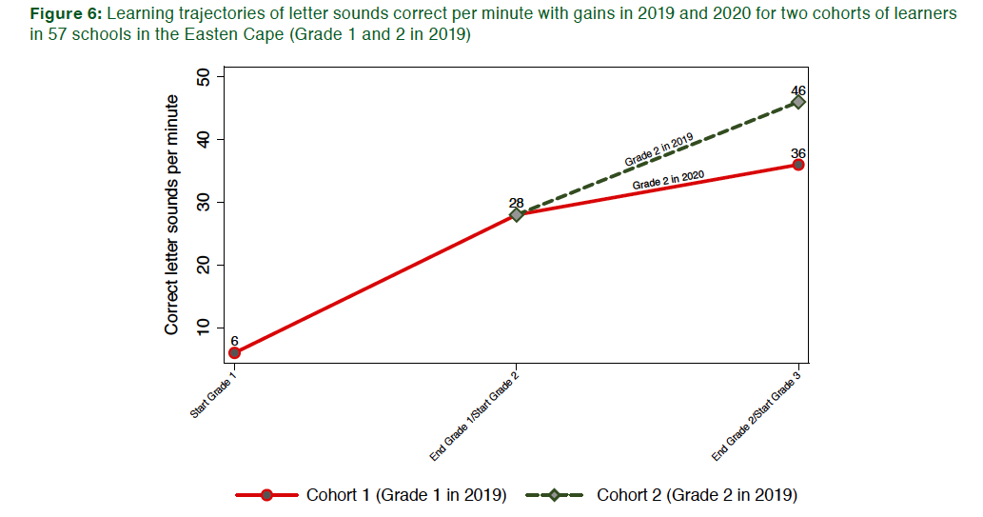
5. Learning trajectories
Flattening learning trajectories.
Grade 1 in 2019
Source: Ardington (2021) analyzing 57 no-fee schools in the Eastern Cape

Slide 16
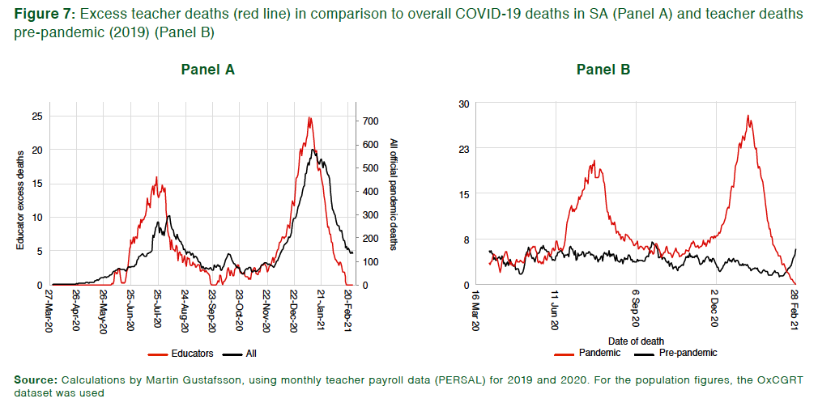
6. Teacher mortality
Analysing teacher payroll data (Persal) shows an increase in excess deaths among teachers but unrelated to school opening/closing.
Instead follows SA mortality trends almost perfectly.

Slide 17
7. Teacher mortality
Teachers at secondary schools are not at higher risk of COVID-19 transmission compared to those at primary schools. Schools (neither primary nor secondary) are not the primary sites of infection.

Slide 18
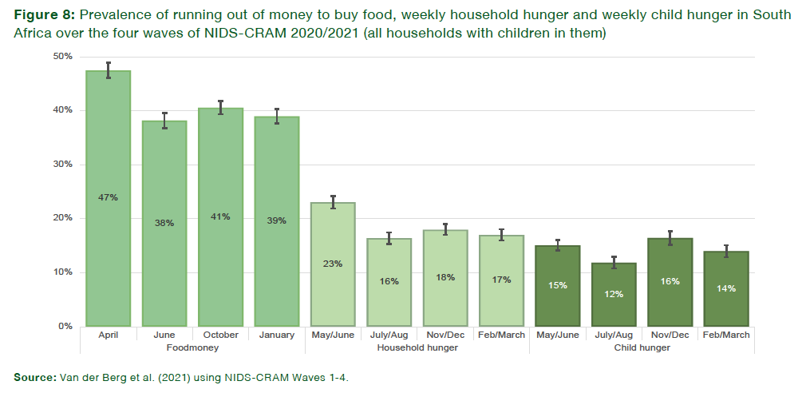
8. Hunger
Weekly child hunger has declined from 16% in Nov/Dec 2020 to 14% in Feb/March 2021, although it is still nearly double pre-pandemic levels (8%)

Slide 19
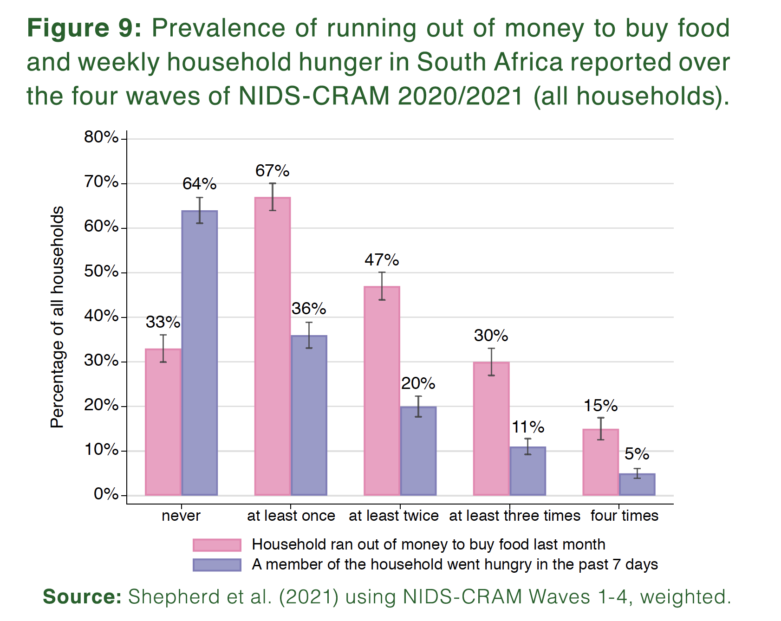
9. Hunger
NIDS-CRAM has been administered four times in the last year. Two thirds of respondents (67%) said that in at least one of these waves their household had run out of money to buy food in the last month.

Slide 20
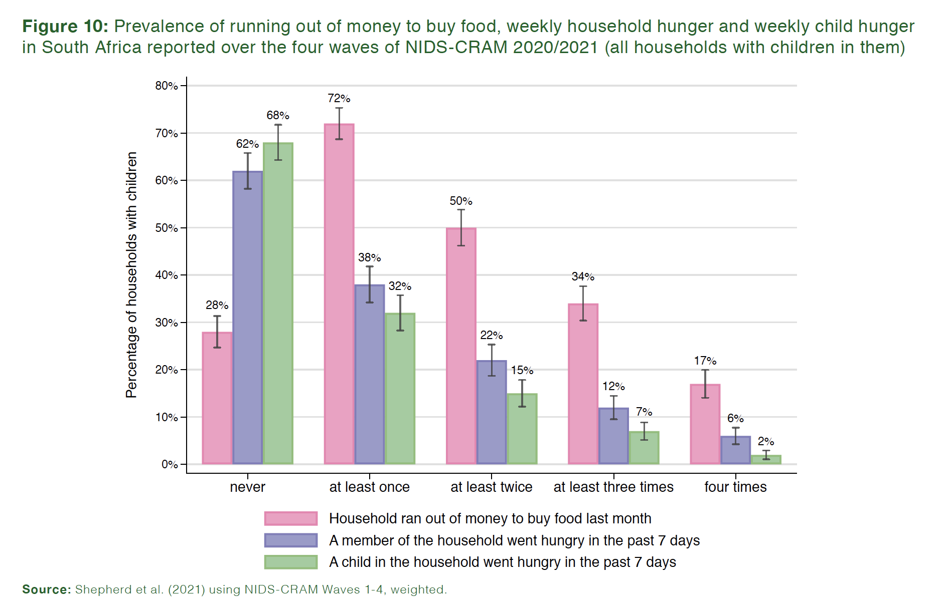
10. Hunger
NIDS-CRAM has been administered four times in the last year. One third of respondents (32%) in households with children in them said that in at least one of these waves, a child had gone hungry in the past week in their household

Slide 21
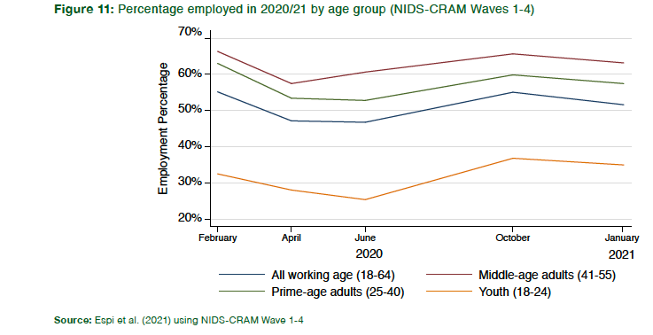
11. Employment
Between Oct’20 and Jan’21 the % of employed adults in the NIDS-CRAM cross-sectional sample declined from 55% to 53% following the second wave of infections and associated lockdowns

Slide 22


12. Employment
Significant churning in the labour-market
Between October 2020 and January 2021one fifth of those who were employed lost their jobs and one fifth of those who weren’t employed found work.
Women remain hardest hit
Of those men who were employed in February 2020, 78% were still employed in January 2021. For women the figure is only 70%. Women were more likely to be in sectors that were hardest hit by the crisis.
Notes:
Of those men who were employed in February 2020, 78% were still employed in January 2021. For women the figure is only 70%. Women were more likely to be in sectors that were hardest hit by the crisis.

Slide 23
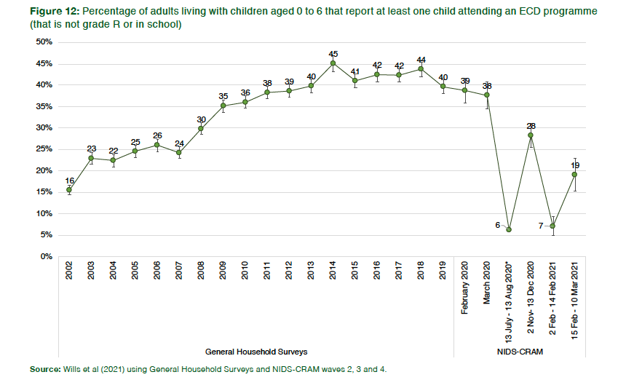
13. ECD
ECD attendance follows school opening dates and in Feb/March 2021 it remains well below pre-pandemic levels
Temporary ECD programme closure remains the primary reason (26%) for non-attendance at ECD programmes
Notes:
Of those men who were employed in February 2020, 78% were still employed in January 2021. For women the figure is only 70%. Women were more likely to be in sectors that were hardest hit by the crisis.

Slide 24

Brief comment on required rates of vaccination in South Africa

Slide 25
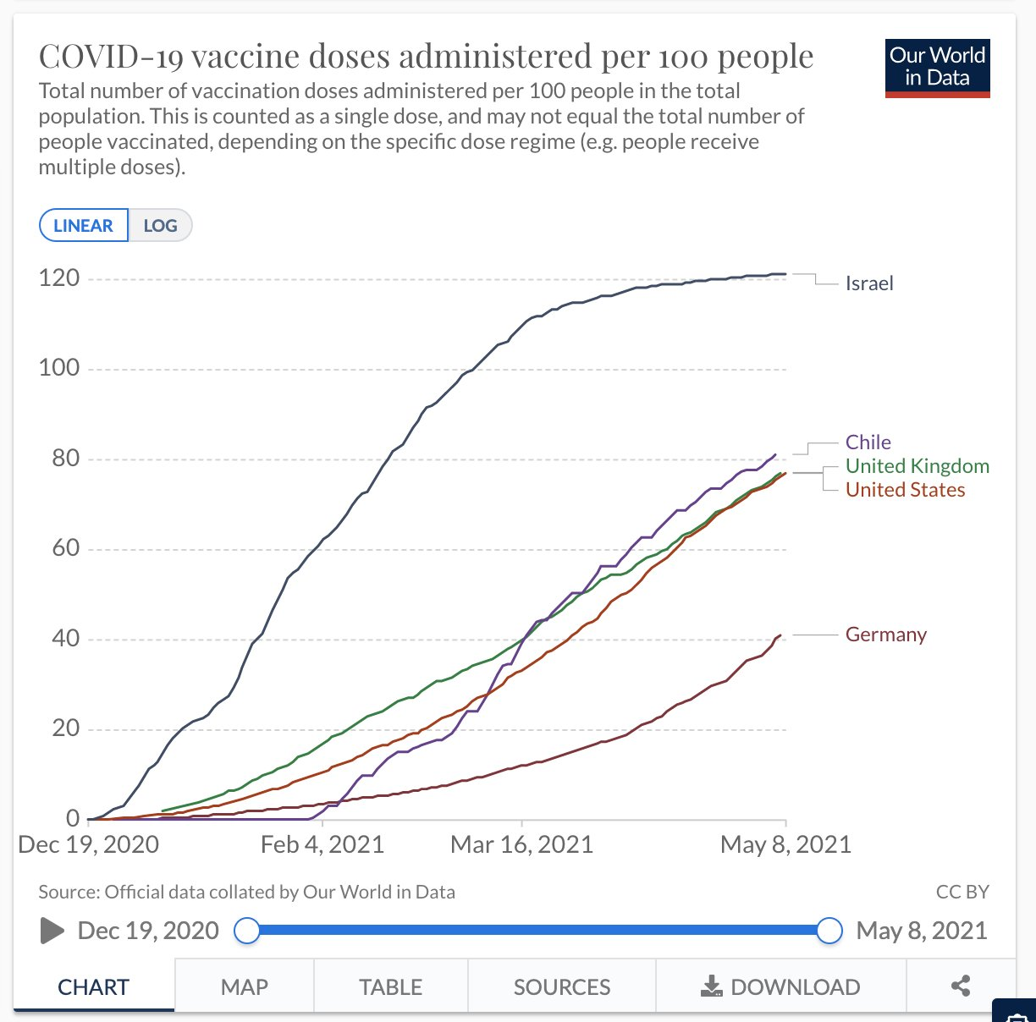


Realistic vaccination rates per day in South Africa
Although it is true that the UK/US/Germany managed to reach very high rates of vaccinations (500,000 – 1-mil / day) it took months to get to this level. SA will not be able to ‘parachute in’ at this very high level. Teething problems around roll-out will slow initial roll-out (as in all countries). Better to look at total vaccinations over the total time period since the vaccination program began (e.g. in Chile 117,000/day every day for 132 days; Israel 77,000/day/every day for 137 days).

Slide 26
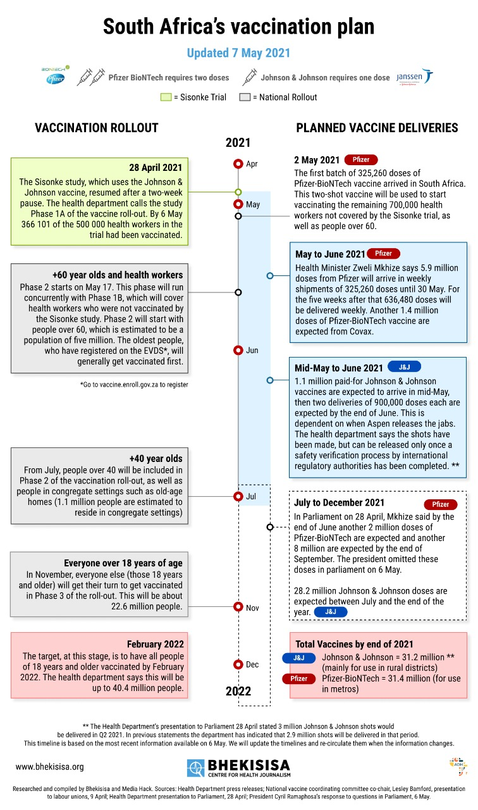
Current DoH plans to vaccinate 40-mil people by end Feb 2022 will require 188,000 doses per day, every day, for 287 days. i.e. On daily average from 17 May to 28 Feb 2022. This is faster than the average rate achieved by the UK, Chile, Israel over their vaccination periods to date.

Slide 27
12 NIDS-CRAM Wave 4 Working Papers. Available at cramsurvey.org

Slide 28
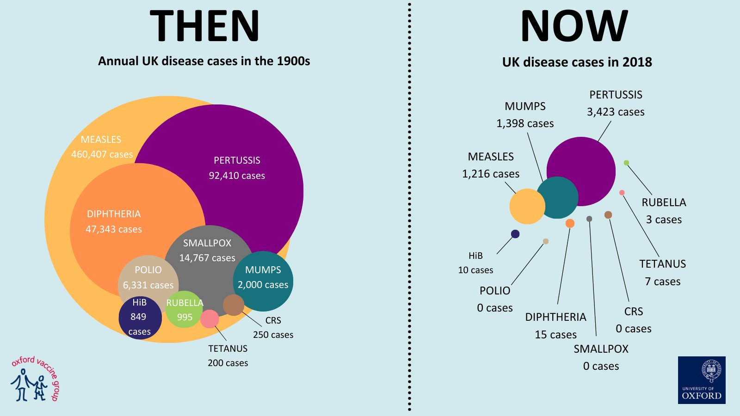

Slide 29
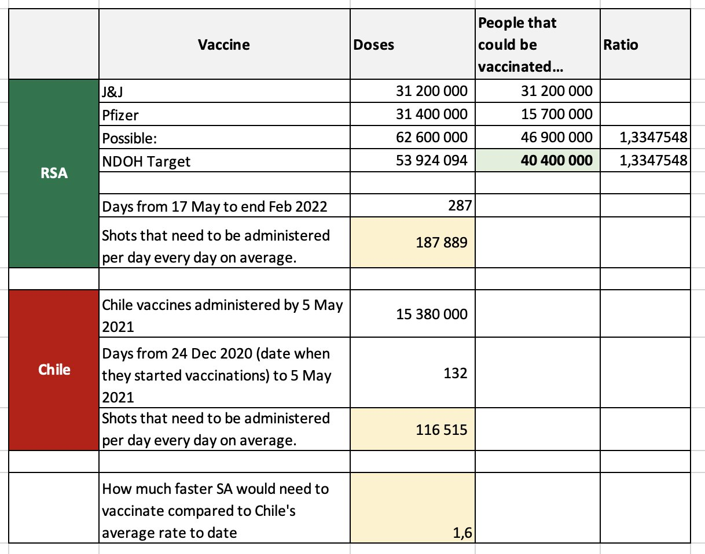


Slide 30
