Slide 1


Setting the Scene: Tutuwa Foundation 5 Aug 2021
Youth & Education in SA
Nic Spaull
Associate Professor | Economics Department
Stellenbosch University

Slide 2
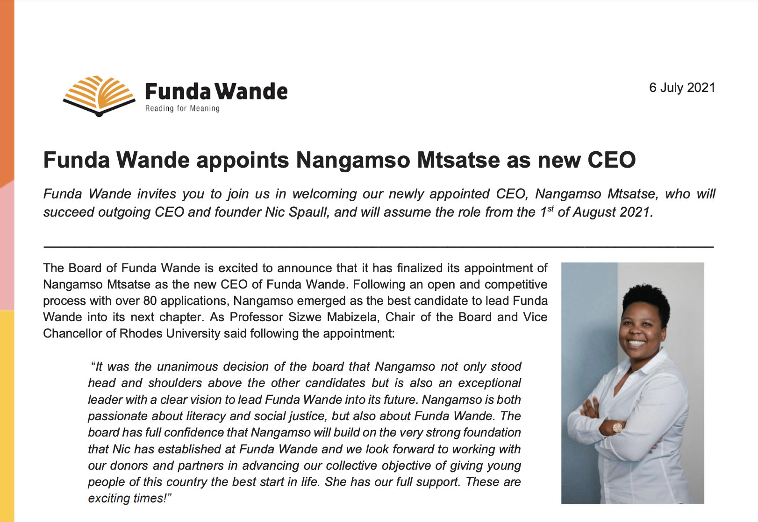

Slide 3

Setting the scene…
The impact of COVID-19 (Learning Losses & Dropout)
Skills & qualifications in post-apartheid SA (1994-1920)
University access
BOTH AND thinking: Improving no fee schools AND expanding access to functional schools

Slide 4

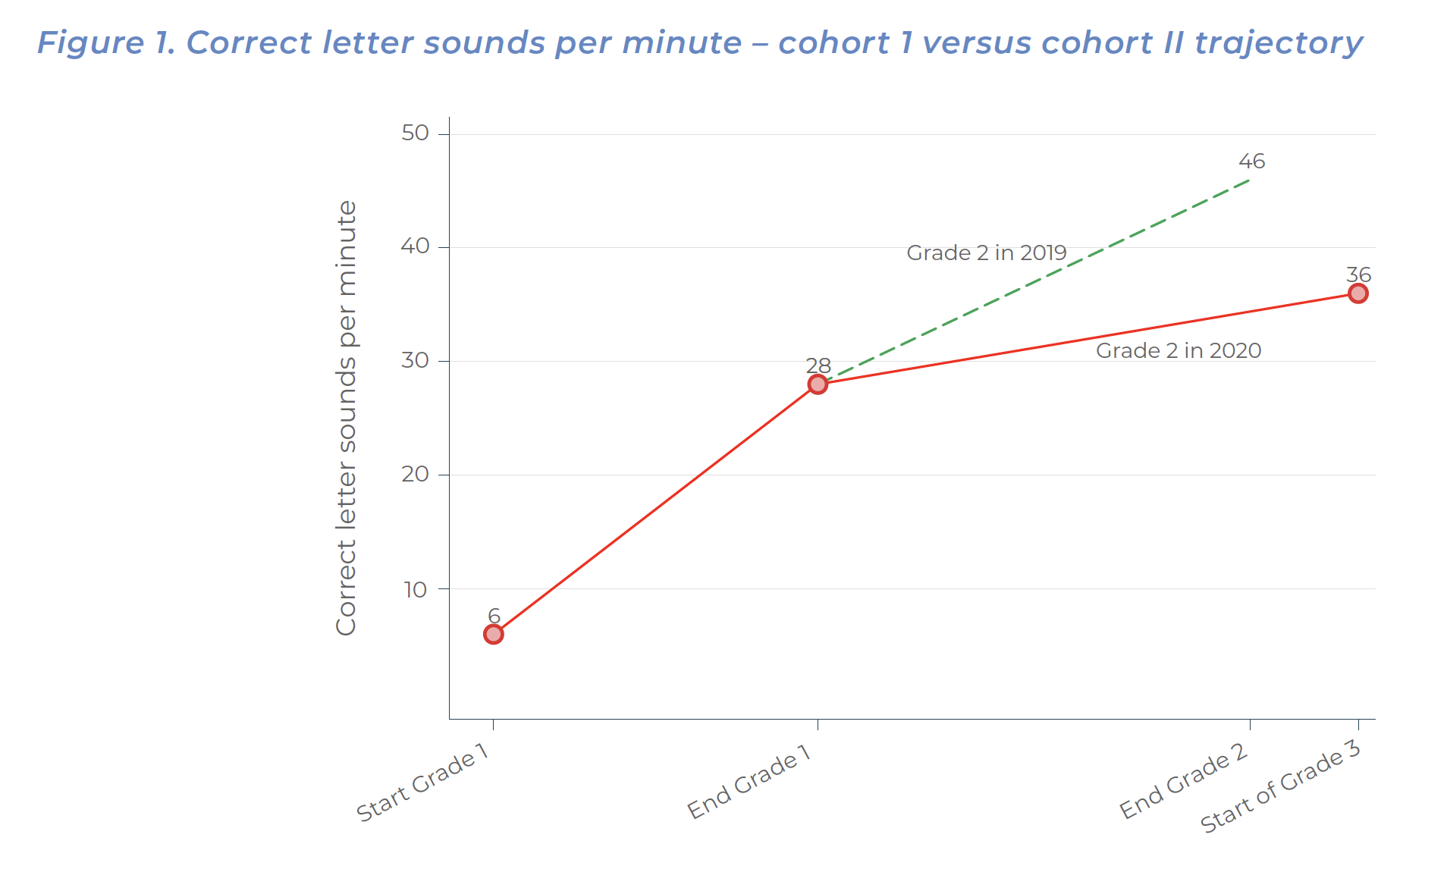

COVID Learning losses
Notes:
https://fundawande.org/img/cms/news/Ardington%202021%20-%20Funda%20Wande%20EC%20learning%20losses%20report%20(24%20May%202021)_1.pdf

Slide 5
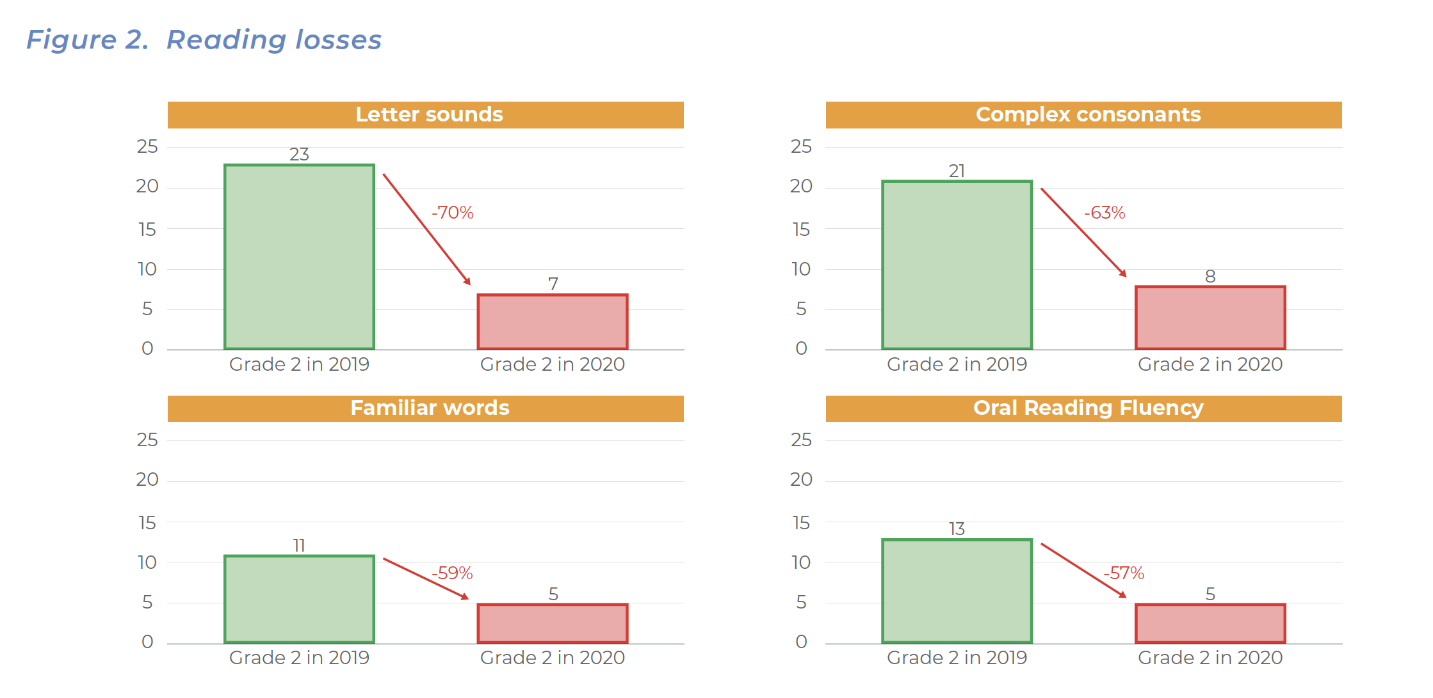
COVID Learning losses
Was 50-75% in 2020, now 75-100% of a year of learning lost by June 2021

Slide 6

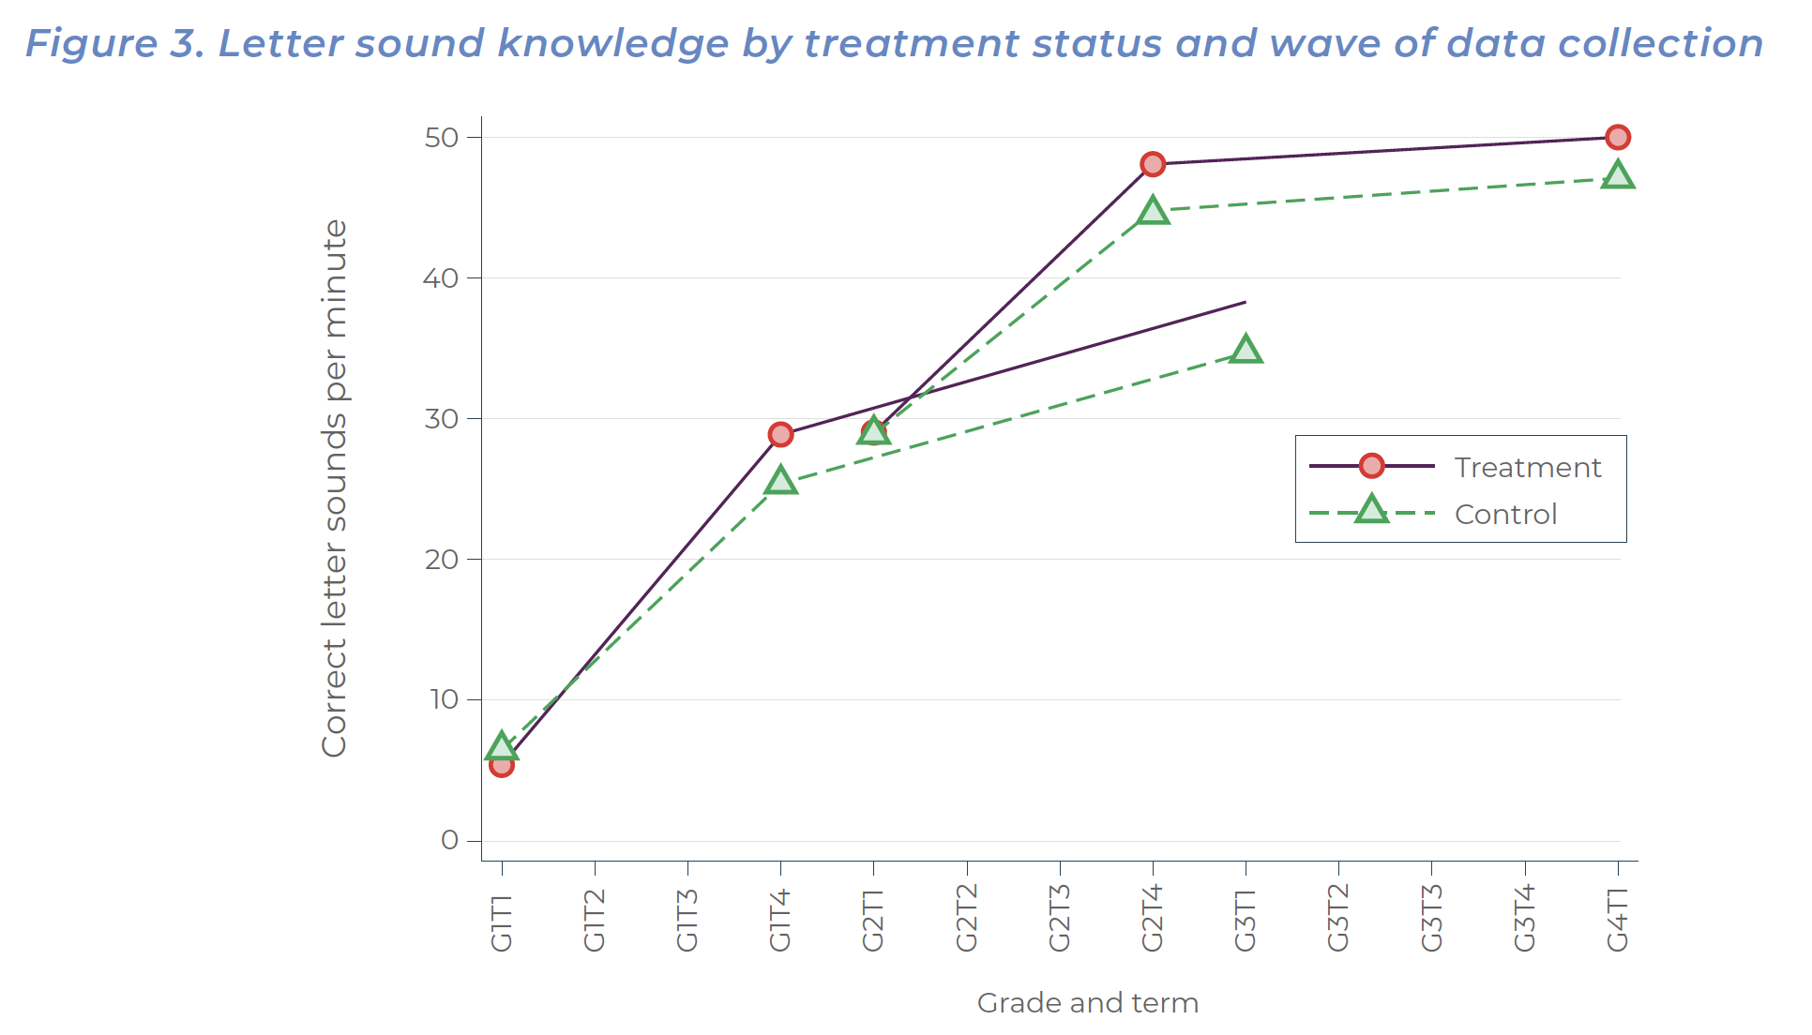
Learning losses
Even with significant intervention, out of school curricular learning is virtually zero
Notes:
https://fundawande.org/img/cms/news/IMPACT%20EVALUATION%20OF%20FUNDA%20WANDE%20COACHING%20INTERVENTION%20MIDLINE2_v3.pdf

Slide 7


NIDS-CRAM Wave 5
Nic Spaull
Associate Professor | Economics Department | Stellenbosch University
National income Dynamics Study (NIDS) Coronavirus Rapid Mobile Survey (CRAM)

Slide 8
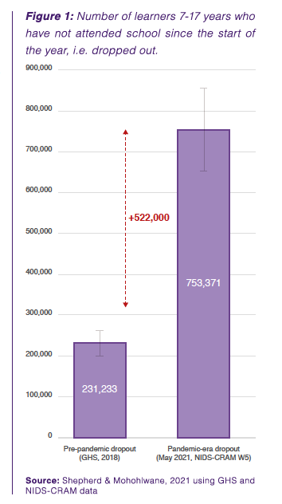
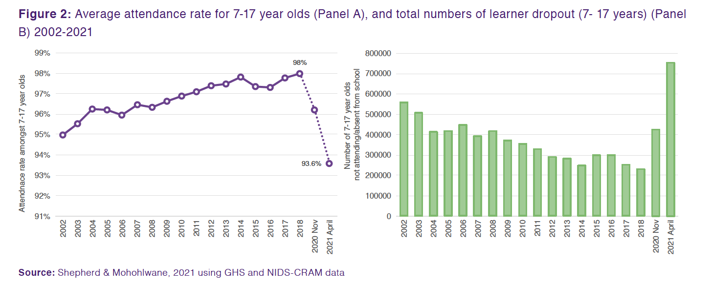
Dropout
An extra 500,000 children have dropped out of school during the pandemic. School dropout has tripled from 230,000 pre-pandemicto approximately 750,000 in May 2021, it is now at the highest rate in at least 20 years.

Slide 9

Skills & qualifications in South Africa Post-apartheid

Slide 10



How many students actually make it to university?
How many of those who start school reach matric? Graduate with matric? Graduate with a degree?
RESEP study followed the entire matric cohort of 2008 into university and tracked them 2009-2014
(Van Broekhuizen & Van der Berg, 2016)

Slide 11

How many students actually make it to university?

Slide 12

How many students actually make it to university?

Slide 13

How many students actually make it to university?

Slide 14

How many students actually make it to university?
Source: Van Broekhuizen & Van der Berg, 2016 (Higher Education Access and Outcomes for the 2008 National Matric Cohort)

Slide 15

How has this changed over time?
1994-2020

Slide 16
Skills production in SA 1994-2020
Source: Siyaphambili, 2021

Slide 17
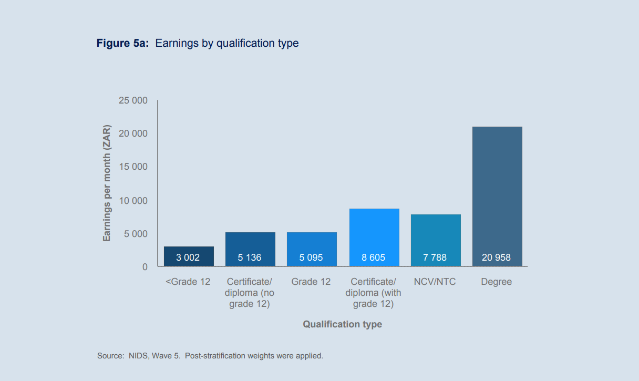
Earnings by qualifications type (2017)
Source: Branson, Culligan & Tollini (2019) NIDS Wave 5 (post stratification weights applied)

Slide 18
Earnings by qualifications type (2017)
Source: Branson, Culligan & Tollini (2019) NIDS Wave 5 (post stratification weights applied)

Slide 19
Earnings by qualifications type (2017)
Source: Branson, Culligan & Tollini (2019) NIDS Wave 5 (post stratification weights applied)

Slide 20
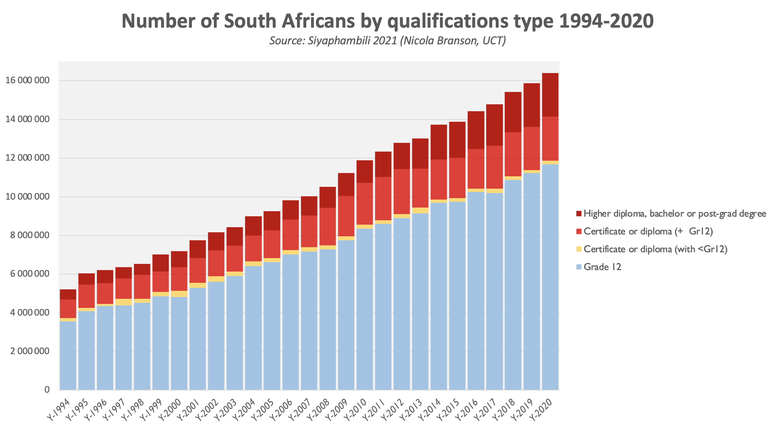
Matric +

Slide 21
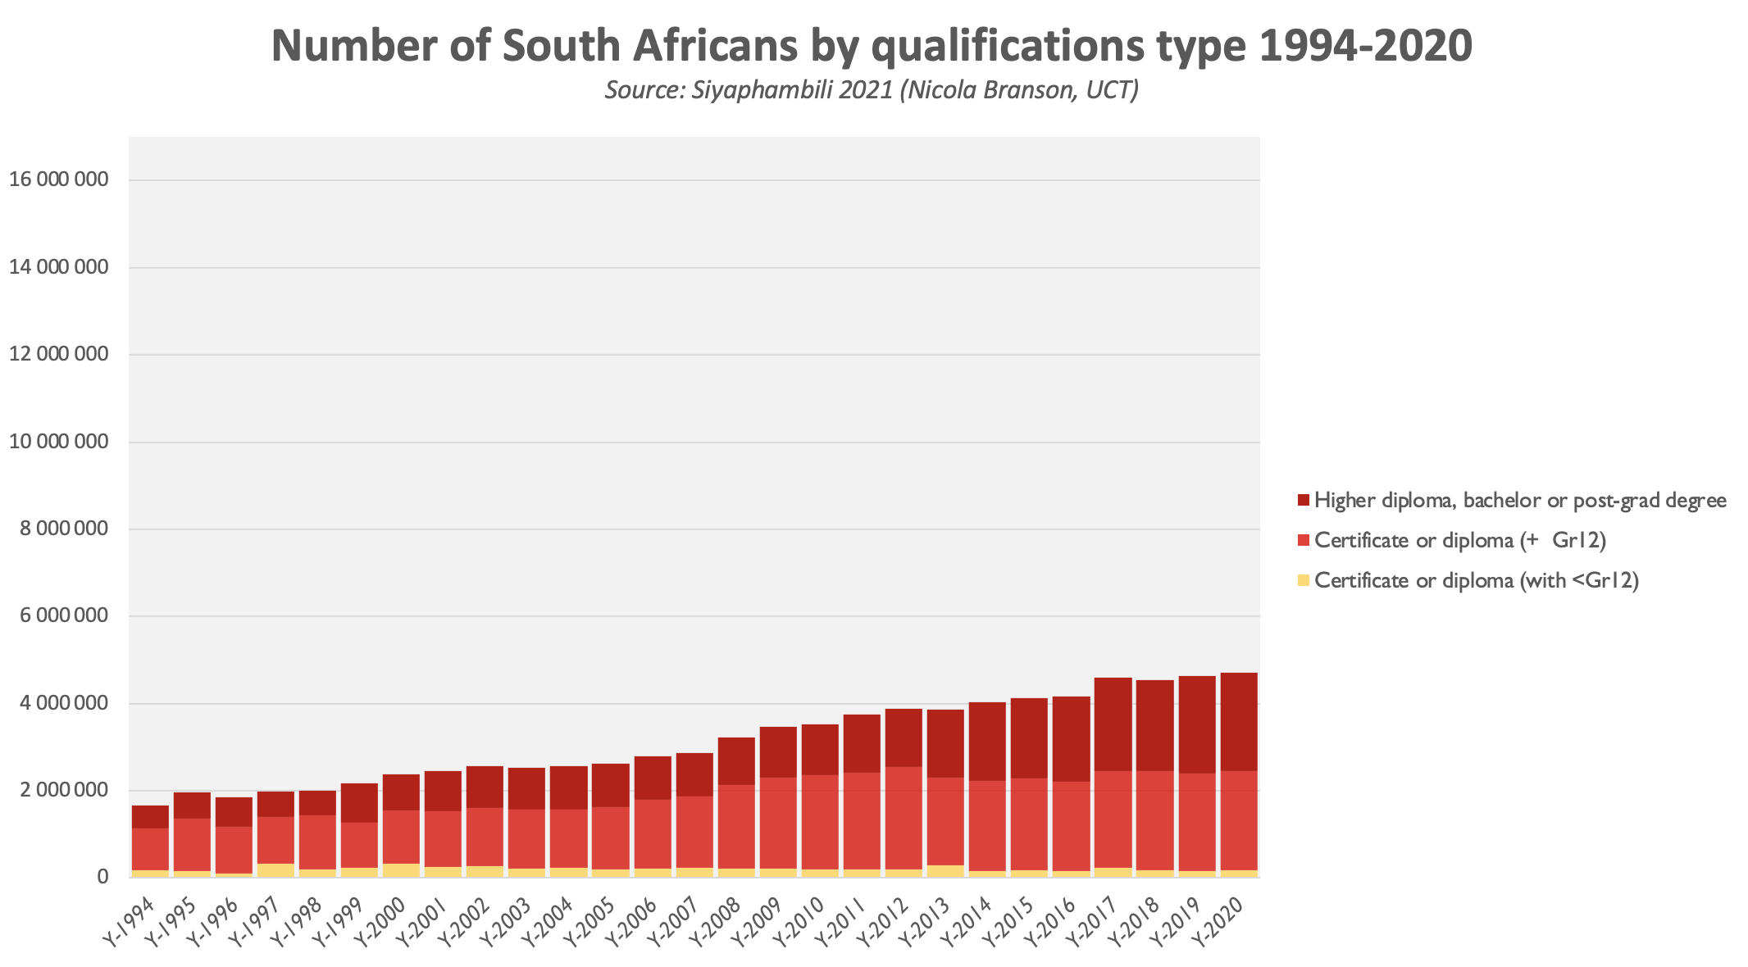
Further education

Slide 22
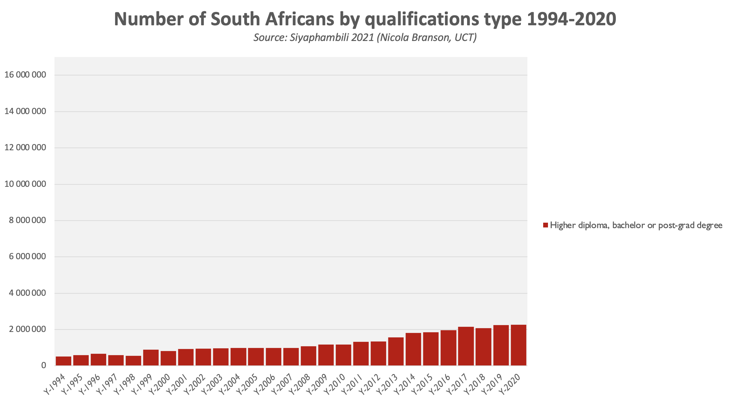
Higher Diploma, Degree, Postgrad

Slide 23
Higher Diploma, Degree, Postgrad

Slide 24

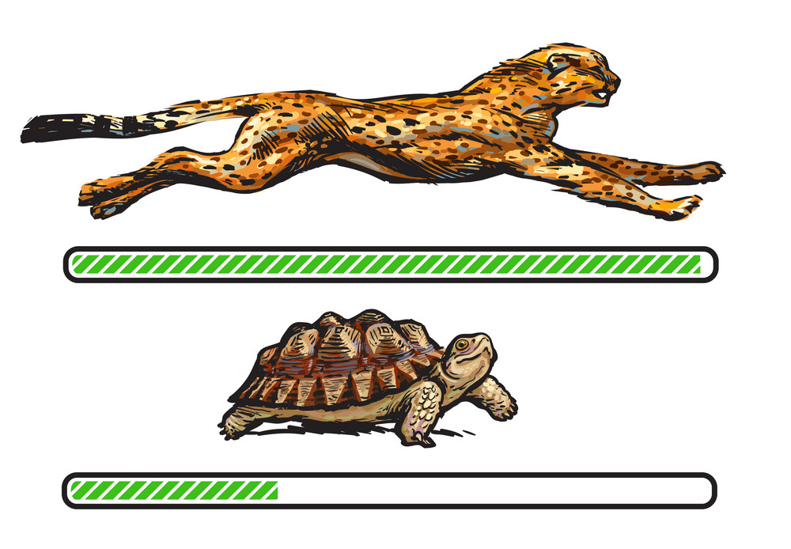

Understanding one factor contributing to the increase in university enrolment-related protests…
The schooling system and the higher education system are moving at different speeds

Slide 25
Average annual increase in bachelor passes (2011→2020)
⬆ 7%
Average annual increase in…
University enrolment (2011→2019)
…⬆ 2.6%
TVET enrolment (2012→2019):
…⬆ 0,6%

Slide 26
Higher Diploma, Degree, Postgrad

Slide 27
Expanding access to functional schools

Slide 28
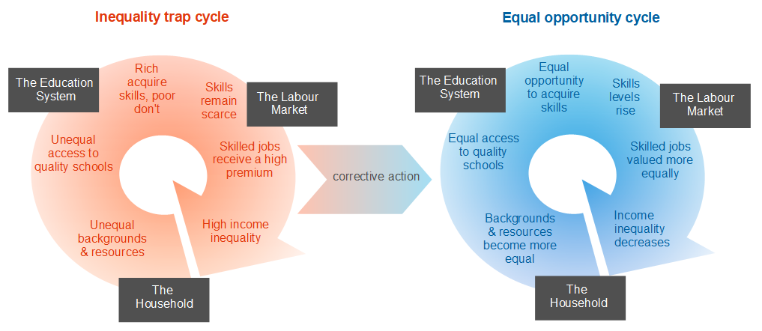
Increasing opportunity
Source: Siyamphambili, 2021 (Nicola Branson)

Slide 29

Both And
“We need to both improve no-fee schools and expand enrolment in functional schools”
Demand for skills: South Africa has one of the highest skills premiums in the world. Huge demand for learners with degrees, especially in applied disciplines. The production of skills < demand for those skills
Increase opportunity and diversity in functional schools by expanding enrolment. 40% of learners in the top 200 high schools are White.
Concentration of functionality: Top 200 high schools in SA produce more Mathematics A’s (80%+) than the remaining 6600 combined (i.e. 3% of high schools produce more A’s than 97% combined) (Spaull, 2019).
Possible solution: Functional schools need to expand enrolment by 50% by 2025 – philanthropic / state-funded bursaries for children who can’t pay fees.

Slide 30
Comments & Questions
Presentation available at www.nicspaull.com/presentations

Slide 31
“Inequality in every country needs to be justified. You need to tell a story about why this level of inequality is acceptable or unacceptable.”
Thomas Picketty

Slide 32
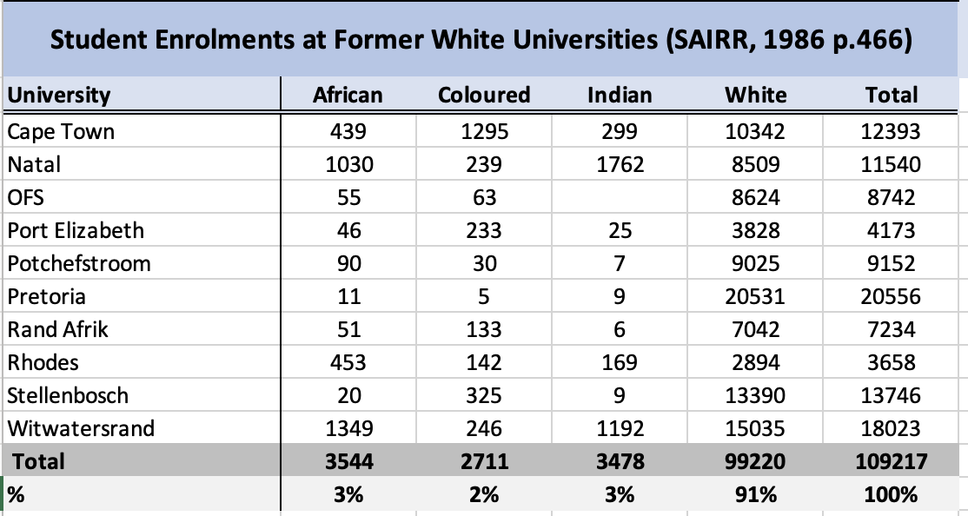
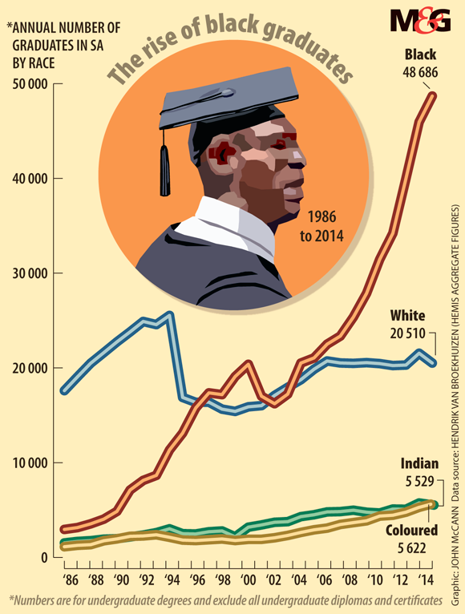
Dramatic increase in the number of Black graduates (starting from a very low base)
Dramatic increase in the number of Black graduates (starting from a very low base)

Slide 33
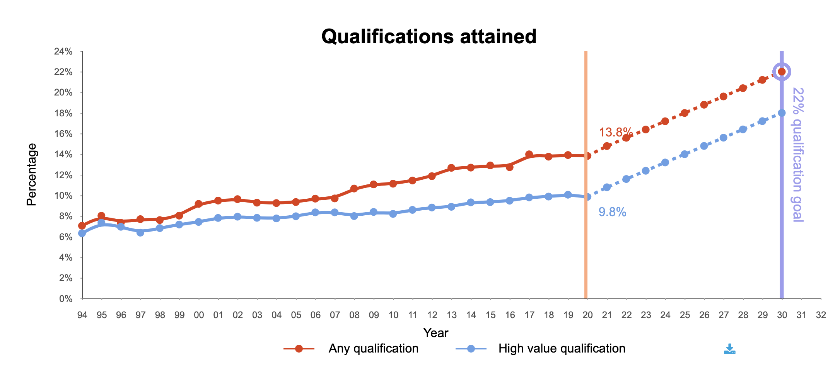
Skills production in SA 1994-2020
NDP 2030 Goals
Source: Siyaphambili, 2021 (note 15-64yrs)
Note: High value qualification: Includes only diplomas, higher diplomas, bachelor degrees and post-graduate degrees completed from a university, college or other post-school institution. These are qualifications classified of NQF level 6-10.

Slide 34

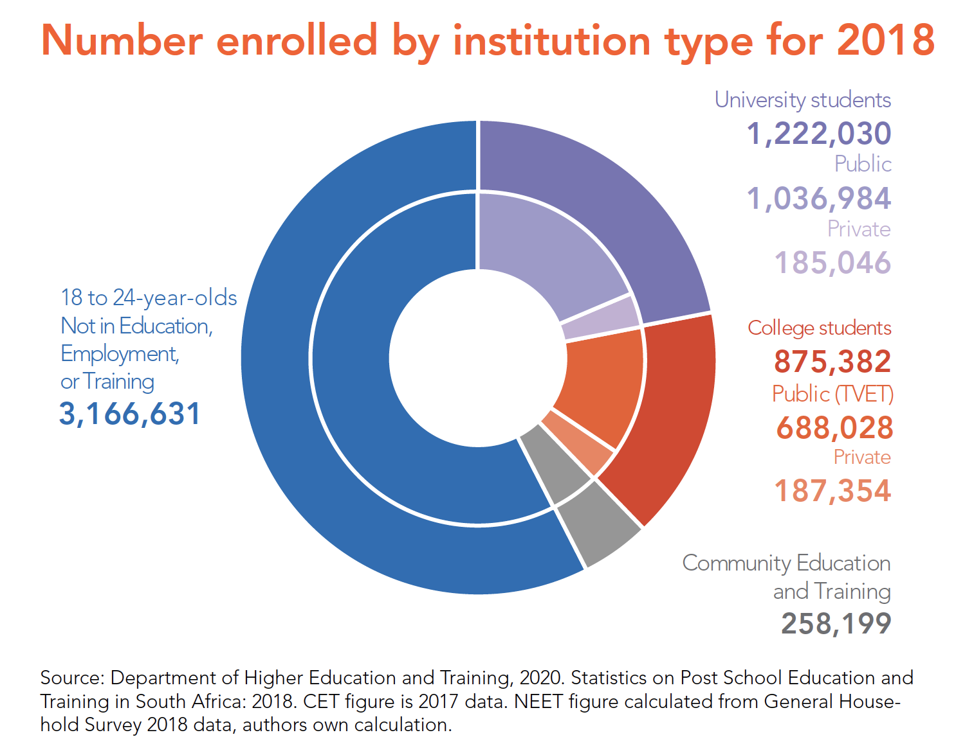
What does higher education in SA look like?
Source: Branson, Culligan and Ingle (Siyaphambili)

Slide 35
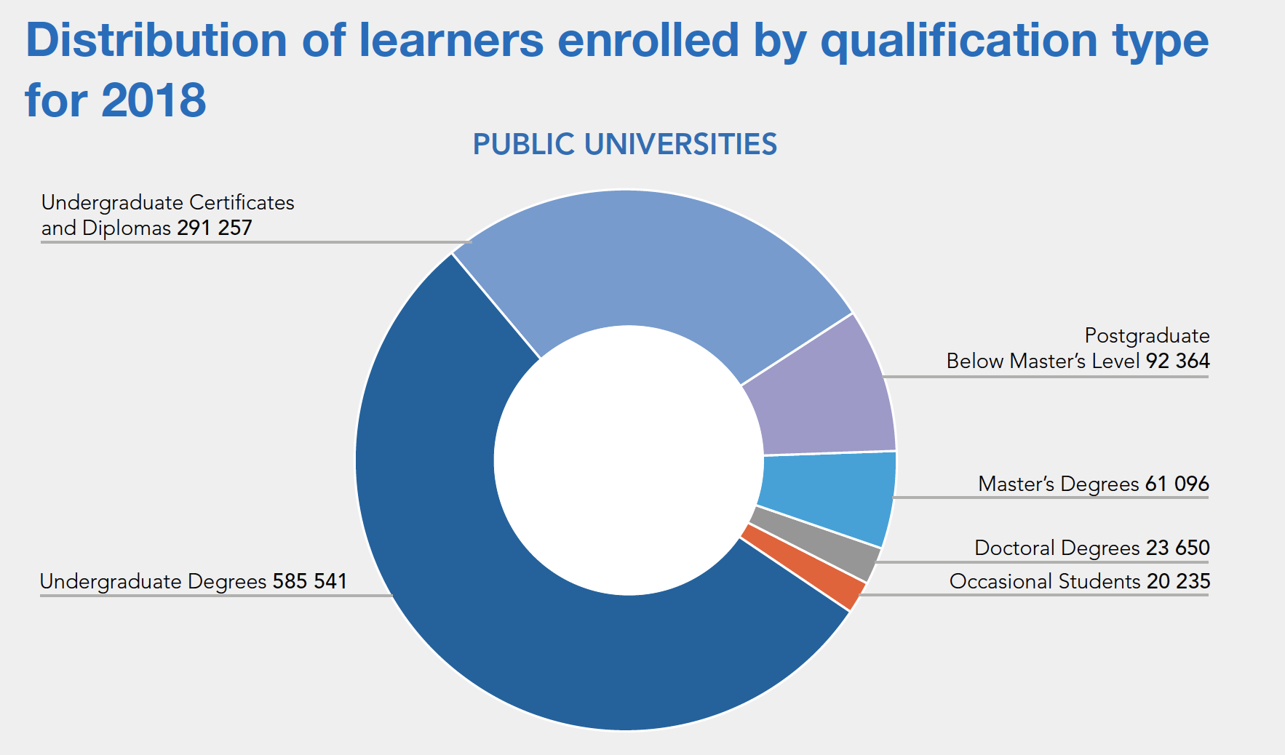
What does higher education in SA look like?
Source: Branson, Culligan and Ingle (Siyaphambili)

