Slide 1

COVID-19 and Learning Losses in SA: Evidence from NIDS-CRAM and learning assessments
17 June 2021
Nic Spaull
Stellenbosch University

Slide 2
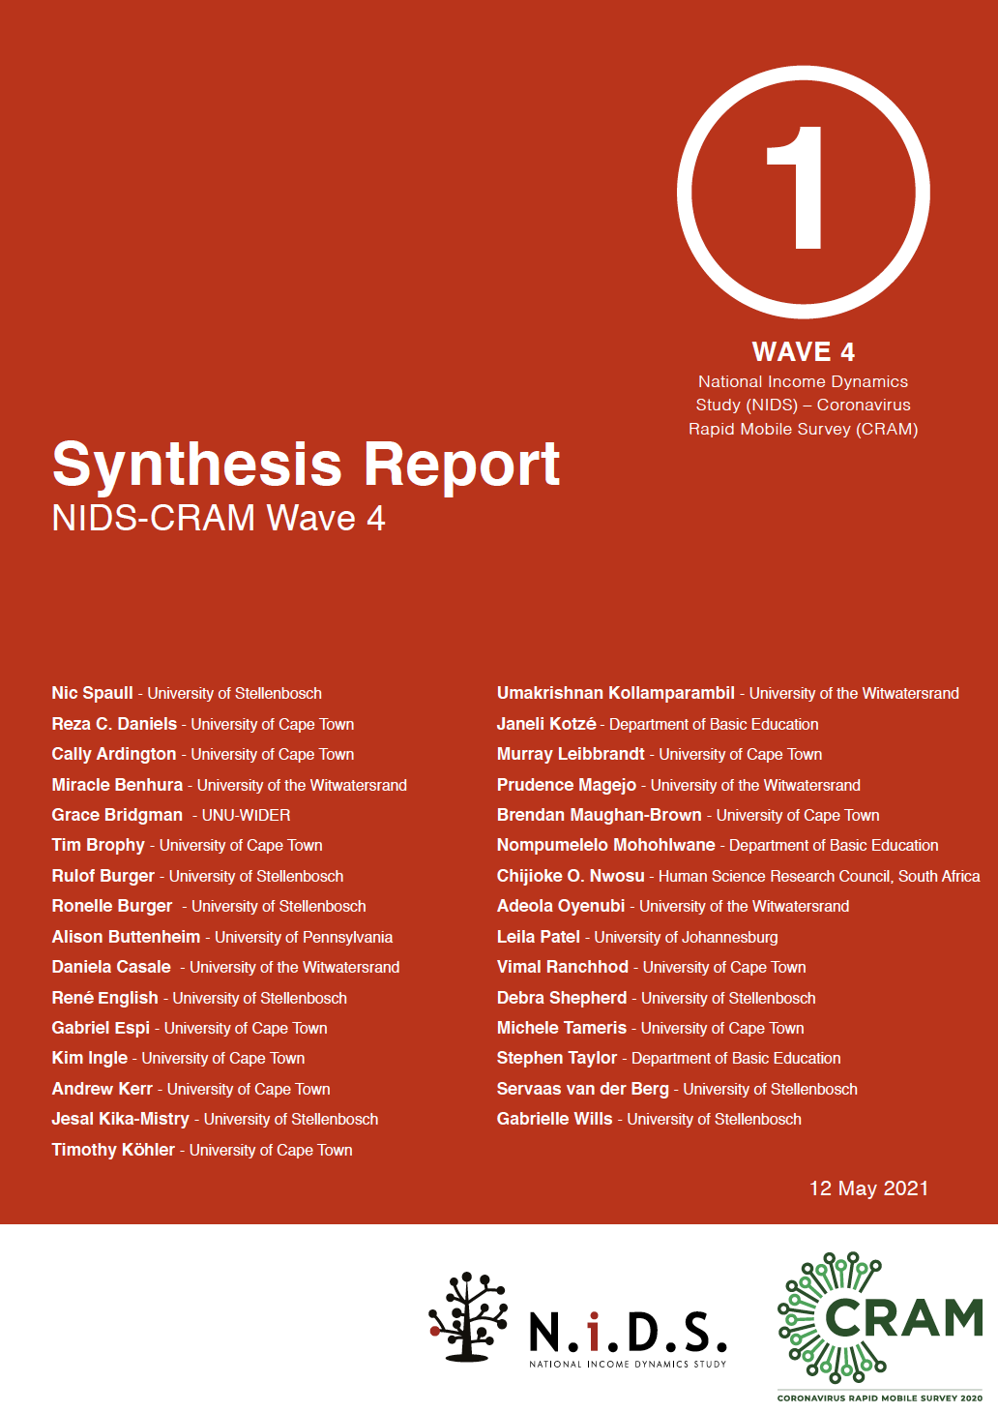

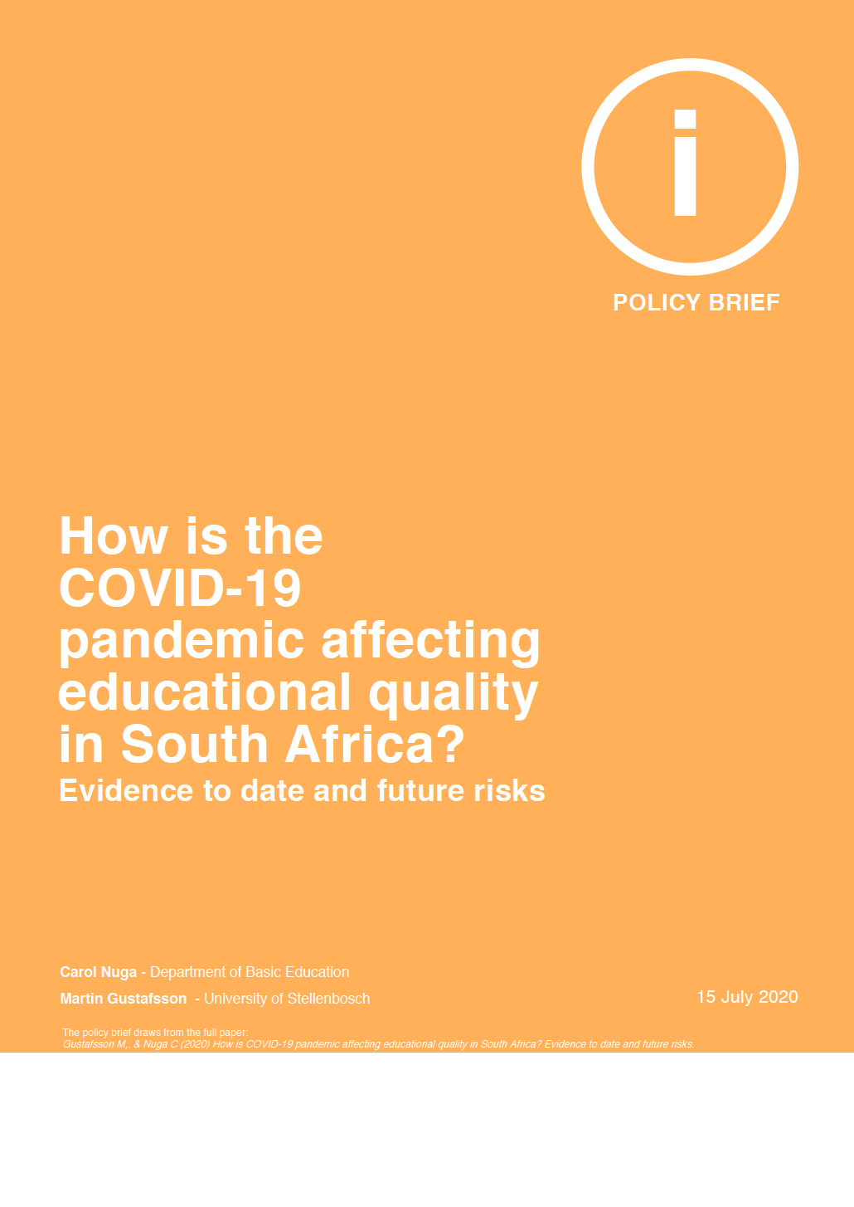



Slide 3
Reminder of the situation pre-COVID (i.e. 2019)

Slide 4

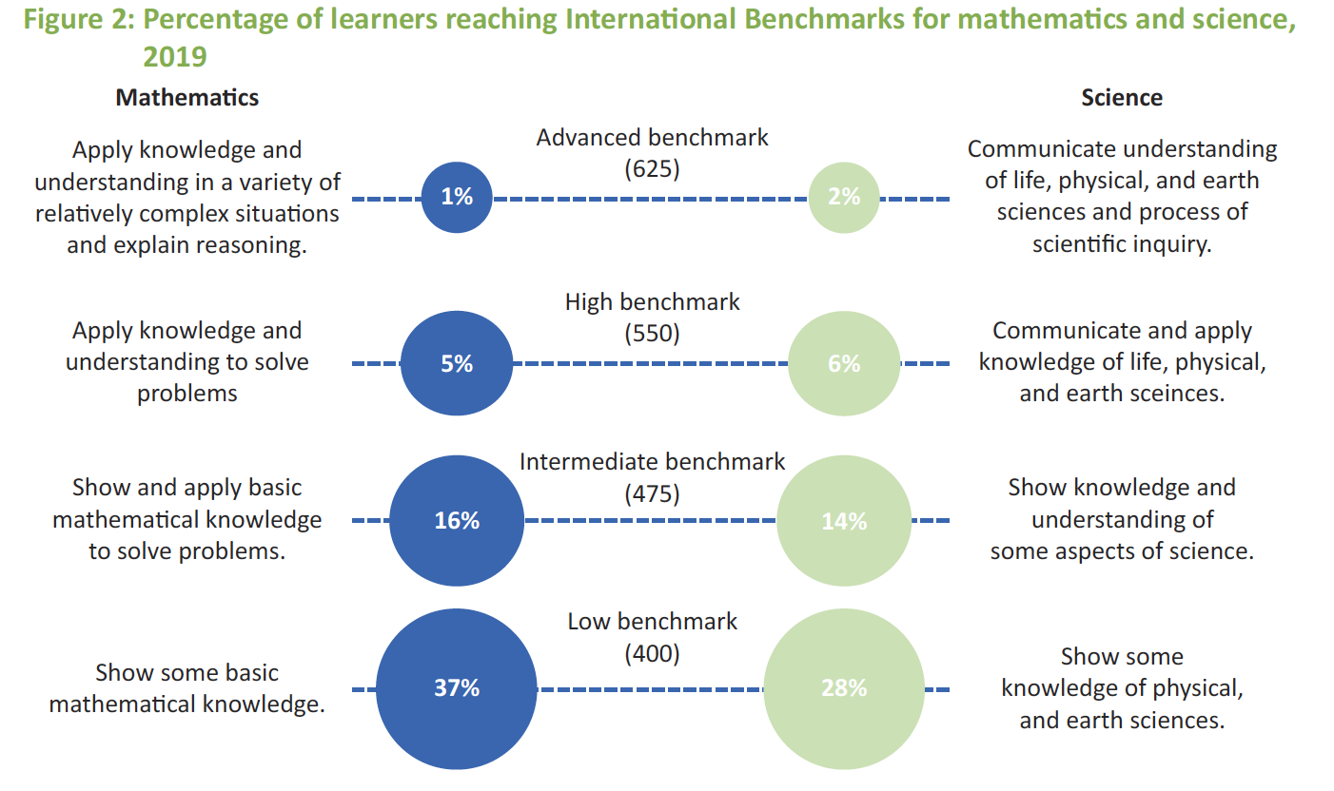
Example questions from TIMSS 2019 Gr5:
700 – 28 = ____ [MN11128 – CAPS Gr3]
5 x 25 = ___ [MN11136 – CAPS Gr4]
(SA: 25%)
(SA: 38%)

Slide 5
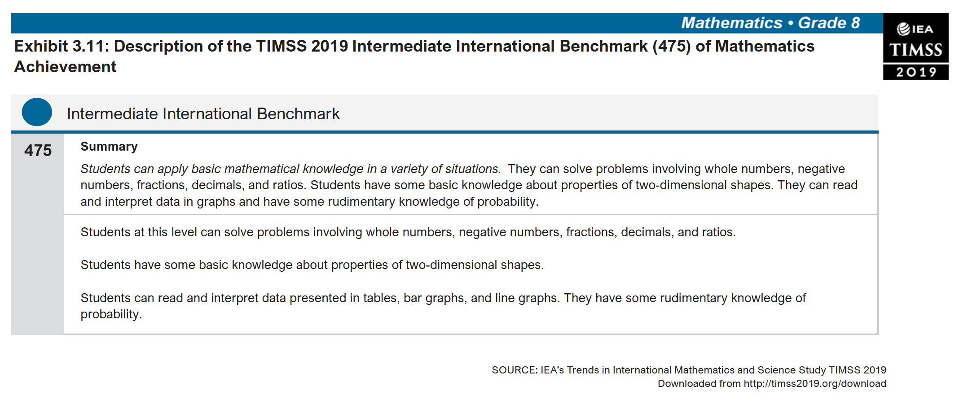
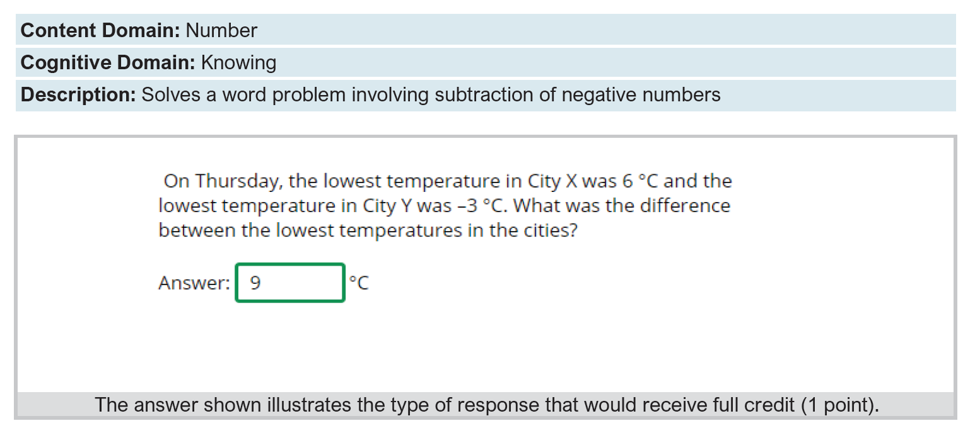
Intermediate International Benchmark

Slide 6

NIDS-CRAM - BACKGROUND
NIDS-Wave 5 (2017)
  Existing panel study 2008-2017: The National Income Dynamics Study. NIDS is a panel study that began in 2008 as a nationally representative survey with the same individuals and their descendants being re-interviewed every 2-3 years between 2008 and 2017. It has been used in over 100 academic articles
NIDS-CRAM (2020/21)
  Wave 1: ~ 7000 individuals surveyed in NIDS-CRAM Wave 1: In total 17,568 randomly selected individuals from NIDS were called and of these, 7,073 were interviewed in NIDS-CRAM
  Wave 2: ~5700 responses (80% response rate – same individuals
  Details of the telephonic survey:
    Managed by SALDRU at UCT
    50 call centre agents phoning from 13 July to 13 August 2020
    20-minute survey (available in all 11 languages)
    R20 airtime given to respondents to thank them for participation.
    Questions on demographics, migration, grant-receipt, employment, income, hunger + COVID-19 risk perceptions and behaviour education, ECD, mental health, vaccine hesitancy

Slide 7




Funders?
Who funded NIDS-CRAM?
  The Allan & Gill Gray Philanthropy, the FEM Education Foundation, the Michael & Susan Dell Foundation
Who will have access to the data?
  All NIDS-CRAM data is immediately made freely available to the public and other researchers on the DataFirst platform. W2 data is now up. We encourage others to analyze the data for their own purposes and to replicate our results (we have also posted our do files so people can replicate our analysis.

Slide 8
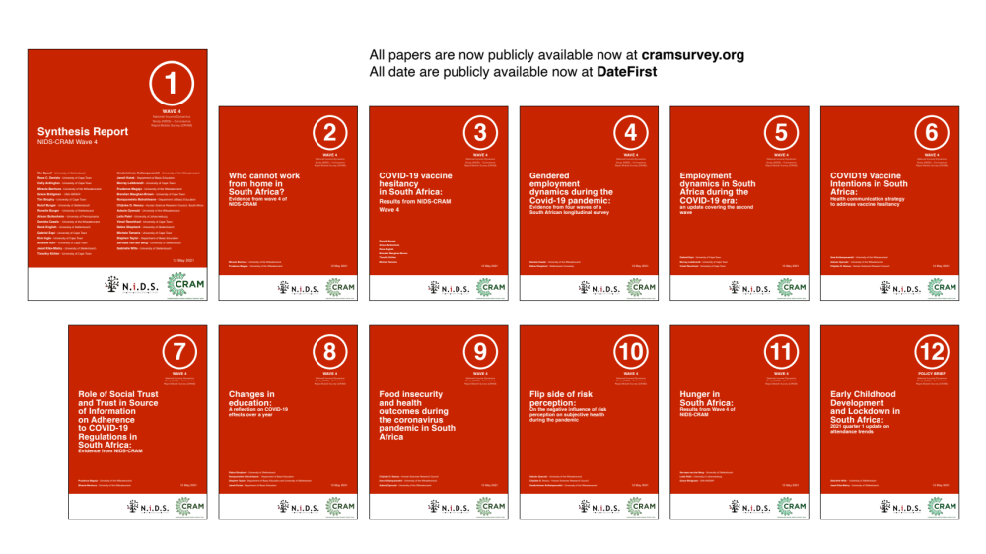
12 NIDS-CRAM Wave 4 Working Papers. Available at cramsurvey.org

Slide 9
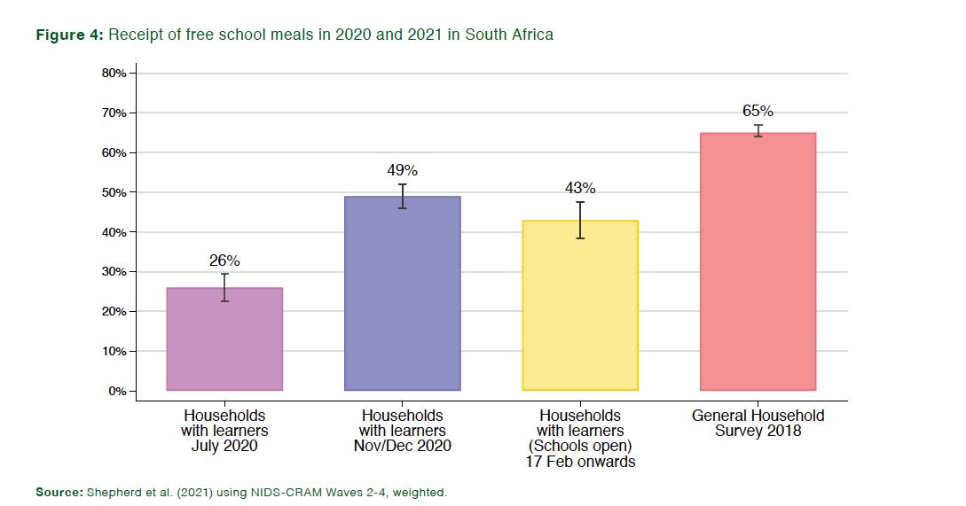
School meals
Less than half of respondents (43%) reported their child received a school meal in the last 7 days in Feb March 2021 (while schools were open). (NB 58% of parents support going back to school every day (W3)

Slide 10
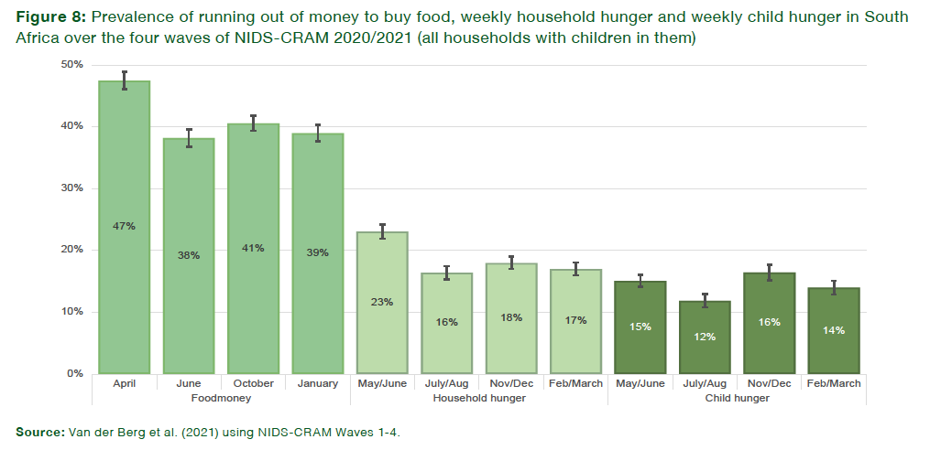
Hunger
Weekly child hunger has declined from 16% in Nov/Dec 2020 to 14% in Feb/March 2021, although it is still nearly double pre-pandemic levels (8%)

Slide 11
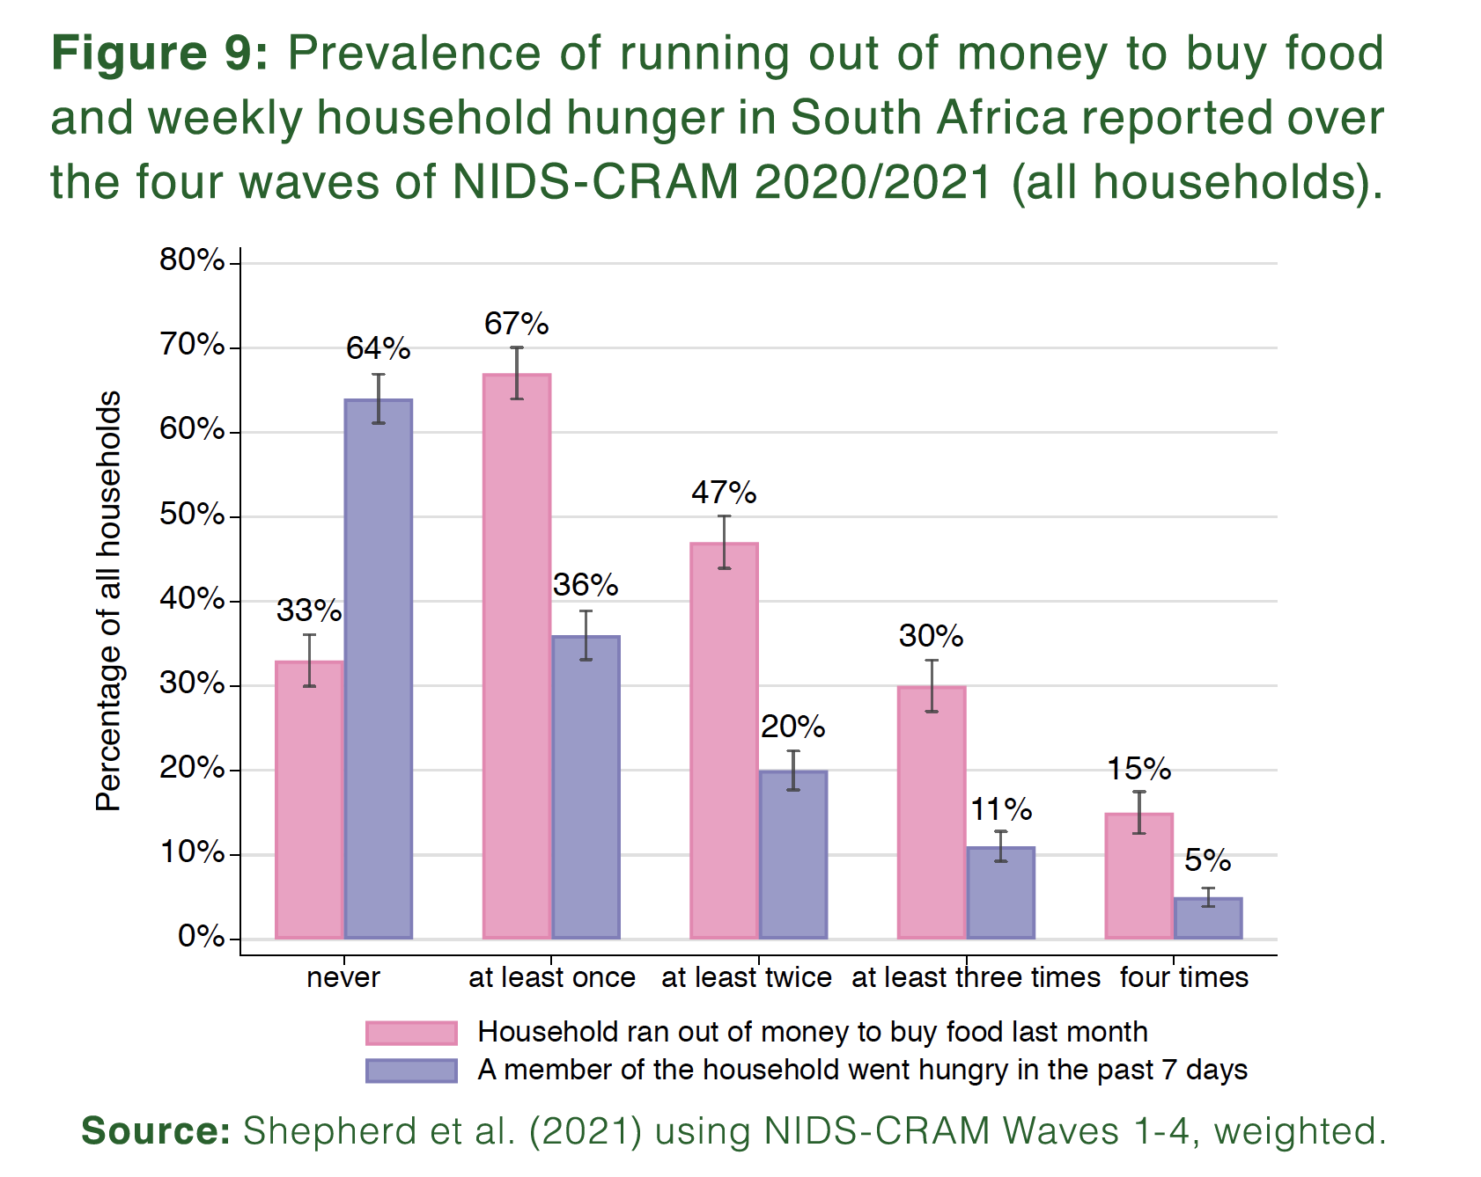
Hunger
NIDS-CRAM has been administered four times in the last year. Two thirds of respondents (67%) said that in at least one of these waves their household had run out of money to buy food in the last month.

Slide 12
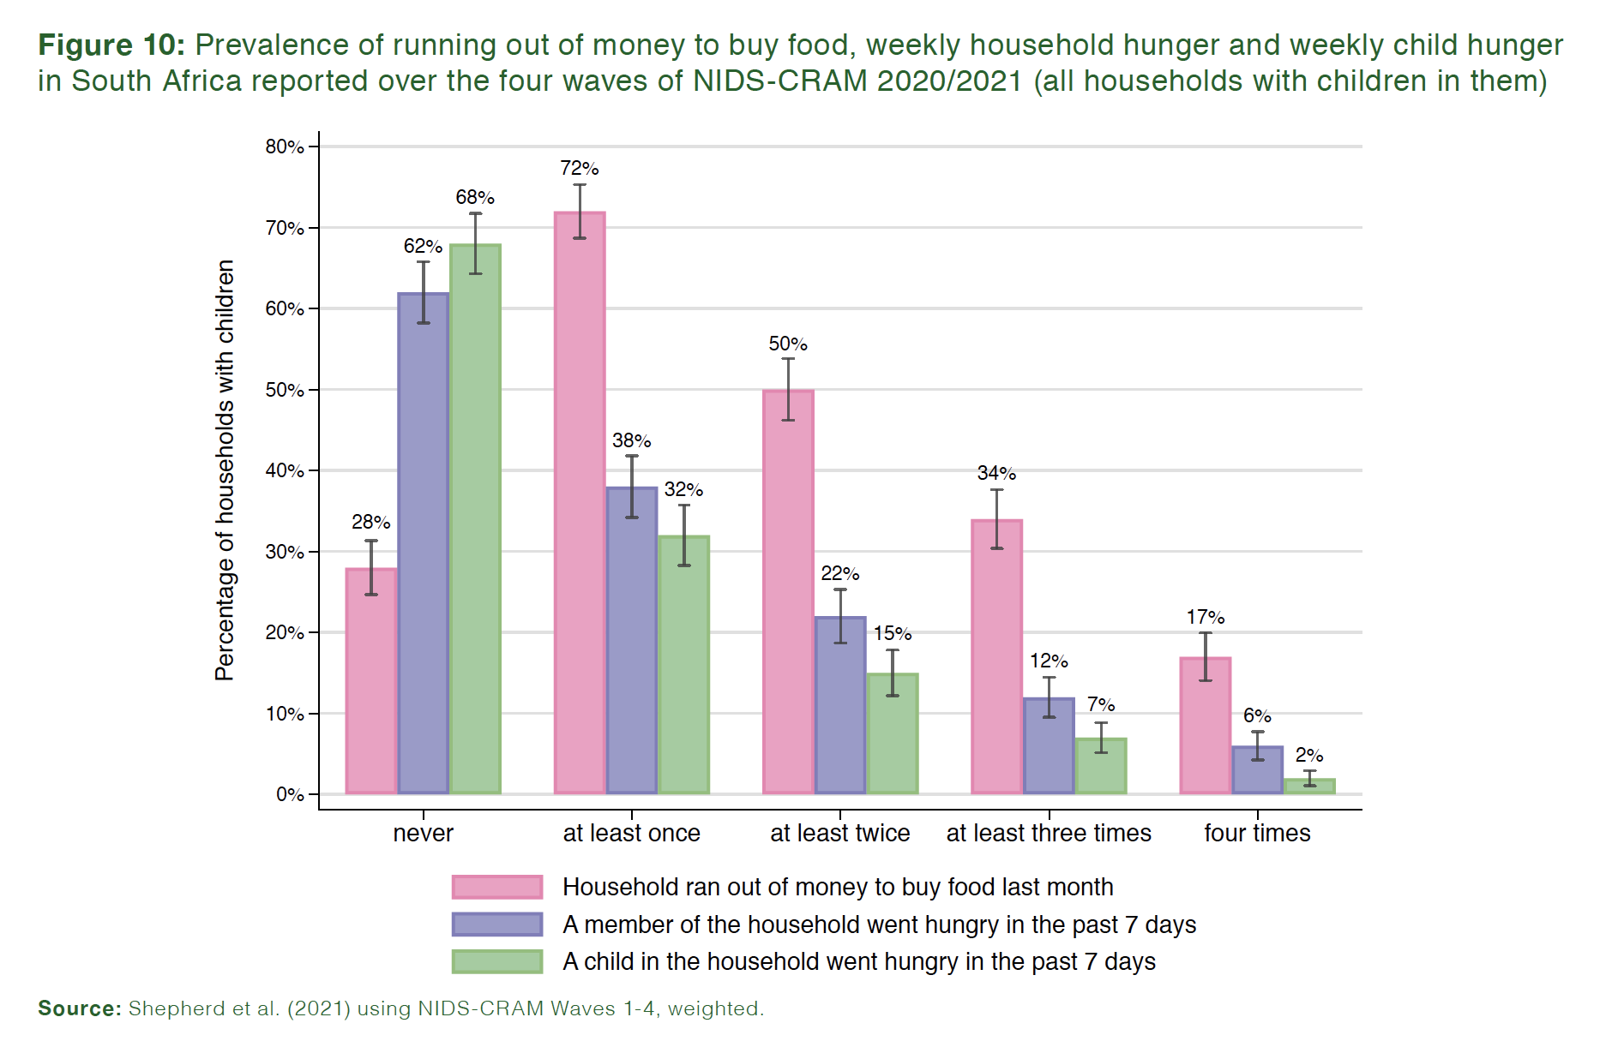
Hunger
NIDS-CRAM has been administered four times in the last year. One third of respondents (32%) in households with children in them said that in at least one of these waves, a child had gone hungry in the past week in their household

Slide 13
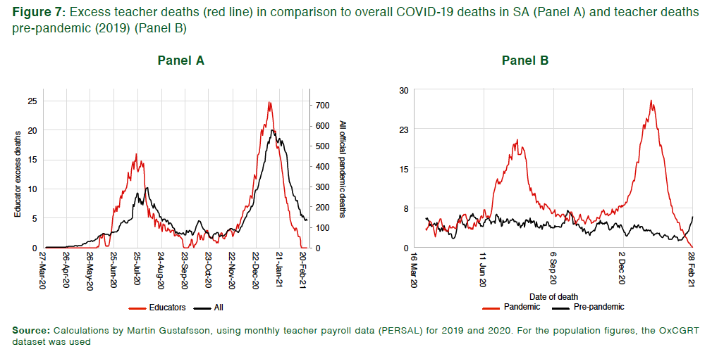
Teacher mortality
Analysing teacher payroll data (Persal) shows an increase in excess deaths among teachers but unrelated to school opening/closing.
Instead follows SA mortality trends almost perfectly.

Slide 14
Teacher mortality
Teachers at secondary schools are not at higher risk of COVID-19 transmission compared to those at primary schools. Schools (neither primary nor secondary) are not the primary sites of infection.

Slide 15
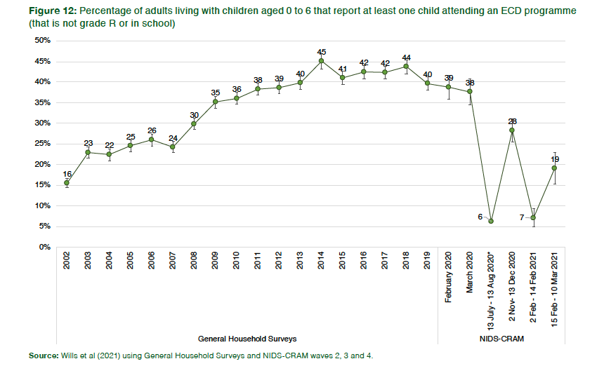
ECD
ECD attendance follows school opening dates and in Feb/March 2021 it remains well below pre-pandemic levels
Temporary ECD programme closure remains the primary reason (26%) for non-attendance at ECD programmes
Notes:
Of those men who were employed in February 2020, 78% were still employed in January 2021. For women the figure is only 70%. Women were more likely to be in sectors that were hardest hit by the crisis.

Slide 16
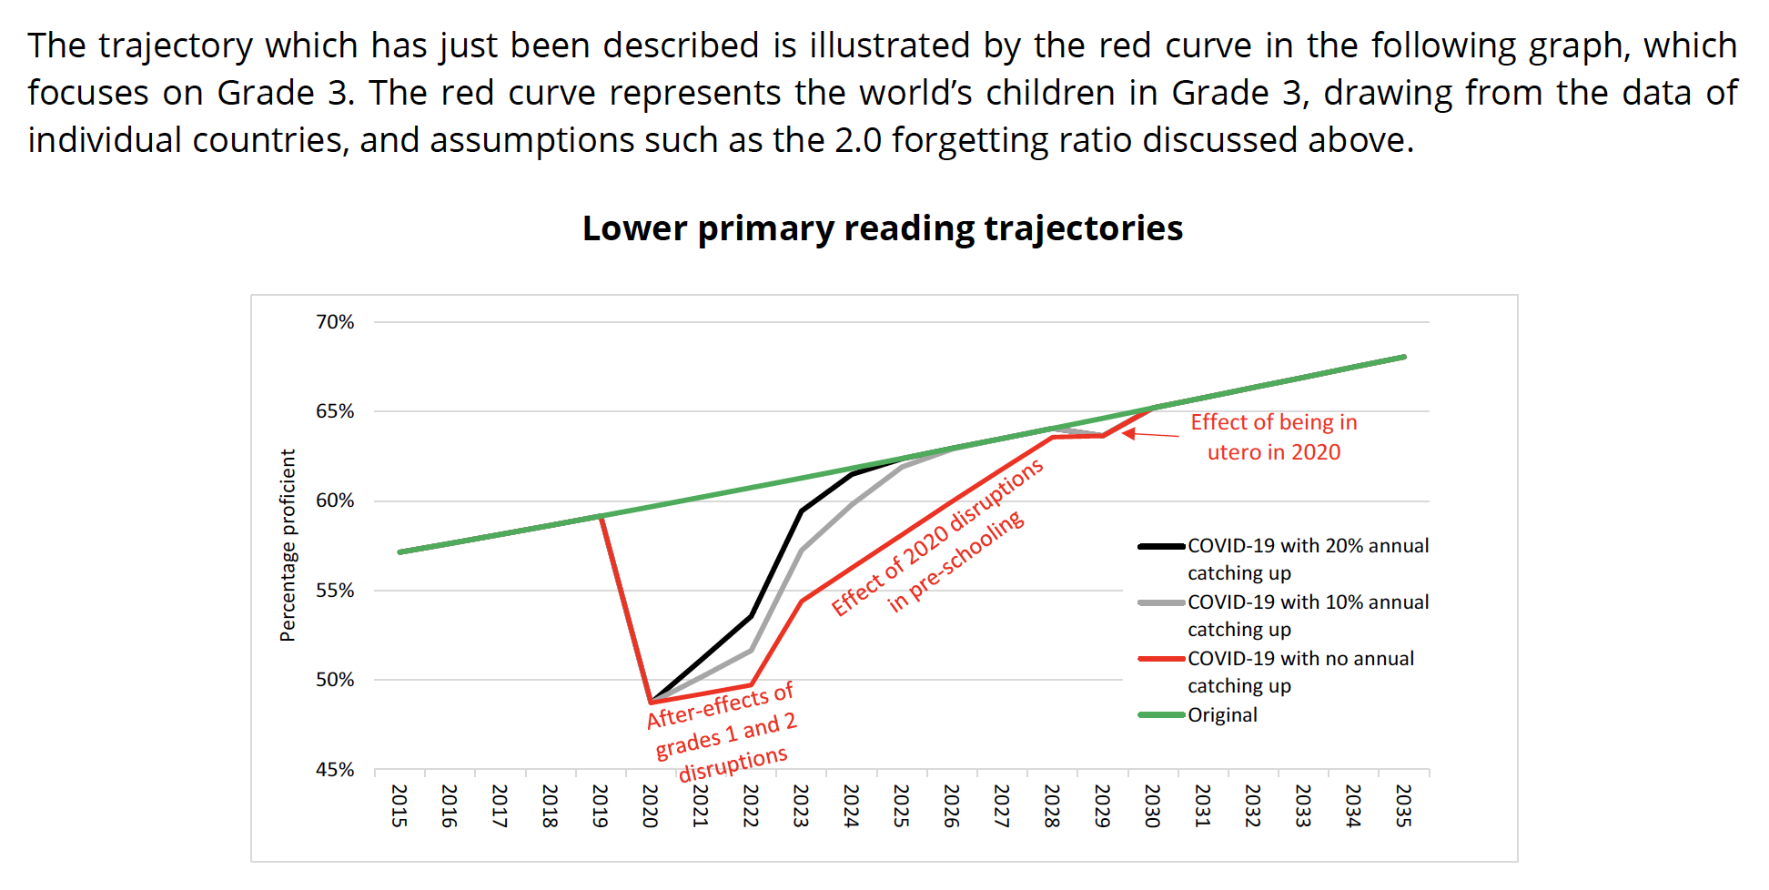

Slide 17
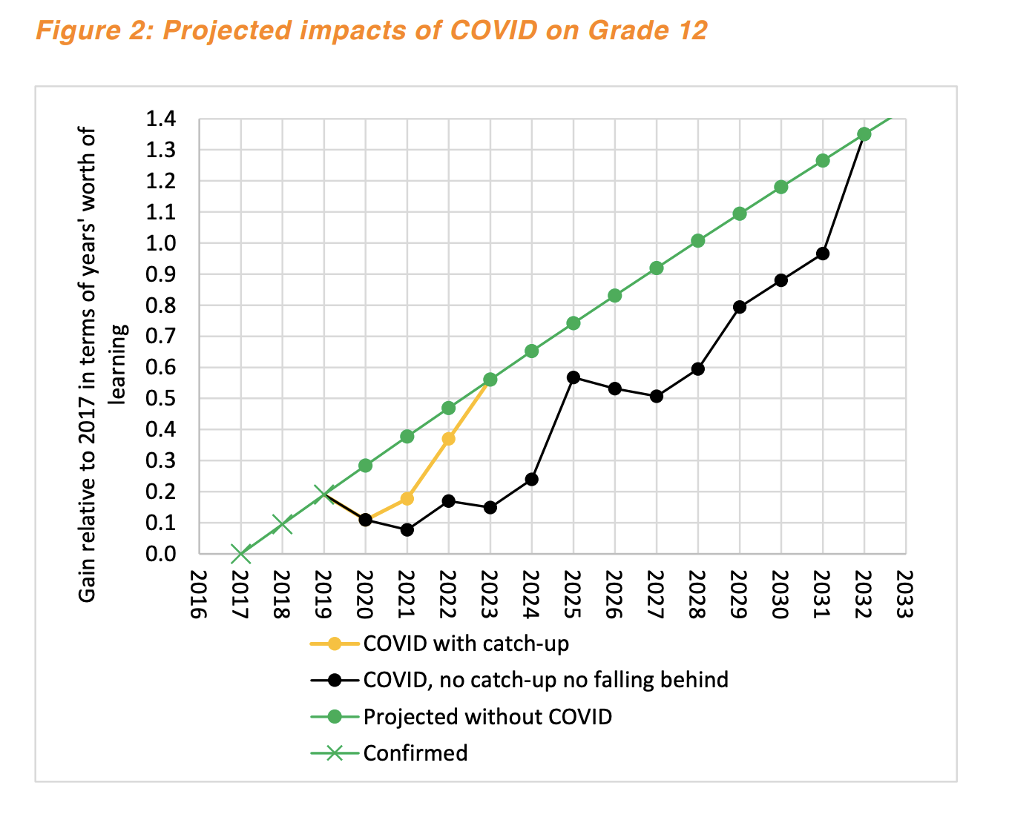
“Without catching up, the skills of Grade 12 graduates would be lower than in the no-pandemic scenario for a decade up to 2031.”

Slide 18
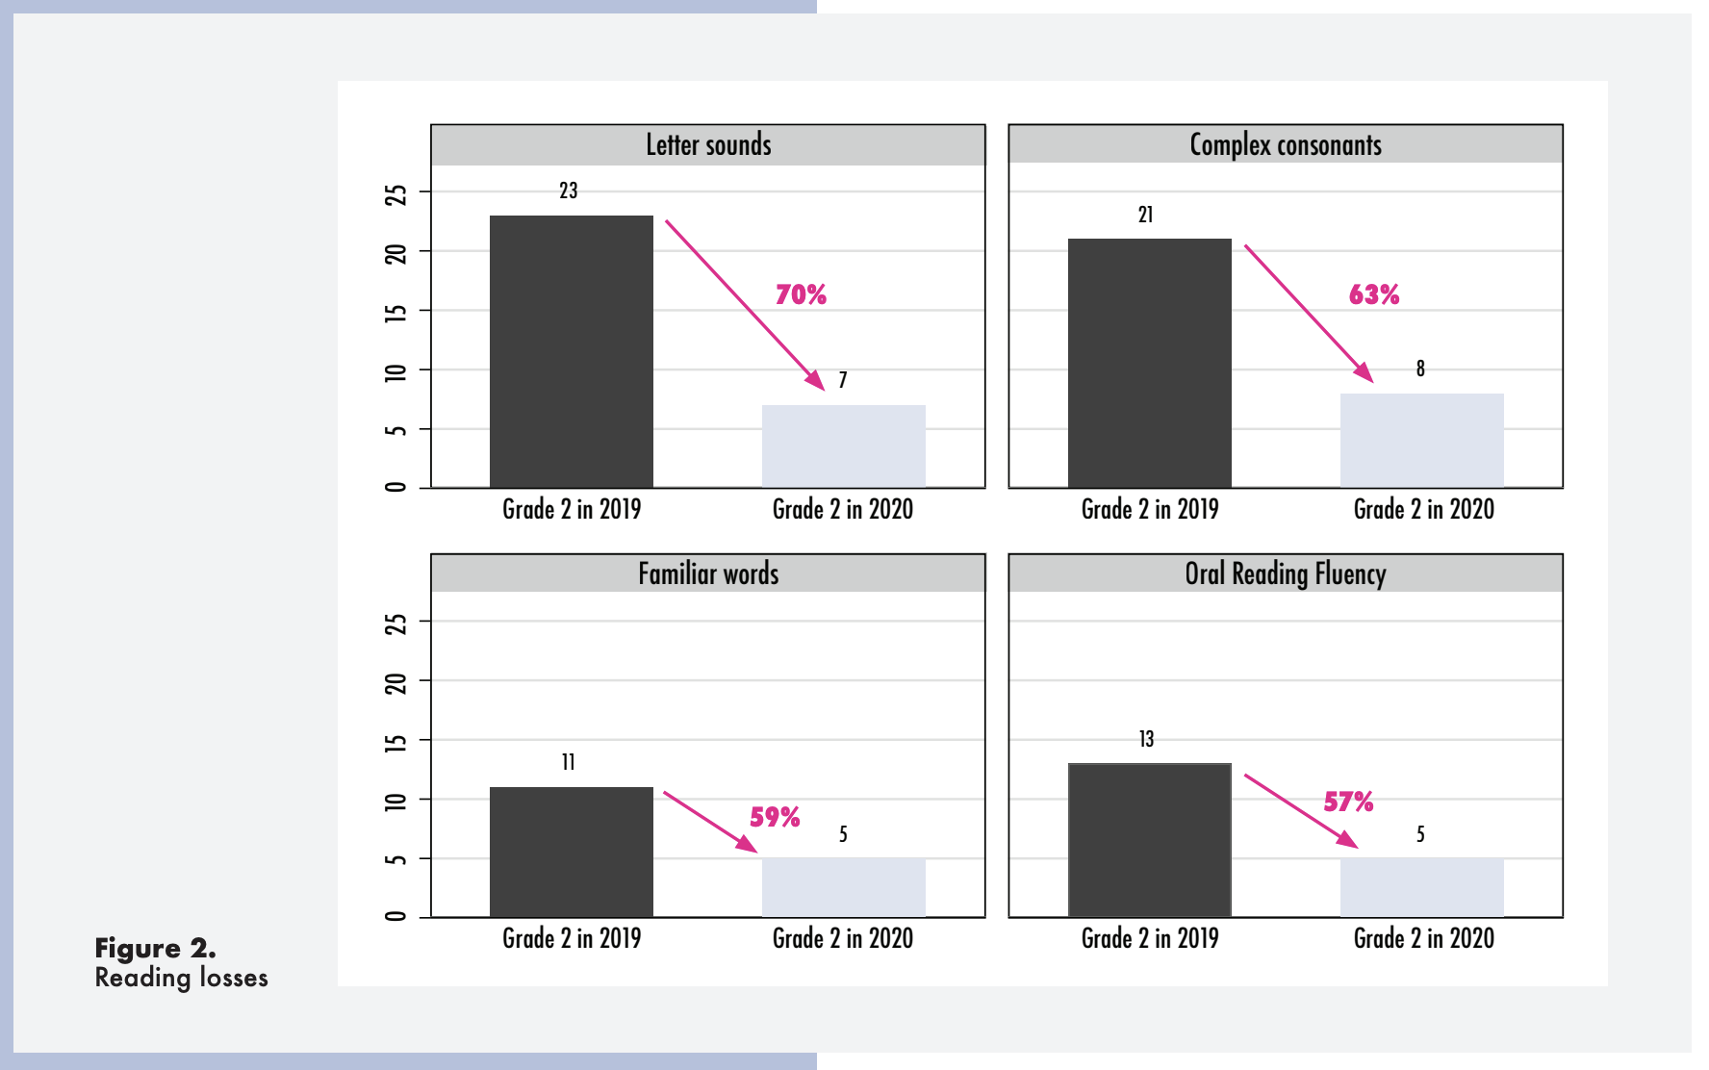

Slide 19
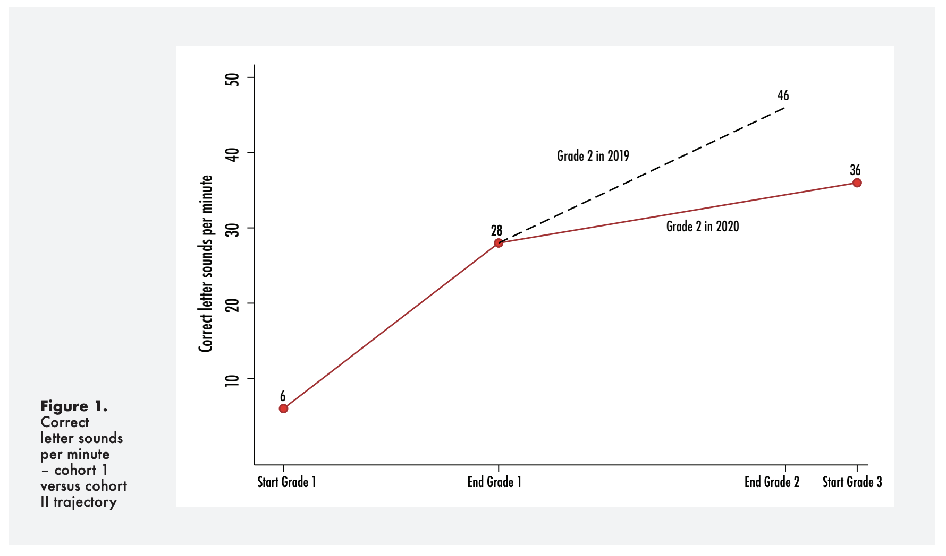
Flattening learning trajectories.

Slide 20
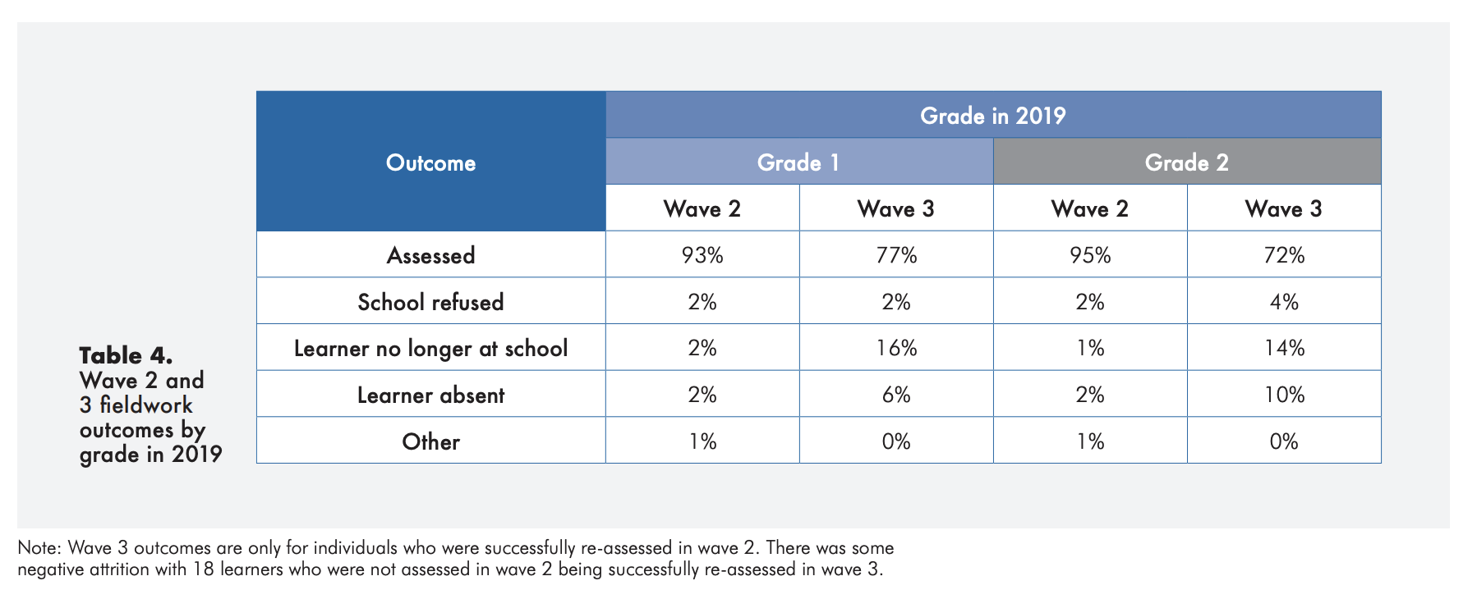
~ 15% dropout ?!

Slide 21
Where should we be intervening?
New Solutions for a New Future
Insurmountable learning deficits
Figure 10b: South African mathematics learning trajectories by national socioeconomic quintiles using a variable standard deviation for a year of learning (0.28 in grade 3 to 0.2 in grade 8 with interpolated values for in-between grades (Based on NSES 2007/8/9 for grades 3/4/5, SACMEQ 2007 for grade 6 and TIMSS 2011 for grade 9, including 95% confidence interval
(Spaull & Kotze, 2015)

Slide 22

“
“
Prevention is better than cure
FOUNDATIONS
“The later in life we attempt to repair early deficits, the costlier the remediation becomes’’
Nobel Laureate James Heckman (2000, p. 5).

Slide 23

“
What is the binding constraint to progress in this area?
“
PRIORITISE
“The binding constraints approach is based on the idea that not all constraints bind equally, and that a sensible and practical strategy consists of identifying the most serious constraints at work”
- Professor Dani Rodrik (2009: 6)

Slide 24
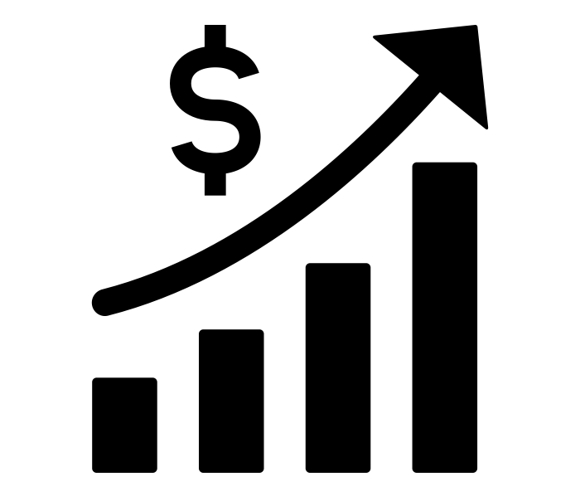
“
The best use of private money is influencing how public money is spent.
“
LEVERAGE
R387 Billion
R5,4 Billion
(1,4%)
2020/21 SA Government expenditure on education (Treasury, 2021)
Trialogue estimate of
all education CSI in SA in 2020
(50% of total CSI in SA)

Slide 25

Thank you

Slide 26

How many students actually make it to university?
}
?
Source: Van Broekhuizen & Van der Berg, 2016 (Higher Education Access and Outcomes for the 2008 National Matric Cohort)

