Slide 1


COVID-19, Learning Losses
& Dropout in SA
Evidence from NIDS-CRAM and learning assessments
19 Aug 2021
Nic Spaull
Associate Professor | Economics Department | Stellenbosch University
National income Dynamics Study (NIDS) Coronavirus Rapid Mobile Survey (CRAM)

Slide 2






Slide 3
Reminder of the situation pre-COVID (i.e. 2019)

Slide 4


Example questions from TIMSS 2019 Gr5:
700 – 28 = ____ [MN11128 – CAPS Gr3]
5 x 25 = ___ [MN11136 – CAPS Gr4]
(SA: 25%)
(SA: 38%)

Slide 5
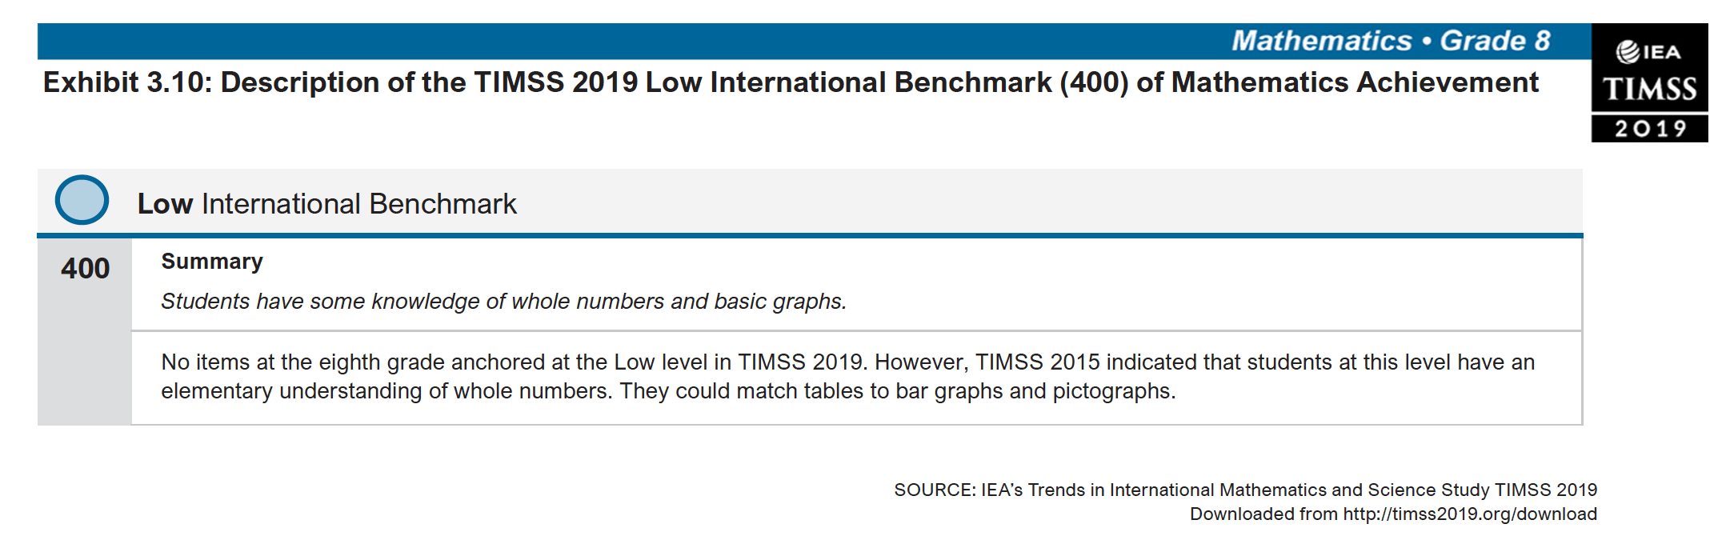


Low International Benchmark Gr9

Slide 6

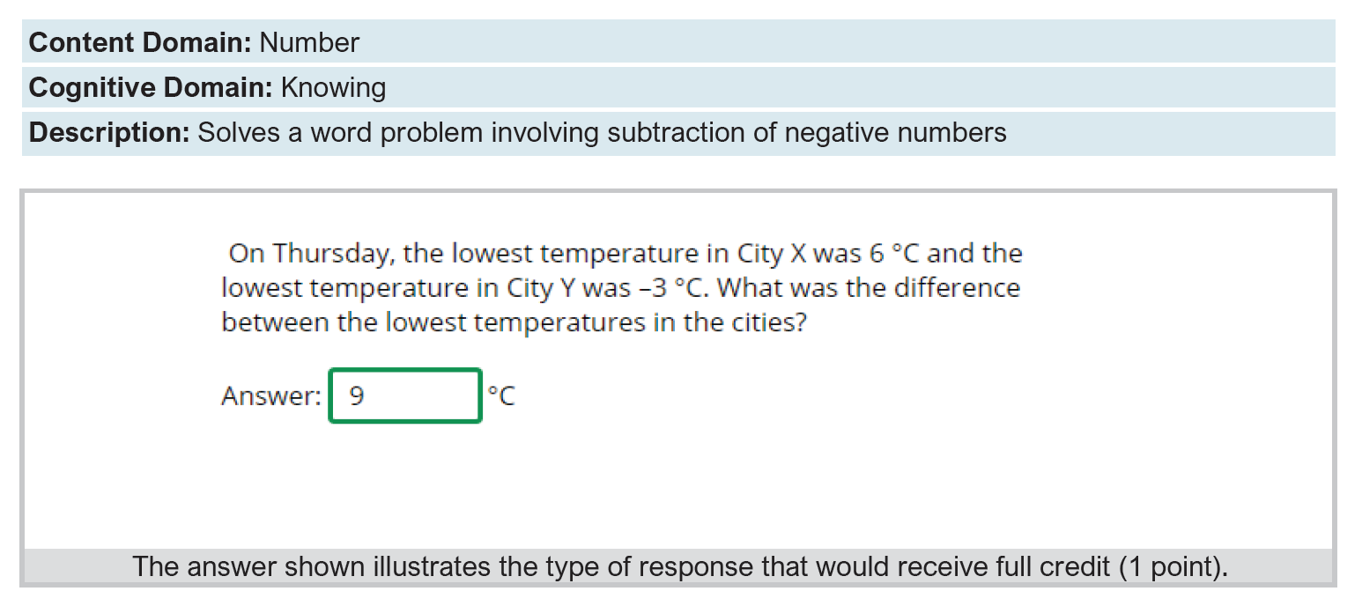
Intermediate International Benchmark

Slide 7






NIDS-CRAM is a public good
Overview: Largest non-medical study in SA at the moment.
  Broadly nationally representative telephonic survey available in all 11 languages.
  Sample drawn from existing NIDS 2017 survey.
  5 waves over the last year.
  30+ researchers, 6 universities
  Wave 5: 6 April to 11 May 2021
Data: All data (Waves 1-5) are freely available for download at DataFirst (https://www.datafirst.uct.ac.za/)
Research: All 67 Working Papers from Waves 1-5 are freely available for download at the NIDS-CRAM website (from 8 July) (www.cramsurvey.org)

Slide 8
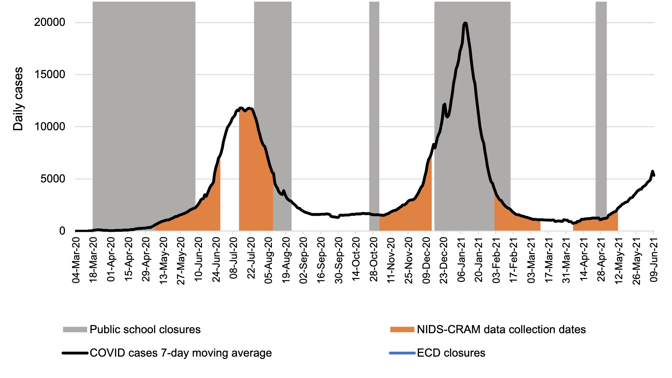
1
2
3
4
5

Slide 9
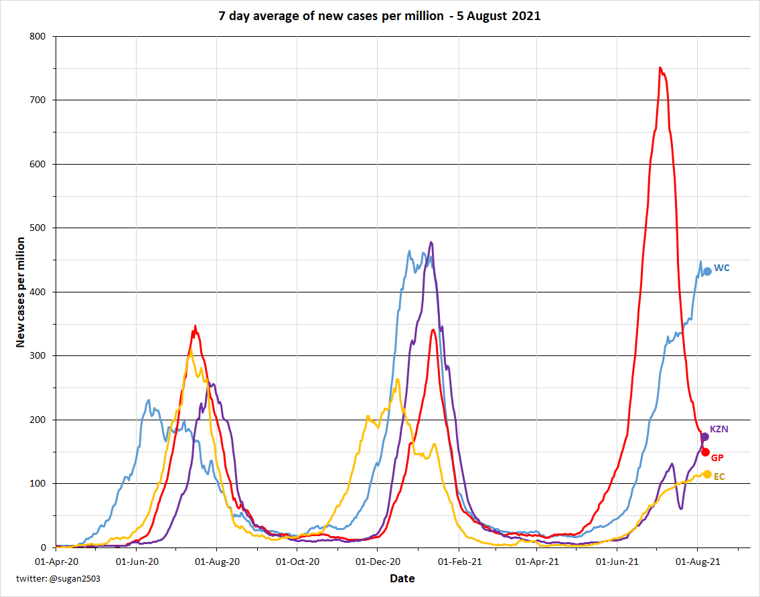
NIDS-CRAM Wave 5
6 April – 11 May 2021
W5

Slide 10
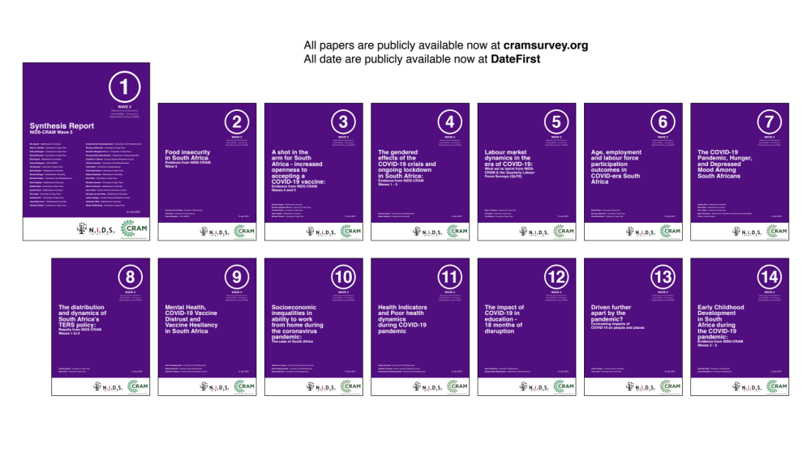
16 NIDS-CRAM Wave 5 Working Papers. Available at cramsurvey.org from 8 July 10am

Slide 11

cramsurvey.org

Slide 12
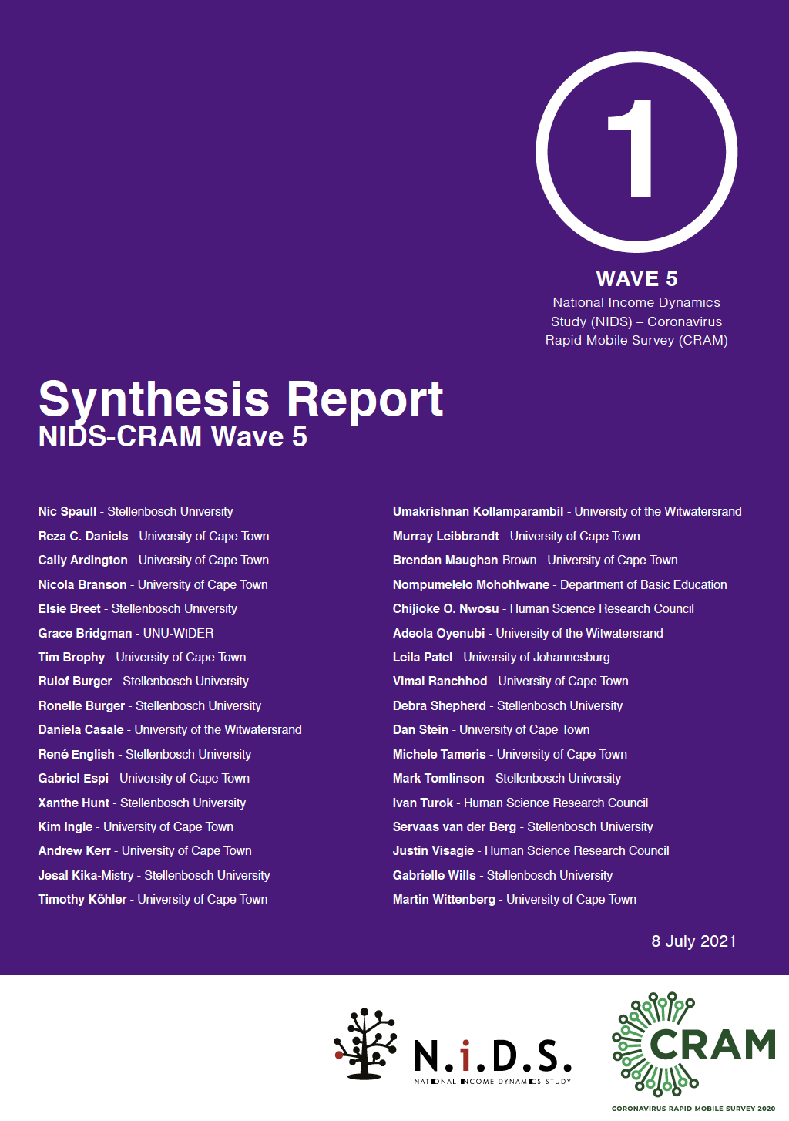

Wave 5: 6 April – 11 May 2021

Slide 13
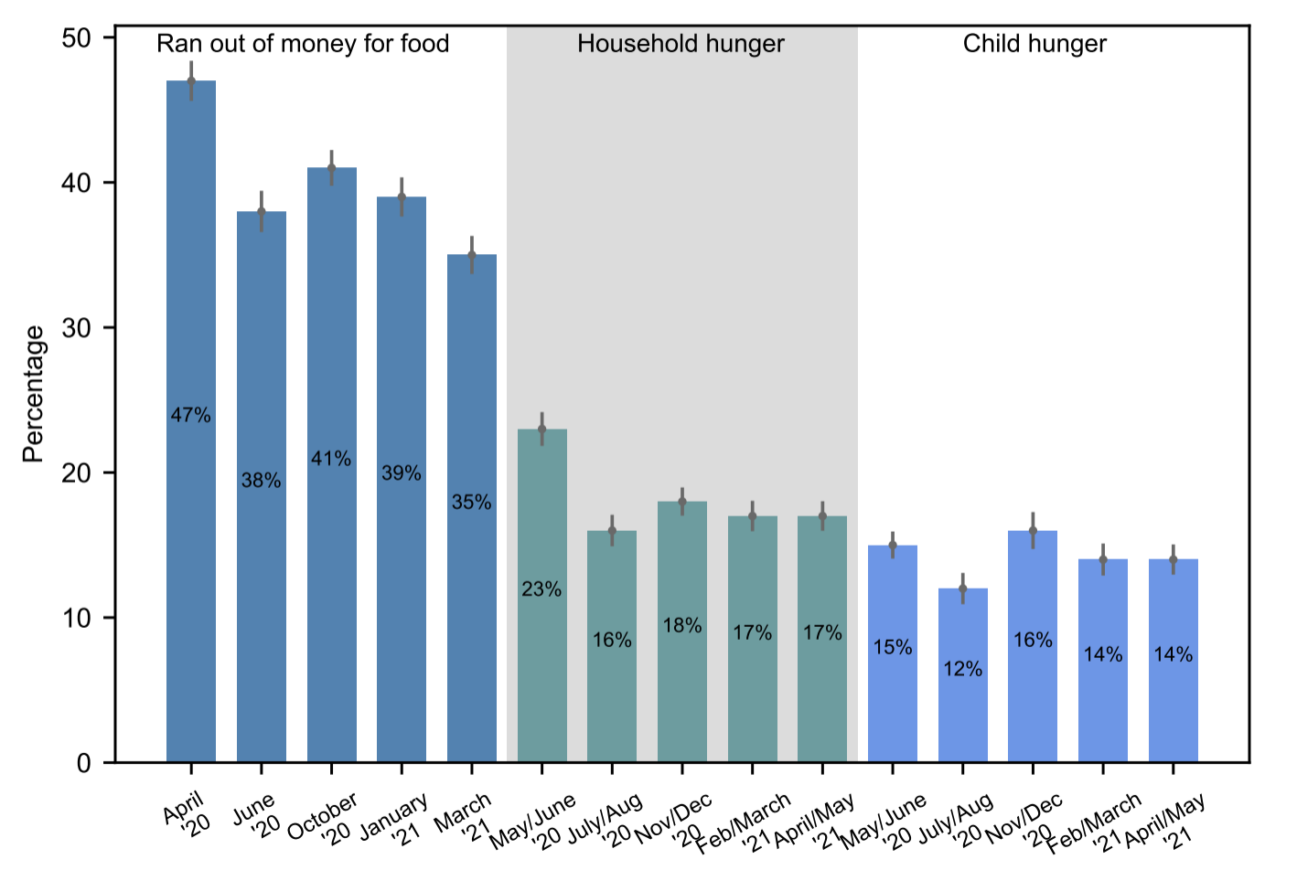
Hunger
Child hunger remains extremely high at 14% in the past week in April/May 2021 Hunger sems to have stabilised at a new (higher) rate both for adults and children.
Women were more likely to shield children from hunger than men.
Source: Van der Berg et al., 2021 (W5)

Slide 14
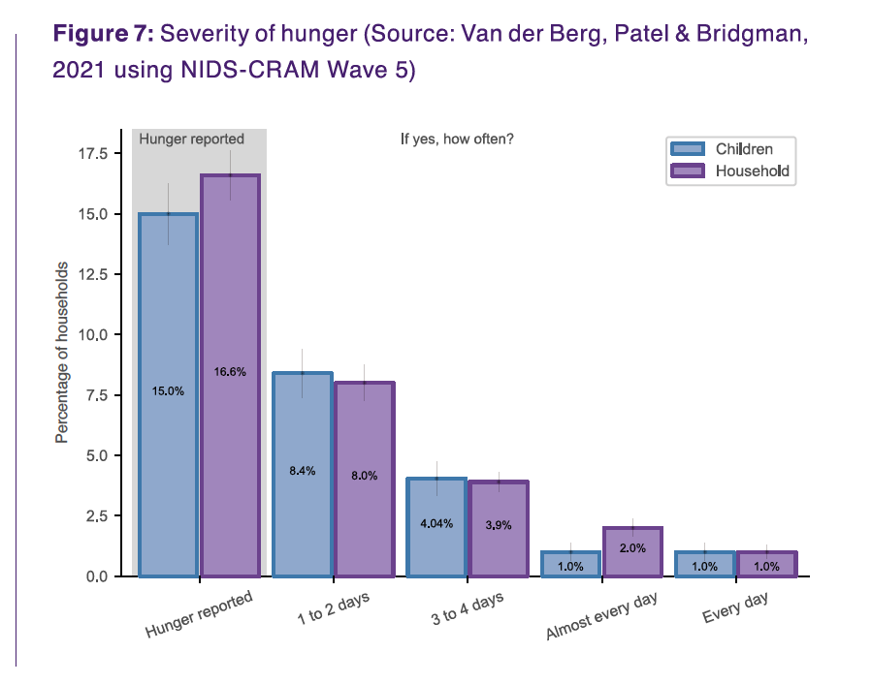
Hunger
Approximately 10-million people and 3-million children were in households affected by hunger in April/May 2021 (Wittenberg & Branson, 2021)
Perpetual hunger
(every day or almost every day):
1,8million people
400,000 children
Source: Van der Berg et al., 2021 (W5)

Slide 15

MENTAL HEALTH
03
Slide: Debra Shepherd

Slide 16
Figure 10: Population of people affected by depressed mood at single time points compared to population ever affected by depressed mood
NEARLY ONE THIRD OF RESPONDENTS HAD DEPRESSED MOOD IN EITHER WAVES 3 OR 5 OF NIDS-CRAM (increase from Wave 2)
Source: Hunt et al (2021) using NIDS-CRAM Waves 2, 3 and 5 data
Slide: Debra Shepherd

Slide 17
Figure 10: Population of people affected by depressed mood at single time points compared to population ever affected by depressed mood
NEARLY ONE THIRD OF RESPONDENTS HAD DEPRESSED MOOD IN EITHER WAVES 3 OR 5 OF NIDS-CRAM (increase from Wave 2)
Half (53%) of respondents screened positive for depressed mood in at least one of these three time periods.
Source: Hunt et al (2021) using NIDS-CRAM Waves 2, 3 and 5 data
Slide: Debra Shepherd

Slide 18
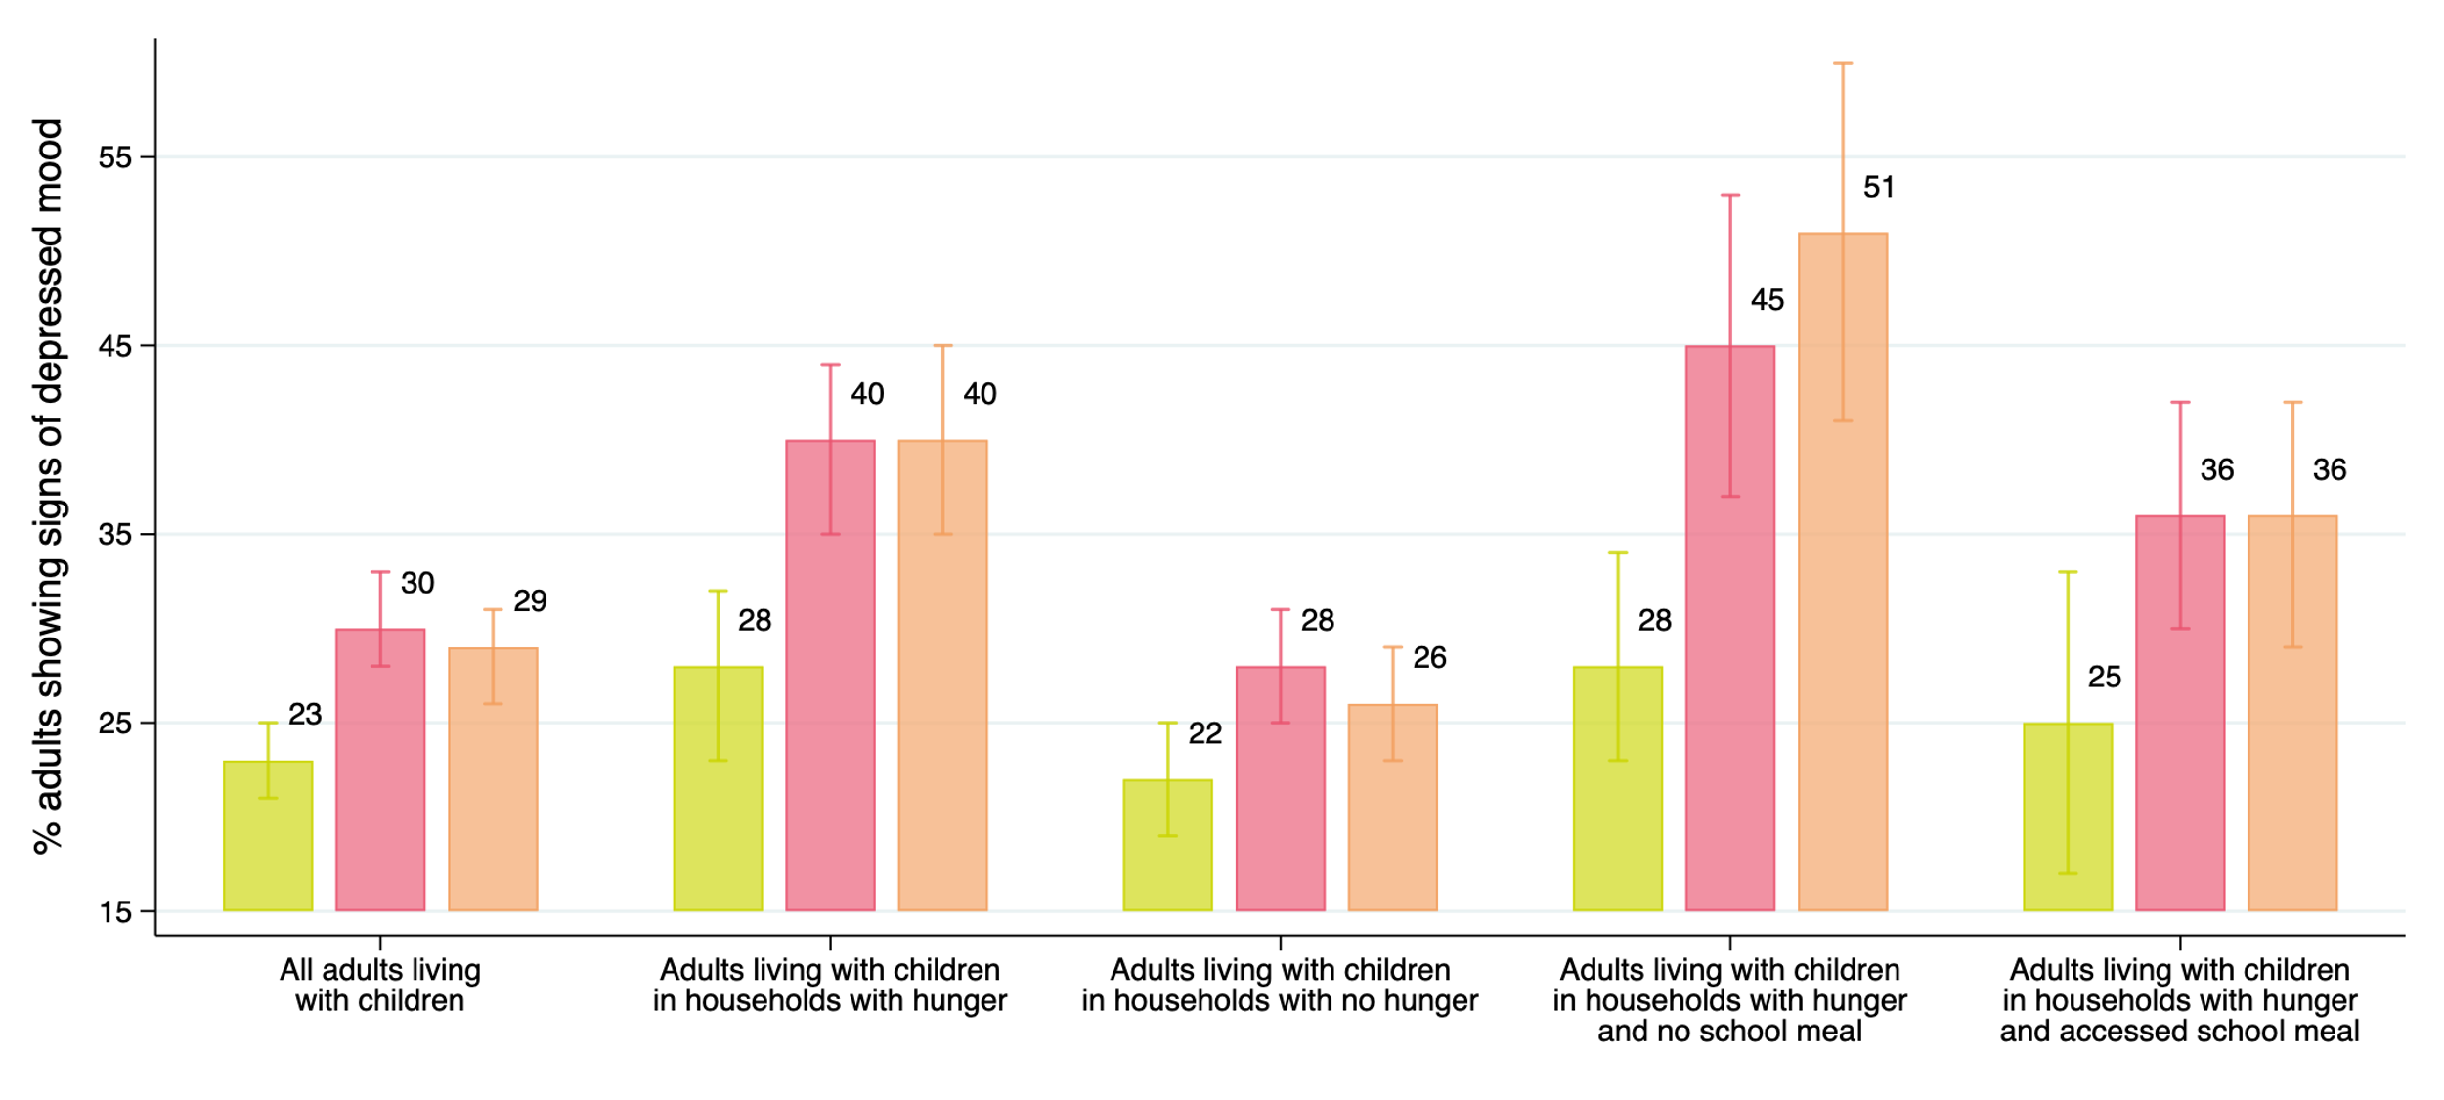
40% OF ADULTS LIVING WITH CHILDREN IN FOOD INSECURE HOUSEHOLDS SHOW SIGNS OF DEPRESSED MOOD IN APRIL 2021.
Figure 10: Rate of adult depressive mood by household food insecurity in July 2020 (), November 2020, and April 2021
This is compared to 26% amongst those living with children in food secure households.
Source: Shepherd and Mohohlwane (2021) using NIDS-CRAM Waves 2, 3 and 5 data
Slide: Debra Shepherd

Slide 19
THIS PROPORTION RISES TO 51% WHEN WE CONSIDER FOOD INSECURE HOUSEHOLDS THAT REPORT LACK OF CHILD ACCESS TO FOOD AT SCHOOL.
Figure 10: Rate of adult depressive mood by household food insecurity in July 2020 (), November 2020, and April 2021
Source: Shepherd and Mohohlwane (2021) using NIDS-CRAM Waves 2, 3 and 5 data

Slide 20
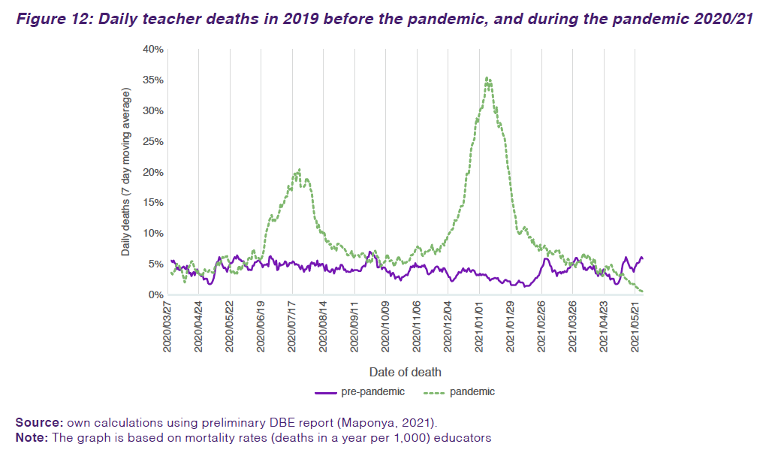
Teacher mortality
According to the excess-death analysis of teacher payroll (PERSAL) data, a total of 171 excess teacher deaths were recorded Term 1 (15 February to 26 April 2021), representing the first term of the 2021 school year. This is compared to 1,123 excess teacher deaths recorded over the 8-week December/January holidays that coincided with the second wave of infections.
There is no apparent association between the timing of schools being open and increased spread of the virus (NICD, 2021)
Source: Shepherd & Mohohlwane, 2021 (W5)

Slide 21
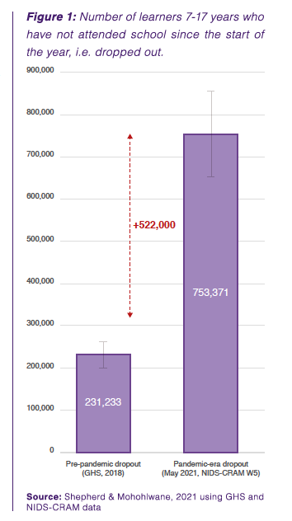
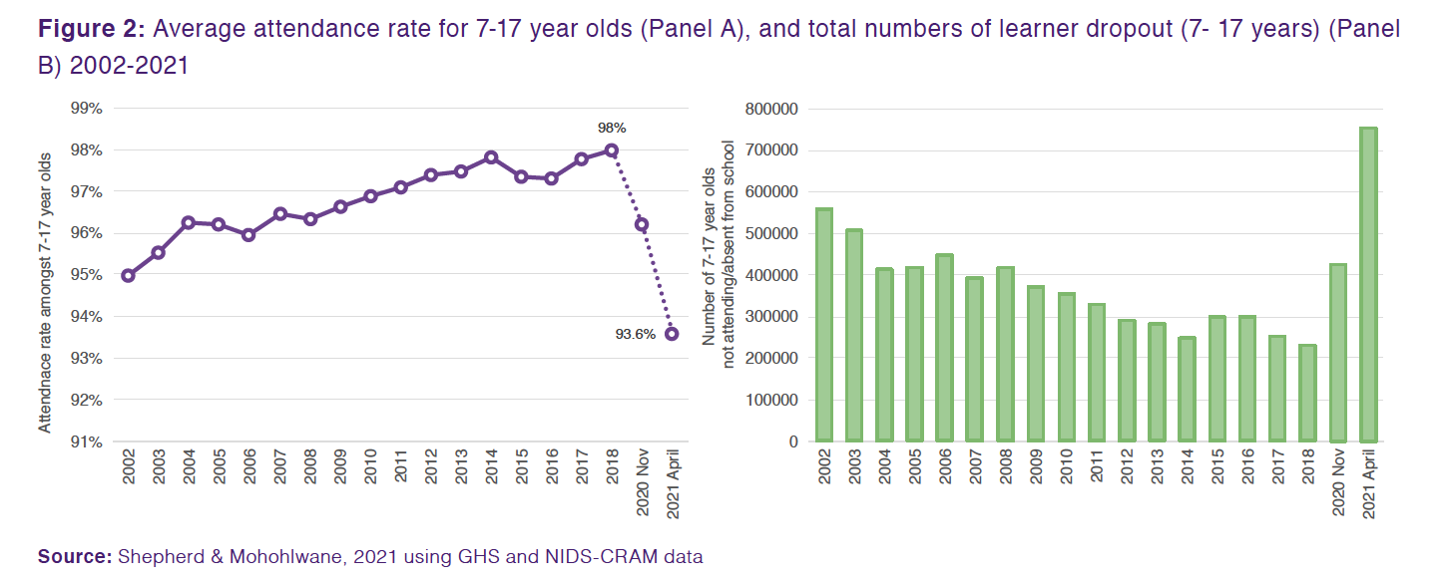
Dropout
An extra 500,000 children have dropped out of school during the pandemic. School dropout has tripled from 230,000 pre-pandemic to approximately 750,000 in May 2021, it is now at the highest rate in at least 20 years.

Slide 22
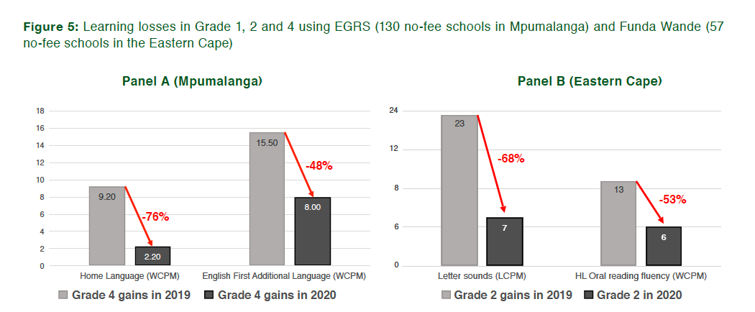
Learning losses
Extrapolating from Wave 4 reported learning losses using known number of lost days up to June 2021, children in no-fee schools have learnt
70 - 100% less
By June 2021 compared to what they normally learn.
Source: Shepherd & Mohohlwane, 2021 (W5)

Slide 23
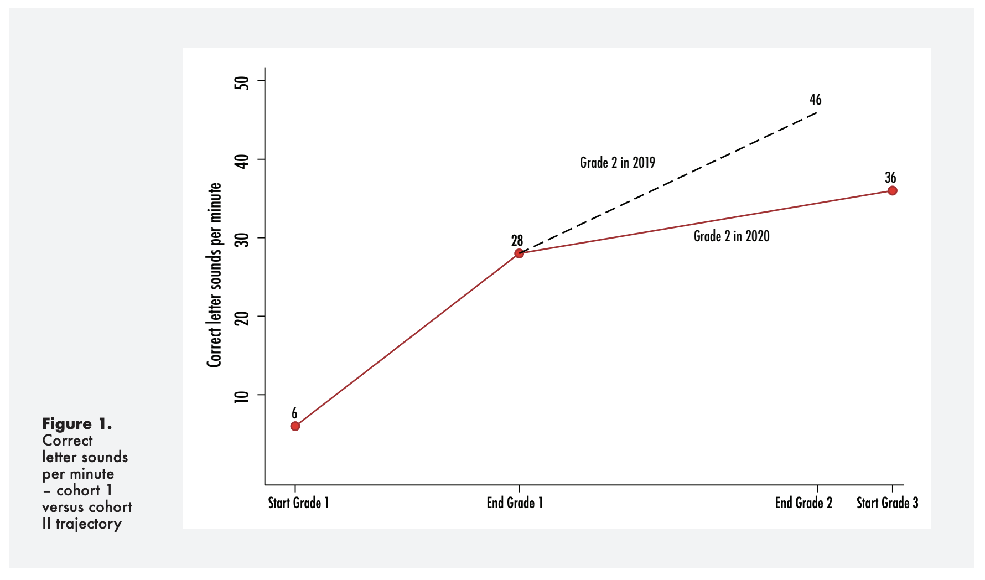
Flattening learning trajectories.

Slide 25
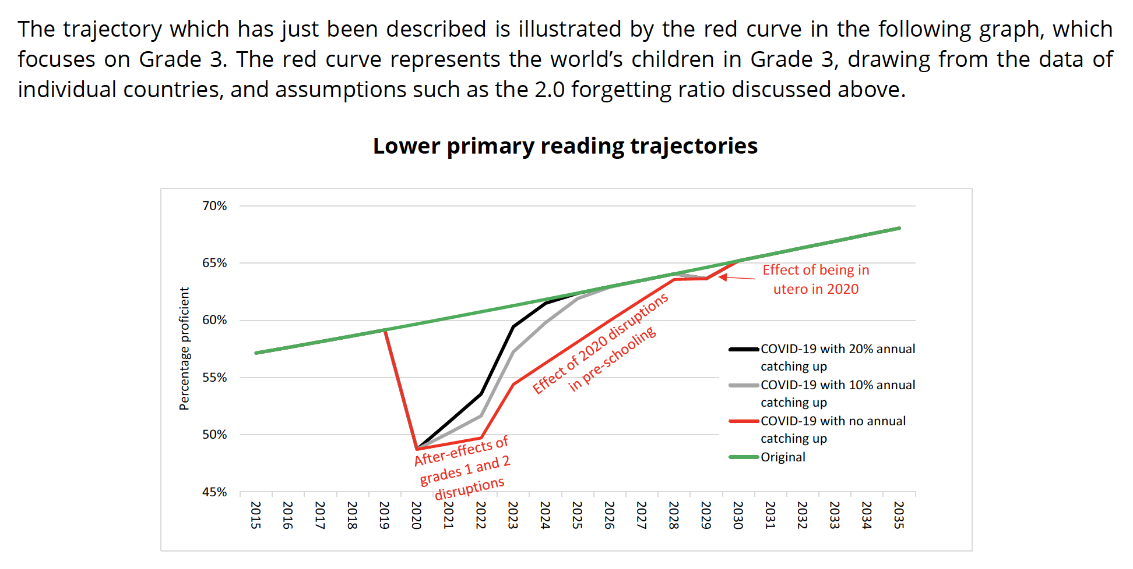

Slide 26
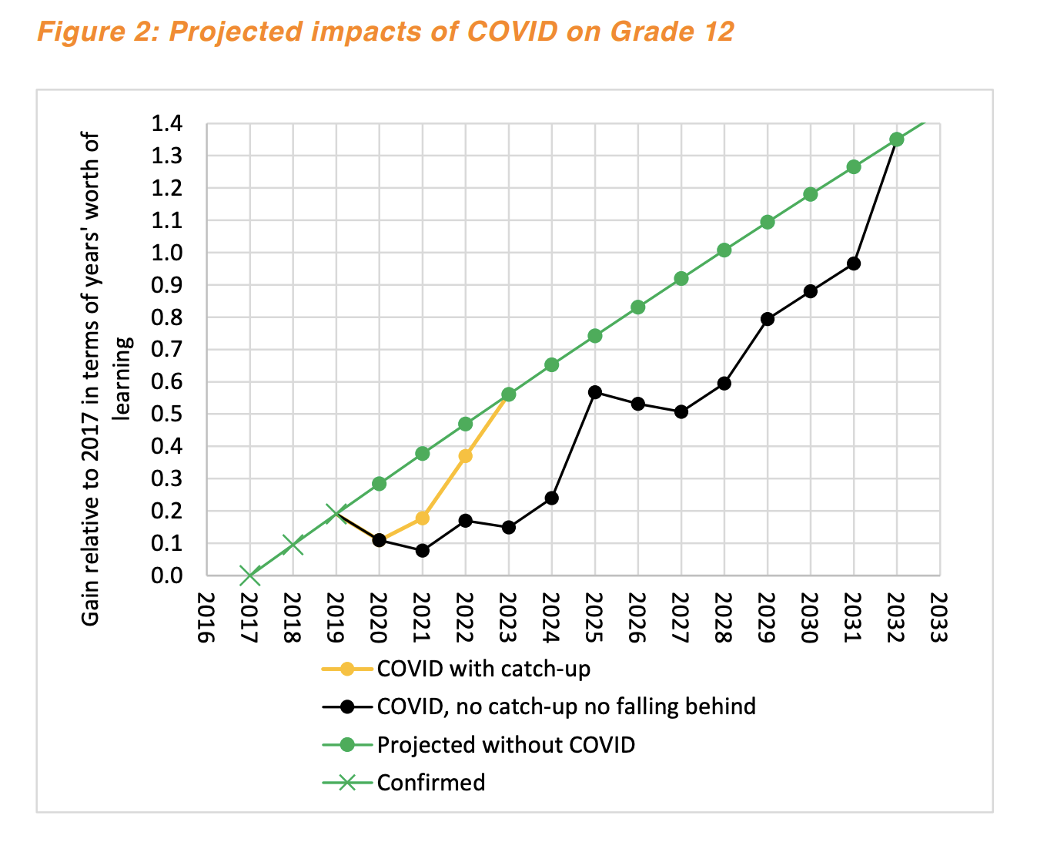
“Without catching up, the skills of Grade 12 graduates would be lower than in the no-pandemic scenario for a decade up to 2031.”

Slide 27
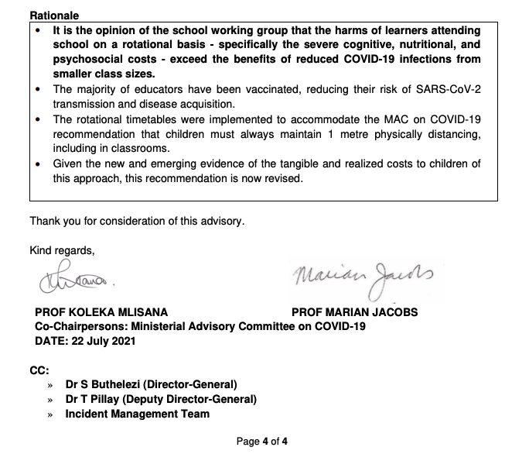
MAC recommendation RE schools
(July 2021)
https://t.co/anlOi0yvJh?amp=1

Slide 28
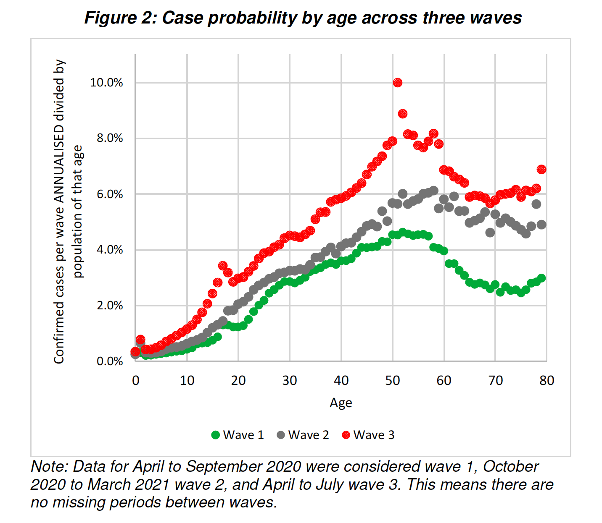
(Source: Gustafsson, 2021)
"The August 2021 NICD report shows that this is still true even for the Third Wave "The national demographic trends have remained unchanged in this reporting period, children aged <10 years had the lowest incidence risk and individuals aged 40-59 years had the highest incidence."
Also this: "As of 19 June 2021, individuals aged ≤19 years made up 13.4% of SARS-CoV-2 tests, 10.2% of laboratory-confirmed COVID-19 cases, 4.2% of all COVID-19-associated admissions and 0.7% of COVID-19 associated deaths."
It is a tragedy when anyone dies of COVID-19, especially a child. Parents are also understandably worried about their children given that we are in a pandemic. Although it is extremely extremely rare that children die of COVID-19, it is not impossible. For example, there are 21,825,534 children aged 19 or younger. Since the beginning of the pandemic last year 380 children died of COVID-19. that is to say 0,0017% of children." Children are far more likely to die of many other things than COVID-19. Including diarrhoea, pneumonia, TB etc.

Slide 29
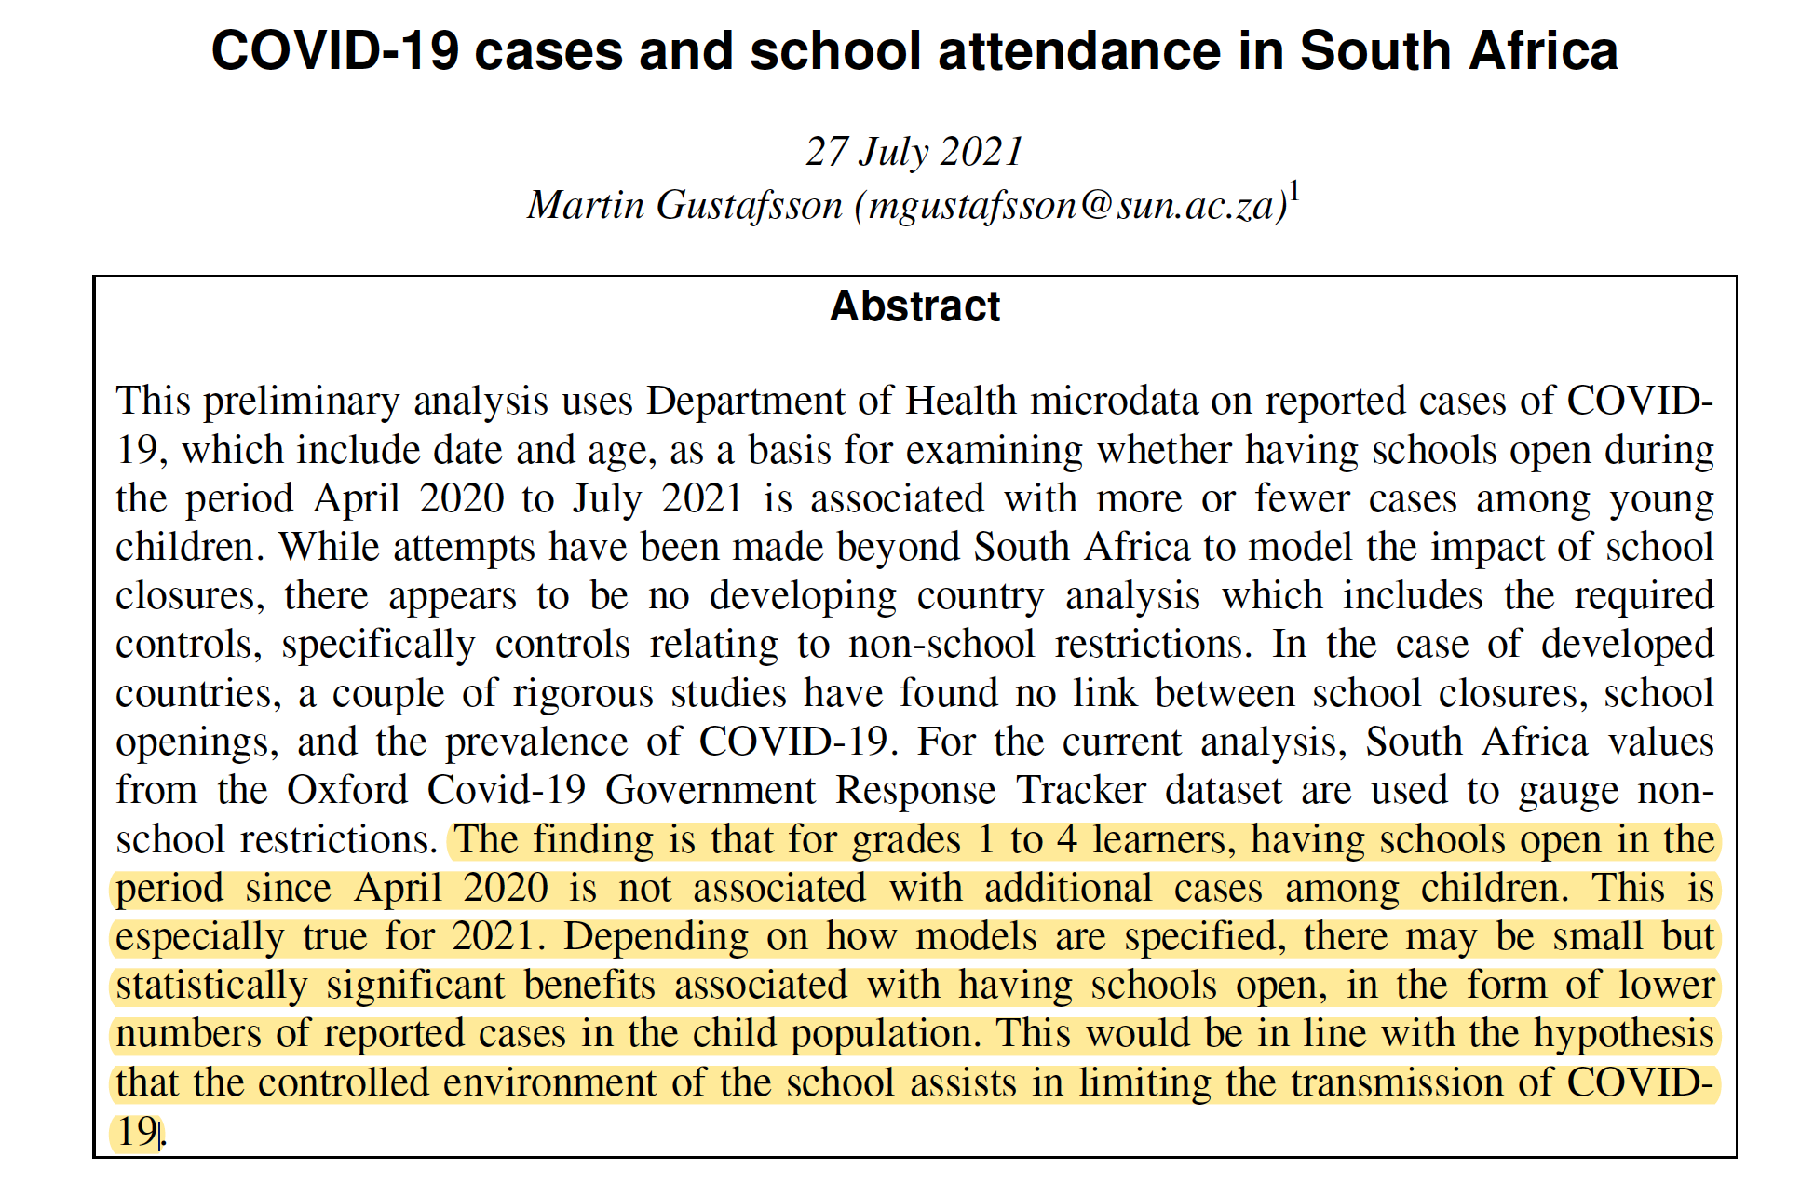

Slide 30
Thoughts for WC

Slide 31
Not ‘business-as-usual’ teaching for 2021/22
Trimmed curriculum in 2020 was aware of limited time for teaching.
Current 2021 ATP’s are identical to pre-COVID ATPs. Covers full CAPS but in half the time.
Focus on early grades (arguably biggest losses) reading and mathematics
Existing pilot

Slide 32
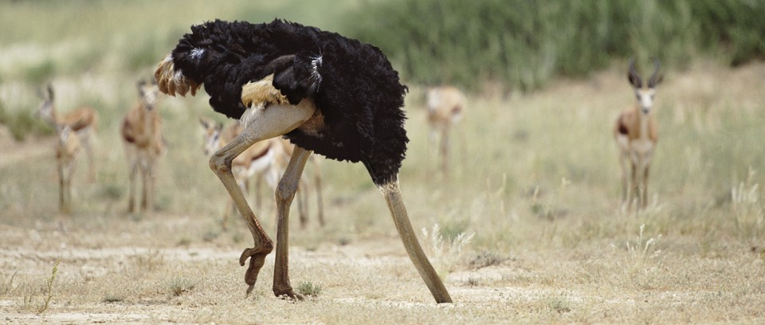

Slide 33

Biggest need is in the lowest grades.
WCED is in the fortunate position of having a fully-fledged Grade 1 program for literacy and numeracy in Afrikaans and isiXhosa. Already piloted in 50 schools.
Read. Write. Calculate

Slide 34
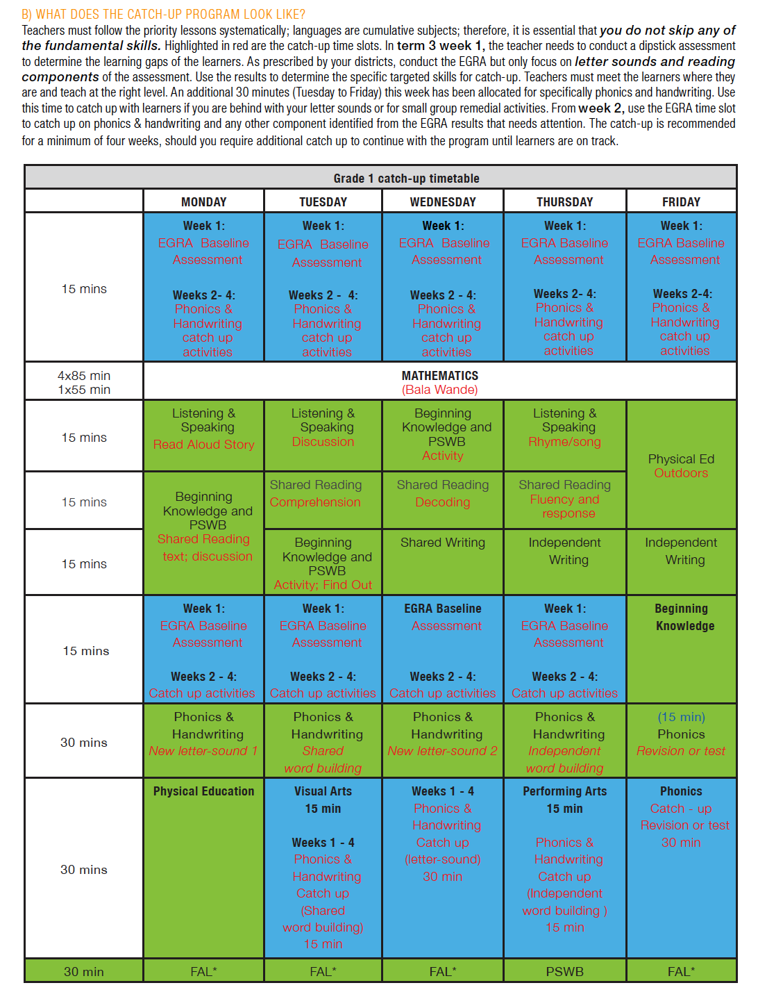
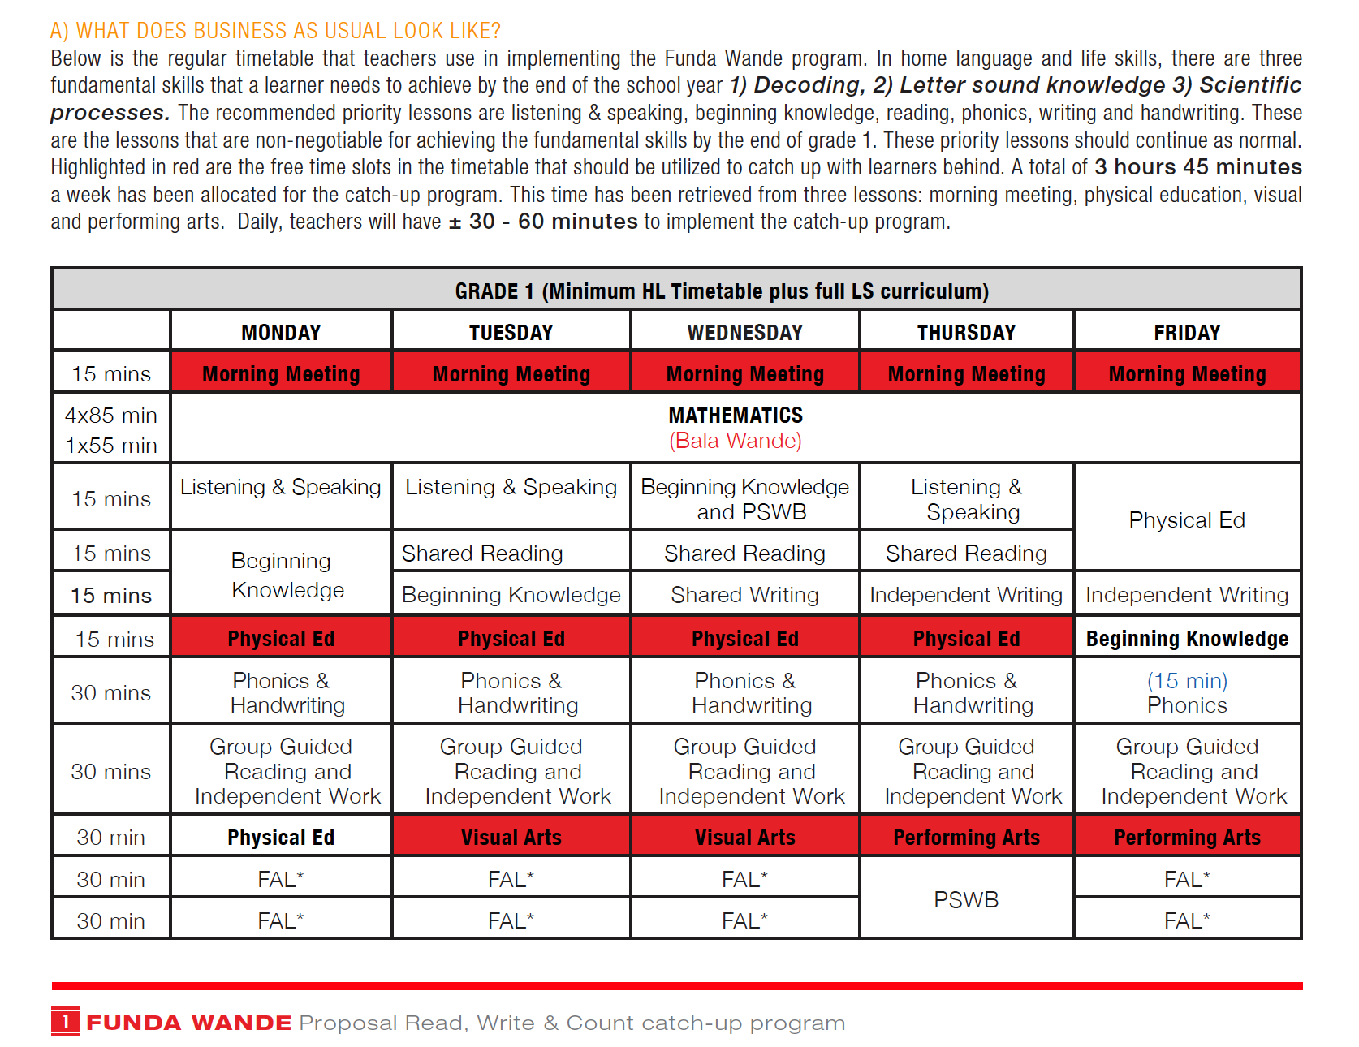

Slide 35


Slide 36


Slide 37
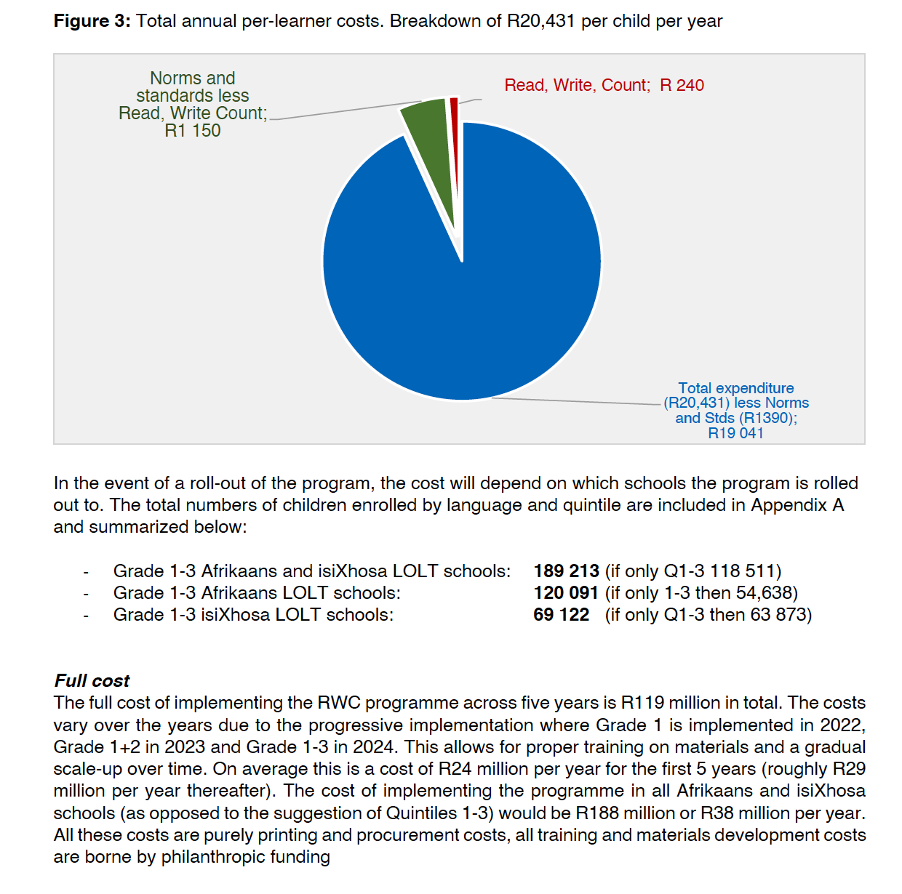
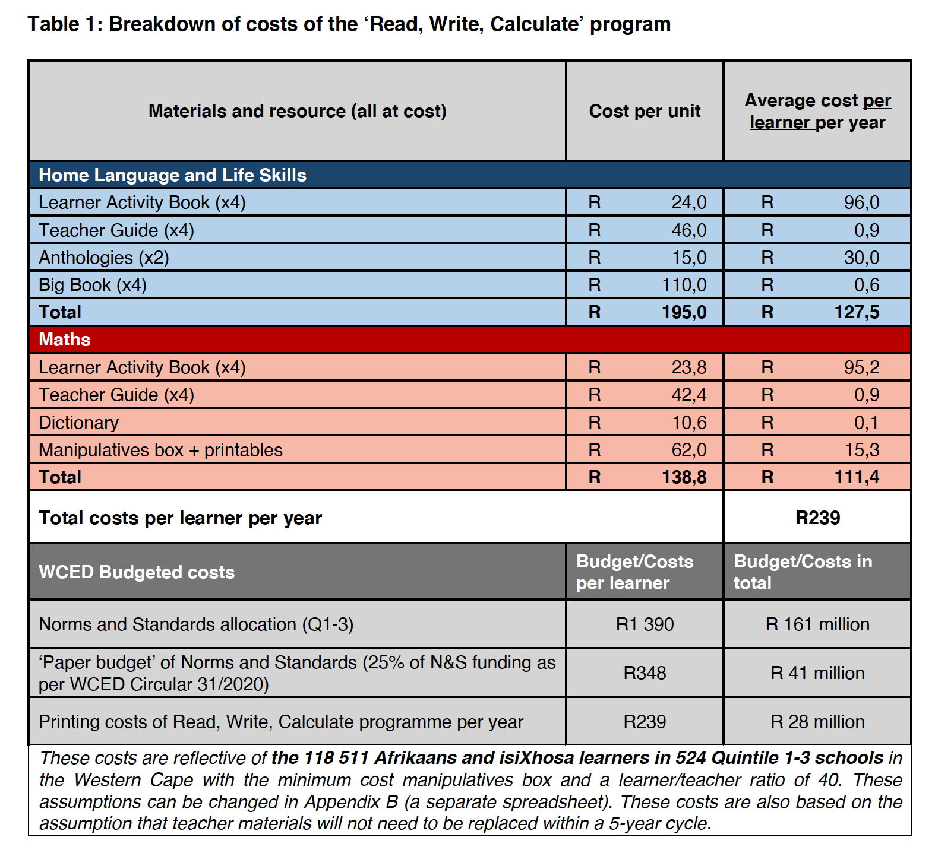

Slide 38
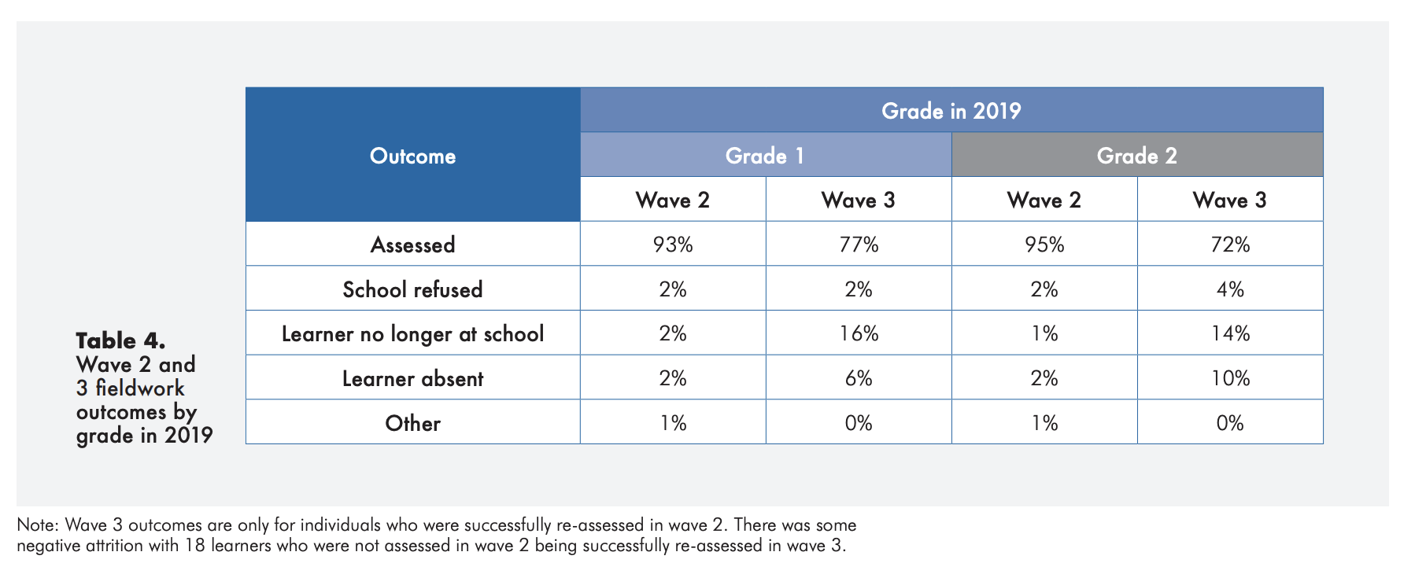
~ 15% dropout in EC?!

Slide 39

Vaccination in South Africa
(1) The binding constraint to economic recovery in SA is the vaccination rate.
(2) The binding constraint to the vaccination rate is not vaccinating on weekends.

Slide 40
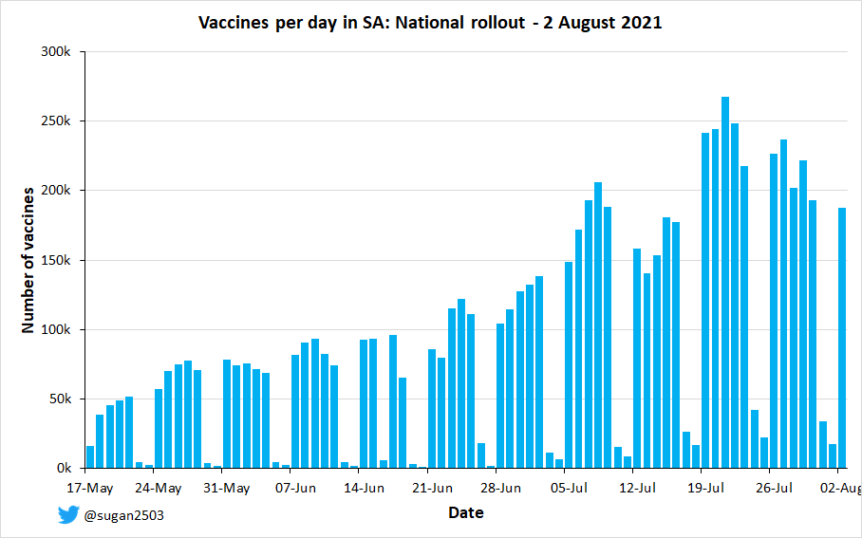
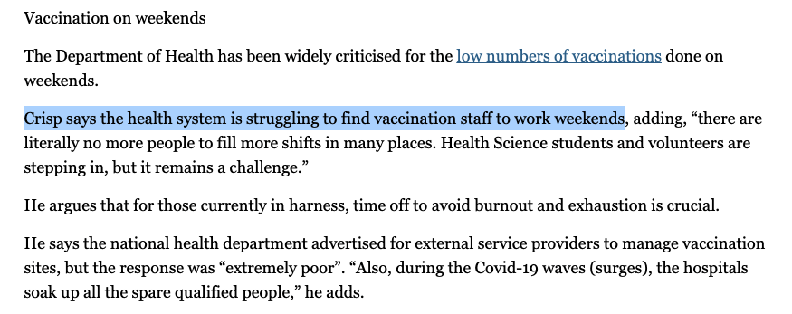
On Sunday 1 August only 22,601 vaccines administered (13% of regular weekday, 180,000)
Announcement that vaccinations on weekends will commence 1Aug

Slide 41
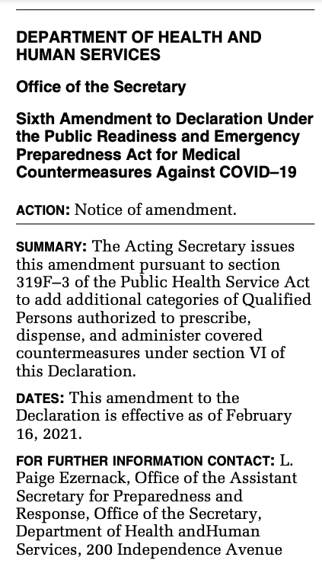
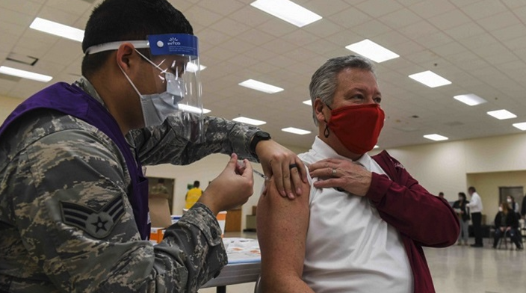

Vaccines
No reason why only nurses should be able to administer vaccines.
  US Army vaccinated over 1-million people: In Feb 2021 US passed the Public Readiness and Emergency Preparedness Act (PREP) for Medical Countermeasures Against COVID-19 limiting the liability of military personnel and allowing them to administer vaccines.
HPCSA must comply – it’s a disaster
  If the Health Professions Council of SA (HPCSA) is obstinate that only nurses can administer injections they should be summoned to parliament.
  Even if funds are released to pay nurses for overtime, people cannot work 8am to 8pm Monday-Sunday for 6-months.
  SA has 70,000 Community Health Workers who can be trained and supervised by registered nurses at large sites (CTICC) with medical oversight.

Slide 42
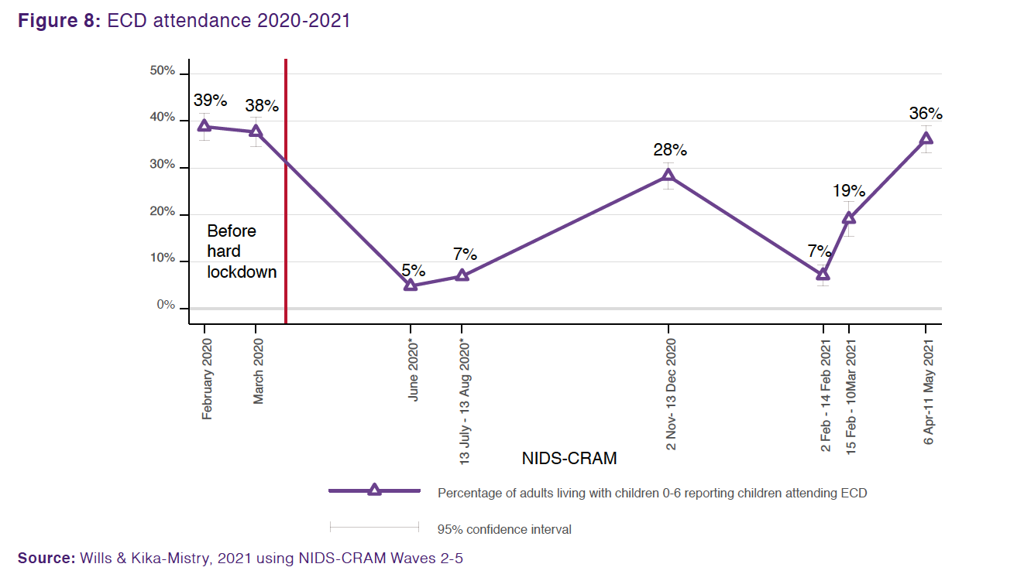
ECD
ECD attendance has recovered remarkably to 36% in April/May 2021. This is very close to pre-pandemic levels (39% in Feb 2021)
Notes:
Of those men who were employed in February 2020, 78% were still employed in January 2021. For women the figure is only 70%. Women were more likely to be in sectors that were hardest hit by the crisis.

Slide 43
Vaccination in South Africa

Slide 44
Binding constraint to social and economic recovery is the rate of vaccination.
Single biggest factor limiting vaccination is the lack of vaccinations on weekends
Speaking about vaccine hesitancy does not make sense at the present moment.

Slide 45
The government is already well behind its own vaccination plan having only vaccinated 3-million of a forecasted 5-million people (i.e. 60% of the target).
Supply is no longer the issue (we have 7,4million doses in SA now, have had more than able to inject since May).
Vaccines

Slide 46
Vaccines
No weekend vaccinations means
1,3-million fewer jabs between 17 May & 5 July 2021

Slide 47


Department of Health Spokesperson Dr Lwazi Manzi (23 June 2021):
“Basically, the provinces indicated they don't have the budget to be able to pay the overtime over weekends.”
“Provincial administration health budgets were all cut and all remuneration of employees budgets were frozen. This is common knowledge,” Dr Nicholas Crisp, deputy director-general of health, said last week when City Press sister publication Rapport asked him about the sluggish vaccination rate over the weekends. (4 July 2021)
However, Treasury says that the health department has not yet applied for emergency funds
Funding? (R9bn COVID-19 contingency in Feb 2021 budget).
“We have not yet received any such request and the claimed response about the National Treasury is incorrect,” a spokesperson said when contacted. (4 July 2021)

Slide 48

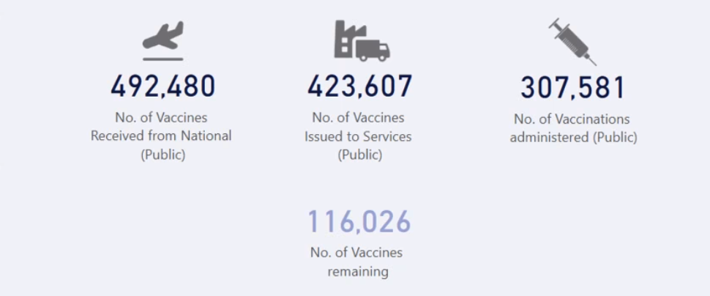
Supply?
Funding?
WC Treasury made R800m
available as COVID reserve
WC only administered
62%
of doses it has on hand.

Slide 49
The DBE reports that on Wednesday the 23rd of June 48,000 teachers and administrative staff were vaccinated across seven provinces. Limpopo chose to administer vaccines on two successive weekends instead, and on the first weekend alone managed to achieve 30,000 vaccines - higher than any of the other provinces.
Vaccines administered Tuesday 6 July 2021: 28 502
100%
Vaccines administered on Sunday 4 July 2021: 1 072
4%

Slide 50
Vaccines
No reason why only nurses should be able to administer vaccines.
  US Army vaccinated over 1-million people: In Feb 2021 US passed the Public Readiness and Emergency Preparedness Act (PREP) for Medical Countermeasures Against COVID-19 limiting the liability of military personnel and allowing them to administer vaccines.
HPCSA must comply – it’s a disaster
  If the Health Professions Council of SA (HPCSA) is obstinate that only nurses can administer injections they should be summoned to parliament.
  Even if funds are released to pay nurses for overtime, people cannot work 8am to 8pm Monday-Sunday for 6-months.
  SA has 70,000 Community Health Workers who can be trained and supervised by registered nurses at large sites (CTICC) with medical oversight.

Slide 51

Vaccination
Pay nurses overtime for the month of July (irrespective of if you have the money)
  The costs to the WC government of a fully-fledged Third and Fourth wave are orders of magnitude higher than overtime costs for nurses for evenings and weekends
Announce that from 10 July all vaccine sites will operate on weekends in WC
  Draft legislation providing a liability waiver for trained and supervised Community Health Workers and medical students to give vaccines under the supervision of a registered nurse.
  Submit formal request addressed to the Acting Minister of Health and the President of HPCSA requesting comment on the attached draft legislation allowing selected and trained Community Health Care Workers to vaccinate under supervision of nurses.
  Employ nurses (and pay overtime) to oversee CHW’s who vaccinate on weekends and after hours (4-8pm) on a 1:4 ratio (1 nurse to 4 CHWs)
Not business as usual
  What is the point of issuing a Disaster Management Act if the powers delegated to government are not used to avert the disaster. It’s very clear now that the only way out of this is increased vaccination rates and that’s not possible if (a) we don’t vaccinate on weekends and evenings, and (b) if more people are not authorized to give vaccines. Nurses will burn out.
Community Health Workers
&
Medical Students
https://www.federalregister.gov/documents/2021/02/16/2021-03106/sixth-amendment-to-declaration-under-the-public-readiness-and-emergency-preparedness-act-for-medical

Slide 52
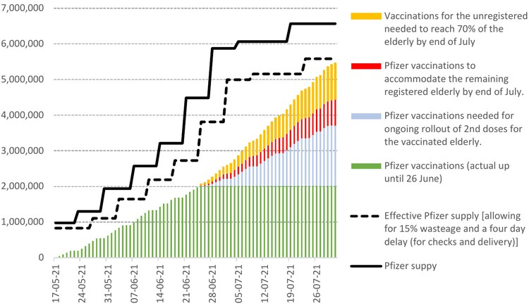

Slide 53
“The Department of Health’s target for the end of June 2021 was to administer 5-million doses, of which it managed to achieve only 3-million (60% of the target).
Had weekend vaccinations been planned for, the estimate is that approximately 4,3-million or 86% of the target would have been administered by end June 2021 (to ensure 40-million South Africans are vaccinated by the end of February 2022).
Perhaps more importantly this would have gone a long way towards ensuring that the lion’s share of the 5,5-million target for the high-risk 60+ category could’ve been met. This is critical given the high infection and mortality risk that the eldery are facing during the winter months of June and July. Given this demographic group’s share of COVID-19 hospital cases, weekend vaccinations would also have had a substantial impact on lightening the burden that hospitals are now facing during wave 3.

Slide 54
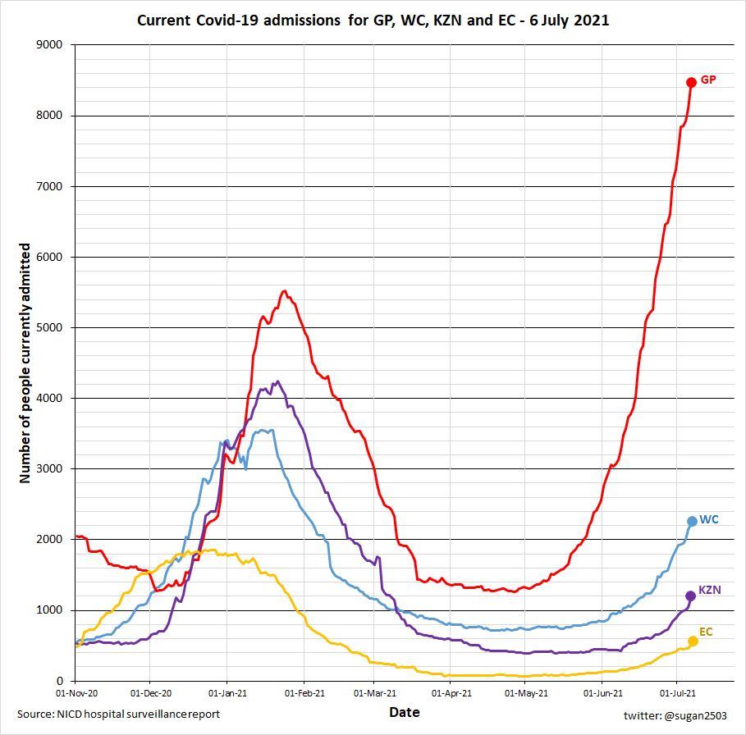
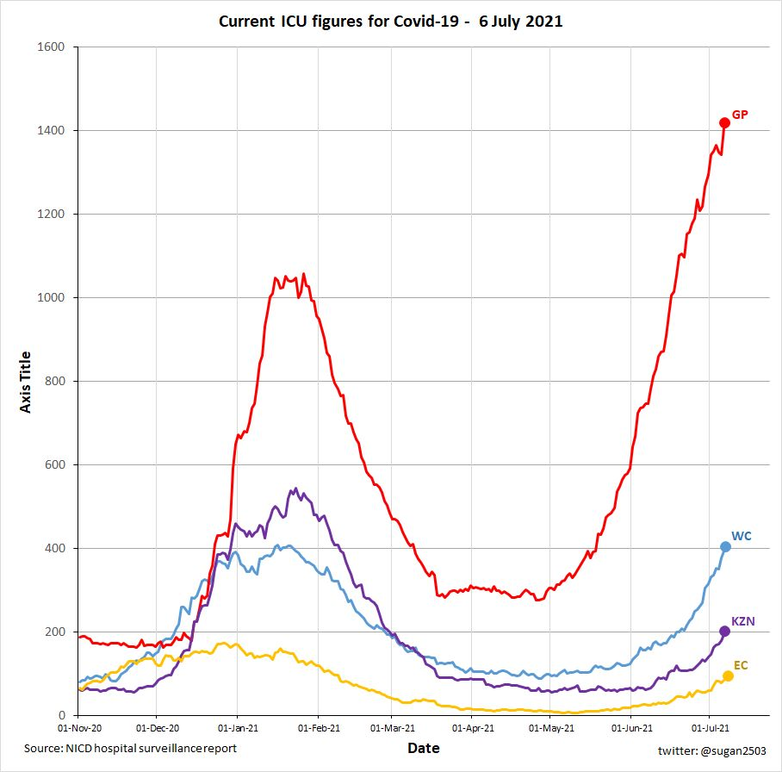

Slide 55
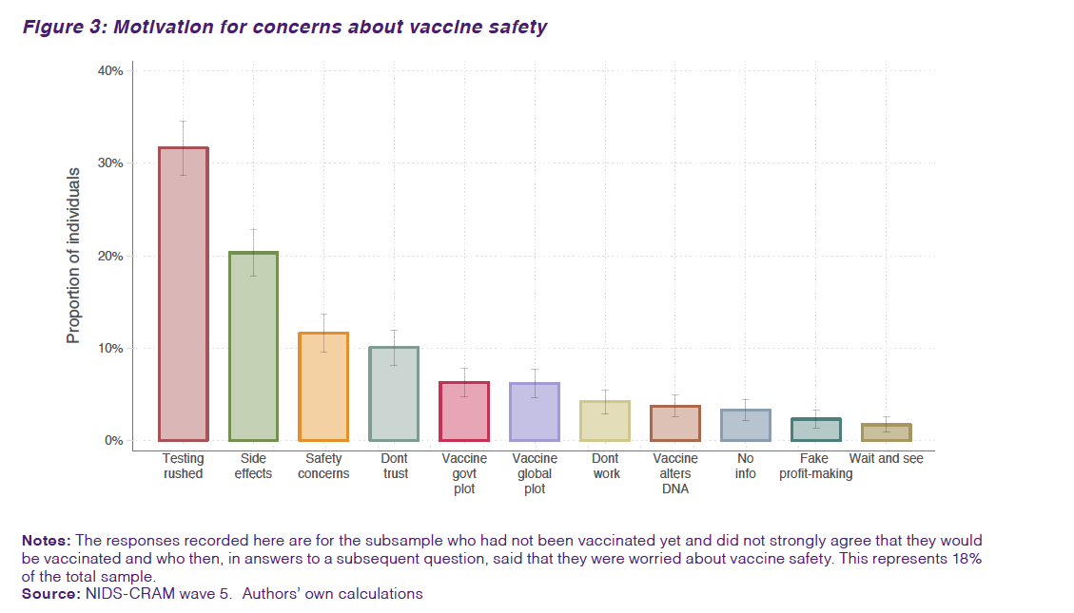
Vaccines
18% of total sample with concerns about vaccine safety…
Source: Burger et al. 2021 (W5)

Slide 56
Employment
(1) There was also a high prevalence of temporary employment transitions among those who remained
in one state in both periods. Among those employed in both periods, 32% lost their job between Feb 2020 and March 2021. Among those non-employed in both periods, 24% were employed at some point in-between
Churning
(2) Labour market transitions from the hard lockdown in April 2020 to March 2021. Job finding was high relative to historical rates among all those without work in April 2020, with active job searching most strongly associated with employment in March 2021. A striking 44% of the April 2020 searching unemployed were employed by March 2021, compared to 37% of discouraged work seekers and 22% of the not economically active.
Source: Espi et al, 2021 (W5)

Slide 57
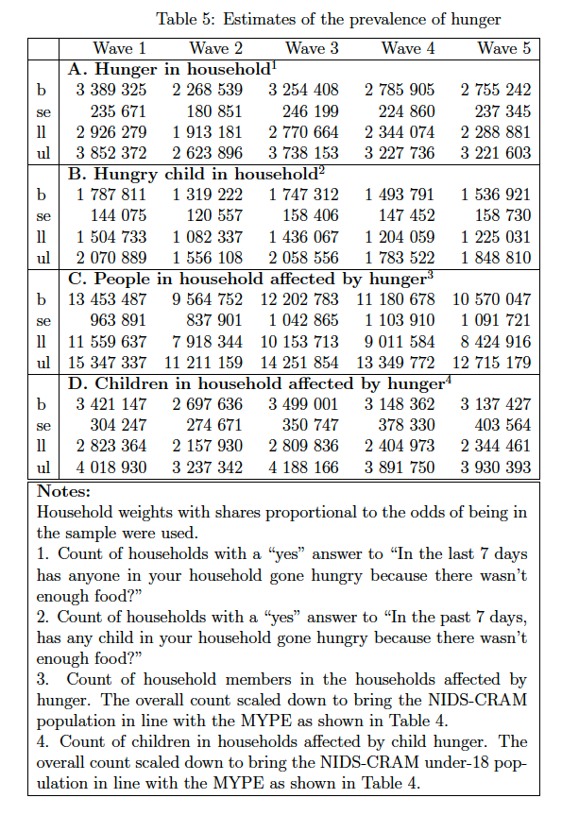
Hunger
Approximately 10-million people and 3-million children were in households affected by weekly hunger in April/May 2021
(Wittenberg & Branson, 2021)
Source: Wittenberg & Branson, 2021 (W5)

Slide 58


Slide 59
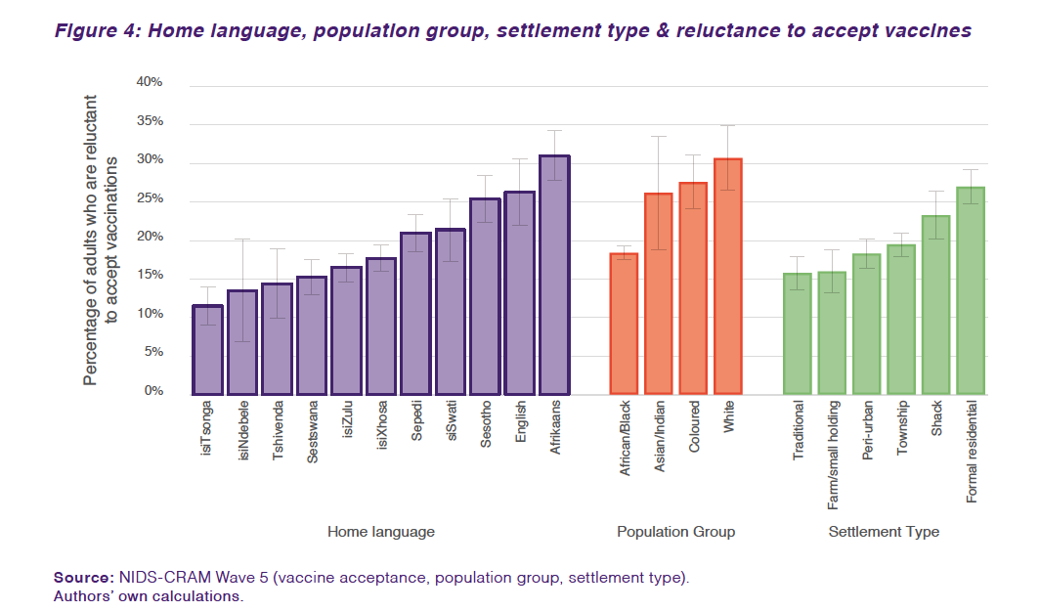
Source: Burger et al. 2021 (W5)

Slide 60
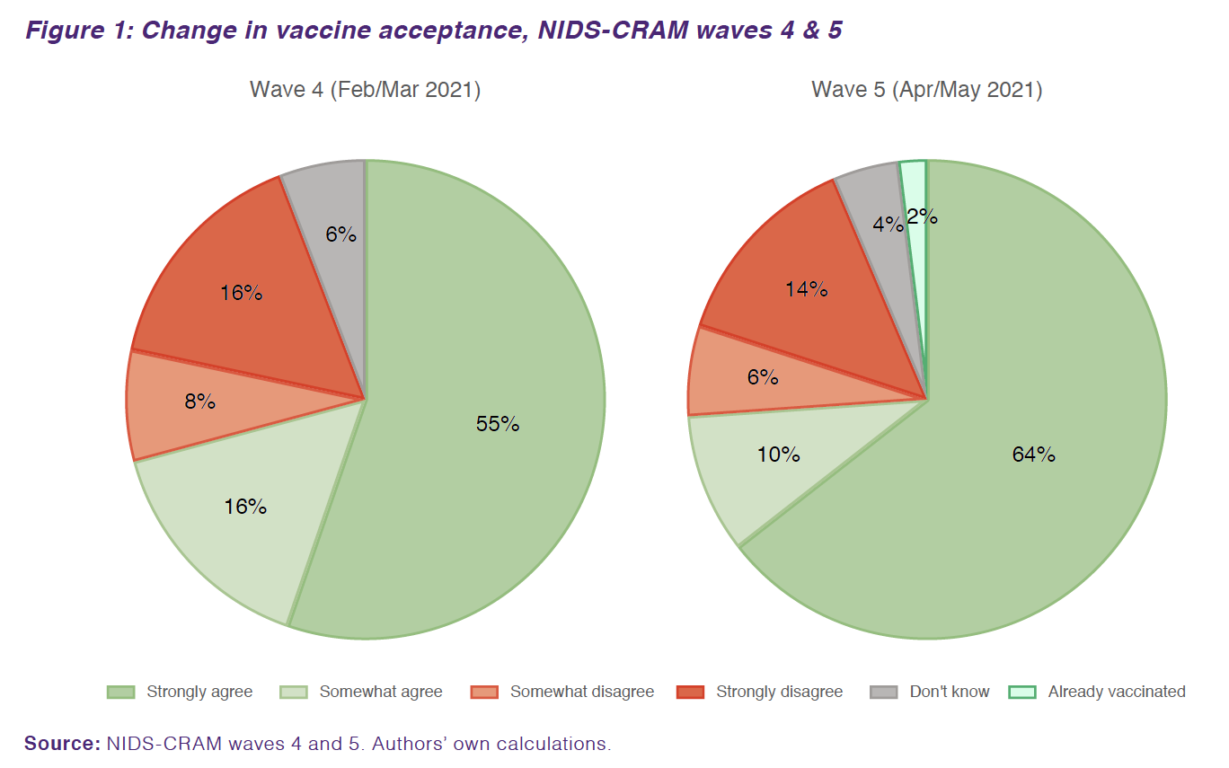
Vaccines
Vaccine acceptance is rising
…from 71% in Feb’21 to 76% in May’21
Source: Burger et al. 2021 (W5)

Slide 61
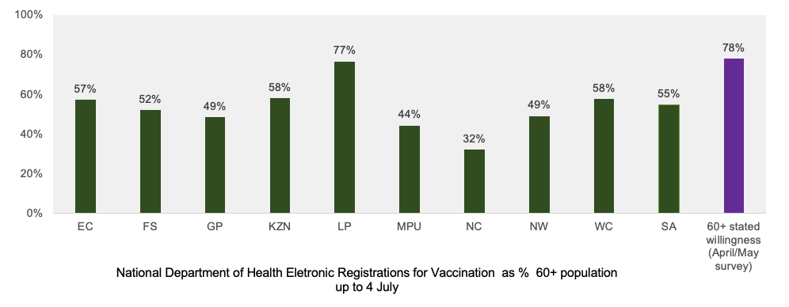
Stated vaccine intent is higher than observed registrations
Vaccines
Source: Burger et al. 2021 (W5)

