Slide 1
Inspiring Innovation Public Sector Reform
Western Cape Treasury
29 July 2021
Nic Spaull
Associate Professor of Economics, Stellenbosch University

Slide 2


NIDS-CRAM
Nic Spaull
Associate Professor | Economics Department | Stellenbosch University
National income Dynamics Study (NIDS) Coronavirus Rapid Mobile Survey (CRAM)

Slide 3

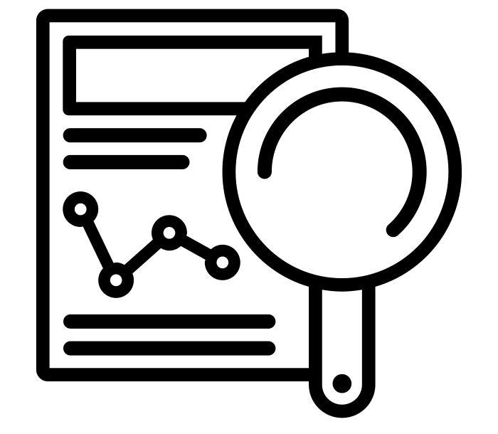




NIDS-CRAM is a public good
Overview: Largest non-medical study in SA at the moment.
  Broadly nationally representative telephonic survey available in all 11 languages.
  Sample drawn from existing NIDS 2017 survey.
  5 waves over the last year (service provider: AskAfrica)
  30+ researchers, 6 universities
  Wave 5: 6 April to 11 May 2021
Data: All data (Waves 1-5) are freely available for download at DataFirst (https://www.datafirst.uct.ac.za/)
Research: All 67 Working Papers from Waves 1-5 are freely available for download at the NIDS-CRAM website (from 8 July) (www.cramsurvey.org)

Slide 4
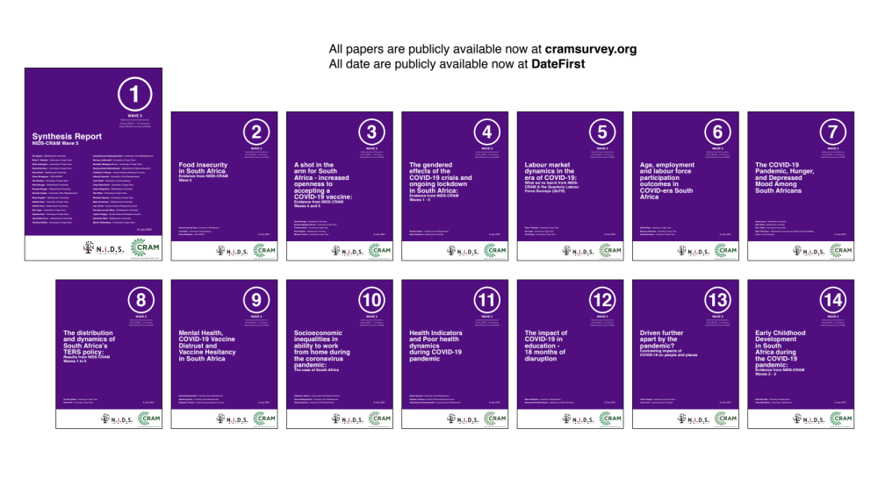
16 NIDS-CRAM Wave 5 Working Papers. Available at cramsurvey.org from 8 July 10am

Slide 5

cramsurvey.org

Slide 6
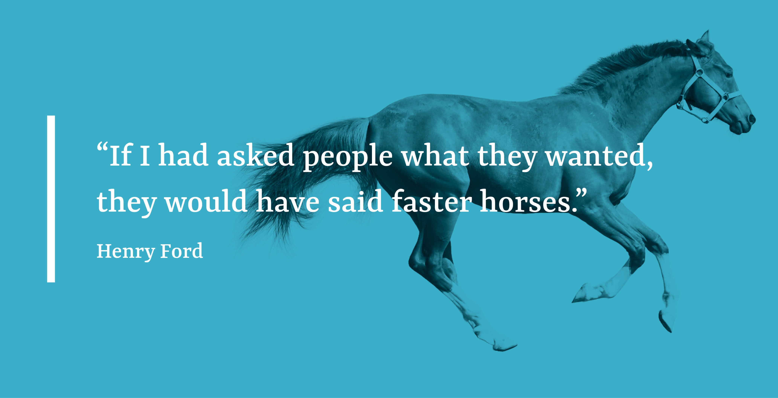

Slide 7

(1) Moving from a culture of compliance to one driven by positive deviance.
(2) Managing on objectively verifiable outcomes not plans, intentions or fidelity.
(3) Authority should follow observed competence, not seniority or compliance.
Innovation = positive deviance

Slide 8
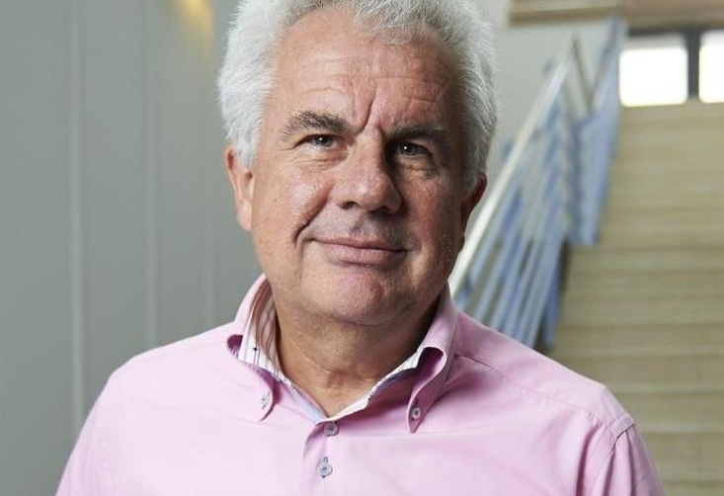

Lant Pritchett

Slide 9
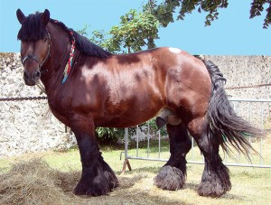
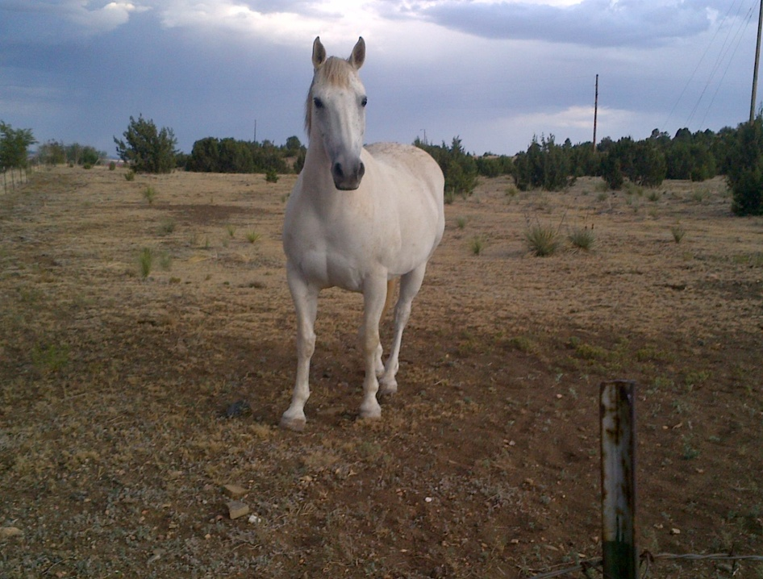
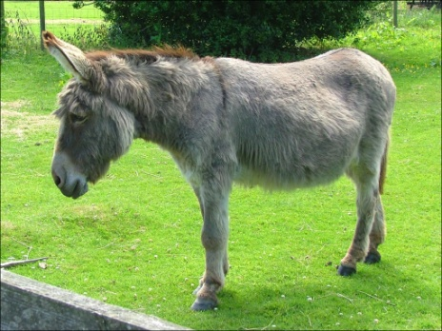
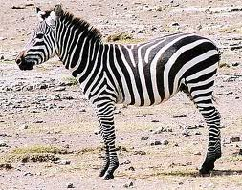
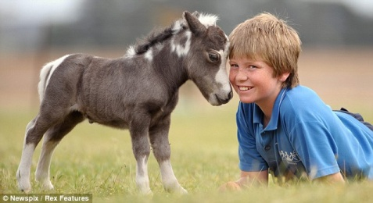
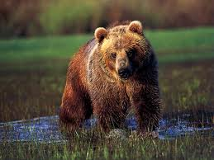
What is the real capability for implementation of your province today?
Strong, capable
and willing
Capable and willing, not so strong
Capable, but stubborn
Not domesticated
Cute,
but tiny
Not really a horse at all
Source slides: Lant Pritchett

Slide 10
One big question, four main points
How is it that countries manage to stay engaged in development and yet fail to acquire capability?
Source slides: Lant Pritchett

Slide 11
One big question, four main points
How is it that countries manage to stay engaged in development and yet fail to acquire capability?
  Conflate institutional form and function
    Change (and assess/measure) what institutions “look like”, not what they actually “do” (isomorphic mimicry)
Source slides: Lant Pritchett

Slide 12
How is it that countries manage to stay engaged in development and yet fail to acquire capability?
  Conflate institutional form and function
    Change (and assess/measure) what institutions “look like”, not what they actually “do” (isomorphic mimicry)
  Promote an inadequate theory of change
    Accelerated modernization via transplanted best practice
One big question, four main points
Source slides: Lant Pritchett

Slide 13
How is it that countries manage to stay engaged in development and yet fail to acquire capability?
  Conflate institutional form and function
    Change (and assess/measure) what institutions “look like”, not what they actually “do” (isomorphic mimicry)
  Promote an inadequate theory of change
    Accelerated modernization via transplanted best practice
  Set (excessively) great expectations
    Time frames too short, bar too high, road not straight
One big question, four main points
Source slides: Lant Pritchett

Slide 14
Failing to acquire capability
How is it that countries manage to stay engaged in development and yet fail to acquire capability?
  Conflate institutional form and function
    Change (and assess/measure) what institutions “look like”, not what they actually “do” (isomorphic mimicry)
  Promote an inadequate theory of change
    Accelerated modernization via transplanted best practice
  Set (excessively) great expectations
    Time frames too short, bar too high, road not straight
  Collude in premature load bearing
    Too much asked of too little, too soon, too often
    Failing in this way itself undermines progress; kills learning
Source slides: Lant Pritchett

Slide 15
Staying seriously stuck
‘Capability traps’ become entrenched when action across three levels – agents, organizations and systems – conspires to favor:
  Mimicry over innovation
  Inputs over outcomes
  Self-interest over collective value creation
  Compliance over experimentation
Source slides: Lant Pritchett

Slide 16
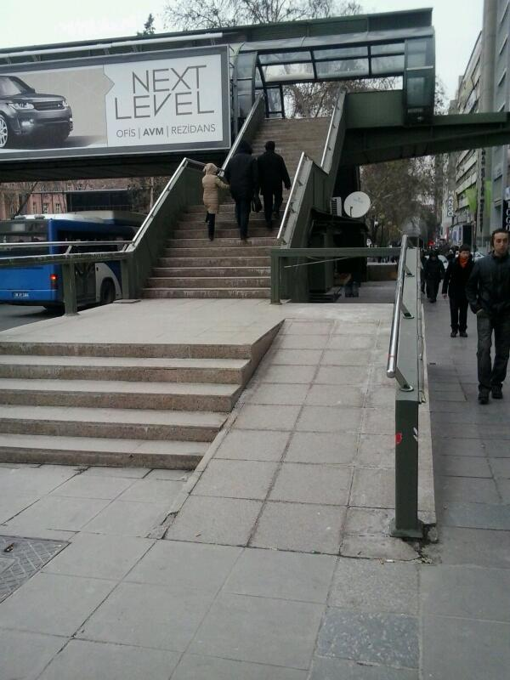
(1) Mimicry over innovation
Wheelchair ramp to subway station in Turkey

Slide 17
(2) Inputs over outcomes
Why is it that we often substitute the word “spending” for “investment” ?
Source slides: Lant Pritchett

Slide 18

“Spending aint investment”
It is only ‘investment’ if it works. If I worship a god of the ocean, and I throw gold into the ocean, and call that investment in my prosperity, I have made a mistake because there is no causal link between my spending and my prosperity.
Unless you are causally right about the chain of events that leads from your spending to the desired outcomes, you can spend all you want and not actually improve outcomes.” (Pritchett, 2021)

Slide 19

(3) Self interest over collective value creation

Slide 20
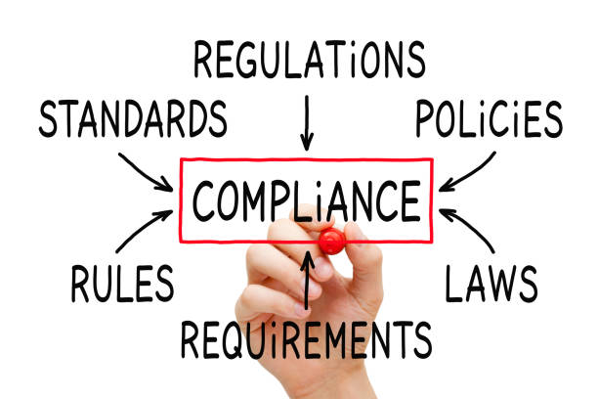
(4) Compliance over experimentation

Slide 21
Pushing
Problem-Driven
Positive Deviation
Authorize some agents (not all) to move from process-driven to flexible-and-autonomous-control to seek better results
An “autonomy” for “performance accountability” swap (versus “process accountability”)
Only works if the authorization is problem driven and measured and measurable… increase the ratio of “gale of creative destruction” to “idiot wind”
Source slides: Lant Pritchett

Slide 22
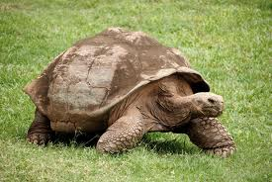
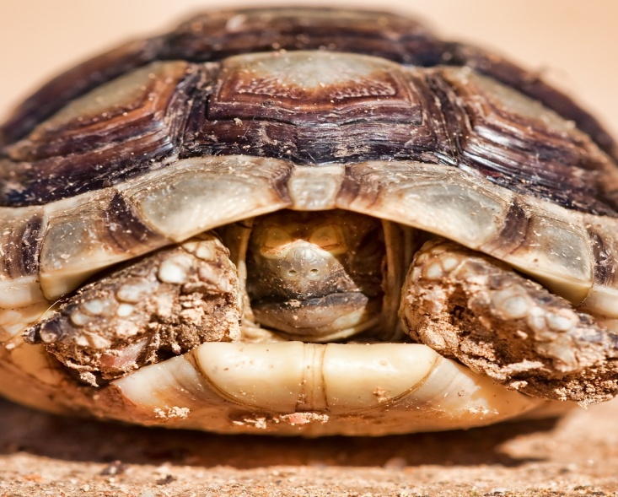

Authorize the internal and interested to move.
Organizations are robust to external attack.
The head has to come out for the body to move
Organizations can survive external attack… by not moving
Source slides: Lant Pritchett

Slide 23
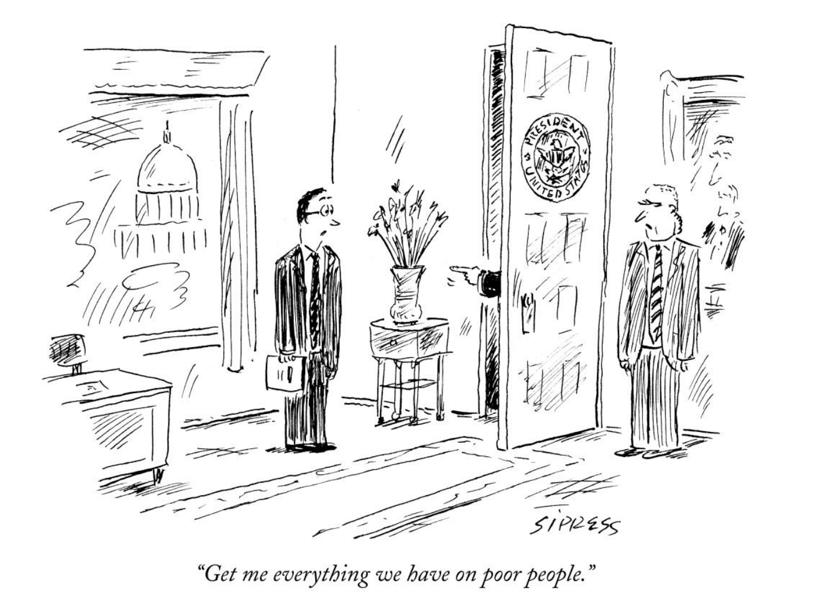
How?
Improving service delivery…
Top down?
Bottom up?
Middling along?

Slide 24
Design policy based on
global “best practice”
Policy Makers
Organizations & Agencies
Implement according to local constraints
Policies include process barriers to prevent malfeasance
Process controls also prevent positive deviations
Rent Seekers
Bureaucrats
Innovators
Space for
Achievable
Practice
Process Controls
Process Controls
Lower
Outcome
Outcome
Higher
Outcome
Source slides: Lant Pritchett

Slide 25
Design policy/project to allow designated innovators to search for local “Best Fit ”
Policy Makers
Internal authorization of positive deviation
Rent Seekers
Bureaucrats
Designated Innovators
Space for
Achievable
Practice
Policy Deviations
Process Controls
Process Controls
Feedback on Outcomes with shut down or modification of failures and/or replication of successes
Worse outcomes
Current outcomes
Better Outcomes
Source slides: Lant Pritchett

Slide 26
Authorizing positive deviation
Positive Deviation…
Existing culture…
Allow flexibility in methods against specified and agreed to problems
“Fence breaking” activities that allow deviations from process controls for designated activities
Rapid feedback loops to search over design space
Audit culture with little scope for innovation
Risk averse and “scandal avoidance” culture in which admitting “failure” is not an option
Little flexibility in process controls in project preparation (e.g. safeguards)
Insistence on high levels of policy compliance
Not a problem of staff but of structure of organization governance
Source slides: Lant Pritchett

Slide 27
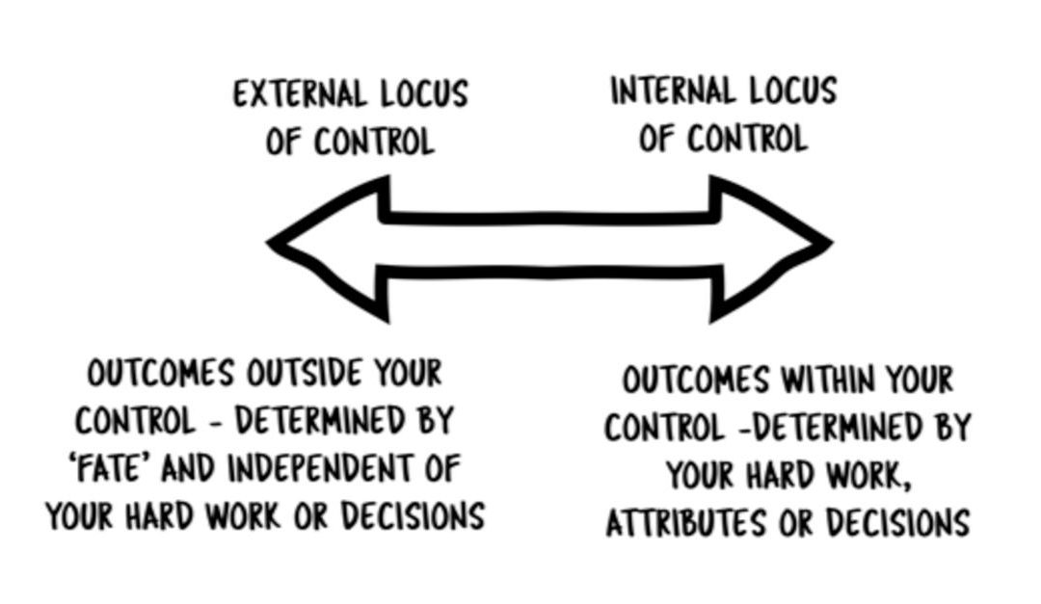

What is within my control?
The Locus of Control theory describes the degree to which individuals perceive that outcomes result from their own behaviours or from forces that are external to them.

Slide 28
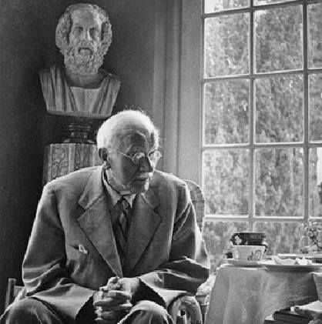
“The spirit of evil is the negation of the life force by fear.
Only boldness can deliver us from fear.
And if the risk is not taken, the meaning of life is violated.”
- Carl Jung

Slide 29
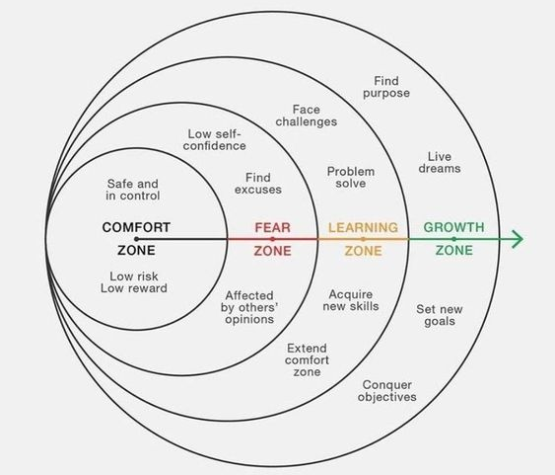

Slide 30
Questions for discussion…
Do we have well defined problems where the outcomes are clear and measurable?
What are the reasons why we don’t “try something new”?
Why am I in government if not to try and improve the lives of people in our province?
What are the things that are within my control that I can change?
What are some of the risks in my portfolio that are worth taking? (that is, where the positive outcomes if the risk pays off are well worth the costs if it doesn’t).
In general do I have an internal locus of control (my actions can change this) ordo I have an external locus of control (there’s nothing I can do about this?
What are the practical ways that I can authorize and incentivize positive deviance in my team?
If not now then when?

Slide 31
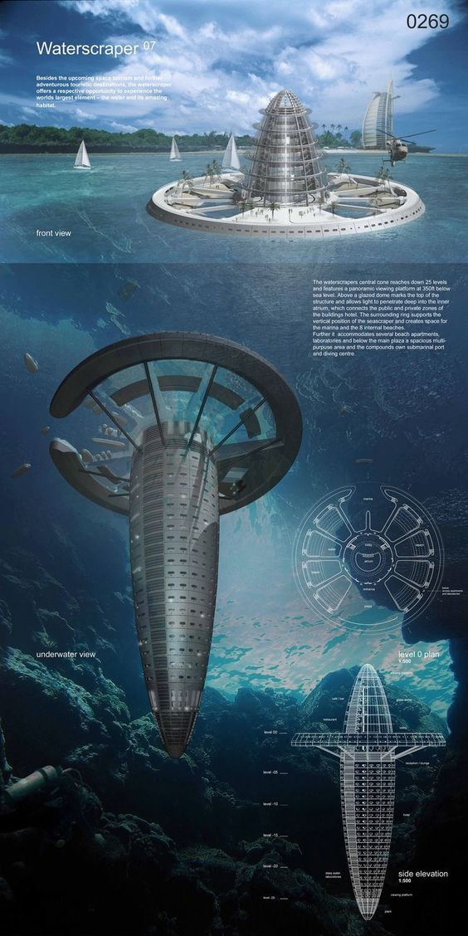
Comments & questions?

Slide 32



