Slide 1
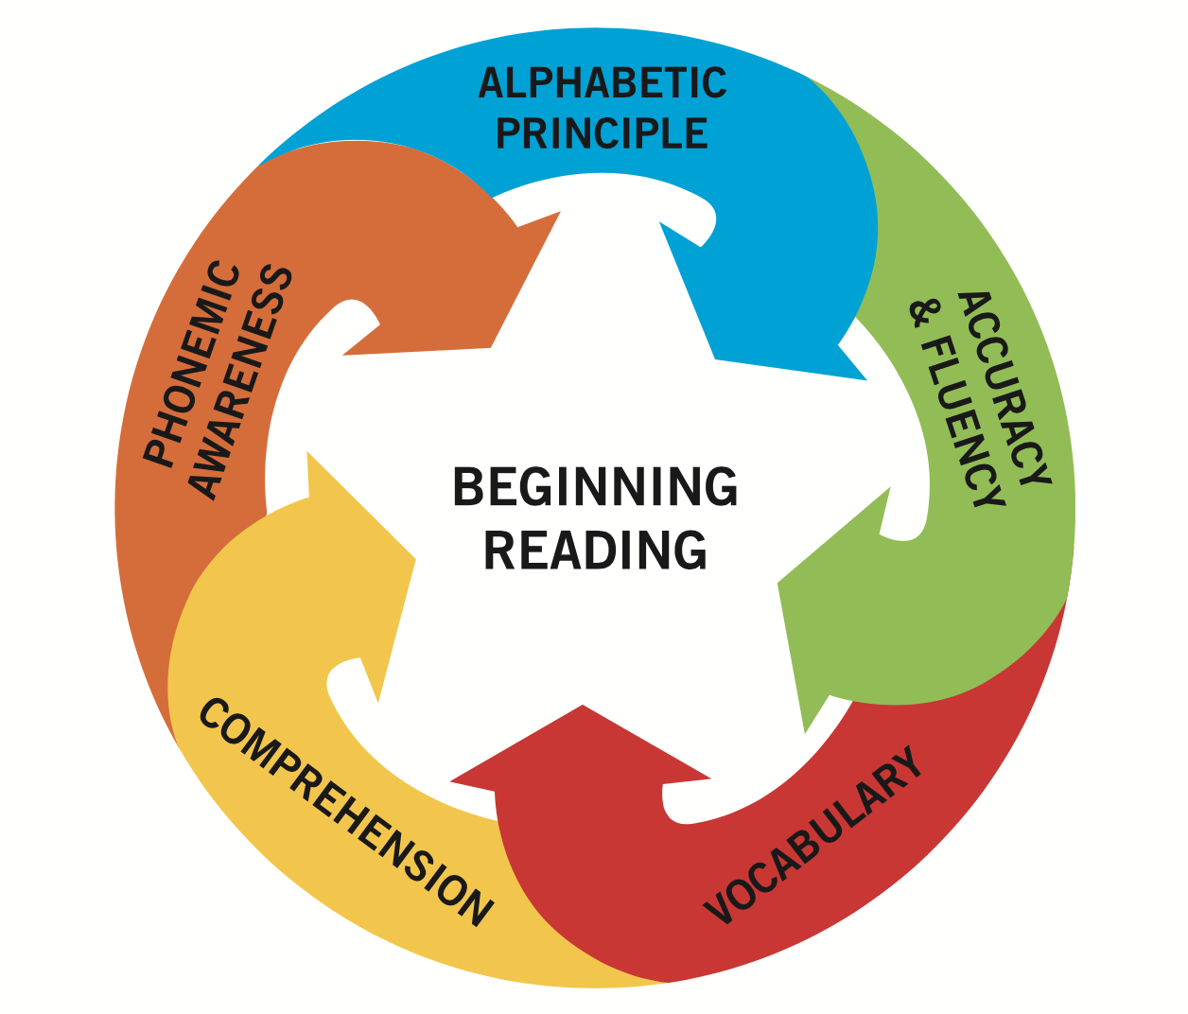

Falling at the First Hurdle
Early Grade Reading in South Africa
Nic Spaull
21 October 2021
Department of Economics
•
Faculty of Economic and Management Sciences

Slide 2
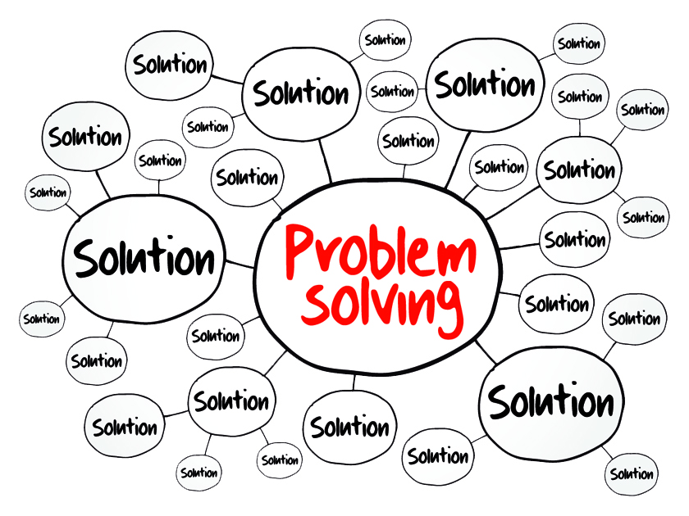
Overview
Correctly diagnosing the problem
  How do children learn to read?
  What do we know from large scale assessments?
    PIRLS 2016
    EGRA-data (EGRS, SPS, FW, LFL)
Correctly identifying the solution
  Framework for thinking about possibilities
  Zone of Proximal Development

Slide 3
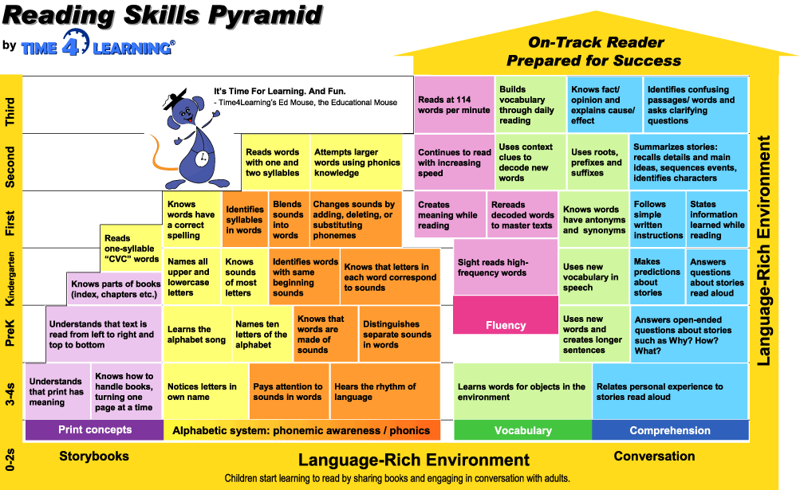
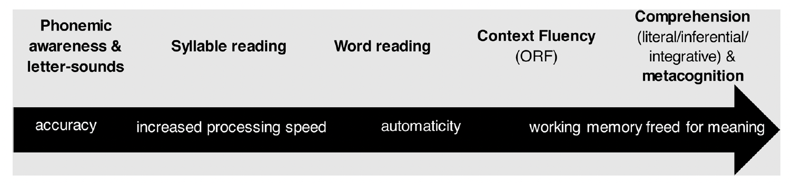
How children learn to read?

Slide 4
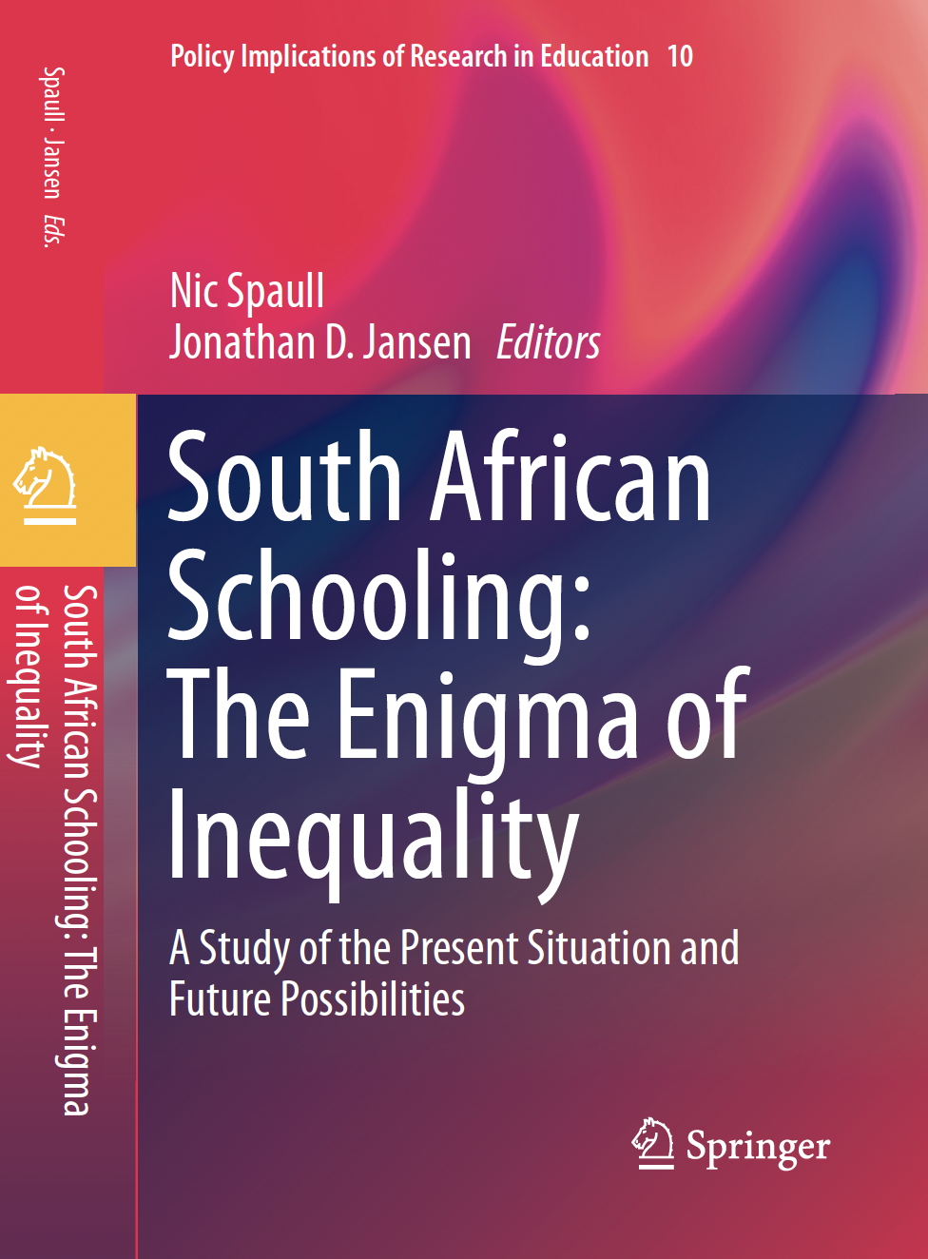
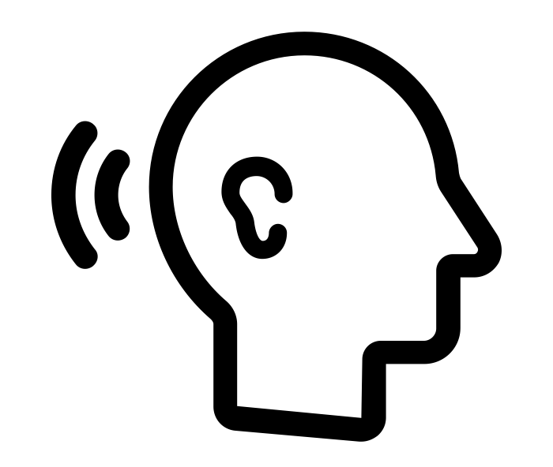
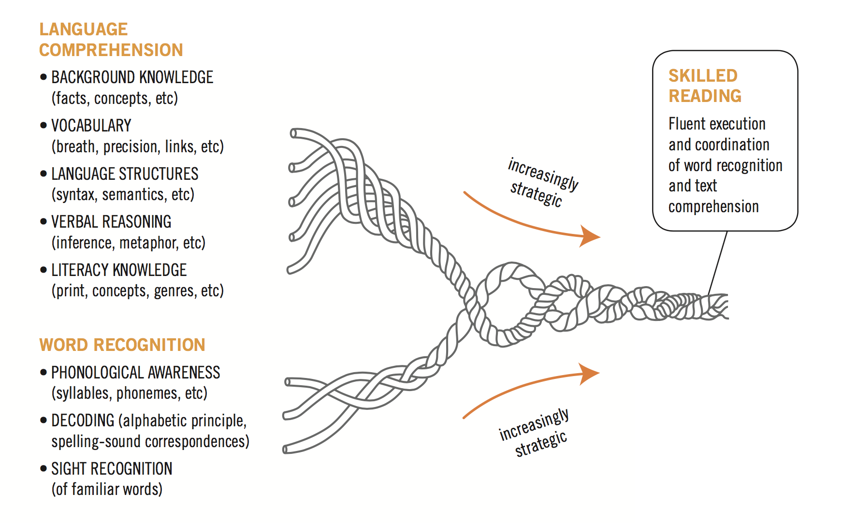

Falling at the First Hurdle
Spaull & Pretorius (2019)
(1) Language comprehension
We know almost nothing about this at scale
Oral
Oral
(2) Decoding
We know a little about this.
We know the most about this
Print
Scarborough’s Reading Rope

Slide 5
What does
PIRLS 2016 show?

Slide 6

What does PIRLS assess?
Mullis et al. 2017, p.55

Slide 7
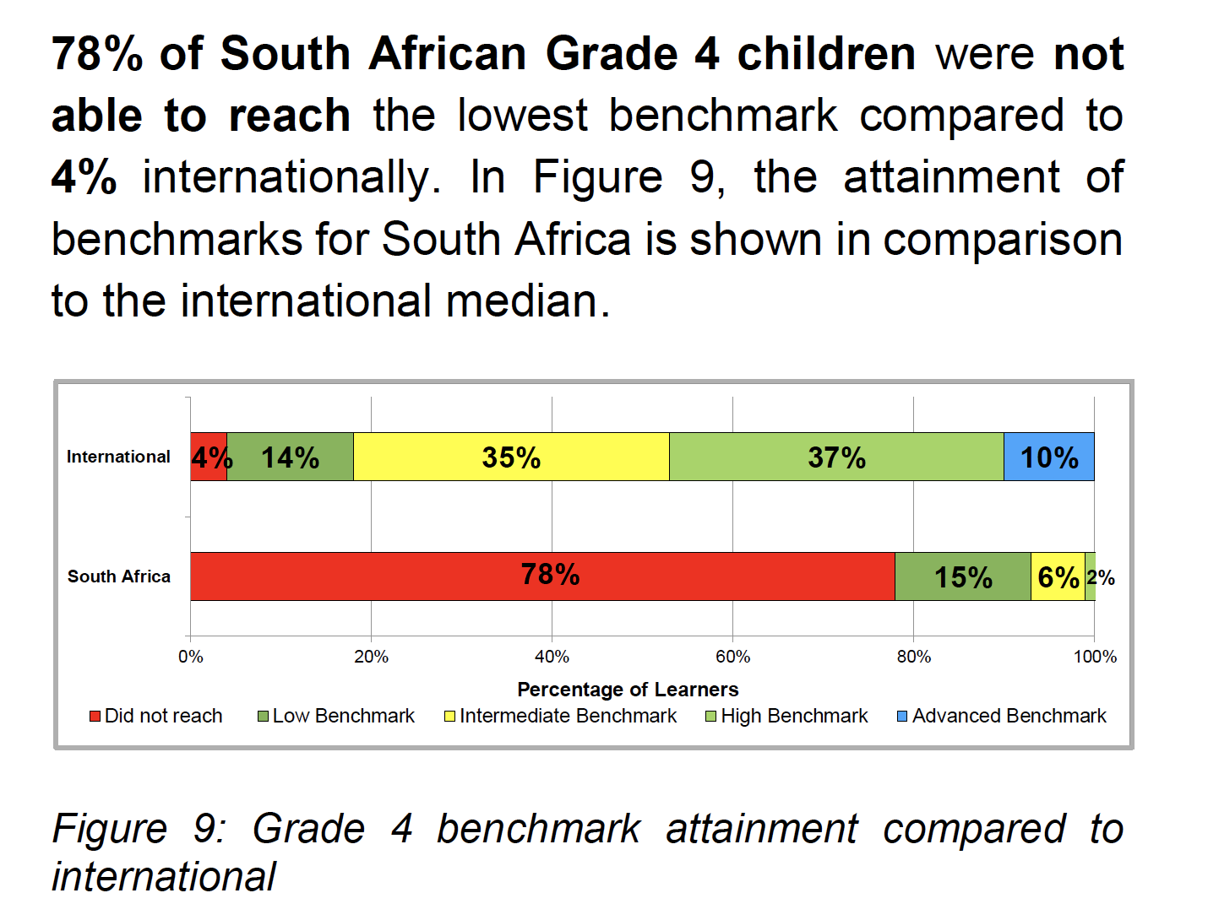
78%
of South African Gr4 learners cannot read for meaning in any language
“locate and retrieve explicitly stated information, actions or ideas;
make straightforward inferences about events and reasons for actions; or
begin to interpret story events and central ideas” (Mullis et al, 2017; p.53).
Source: SA PIRLS Literacy 2016 report

Slide 8
How does this differ by school wealth?
Spaull & Pretorius (2018) Falling at the first hurdle. Springer.

Slide 9


SA Gr4
Released passage from PIRLS Literacy 2016
40%
40%
32%
Mullis et al. 2017

Slide 10
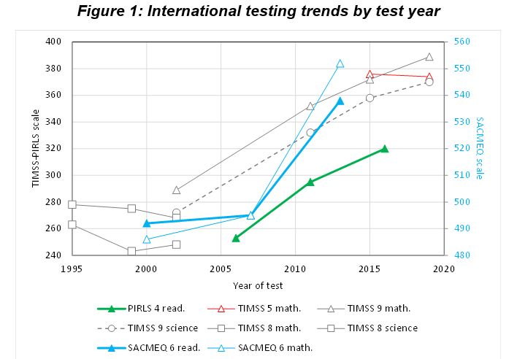
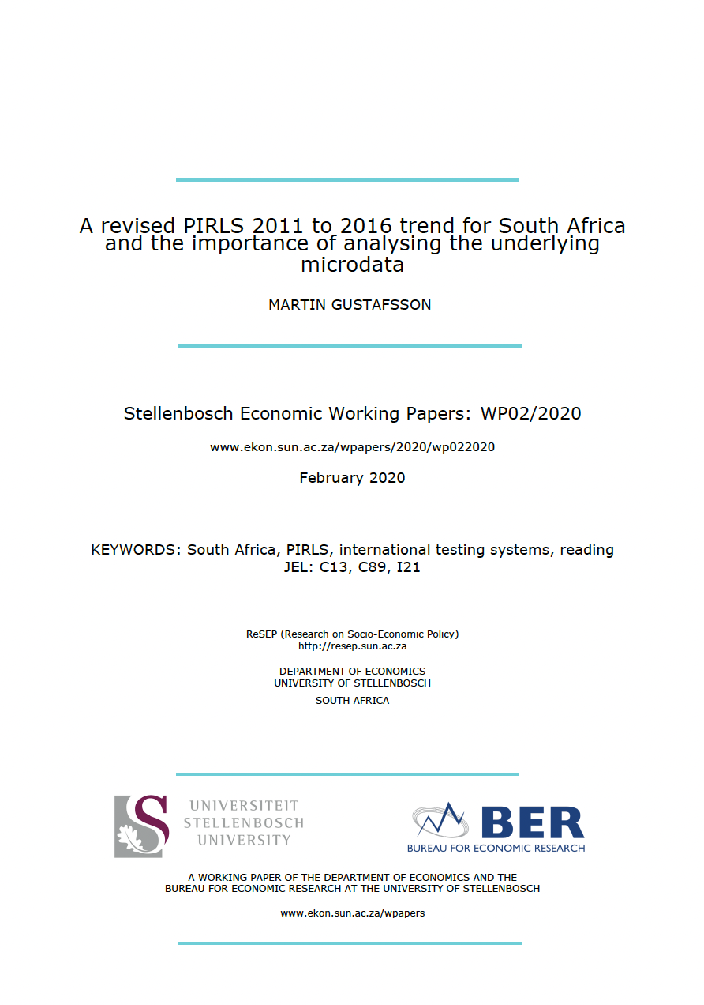
22%
18%
13%
(Source: Gustafsson & Taylor, forthcoming)

Slide 11
What do EGRAs
show?

Slide 12
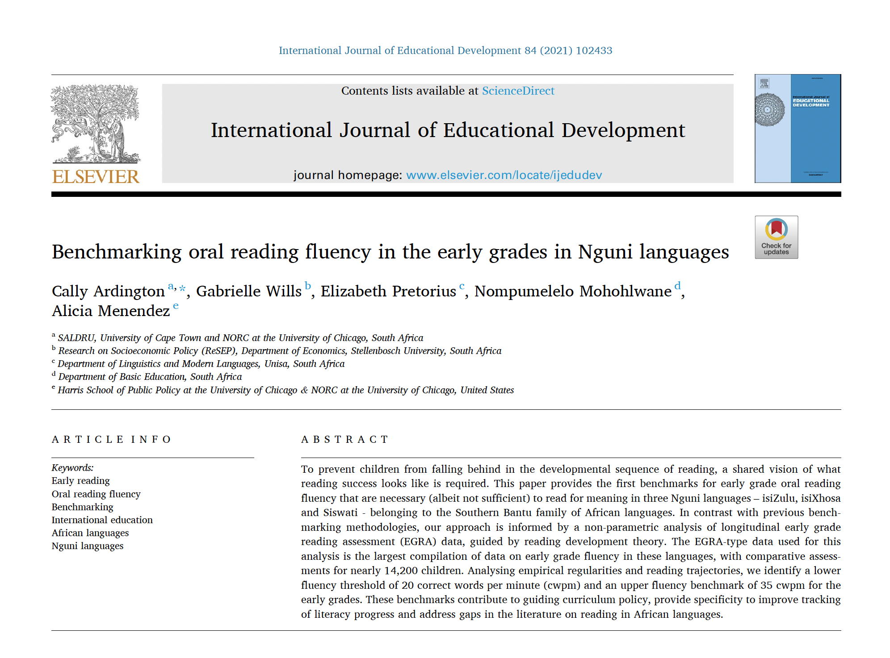
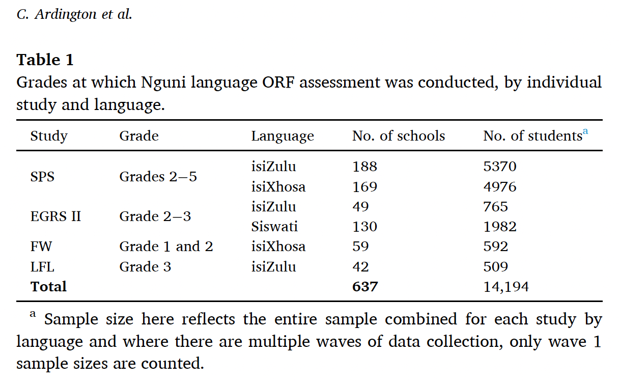
Over 14,000 individual assessments from more than 600 schools

Slide 13
What do EGRAs / ELNAs assess?

Slide 14
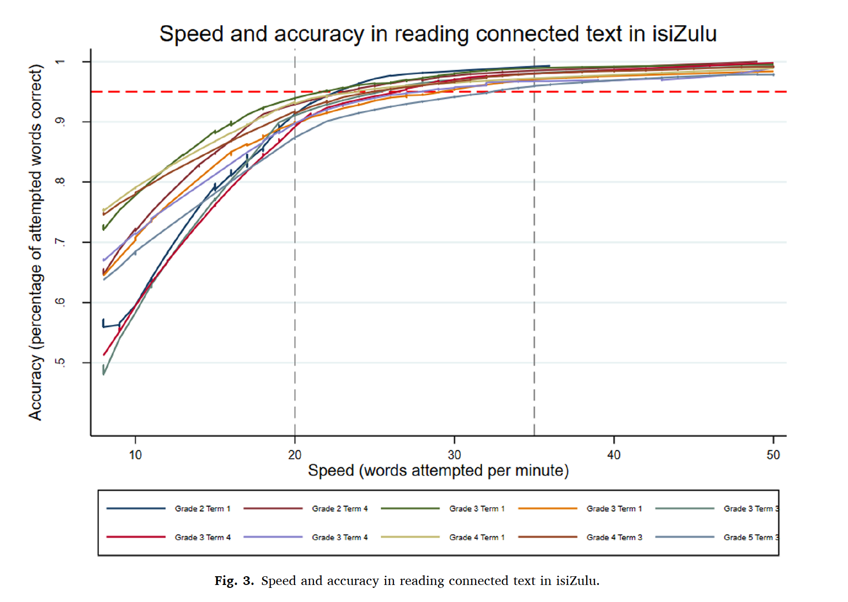
Speed & Accuracy
There is a extremely strong relationship between speed and accuracy in Nguni languages.
If children read accurately they read quickly.
If children read quickly they read accurately. i.e. There are no children that read quickly without 95% accuracy.
(Ardington et al. (2021)
35

Slide 15
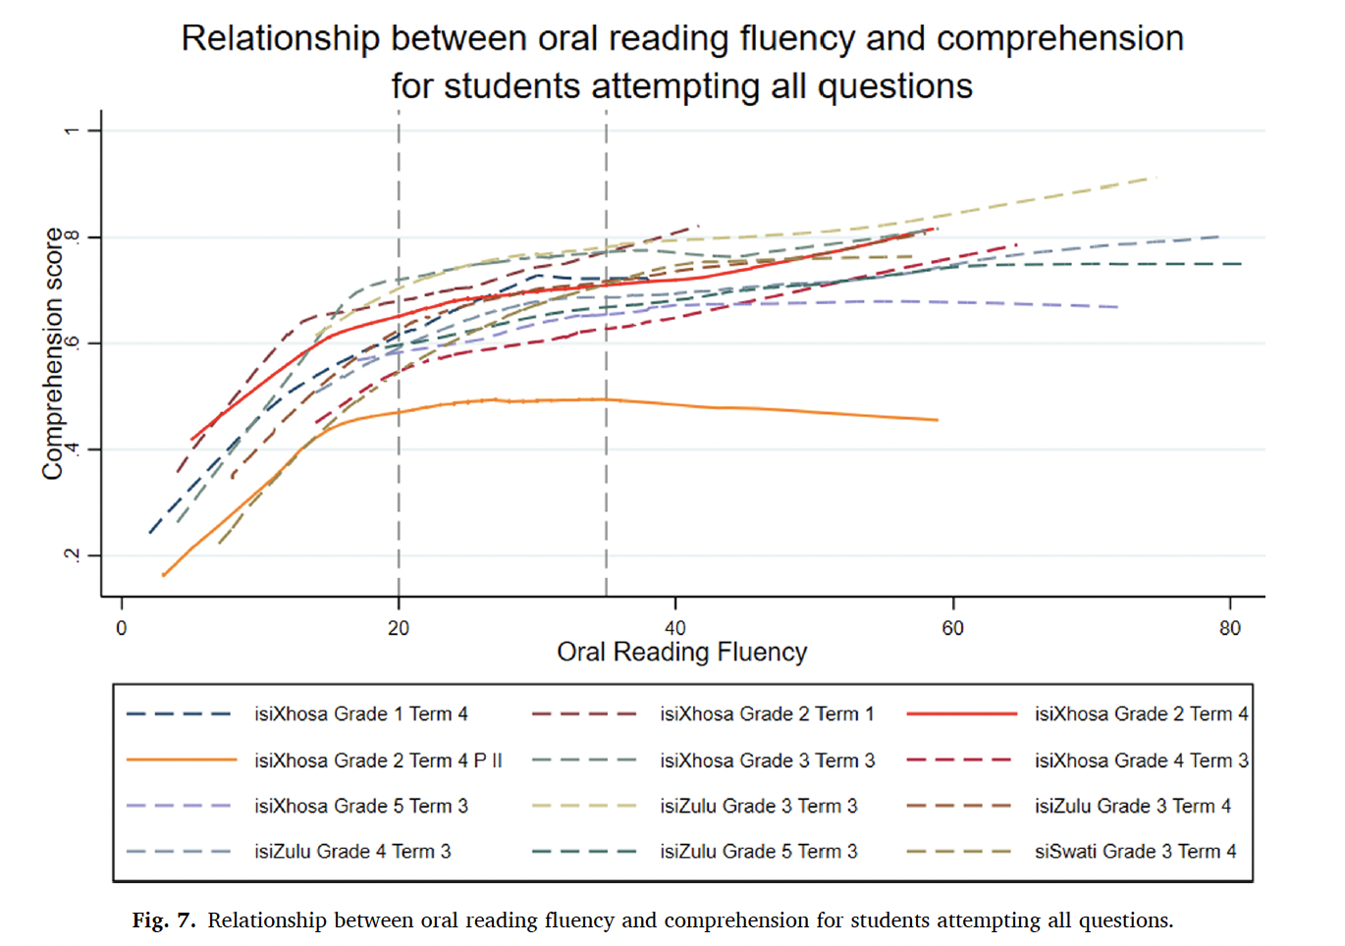
Speed & Comprehension
There is a clear & consistent relationship between speed and comprehension in Nguni languages.
Although there is variation in comprehension outcomes for those that read < 20 WCPM…
If a child reads at least 35 WCPM then they score 60%+ on comprehension.
(Ardington et al. (2021)
35

Slide 16
How predictive is ORF in Time 1 of ORF in Time 2?

Slide 17
Assessing the same learners over time…
(usually 1-2 years apart)
If a student was a non-reader in Time 1…
If a student was a struggling reader in Time 1…
If a student was a basic reader in Time 1…

Slide 18
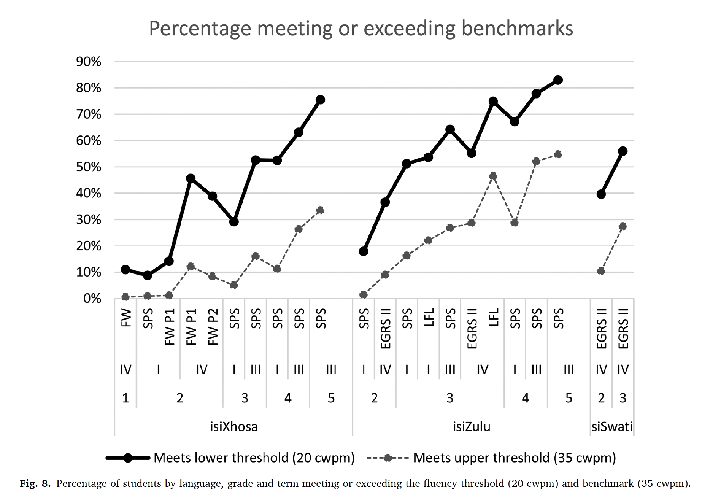
Ardington et al. 2021

Slide 19
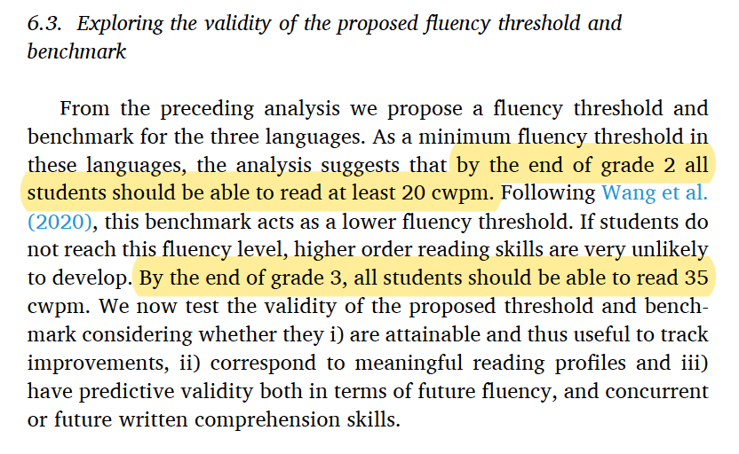
Ardington et al. 2021

Slide 20
At most 40% of Grade 2’s are
‘on track’
At most 25-30% of Grade 3’s are ‘on track’

Slide 21
A framework for thinking about solutions…

Slide 22
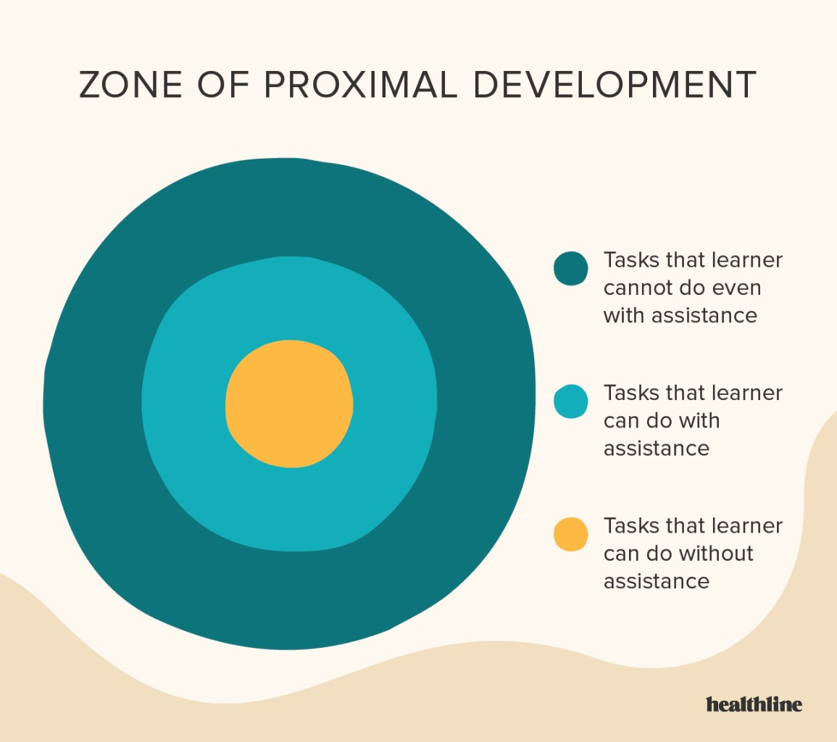

Zone of Proximal Development
(for our education system)
UNREALISTIC: La-la Land: This is impossible even with “help/change” – the help or change needed for this would be too great (e.g. class sizes of 25 would require 8% of GDP on teacher salaries. Currently it is 4%
ZPD
POSSIBLE with help/change: How the system might operate with plausible changes (20% more resources, better trained new teachers, class sizes etc
ZPD
ZPD
ZPD
CURRENT: How the system currently operates (current resources, teachers, PRESET/INSET, class sizes etc )

Slide 23
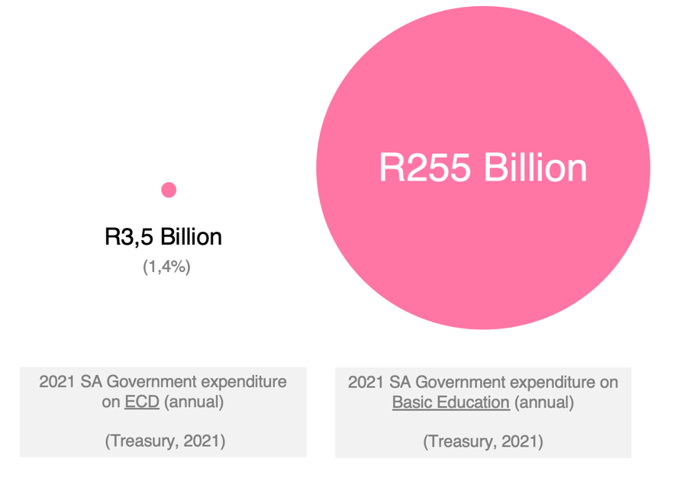
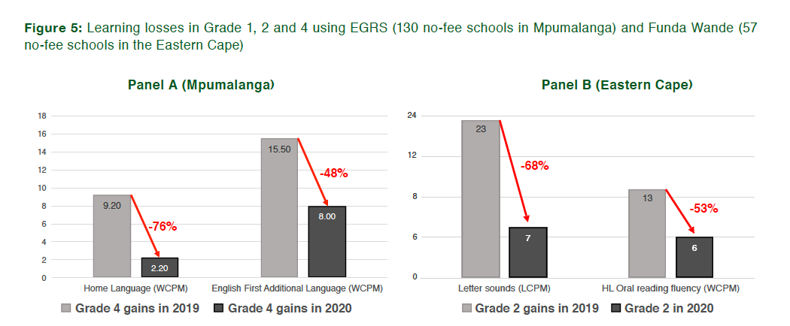
Public Service Announcements
(2) Rotational timetables are the biggest threat to any gains that have been made in SA
2020 rotational timetables led to 75% of a year of learning lost. 2021 rotational timetables continue in at least 50% of schools. In some provinces 70% (!) of schools have applied for rotational timetables for NEXT year (2022)
(1) ECD is still being thrown under the bus

Slide 24
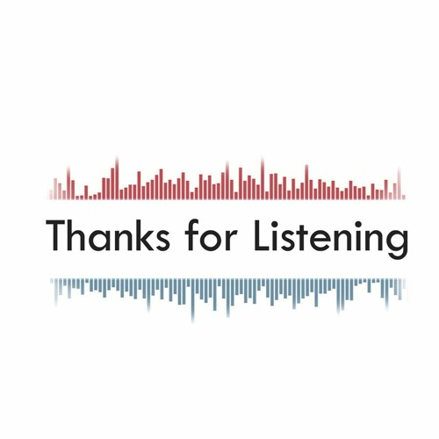

Slide 25
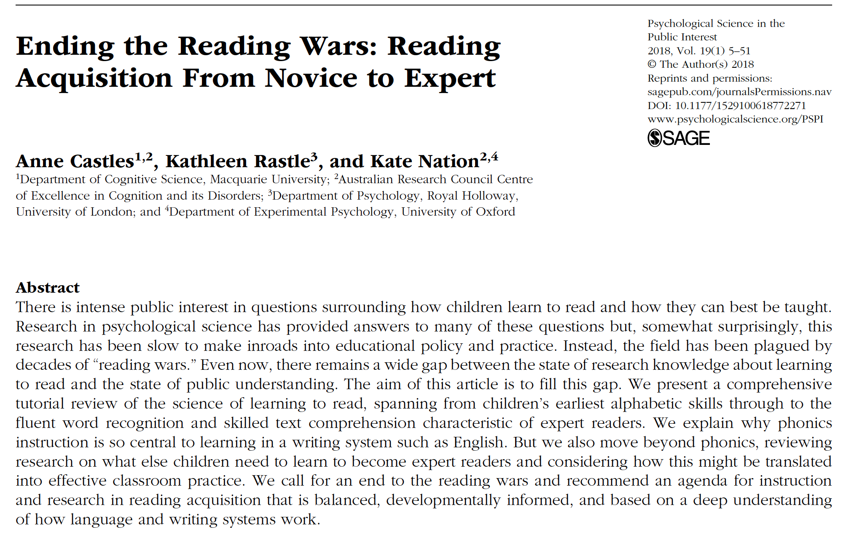
If you are interested in the reading wars…
Increasingly becoming irrelevant as more (and better) data and experiments are available.
Empirical neuroscience and psycholinguistic research now difficult to dispute. When learning to read in the early grades you need to teach phonics systematically and explicitly.
Of course lots of other stuff is also necessary (vocab, oral language proficiency etc).

