Slide 1
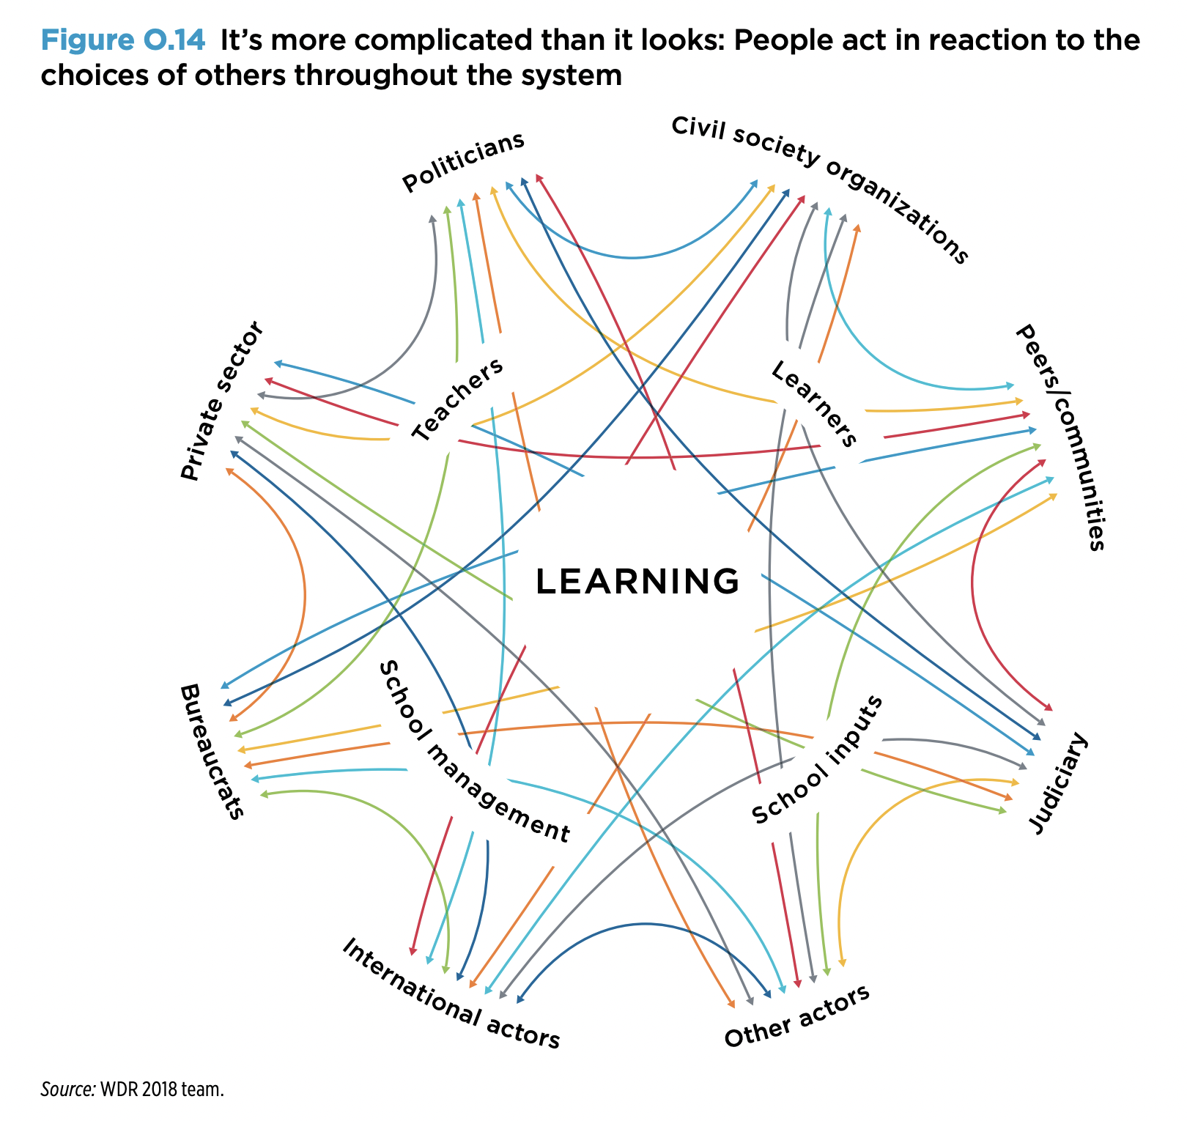
Putting learning at the center of everything we do.
Premier’s Council on Skills
28 Oct 2021
Nic Spaull
Associate Professor of Economics
Stellenbosch University

Slide 2
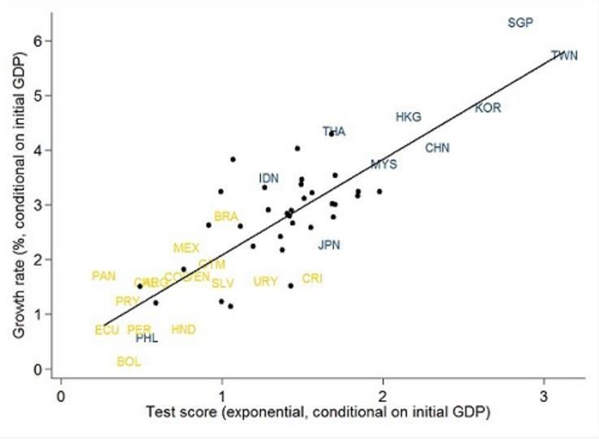
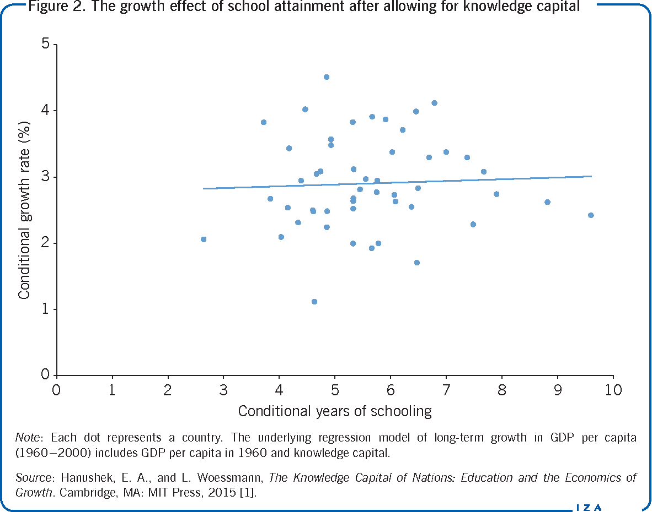
Knowledge Capital and Economic Growth
Figure 1
Economic growth and years of schooling (1960-2000)
Figure 2
Economic growth and learning outcomes (1960-2000)

Slide 3
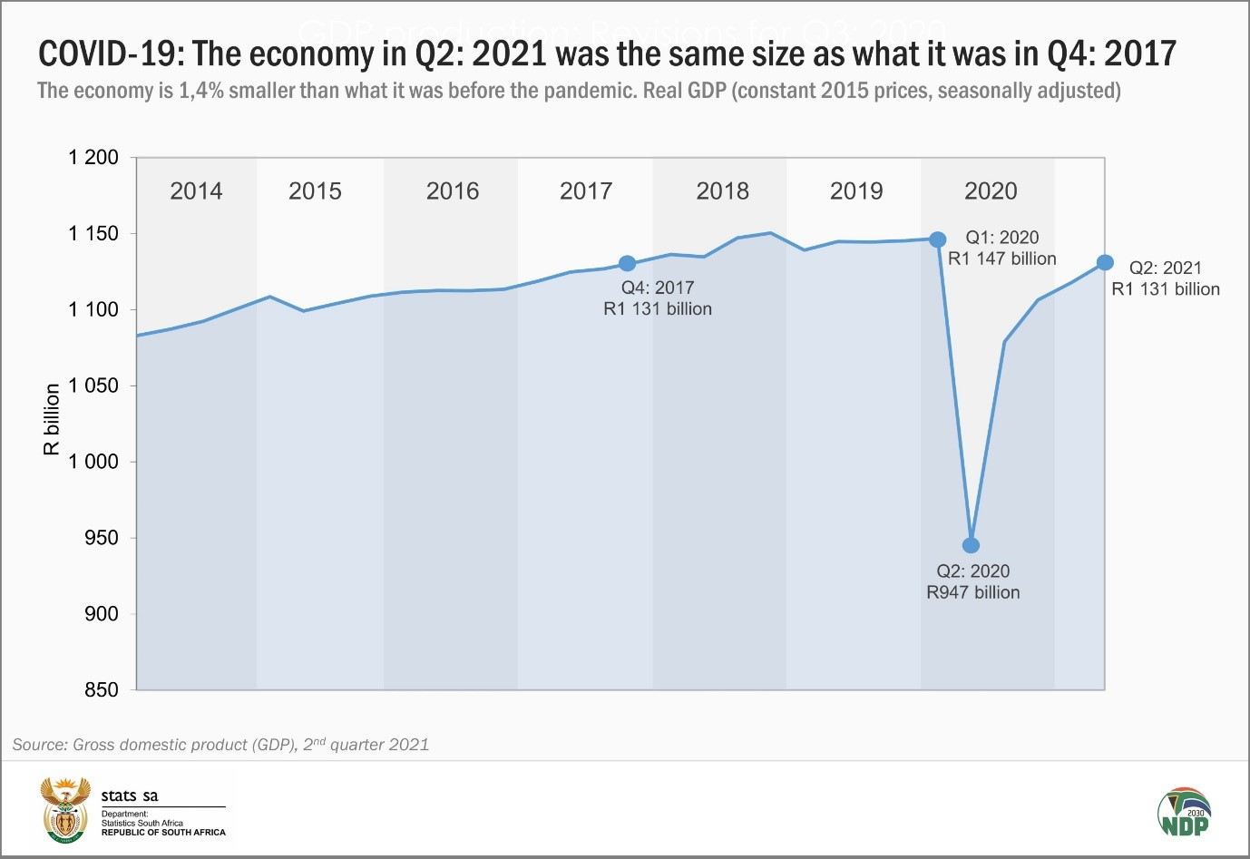
Anemic economic growth of ~1% p.a in SA.
29% unemployment in WC in Q2 2021

Slide 4
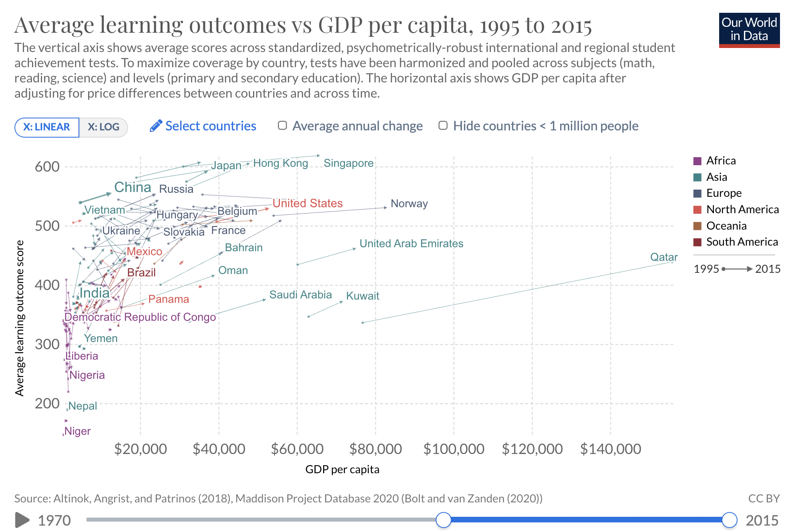

Slide 5
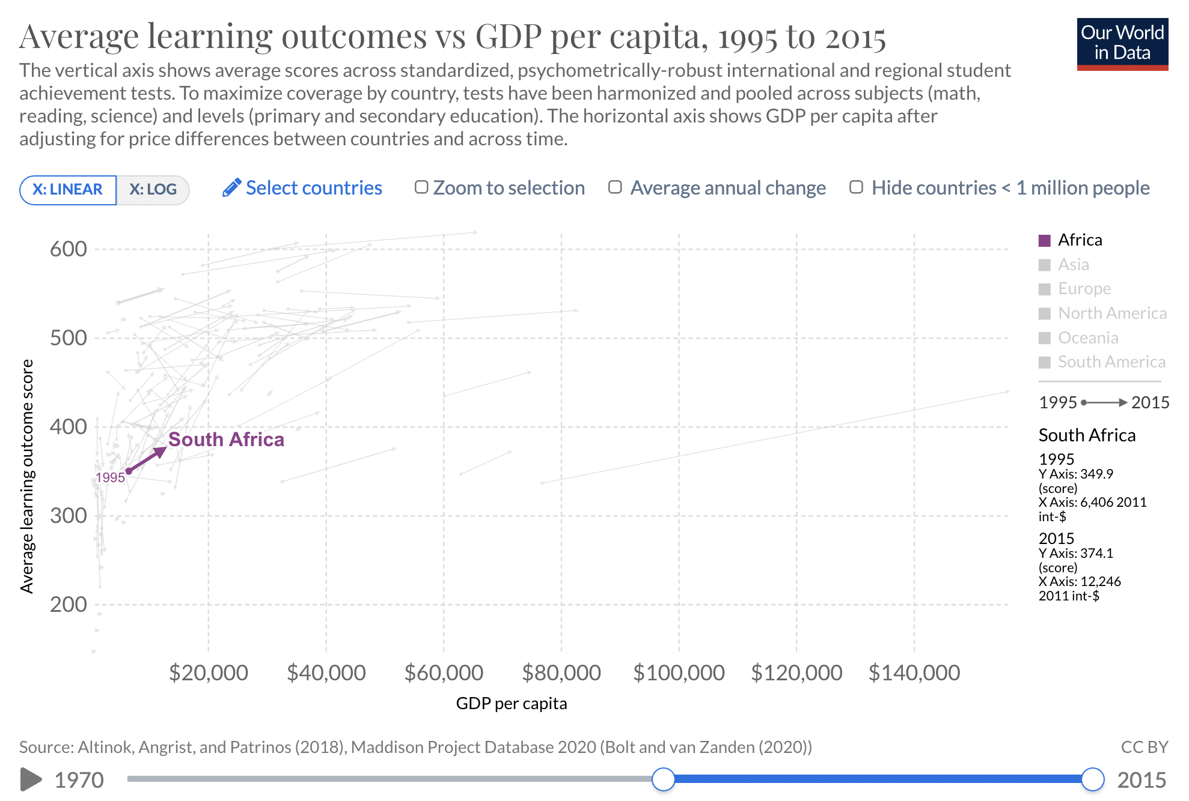

Slide 6
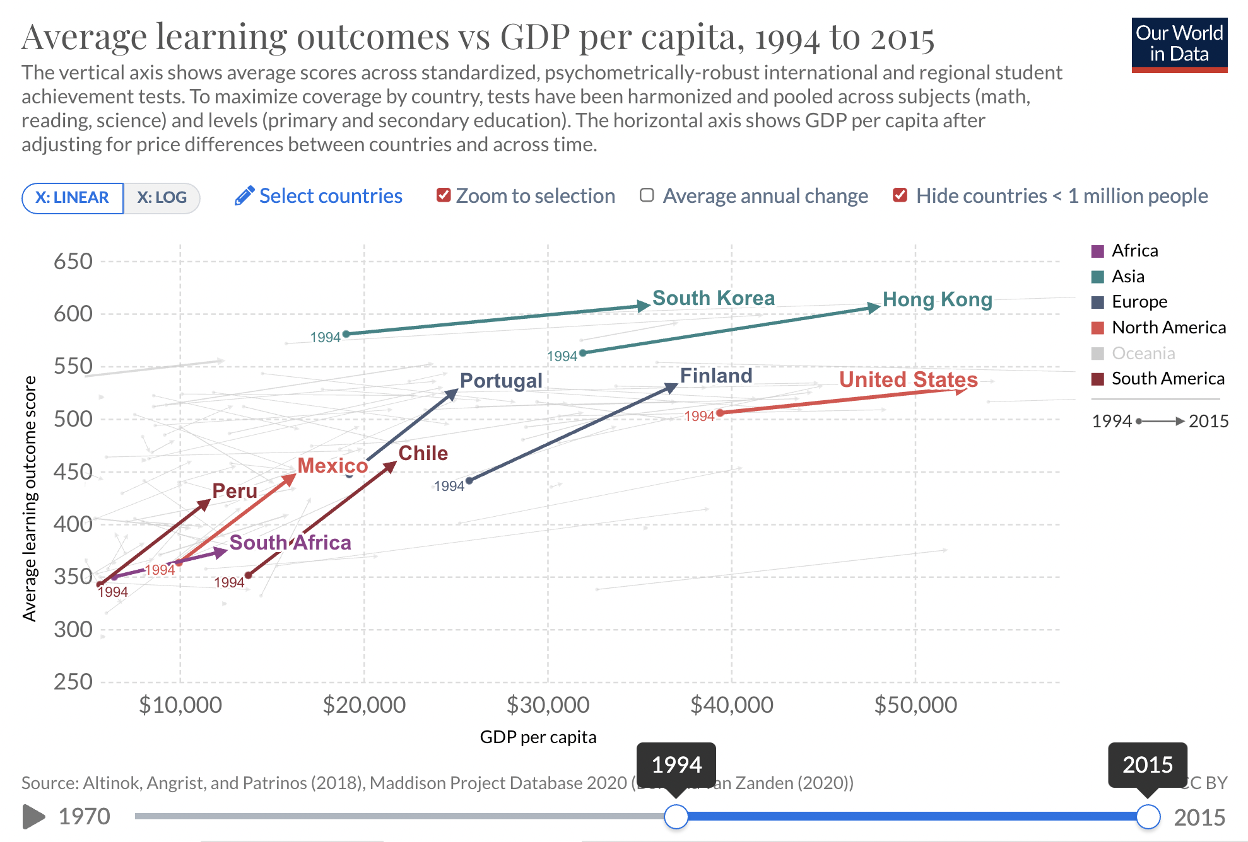

Slide 7



What can
industry do?
Vocational

Slide 8

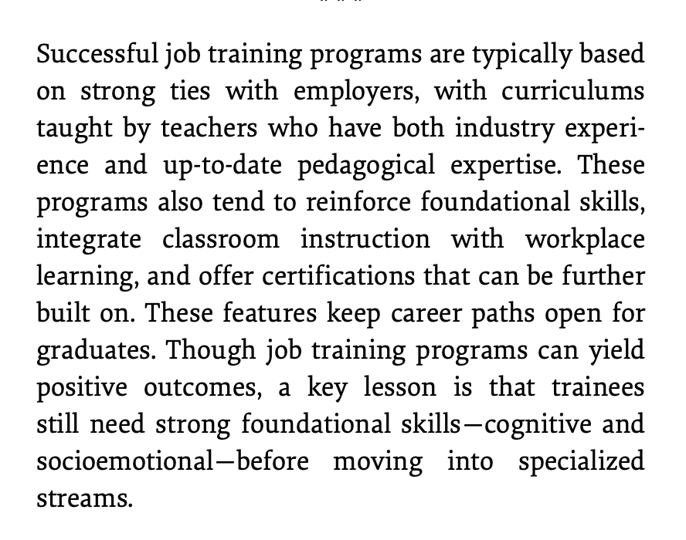
(WDR, 2018: p.159)

Slide 9




Features of successful job training programs
(WDR, 2018: p.154)
1. Establishing partnerships before training is designed Sectoral training programs partner learners with employers early and sustain their commitment. “These programs set up partnerships between intermediary institutions – usually network aggregators or nonprofits with industry-specific expertise – and employers in an industry to anticipate job openings, design program content and maximize potential placement.
2. Combining classroom with workplace learning
Formal apprenticeships are a common way to combine classroom with workplace learning; such programs are often referred to as “learning while earning.” Good programs offer structured training, a professional trainer and a written contract stipulating arrangements and assessments
3. Identifying capable teachers
Successful approaches to training depend on capable teachers with industry expertise who can tailor training to meet job requirements. Students gaps in foundational skills and lack of motivation intensify the complexity of teachers’ roles and responsibilities.
4. Creating certification frameworks that are relevant, modular & widely recognized
Industries need to be involved in creating and recognizing specific and shared certification frameworks that can be built on as students progress through their careers progress.

Slide 10
However, it’s a mistake to think you can focus on technical skills in isolation…
Vocational

Slide 11
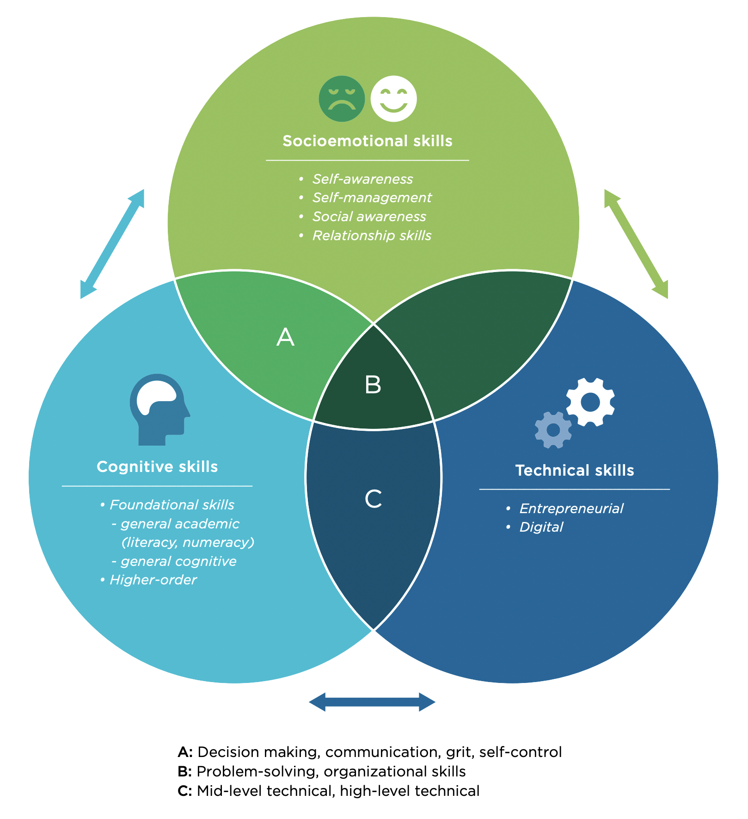
Cognitive, socioemotional
& technical skills interact
- Vocational

Slide 12

Setting the scene…

Slide 13



How many students actually make it to university?
(Van Broekhuizen & Van der Berg, 2016)

Slide 14

How many students actually make it to university?

Slide 15

How many students actually make it to university?

Slide 16

How many students actually make it to university?

Slide 17

How many students actually make it to university?
Source: Van Broekhuizen & Van der Berg, 2016 (Higher Education Access and Outcomes for the 2008 National Matric Cohort)

Slide 18
Where does the problem begin?

Slide 19
Where does the problem begin?
Only 25% of Grade 5 learners in SA can answer: 700 – 28 = ____ (TIMSS-N 2019)
Insurmountable learning deficits
Figure 10b: South African mathematics learning trajectories by national socioeconomic quintiles using a variable standard deviation for a year of learning (0.28 in grade 3 to 0.2 in grade 8 with interpolated values for in-between grades (Based on NSES 2007/8/9 for grades 3/4/5, SACMEQ 2007 for grade 6 and TIMSS 2011 for grade 9, including 95% confidence interval
(Spaull & Kotze, 2015)
See Spaull, 2019: p21: in 2018 270,516 took maths, 58% got 30%+,; 14% got 40%+ and 5% got 60%

Slide 20
The problem starts early (Gr 1-3) and is never overcome
Only 25% of Grade 5 learners in SA can answer: 700 – 28 = ____ (TIMSS-N 2019)
Insurmountable learning deficits
Figure 10b: South African mathematics learning trajectories by national socioeconomic quintiles using a variable standard deviation for a year of learning (0.28 in grade 3 to 0.2 in grade 8 with interpolated values for in-between grades (Based on NSES 2007/8/9 for grades 3/4/5, SACMEQ 2007 for grade 6 and TIMSS 2011 for grade 9, including 95% confidence interval
SA Grade 5 (2019)
37% add and subtract
SA Grade 9 (2019)
41% have a basic understanding of whole numbers and graphs
SA Grade 12 (2018)
27% took maths (of Gr1 cohort)
3,7% passed @40%+ (37,872)
1,4% passed @60%+ (13,526)
See Spaull, 2019: p21 In 2018 270,516 took maths, 58% got 30%+,; 14% got 40%+ and 5% got 60%
Gr5 and Gr9 Maths results from HSRC (2019)
(Spaull & Kotze, 2015)
See Spaull, 2019: p21: In 2018 53,768 WC matrics entered 29% took maths, 16% passed @40% and 7% passed @60%

Slide 21
The problem starts early (Gr 1-3) and is never overcome
Only 25% of Grade 5 learners in SA can answer: 700 – 28 = ____ (TIMSS-N 2019)
Insurmountable learning deficits
Figure 10b: South African mathematics learning trajectories by national socioeconomic quintiles using a variable standard deviation for a year of learning (0.28 in grade 3 to 0.2 in grade 8 with interpolated values for in-between grades (Based on NSES 2007/8/9 for grades 3/4/5, SACMEQ 2007 for grade 6 and TIMSS 2011 for grade 9, including 95% confidence interval
SA Grade 5 (2019)
37% add and subtract reliably
SA Grade 9 (2019)
41% have a basic understanding of whole numbers and graphs
SA Grade 12 (2018)
27% took maths (of Gr1 cohort)
3,7% passed @40%+
1,4% passed @60%+
WC Grade 5 (2019)
65% add and subtract reliably
WC Grade 9 (2019)
64% have a basic understanding of whole numbers and graphs
WC Grade 12 (2018)
18% took maths (of Gr1 WC cohort)
10% passed @40%+ (of Gr1)
4,3% passed @60%+ (of Gr1)
See Spaull, 2019: p21 In 2018 270,516 took maths, 58% got 30%+,; 14% got 40%+ and 5% got 60%
Gr5 and Gr9 Maths results from HSRC (2019)
(Spaull & Kotze, 2015)
See Spaull, 2019: p21: In 2018 53,768 WC matrics entered 29% took maths, 16% passed @40% and 7% passed @60%

Slide 22
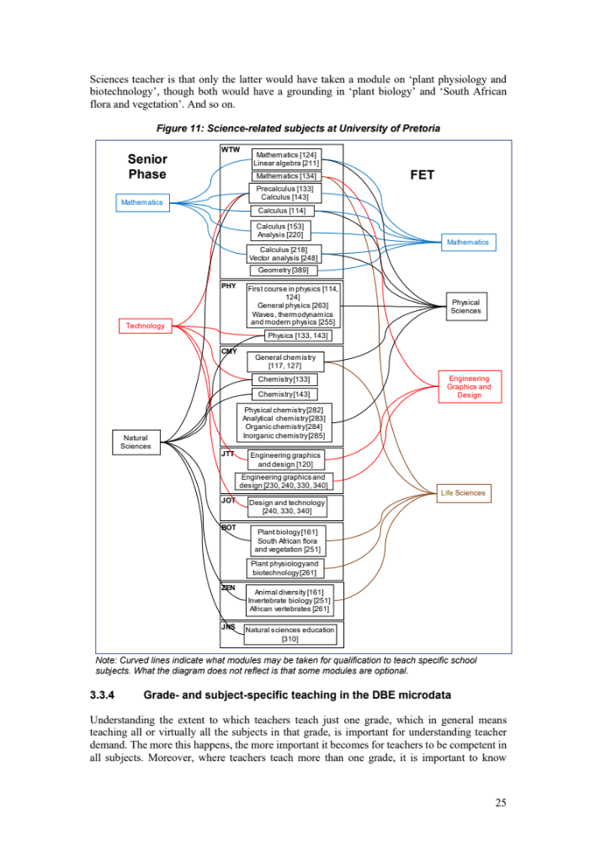
University subjects
The Importance of
Maths, Science & Reading
especially in primary school
Source: Gustafsson & Van der Berg, 2021 Teacher Demand and Supply Report. Science-related subjects at University of Pretoria. Requirements for teacher training. Note: Curved lines indicate what modules may be taken for qualification to teach specific school subjects. What the diagram does not reflect is that some modules are optional.

Slide 23
Rotational timetables are the single biggest threat to LT-skills-production in SA
In October 2021
86%
of WC primary schools have been approved to continue with rotational timetables (WCED). A generational catastrophe.
Government Gazette 44633
(May 2021)
"Primary school learners (Grades R to 7) must return to the daily attendance and traditional timetabling model from 26 July 2021." (5A.2)
DoH MAC Advisory
(July 2021)
“All primary schools should open at full capacity. It is the opinion of the school working group that the harms of learners attending school on a rotational basis - specifically the severe cognitive, nutritional, and psychosocial costs - exceed the benefits of reduced COVID-19 infections from smaller class sizes.

Slide 24
Take homes
(1) Coalitions: Industry needs to act with one voice in a consortium/coalition and not act individually.
(2) In it for the Long Term: Industry needs to be actively involved in the training and certification of youths.
(3) WCED to Ruthlessly Prioritize Foundational Skills by ensuring that all children acquire basic literacy, numeracy and science skills, especially in primary school where the trajectory is set.
(4) End Rotational Timetables for 2022: Of face the consequence of radical learning losses that will take decades to make up.
It’s more complicated than it looks

Slide 25
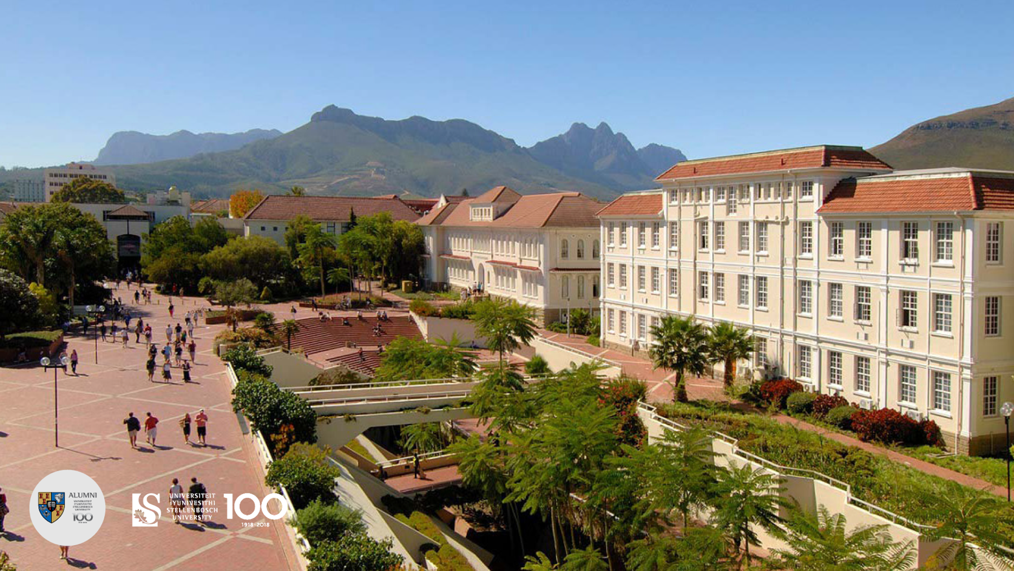
Thank you.

