Slide 1


NIDS-CRAM Wave 5 & COVID-19
Premier Coordinating Forum
31 Aug 2021
Nic Spaull
Associate Professor | Economics Department | Stellenbosch University
National income Dynamics Study (NIDS) Coronavirus Rapid Mobile Survey (CRAM)

Slide 2







NIDS-CRAM is a public good
Overview: Largest non-medical study in SA at the moment.
  Broadly nationally representative telephonic survey available in all 11 languages.
  Sample drawn from existing NIDS 2017 survey.
  5 waves over the last year (service provider: AskAfrica)
  30+ researchers, 6 universities
  Wave 5: 6 April to 11 May 2021
Data: All data (Waves 1-5) are freely available for download at DataFirst (https://www.datafirst.uct.ac.za/)
Research: All 67 Working Papers from Waves 1-5 are freely available for download at the NIDS-CRAM website (from 8 July) (www.cramsurvey.org)

Slide 3
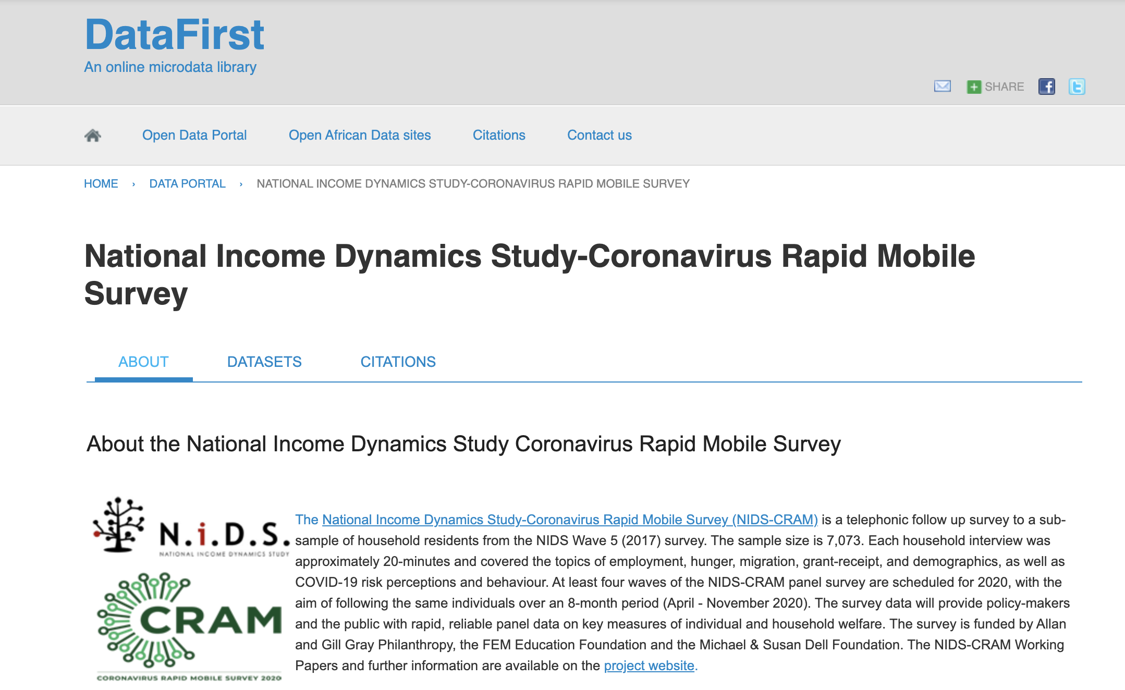

Slide 4
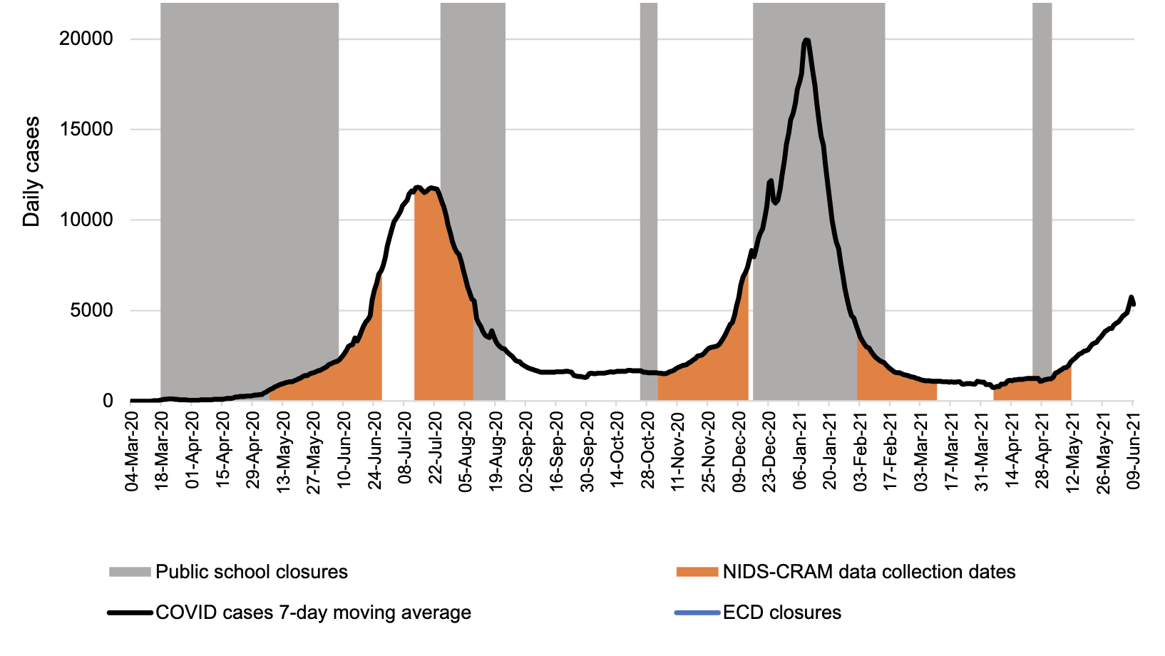
1
2
3
4
5
Source: Wills & Kika-Mistry. 2021.

Slide 5
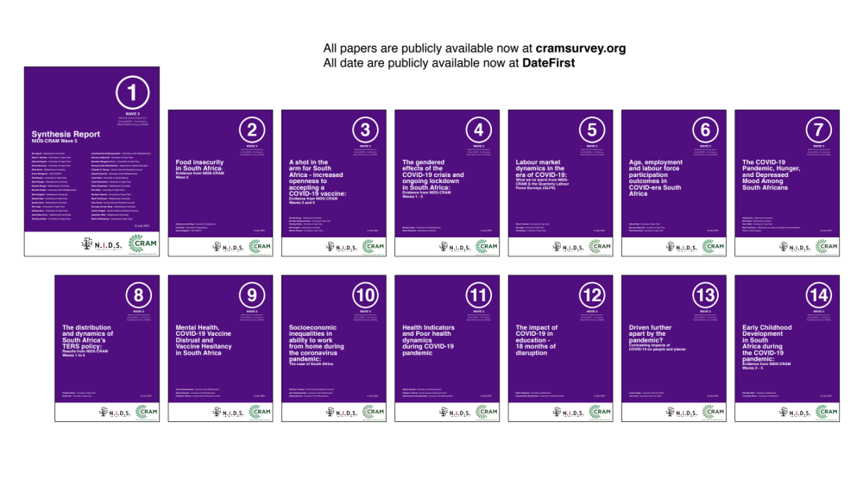
16 NIDS-CRAM Wave 5 Working Papers. Available at cramsurvey.org from 8 July 10am

Slide 6
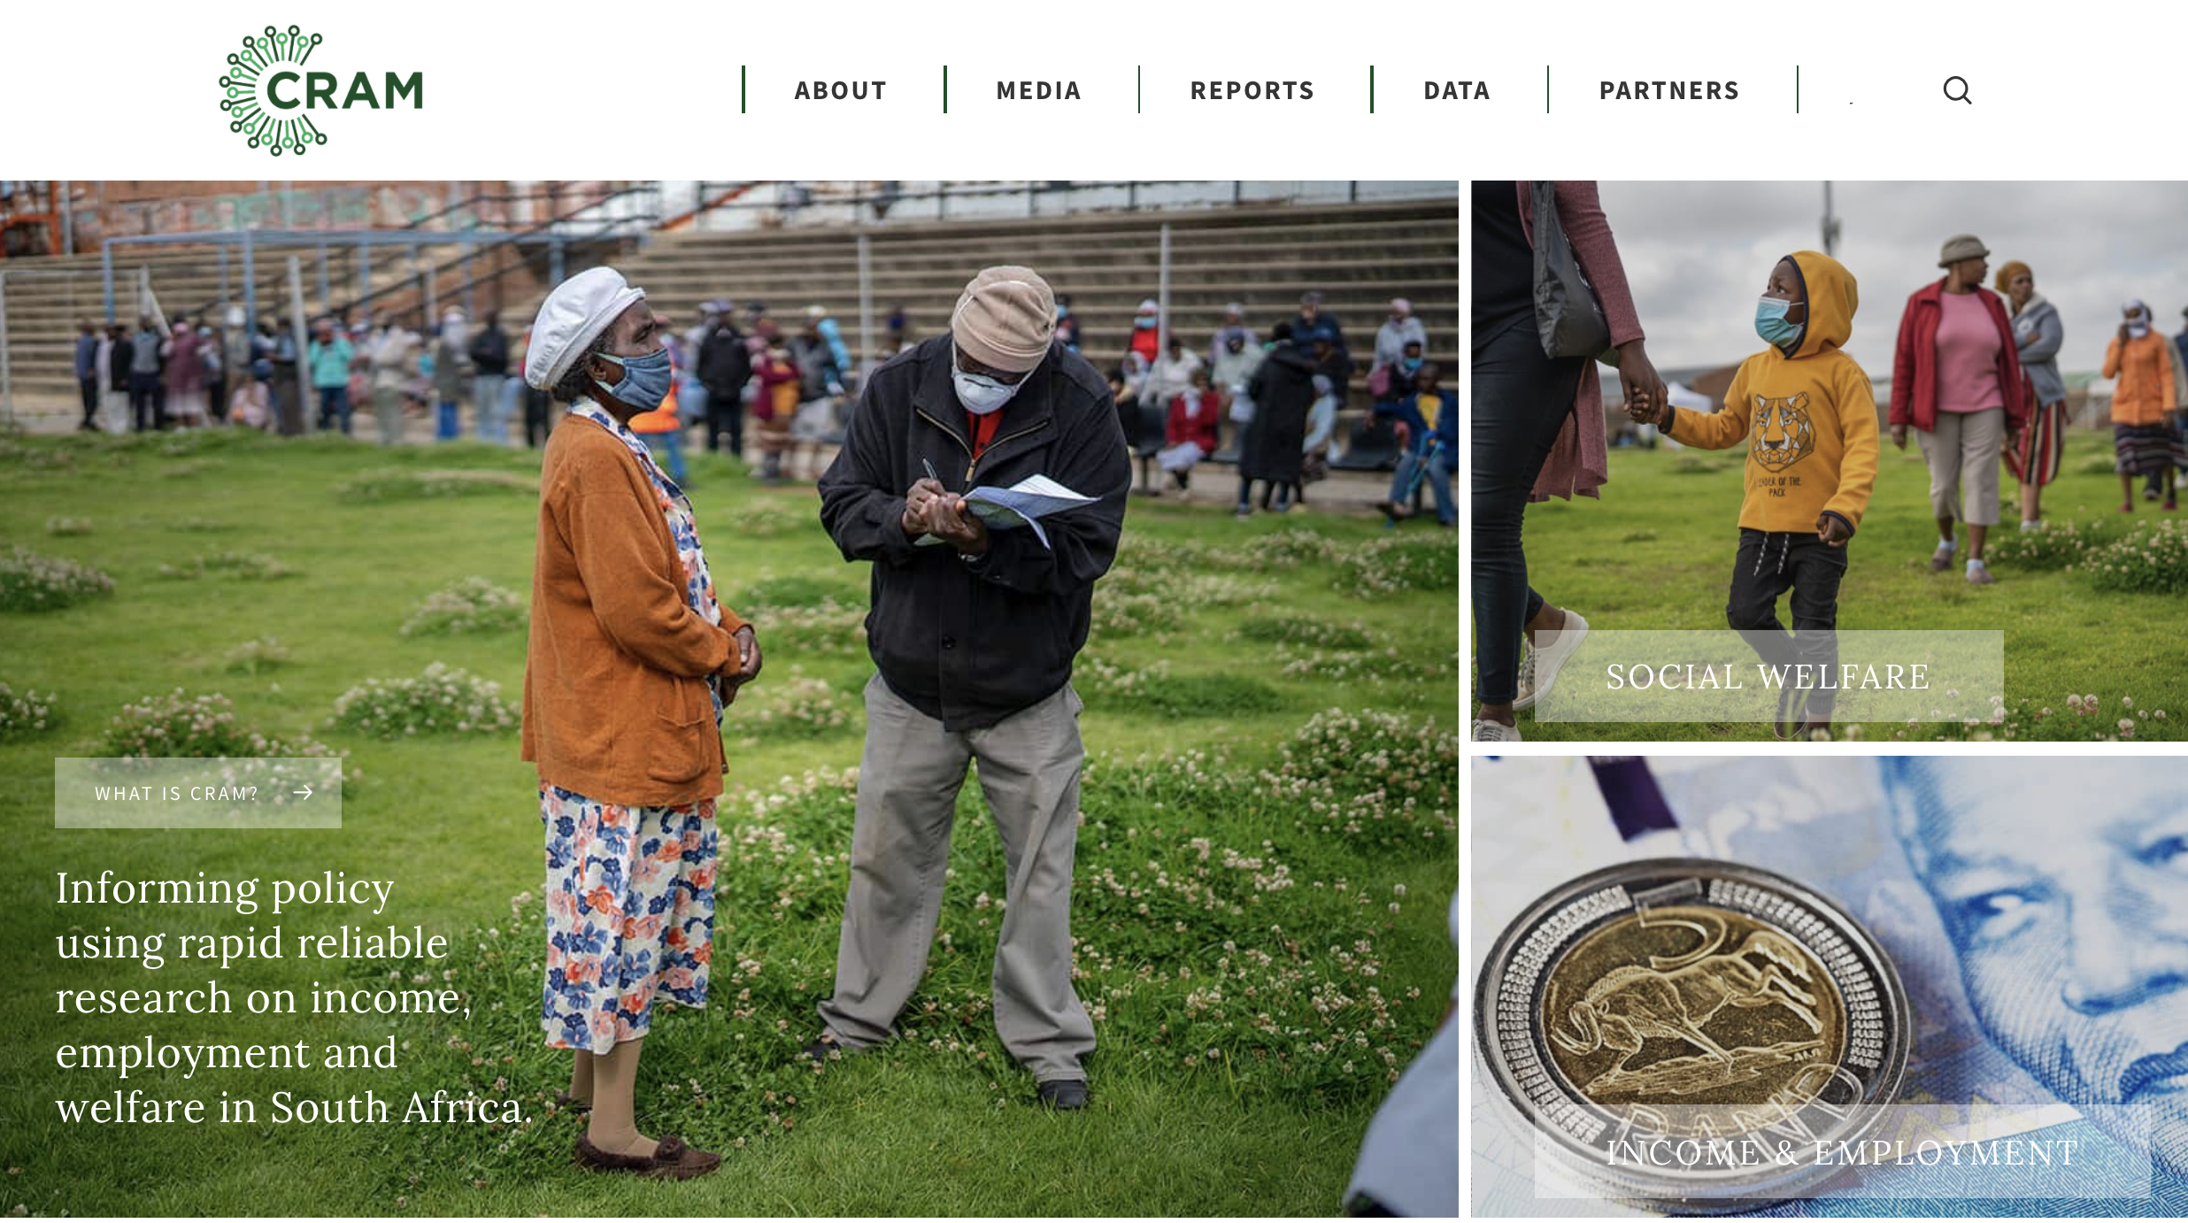
cramsurvey.org

Slide 7
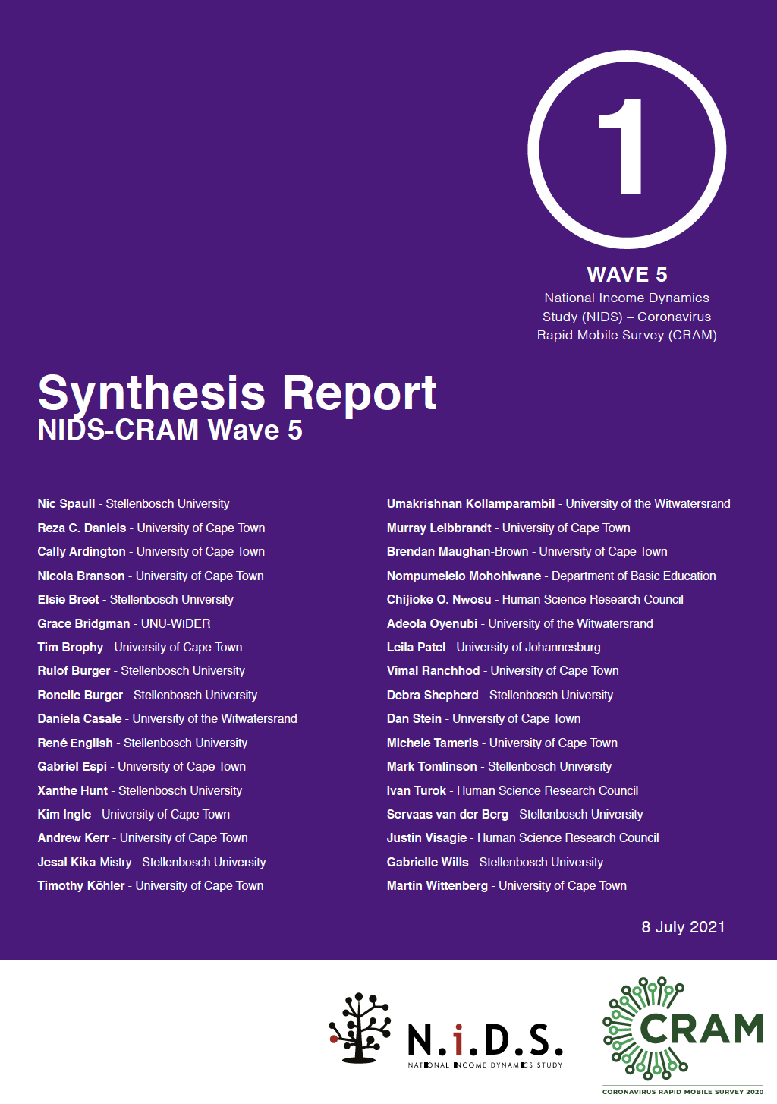
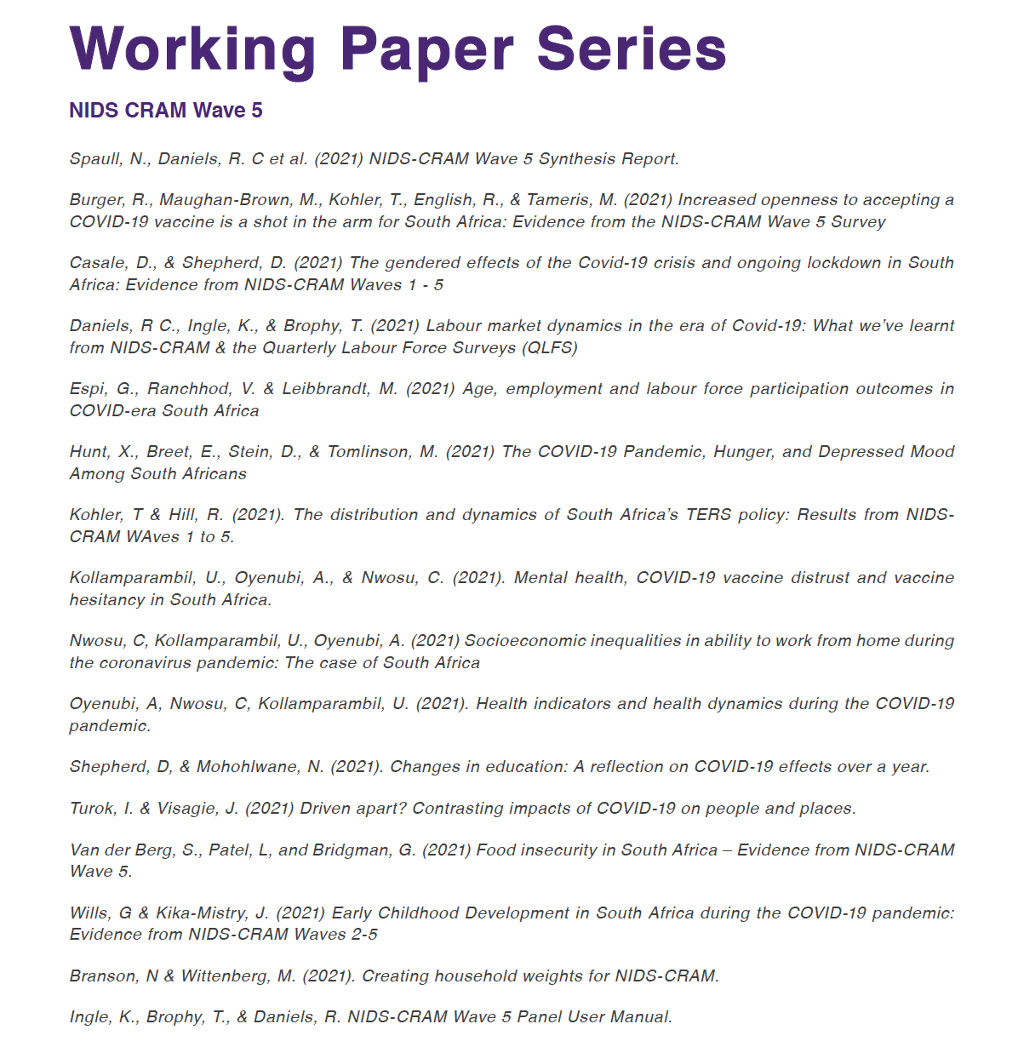
Wave 5: 6 April – 11 May 2021

Slide 8
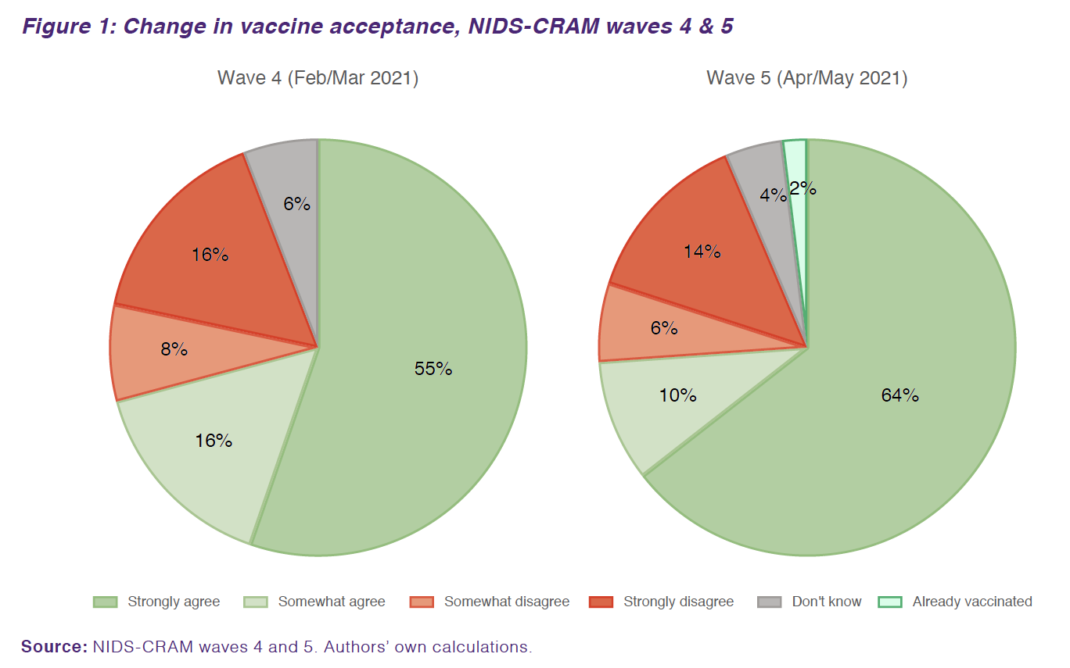
Vaccines
Vaccine acceptance is rising
…from 71% in Feb’21 to 76% in May’21
Source: Burger et al. 2021 (W5)

Slide 9
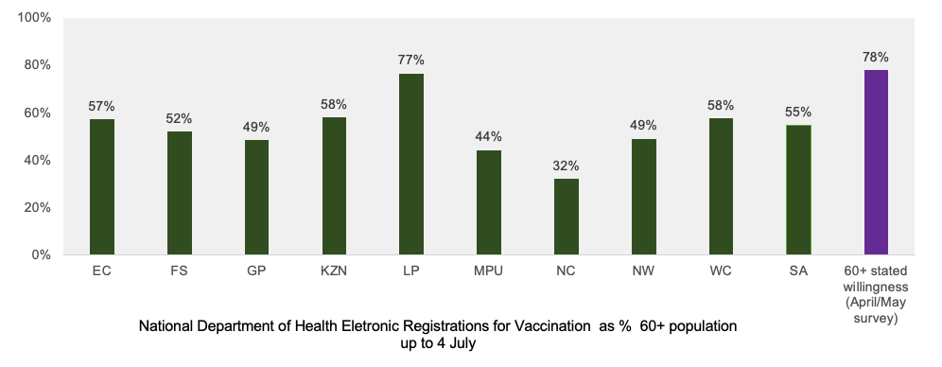
Stated vaccine intent is higher than observed registrations
Vaccines
Source: Burger et al. 2021 (W5)

Slide 10
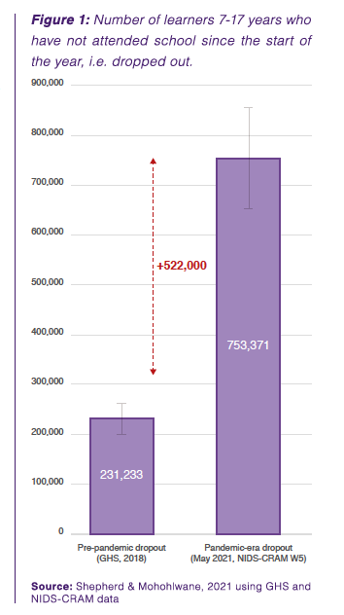
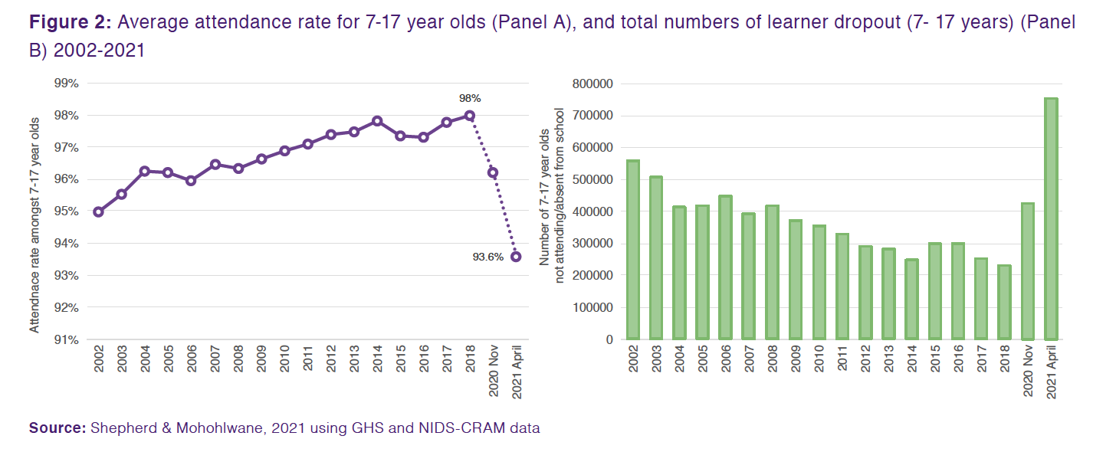
Dropout
An extra 500,000 children have dropped out of school during the pandemic. School dropout has tripled from 230,000 pre-pandemicto approximately 750,000 in May 2021, it is now at the highest rate in at least 20 years.

Slide 11


Slide 12
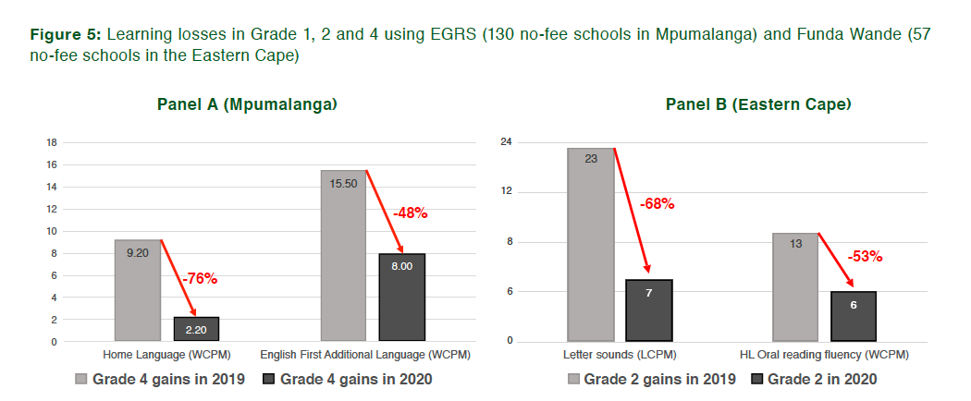
Learning losses
Extrapolating from Wave 4 reported learning losses using known number of lost days up to June 2021, children in no-fee schools have learnt
70 - 100% less
By June 2021 compared to what they normally learn.
Source: Shepherd & Mohohlwane, 2021 (W5)

Slide 13

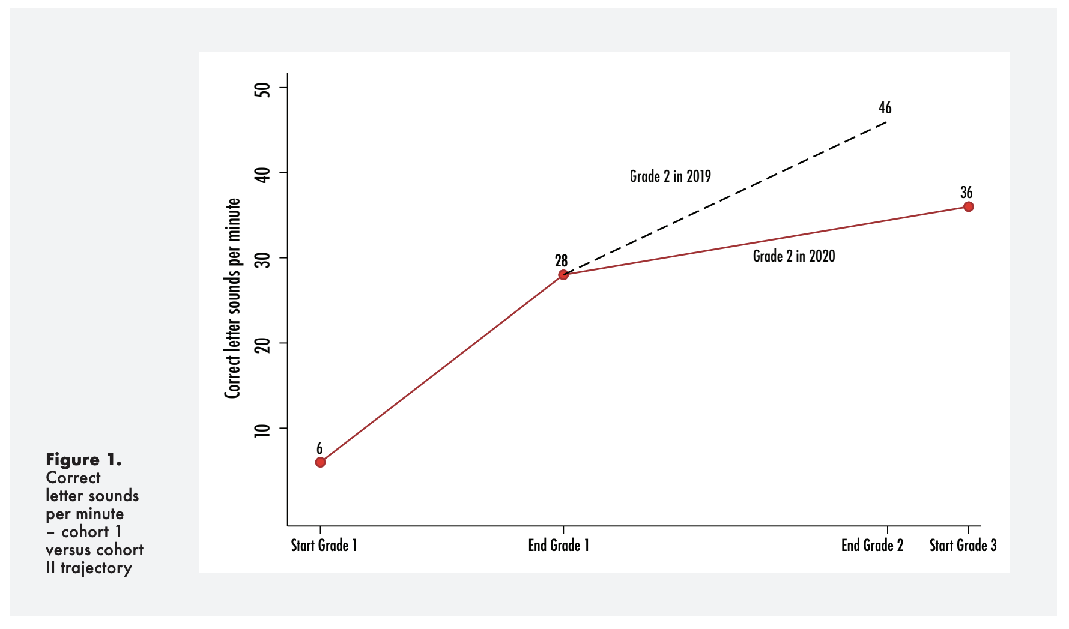
Flattening learning trajectories.

Slide 14

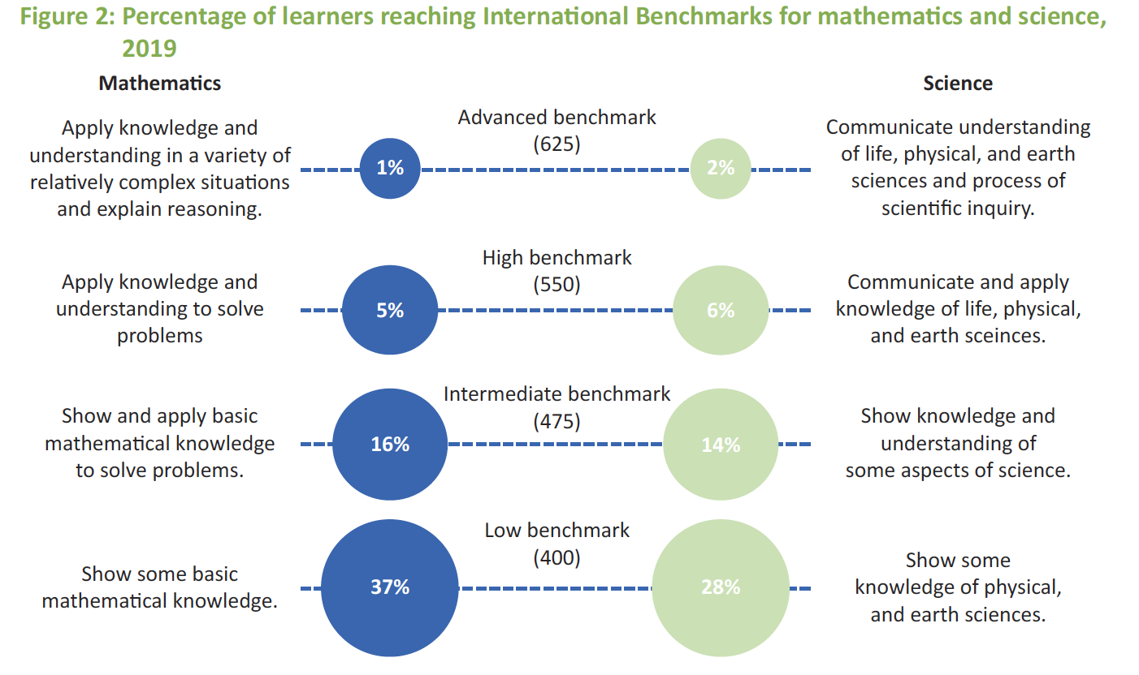
Example questions from TIMSS 2019 Gr5:
700 – 28 = ____ [MN11128 – CAPS Gr3]
5 x 25 = ___ [MN11136 – CAPS Gr4]
(SA: 25%)
(SA: 38%)

Slide 15
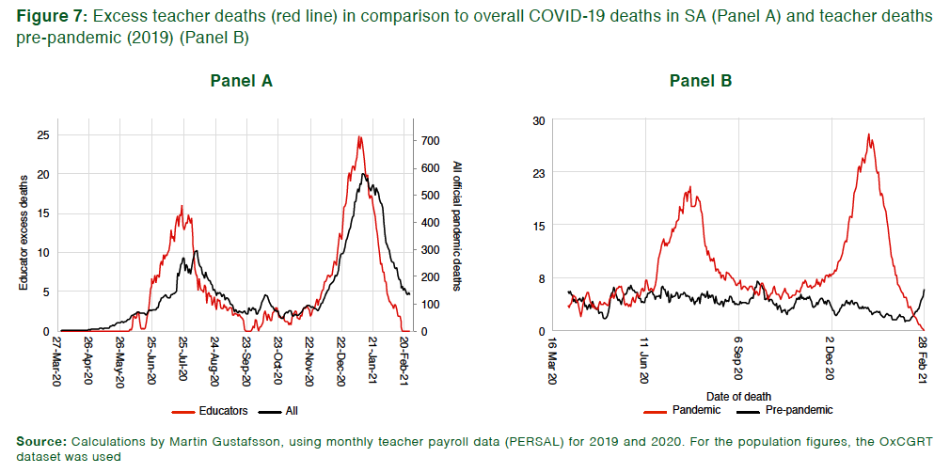
Teacher mortality
Analysing teacher payroll data (Persal) shows an increase in excess deaths among teachers but unrelated to school opening/closing.
Instead follows SA mortality trends almost perfectly.

Slide 16
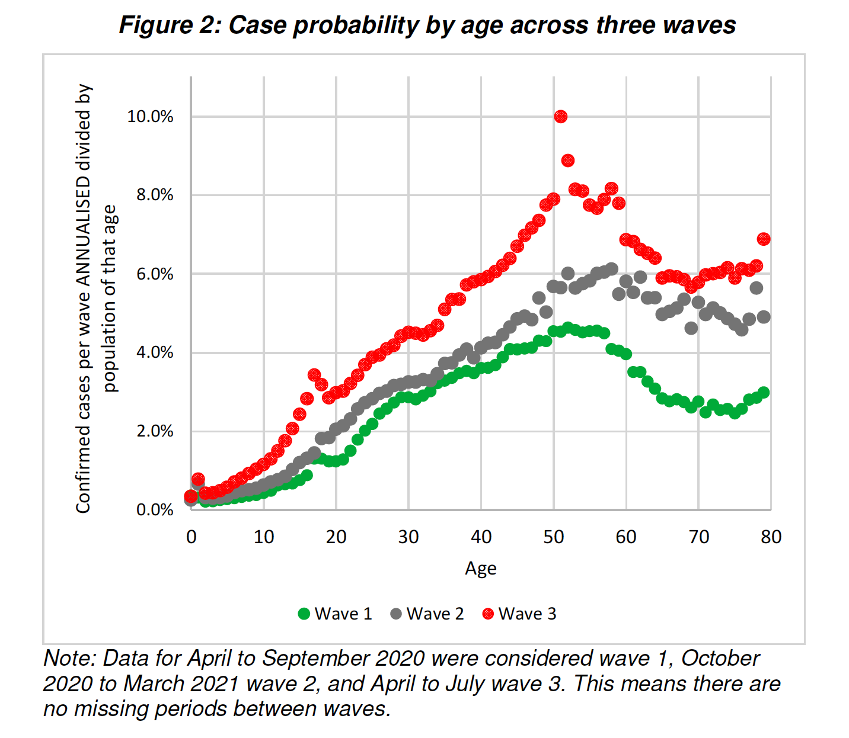
(Source: Gustafsson, 2021)
"The August 2021 NICD report shows that this is still true even for the Third Wave "The national demographic trends have remained unchanged in this reporting period, children aged <10 years had the lowest incidence risk and individuals aged 40-59 years had the highest incidence."
Also this: "As of 19 June 2021, individuals aged ≤19 years made up 13.4% of SARS-CoV-2 tests, 10.2% of laboratory-confirmed COVID-19 cases, 4.2% of all COVID-19-associated admissions and 0.7% of COVID-19 associated deaths."
It is a tragedy when anyone dies of COVID-19, especially a child. Parents are also understandably worried about their children given that we are in a pandemic. Although it is extremely extremely rare that children die of COVID-19, it is not impossible. For example, there are 22-million children aged 19 or younger. Since the beginning of the pandemic last year 380 children died of COVID-19. that is to say 0,0017% of children." Children are far more likely to die of many other things than COVID-19. Including diarrhoea, pneumonia, TB etc.

Slide 17
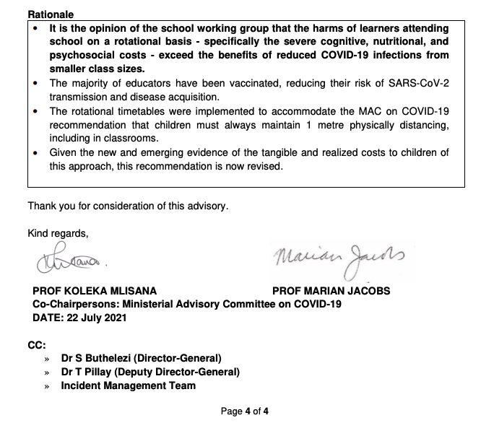
MAC recommendation RE schools
(July 2021)
https://t.co/anlOi0yvJh?amp=1

Slide 18
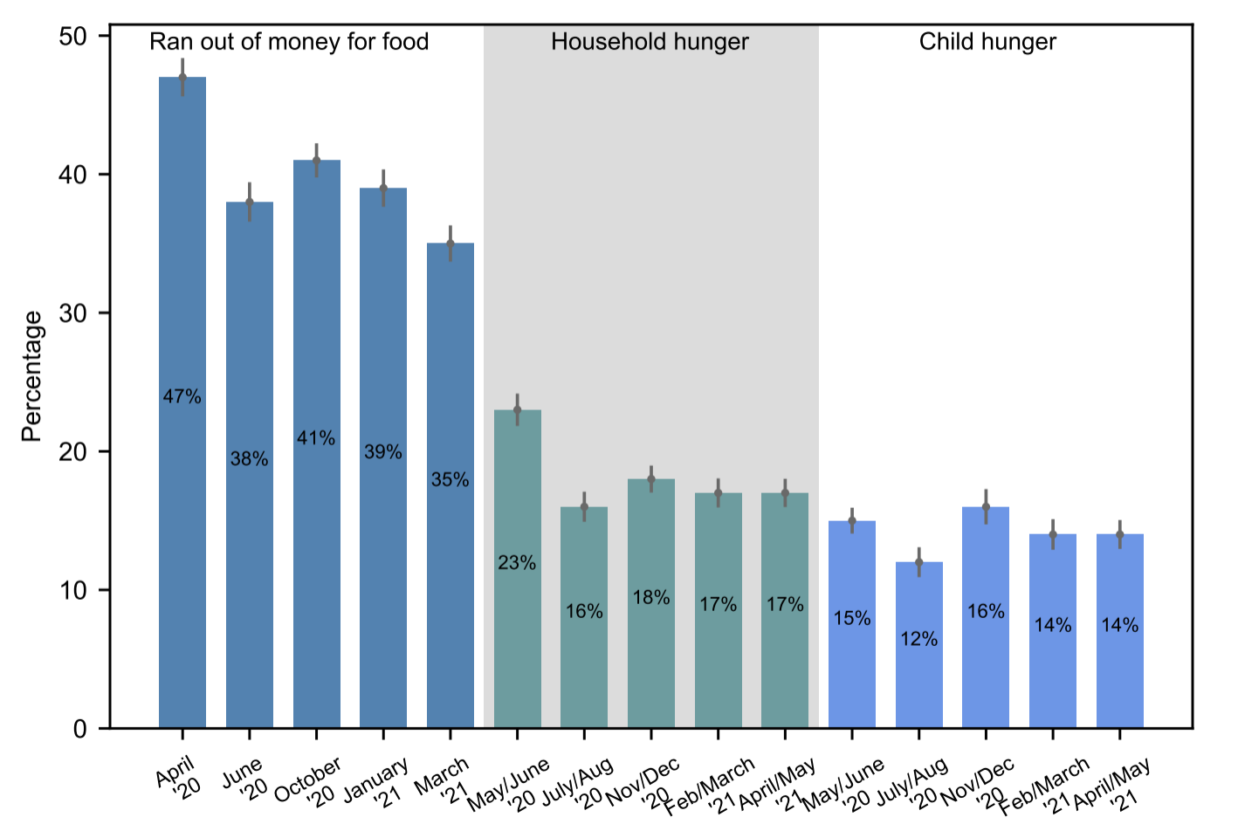
Hunger
Child hunger remains extremely high at 14% in the past week in April/May 2021 Hunger sems to have stabilised at a new (higher) rate both for adults and children.
Women were more likely to shield children from hunger than men.
Source: Van der Berg et al., 2021 (W5)

Slide 19
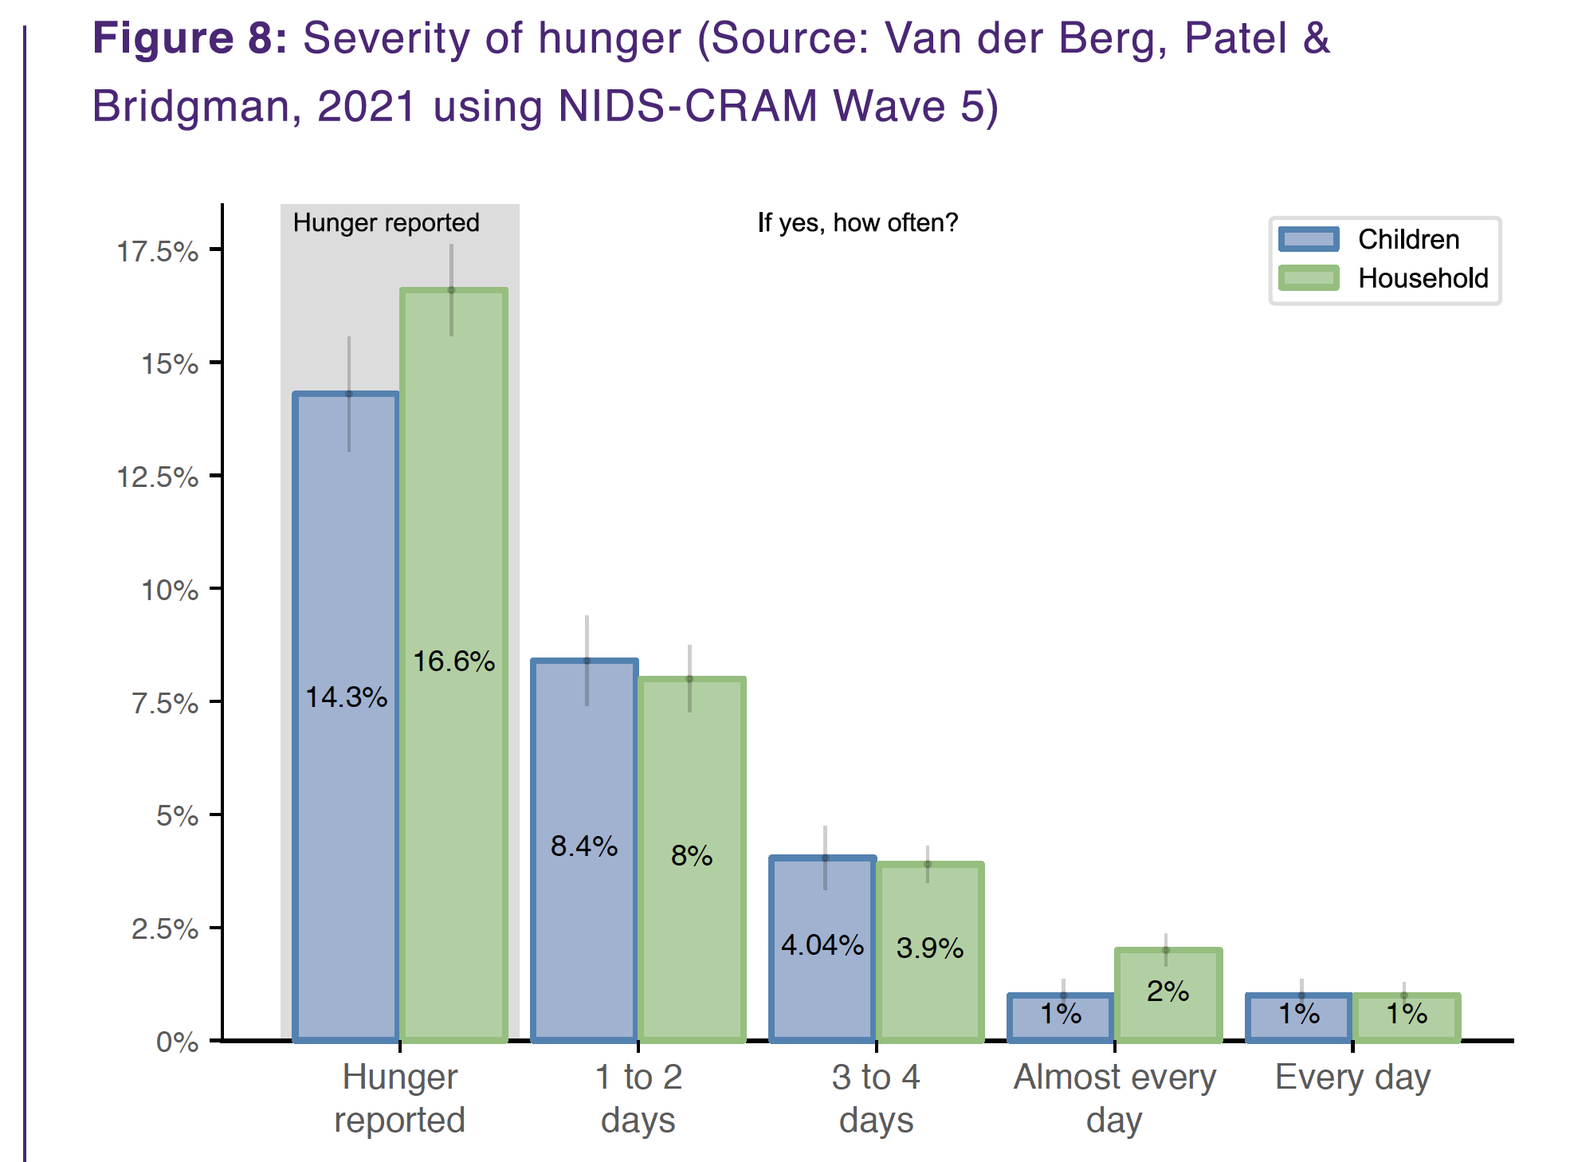
Hunger
Approximately 10-million people and 3-million children were in households affected by hunger in April/May 2021
(Wittenberg & Branson, 2021)
Perpetual hunger
(every day or almost every day):
1,8million people
400,000 children
Source: Van der Berg et al., 2021; Wittenberg et al, 2021

Slide 20
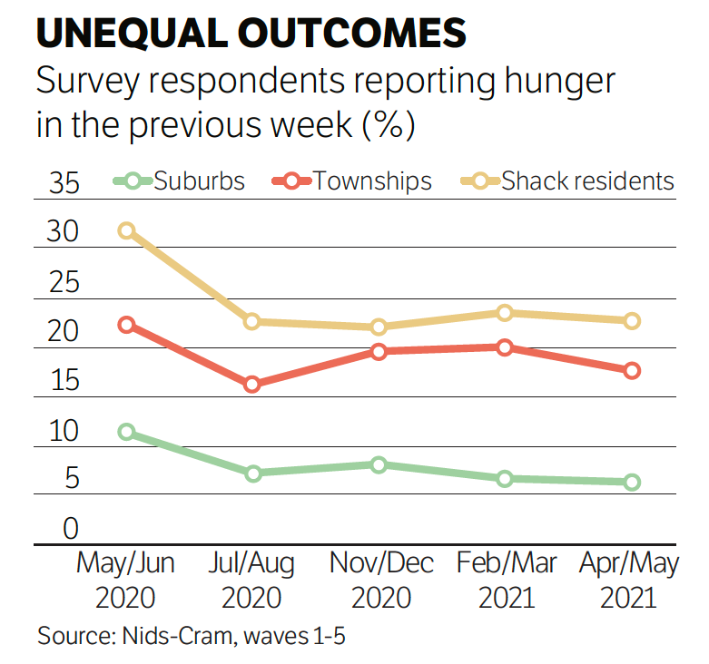
Shack residents
Among those in urban areas, shack-dwellers and those in peri-urban areas had the highest rates of reported hunger.
Shack dwellers were hit hardest in terms of job loss, running out of money to buy food, hunger and access to grants.
Source: Turok & Visagie, 2021 (W5)

Slide 21
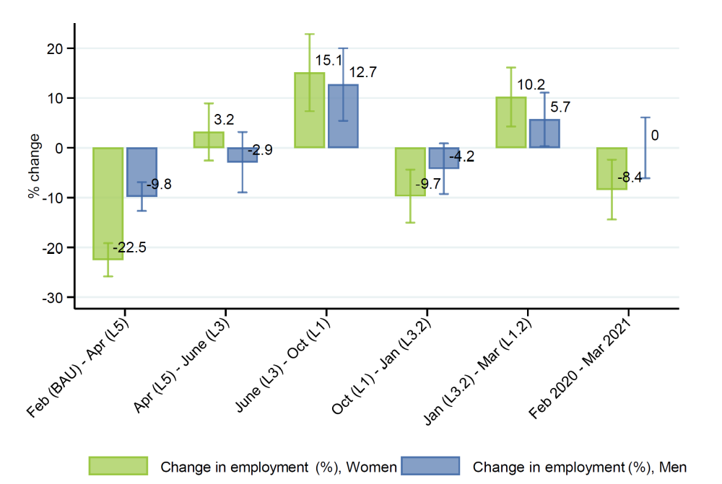
Employment, by gender
GENDER
Compared to pre-pandemic (February 2020), women’s employment is still down 8.4% in March 2021, while men’s employment recovered over the same time period
Source: Casale & Shepherd, 2021 (W5)

Slide 22
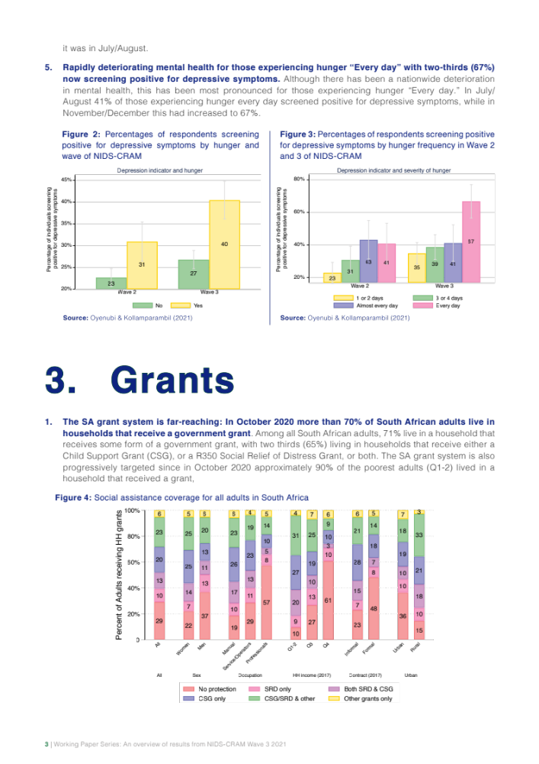
3. Grants
71%
of adult South Africans are in HH’s that receive a government grant
Note that this was before August 2021 SRD CSG announcement
Source: Bassier, Budlender & Zizzammia, 2021

Slide 23
3. Grants
10%
of adult South Africans are in HH’s that ONLY receive a R350 SRD grant
Note that this was before August 2021 SRD CSG announcement
Source: Bassier, Budlender & Zizzammia, 2021

Slide 24

MENTAL HEALTH
03
Slide: Debra Shepherd

Slide 25
Figure 10: Population of people affected by depressed mood at single time points compared to population ever affected by depressed mood
NEARLY ONE THIRD OF RESPONDENTS HAD DEPRESSED MOOD IN EITHER WAVES 3 OR 5 OF NIDS-CRAM (increase from Wave 2)
Source: Hunt et al (2021) using NIDS-CRAM Waves 2, 3 and 5 data
Slide: Debra Shepherd

Slide 26
Figure 10: Population of people affected by depressed mood at single time points compared to population ever affected by depressed mood
NEARLY ONE THIRD OF RESPONDENTS HAD DEPRESSED MOOD IN EITHER WAVES 3 OR 5 OF NIDS-CRAM (increase from Wave 2)
Half (53%) of respondents screened positive for depressed mood in at least one of these three time periods.
Source: Hunt et al (2021) using NIDS-CRAM Waves 2, 3 and 5 data
Slide: Debra Shepherd

Slide 27
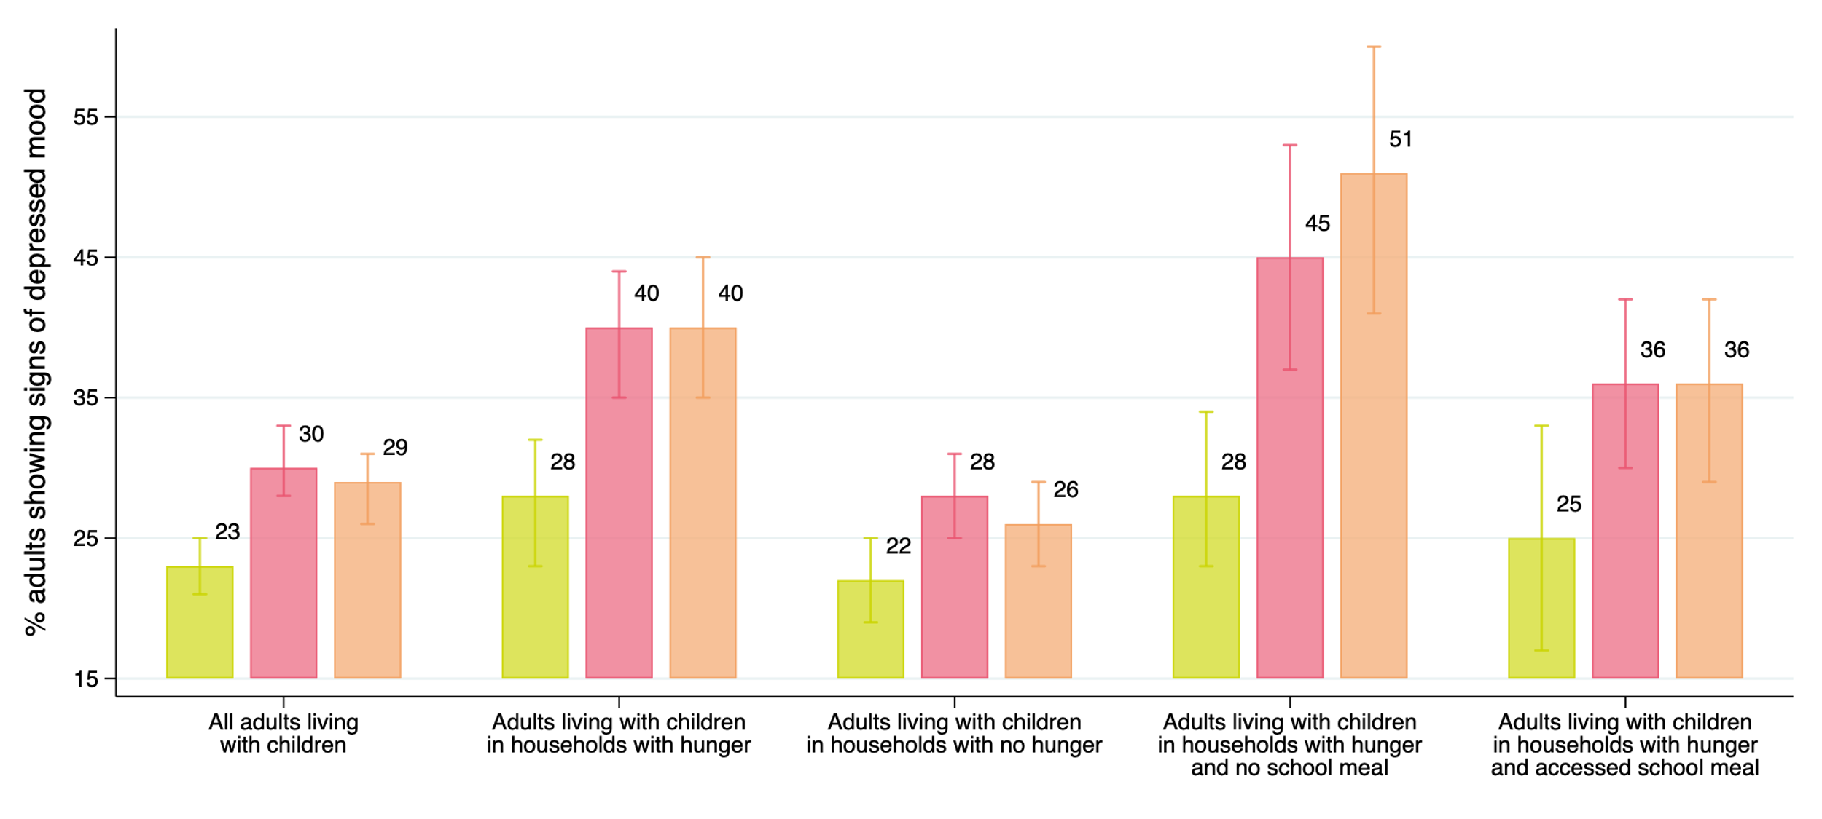
40% OF ADULTS LIVING WITH CHILDREN IN FOOD INSECURE HOUSEHOLDS SHOW SIGNS OF DEPRESSED MOOD IN APRIL 2021.
Figure 10: Rate of adult depressive mood by household food insecurity in July 2020 (), November 2020, and April 2021
This is compared to 26% amongst those living with children in food secure households.
Source: Shepherd and Mohohlwane (2021) using NIDS-CRAM Waves 2, 3 and 5 data
Slide: Debra Shepherd

Slide 28
THIS PROPORTION RISES TO 51% WHEN WE CONSIDER FOOD INSECURE HOUSEHOLDS THAT REPORT LACK OF CHILD ACCESS TO FOOD AT SCHOOL.
Figure 10: Rate of adult depressive mood by household food insecurity in July 2020 (), November 2020, and April 2021
Source: Shepherd and Mohohlwane (2021) using NIDS-CRAM Waves 2, 3 and 5 data

Slide 29
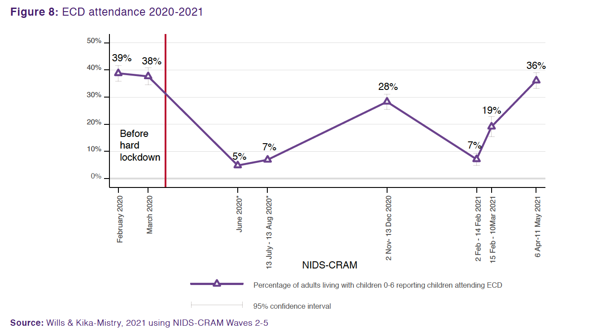
ECD
ECD attendance has recovered remarkably to 36% in April/May 2021. This is very close to pre-pandemic levels (39% in Feb 2021)
Notes:
Of those men who were employed in February 2020, 78% were still employed in January 2021. For women the figure is only 70%. Women were more likely to be in sectors that were hardest hit by the crisis.

Slide 30
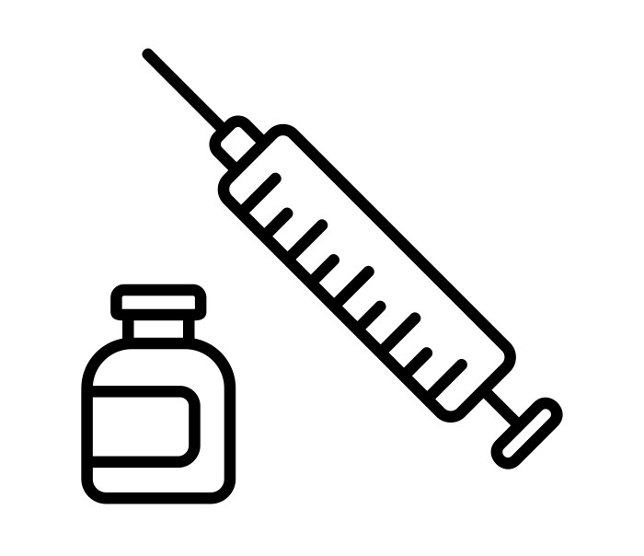
Vaccination in South Africa
(1) The binding constraint to economic recovery in SA is the vaccination rate.
(2) The binding constraint to the vaccination rate is not vaccinating on weekends.

Slide 31
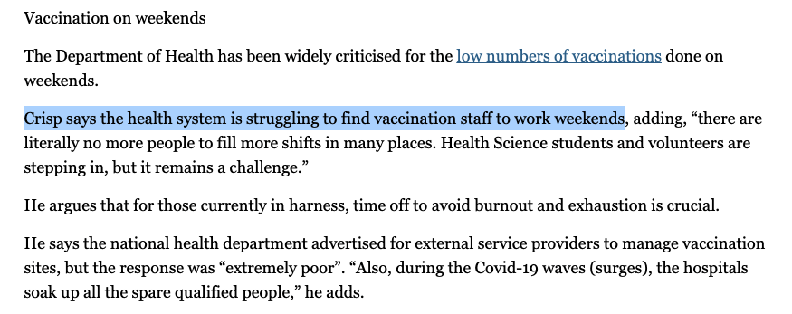
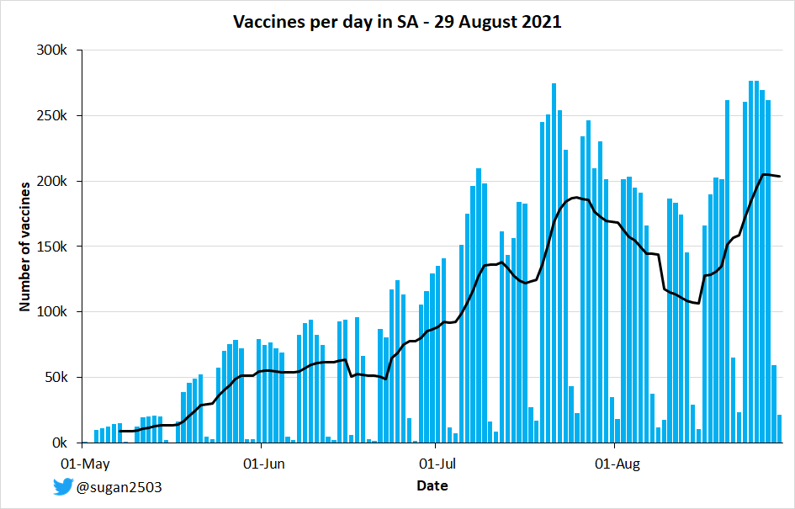
On Sunday 1 August only 22,601 vaccines administered (13% of regular weekday, 180,000)
Announcement that vaccinations on weekends will commence 1Aug

Slide 32
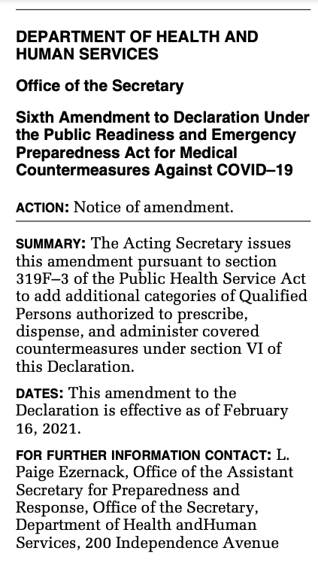
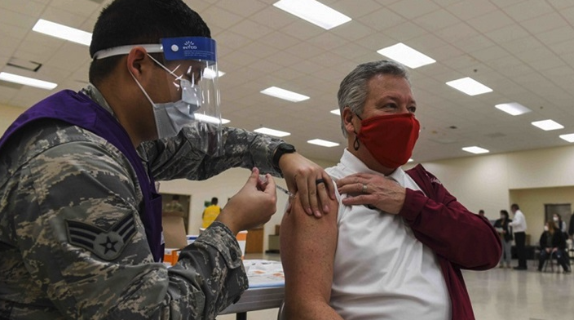

Vaccines
No reason why only nurses should be able to administer vaccines.
  US Army vaccinated over 1-million people: In Feb 2021 US passed the Public Readiness and Emergency Preparedness Act (PREP) for Medical Countermeasures Against COVID-19 limiting the liability of military personnel and allowing them to administer vaccines.
HPCSA must comply – it’s a disaster
  If the Health Professions Council of SA (HPCSA) is obstinate that only nurses can administer injections they should be summoned to parliament.
  Even if funds are released to pay nurses for overtime, people cannot work 8am to 8pm Monday-Sunday for 6-months.
  SA has 70,000 Community Health Workers who can be trained and supervised by registered nurses at large sites (CTICC) with medical oversight.

Slide 33

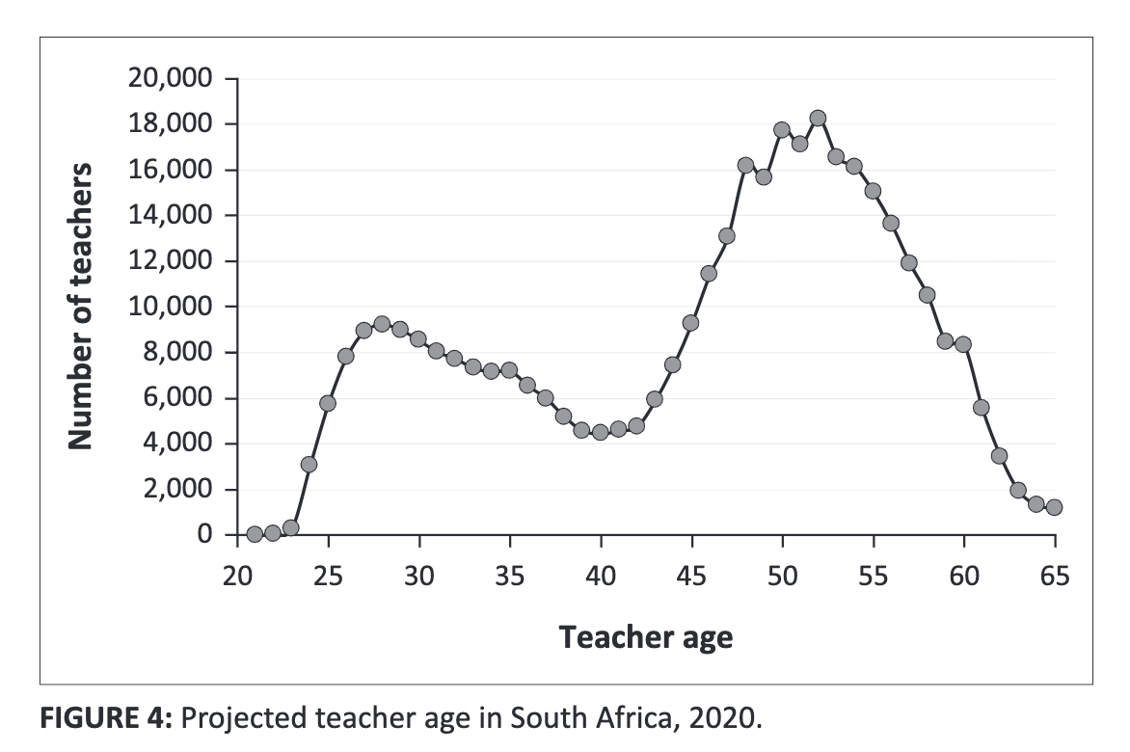
COVID-19 is crowding out attention on critical medium and long-term trends. For example wave of teacher retirements coming in the next 5 years…
(Spaull & Van der Berg, 2020)

Slide 34


Slide 35


Slide 36
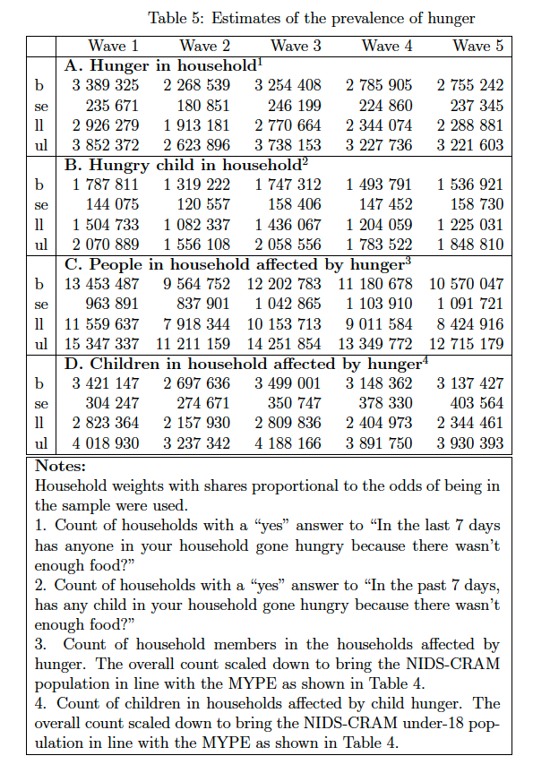
Hunger
Approximately 10-million people and 3-million children were in households affected by weekly hunger in April/May 2021
(Wittenberg & Branson, 2021)
Source: Wittenberg & Branson, 2021 (W5)

Slide 37

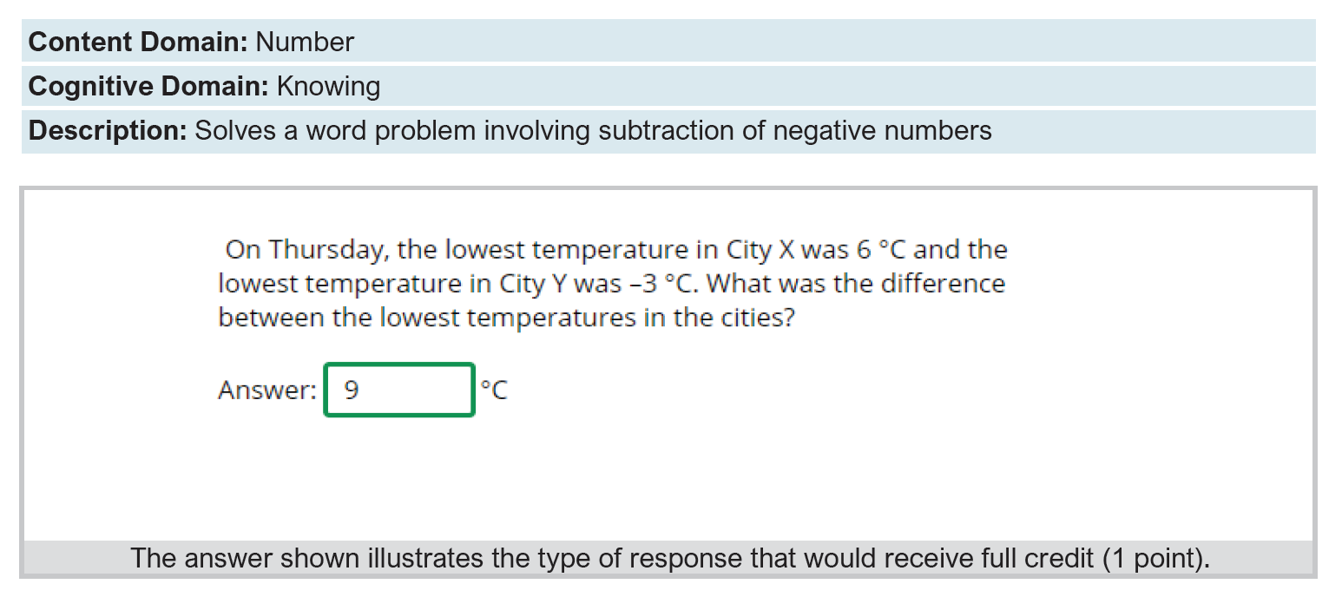
TIMSS 2019 Gr9 Intermediate International Benchmark

