Slide 1
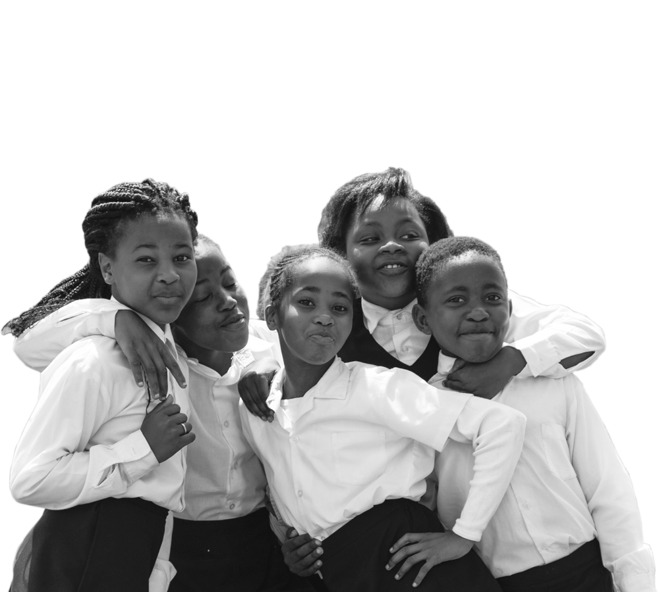
Getting it right from the beginning
Early grade reading and mathematics
Dr Nic Spaull
Gates Foundation
2 October 2024 | FSDOE Strategic Planning Lekgotla

Slide 2
Setting the scene
- Demographics (TDD project)

Slide 3
Demographics: Educator age distribution (2021)
1
Source: Anonymised PERSAL data from 2021, only educators (Rank 60 000 – 69 999) are considered. ECD practitioners, TVET lecturers and ABET teachers were removed.

Slide 4
FS Demographics: Educator age distribution (2021)
1
A lower proportion of educators are over 50 years old in the Free State than in the rest of the country
A slightly higher proportion of young educators under 35 years in the Free State than in the rest of the country
Source: Anonymised PERSAL data from 2021, only educators (Rank 60 000 – 69 999) are considered. ECD practitioners, TVET lecturers and ABET teachers were removed.

Slide 5
Older teacher proportions for senior educator and primary schools educators
1
 |  | Percentage of educators aged 50+ in 2021
Province |  | All educators |  | Senior educators (HOD, Dep.- principals, Principals & Other) |  | Primary school educators
EC |  | 51% |  | 71% |  | 58%
FS |  | 43% |  | 65% |  | 49%
GP |  | 41% |  | 65% |  | 42%
KN |  | 39% |  | 65% |  | 44%
LP |  | 58% |  | 81% |  | 63%
MP |  | 50% |  | 73% |  | 55%
NC |  | 43% |  | 69% |  | 44%
NW |  | 47% |  | 70% |  | 52%
WC |  | 42% |  | 73% |  | 40%
SA |  | 46% |  | 69% |  | 49%
Source: Anonymised PERSAL data from 2021, only educators (Rank 60 000 – 69 999) are considered. ECD practitioners, TVET lecturers and ABET teachers were removed. The 2021 rankclass file was expanded to include ranks found only in years prior to 2021, used to classify educators by rank. Primary school only includes all educators that are in a component that is classified as a Primary school.

Slide 6
Older teacher proportions for senior educator and primary schools educators
1
 |  | Percentage of educators aged 50+ in 2021
Province |  | All educators |  | Senior educators (HOD, Dep.- principals, Principals & Other) |  | Primary school educators
EC |  | 51% |  | 71% |  | 58%
FS |  | 43% |  | 65% |  | 49%
GP |  | 41% |  | 65% |  | 42%
KN |  | 39% |  | 65% |  | 44%
LP |  | 58% |  | 81% |  | 63%
MP |  | 50% |  | 73% |  | 55%
NC |  | 43% |  | 69% |  | 44%
NW |  | 47% |  | 70% |  | 52%
WC |  | 42% |  | 73% |  | 40%
SA |  | 46% |  | 69% |  | 49%
zvc
zvc
zvc
FS has 43% of educators aged 50 years and older in 2021 with a higher proportion in primary schools (49%)
Source: Anonymised PERSAL data from 2021, only educators (Rank 60 000 – 69 999) are considered. ECD practitioners, TVET lecturers and ABET teachers were removed. The 2021 rankclass file was expanded to include ranks found only in years prior to 2021, used to classify educators by rank. Primary school only includes all educators that are in a component that is classified as a Primary school.

Slide 7
FS Demographics: Educator age distribution in 2021 & 2030
1
Assume constant 2021 educator numbers
Age: 51
2021
2030
Source: Anonymised PERSAL data from 2021, only educators (Rank 60 000 – 69 999) are considered. ECD practitioners, TVET lecturers and ABET teachers were removed.

Slide 8
Demographics: Projected growth in school-aged population
3
Population of children aged 7-18 in the Free State, is expected to decrease by
~26K children (-4%)
from 2021 to 2030
Note: Period 2021 – 2030 is the same timeframe, nine years, as 2012 – 2021.
Source: Thembisa age-specific estimates from the model V4.5 for children aged 7-18 by province

Slide 9
Demographics: School aged-population estimates to 2030
3
 | Number of children Aged 7-18 |  |  |  | Growth '12-21 | Growth '21-30
Province | 2012 | 2021 | 2030E
EC | 1 657 202 | 1 598 475 | 1 361 637 |  | -4% | -15%
FS | 592 445 | 676 489 | 650 820 |  | 14% | -4%
GP | 1 962 793 | 2 498 533 | 3 180 884 |  | 27% | 27%
KN | 2 485 822 | 2 690 378 | 2 657 716 |  | 8% | -1%
LP | 1 395 864 | 1 507 386 | 1 612 125 |  | 8% | 7%
MP | 977 749 | 1 100 594 | 1 165 728 |  | 13% | 6%
NC | 254 075 | 277 560 | 281 208 |  | 9% | 1%
NW | 742 943 | 893 530 | 930 323 |  | 20% | 4%
WC | 1 068 009 | 1 298 801 | 1 496 731 |  | 22% | 15%
Total | 11 136 902 | 12 541 746 | 13 337 172 |  | 13% | 6%
676K
592K
651K
Note: Period 2021 – 2030 is the same timeframe, nine years, as 2012 – 2021.
Source: Thembisa age-specific estimates from the model V4.5 for children aged 7-18 by province

Slide 10
Why focus on the early grades?
- Starting from matric and working backwards

Slide 11

How many students make it through the schooling system in South Africa? (2016 study)

Slide 12

How many students make it through the schooling system in South Africa? (2016 study)

Slide 13

How many students make it through the schooling system in South Africa? (2016 study)

Slide 14

How many students make it through the schooling system in South Africa? (2016 study)

Slide 15

How many students make it through the schooling system in South Africa? (2016 study)
Source: Van Broekhuizen & Van der Berg, 2016 (Higher Education Access and Outcomes for the 2008 National Matric Cohort)

Slide 16
How many students make it through the schooling system in South Africa? (2016 study)
}
?
51
2023
- 62%
Source: Van Broekhuizen & Van der Berg, 2016 (Higher Education Access and Outcomes for the 2008 National Matric Cohort)

Slide 17
What about Free State?

Slide 18
2023 NSC: Data
 | Gr1-12 in 2013 | Grade 2 in 2013 | Wrote NSC 2023 | Passed NSC 2023 | Bachelors Pass 2023
EC | 1,938,078 | 180,710 | 95,697 | 77,917 | 37,898
FS | 664,508 | 63,575 | 34,451 | 30,673 | 15,414
GP | 2,129,526 | 197,942 | 127,697 | 109,030 | 56,552
KZN | 2,866,570 | 243,317 | 157,911 | 136,366 | 72,099
LP | 1,714,832 | 139,782 | 93,533 | 74,400 | 34,018
MP | 1,052,807 | 93,306 | 65,534 | 50,429 | 21,819
NW | 788,261 | 75,022 | 41,418 | 33,808 | 15,061
NC | 282,631 | 25,582 | 12,842 | 9,740 | 3,851
WC | 1,052,435 | 97,191 | 62,077 | 50,620 | 26,182
National | 12,489,648 | 1,116,427 | 691,160 | 572,983 | 282,894

Slide 19

Where do the
wheels come off?
What does this look like in Grade 5?

Slide 20

What does it look like when children can’t read?
Draper, K., and Spaull, S. (2015). Examining oral reading fluency among grade 5 rural English Second Language (ESL) learners in South Africa: Analysis of NEEDU 2013. South African Journal of Childhood Education 5(2) pp.44-77.

Slide 21
What does it look like when children can’t read?
Many
years
ago
Leopard
was
a
creature
with
no
spots.
Recommended rate at Gr5
One
day,
he
was
relaxing
in
the
shade
of
a
thorn
tree
when
Zebra
walked
past.
Many
years
ago
Leopard
was
a
creature
with
no
spots.
40% of SA rural Gr5 learners (<40WCPM) WCPM
One
day,
he
was
relaxing
in
the
shade
of
a
thorn
tree
when
Zebra
walked
past.
Draper, K., and Spaull, S. (2015). Examining oral reading fluency among grade 5 rural English Second Language (ESL) learners in South Africa: Analysis of NEEDU 2013. South African Journal of Childhood Education 5(2) pp.44-77.
Notes:
40 words in 60s = 1,5s/word
130 words in 60s = 0,46s/word

Slide 22
And what about
Grades 1-7?
Reading Trajectories Gr1 → Gr7 (EGRS 1, RSA)
Letter Decoders (39%)
Delayed Decoders (20%)
Alphabetically illiterate (42%)
Children who do not learn the basics about decoding are ‘falling at the first hurdle’
Grade 3 Minimum Fluency Benchmark
60
“The psycholinguistic skills that go into early reading are now well-documented both locally and internationally, showing a hierarchy of skills that builds from oral proficiency to auditory discrimination (phonemic awareness) and letter-sound recognition. Once learners can segment individual letter-sounds in words and blend letters to form words, increasing accuracy and fluency then aid comprehension”
PIRLS 2021 showed that 81% of Grade 4 learners could not read in any language (all 11 were assessed)
(Pretorius & Spaull, 2022 & Wills et al, 2022)

Slide 23
What can we do about this?

Slide 24




We have learnt a lot in the last 10 years in SA (2022)
41 Chapters
77 Authors
Open Access
Open Access and available here: https://t.co/Z2IxegRHA0

Slide 25
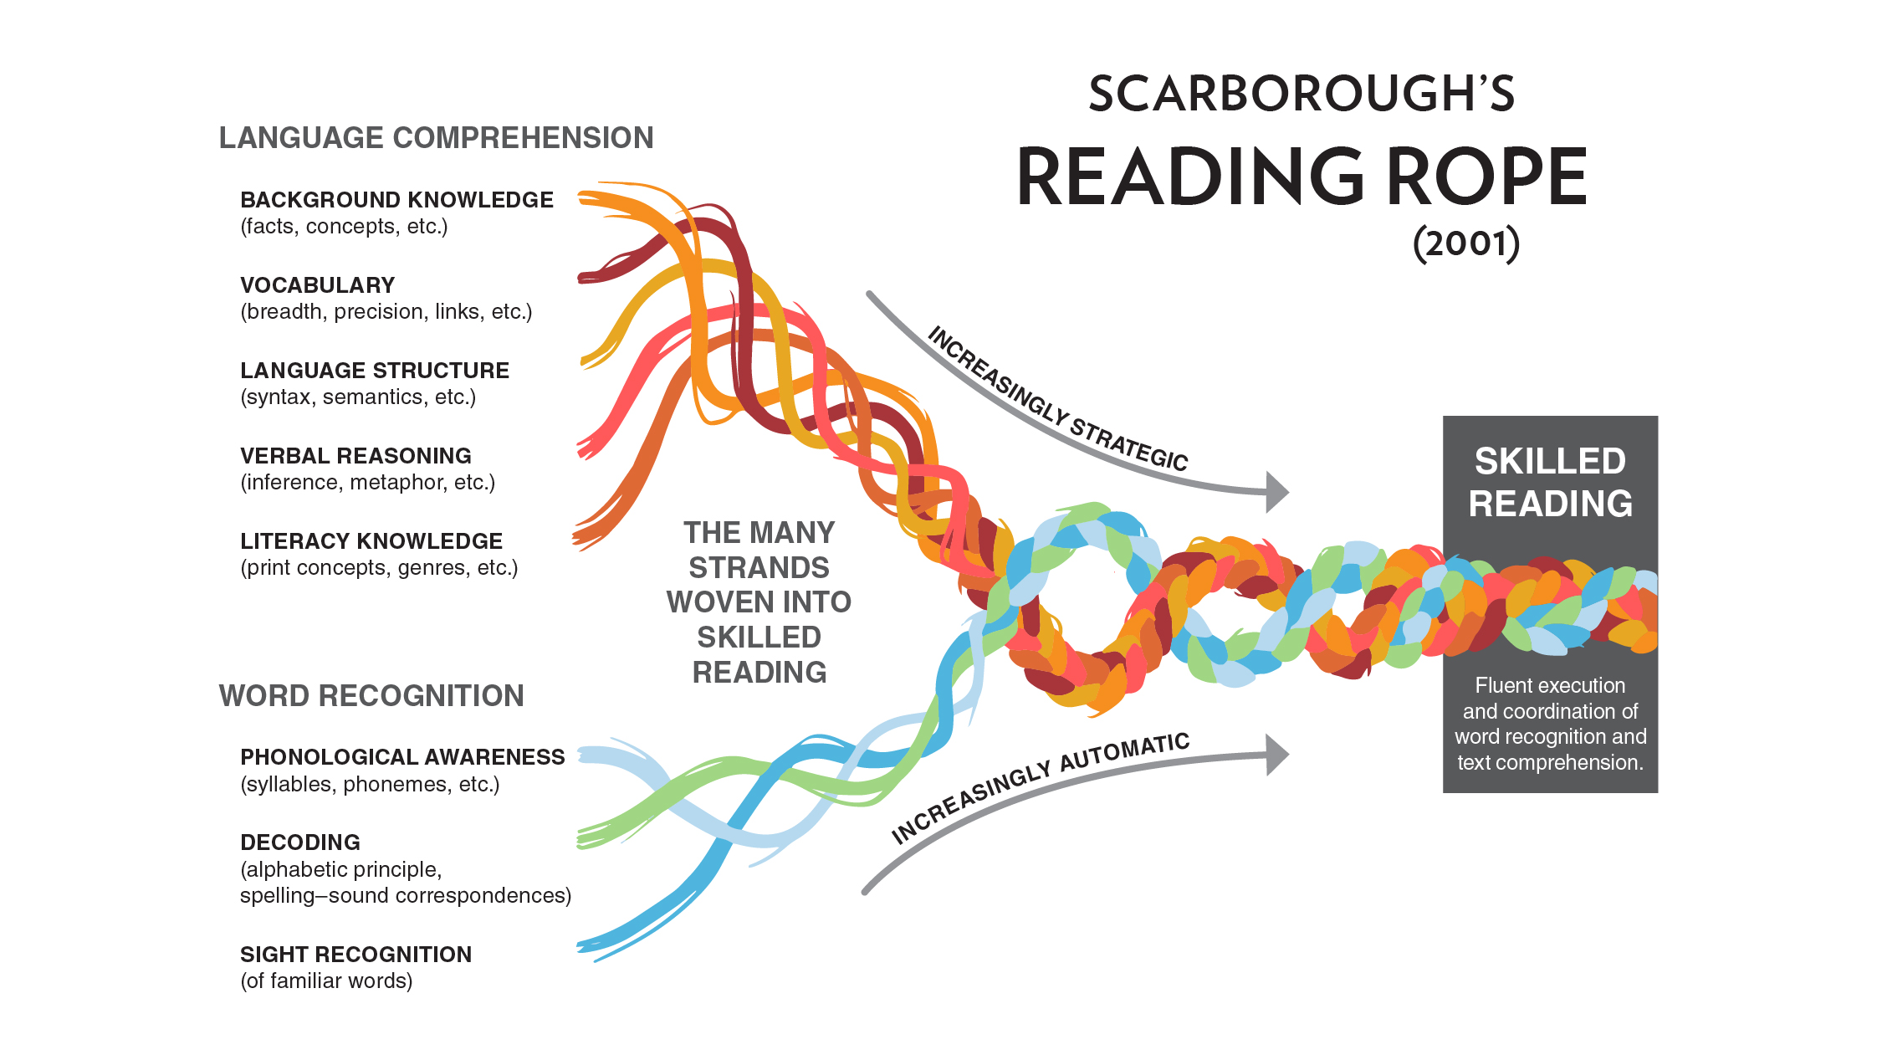


How do children learn how to read?
Oral
Print

Slide 26
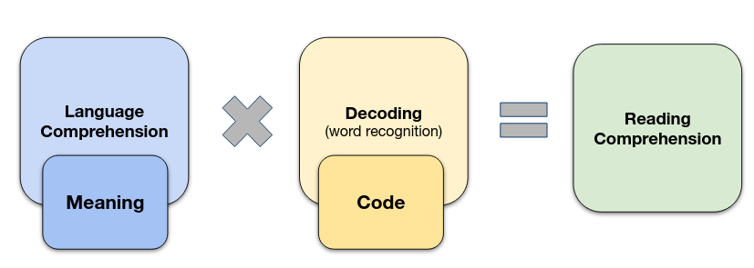
The Simple View of Reading
(Gough & Tunmer, 1986)
Oral
Print

Slide 27

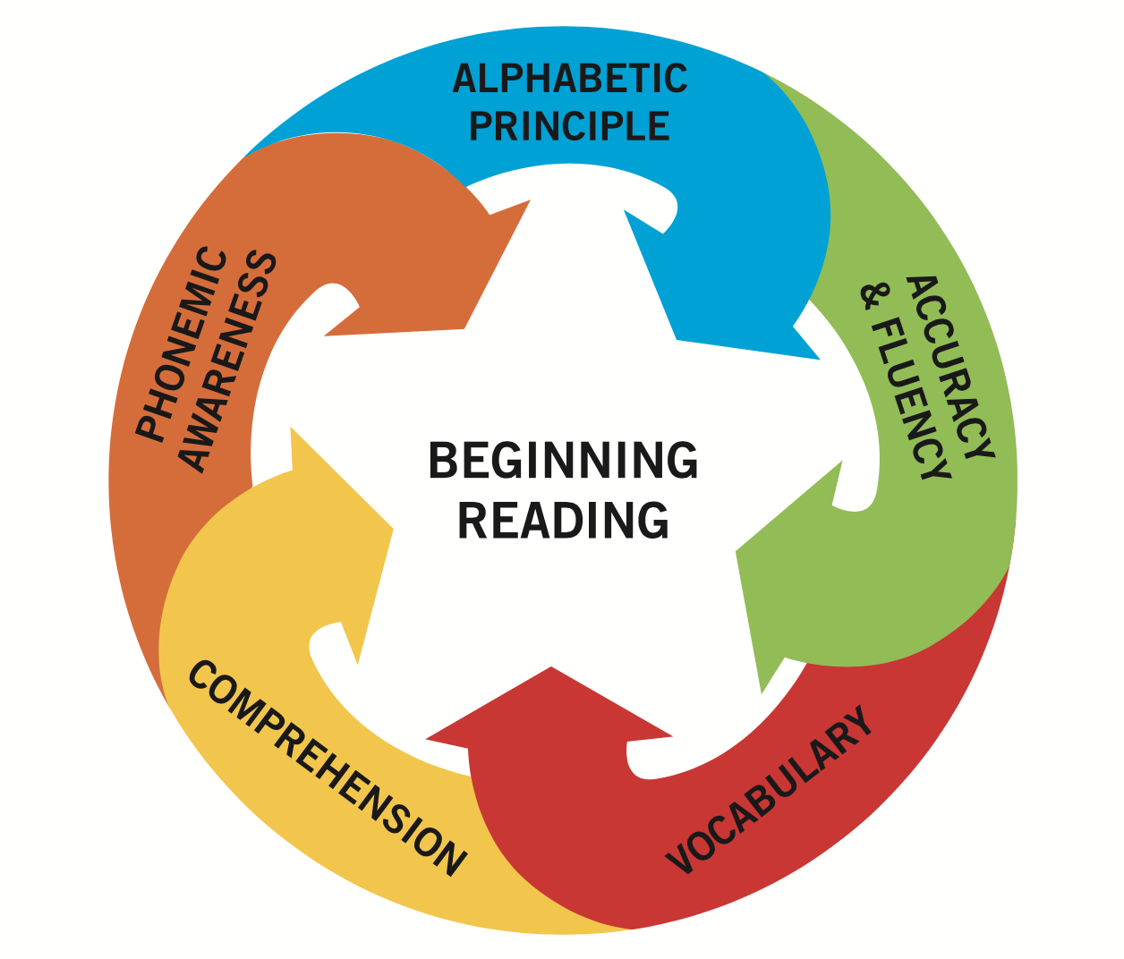
The Big 5
(National Reading Panel, 2000)

Slide 28
Alphabetic Principle: Letter-sound knowledge
Early failure is already evident by the end of Grade 1 in no-fee schools.
  Longitudinal data from EGRS (NW) and Funda Wande (EC) reveal that more than half of children in no-fee schools do not know all of the letters of the alphabet by the end of Grade 1.
  Even by the end of Grade 2, 30% of children still don’t know all the letters of the alphabet.
Even at the end of Grade 2, only 53% of learners know all the letters of the alphabet.
This is after 400 days of teaching and learning
Source: Wills, Ardington & Sebaeng (2022: p.46)

Slide 29
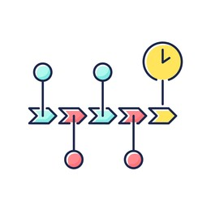
What is Structured Pedagogy?
Scope and sequence
Form and Structure

Slide 30



What is Structured Pedagogy?
Structured pedagogy means different things to different people. To me it means the following:
Structured and systematic program: There is a structured program that systematically sets out what the teacher should do, when, and how, as well as with what materials. This means that there are key areas of content, sequencing, and pacing ‘baked into’ the program.
Standardizing materials and pedagogy: There are some methods of teaching children to read (phonics) and do mathematics (CPA, base 10 system) that are better than others (Whole Language, Constructivism, Forest Literacy etc.). We have quantitative evidence to show this now (Castles et al. 2019). We should require teachers to use standardized materials and standardized approaches, while allowing some flexibility for local context (class size, catch-up pacing etc.).
Alignment & coherence between Learner & Teacher materials & training: Learners are given books (1:1 ratio) and teachers are given guides. The two are developed concurrently, by the same people, at the same time. Integrated and aligned.
  One Learner Book per child – the entire curriculum in one book.
  One Teacher Guide per teacher – explaining how to teach using the one learner book.
Alignment & coherence in training/coaching on specific skills (not generic training):
  General training (on theory for example) much less effective than on SPECIFIC skills & practical activities
  Most effective training uses the materials that the teachers will be using themselves (i.e. not generic training) and
  is highly applied. Similarly, coaching feedback on particular skills (Teaching letter-sounds, Shared reading, classroom mgt etc)
  3. Elmore’s ‘Law’ – The effectiveness of professional development is inversely proportional to distance from the classroom. (Least effective is centralized training away from the school, most effective is in-classroom coaching.

Slide 31

An example of a
Structured Pedagogy program implemented in WC:

Slide 32




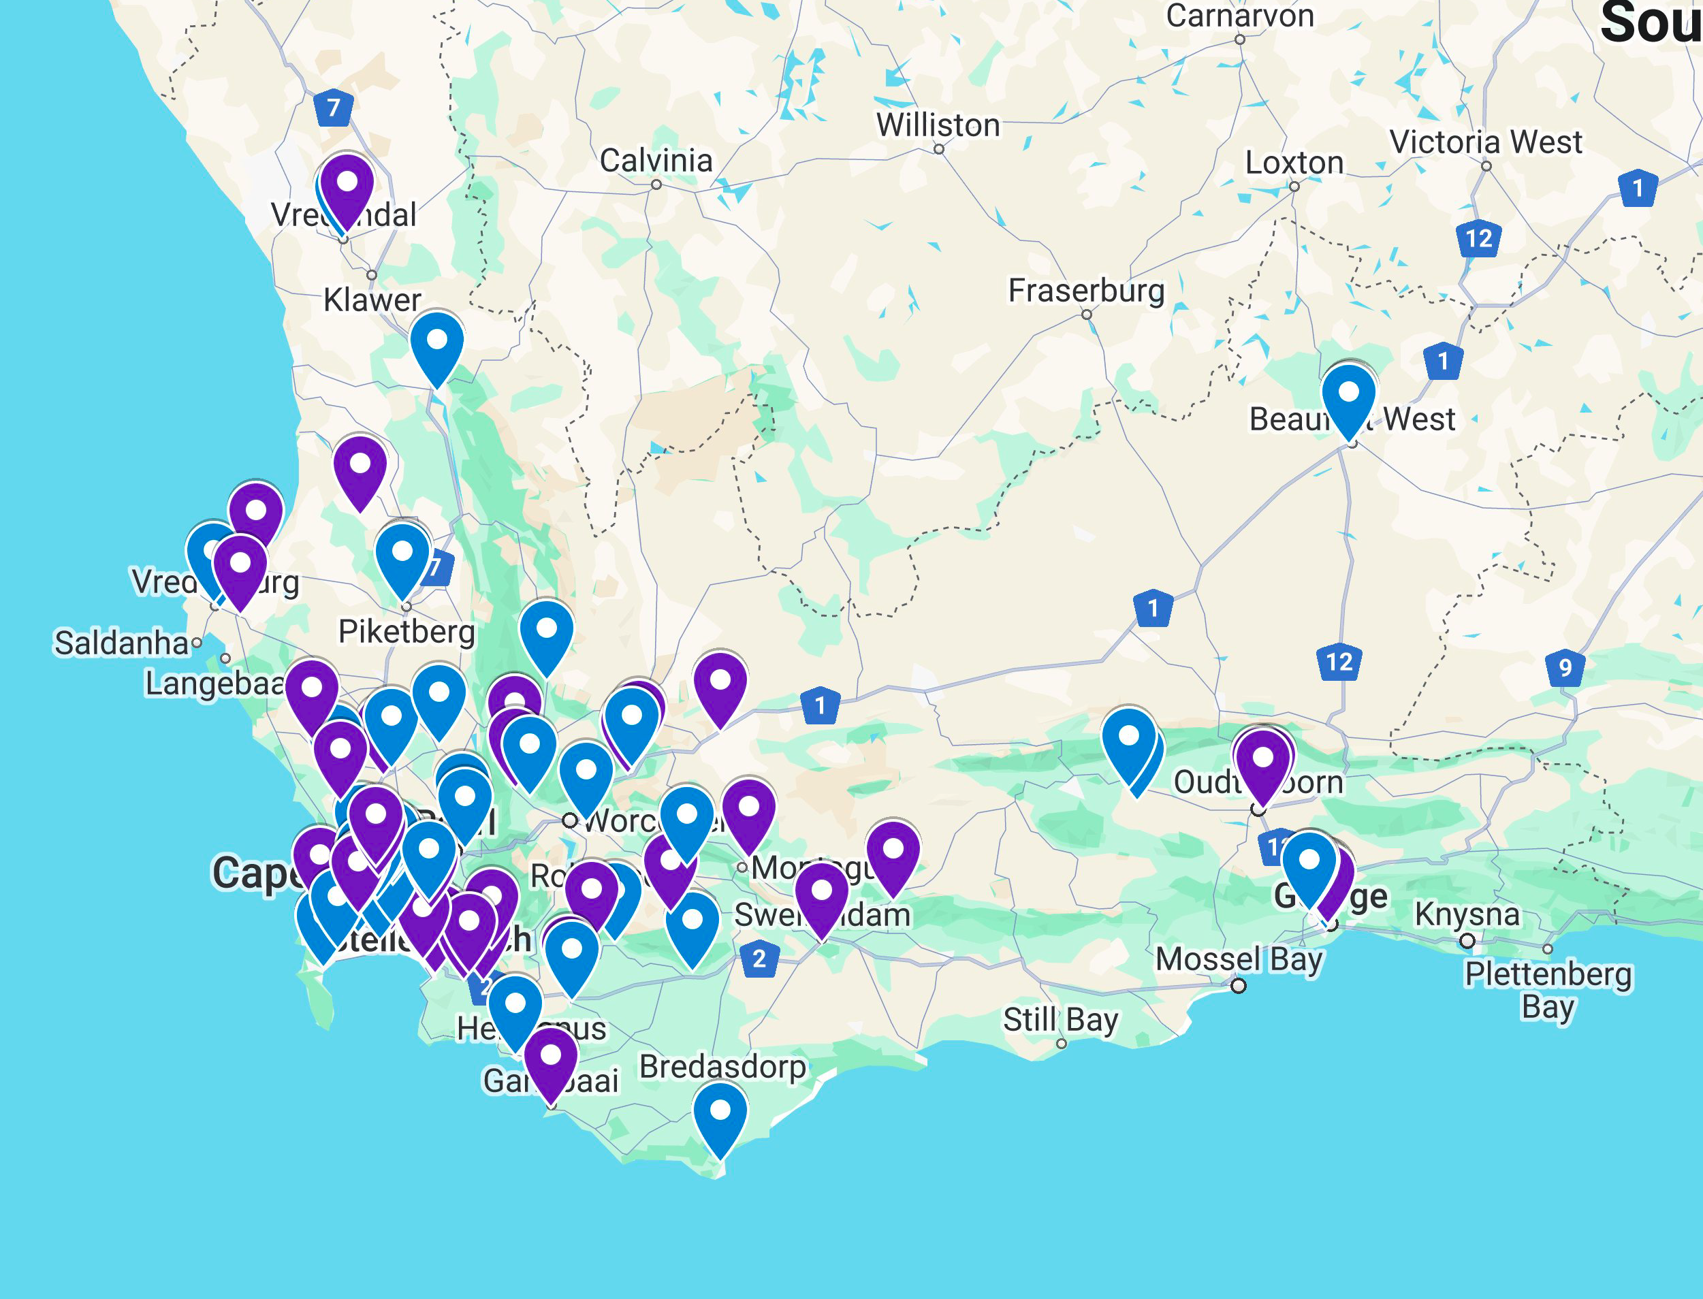
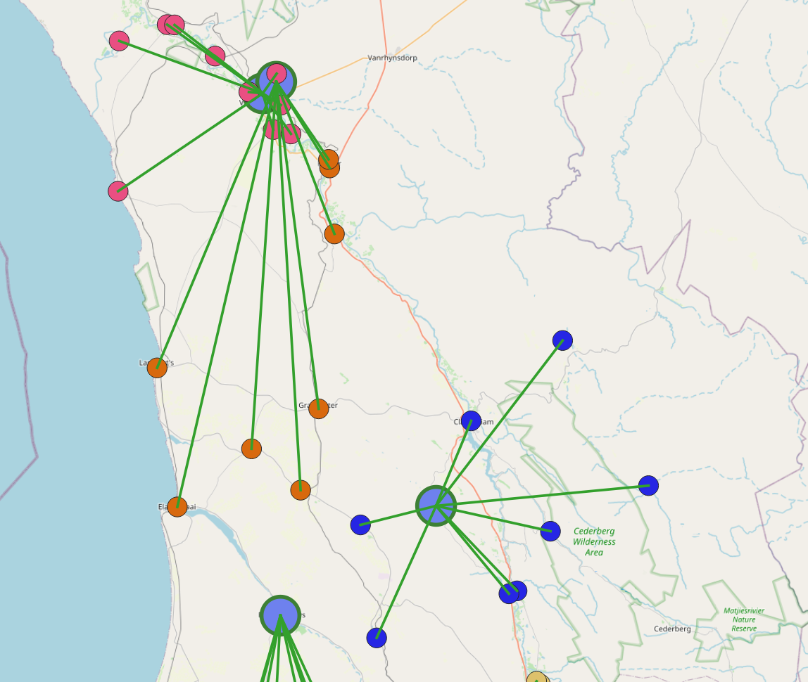
Western Cape Funda Wande intervention
Hub and spoke circles of support for teachers
100+ learning hubs led by Grade 1-3 teachers as Master Teachers who undergo an initial 4-day training (with 2-day annual refreshers) and receive a cash incentive per PLC run. Each hub serves 10 schools who meet termly with groups of ~30 teachers. Many of the master teachers have already been teaching using the program for 3 years (2021-2023). Staggered piloting and rollout in clusters of districts, e.g. 2 districts in 2025, +3 in 2026, and +3 in 2027.

Slide 33
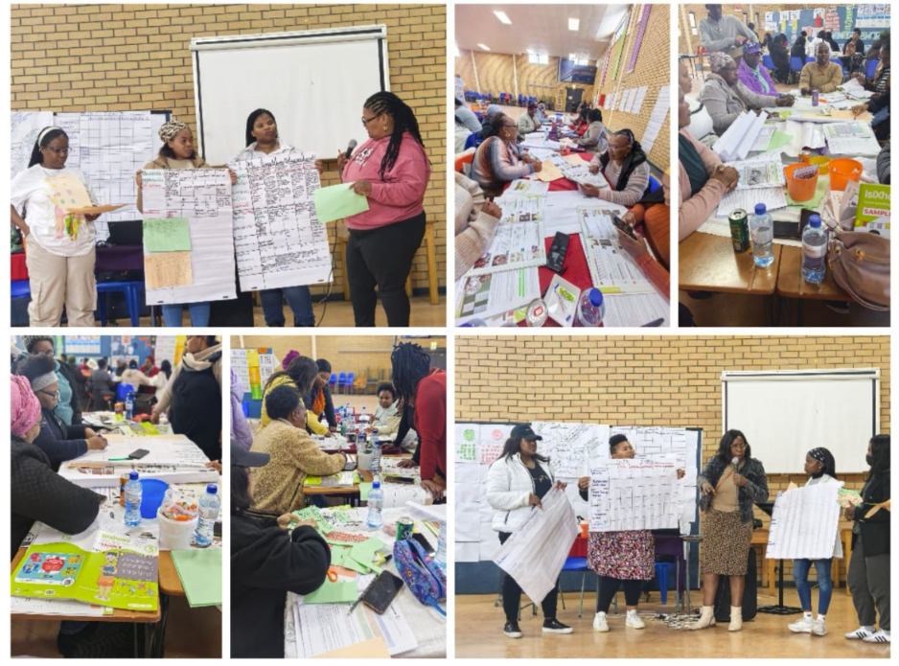

Slide 34

Examples of alignment & coherence:
(Western Cape & Eastern Cape)
Does it make sense?
Is it logical?
Is it impossible to misunderstand?

Slide 35
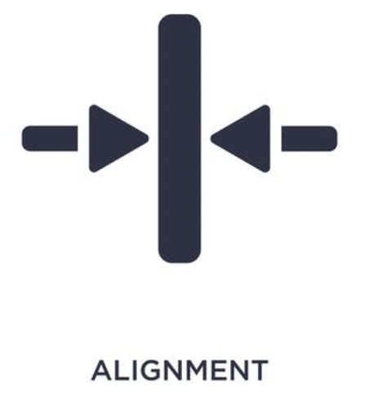


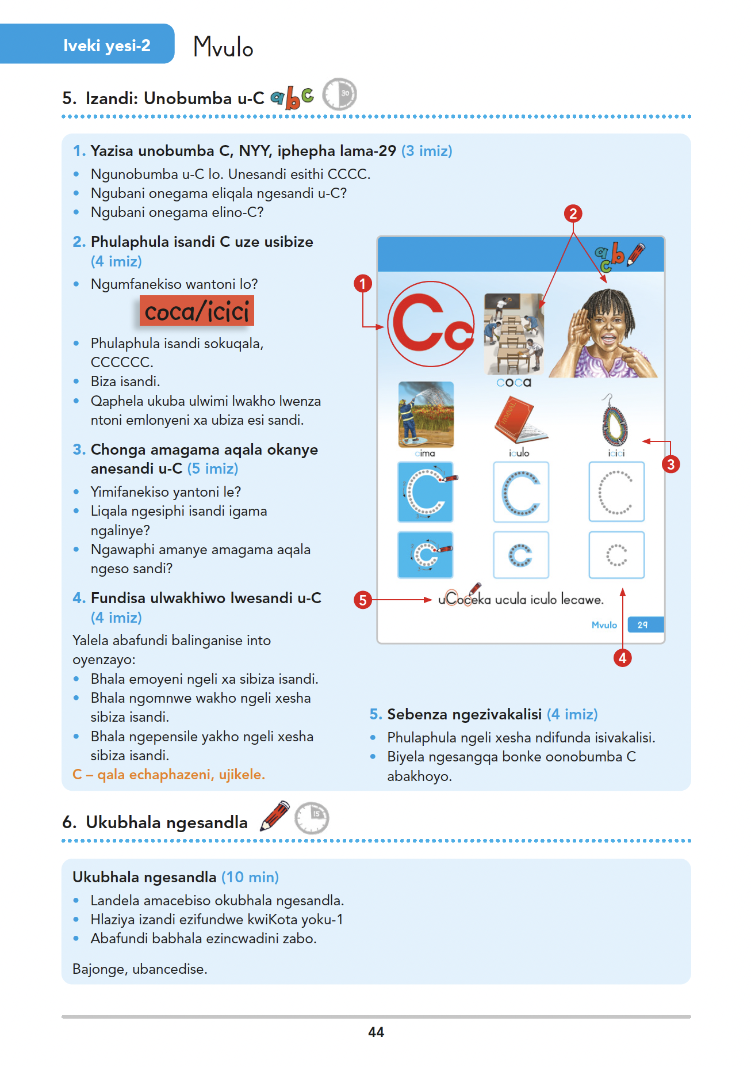
Learner Book
Teacher Guide

Slide 36
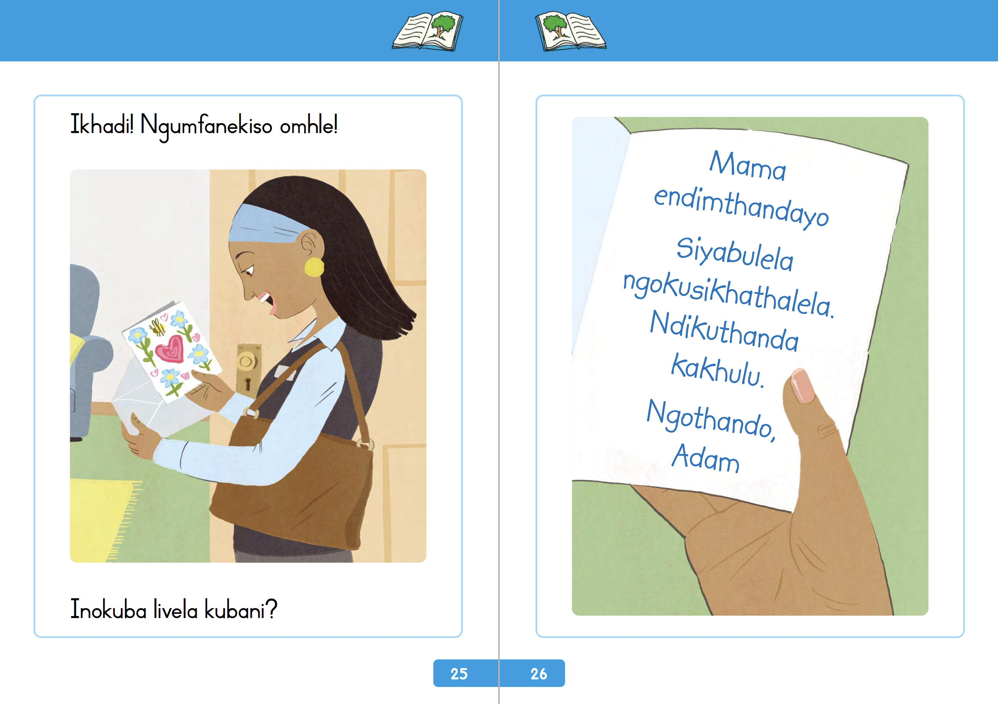
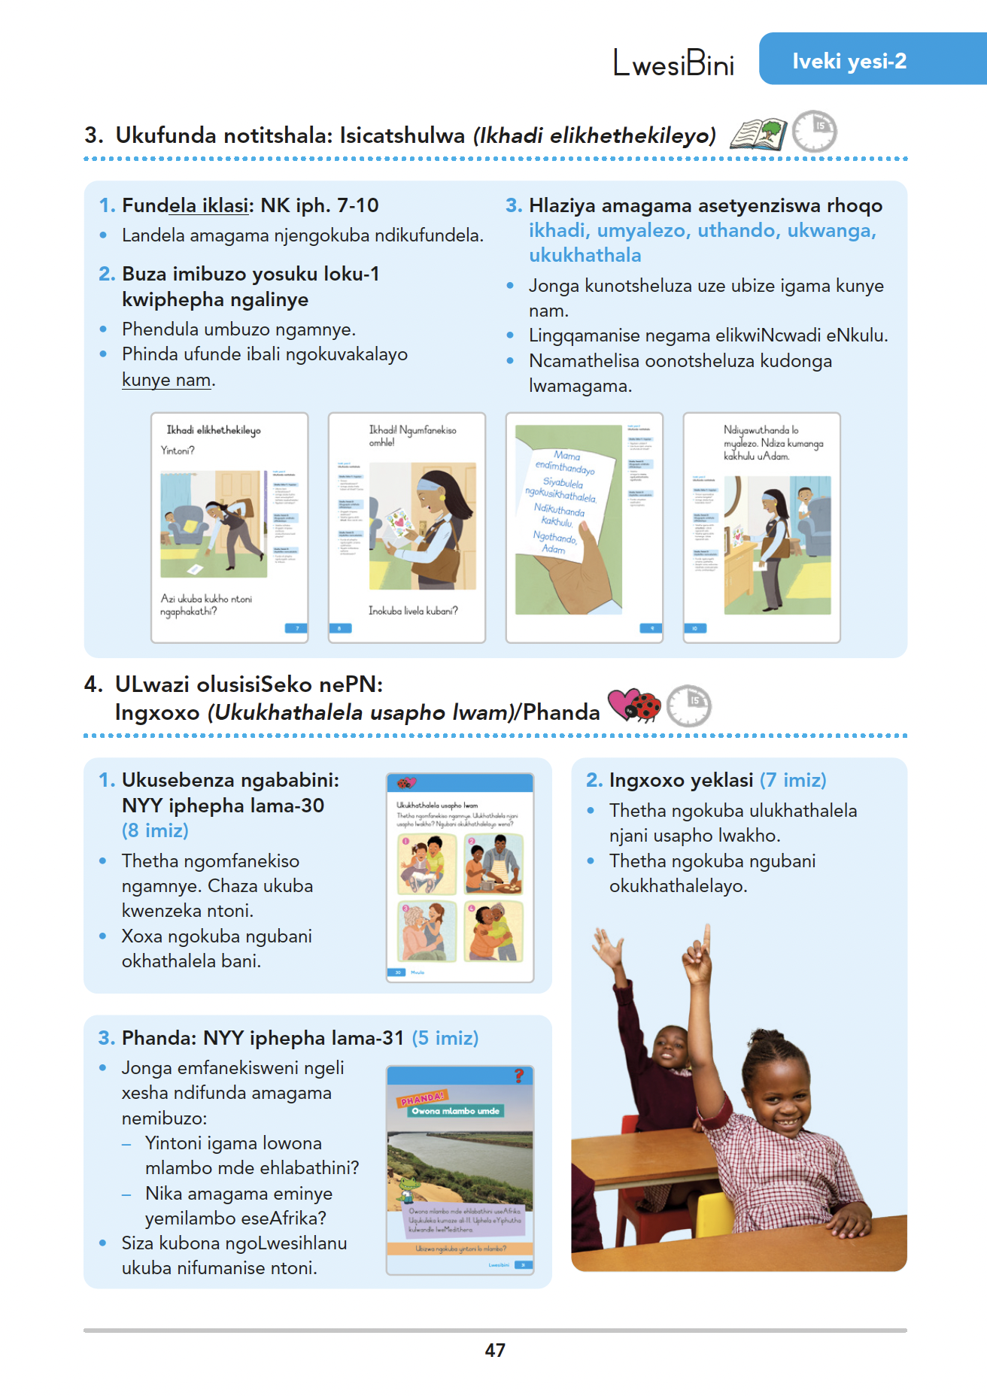
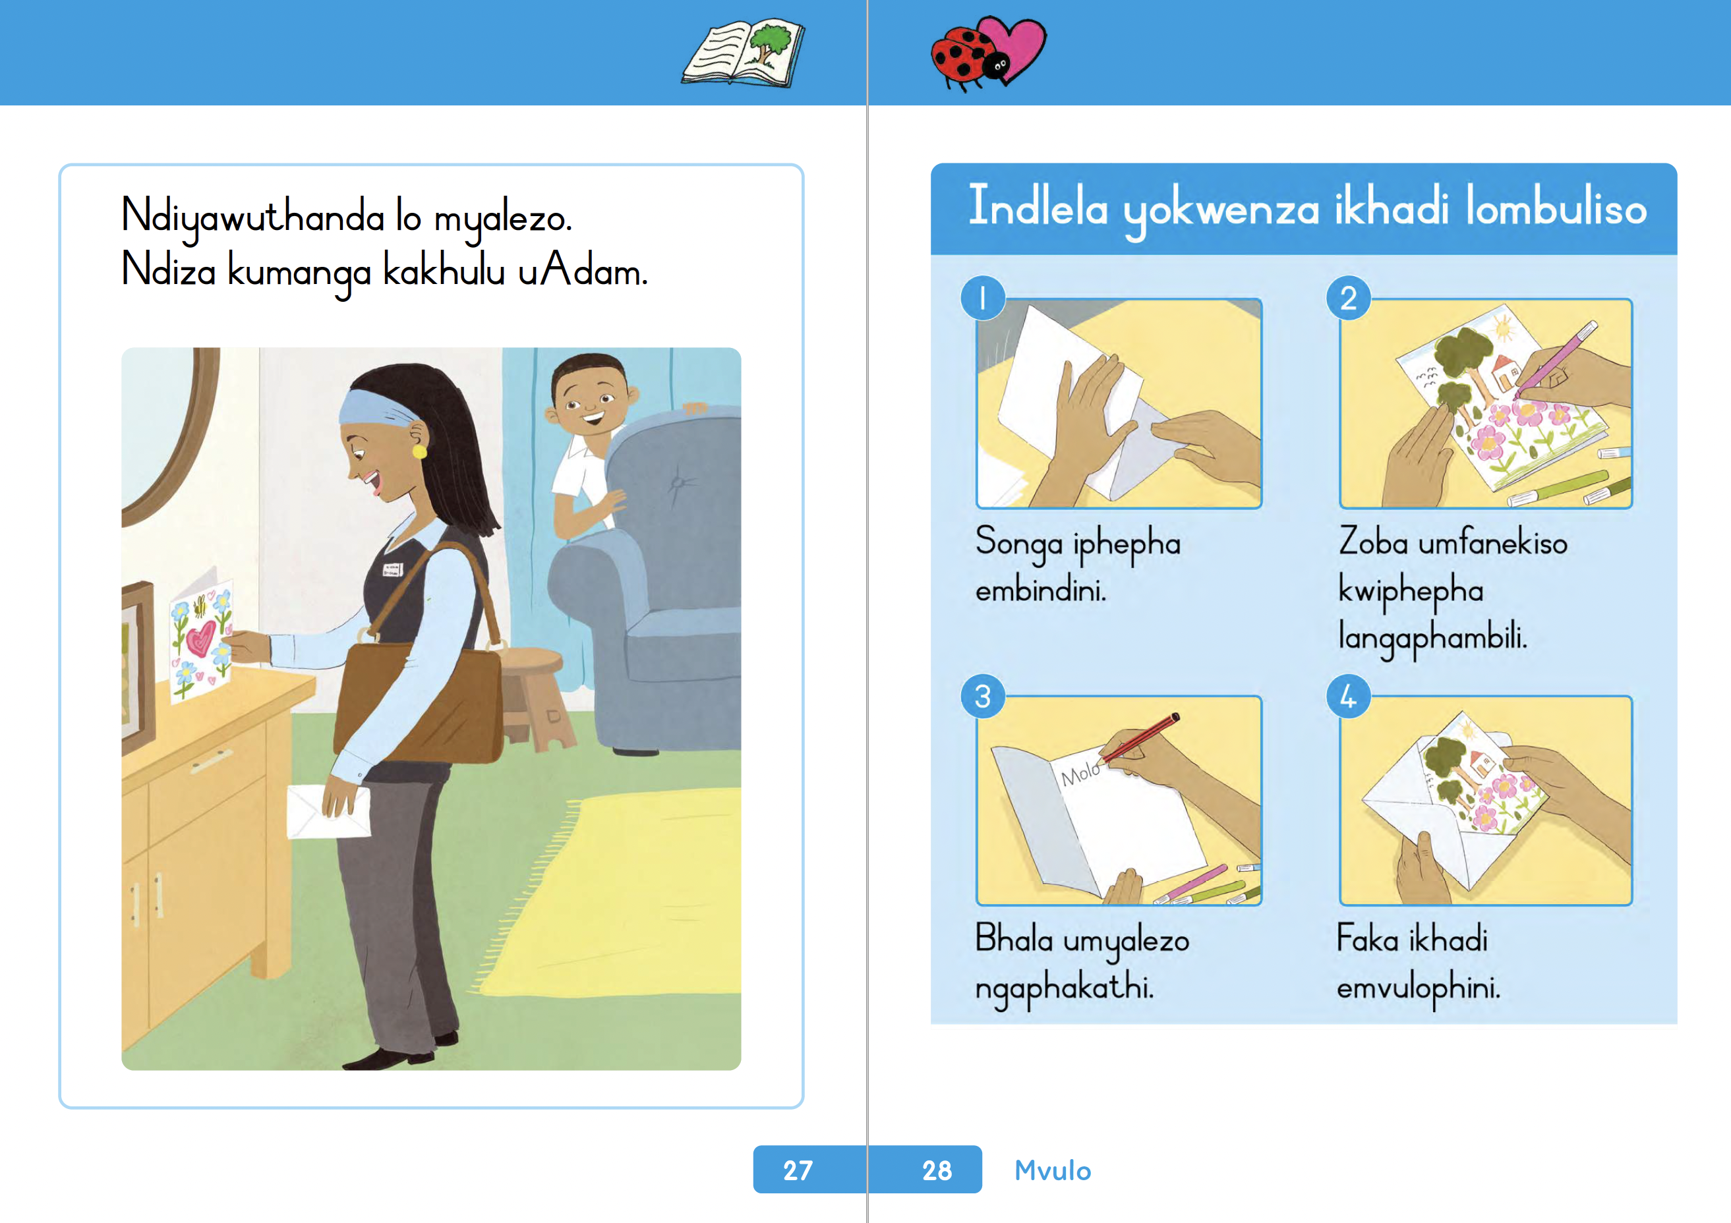
Learner Book
Teacher Guide

Slide 37

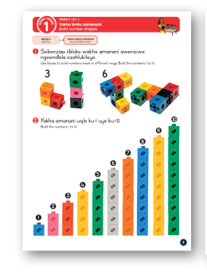

Slide 38
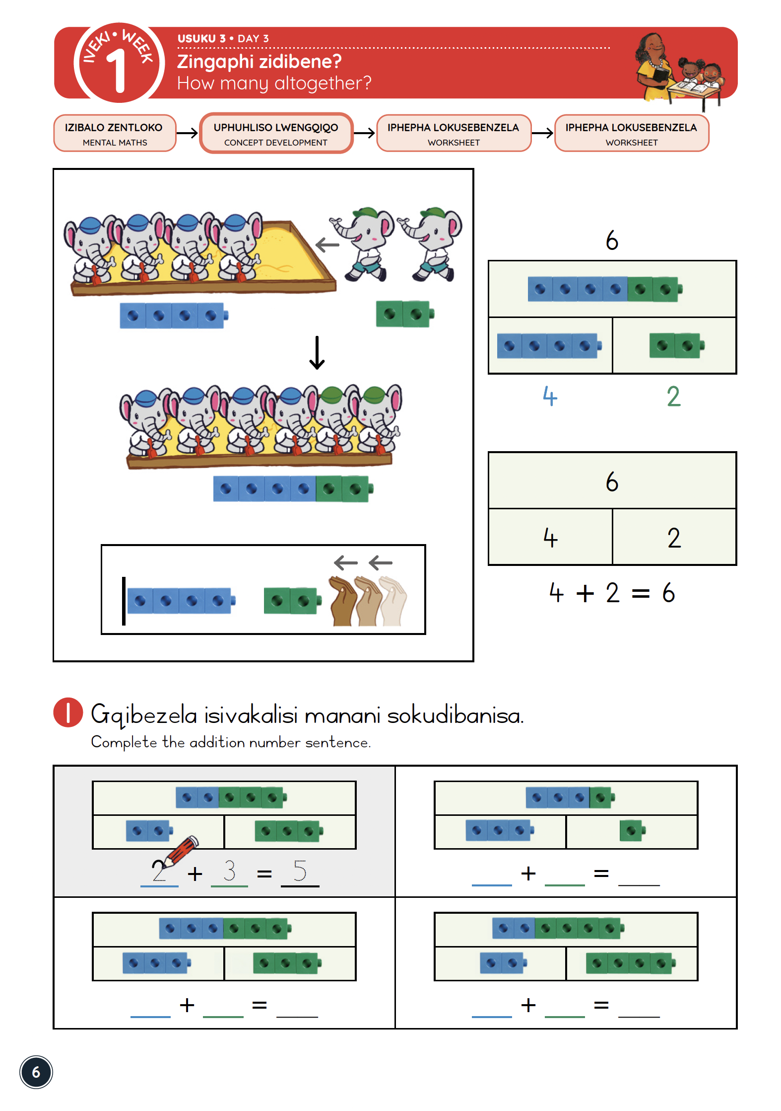
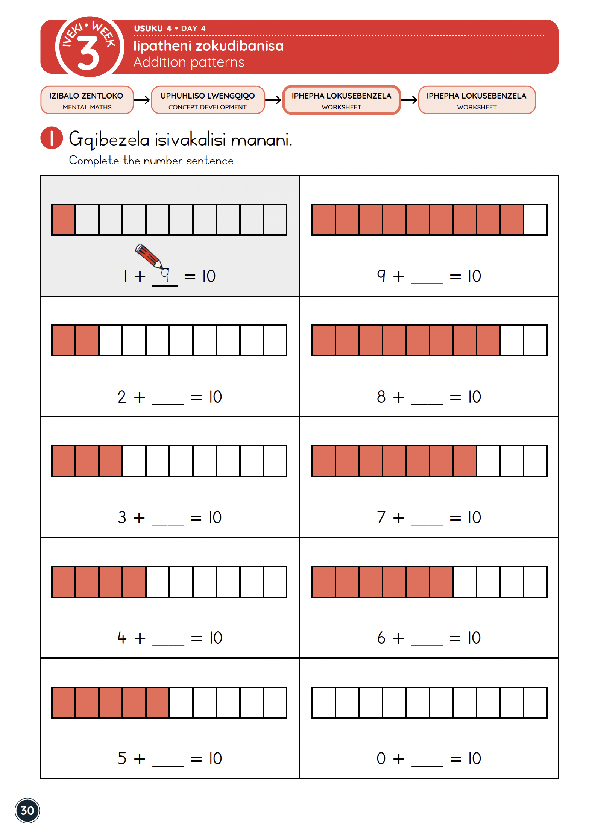
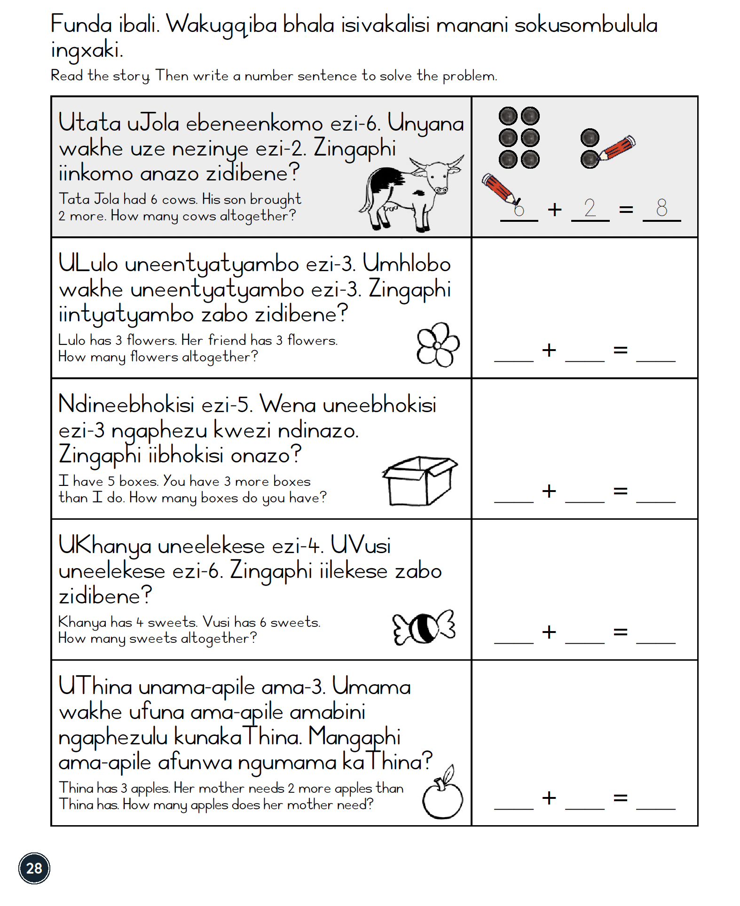

What does coherence look like?
Bala Wande: isiXhosa (Grade 1, Term 2)

Slide 39

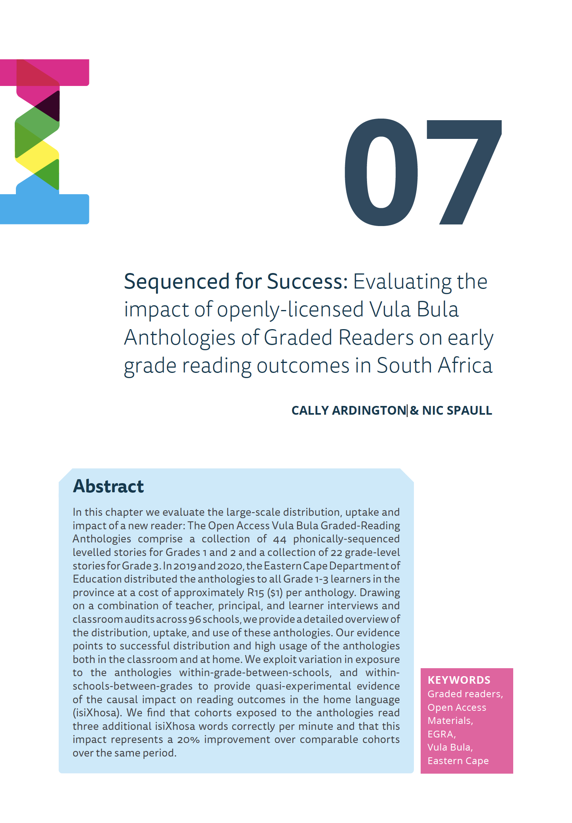
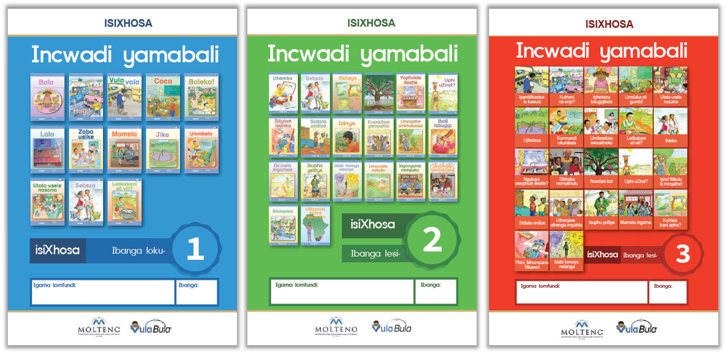
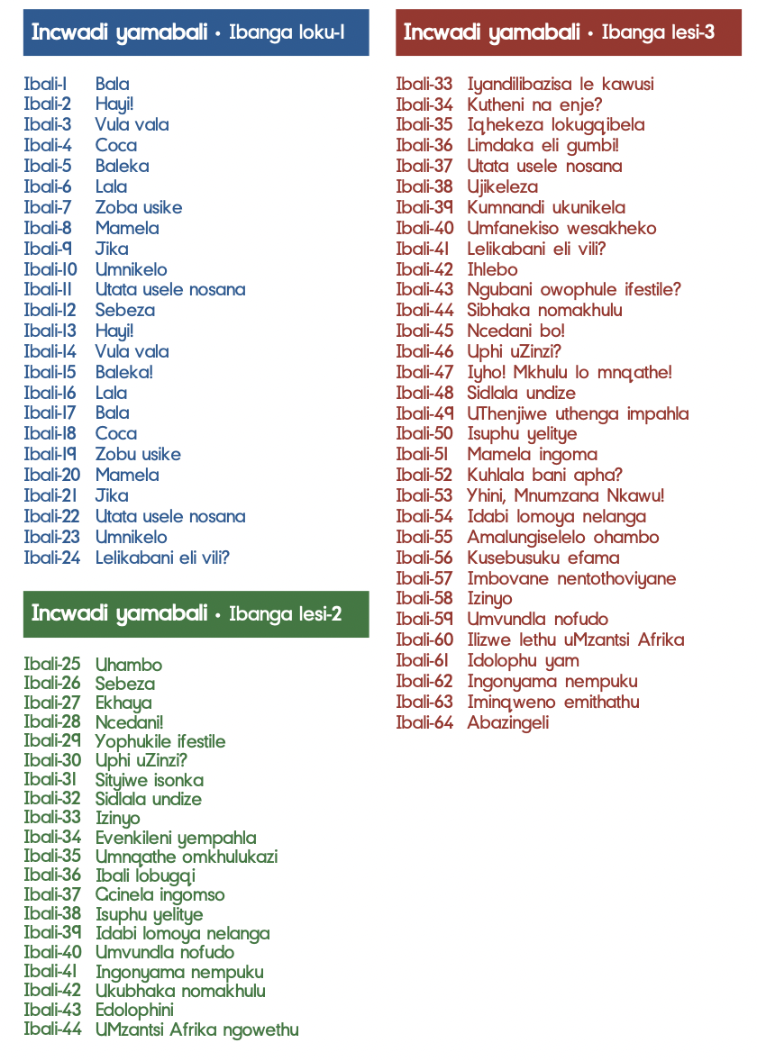
Eastern Cape
Alignment & Coherence
Vula Bula Anthologies of Graded reading
Sequenced for Success: Evaluating the impact of openly-licensed Vula Bula Anthologies of Graded Readers on early grade reading outcomes in South Africa (Ardington & Spaull, 2022).
Phonically-sequenced anthologies of graded readers
Developed for African languages specifically (not versioned from English)
Distributed to all 400,000 Grade 1-3 children in the Eastern Cape (1:1 ratio)
At government expense
Key innovation: Packaging as an anthology
$1 per book because print runs of >100,000 and no copyright
Evaluated using diff-in-diff EGRAs and we found a 20% increase in fluency (3 additional isiXhosa WCPM)
Notes:
https://www.education.gov.za/Curriculum/LearningandTeachingSupportMaterials(LTSM)/Workbooks.aspx

Slide 40
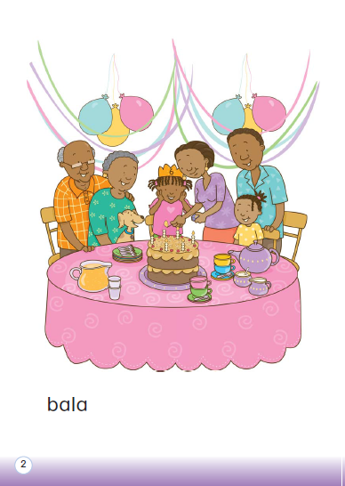
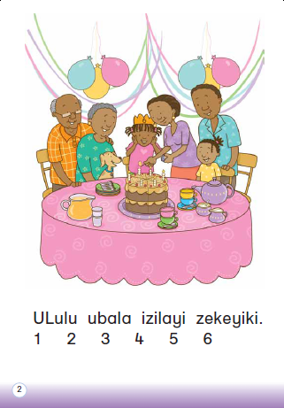
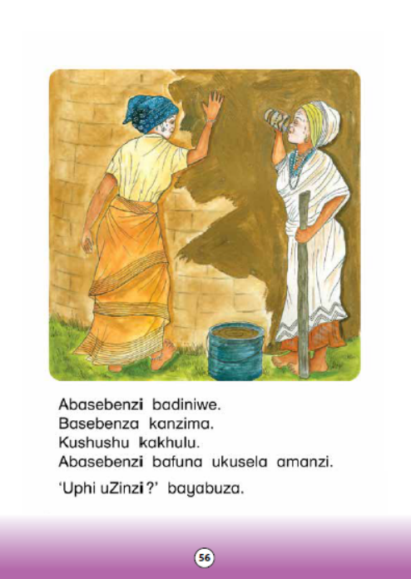
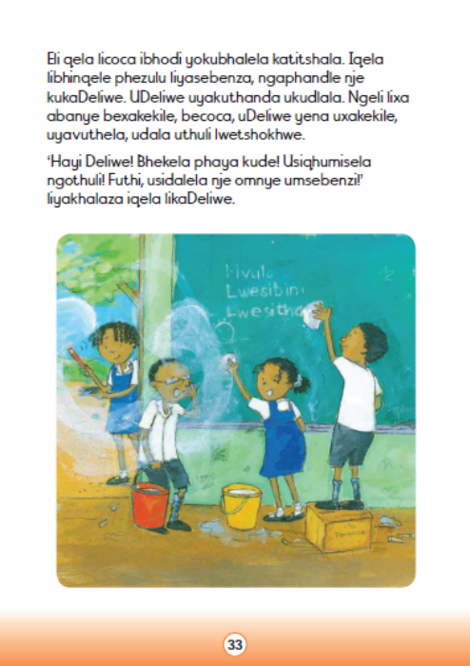
Vula Bula Graded Readers
Stories that are phonically sequenced and increase in difficulty incrementally.
Learners progress from reading one or two words to reading sentences and then paragraphs.
STORY 1
STORY 17
STORY 30
STORY 48

Slide 41
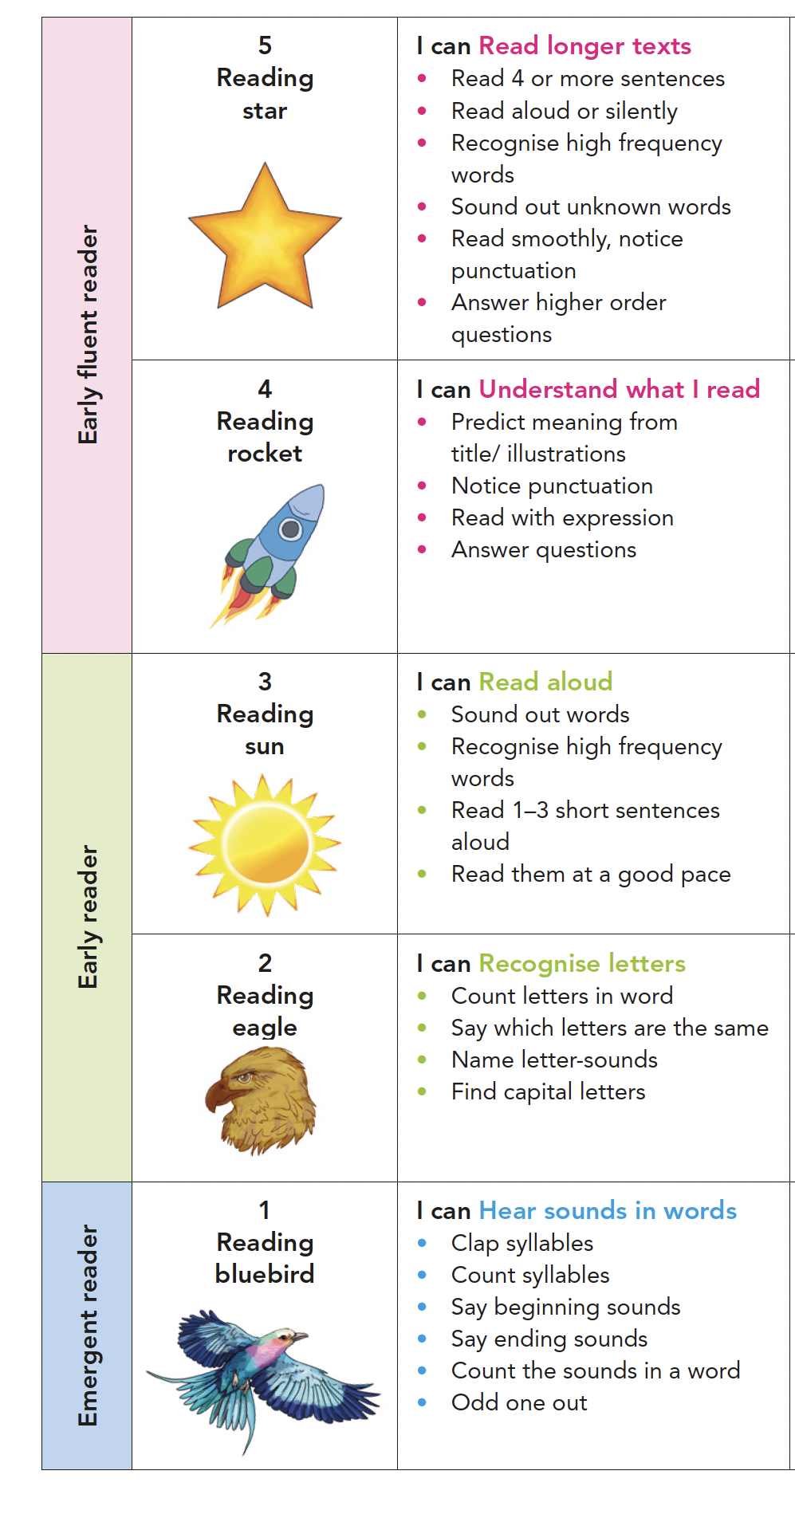

Alignment & Coherence:
Anthologies of Graded Readers
Vula Bula Anthologies Learners exposed to the anthologies got three additional isiXhosa word correct per minute ~ 20% improvement Spaull & Ardington (2022)
Climbing the reading ladder

Slide 42
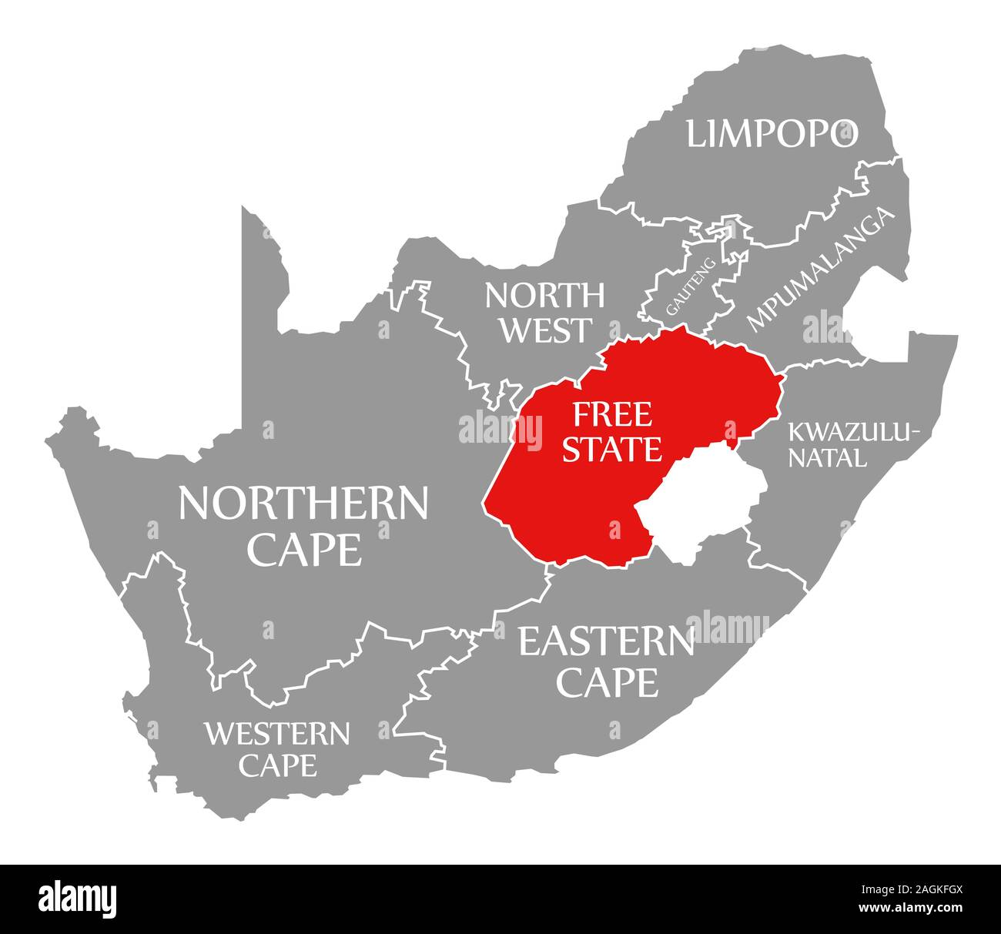
What can the Free State do to improve reading and mathematics?
Prioritize early grade reading and mathematics
  Allocate enough time to reading and mathematics in FP (WC took 3hrs from Lifeskills and added +2hrs to HL and +1hr to maths)
Measure what matters
  Measure reading in Grades 1, 2 and 3 (FUNS) and report against DBE benchmarks
Provide meaningful training & support to FP teachers
  Training should be aligned to materials and specific (grade/subject) not generic. 1-2 days every term.
Implement an evidence-based approach to reading
  Science of reading is clear about how reading should be taught. Teachers need explicit training on how to teach reading and materials (for learners and teachers) to assist them.

Slide 43
Additional programs
      FLOAT
      FUNS

Slide 44







What is FLOAT?
FLOAT is a long-term collaborative endeavour by a group of approximately 10 donors to improve literacy and numeracy outcomes (Grade R-3) at scale in South Africa. By working collaboratively with provincial governments FLOAT will support evidence-based approaches to improving reading and mathematics outcomes and thereby assist provinces with the implementation of their literacy and numeracy strategies.
The overall vision is to catalyse a measurable and sustainable improvement in the percentage of children reaching the DBE’s reading and mathematics benchmarks in Grades R-3 at meaningful scale by 2030.
Who are the funders of FLOAT?

Slide 45
“By working with government, we will partner to fund evidence-based approaches to catalyse a measurable and sustainable improvement in the percentage of children reaching DBE’s reading and mathematics benchmarks in Grades R-3 at meaningful scale by 2030”
What do we mean by those terms?
By “working with government” we mean that national and provincial governments are key active partners in the process. They exercise decision-making authority and have ‘skin-in-the-game’ (i.e. contribute some of their own financial and human resources to the project).
By “partner” we mean a collaborative of donors who will partner to collectively fund FLOAT. A common funding pool will be created.
By “measurable improvement” we mean a statistically significant improvement in learning outcomes as set out by the Department of Education (DBE) and National Planning Commission (NPC) with “SMART milestones en route”. We mean that there should be measurable intermediate indicators, for example, books distributed, training attended, number of school visits, changes in teacher practices, usage of materials.). There must be intermediate data collection related to those indicators.
By “meaningful scale” we mean a sufficient number of schools where the ‘problems of scale’ emerge. This would likely be either a few districts or an entire province. The level of intervention should align to the bureaucratic realities and structures of government.
By “sustainable” we mean that it is plausible that the intervention is embedded in government funding, processes and systems after the donor-funded project.
By “evidence-based” we mean that there is high-quality research showing that the proposed project/s have led to improvements in FLN outcomes at some scale (50+ schools), ideally in the South African context (or comparable LMIC context) and is designed to continuously provide evidence during implementation.

Slide 46
Key facts about the initiative
How much funding is available?
  FLOAT aims to disburse R300mil over 3 years, R100mil/yr x 3 years. We am to fund up to 3 provinces per year at approximately R25million per province per year.
How do provinces apply?
  The HODs and MEC’s of all provinces should have received an email from the FLOAT Donor Group (dated 13 Sept 2024) with an Expression of Interest template to complete and submit by 11 Oct 2024.
What is the time frame for the project?
  Provinces should aim to plan and pilot in 2025 with plans to implement at larger scale in 2026-2027. Provinces can apply for up to R75mil for 3 years (2025-2027)
4. What criteria will be used to select the 2-3
successful provinces?
Because there are limited funds, only 2-3 province swill be selected. This will be based on (1) The quality of the submission and the extent to which it is evidence-based and aligned to the national reading plan and provincial plans, (2) Commitment to evaluate learning outcomes using EGRA/EGMA, and (3) Willingness to commit provincial resources to the partnership (i.e. province’s ‘skin-in-the-game’).
Contact: Gail@zenexfoundation.org.za

Slide 47
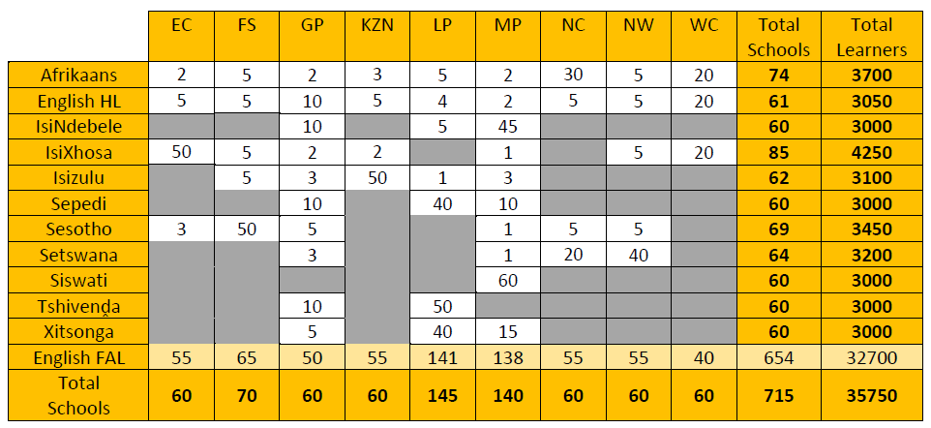
FUNS: Funda Uphumelele National Reading Study (2024 Term4)
FUNS is intended to be a nationally and provincially representative survey of reading in Grades 1, 2, 3, and 4 by the DBE with the ability to report across all 12 languages and all 9 provinces. The sample size is intended to provide good precision for national statistics and relatively good precision for provincial analysis.
Data collection will be in Term 4 2024: DBE is currently contacting provinces and schools with all formal requests for the data collection.
Tool for monitoring reading achievement at the provincial level, especially on the building blocks of reading, like letter-sound knowledge, accuracy and fluency.
Note, these measures (LCPM, WCPM etc) improve more quickly than comprehension.

Slide 48
Thank you!
Nic.Spaull@GatesFoundation.org

